Slide 1
NAME: Patience Christele MOUNPAIN
STUDENT ID : 2133952
MODULE NAME : ACADEMIC AND EMPLOYABILLITY SKILLS
MODULE CODE : BMSW4001
LECTURER :ANITA NAN

Slide 2
OVERVIEW
CARE HOME MANAGER
SWOT ANALYSIS
COMMUNICATION
FLEXIBILITY
TEAMWORKER
MEDICAL ENTREPRENEURSHIP
PDP
CONCLUSION
REFERENCES

Slide 3
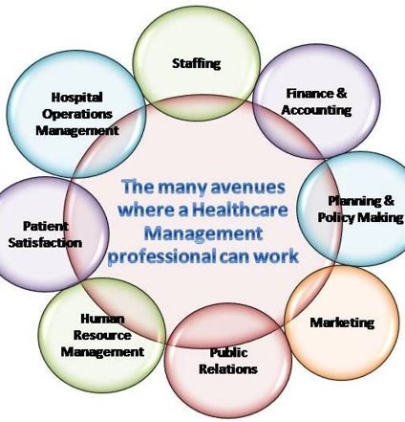
CARE HOME MANAGER
CARE HOME MANAGER CAN BE DEFINE AS A HEALTH CARE PROVIDER WHO ADVISES,
PROVIDES INFORMATION, AND SUPPORTS FAMILIES, STAFF AND RESIDENTS.
RESPONSABILITIES
Managing or/and monitoring budgets and facility finances.
Communicating with medical staff, investors and department's heads.
Making sure compliance with patient privacy laws and state, local regulations is achieved
Supervising, recruiting and training medical staff.
SKILLS
COMMUNICATION
FLEXIBILITY
TEAMWORK
MEDICAL ENTREPRENEURSHIP
PATIENCE
TIME MANAGEMENT

Slide 4
SWOT ANALYSIS
STRENGTHS
Outstanding level of organizational efficiency
Motivational manager inspire their team to be their best
WEAKNESSES
Time management: as a health care administrator, I have responsabilities which requires me to manage my time effectively.
Decision-Making: I will have to take daily crucial decisions that can impact the health and wellness of service users
Patience: Taking care of someone who is unable to take care of himself. Tolerate and accept delay, endure trouble without getting angry or upset
OPPORTUNITIES
Good salary: £25000 and £55000 a year
Varied work environment: hospital, government, physicians' office...
THREATS
Competition from other home care : In order to be a competition and contend with other organizations it is paramount to be at the top in all aspects.
Denial of grant: Care home organizations encounter an important issue which is the denial of grant and they have to deal with it rationally.

Slide 5
CARE HOME MANAGER
SKILLS
COMMUNICATION:
Clear communication is a paramount skill in health care administration, which entails communicating with concern, consideration for others and effective interaction with people in person, by phone and writing.
FLEXIBILITY:
Health care can be very unpredictable. Therefore It is important to be ready to adapt to speedily changing circumstance in order to obtain success in health care management.
TEAMWORK:
In the care home, teamwork is important because a multidisciplinary team is put together in order to deliver the best service to the service users.
MEDICAL ENTREPRENEURSHIP:
Biological and emerging technology in the medical industry can provide support to emerging companies that have successfully developed new devices and treatments. Therefore, it can be both lucrative and fulfilling to start your own business in the health care sector.

Slide 6
PDP
TIME MANAGEMENT: I need to improve my time management skill by using the 80-20 rules that require to set priorities and the EISENHOWER method which requires to always start with the most important and urgent task
DECISION MAKING: I need to improve my Decision making skill by learning from the experience, always thinking about what I have learnt from the past and by avoiding feeling that I am the only one responsible to take decision.
PATIENCE: By being a good listener, focusing on understanding and listening carefully to what family members or others conversation partners are saying, I can improve my patience skill

Slide 7

Conclusion
In short, research indicates that the gaps in health care services are significant. However this issue can be sorted effectively in order to be able to face current healthcare practices.
The gap for the future can use SWOT ANALYSIS to analyze all these factors and PDP can be used to show how to improve them.

Slide 8
REFERENCES
Wahl, S. (2015). An examination of the effectiveness of America’s current end of live (Doctoral dissertation, Utica College).
van Wijngaarden, J. D., Scholten, G. R., & van Wijk, K. P. (2012). Strategic analysis for health care organizations: the International journal of health planning and management, 27(1), 34-49.
Tucker, S., Hughes, J., Brand, C., Buck, D., & Challis, D. (2015). Health Services Management Research, 28(1-2), 34-45.
Adams, R. (2007) foundation of health and social care. New york : Palgrave Macmillan

Slide 9


