Slide 1
SHSS6067
Sports Trauma Management
Initial Assessment and Management

Slide 2

Previously…
  Algorithms
  SAFE Approach
  Primary Survey (with Resuscitation as required)
  Secondary Survey
  Definitive Care (onward referral)

Slide 3
The Primary Survey
  Catastrophic haemorrhage control
  Airway maintenance with C- spine protection
  Breathing with adequate ventilation
  Circulation with haemorrhage control
  Disability: neurological status
  Exposure and Environment control & Everything Else

Slide 4

Catastrophic haemorrhage control
  A catastrophic haemorrhage would be obvious on the approach to the injured player
  Any obvious catastrophic bleed should be dealt with:-
    Application of compression with a dressing directly over the wound
    Use of a tourniquet ?

Slide 5
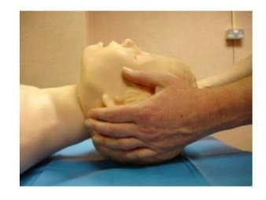
Airway Maintenance with C-Spine Protection
If you suspect a spinal injury you must protect the C-spine using Manual In-line Immobilisation at the initial approach
Then we can assess the airway
  Are they talking in full sentences?
    If so, they have a patent airway!
  Listen to the quality of the voice
    It can indicate airway status and let you know about any potential airway problems
Important to identify airway issues early
  Hypoxia & Hypercarbia are progressive, they may not be apparent initially but can be life threatening so its important to keep checking the primary survey !

Slide 6
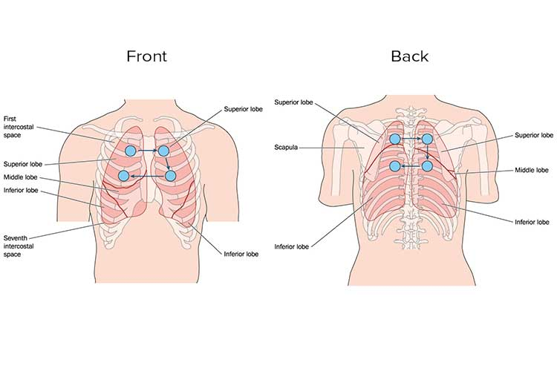
Breathing with Adequate Ventilation
Is the player breathing?
If so, what is the rate of their breathing?
Does the chest wall expand evenly (right to left side?)
Palpate for soreness, crepitus or tenderness
Unlikely for this to be an immediate life threatening injury so we will need to monitor breathing for deterioration
More detailed assessment will happen off field in the medical room

Slide 7
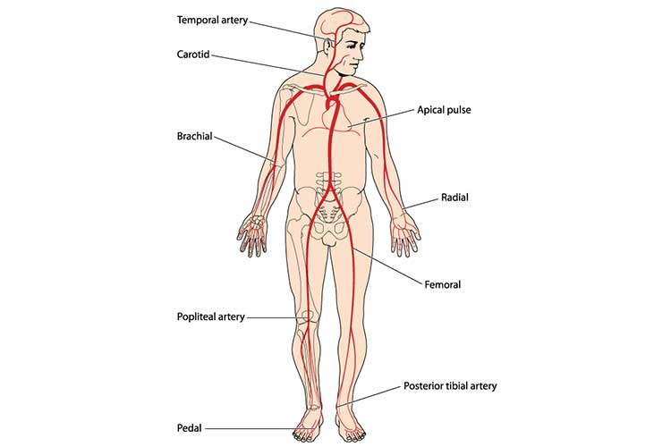
Circulation with Haemorrhage Control
We need to check:
Pulse – presence of the Radial Pulse is a key on-field assessment method
Pulse – rate and volume
Colour of the player – noting pallor
Mental status – conscious level and agitation
Evidence of external bleeding
Evidence of internal bleeding

Slide 8
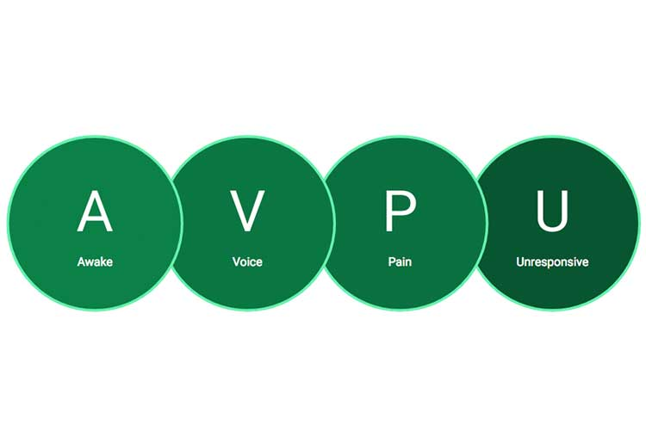
Disability including Neurological Status
On field assessment uses
  A for Alert (orientated in Time, Place & Person)
  V for VOICE Response (e.g. only has their eyes opens when you talk to them)
  P for Pain Response to Stimulus (e.g. only has their eyes open when they are in pain)
  U for Unresponsive (Does not open their eyes to voice or painful stimulus)
Pupillary Response
C-spine clearance
Glasgow Coma Scale (in medical room)

Slide 9
Exposure and Environment Control & Everything Else
This element of the primary survey will consider other medical emergencies such as
  Hypothermia
  Heat illness
Top to survey including
  Fractures
  Dislocations
  IF time allows, do not delay transfer to the emergency department
This is often done rapidly prior to extrication to the medical room or ambulance

Slide 10
Re-Evaluation
  Continuous monitoring of vital signs and neurological status
  Identifying deterioration
  Identifying other less obvious or acute life threatening or potentially life or limb threatening injuries may become more apparent
Re-Evaluation should occur after:
  Intervention
  Deterioration
  Cause for concern
  Uncertainty

Slide 11
The Secondary Survey
Only proceed to this if:
Primary Survey with appropriate
Resuscitation has been completed
ABCDE have been Reassessed
Vital Signs are Normalising
The Secondary Survey
Full history of the incident
Players PMHx
Systematic head to toe examination of the patient designed to detect all of the players injuries
  Pain
  Deformity
  Haematomas
  Evidence of blood loss
  Vascular compromise
  Neurological compromise

Slide 12
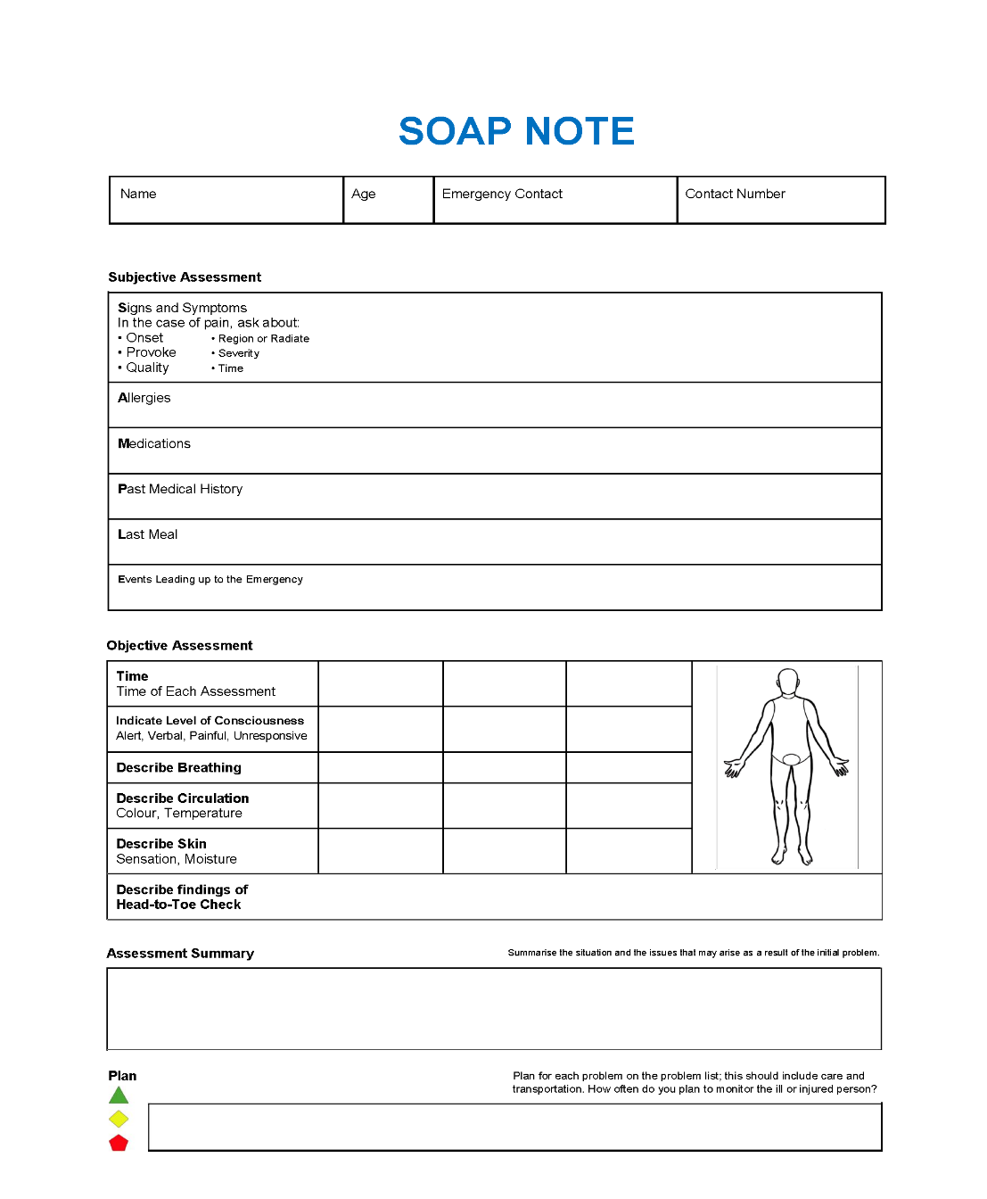
SAMPLE forms
S – Signs and Symptoms
A – Allergies
M – Medications
P – Past Medical History
L – Last Meal or Drink
E – Event and Environment of the injury or illness

Slide 13
Definitive Care
Completion of Primary and Secondary survey
Monitoring and re-evaluation
Documentation (SAMPLE)
Transfer to Emergency Department

Slide 14
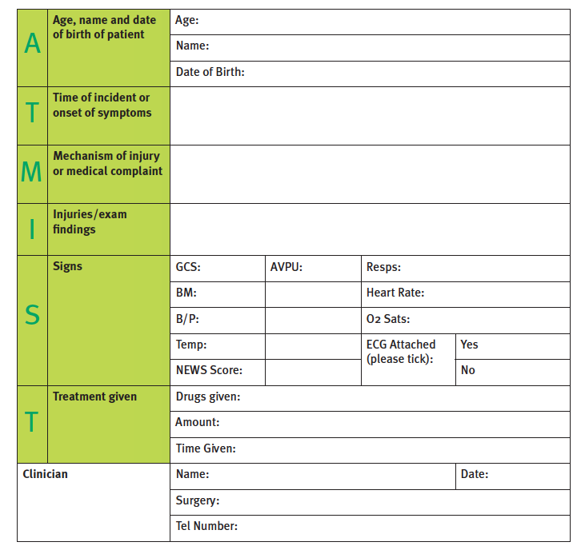
Definitive Care
When completing a face to face hand over to paramedics use the pneumonic ATMIST
  A for Age and sex of athlete
  T for Time of injury (and Estimated Time of Arrival)
  M for Mechanism of Injury
  I for Injuries present and suspected
  S for Signs including Physiological Parameters
  T for Treatment given and needed

Slide 15
Summary
Catastrophic haemorrhage control
Airway maintenance with C- Spine protection
Breathing with adequate ventilation
Circulation with haemorrhage control
Disability: neurological status
Exposure and Environment control & Everything Else
SAMPLE
ATMIST

Slide 16
Resources
Faculty of Pre Hospital Care, Manual of Core Material (Royal College of Surgeons of Edinburgh)
Advanced Life Support Manual (Resuscitation Council UK)
Essential of Immediate Medical Care (C. John Eaton) (ISBN 0-443-05345-6)
Handbook of Immediate Medical Care (Greaves et al) (ISBN 0-7020-1881-3)
Practical Pre-hospital Care (Greaves et al) (ISBN 978-0-443-10360-5)
Pre-Hospital Care (Cooke) (ISBN 0-443-05987-X)
Pre-hospital Trauma Life Support Manual (ISBN 0-8151-6333-9)
Pre Hospital Medicine (Greaves & Porter) (ISBN 0-340-67656-6)
http://www.resus.org.uk/
http://www.rcsed.ac.uk/
http://www.basics.org.uk/

