Slide 1
Event Impacts
National, Local, corporate and community

Slide 2
Balancing the impact of events
Events have both positive and negative impacts
Positive impacts must be developed and maximised
Negative impacts need to be addressed through awareness and intervention
The task of the event manager is to balance the impacts of events in the interests of all stakeholders

Slide 3
Balancing the
impact of events
Social and cultural impacts
POSITIVE
Shared experience
Revitalising traditions
NEGATIVE
Community alienation
Manipulation of community
Building pride
Validation of community groups
Increased participation
Introducing new ideas
Expanding perspectives
Negative image
Bad behaviour
Substance abuse
Social dislocation
Loss of amenity

Slide 4
Balancing the
impact of events
Political impacts
POSITIVE
International prestige
NEGATIVE
Risk of event failure
Improved profile
Promotion of investment
Social cohesion
Development of administrative skills
Misallocation of funds
Lack of accountability
Propaganda
Loss of community ownership and control
Legitimation of ideology

Slide 5
Balancing the
impact of events
Environmental impacts
POSITIVE
Showcasing of the environment
NEGATIVE
Environmental damage
Providing best practice models
Increasing awareness
Infrastructure legacy
Improved transport and communication
Urban renewal
Pollution
Destruction of heritage
Noise disturbance
Traffic congestion

Slide 6
Balancing the
impact of events
Tourism and economical impacts
POSITIVE
Destination promotion and increased tourist visits
NEGATIVE
Community resistance to tourism
Extended length of stay
Higher yield
Increased tax revenue
Business opportunities
Commercial activity
Job creation
Loss of authenticity
Damage to reputation
Exploitation
Inflated prices
Opportunity costs
Financial mismanagement and loss

Slide 7
Economic impacts and the role of governments
Governments & local authorities have become increasingly aware of the role & contribution of events
Governments pursue events because of the ‘spillover effects’ for related industries:
  travel, restaurants, etc.
Also because of long-term benefits
  increased tourism spending
  http://www.youtube.com/watch?v=uo38W13krcA Gŵyl y Golau, Machynlleth

Slide 8
Economic impact studies & ROI
Identify all expenditure involved in the staging of an event
Determine their impacts on the wider economy
Expenditure from events can be direct, indirect or induced

Slide 9
The government perspective
National government
Major celebrations of national significance
Major international political/economic
events
Promote trade through foreign affairs departments

Slide 10
The government perspective
Welsh government
Bidding and staging of major events
including cultural & economic
Events fall under individual portfolios
  e.g. sports competitions under sport bodies (WRU, ERC, FIFA)
Local government
Involvement in events is increasing
Recent focus on business events

Slide 11
The government perspective
The role of government in events
Venue owner/manager
Consent authority and regulatory body
Service provider
Funding body
Event organiser
Event/destination marketer

Slide 12
The government perspective
Event strategies
Delineate government objectives in
events
Identify appropriate policies, infrastructure, resources, staffing and programmes
Provide a framework for the appraisal of proposed events to determine fit with strategic objectives

Slide 13
The government perspective
Creating celebration spaces and precincts – Castle Square Swansea
Cardiff Bay
Millennium Coast (North Dock), Llanelli

Slide 14
The government perspective
Events and urban development
Governments see events as tools for
urban regeneration
Can provide impetus for development, bringing new life to communities

Slide 15
The corporate perspective
Corporate use of events
Can be focused:
  Internally – aimed at the business and staff
  Externally – aimed at customers/clients
  e.g. tall ships race; major sporting events

Slide 16
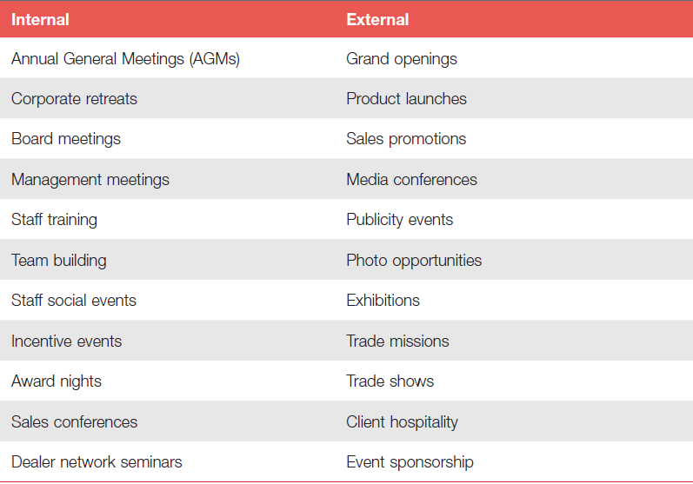
The corporate perspective
Table 2.1 Corporate use of events

Slide 17
The corporate perspective
Association conferences
Meetings, congresses and conferences
Return on investment
Five levels of evaluation:
  Reaction and planned action
  Learning
  Job applications
  Business results
  Return on investment

Slide 18
The community perspective
The individual perspective
Community members want to participate and be entertained
Major events and the community
Community members are more concerned with the wider impacts of the event
Less direct relationship

Slide 19
The community perspective
Strategies for community engagement
Outreach
Community development and capacity building
Friends of the event
Local business engagement

Slide 20
The community perspective
Strategies for community engagement
Participation facilitation
Community input and feedback facilitation
Inclusive programming
Incentives
Evaluation?

Slide 21
http://www.youtube.com/watch?v=uo38W13krcA Gŵyl y Golau, Machynlleth
http://www.youtube.com/watch?v=N29VUFBu33Q Venice Festival of Masks
http://www.youtube.com/watch?v=jl1KD7nte60 Venice Carnival

Slide 22
Tutorial Monday 21st Oct
What do you think are the major challenges currently facing event managers in the UK?
What are the key political, cultural and social trends that determine the current climate of events in Britain?
Identify an event that you know of that has the capacity to be developed into something bigger than its current size. Give your reasons for suggesting this.

