Slide 1
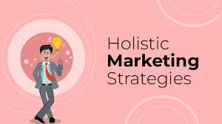
The Most Effective Marketing Concept for Business in 2025
Florin Mateus Dumitru

Slide 2
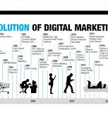
Introduction: Evolution of Marketing Concepts
Marketing has evolved through six major phases:
Production → Product → Selling → Marketing → Societal → Holistic.
Initially appeared to be mainly about efficiency, production, and selling.
Today, businesses must combine customers, employees, society, technology.
The Holistic Marketing Concept is better suited for the complex, interconnected business world of 2025.

Slide 3

What Is Holistic Marketing?
The development, design, and implementation of marketing programs, processes, and activities that take into account the breadth and interdependencies of marketing.
Considers the business as a total system, not as separate departments.
Everything matters when creating value.
Takes the company's and customers’ place in the economy and society into account.

Slide 4
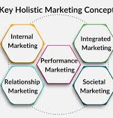
Core Components of Holistic Marketing
Internal Marketing: Recognising employees as internal customers and understanding that their motivation and satisfaction will greatly influence the quality of a service experience.
Integrated Marketing: Offering a consistent, cohesive brand messages and experiences across all direct and indirect channels as well as in digital and physical spaces.
Relationship Marketing: Building, long-term, value-based relationships with customers, suppliers and partners.
Social Responsibility Marketing: Consideration of profit, customer satisfaction and public interest.

Slide 5
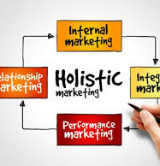
Why Holistic Marketing Is Best for 2025
Corresponds with digital transformation, artificial intelligence and data-driven individualisation.
Supports ESG goals and sustainable practices.
Promotes a unified brand image and reputation for ethics.
Examples:
Apple: relationship ecosystem -> strong loyalty.
Patagonia: social responsibility and social consciousness -> trust.
Google: internal culture -> innovation and customer happiness.

Slide 6
References
Arabeche, Z., Soudani, A., Brahmi, M., Aldieri, L., Vinci, C. P., & Abdelli, M. E. A. (2022). Entrepreneurial orientation, organisational culture and business performance in SMEs: Evidence from emerging economy. Sustainability, 14(9), 5160. https://doi.org/10.3390/su14095160
Hutapea, J. Y. (2016, January). The evolution on marketing concept: Analysis on the perspective changes in marketing concept. Journal of International Scholars Conference – Business & Governance, 1(3), 66–76.
Kolakaluri, V. N. S. K. (2022). New modern marketing myopia: A clouded innovation and stigmatised marketing.
Kotabe, M. M., & Helsen, K. (2022). Global marketing management. John Wiley & Sons.
Kurniawan, R., Manurung, A. H., Hamsal, M., & Kosasih, W. (2021). Orchestrating internal and external resources to achieve agility and performance: The centrality of market orientation. Benchmarking: An International Journal, 28(2), 517–555. https://doi.org/10.1108/BIJ-07-2020-0355
Mowar, A. (2022). Marketing management. Blue Rose Publishers.
https://www.simplilearn.com/holistic-marketing-concept-article
https://www.indeed.com/career-advice/career-development/what-is-holistic-marketing

