Slide 1
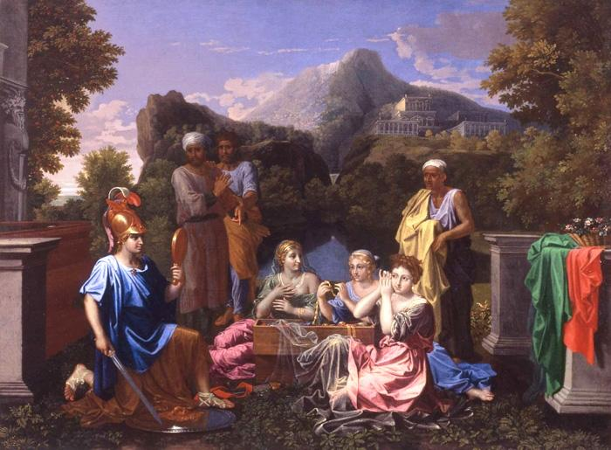
Deidamia Achilli

Slide 2
Background
● the anonymous elegiac epistle of the eleventh century, “Deidamia Achilli” (ca.1070), in Leonine elegiac verse
● Deidamia/Achilles myth popular in antiquity e.g. Euripides’ (now lost) play Skyrians; pseudo-Bion’s Epithalamium (see Heslin, The Transvestite Achilles 2005)
“love at Skyros, Achilles’ secret kisses and lovemaking, how the boy put on a dress to change his looks, and how among Lykomedes’ daughters, careless Deidameia came to know Achilles in her bedchamber” (pseudo-Bion 2.5-9)
“why do you have wool in the hand by which Hector shall fall?” (Ov. Ars Amatoria 1.694, Ovid to Achilles)

Slide 3
Ovid in the Middle Ages
● DA looks to Ovid’s Heroides: Ovid’s works including Heroides popular in Middle Ages (see Hagedorn 2004); nb tradition of medieval pseudo-Ovidiana (or, less perjoratively, “para-Ovidiana”, as Hexter 2002 in Brill’s Companion to Ovid)
“[imitation was] an essential tool in the pedagogical process and a central element in a writer’s self-fashioning” (Hexter R J. 2011. ‘Shades of Ovid: Pseudo-(and Para-) Ovidiana in the Middle Ages’. In Ovid in the Middle Ages. eds. James G. Clark, Frank T. Coulson, and Kathyrn L. McKinley, 284-309. Cambridge at 291)

Slide 4
Ovid in the Middle Ages
“It seems fairly obvious to me that within a system of literary production, reproduction and transmission that was based at its most fundamental level on imitation, masquerade and ventriloquism, ‘forgery’ is not the best or even most accurate term for what writers were doing when they created new Ovidian texts.” (Hexter 2011: 291)

Slide 5
Ovid in the Middle Ages
Early imitators? “a belief encouraged by Ovid's statement (Amores 2.18.17-8) that his friend Sabinus penned replies from their menfolk to his own heroines' epistles” (Kennedy, D. 2002. ‘Epistolarity: the Heroides’ in The Cambridge Companion to Ovid ed. Hardie, 218)
"Literary imposture is written into epistolary heroinism from the start" (Kennedy 2002: 218 n. 7)

Slide 6
Ovidian intertext
● DA: Ovidian strategy and echoes of Heroides (esp. 1 (prominent), 3 (Briseis, Deidamia’s replacement), 5 and 6 (both half of “pairs”: Her. 17/ Her. 12)
“Send words for me to read, / send words for your son to read, with your dear wife!/ Or do not wish to send them but come yourself!” (Deidamia Achilli, 4-6) (cf. Penelope)
“Let the barbarian mistress depart from the bed she has usurped!” (Deidamia Achilli, 126)

Slide 7
Ovidian
“the “Deidamia Achilli” authors creates a female voice and a perspective that subtly challenges and corrects the conclusion of the Achilleid, which focuses on Achilles and his quest for martial glory at the expense of the domestic sphere” (Hagedorn, 2004: 38)
"Your Penelope sends these words to you, tarrying Ulysses; it is no good your writing me a reply: you yourself come!" (Ov. Her. 1.1-2)

Slide 8
Ovidian
“If it is right for a lawful wife to be called a mistress, / a chaste mistress sends these words to you, her husband.” (DA 1-2)
"If it is right for me to complain briefly about you, my master and lover, I shall complain briefly about my master and lover" (Ov. Her. 3.5-6)

Slide 9
Ovidian
"If you ask whom they resemble, you are recognized in them. They do not know how to deceive; the other traits they have from their father" (Her. 6.123-4, Hypsipyle to Jason about twins)
“Now he is a boy who is not to be disowned even by a father Achilles,/ but he is such that he is worthy to have such a father, /except that noone is able to become equal with you / in savagery, which the burning of the Stygian water bestowed on you.” (DA 35-8, Deidamia to Achilles about Pyrrhus AKA Neoptolemus)

Slide 10
Statius
● DA looks to Statius’ Achilleid (which itself drew on the Heroides)
“Grant this one thing to me who beg, that a barbarian wife does not bear a child for you and no captive gives Thetis unworthy grandsons” (Deidamia, Achilleid, 1.933-955)

Slide 11
Statius
“There will be a time when you will joyously see me returning, when Trojan booty will follow snow-white horses and gifts of foreign treasure will come to you, and Phrygian slave girls” (Deidamia quoting Achilles’ speech on departure, Deidamia Achilli, 19-22)
“Achilles consoles her, swearing fidelity and guaranteeing what he swears with tears. He promises strapping handmaids and captured Ilium and gifts of Phrygian treasure when he returns. Windy gales snatch his empty words away.” (Achillleid 1.956-960)

Slide 12
Contemporary Reading
● NB the medieval format (collected with double Heroides; accessus; interlinear and marginal glosses etc)
“In many medieval commentaries, the predominating approach to interpretation of classical literature was the theory that underneath the integumentum of the fable’s story line, or its surface, lay the true significance (or significances) of a moral or spiritual nature” (Kathryn L., Reading the Ovidian Heroine: "Metamorphoses" Commentaries 1100-1618, 52-3)
“that we may cling to chaste love alone” (commentator drawing moral from illicit love affairs in C12th Heroides manuscript: Hexter 2011: 158)

Slide 13
Message?
“While the readers of the texts would have been clerics, not all clerics would have been in orders or ordained as priests. Moreover, the question of priestly celibacy, was being hotly debated during this period” (Hexter 2011: 158)
“If it is right for a lawful wife to be called a mistress, a chaste mistress sends these words to you, her own husband” (Deidamia Achilli, 1-2)
“serious message about the value of fidelity and marriage” (Hagedorn 2004: 45)

Slide 14
Message?
● Ovidian heroines select /manipulate: also Deidamia here? Legitimate “wife” (DA 1; 41) v "mistress" Briseis ("slave girl", 66; 112, and a disgrace to Achilles: cf. DA 89; 110; 128)
Hagedorn perceives authorial privileging of marital over extramarital love which forms a "literary counterpart to the medieval commentaries on the Heroides that emphasise the importance of "castus amor" − chaste marital love" (Hagedorn 2004: 44).
BUT tension with past? Cracks visible?

Slide 15
Message?
Erotic past: “third, that you are able to have overpowered a youthful girl / and that you have the flower of my virginity. / I regret, descendant of Aeacus, that I yielded to you when you were a boy” (DA 113-15)
instability of such categories as "wife" and "mistress"?
“One might ... argue that the abandoned women of the Heroides and Statius give medieval poets an opportunity to play with another perspective and offer a corrective to the standard discourse” (Skoie 2004, reviewing Hagedorn)

