Slide 1

On-Campus Session
Week Nine

Slide 2

Aims
Check-In
Review Of Assessments: Presentation and Portfolio
Presentation Skills Activity
Portfolio Building Activity
Progression – Counselling Programmes
Group Activity
Reflection on Skills – Self Assessment Skills Survey.
Group Process – Where do we go from here?

Slide 3
Presentation (20%)
10 min PPT Presentation on your Chosen Organisation
All ppts to be submitted via turnitin by Tuesday 7th December 23:59
Please include your notes:
Please utilise the draft portal to check for Text Matching
Schedule of presentation times will be determined in class.
Sharing Your Experience
This is an opportunity to share your experience expanding upon skills (transferable), attributes and knowledge, including theoretical knowledge gained.
You will also have an opportunity to speak about wider implications within this experience for potential future personal and professional development.
Ethical and confidentially consideration with respect to the organisation and individuals

Slide 4

Schedule of Presentations

Slide 5

Presentation Activity
Small Groups
What challenges do you have in giving presentation?
What are the benefits of presenting your information to a group?
Prepare a 3-minute presentation of your organization.
3-minute mini presentation of your organization

Slide 6
Portfolio Building (30%) – What to include
Appendices:
Completed information Sheet
Correspondence with the Organisation – confirming your spot
Email from Module Lead confirming your placement
Attendance Confirmation and own record of time spent
Evidences:
Log Book – Reflection on various tasks, learning/trainings opportunities/ helping and listening skills
Safeguarding policies – confidentiality
Include your profile (CONNECT VOLUNTEERS)
Mission Statement/Purpose of organisation.
Skills used within the placement - Listening and other skills you developed while in placement
Pandemic Support
Supporting/Helping Activities/Counselling Activities
Any correspondence or inquiries/emails
Application Form/ Skills Requirements or other requirements
Annual Reports – What do these say about the organisation
Website information/Media information]
Others

Slide 7

Portfolio Layout
 |  | Professional Portfolio and Reflective Commentary
 |  |  | SSAFA: Soldiers, Sailors, Airmen and Families Association
 |  |  | May 2021 Professional Portfolio Bethan Smith
Title Page/Cover Page
Table of Contents
Reflective Commentary/narrative essay 1, 000 Words with REFERENCE LIST
Portfolio of Evidence
Evidence 1: Background Information – Provide brief narratives as the information that is included
  Mission Statement or general introduction of your organisation
  Correspondence
  Other examples
Evidence 2: Reflective Logs
  Examples that tell what you have been reflecting on with various task – Skills that you have been developing
Evidence 3: Trainings/Meeting – Provide brief descriptions of the information that is included.
  Training examples
  Certificates]
  Pictures or pamphlets
Appendices –Assessment Proforma for guidance
References

Slide 8

Example of Good Practice
Title Cover Sheet
Table of Contents
Example of Reflective Commentary
Example of Reference List
Example of Annotations on Mission Statement and Values of Organisation
Example of Logbook

Slide 9
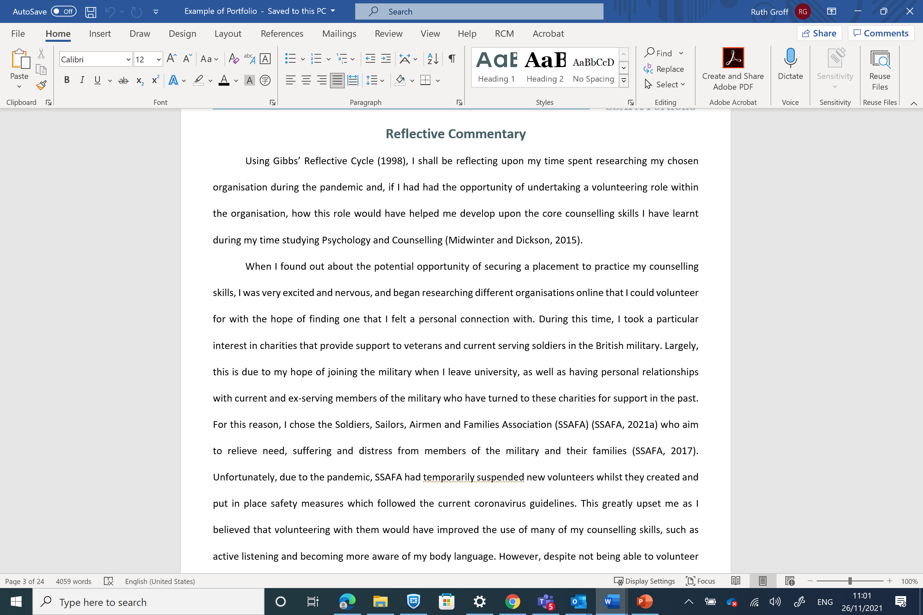

Slide 10
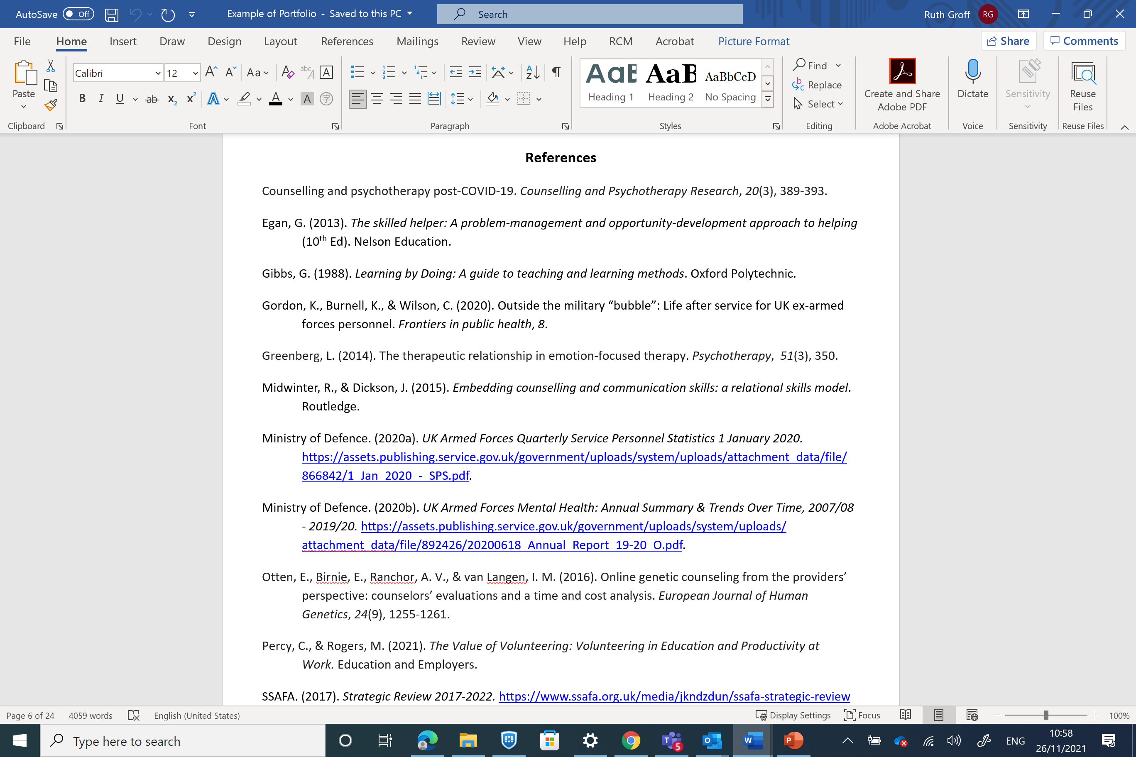

Slide 11
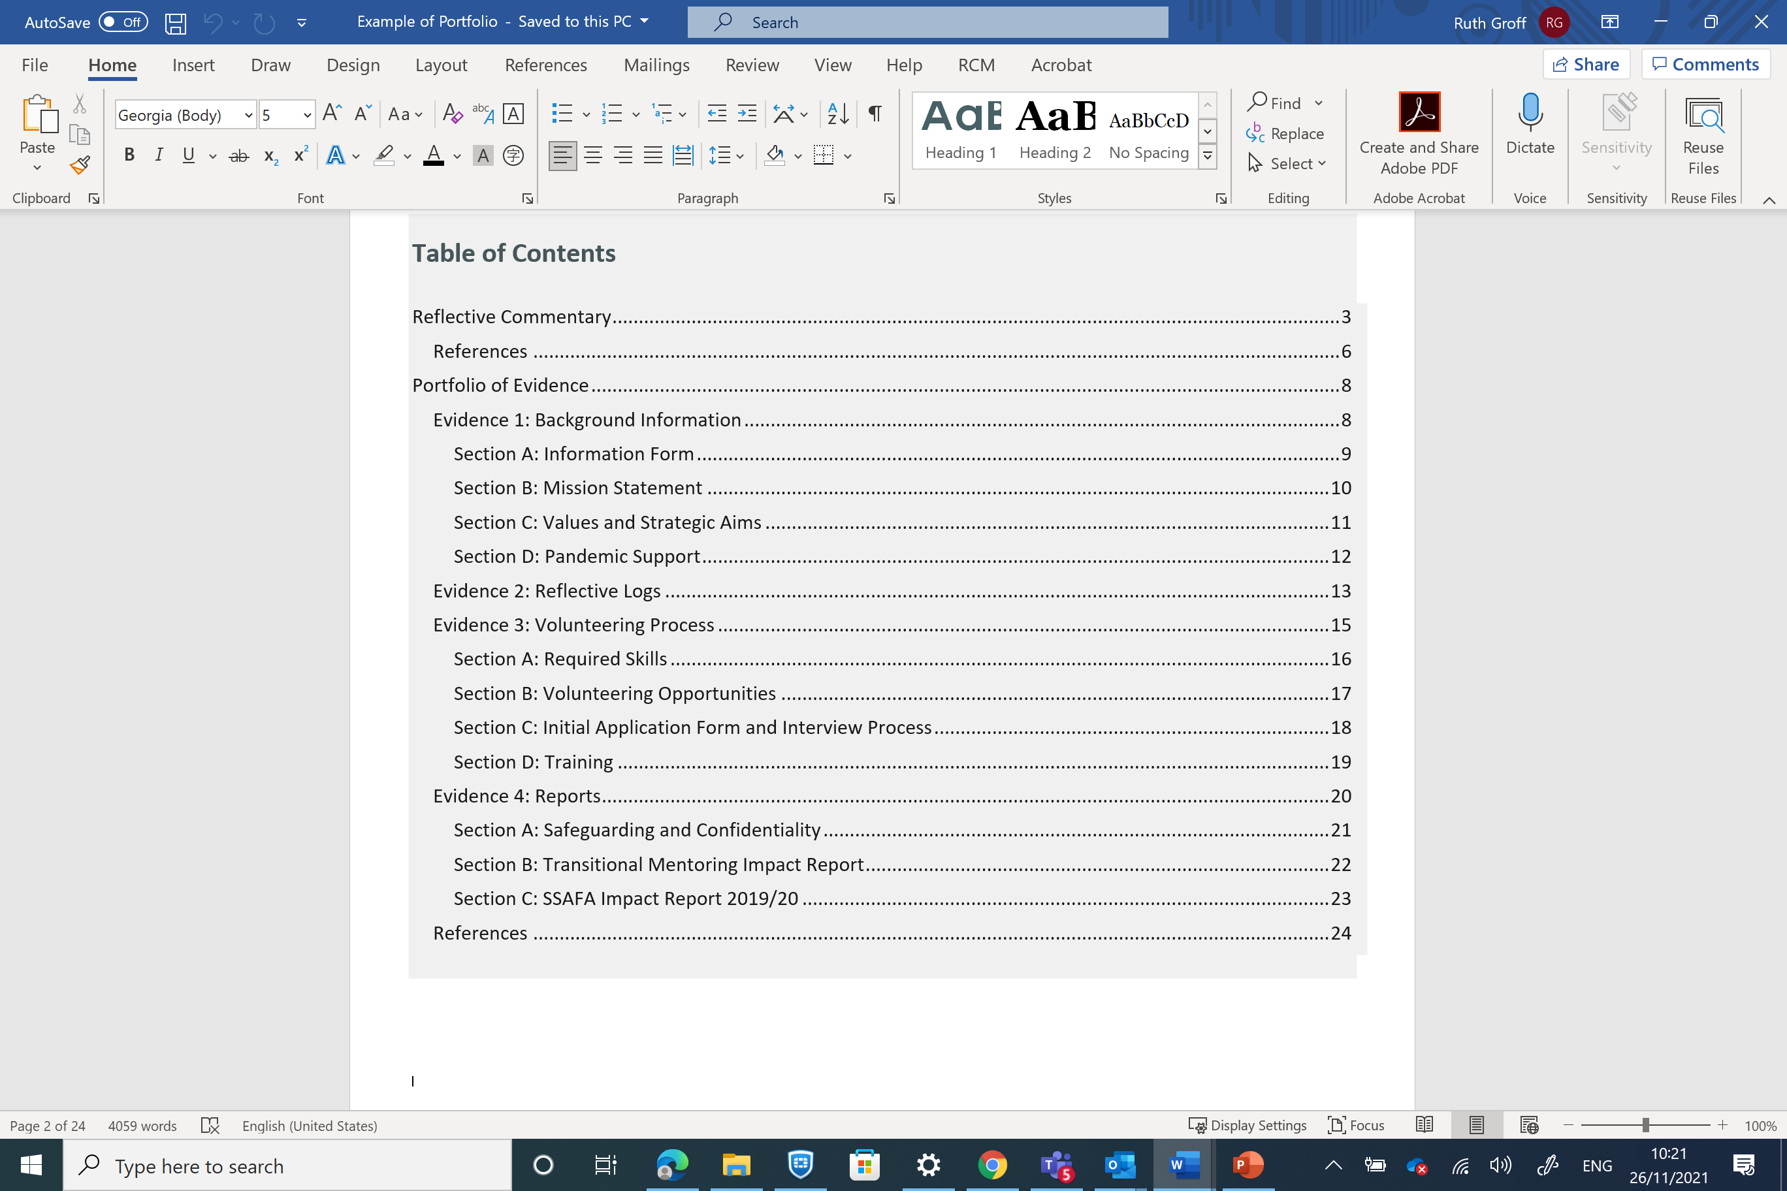

Slide 12
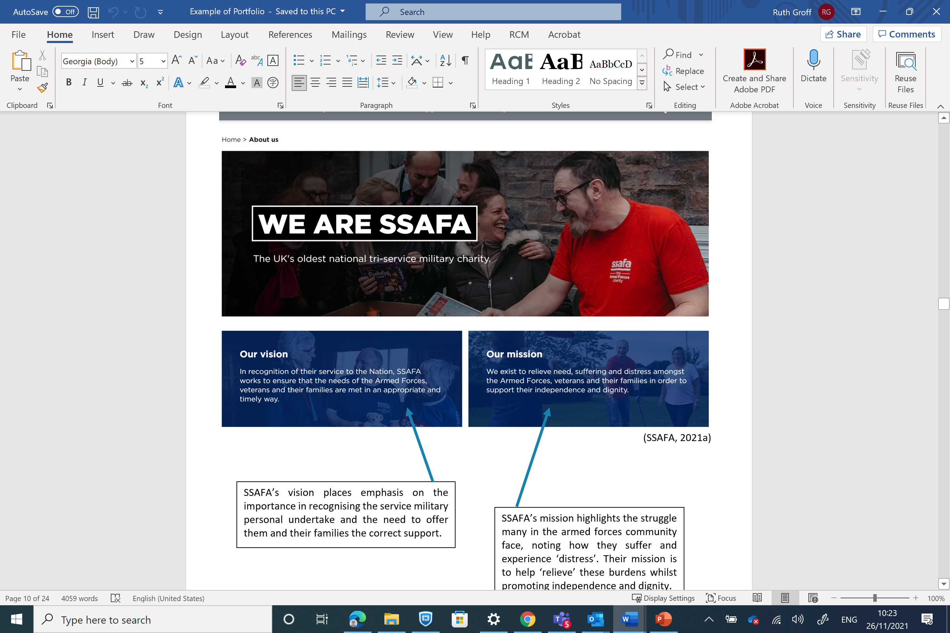

Slide 13
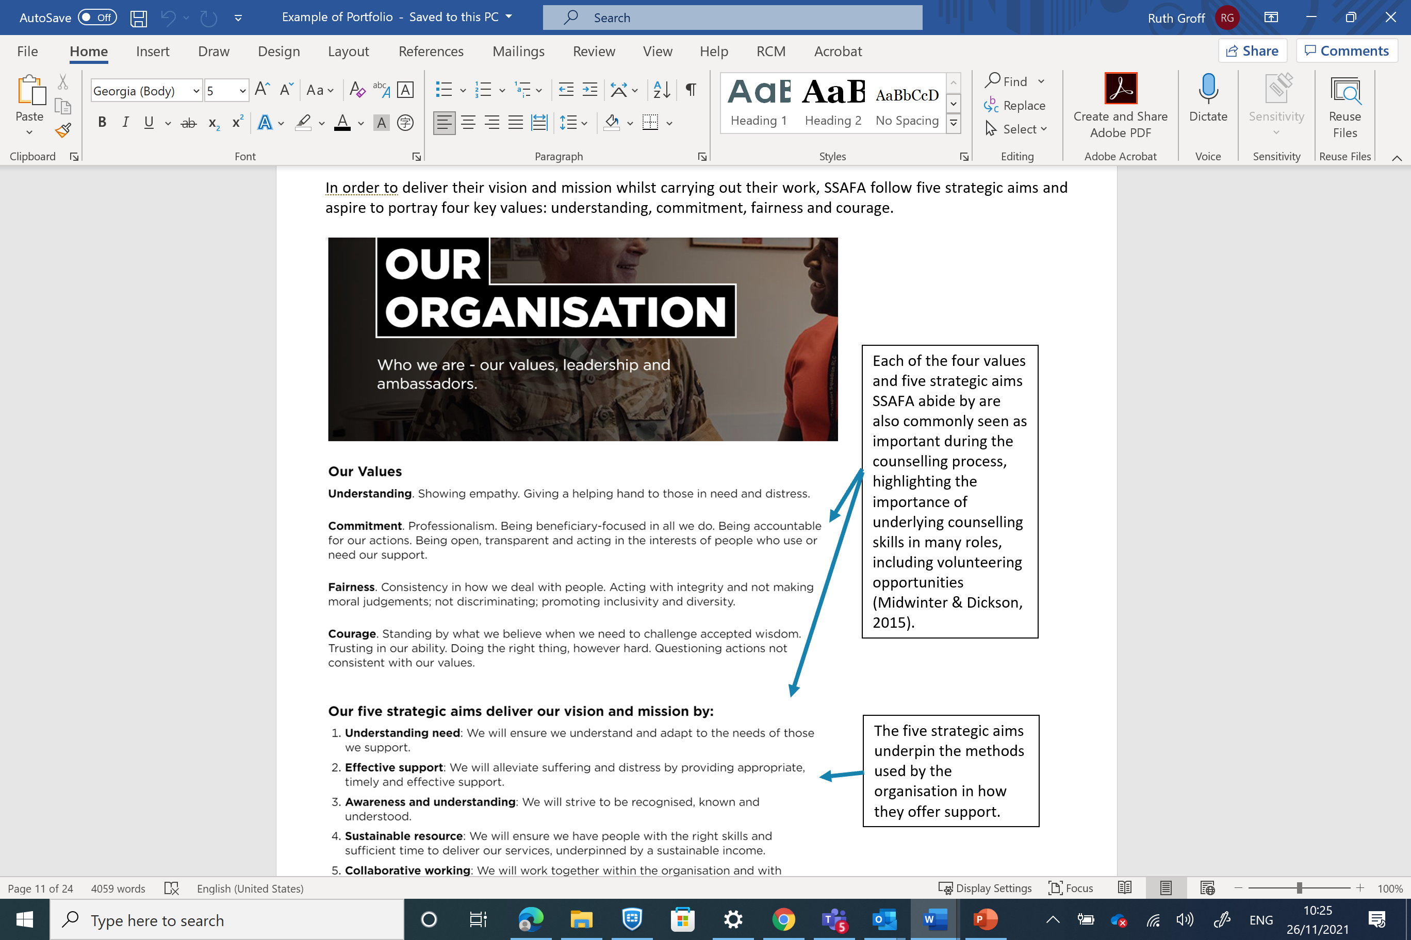

Slide 14
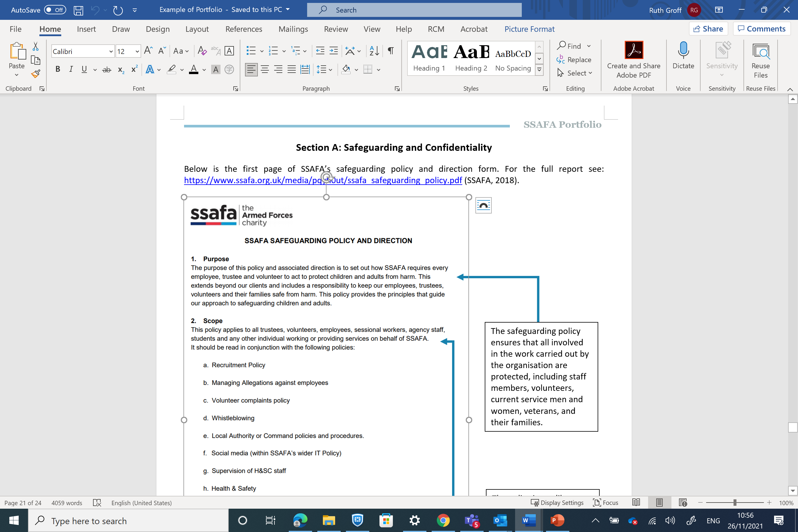

Slide 15
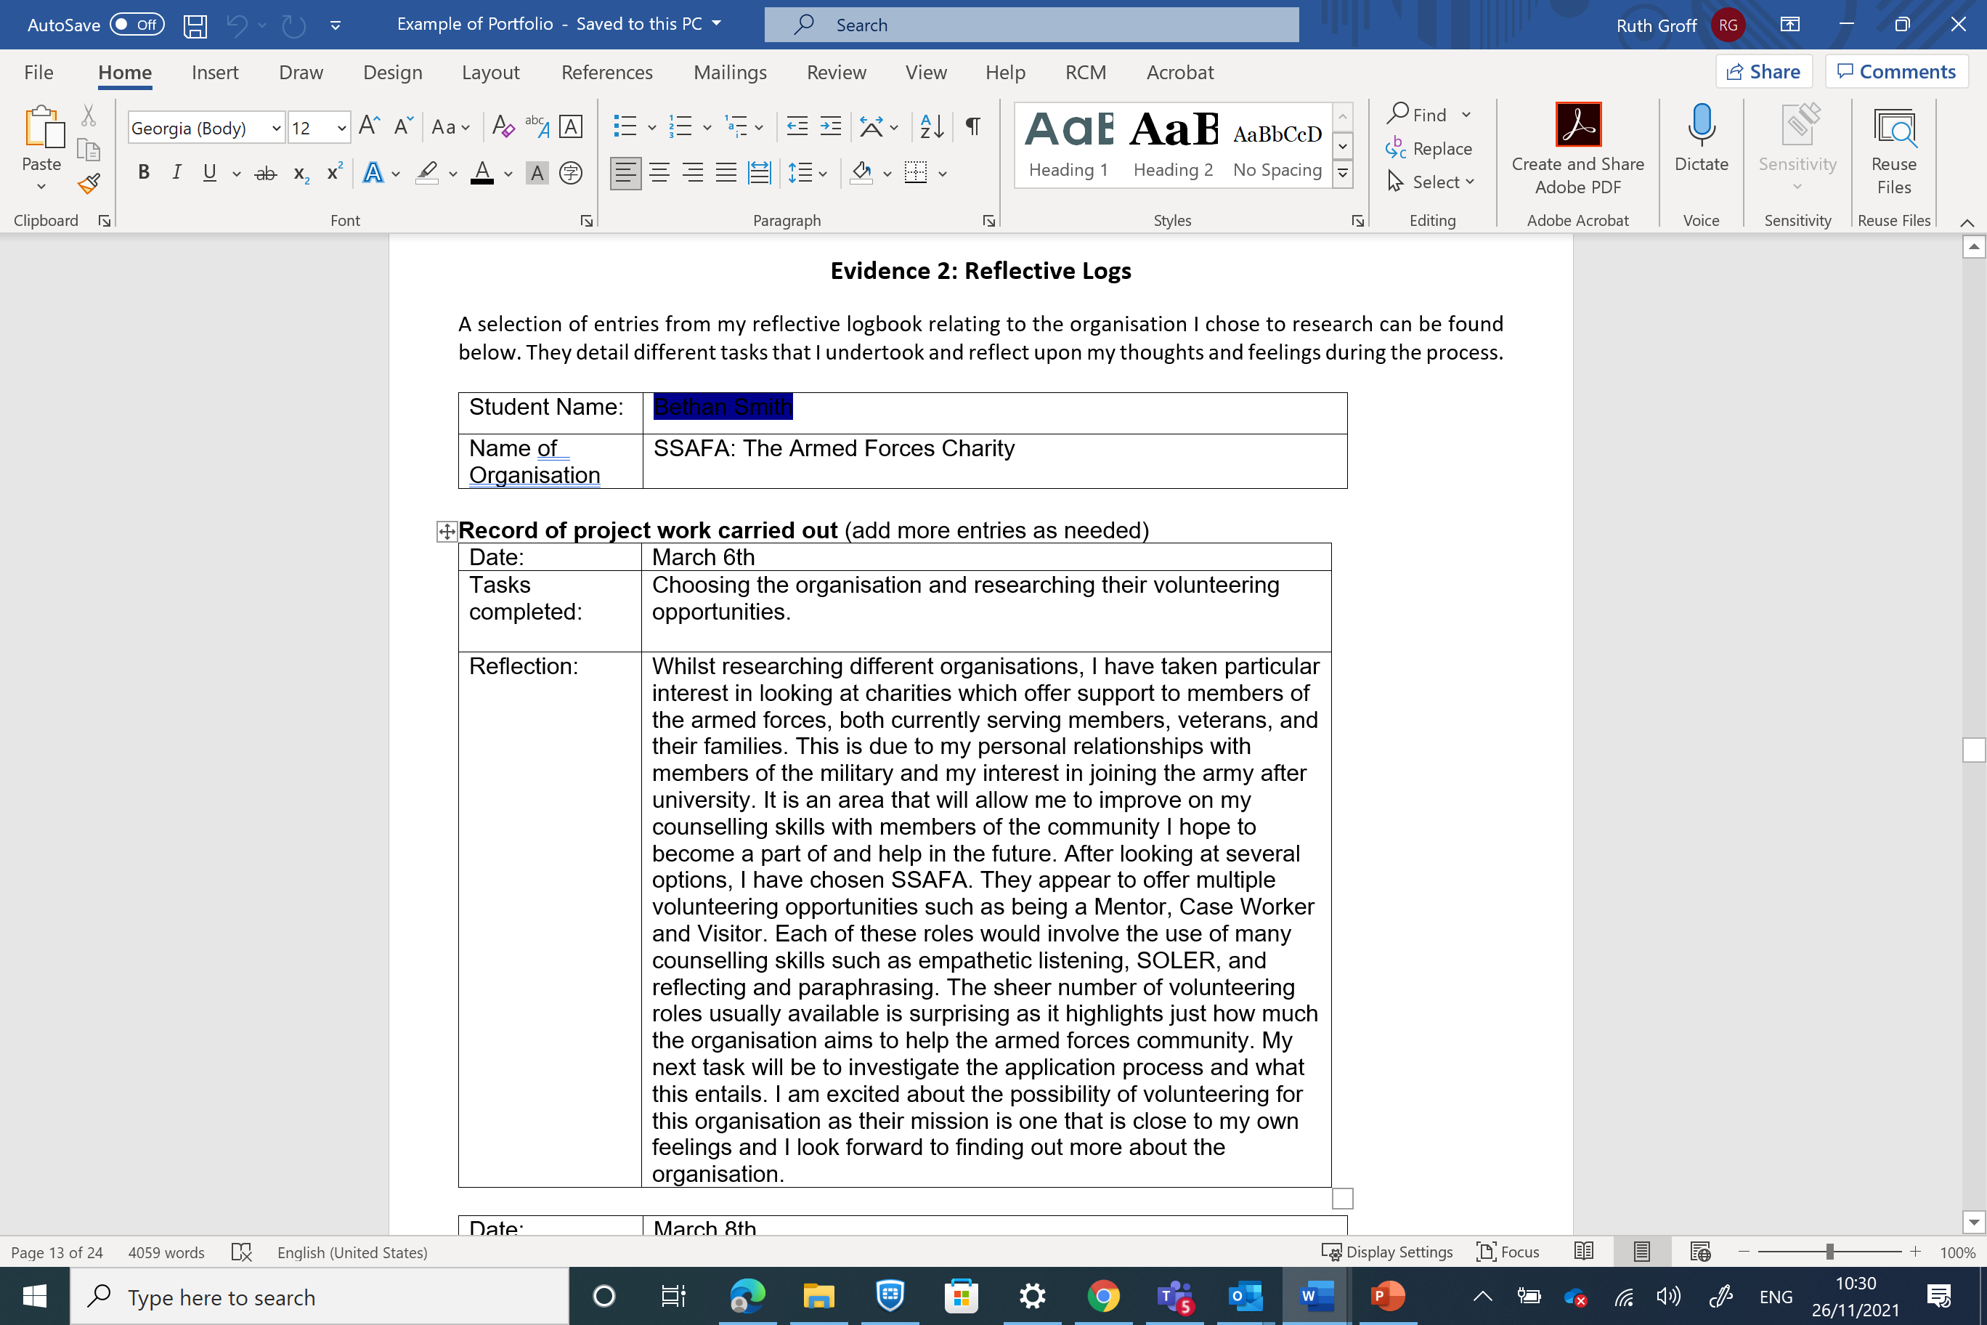

Slide 16

Portfolio Building Activity
Small Groups
What makes professional portfolio?
Reflections on not so good portfolios?
From your own chosen organisation what would you like to include as evidence?
What are your concerns?
How might you problem solve your concerns?
Annotation tools (How to use them)
Snip-it
Screen shots
others

Slide 17

Future Progression?
Counselling – Practice-Based Programme
MA in Psychotherapeutic Practice UWTSD
USW University of South Wales
Foundation Degree at Coleg si gar
Others
Non-practiced based programmes
MA Advanced Counselling Theory and Research
MSc Applied Psychology
Grad-Certificate in Counselling Skills
Other Post-graduate Programmes at UWTSD
Careers Services at UWTSD
Employability Week TBA
Professional Learning Community Days

Slide 18

Group Activity
What do you know?
Counselling Approaches
Counselling Skills
Working and helping others

Slide 19

Self-Assessment
Skills
Reflection on your own development

Slide 20

Group Process & Check out
Where to we to from here?

