Slide 1
LCBB5015
Principles of Marketing
Week 7 Session 2
Pricing Strategies

Slide 2
Learning Outcomes
Explain how customers perceive price.
Understand pricing strategies and how to price new offerings.
Explain cost-, competitor-, demand-, and value-oriented approaches to pricing.
Explain how pricing tactics works in business settings.

Slide 3
Some Dictionary Definitions
‘the amount of money expected, required, or given in payment for something expended or endured in order to achieve an objective the odds in betting archaic value; worth’
Price
$£€
‘the standard of something as measured against other things of a similar kind general excellence
archaic high social standing’
Quality
‘the regard that something is held to deserve; importance or worth material or monetary worth
the worth of something compared to its price: at £12.50 the book is good value’
Value
$£€
/
Source: Oxford English Dictionary

Slide 4
The Nature of Price
To a buyer price is:
The amount of income sacrificed in order to gain a package of benefits from a product or service.

Slide 5
The Relationship between Pricing and Proposition Costs
The price at which a proposition is set is important because increases in price have a disproportionately positive effect on profits and decreases in price have a disproportionately negative effect on profits.
A study identified that a:
1% improvement in price achieves an 8.7% improvement in operating profit;
1% improvement in variable costs only achieves a 5.9% improvement in operating profit;
1% improvement in volume sales achieves a 2.8% improvement in operating profit;
1% improvement in fixed costs achieves only a 1.8% improvement in operating profits (Baker et al., 2010:5)

Slide 6
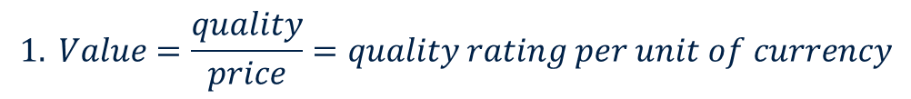
Different Definitions of Value
Note this equation does not work if we do not pay anything for an offering. Also is quality a rating or is quality the customer’s perceived reference price for the offering given its benefits?
Here customer perceives value if perceived benefits outweigh the price paid for those benefits.

Slide 7
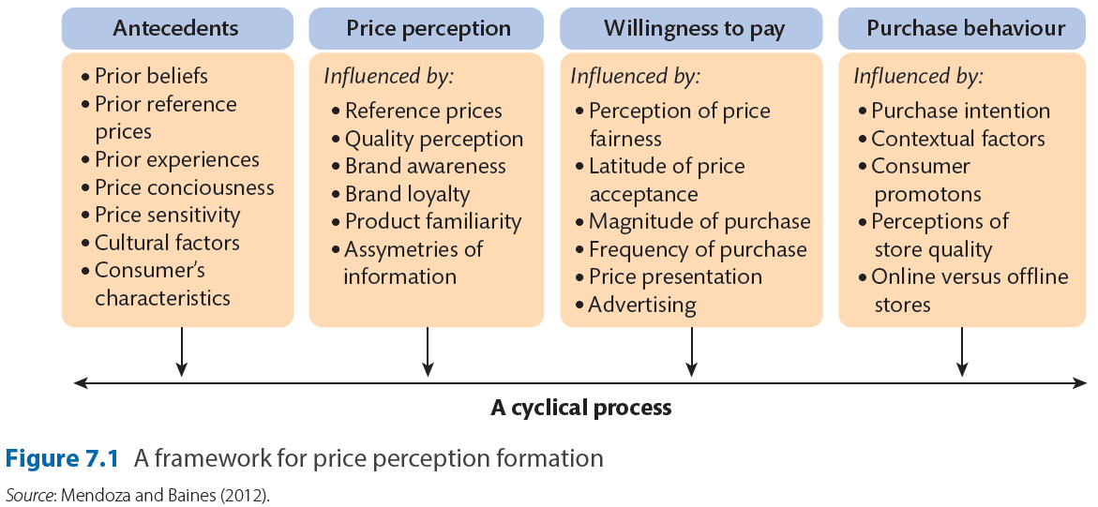
A Framework for Price Perception Formation

Slide 8
Pricing Strategies
The four main pricing strategies include:
Premium pricing – focuses on pricing an offering to indicate its distinctiveness in the marketplace.
Penetration pricing – where the price is set low relative to the competition to gain market share.
Economy pricing – where the prices are set at the bare minimum to attract price sensitive customers.
Price skimming – where the price is initially set high, then lowered in sequential steps. This strategy is frequently used for the launch of new offerings.

Slide 9
Price Competition
When price competition is used:
Companies closely monitor rival prices and either match or undercut rivals.

Slide 10
Non-Price Competition
Companies use factors other than low price to compete with rivals.

Slide 11
Pricing Objectives
The strategic pricing objectives are influenced by the mission statement of the organisation and segmentation, targeting and positioning.

Slide 12
Stages for establishing prices
Set the strategic pricing objectives
Estimate demand, price elasticity of demand and perceived value.
Determine costs and relationship to volume.
Examine competitors prices and costs.
Select a method for calculating the price.
Set a price level
Adapt the price structure to meet changes in demand and cost across different target markets, channels of distribution and countries.

Slide 13
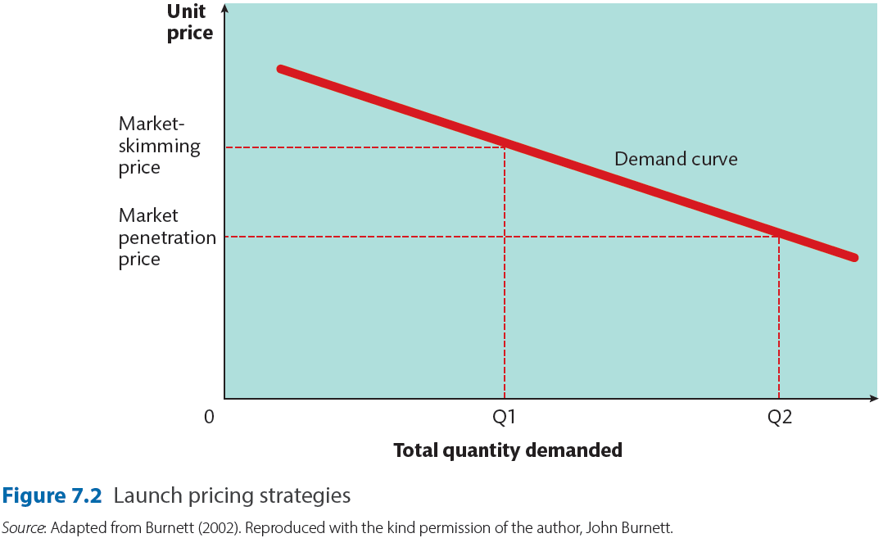
Launch Pricing

Slide 14
Launch Pricing
The price-skimming approach is a fairly standard approach for high-technology offerings or those offerings that require substantial R&D investment initially (such as games consoles and prescription pharmaceuticals).
The market penetration pricing approach is used for fast-moving consumer goods and consumer durables, when the new offering introduced is not demonstrably different from existing formulations. Items aimed at capturing price-sensitive customers might use this approach. The penetration approach is more effective when there is a strong threat from competition and demand is very elastic. (Dean, 1950; Doyle, 2000).

Slide 15
Pricing Approaches
Broadly, there are four types of underlying pricing approach:
the cost-oriented approach (that is, prices set based on costs);
the demand-oriented approach (that is, prices set based on price sensitivity and demand);
the competitor-oriented approach (that is, prices set based on competitors’ prices); and
the value-oriented approach (that is, prices based on what customers believe to offer value).

Slide 16
The Demand-oriented Approach
With the demand-oriented approach to pricing, the firm sets prices according to how much customers will pay.
This approach is prevalent in marketing services, but again could be used in B2B or consumer marketing contexts.
Airline companies frequently operate this approach, with customers paying different amounts for seats with varying levels of service attached.

Slide 17
The Competitor-oriented Approach
In this approach, companies set their prices based on the prices of their competitors, the so-called ‘going rate’. This is also called ‘me-too’ pricing.
The advantage of this approach is that when your prices are lower than your competitors, customers are more likely to purchase from you, providing that they know that your prices are lower, which is not always the case.

Slide 18
The Value-oriented Pricing Approach
When setting value-based prices, consider following six questions:
What is the market strategy for the segment? What does the supplier want to accomplish?
What is the differential value that customers are likely to perceive? (I.e. the value between this offering and the next best alternative, assuming that the differential value can be verified with the customer’s own data.)
What is the price of the next best alternative?
What is the cost of the supplier’s offering?
What pricing tactics will be used initially (e.g. price discounting)?
What is the customer’s expectation of a ‘fair’ price? (Anderson et al., 2010).

Slide 19
Pricing Tactics
In reality, when setting prices, an organisation trades off the different approaches against each other by considering all of the following factors.
Competition—How much are competitors charging for similar offerings?
Cost—How much do the individual components that make up our offering cost?
Demand—How much of this product or service will we sell at what price?
Value—What components of the offering do customers value and how much are they prepared to pay for them?

Slide 20
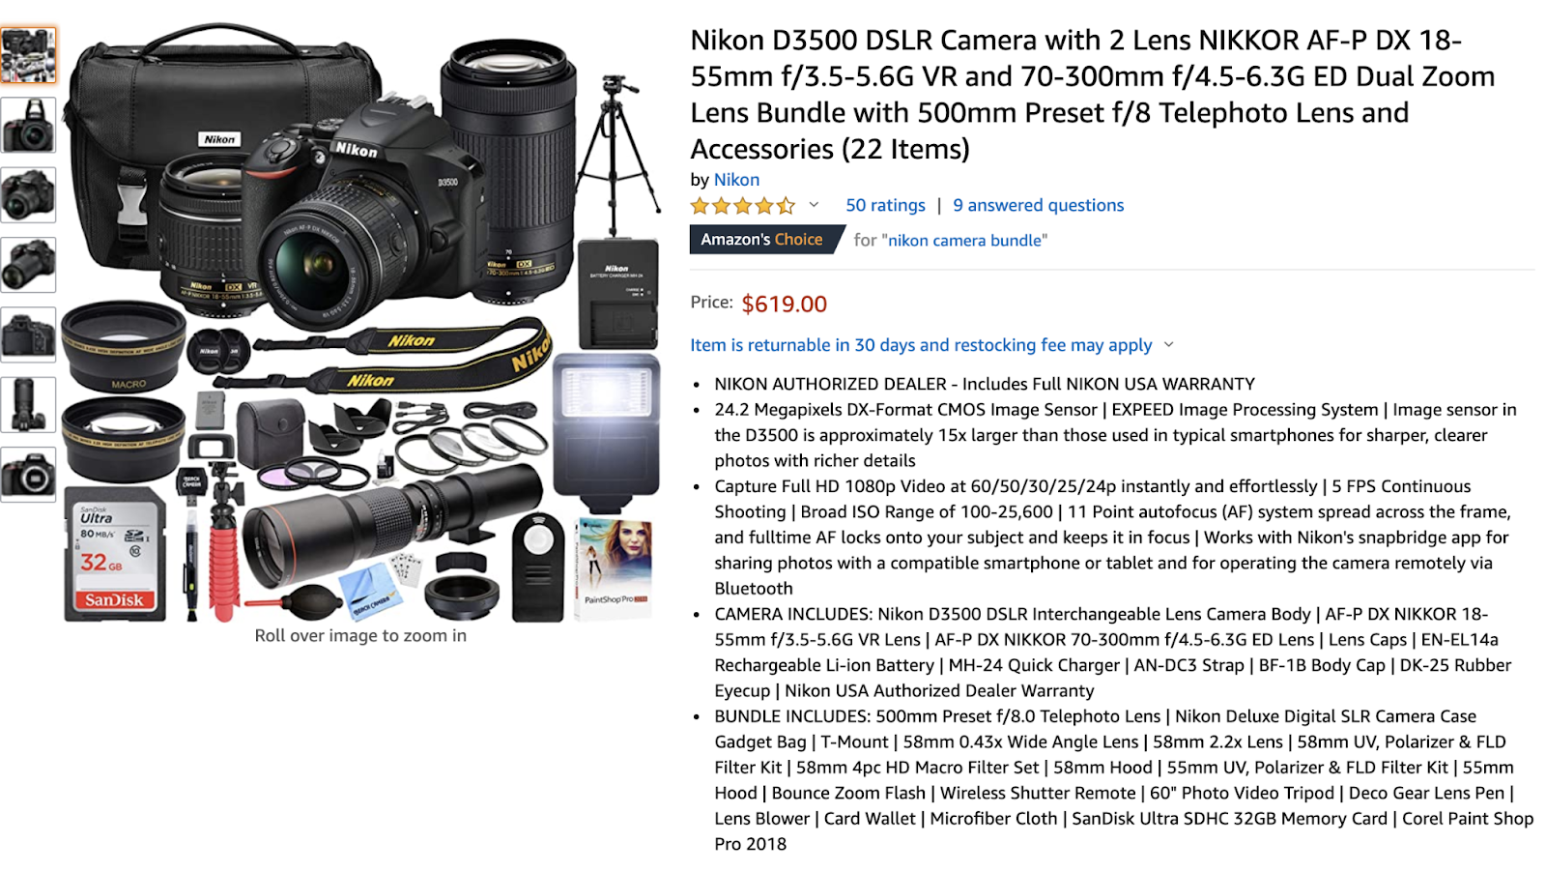
Bundle Pricing

Slide 21
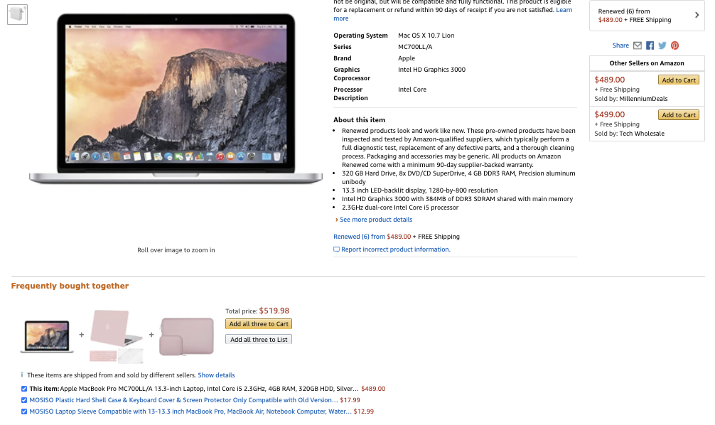
Bundle Pricing

Slide 22
Summary
In this session, we can now explain how customers perceive price.
We have discussed the pricing strategies and how businesses use it to price new offerings.
We have discussed the cost-, competitor-, demand-, and value-oriented approaches to pricing.
We can now explain how pricing tactics works in business settings.

Slide 23
References
Montgomery, Stephen L. Profitable Pricing Strategies. New York, Mcgraw-Hill, 28 July 2021.
Z John Zhang. Pricing Strategies. Boston, Mcgraw-Hill Custom Publishing, 2019.
Kotler, P., Armstrong, G. and Opresnik, M.O. (2018). Principles of marketing. 17th ed, global edition. Harlow: Pearson.

