Slide 2
Chapter 9
Site-to-Site VPN

Slide 3
Learning Objectives
Discuss Site-to-Site VPN basics, deployment, and communities.
Describe how to analyze and interpret VPN tunnel traffic.
Articulate how pre-shared keys and certificates can be configured to authenticate with third-party and externally managed VPN Gateways.
Explain Link Selection and ISP Redundancy options.
Explain tunnel management features.
Notes:
Discuss Site-to-Site VPN basics, deployment and communities
Describe how to analyze and interpret VPN tunnel traffic
Articulate how pre-shared keys and certificates can be configured to authenticate with third party and externally managed VPN gateways
Explain Link Selection and ISP Redundancy options
Explain tunnel management features

Slide 4
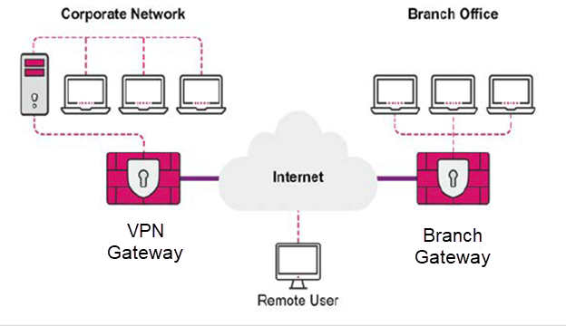
Introduction to VPN
A VPN securely connects networks and protects the data that passes between them.
Tunnels are used to securely encrypt and decrypt the network communications.
A VPN Gateway provides virtual connectivity and security for a wide range of situations.
Notes:
A VPN securely connects networks and protects the data that passes between them. Tunnels are used to securely encrypt and decrypt the network
communications. A VPN gateway provides virtual connectivity and security for a wide range of situations. For example, a company has multiple offices
throughout the world that communicate over the Internet. The offices have connectivity but the communications are not secured or encrypted. A VPN
gateway provides privacy and security by encrypting connections and data.
Another situation is when company employees need to download files and check email when they are offsite. A VPN gateway allows the employees to log
in to the company network and gives them all the necessary connectivity and security.
The Check Point VPN solution guarantees authenticity by using standard authentication methods to transfer information and data. It provides privacy,
securely encrypting all data sent over the network. It also has integrity with the use of industry-standard protocols that make sure the data is safe and
protected.

Slide 5
The IPSec VPN Solution
Lets the Security Gateway encrypt and decrypt traffic to and from other Security Gateways and clients.
SmartConsole is used to easily configure VPN connections between Security Gateways and remote devices.
The VPN tunnel guarantees:
  Confidentiality - All VPN data is encrypted.
  Integrity - Uses industry-standard integrity assurance methods.
  Authenticity - Uses standard authentication methods.
Notes:
The IPSec VPN solution lets the Security Gateway encrypt and decrypt traffic to and from other Security Gateways and clients. The SmartConsole is used to
easily configure VPN connections between Security Gateways and remote devices.
The VPN tunnel guarantees:
• Confidentiality - All VPN data is encrypted
• Integrity - Uses industry-standard integrity assurance methods
• Authenticity - Uses standard authentication methods
The Check Point VPN solution uses secure VPN protocols to manage encryption keys, and send encrypted packets.

Slide 6
Internet Key Exchange (IKE)
Standard key management protocol that is used to create the VPN tunnels.
Authenticate peers.
Agree on keys and methods to be used for encryption.
Produce a symmetric key on both sides to use for encryption and decryption of data.
Notes:
IKE (Internet Key Exchange) is a standard key management protocol that is used to create the VPN tunnels. IKE is used to do the following:
• Authenticate peers • Agree on keys and methods to be used for encryption
• To produce a symmetric key on both sides to use for encryption and decryption of Data
There are two versions of IKE available:
• IKEv1 – The default version which is supported on most new and older systems.
• IKEv2 – The newer version supporting IPv6 but currently Check Point Remote Access VPN clients do not support it.
The IKE protocol performs the negotiations and comes out with a Security Association (SA) with all the agreed keys and methods for encryption and
decryption. The VPN module refers to this SA before doing any encryption or decryption. In the absence of an SA, the VPN module will invoke the IKE to
negotiate with the peer and generate a Security Association.
To further secure the negotiation process itself, IKE is composed of two phases where the Phase I will prepare for protecting the IKE communication
itself and the Phase II will prepare for protection of the network traffic.

Slide 7
IKE Versions
1
2
IKEv1 - The default version that is supported on most new and older systems.
IKEv2 - The newer version supporting IPv6 but currently Check Point Remote Access VPN clients do not support it.
Notes:
There are two versions of IKE available:
• IKEv1 – The default version which is supported on most new and older systems.
• IKEv2 – The newer version supporting IPv6 but currently Check Point Remote Access VPN clients do not support it.
The IKE protocol performs the negotiations and comes out with a Security Association (SA) with all the agreed keys and methods for encryption and
decryption. The VPN module refers to this SA before doing any encryption or decryption. In the absence of an SA, the VPN module will invoke the IKE to
negotiate with the peer and generate a Security Association.
To further secure the negotiation process itself, IKE is composed of two phases where the Phase I will prepare for protecting the IKE communication
itself and the Phase II will prepare for protection of the network traffic.

Slide 8
IKE Phase I
Agreement of encryption methods that are used to protect the IKE communication
Diffie-Hellman key creation and exchange
This is used to create a shared-secret between the peers for use as a source for generating encryption keys.
Authentication between peers using a Pre-Shared Secret or Certificates, per the configuration.
IKEv1 Phase I - Main Mode and Aggressive Mode.
IKEv2 Phase I - 0ne mode and consists of two packets.
Notes:
Phase I prepares encryption parameters for securing the IKE communication (mainly the Phase II) between the VPN devices.
During this phase, the following actions are performed:
Agreement of encryption methods that are used to protect the IKE communication
Diffie-Hellman key creation and exchange
This is used to create a shared-secret between the peers for use as a source for generating encryption keys.
Authentication between peers using a Pre-Shared Secret or Certificates, per the configuration
The result of Phase I is a bidirectional Security Association called IKE SA that has a default validity of one day, after which it must be renegotiated.
IKEv1 Phase I is performed in one of two modes:
Main Mode – This is the preferred and default mode which is more secure as it is partially encrypted and less susceptible to DoS attacks. Main mode uses six packets for negotiation.
Aggressive Mode – This is a less secure mode that must be used only with a third-party device that does not support Main Mode. Aggressive Mode uses three packets for negotiation.
IKEv2 Phase I has one mode and consists of two packets.

Slide 9
IKE Phase II
Agreement of encryption methods that are used to protect the network traffic
(Optional) Diffie-Hellman key exchange might happen based on the configuration of the Perfect Forward Secrecy (PFS) option
Defining which networks or hosts need to secure the communication (VPN Domains)
IKEv1 Phase II - Quick Mode. Requires three packets for negotiation.
IKEv2 Phase II - Consists of two packets.
Notes:
The Phase II prepares encryption parameters for securing the traffic between the VPN Domains (Networks/Hosts behind the VPN Device that require secure communication).
During this phase, the following actions are performed:
Agreement of encryption methods that are used to protect the network traffic
(Optional) Diffie-Hellman key exchange might happen based on the configuration of the Perfect Forward Secrecy (PFS) option
Defining which networks or hosts need to secure the communication (VPN Domains)
The results of Phase II are two unidirectional Security Associations called IPSsec SAs that has a default validity of one hour, after which it must be renegotiated.
IKEv1 Phase II is called Quick Mode and requires three packets for negotiation.
IKEv2 Phase II consists of two packets.

Slide 10
Site-to-Site VPN
IPSec VPN tunnels can be established between two Security Gateways to securely pass traffic between hosts behind these Security Gateways by encrypting and authenticating it.
Notes:
Site-to-Site VPN refers to a deployment where IPSec VPN tunnels can be established between two Security Gateways to securely pass traffic between hosts behind these Security Gateways by encrypting and authenticating it. A single Security Gateway can maintain more than one VPN tunnel at the same time.
In the figure, the two Security Gateways (Corporate Gateway and Branch Gateway) establish a tunnel between them to security transfer traffic between the two networks named Corporate Network and Branch Network.

Slide 11
Site-to-Site VPN (Continued)
Check Point Security Gateway
Check Point Security Gateway
Managed by the same Management Server.
Check Point Security Gateway
Managed by different Management Server.
Non-Check Point IPSec VPN
Managed by a third-party.
Externally Managed VPN Gateway
Interoperable Device
Notes:
A Check Point Security Gateway can establish a Site-to-Site VPN with a peer gateway which can be:
• Another Check Point Security Gateway managed by the same Security Management Server.
• Another Check Point Security Gateway managed by a different Security Management Server. This is called an Externally Managed VPN Gateway
• A 3rd Party (Non-Check Point) IPSec VPN device. This is called an Interoperable Device.
The Check Point Security Gateway also forwards other traffic not meant for encryption, directly to the Internet, without passing it through the VPN Tunnel.

Slide 12
Security Gateway Configuration
Domain-based:
  VPN domains are predefined for all VPN Gateways. A VPN domain is a host or network that can send or receive VPN traffic through a VPN Gateway.
Route-based:
  The Security Gateways have a Virtual Tunnel Interface (VTI) for each VPN Tunnel with a peer VPN Gateway.
Notes:
Domain-based
VPN domains are predefined for all VPN Gateways. A VPN domain is a host or network that can send or receive VPN traffic through a VPN Gateway. When the Security Gateway encounters traffic originating from one VPN Domain with the destination to a VPN Domain of another VPN Gateway, that traffic is identified as VPN traffic and is sent through the VPN Tunnel between the two Gateways.
Route-based
The Security Gateways have a Virtual Tunnel Interface (VTI) for each VPN Tunnel with a peer VPN Gateway. The Routing Table can have routes to forward traffic to these VTIs. Any traffic routed through a VTI is automatically identified as VPN Traffic and is passed through the VPN Tunnel associated with the VTI.

Slide 13

Authentication Between Peer VPN Gateways
IKE Phase I authentication based on one of the following:
  Pre-shared secret
  PKI certificate
Notes:
In IKE Phase I, the VPN Gateways need to authenticate each other before they proceed with the VPN Tunnel establishment. This authentication is based on
one of these credentials:
Pre-shared Secret – Also called PSK or Shared Secret, is like a password or passphrase that the administrator configures for authentication with a peer VPN
Gateway. PSK cannot be used in case of Internally Managed VPN Gateways
PKI Certificate – Internally Managed VPN Gateways are always authenticated in Phase I using certificates. To use Certificate authentication, each VPN Gateway
must trust the issuer of the peer's certificate and must validate the certificate before accepting it. All Internally Managed VPN Gateways receive their certificates
from the same Certificate Authority (ICA) and hence there is no action needed. However, with Externally Managed VPN Gateways or Interoperable Devices, it is
required that this trust be established explicitly.

Slide 14

VPN Communities
Named collection of VPN domains (hosts/networks that use the Security Gateway to send/receive VPN traffic), each protected by a VPN Gateway.
All attributes of the VPN Tunnels are defined in the VPN Community.
Based on Mesh and Star topologies.

Slide 15
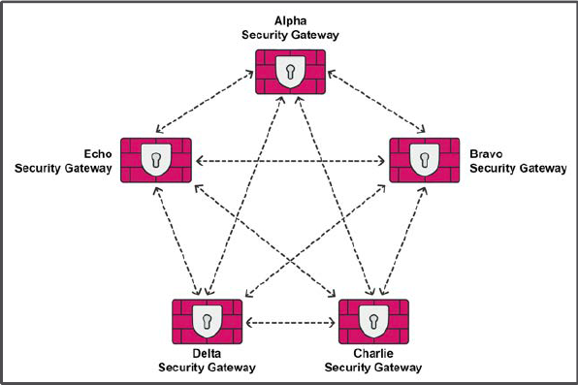
Mesh Topology
Any VPN Gateway in the Mesh community can establish a direct VPN tunnel with any peer Gateway in the Mesh community.
Notes:
Any VPN Gateway that is a member of the Mesh Community can establish a direct VPN Tunnel with any peer Gateway in that Community.

Slide 16
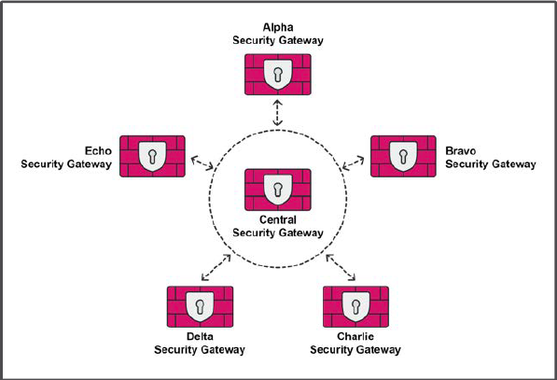
Star Community
One or more Center Gateways with Satellite Gateways as peers.
Notes:
Star Communities have one or more center gateways, with satellite gateways as peers.
Each Gateway can establish a VPN tunnel with a Center Gateway or a Satellite
Gateway. All traffic passes from the satellites to the Center Gateway, or from
the Center Gateway.

Slide 17
Combination of VPN Communities
A VPN Gateway can be a member of more than one VPN Community if it does not pair with another VPN Gateway in more than one VPN Community.
Community 1 Mesh | Community 2 Star | Community 3 Mesh
A-GW B-GW C-GW | Center: A-GW | A-GW F-GW G-GW
 | Satellites: D-GW E-GW
Notes:
A VPN Gateway can be a member of more than one VPN Community as long as it does not pair with another VPN Gateway in more than one VPN Community.
As an example, consider the following VPN Communities:
In the table that the A-GW is a member of all three communities, this is valid as long as no other gateway is duplicated in any community. If, for
example, B-GW was included in Comm3, this would become invalid because the pair of A-GW and B-GW will match two communities, Comm1 and Comm3.

Slide 18
VPN Routing
In a Star Community, two Satellite VPN Gateways cannot establish a VPN tunnel.
If communication is required, traffic must be routed through the VPN tunnels the two Satellite VPN Gateways have with the Center VPN Gateway.
Called VPN Routing because traffic is routed through two VPN tunnels.
Notes:
In a Star Community, two Satellite VPN Gateway cannot establish a VPN Tunnel. In case where it is required to have communication between the VPN
Domains of two Satellite VPN Gateways, the traffic has to be routed through the VPN Tunnels that the two Satellite VPN Gateways have with the Center
VPN Gateway. This is called VPN Routing because the traffic is routed through two VPN Tunnels to reach the final destination.

Slide 19
VPN Routing Options
The VPN Routing options available in Star VPN communities are from one Satellite to:
  To Center only.
  To Center and to other Satellites through Center.
  To Center, or through the Center to other Satellites, to Internet and other VPN targets.
Notes:
In a Star Community, two Satellite VPN Gateway cannot establish a VPN Tunnel. In case where it is required to have communication between the VPN
Domains of two Satellite VPN Gateways, the traffic has to be routed through the VPN Tunnels that the two Satellite VPN Gateways have with the Center
VPN Gateway. This is called VPN Routing because the traffic is routed through two VPN Tunnels to reach the final destination.
VPN Routing Options
The VPN Routing options available in Star VPN communities are from one Satellite to:
• To center only
• To center and to other satellites through center
• To center, or through the center to other satellites, to Internet and other VPN targets

Slide 20
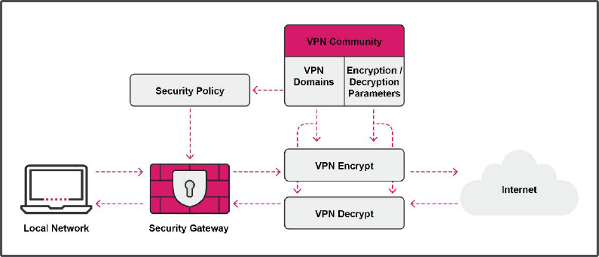
Access Control for VPN Traffic
Role of the Firewall is to allow or drop traffic, according to policy.
Notes:
The role of the Firewall is to allow or drop traffic, according to policy.
The VPN is responsible for encrypting, decrypting, and encapsulating packets.
The VPN community decides which traffic is tagged as VPN traffic and which parameters are used for the encryption and authentication.
The Firewall Policy decides whether the packets are accepted or dropped.

Slide 21
VPN Traffic Flow
The traffic going out from the VPN Domain to the Internet hits the Firewall first.
A decision is made whether to allow or drop the traffic.
The rule that determines the action can based on the Source, Destination, and Service or it can include VPN Communities.
Even if the Source and Destination are left with Any, the rule is limited to the VPN Domains. The Source and Destination can be used to further limit the rule to certain hosts or direction.
Notes:
The traffic going out from the VPN Domain to the Internet hits the Firewall first, and a decision is made whether to allow or drop the traffic. The rule that determines the action can based on the Source, Destination, and Service or it can include VPN Communities.
By including VPN Communities in the Firewall rule, all VPN Domains defined in the VPN Communities in the Source and Destination are automatically included.
Even if the Source and Destination are left with Any, the rule is limited to the VPN Domains. The Source and Destination can be used to further limit the rule to certain hosts or direction.
A VPN Community can be configured to add an Implied Firewall rule to allow all communication between its VPN Domains. This eliminates the need to add an explicit rule in the Firewall Policy to allow the VPN traffic..

Slide 22

Configuring Site-to-Site VPN - Considerations
  What traffic from hosts/networks needs to be encrypted?
  Which Security Gateways perform the encryption and decryption?
  What encryption methods and IKE protocol will be used?
  What authentication method will be used?
Notes:
Before beginning to configure Site-to-Site VPN, it is important to consider:
• Traffic from which Hosts / Networks need to be encrypted?
• Which Security Gateways will do the encryption / decryption?
• What encryption methods and IKE protocol is to be used?
• What will be the authentication method?

Slide 23
Workflow
Enable IPSec VPN blade and set the VPN Domain (for Domain-based) & Link Selection for each Security Gateway object.
Create or use an existing default VPN community and add the Gateways.
Select the VPN Community encryption parameters, as needed.
Set the Tunnel Management and other Advanced properties.
For external or third-party VPNs, optionally select the Shared Secret.
Either add an explicit Firewall Rule to all traffic as required or enable the Encrypted Traffic option in the VPN community.

Slide 24
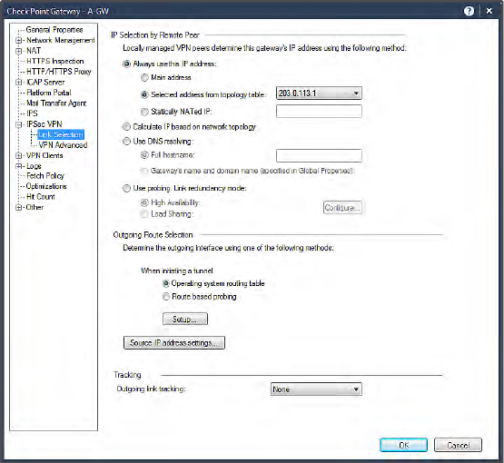
Step 1
Enable IPSec VPN Blade, set the VPN domain, and configure link selection.
Notes:
Link Selection
In the Security Gateway properties for each Gateway, the IPSec VPN Blade must be enabled.
If the Main IP address of the Gateway (in the General Properties) is not the external IP on which the VPN Peers communicate, the Link Selection must be set. Always use the External IP Address from the topology table.
The VPN Domain for the Security Gateway must be set accordingly.
This VPN Domain can later be overridden by a VPN Domain defined in a VPN community.

Slide 25
Step 2
Add Gateways to community.
  Create a new VPN community or use an existing default VPN Community. Add the Gateways to the community.
  The VPN community MyIntranet is a predefined Mesh Community. Administrators can use this default community or create a new VPN community by choosing a Mesh or Star topology.
  In a Mesh community, the Participating Gateways list must include all VPN Gateways.
Notes:
Create a new VPN community or use an existing default VPN Community. Add the Gateways to the community.
The VPN community MyIntranet is a predefined Mesh Community. Administrators can use this default community or create a new VPN community by choosing a Mesh or Star topology.
In a Mesh community, the Participating Gateways list must include all VPN Gateways. Because the VPN domains are assigned to each VPN Gateway, all VPN domains are included in the VPN community. Any traffic passing between these are automatically be encrypted using the community parameters.
If required, VPN domains can be overridden with specific VPN domains to be used only in a VPN community.

Slide 26
Step 3
Select the VPN community encryption parameters, as needed.
The encryption parameters apply to all the Gateways in the community; however, additional set of parameters can be defined for externally managed Gateways.
Parameter Name | Options
Encryption Method | IKEv1 / IKEv2
Encryption Algorithms | DES, 3DES, CAST, AES-128/256 & other variants
Hashing Algorithms | MD5, SHA1/256/384/512, AES-XCBC
Diffie-Hellman groups | Group 1/2/5/14/19/20
Notes:
Select the VPN community encryption parameters, as needed.
The encryption parameters apply to all the Gateways in the community; however, additional set of parameters can be defined for externally managed Gateways.

Slide 27
Step 4
Tunnel management and other advanced properties.
  Setting Permanent Tunnels
  VPN Tunnel Sharing
Tunnel Sharing options available in the community:
  One VPN tunnel per each pair of hosts
  One VPN tunnel per subnet pair
  One VPN tunnel per Gateway pair
Notes:
The VPN Community includes Tunnel Management configuration for:
Setting Permanent Tunnels – VPN tunnels in a community or on a specific Gateway or specific Gateway-to-Gateway tunnels can be set as permanent.
When a tunnel is set as permanent, it is continuously monitored by actively probing the Gateways using a tunnel testing mechanism using UDP Port 18234. This mechanism is specifically for Check Point Gateways only. For third-party VPN Gateways, the Dead Peer Detection (DPD) mode can be used in IKE.
VPN Tunnel Sharing – IPSec tunnels are created to secure communication between hosts of VPN Domains of two VPN Gateways. Each pair of hosts can have separate VPN tunnels. By default, VPN tunnels are created for a pair of subnets and all the hosts in these subnets share the same tunnel.
The Tunnel Sharing options available in the community are:
One VPN tunnel per each pair of hosts
One VPN tunnel per subnet pair
One VPN tunnel per Gateway pair

Slide 28

Step 5
For external or third-party VPNs, optionally select the Shared Secret.
If PKI certificates are not used, set a Shared Secret for each External VPN Gateway. This must match exactly what is set on the remote device and must be at least six characters; however, is recommended to have a secret of 20 or more characters
Notes:
For external or third-party VPNs, optionally select the Shared Secret.
If PKI certificates are not used, set a Shared Secret for each External VPN Gateway. This must match exactly what is set on the remote device and must be at least six characters; however, is recommended to have a secret of 20 or more characters.

Slide 29

Step 6
Create the VPN rules.
To allow traffic between the VPN domains of internally managed VPN Gateways in a community, either:
  Set Accept all encrypted traffic option.
  Create an Explicit Firewall rule.
Notes:
To allow traffic between the VPN domains of all internally managed VPN Gateways of a VPN Community, the Accept all encrypted traffic option can be set in the community's Encrypted Traffic section. If this option is not set or the traffic has to be allowed for External or Interoperable VPN Gateways, an explicit Firewall rule is required.
The VPN column can be used in the Firewall rule to limit the rule to traffic belonging to specific communities. This column does not affect the encrypt or decrypt functionality of the VPN; however, it limits the rule to match on the traffic match the specified communities.

Slide 30
What is a VPN community?
Define IKEv1 and IKEv2.
List the two topologies on which VPN communities can be based.
Review Questions
Notes:
Answers:
Question 1:
A VPN community is a named collection of VPN domains (hosts / networks that use the Security Gateway to send / receive VPN traffic), each protected by a VPN Gateway. All the attributes of the VPN Tunnels are defined in the VPN Community
Question 2:
IKEv1 is the default version which is supported on most new and older systems.
IKEv2 is the newer version supporting IPv6, but currently Check Point Remote Access VPN clients do not support it.
Question 3:
VPN communities can be based on Mesh and Star topologies.

Slide 31

Lab 9A
Configuring a Locally Managed Site-to-Site VPN
LAB
BREAK

Slide 32
Chapter 10
Monitoring Operations
Notes:
This chapter provides a brief overview of essential tools that help administrators to monitor operations in a Check Point environment.

