Slide 1
history of explosive materials
Acda6020
e.kazimierska@uwtsd.ac.uk

Slide 2
Black powder
Nitroglycerine
Mercury fulminate
Nitrocellulose (NC)
Picric acid
Tetryl
TNT
Nitroguanidine
Hexogen (RDX)
Pentaerythritol tetranitrate (nitropenta, PETN)
HMX

Slide 3
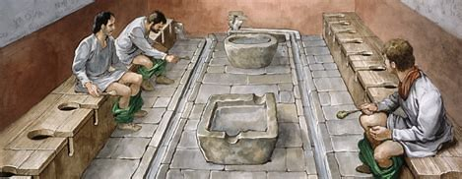
Black powder
- black powder = gunpowder
- very first explosive composition produced accidentally in China (220 BC)
- first confirmed reference occurred in China almost 1000 years later as warning against:
“an assortment of dangerous formula of heated together sulfur, realgar (arsenic
disulfide), and saltpeter with honey; smoke [and flames] result, so that (…)
hands and faces have been burnt, and even the whole house burned down.“
- consists of a fuel and oxidiser (10% S8, 15% charcoal and 75% KNO3)
fuel: powdered mixture of charcoal and sulfur
mixed with potassium nitrate, oxidiser
potassium nitrate (salpeter)– naturally occurring
mineral
http://salt.org.il/frame_saltpet.html

Slide 4
Gun powder chemistry
The optimum proportions for black powder:
74.64% Potassium nitrate,
13.51% charcoal
11.85% sulfur by weight. .
The current standard for black powder manufactured by pyrotechnicians today is: 75% potassium nitrate,
15% charcoal
10% sulfur by weight
74 KNO₃ + 96 C + 30 S +16 H₂O →
→ 35 N₂ + 56 CO₂ +14 CO + 3 CH₄ + 2 H₂S + 4 H₂ +
+ 19 K₂CO₃ + 7 K₂SO₄ + 8 K₂S₂O₃ + 2 K₂S + 2 KSCN + (NH₄)₂CO₃ + C + S
GASES
SOLIDS
https://www.youtube.com/watch?v=nf1mCiAodl0
https://www.youtube.com/watch?v=rmtK2BgmGCw
Notes:
By basic trial and error, rather than studying an equation, we arrived at 75% Potassium nitrate, 15% Charcoal and 10% Sulphur.
I’d like to include the “Cast Equation for the combustion of gunpowder” here but have had great difficulty in finding it. Suffice it to say for the moment it’s more complicated than the simple equation above and tries to balance out the list of products at the bottom of the slide.
The quantities were determined after using a bomb calorimeter and examining the residue. So that in itself may have had an influence on the products……
But is the chemistry everything?
The reverend Ron Lancaster may explain the burning of gunpowder better than me in his lecture.
https://www.youtube.com/watch?v=nf1mCiAodl0
Note the “dragon’s egg” effect on the end…….Bismuth Trioxide will be mentioned later on in the in the ignition phase.

Slide 5
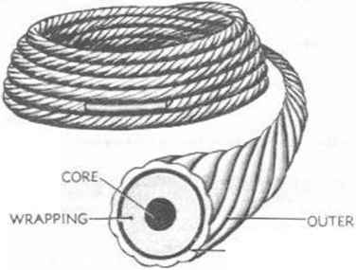
Bp in Europe
13 th / 14 th centuries - English monk Roger Bacon and the German monk Berthold Schwarz started to research the properties of black powder to introduce into the military world
1425 - black powder (or gunpowder) introduced as a propellant charge for smaller and later also for large calibre guns
Corning is the process by which meal powder, or finely divided black powder, is compressed into cakes, crushed, and then screened by particle size into different size categories. This process alters the burn rate of black powder, giving it more flexibility for different applications
One application in which BP is still in use ins in ‘time blasting fuses’
They were invented as early as 1831, and contain approx. 4.7 g/m BP in the core. The burn rate is about 135 m/s and since they are RF safe (radio frequency), they are very popular with military
https://www.youtube.com/watch?v=mqHVRgCkCDE

Slide 6

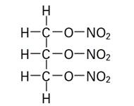
Nitroglycerine – need for better explosive
1846 (Ascanio Sobrero) - first small-scale synthesis of nitroglycerine
1863 (Immanuel Nobel and his son Alfred) commercialised NG production in a small factory near Stockholm
The greatest advantage of NG in comparison to black powder is that it contains both the fuel and oxidiser in the same molecule which guarantees optimal contact between both components
very difficult to handle because of its high impact sensitivity and unreliable initiation by black powder
nitroglycerine, NG

Slide 7
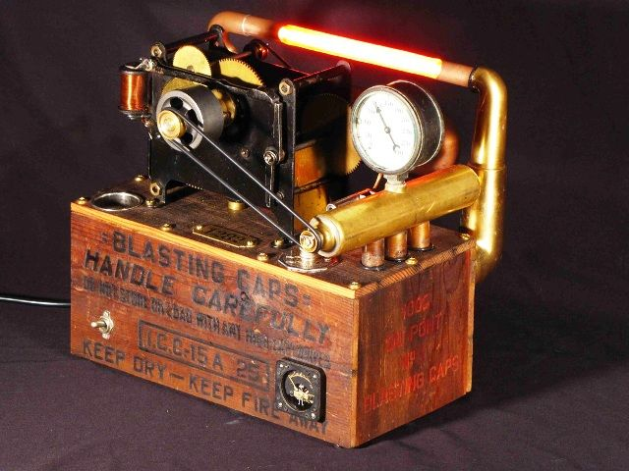
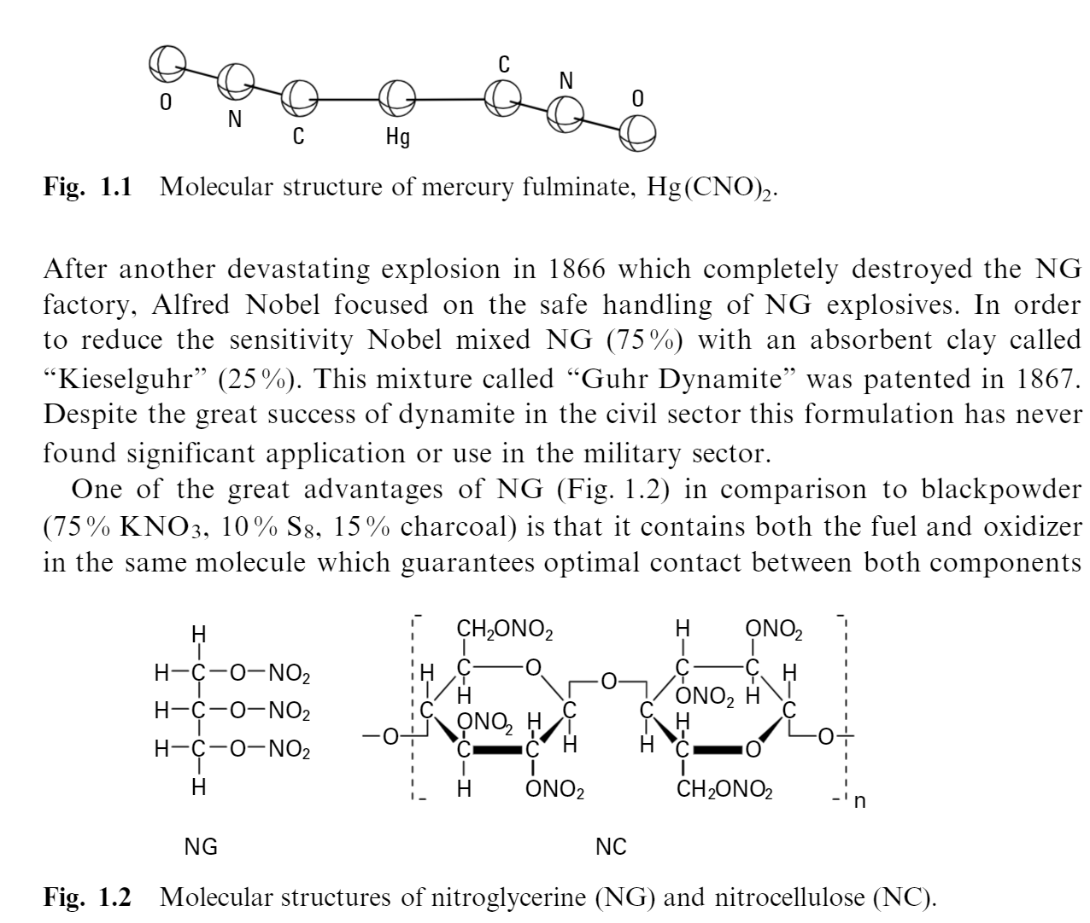
Nobel’s inventions
metal blasting cap detonator
black powder used originally to initiate NG was replaced with mercury fulminate (MF) , Hg(CNO)₂ . (known since the 17th but it did not have any practical application prior to blasting caps)
MF blasting cap produced an initial shock which was transferred to a separate container via a fuse, initiating the NG
ghur dynamite (patented in 1867)
to address the sensitivity issues of NG (solidify the NG by adding absorbent clay powder, ‘Kieselguhr’). MF blasting cap produced an initial shock which was transferred to a separate container via a fuse, initiating the NG
Despite the great success in the civil sector, this formulation has never found significant application in the military sector.

Slide 8
nitrocellulose
result of nitration of cellulose
1875 - Nobel discovered that when NC is formulated with NG, they form a gel. This gel was further refined to produce blasting gelatine, gelatine dynamite, and later in 1888 ballistite (49% NC, 49% NG, 2% benzene, and camphor), which was the smokeless powder.
1889 – Cordite with a very similar composition was developed in Britain.
In 1867 it was proven that mixtures of NG or dynamite and ammonium nitrate (AN, 1654) showed enhanced performance and were used in the civil sector.

Slide 9
Anfo – commercial explosives
1950 - waterproof explosives with less hazardous AN
The most prominent formulation was ANFO (Ammonium Nitrate Fuel Oil) which found extensive use in commercial areas (mining, quarries etc.).
Since the 1970s aluminium and mono-methylamine (MAN) were added to such formulations to produce gelled explosives that could detonate more easily.
More recent developments include the production of emulsion explosives which contain suspended droplets of a solution of AN in oil.
Such emulsions are waterproof, yet readily detonate because the AN and oil are in direct contact.
Generally, emulsion explosives are safer than dynamite and are simple and cheap to produce.

Slide 10
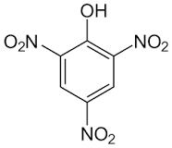
Military explosives – picric acid
first reported in 1742 however, it was not used as an explosive until the late 19th century (1885 - 1888), when it replaced black- powder in nearly all military operations worldwide - LIDDITE
The earliest known nitrophenol
Although pure PA can be handled safely, a disadvantage of PA is its tendency to form impact-sensitive metal salts (picrates, primary explosives) when in direct contact with shell walls. COMPATIBILITY ISSUES !!!
PA was used as a grenade and as mine filling.
Picric acid is used in the production of explosives, matches, and electric batteries

Slide 11
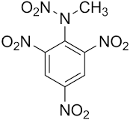
TETRYL
developed at the end of the 19th century and represents the first explosive of the nitroamino (short: nitramino) type.
Tetryl was used to make explosives, as a base charge of blasting caps.

Slide 12
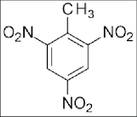
TNT
These disadvantages of PA are overcome by the introduction of trinitrotoluene (TNT).
First prepared by Wilbrand in1863 (procedure and discovery of 2,4,5-TNT dates 1870)
Pure 2,4,6-TNT was prepared in 1880 (Hepp) and its structure was established in 1883 (Claus and Becker)
1891 – manufacturing starts in Germany (1898 – Al added to form explosive composition)
In the aearly 20 th century TNT almost completely replaced PA and became the standard explosive during WW I.
TNT is still one of the most important explosives for blasting charges today.
Production limited by the availability of toluene; addition of AN - AMATOL

Slide 13
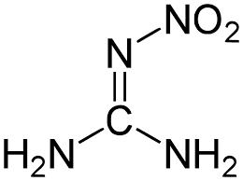
nitroguanidine
nitroguanidine (NQ) was first prepared by Jousselin in 1887
during WW I and WW II it only found limited use (in formulations with AN in grenades for mortars) due to compatibility issues with NC when used as flashless propellant
Overcome by Dynamit AG (1937) – ‘Gudol Pulver’ (produces very little smoke, no muzzle flash, increases life if gun barrels)
in more recent days NQ is used as a component in triple-base propellants together with NC and NG.

Slide 14
nitroguanidine
Advantages of the triple- base propellants:
  unlike double- base propellants the muzzle flash is reduced.
  The introduction of about 50 % of NQ to a propellant composition also results in a reduction of the combustion/explosion temperature and consequently reduced erosion and increased lifetime of the gun.

Slide 15
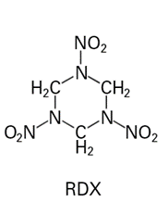
Rdx
Hexogen (RDX) was first prepared in 1899 by Henning for medicinal use. (NG and PETN are also used in medicine to treat angina pectoris. The principal action of these nitrate esters is vasodilation (i.e. widening of the blood vessels).
Nitration of hexamine
The most widely used explosives in WW II

Slide 16
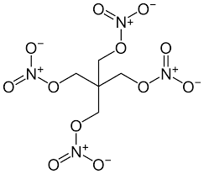
petn
1894 – nitration of pentaerythritol formed pentaerythritol tetranitrate (nitropenta, PETN) - another most widely used explosives in WW II
PETN is more sensitive and chemically less stable than RDX; not used in its pure form because it is too sensitive.
A formulation of 50 % TNT and 50 % PETN is known as “pentolite”.
making RDX the most commonly used explosive.
has a great shattering effect (brisance).
It is used in grenades, blasting caps, detonation cords, and boosters.
The military application of PETN has largely been replaced by RDX.

Slide 17
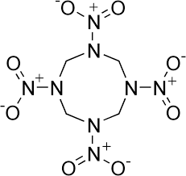
hmx
After WW II octogen (HMX) started to become available.
Until today, most high explosive compositions for military use are based on TNT, RDX and HMX
NAME | COMPOSITION
Composition A | 88.3% RDX, 11.7 % non-energetic plasticiser
Composition B | 60% RDX, 39% TNT, 1% binder (wax)
Composition C4 | 90% RDX, 10% polyisobutylene
Octol | 75% HMX, 25% RDX
Torpex | 42% RDX, 40% TNT, 18% aluminum
PBXN-109 | 64% RDX, 20% aluminum, 16% binder and plasticiser
OKFOL | 96.5% HMX, 3.5% wax

