Slide 1

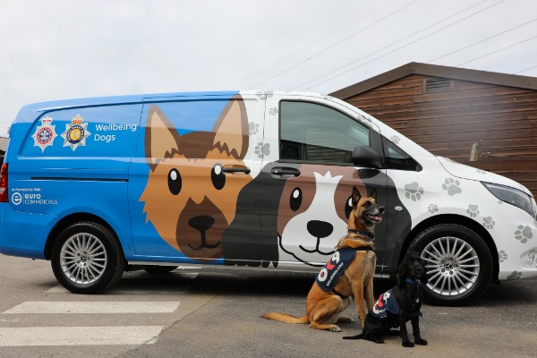
PIP 1 Suspect Interviewing
Day 1

Slide 2
https://www.bing.com/videos/search?q=smith+and+jones+police+interview&view=detail&mid=D10AEF4C07822522D711D10AEF4C07822522D711&FORM=VIRE
Notes:
Hyperlink to Alas Smith and Jones interview. Trainer to link in the introduction of PACE.

Slide 3
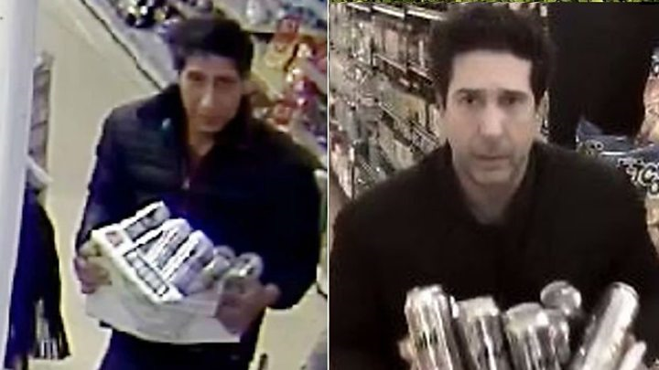

What is a suspect ?
“A person thought to be guilty of a crime or offence”
Notes:
QTS – what is a suspect?
Trainer to discuss what is a suspect

Slide 4
Why do we interview suspects ?
Investigators do have a duty to allow a suspect the opportunity to answer the allegations against them & give their own account before a decision on prosecution is made. An interview under caution may provide:-
Important evidence against the suspect, which you would otherwise be unable to obtain
Important information revealing further lines of inquiry
Relevant information to be considered in the prosecution decision
Notes:
QTS – why do we interview suspects?
Trainer to discuss why we interview suspects

Slide 5
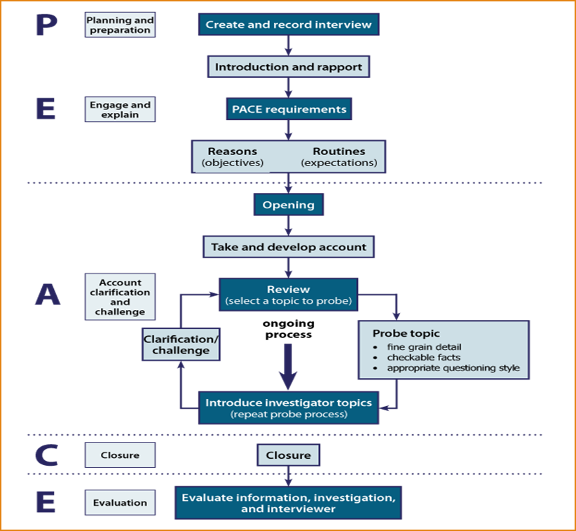
Use the PEACE model
Witness interviewing – 4 phase approach
Suspect interviewing – Conversation Management Model
Notes:
QTS – what are the components of the PEACE model?
Discuss the model in brief and how PEACE is the overarching model but it differs that witness interviewing includes the 4 phase approach within PEACE and suspect interviewing follows the Conversation Management Model (next slide)

Slide 6
Consider
What’s relevant, what’s in dispute, what’s checkable
Questioning (those areas identified when P & P & relevant areas from suspect’s account
Once an area of questioning is completed summarise before moving to next area
Memo Card (PACE Requirements)
Suspect’s Account (Record Account)
Summarise (Suspect’s Account)
Challenges (Those relevant areas in dispute with witness evidence), PDGs, CCTV, forensics etc
Closure of interview (final section of memo card)
Special warnings (should suspect’s account be unsatisfactory/failed to answer)
Notes:
P&P - Planning & Prep
PDG – Passive Data Generators
Trainer to go through the Conversation Management Model and explain that each section will be covered in detail over the coming days
This can also be emailed/distributed as a handout ‘Handout Conversation Management Model V1.0’ if students wish. This shows it in a different format.

Slide 7


Planning and Preparation
Notes:
QTS – why is planning for an interview so important?
The importance of planning cannot be overstated
Every interview should have an aim and a number of agreed and planned objectives.
The purpose of an investigative interview is to ascertain the witness’s account of the alleged event(s) and any other information that would assist the investigation

Slide 8
Planning and Preparation
Responsibilities of the Interviewing Officer
Welfare
Security
Legal Rights
Notes:
QTS – what are your responsibilities in relation to being an interviewing officer?
The Custody sergeant releases detainee into the custody of the interviewing officer who is then responsible for the welfare, security and legal rights of the detainee and compliance with the codes of practice until such time as the detainee is handed back following interview.
Welfare – fit for interview (physically & emotionally), fed & watered, toilet breaks. Need for an appropriate adult/Parent or Guardian
Security – sit them in area away from the door preventing escape, separated from other inmates.
Legal rights – speak to or have solicitor present at any time.
This is also the case when the person is released for other processes, such as fingerprints photographs, and DNA. On each of these occasions, the officer (not the custody officer) will be responsible for ensuring the detainee’s rights are complied with.
When they return the suspect to the custody officer, the officers will certify to the custody officer that the detainee has been treated in accordance with PACE and the Codes of Practice, and sign the custody record to this effect.

Slide 9
Physical and emotional condition of the suspect
Presence & potential impact of drugs &/or alcohol
Presence and potential impact of injuries or illness
Current behavioural/ emotional state of the suspect
Requirement for medical assessment for fitness for detention & interview.
Notes:
QTS – what would you consider when thinking about the health of the suspect?
HCP also advise on length of interviews. They should inform the CO whether the persons condition is likely to improve , will require treatment and indicate how long it may take for the persons condition to improve. They should make recommendations in writing on the custody record.
Custody officers decision whether to allow the interview to proceed . Consider other safeguards e.g HCP in monitoring room (Zoe David)
The Vulnerability assessment framework may be used at the NDM stage for this purpose.
Developed by Dr Karen Wright and Ivan McGlen at the University of Central Lancashire. This is the guidance on APP as at 7/12/16
Appearance and atmosphere: what you see first, including physical problems such as bleeding.
Behaviour: what individuals are doing, and if this is appropriate behaviour given the situation.
Communication: what individuals say and how they say it.
Danger: whether individuals are in danger and whether their actions put other people in danger.
Environment: where they are situated, whether anyone else is there and what impact the wider circumstances may have on the individual’s health and safety.

Slide 10
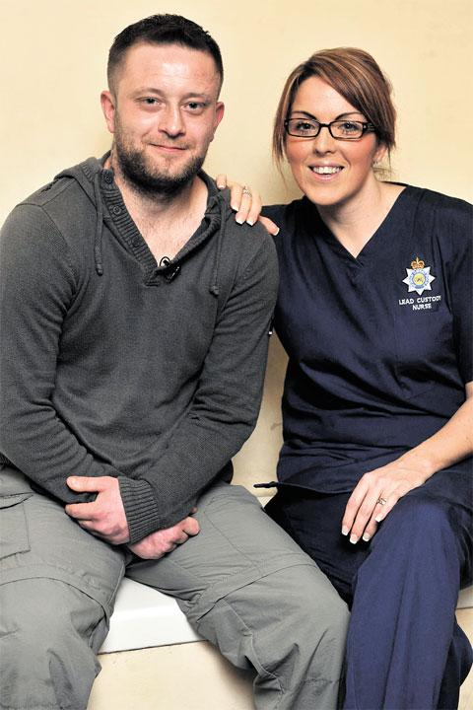
Medical Assessment
Understanding of Questions asked
Understanding of the caution
Understanding of the nature & purpose of the interview.
Significance & purpose of Q & A’s
Mental effects & ability to represent a rational & accurate explanation
Will the nature of the interview harm the detainee
Notes:
HCP also advise on length of interviews.
They should inform the Custody Officer whether the persons condition is likely to improve , will require treatment and indicate how long it may take for the persons condition to improve.
They should make recommendations in writing on the custody record.
Custody officers informed decision whether to allow the interview to proceed

Slide 11
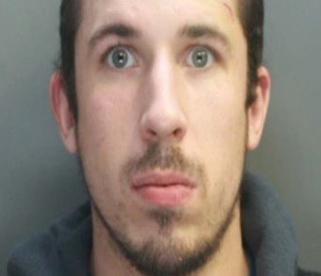
Annex E – Code C
If an Officer has any suspicion, or is told in good faith that a person of any age may be mentally disordered or otherwise mentally vulnerable, or mentally incapable of understanding the significance of questions or their replies that person shall be treated as mentally disordered or otherwise mentally vulnerable for the purposes of this Code
Special care should always be taken when questioning such a person & the appropriate adult should be involved if there is any doubt about a person’s mental state or capacity
Because of the risk of unreliable evidence, it is important to obtain corroboration of any facts admitted whenever possible

Slide 12
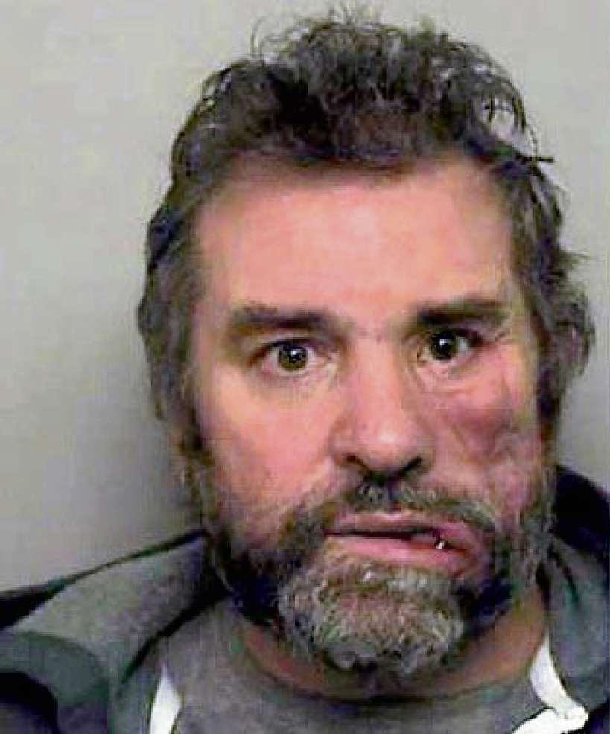
Annex G - Code C
Risk to detainee. Consider if conducting the interview would significantly harm the detainee’s physical or mental state
Anything the detainee says about the offence for which they are being interviewed might be considered unreliable because of any physical or mental state (at the time of the interview)
Notes:
Background info for Trainer -Christopher Parry
Caroline Parry was shot dead by estranged her husband on 8th August 2013 along Seabreeze Avenue in Newport. Immediately after her estranged husband Christopher Parry shot himself in the face sustaining serious facial injuries but later survived.
There were warning signs prior to this incident which according to the IPCC were not dealt with accordingly by Gwent Police and the risk to Mrs parry was not identified. Specifically there were 2 calls prior to her death on 1st May 2013 and 20th May 2013. On the 1st May Mrs Parry telephoned Gwent Police to report that her estranged husband was stalking her. A officer attended and spoke with Mrs and Mr Parry. Mr Parry admitted that he had been following his wife to keep an eye on her. Only words of advice were given to deal with the matter via a solicitor.
On 20th May both Mr and Mrs Parry telephoned Gwent Police. Mr Parry stated that his wife Mrs Parry had been to the address and assaulted his mother. Mrs Parry telephoned to stated that she went to the address to get her passport she believed that Mr Parry was keeping. She stated that the mother and husband were aggressive towards her. NFA was taken in relation to the alleged assault as a independent witness confirmed that the mother was the aggressor and no assault had taken place, therefore backing up what Mrs Parry had stated.
Mrs Parry had raised concerns about her husbands state of mind and when officers attended on the second occasion he was said to be aggressive towards officers. Regardless there was no direction by Gwent Police to remove the firearm. Neither did anyone see the risk to Mrs Parry or correctly identify that she was high risk and Mr Parry had already committed an offence which had not been dealt with correctly. We may have never prevented the death of Mrs Parry but we could have done more. The Police have a duty care to take positive action under HRA – right to life and right not to be subjected to torture.
PARRY had serious facial injuries when interviewed and was a controlling individual, he wanted regular breaks and would soil himself. The HCP sat in the interview room with him to ensure it continued.

Slide 13
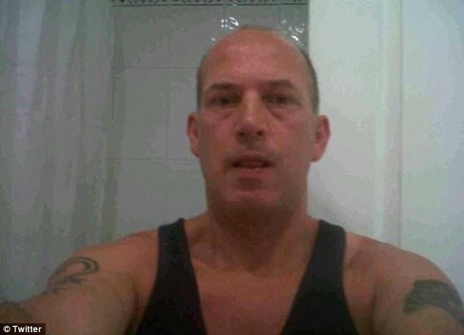
Gather Information about the Suspect
Intelligence
Handover package
Other agencies
Health care professionals
Notes:
QTS – what sources could you use to gather information on the suspect?
Trainer to talk about where information on suspects can be located, include custody record which will include injuries, illness. Property etc
Trainer to sign post students to look for warning markers on Niche ie..assault officer on duty etc.
QTS – What if the suspect was a police officer or police staff?
In deciding whether there is an indication of misconduct or criminality, the Appropriate Authority (Detective Inspector/DCI) at PSD will give careful consideration to readily available evidence such as body worn evidence, CCTV and statements.
• Most investigations (conduct matters) will be allocated to investigators at PSD but some will be allocated or referred elsewhere.
If the matter is an off duty criminal matter then the criminal element, for example, will usually be progressed by an appropriate/suitable department/BCU and not PSD.
• A member of the PSD Investigations Team will link in with the investigating officers to ensure that any misconduct matters are progressed. This will usually follow any criminal matter being resolved.

Slide 14
Interview planning
Suspect Assessment
Fit to be detained, fit for interview. Annex G Code C
Previous information
Strategy for pre-interview briefing
Needs of the investigation
Priority lines of enquiry
CSI
Priority actions
Material Time Frame
Interview Objectives
Legal requirements
Aide Memoire
Code C PACE 1984
Code E (audio) & F (video)
Article 6 ECHR
Notes:
Trainer to give students “interview planning example document” handout
QTS - what would you consider prior to interview to include in your plan?
Then reveal slide. Ask them for practical examples..ie cctv phone work etc.

Slide 15
Legal pack
Offence Definition
Points to Prove
Stated Cases
You need to demonstrate knowledge
Notes:
HCP also advise on length of interviews.
They should inform the Custody Officer whether the persons condition is likely to improve , will require treatment and indicate how long it may take for the persons condition to improve.
They should make recommendations in writing on the custody record.
Custody officers informed decision whether to allow the interview to proceed

Slide 16
Appropriate Adult (AA)
AA’s are called to the police station as an important safeguard, providing independent support to detainee’s who are:
Aged 18 or under or
Maybe mentally disordered /vulnerable
They are not simply an observer. Their role is to assist the detainee to ensure that they understand what is happening at the police station during the interview & investigative stages. In particular they should:-
Support, advise & assist the detainee
Ensure that the police act fairly & respect the rights of the detainee
Help communication between the detainee, the police & others
Their role is NOT to provide the detainee with legal advice
Notes:
QTS – when do we require an appropriate adult for an interview?
Interviews
A/P’s must be present when the police interview the detainee. They should:
▪ ensure that the detainee understands the caution that is given by the police at the start of the interview.
▪ intervene if they feel it is necessary to help the detainee communicate effectively with the police, or if they feel that the police questioning is confusing, repetitive or oppressive.
▪ ask for a break in the interview if they feel the detainee needs to rest or if they feel that they need legal advice or they want to talk to them in private.
▪ be present when the detainee is asked to agree and/or sign any documentation.
If they have any queries or complaints about the conduct of an interview they should be directed to speak to the Custody Officer immediately.

Slide 17

Notes:
QTS – when would we require an interpreter for an interview?
13.1B All reasonable attempts should be made to make the suspect understand that interpretation
and translation will be provided at public expense.
13.1C With regard to persons in Wales, nothing in this or any other Code affects the application of
the Welsh Language Schemes produced by police and crime commissioners in Wales in
accordance with the Welsh Language Act 1993. See paragraphs 3.12 and 13.1.
(b) Interviewing suspects - foreign languages
13.2 Unless paragraphs 11.1 or 11.18(c) apply, a suspect who for the purposes of this Code
requires an interpreter because they do not appear to speak or understand English (see
paragraphs 3.5(c)(ii) and 3.12) must not be interviewed unless arrangements are made for
a person capable of interpreting to assist the suspect to understand and communicate.
13.2A If a person who is a juvenile or is mentally disordered or mentally vulnerable is interviewed
and the person acting as the appropriate adult does not appear to speak or understand
English, arrangements must be made for an interpreter to assist communication between
the person, the appropriate adult and the interviewer, unless the interview is urgent and
paragraphs 11.1 or 11.18(c) apply.
13.3 When a written record of the interview is made (see paragraph 11.7), the interviewer shall
make sure the interpreter makes a note of the interview at the time in the person’s language
for use in the event of the interpreter being called to give evidence, and certifies its
accuracy. The interviewer should allow sufficient time for the interpreter to note each
question and answer after each is put, given and interpreted. The person should be
allowed to read the record or have it read to them and sign it as correct or indicate the
respects in which they consider it inaccurate. If an audio or visual record of the interview is
made, the arrangements in Code E or F shall apply. See paragraphs 13.12 to 13.14 and
Annex N for application to live-link interpretation.
13.4 In the case of a person making a statement under caution (see Annex D) to a police officer
or other police staff in a language other than English:
(a) the interpreter shall record the statement in the language it is made;
(b) the person shall be invited to sign it;
(c) an official English translation shall be made in due course. See paragraphs 13.12 to
13.14 and Annex N for application to live-link interpretation.
(c) Interviewing suspects who have a hearing or speech impediment
13.5 Unless paragraphs 11.1 or 11.18(c) (urgent interviews) apply, a suspect who for the
purposes of this Code requires an interpreter or other appropriate assistance to enable
effective communication with them because they appear to have a hearing or speech
impediment (see paragraphs 3.5(c)(ii) and 3.12) must not be interviewed without
arrangements having been made to provide an independent person capable of interpreting
or of providing other appropriate assistance.
13.6 An interpreter should also be arranged if a person who is a juvenile or who is mentally
disordered or mentally vulnerable is interviewed and the person who is present as the
appropriate adult, appears to have a hearing or speech impediment, unless the interview is
urgent and paragraphs 11.1 or 11.18(c) apply.
13.7 If a written record of the interview is made, the interviewer shall make sure the interpreter is
allowed to read the record and certify its accuracy in the event of the interpreter being
called to give evidence. If an audio or visual recording is made, the arrangements in Code
E or F apply.

Slide 18
Interview Advisor
The role of Interview Advisor is to advise on and co-ordinate investigative interviews for a range of investigations including; Major Crimes, Serious and Organised crime, Public Protection in conjunction with the lead investigator. They will assist in the development of interview strategies for interviews involving victims, witnesses and suspects.
In addition they will provide advice and support to assist the development of others in the field of investigative interviewing techniques.
Notes:
QTS – what is the role of the interview advisor?
Key Accountabilities
Provide advice to lead investigators, at all levels, on matters of interview law, guidance, policy, tactics and options to inform decision making relating to the investigation.
Consult with other personnel involved in the investigation to develop effective and informed advice and guidance.
Identify and respond to potential matters relating to the vulnerability of those being interviewed and brief lead investigators to ensure effective safeguarding steps are put in place.
Provide investigative officers with the available tactical interviewing options to meet the strategic policy objectives of an investigation.
Monitor on-going investigative situations and respond to developments, in order to provide updated and relevant strategic policy and tactical advice to lead investigators.
Maintain a record of all tactical advice given to lead investigators to ensure that there is an effective audit trail of the decision making process.
Contribute to the preparation of the case file by evaluating investigative material(s) relating specifically to investigative interviews in order to maximise evidential outcomes.
Provide advice and support for other personnel in approaches to investigative interviewing to assist with their continuing professional development.
Ensure maintenance and currency of tactics, options and approaches to ensure that any and all advice given to lead investigators is reliable and valid.

Slide 19

Engage and Explain
Notes:
The first step to encouraging conversation is to engage the interviewee. This is not always easy, especially if the person is previously unknown to the police.
Active listening assists the interviewer to establish and maintain a rapport.
This then enables them to:
•identify topics during the interview and, therefore, manage the conversation
•communicate interest to the interviewee in their account
•identify important evidential information.
Factors such as the interviewee’s background and personal characteristics should be taken into account

Slide 20
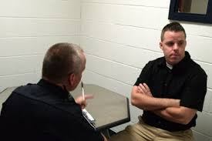
Aide Memoire
Notes:
Trainer to hand out printed ‘aide memoire’ for each of the students. On NICHE this can be found under the persons tab and can be amended to suit yourself (e.g you can remove the part about the appropriate adult if it’s not applicable). DO NOT remove any of the parts that are required by PACE.
QTS – how would an aide memoire help you in an interview?
QTS – what are the benefits of the aide memoire?
This is important and should be considered in the planning stage. The reason for the interview should also be clearly explained, eg, the interviewer may say:
•‘You are here because you have been arrested for (offence)’ or
•‘You are here because you witnessed (offence/incident).’
The interviewer should then check the interviewee has understood the explanation
Objectives of the interview
Before starting an interview, the objectives of the interview should be explained to the interviewee, and they should be provided with an outline or route map of it.
For example, interviewers may say:
•‘During this interview I will talk to you about (list objectives).’
Then go on to explain:
•‘I will also ask you about anything else which may become relevant during the interview in order to properly establish the facts and issues.’
Routines and expectations
It is good practice to explain to the interviewee that if they nod or shake their head the interviewer will state that they have done so. It should also be explained that notes will be taken during the interview.
It may be useful to inform the interviewee that although the police wish to establish certain facts and issues, it is the interviewee’s opportunity to explain their involvement or non-involvement in the incident under investigation.
Investigators should encourage the interviewee to voice anything which they feel is relevant, explaining that there is no time limit for the interview and that as much detail as possible is required, encouraging the interviewee to voice anything which they feel is relevant.
The interviewee should be reassured that they will not be interrupted. It may be appropriate to ask the interviewee to consider fully any question they are being asked before they answer.
The role of the second jockey is to summarise at the end of each topic, ask any questions that the lead interviewer may have missed (also gives the lead interviewer some thinking time). They should also deal with any questions/ comments from the solicitor

Slide 21
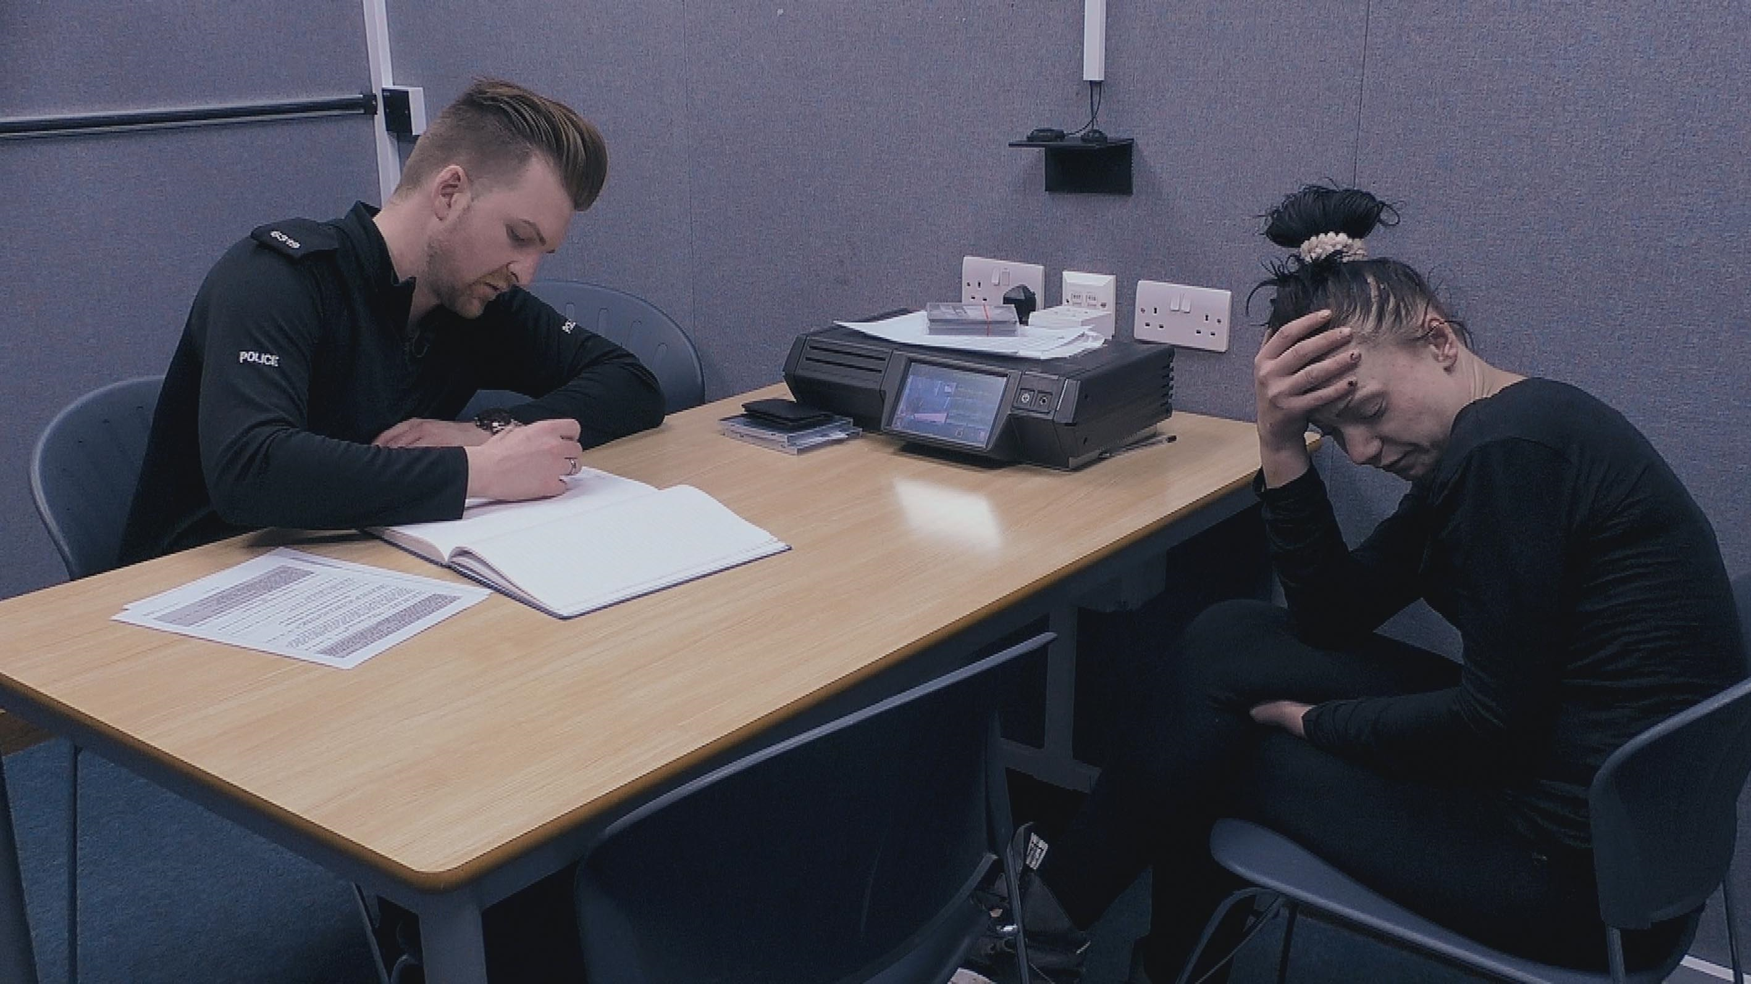
Account
Notes:
QTS – how will active listening help during the interview?
The first step to encouraging conversation is to engage the interviewee. This is not always easy, especially if the person is previously unknown to the police.
Active listening assists the interviewer to establish and maintain a rapport.
This then enables them to:
•identify topics during the interview and, therefore, manage the conversation
•communicate interest to the interviewee in their account
•identify important evidential information.
Factors such as the interviewee’s background and personal characteristics should be taken into account

Slide 22
Scenario
John SMITH has been arrested on suspicion of stealing a bottle of vodka at 3pm yesterday from the SPAR shop on HIGH STREET, CWMBRAN
CCTV inside the store shows a male selecting a bottle from the shelf, putting it inside their jacket, & leaving without offering payment. A local officer PC JONES positively identifies the male on the footage as SMITH & has provided a statement
The shop assistant, Jane EVANS witnesses the theft. She has also identified the culprit as SMITH & knows him as she went to school with him
Notes:
Ask class to identify topics from the circs. Possibly write the answers down on a flip chart then compare to next slide.
RESPONSIBILITY – “Are you responsible for”, “Tell me what you know about”.
MATERIAL TIME FRAME – Identify the times you want to cover. Ask questions; for example around movements, associations, clothing worn, vehicles driven, alcohol / drugs consumed, etc.
KNOWLEDGE OF THE SPAR – How often attend, what type of items purchased, when last there, what purchased when there last, ever purchase alcohol, ever had any issues with the shop / staff.
I-TOPIC – any drink / drugs issues, how often drink, how much, what drink, Vodka?, finances.
CCTV – Show and ask to comment on footage. “is that you”, “do you know who the person is”
STATEMENT PC JONES – cover any issues between them, put relevant points of statement to Smith, ask him to comment.
STATEMENT JANE EVANS – as above.

Slide 23
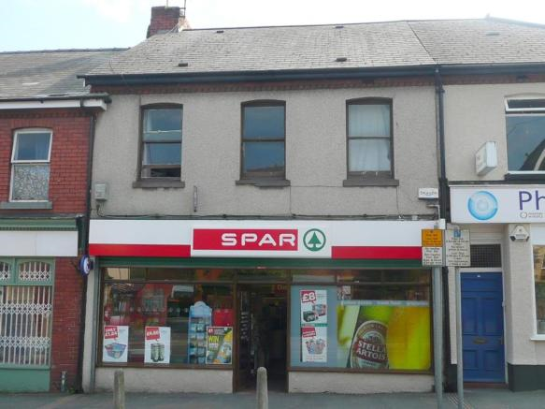
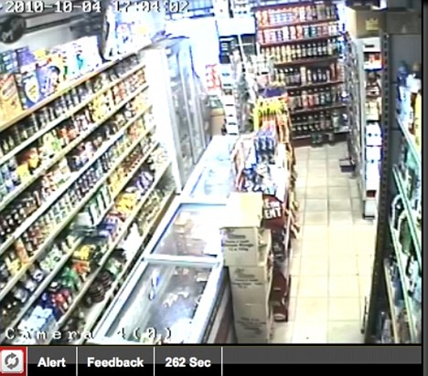
Scenario
You are tasked with interviewing SMITH. From what we know, what are the topics you want to include in your interview plan?
Responsibility
Material time frame
Knowledge of the SPAR
SMITH
CCTV
PC JONES statement
Jane EVANS statement
Notes:
1– “Are you responsible for”, “Tell me what you know about”
2.Try and keep MTF as tight as possible. We can always widen it during the interview if necessary. Ask what the suggested MTF would be in this case (2pm – 4pm). – Identify the times you want to cover. Ask questions; for example around movements, associations, clothing worn, vehicles driven, alcohol / drugs consumed, etc.
3. How often attend, what type of items purchased, when last there, what purchased when there last, ever purchase alcohol, ever had any issues with the shop / staff.
4. – any drink / drugs issues, how often drink, how much, what drink, Vodka?, finances.
5. – Show and ask to comment on footage. “is that you”, “do you know who the person is” –
6. cover any issues between them, put relevant points of statement to Smith, ask him to comment.
7. As above
Ask class to identify topics from the circs. Possibly write the answers down on a flip chart then compare to next slide.
RESPONSIBILITY – “Are you responsible for”, “Tell me what you know about”.
MATERIAL TIME FRAME – Identify the times you want to cover. Ask questions; for example around movements, associations, clothing worn, vehicles driven, alcohol / drugs consumed, etc.
KNOWLEDGE OF THE SPAR – How often attend, what type of items purchased, when last there, what purchased when there last, ever purchase alcohol, ever had any issues with the shop / staff.
I-TOPIC – any drink / drugs issues, how often drink, how much, what drink, Vodka?, finances.
CCTV – Show and ask to comment on footage. “is that you”, “do you know who the person is”
STATEMENT PC JONES – cover any issues between them, put relevant points of statement to Smith, ask him to comment.
STATEMENT JANE EVANS – as above.

Slide 24
Scenario
Following the completion of your interview plan, you are ready to obtain SMITH’s account. The account comprises of 3 parts :
Suspect account
Police agenda
Challenge
Notes:
As per the PEACE model for interviewing.

Slide 25
Suspect Account
This is the account given by the suspect
It will be prompted by the responsibility questions, for example:
“Are you responsible for…..”
“Tell me what you know about..”
OR……..The material time frame questions:
“Tell me where you were and what you did on…..”
Notes:
If they don’t admit responsibility, or deny any knowledge of the offence, then move to the MTF

Slide 26
Suspect Account
This will prompt the suspect to give his/her account which will be one of the following:
Full admission
Denial
Partial admission
Unless…….
The suspect refuses to answer any questions, i.e. no comment
The suspect provides a prepared statement
Notes:
OK, lets have a look at these 5 outcomes in more detail

Slide 27
Full Admission
If the suspect makes a full admission:
Cover the Points to Prove
Explore & if possible negate any defences. E.g, were you acting in self defence (for assault allegations)
It may not be necessary to continue with the Police agenda unless you have identified areas for clarification
Notes:
PTP - In this case how did you obtain the vodka, why did you hide it, what should you have done before leaving the shop, who did the vodka belong to, what did you intend to do with it when you took it, what did you do with it.
DEFENCES – Who gave you permission to take it, was it your intention to pay for it, did you attempt to return it to the shop / owner, were you acting under duress.

Slide 28
Denial
If the suspect denies the offence
Identify topics from the Suspect account
Probe each topic. Gain as much detail as possible
Summarise after each topic & ask any questions missed (2nd interviewer if present)
Once you have exhausted the identified topics from the suspects account:
Move onto the Police agenda
Notes:
As the suspect is talking we should be making notes and identifying topics.
The role of the second jockey is to summarise at the end of each topic, ask any questions that the lead interviewer may have missed (also gives the lead interviewer some thinking time). They should also deal with any questions/ comments from the solicitor

Slide 29
Partial Admission
If the suspect makes a partial admission. E.g, when they admit their involvement but to a lesser degree
Treat the interview as though it is a denial
Identify topics from the Suspects account & probe. Gain as much detail as possible
Summarise after each topic & ask any questions missed
Once you have exhausted the identified topics from the Suspects account:
Move onto the Police agenda

Slide 30
Refusal to answer
Remember it is their right not to answer questions
If the suspect does not answer questions or answers, “no comment”
Explain to the suspect that you understand that is their right but that you still intend to ask the questions. Inform them you will give them time to answer if they wish.
Work through your interview plan topic by topic in detail
Be mindful of the pace of your questions. Don’t ask them too quickly. Answer the question in your head before asking the next
You can remind them of the caution & the implications of not answering questions however doing this repeatedly can be seen as oppressive
Notes:
Don’t take it personally, remain calm and professional

Slide 31

Refusal to answer
At conclusion of the interview say to the suspect.
“Have you any……”
Defences
Alibi
Mitigation
….that you can tell me about at this time. If you have, I will make sure that they are investigated as a priority.”
Notes:
At the conclusion of the interview say to the suspect
“Have you any innocent explanation, any mitigation, an alibi or any defences that you can tell me about at this time. If you have, I will make sure that they are investigated as a matter of priority”

Slide 32
Prepared Statement
A prepared statement will usually be produced after the aide memoire
Ask the legal rep or the suspect to read out the prepared statement. Get the suspect to agree & sign it
Ask the legal rep if you can have a copy. Remember the statement is the property of the legal rep & suspect (some will be happy to give you the original)
Once you have a copy, best practice is to stop the interview to examine the statement & identify topics from it. This is the Suspects account
Notes:
QTS – why would we stop the interview after receiving a prepared statement?
What do we need to consider and look at

Slide 33
Prepared Statement
If you are refused access to it:
Inform the suspect that you will need to stop the interview to allow you to transcribe the statement as you will need to continue with the interview
Identify topics from the prepared statement & probe them. Once you have exhausted the topics, move onto the Police agenda
The Prepared Statement (or copy of) then becomes an exhibit produced by the Officer
Notes:
Trainer to distribute ‘Prepared Statement Handout’

Slide 34
Back to our Scenario
SMITH states he has no knowledge of the offence
He states that at the relevant time he was at home with some friends watching TV & drinking alcohol
He states he knows the shop well & goes there to buy alcohol as he is alcohol dependent
From his account, what topics have you identified to probe?
Notes:
So, in our scenario Smith has denied the offence….
QTS – what topics have you identified from his account?

Slide 35
Possible Topics
SMITH – clothing worn, drinking habits etc
Home
Friends
Alcohol in house
TV
SPAR
After exhausting the topics, refer back to your plan. Whatever is left is the Police agenda

Slide 36
Police Agenda
Once you have exhausted the Suspect account, move onto your Police agenda
If the suspect has covered a topic you have in your plan during their account, there is no need to cover that topic again
Work through your plan topic by topic gaining as much detail as you can
Summarise after each topic & ask any questions you have missed (2nd interviewer if present)
The Police agenda is when we introduce statements, exhibits & forensic evidence. These are not challenges at this point
Notes:
Students can cross topics off covered in suspects agenda from their interview plan so as not to cover again unnecessarily.
You cannot ask any questions based on intelligence, it has to be turned into evidence first.

Slide 37
Back to our Scenario
Police agenda topics left after suspects agenda
Jane EVANS statement
PC JONES statement
CCTV
Notes:
So back to our scenario
QTS - after the suspect account what topic are left for our police agenda?
We read the salient parts of the statements, stopping at appropriate points to ask the suspect if they have anything to say or if they want to make any comment.

Slide 38
Challenge
Once we have covered all the topic on our interview plan, it’s time for the challenge phase
‘Challenges’ are anomalies between the evidence we have at our disposal & the suspect’s account or lack of account
The word ‘challenge’ suggests confrontation. However these anomalies should be put to the suspect in a calm, professional manner

Slide 39
How to challenge
Identify anomalies between our evidence & what the suspect has told us or between conflicting accounts given by the suspect
Raise awareness of the anomaly, ask them to confirm their account
Reveal the anomaly. Do not call the suspect a liar
Move onto the next anomaly
Where appropriate disclose, introduce & question in relation to any information you have withheld
Notes:
Discuss examples of challenges known at the start of the interview, eg. Incriminating CCTV, forensic evidence, bad character evidence.
Discuss examples identified during the interview eg. Discrepancies between the suspects account and what witnesses have said.
3. The impact of the challenges will be for them to decide however an example would be a suspect denying a burglary with a witness seeing someone matching their description in the area, CCTV catching the person in the street outside, and the suspects blood found at the point of entry.
An appropriate order for the challenge would be
Witness
CCTV
Dna / blood.
This can imply that we are not being impartial in the interview. A court will decide who is telling the truth

Slide 40

Strategic use of evidence
Strongest Evidence
Weakest Evidence
Forensic Evidence
Inconsistencies in Suspect account
Special Warning
Bad Character Evidence
Notes:
Trainer to discuss formulating a challenge and include cognitive load by adding the pressure, there are arguments for where special warnings and bad character should be included and so debate with students.
For Trainer Information on differing opinions.
The College of Policing APP guidance says :
When to introduce a special warning
At the end of a relevant topic, in the early stages of an interview or in the latter stages of the interview, prior to the challenge phase.
However SWP are to taught to introduce SW after the Challenge phase
My Rationale behind this (from Paul Andrews Tier 5 interview advisor SWP)/Ed Griffiths (Force interview advisor SWP)
The application of a special warning under Sec 36 or 37 CJPOA 1994 requires the explanation in Code C para 10.11 and Note 10D state that it should include the following:
details of the offence
specific facts which the suspect is being asked to account for
why the investigator thinks these facts may link the suspect to the offence
making the suspect aware that a court may draw an inference if the suspect fails to account for these facts
stating that a record is being made of the interview and that it may be given in evidence if the suspect is brought to trial.
Questioning outside the facts rule the warning in- admissible and subject of evidence obtained unfairly Sec 78 PACE Act.
So if a special warning is given in the early stage you MUST only question about that fact, and therefore remove it before the next topic(there is no specific guidance on taking it off). Then you question about the next topic area NOT under warning , and so on. Another topic area could be special warning so you put one on again, and take it off before you continue because the questions MUST relate ONLY to the particular fact the defendant failed or refused to answer satisfactorily. So you could put one on take it off put another on take it off.
This allows solicitors and legal executives to suggest that their client never really knew if they were subject of a warning or not AND until after the challenge it is only then that you can be satisfied that they failed to answer satisfactory. In a no comment interview a suspect could remain silent but give an explanation that is satisfactory about a topic that was earlier subject of special warning so it has to be edited etc. The challenge phase is used to either ask for an explanation for the inconsistency or their failure to answer. So they could give an explanation at this stage before a Special warning ( Its still an opportunity for them to answer)
They can say nothing in the topic area after special warning then open up in the challenge phase. I am of the opinion that the interview is not over until after the challenge phase. The challenge phase will be delivered over the factual discrepancies of witness evidence fact . forensic or CCTV evidence, it is only then that you can be satisfied that they failed to answer satisfactory
To summarise Special warning material is left to after challenge and in order of strongest to weakest, if the warning is applied incorrectly then the interview can be excluded from that point on, At the end after challenge you would only lose from that point on, however put on early in interview incorrectly excludes the rest of your interview.
What I refer to in training is my experience over ten years as an interview Tier 5 advisor in volume and specialist crime in particular crown courts that special warnings have been the reason interviews been excluded , The most common cause was the special warning either lacked the wording required in C 10.11 (not all 5 points covered) sometimes 2 out of three ,four out of five, or the questions asked fall outside the FACT you were asking the suspect to account for.
I and we are aware of the guidance and it is just that Guidance it does not say MUST be put there.
We have discussed this numerous times with the regional interview advisor who reports to the national advisor with NCA National Crime Agency Gary Shaw. The South West regional advisor confirms this is an alternative option.
I have a strong opinion that this is the safest option, it makes sense, special warning is legal oppression.
In relation to your paragraph 2 about the questions, there used to be a myth that you should ask at least five questions. We or I have not said minimum of 10 max of 20, it depends on the fact your asking them to account for.

Slide 41
Back to our Scenario
SMITH is currently being interviewed
The Suspect & Police agenda have been exhausted & throughout SMITH has maintained that he was at home with friends (who he has refused to name) at the relevant time. He also refused to tell you what alcohol he was drinking & where he got it from
He does however agree that he knows both PC JONES & Jane EVANS and that they know him. He has stated that he has never had any issues with either JONES or EVANS
He also stated that he knows the SPAR & went there a week ago to buy vodka
Notes:
Ask is anyone worried about challenging. Discuss why.
What are the anomalies between Smiths account and our evidence?

Slide 42
Let’s challenge SMITH
What are the anomalies in our scenario between SMITH’s account & the evidence?
The statement of Jane EVANS
The CCTV
The statement of PC JONES
Notes:
QTS – So how would we phrase these challenges?

Slide 43
The Smith challenge
“John , I have listened to what you have to say on this matter & there are a few things that I need you to help me understand. Tell me again in as much detail as possible what you did between…….”
We then reveal the anomaly
“Jane EVANS, who by your own admission you have never had a problem with is saying that she witnessed you select & hide the vodka & leave without paying. How do you account for that?”
Notes:
Challenges based on evidence and NOT personal feelings – REMAIN IMPARTIAL.
Suggest using phrases such as “ I put it to you”.

Slide 44
An effective challenge
Repeat this sequence for all anomalies
Raise awareness of the anomaly & ask the suspect to confirm their version (if appropriate)
Put the anomaly to the suspect
Notes:
IF APPROPRIATE’. In the case of the scenario it would not be required to ask him for his movements again after the first challenge.
An example of when we WOULD do this is if one anomaly related to clothing worn, and another anomaly related to presence at a place at a particular time. In this case we would ask the suspect to explain again what he was wearing, then we would introduce the anomaly and ask him to comment. We would then ask him to explain where he was at the particular time and then introduce that anomaly.

Slide 45
An effective challenge conclusion
At the end, it may be appropriate to put all the evidence to the suspect in one final challenge & ask for a comment
For example in the case of our scenario
“John you have maintained throughout this interview that you are not responsible for the theft & did not attend the SPAR. You have heard however that Jane EVANS will say she saw you stealing the vodka & PC JONES has identified you as the person on the CCTV seen stealing the vodka. So to be fair to you I will ask you one last time & I want you to think carefully. How do you account for that?”
Notes:
Ask no2 if they want to raise anything BEFORE this as this should be the last thing done for maximum impact.

Slide 46
Closure
Give them one last chance
“Is there anything you wish to add or clarify about what you have said in this interview today John?”
“The time is…..”
“The date is……”
And I am stopping the recording
Notes:
QTS – how would you close the interview?

Slide 47

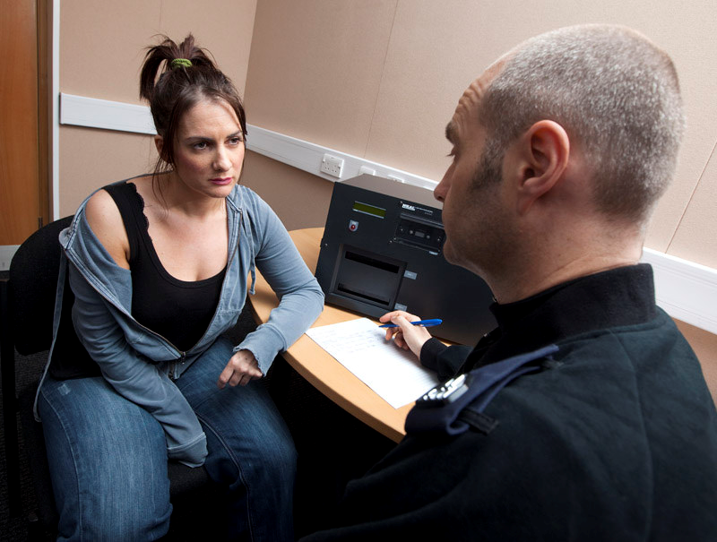
Produce the interview
The interview is conducted by you, you therefore produce it as your exhibit & may be required to play it or read it out in court
Notes:
Trainer to supply ‘sec9Suspectinterviews’ handout

Slide 48
Evaluation
Following an interview, the interviewer needs to evaluate what has been said with a view to:
Determining whether any further action is necessary
Determining how the interviewee’s account fits in with the rest of the investigation
Reflecting on the interviewer’s performance
Notes:
QTS – what areas of the interview should you evaluate?

Slide 49
Evaluation
Information
Obtained
URGENT action
Inform case direction
Interviewers performance
Self-reflection
CPD

Slide 50


