Slide 1
LCHS4010 Psychology in
Health and Social Care
Submitted by :Sajida Faraz
Student id number:2423344
Submitted to: Kal Alnababtah

Slide 2
Introduction
Case study: Amira, 3 years old, recently joined nursery
Signs of anxiety, limited verbal communication, avoids group play
Aim: Apply Erikson’s psychosocial theory to understand and support her development

Slide 3
Overview of Erikson’s Psychosocial Theory
Erik Erikson (1950) proposed eight psychosocial stages across the lifespan
Each stage involves a conflict that must be resolved for healthy development
Successful resolution = sense of competence; failure = insecurity or guilt

Slide 4

How Erikson’s Theory Works
Each stage builds on the previous one
Stages relevant to Amira’s age:
Autonomy vs. Shame and Doubt (1–3 years)
Initiative vs. Guilt (3–6 years)
Development depends on how caregivers respond to the child’s needs and actions

Slide 5

Relevance to Early Years Development
Focuses on emotional and social growth in early childhood
Emphasises trust, independence, and confidence
Helps practitioners understand the emotional needs behind behaviour

Slide 6
Nature and Nurture in Erikson’s Theory
Biological (Nature): inborn temperament and readiness for independence
Environmental (Nurture): caregiver support, opportunities, and feedback
Both influence how each psychosocial stage is resolved

Slide 7
How Erikson Explains Amira’s Behaviour
Stage | Conflict | Amira’s Behaviour | Explanation
Autonomy vs. Shame (1–3 yrs) | Independence vs. fear of failure | Hesitant to separate, anxious | Still developing confidence and control
Initiative vs. Guilt (3–6 yrs) | Taking initiative vs. fear of doing wrong | Avoids group play, quiet | Feels unsure, seeks reassurance

Slide 8

Applying Erikson’s Theory in the Nursery
Build trust through consistent, responsive care
Support independence with small choices (toys, snacks)
Encourage initiative with simple, achievable tasks
Celebrate effort and success to build confidence

Slide 9
Practical Strategies and Interventions
Area | Strategy | Goal
Emotional | Consistent key person | Build trust and security
Social | Pair play with friendly peers | Encourage cooperation
Cognitive | Praise and storytelling | Develop confidence and language
Physical | Encourage self-help skills | Promote autonomy
Environment | Predictable routines | Reduce anxiety

Slide 10
Strengths and Limitations of Erikson’s Theory
Strengths:
Focuses on emotional and social development
Highlights the role of relationships and environment
Broad, lifespan perspective
Limitations:
Stages are general and may not apply universally
Doesn’t fully explain the impact of early attachment bonds
Less focus on cultural differences

Slide 11
Comparison: Erikson vs. Bowlby
Slide content:
Aspect | Erikson | Bowlby
Focus | Psychosocial conflicts | Emotional attachment
Key Age for Amira | Autonomy & Initiative | Secure vs. insecure attachment
Explains | Confidence, independence | Anxiety, need for security
Nature/Nurture | Balance of both | Innate drive shaped by caregiving
In Practice | Encouragement and choice | Consistency and emotional support

Slide 12
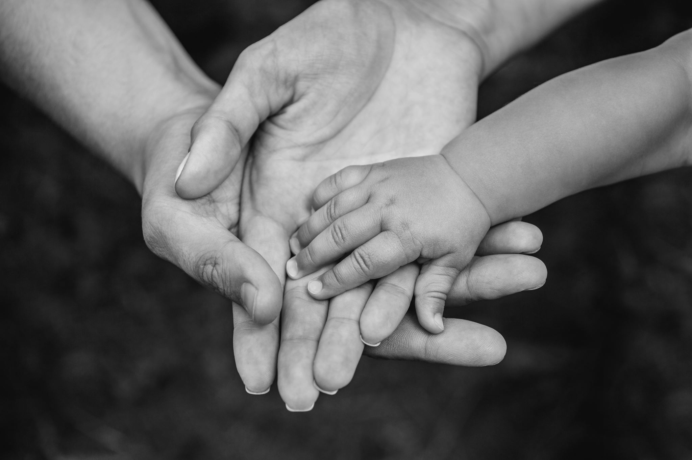
Conclusion
Erikson’s theory helps explain Amira’s emotional and social needs
Highlights the importance of supportive caregiving and positive experiences
Integrating Erikson and Bowlby gives a fuller picture of child development

Slide 13

References
Erikson, E.H. (1950) Childhood and Society. New York: Norton (accessed by 8.10.2025
Bee, H. & Boyd, D. (2019) The Developing Child. 14th ed. Pearson(8.10.2025)
Berk, L. (2021) Development Through the Lifespan. 8th ed. Pearson(9.10.2025
Bowlby, J. (1969) Attachment and Loss, Vol. 1: Attachment. London: Hogarth Press.(10.10.2025)
Cassidy, J. & Shaver, P.R. (2016) Handbook of Attachment: Theory, Research, and Clinical Applications. 3rd ed. Guilford Press.(11.10.2025
Department for Education (2021) Statutory Framework for the Early Years Foundation Stage (EYFS). London: DfE.(11.10.2025)

