Slide 1
Essential Skills:
Assessment Focus

Slide 2
Session Objectives
During this session you will be:
Working out what actually deserves your attention over the next three weeks
spotting the habits helping (and hurting) your progress
making a realistic plan, not an unrealistic fantasy timetable
Identifying one thing ‘Future You’ will genuinely thank you for.
This session will help you make connections between your academic success and your onward professional development.

Slide 3
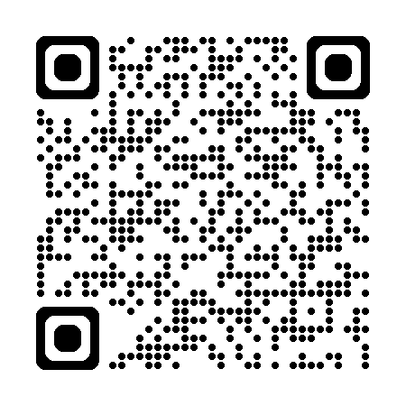

Quick Poll
Complete the multiple-choice poll to log how you are feeling in week 10.

Slide 4
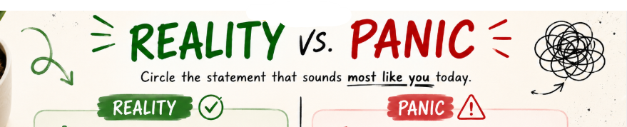
Read the statements below, choose one that sounds most like you feel today.
I have too much to do.
I genuinely have a lot to do but it is manageable.
I will never get everything done in time.
I have lots to do but I don’t know where to start.
I am actually more on track than I give myself credit for.
Everyone else has it together except me.
I am overwhelmed because I am thinking about everything at once .
I am going to fail.

Slide 5
You are doing better than you think.
What is one panic thought that you can let go of today?

Slide 6
Immediate priorities
In your notebook, draw three circles.
Identify one task for each circle
🔥 On Fire
⚠ Simmering
❄ Can Wait
Needs attention in the next 7 days.
Needs planning soon.
Stop feeling guilty about things that are not genuine priorities.

Slide 7
Share
Do we have similar or different tasks to do in the next 7 days?
🔥 On Fire
⚠ Simmering
❄ Can Wait

Slide 8
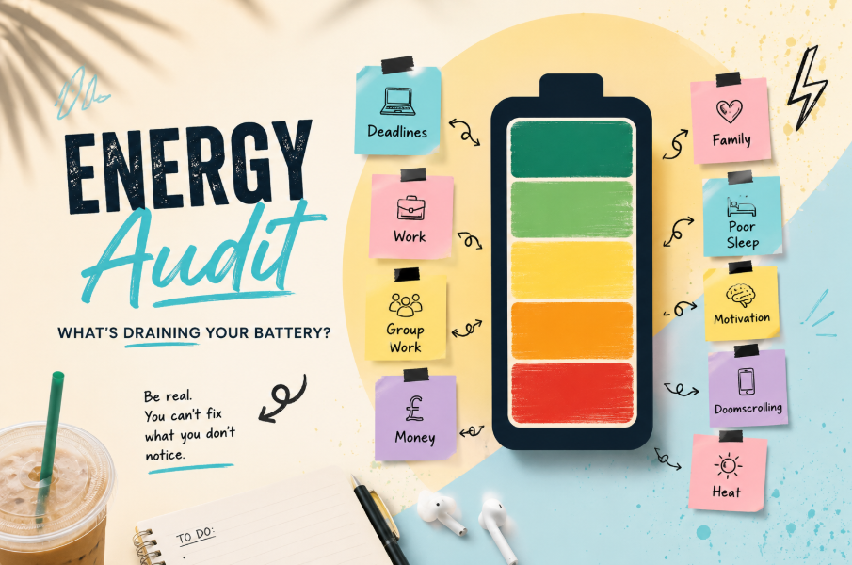
What's draining your battery?
Be real. You cannot fix what you do not notice.
Notes:
□ Group work
□ Motivation
□ Doomscrolling
□ Perfectionism
□ Heat
□ Poor sleep
□ Deadlines
□ Work
□ Placement
□ Family
□ Money
□ Commuting

Slide 9

A reset routine
Everyone goes off track sometimes.
Successful students are not the ones who never struggle, they are the ones who notice it early and know how to reset.
Having a reset routine can help you to get back into your assessment work.

Slide 10
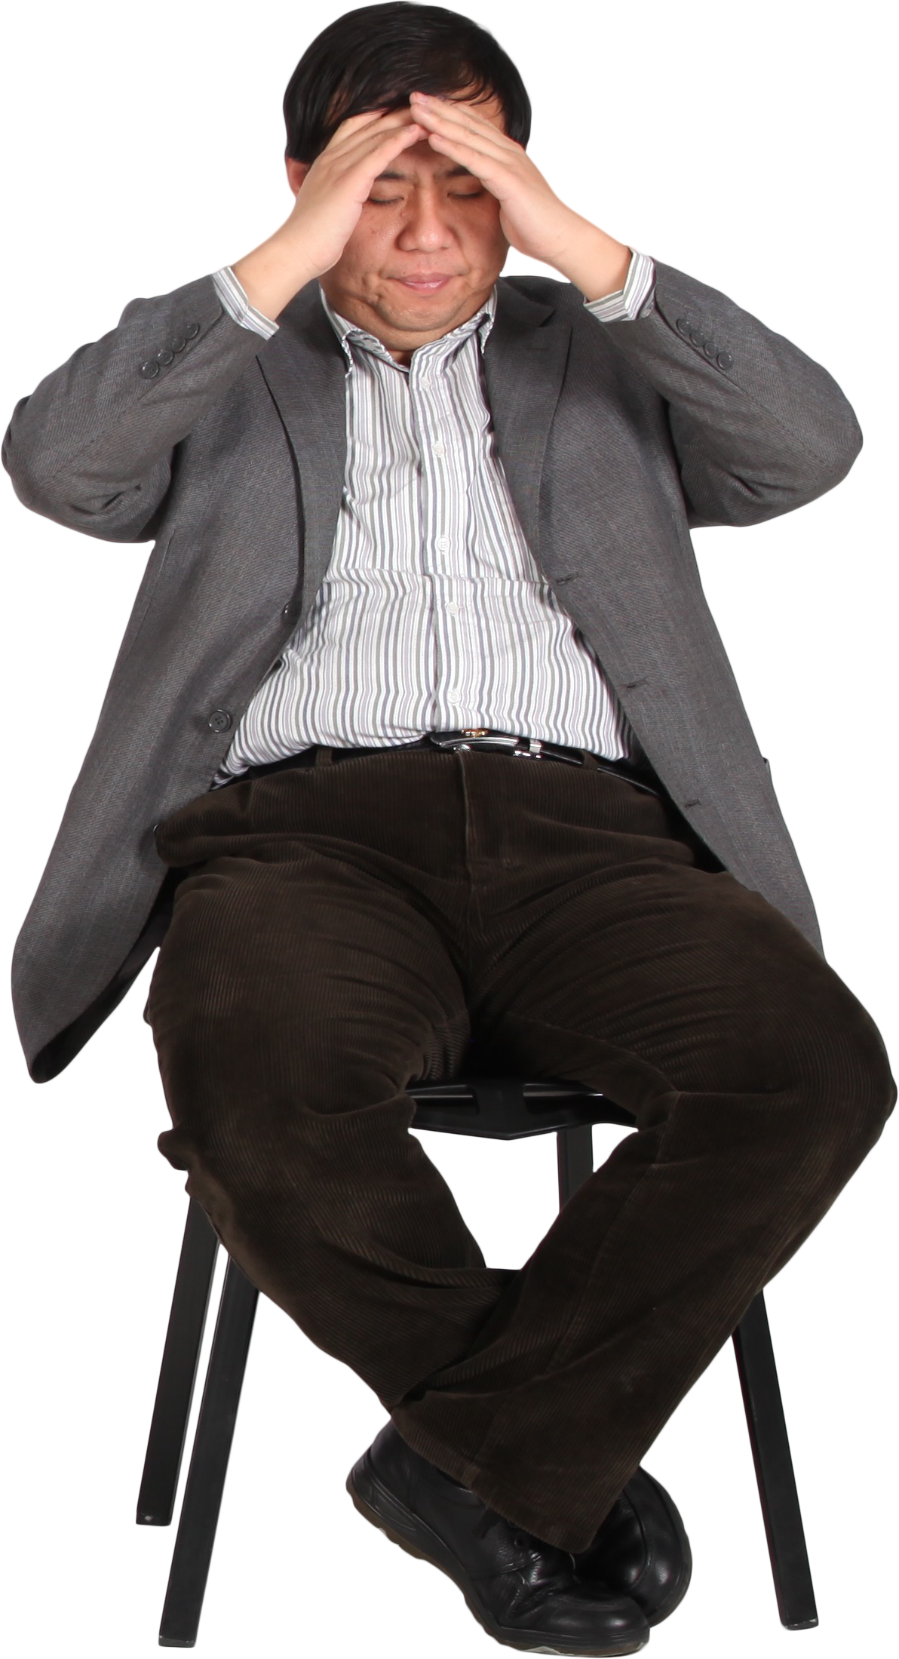
Spot when you need a reset
Know Your Trigger
Feeling overwhelmed
Working too many hours
Money worries
Family commitments
Poor sleep
Heat/lack of energy
Social media distraction
Group work problems
Thinking "I'll start tomorrow"
Perfectionism
Spot Your Warning Signs
I know I'm slipping when I...
Perfectionism stops me finishing
Spending hours planning instead of writing
Ignore emails
Keep making to-do lists instead of starting
Spend hours scrolling
Convince myself I'll work better later
Forgetting to take breaks

Slide 11
Your reset plan
Message a friend
Go somewhere different to study
Break the task into smaller pieces
Which actions would genuinely help you reset?
Discuss in pairs and come up with three more reset methods.
Take a proper break
Resets
Put my phone away
Work for just 20 minutes
Go for a walk
Ask my tutor
Notes:
Go somewhere different to study
☐ Message a friend
☐ Break the task into smaller pieces
☐ Put my phone away
☐ Go for a walk
☐ Ask my tutor
☐ Work for just 20 minutes
☐ Take a proper break

Slide 12
Small wins = Perfect Plans

Slide 13

Small wins
Instead of making huge goals...
Choose one tiny action you'll complete in the next 48 hours.
Read one paper
Email project supervisor.
Write 300 words.
Organise references
Update LinkedIn.
Notes:
Book tutor meeting.
Write 300 words.
Read one paper.
Organise references.
Email dissertation supervisor.
Update LinkedIn.

Slide 14
Small wins
Share your small action goal with a peer or your tutor.
If you do not feel comfortable sharing, try setting an alarm on your phone for two days time to remind you to review your goal.

Slide 15

Week 1 vs Week 10
More confident
More organised
More independent
Still learning
Resilient
Capable
Curious
Ready
Nervous
Confused
Excited
Lost
Curious
Overwhelmed
Motivated
Unsure
You first year of university is a transformative year.
How did you feel in week 1?
How do you feel in week 10?
Discuss in pairs and feedback to your tutor.

Slide 16
Week 1 vs Week 10
How would you complete these sentences?
At the start of the year, I thought university would...
Now I realise...
Work in pairs or small groups to discuss your responses.
Notes:
Allow students time to discuss and make varied responses.

Slide 17
Future You

Slide 18
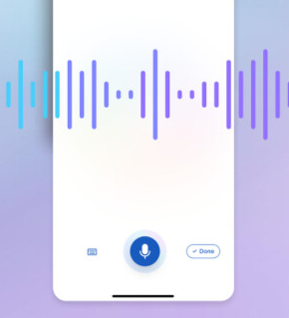
Future You
Imagine this...
It's three weeks from now.
You have submitted your final assessment.
You have closed your laptop.
You have completed the term.
For some of you – you have completed your Cert HE
Future You has just sent you a 30-second voice note.
What do they say?

Slide 19
Future You
Create a voice note on your phone, imagine we are three weeks in the future and the term is complete.
Complete these prompts
🎤 "Thank you for...“
🎤 "I'm so glad you didn't...“
🎤 "The thing that made the biggest difference was...“
🎤 "You were stressing about... but honestly...“
🎤 "One thing I wish you'd done sooner..."
Notes:
🎤 "Thank you for..."
Examples
"...starting earlier than you usually do."
"...finally asking for help."
"...stopping when you needed a break."
"...not trying to make everything perfect."
"...trusting yourself."
🎤 "I'm so glad you didn't..."
Examples
"...leave it until the night before."
"...give up after getting stuck."
"...compare yourself to everyone else."
"...ignore that feedback again."
🎤 "The thing that made the biggest difference was..."
Examples
"...doing a little bit every day."
"...actually using my planner."
"...working in the library instead of my bedroom."
"...breaking big jobs into smaller ones."
🎤 "You were stressing about... but honestly..."
Examples
"...it wasn't as bad as you thought."
"...everyone else felt the same."
"...once you started, it got easier."
"...you knew more than you realised."
🎤 "One thing I wish you'd done sooner..."

Slide 20
Voice note - Pair Discussion
Share one part of your voice note with a partner.
Discuss:
Which message felt most real?
Did anything surprise you?
Is there anything ‘Future You’ would tell both of you?

Slide 21
Reflect and review

Slide 22
Personal Progress Padlet
There are no formal assessments within 'Essential Skills' classes but you are encouraged to keep your Personal Progress Padlet.
Note down in your Personal Progress Padlet:
    What have you learnt today?
    How will you use this new skill?
.
Share your Padlet with your tutor – email the link or share a QR code

Slide 23
The remainder of the session
Spend the remainder of the session focusing on the small goal you have set yourself.

Slide 24


Traffic Light it
 | Where is your learning at ?
Red | I have misunderstood some of the topics. (write down 2 questions that you need help with)
Amber | I have understood most of the topics so far (write down 1 question and 1 key theme you have understood)
Green | I have understood the topics so far (write down 2 key themes from the lesson to show your understanding)

