Slide 1
REIMAGINING BORDERLESSNESS: Exploring Somali identity in Kenya, Belonging, Marginalization and 21st Century Political Implications

Slide 2
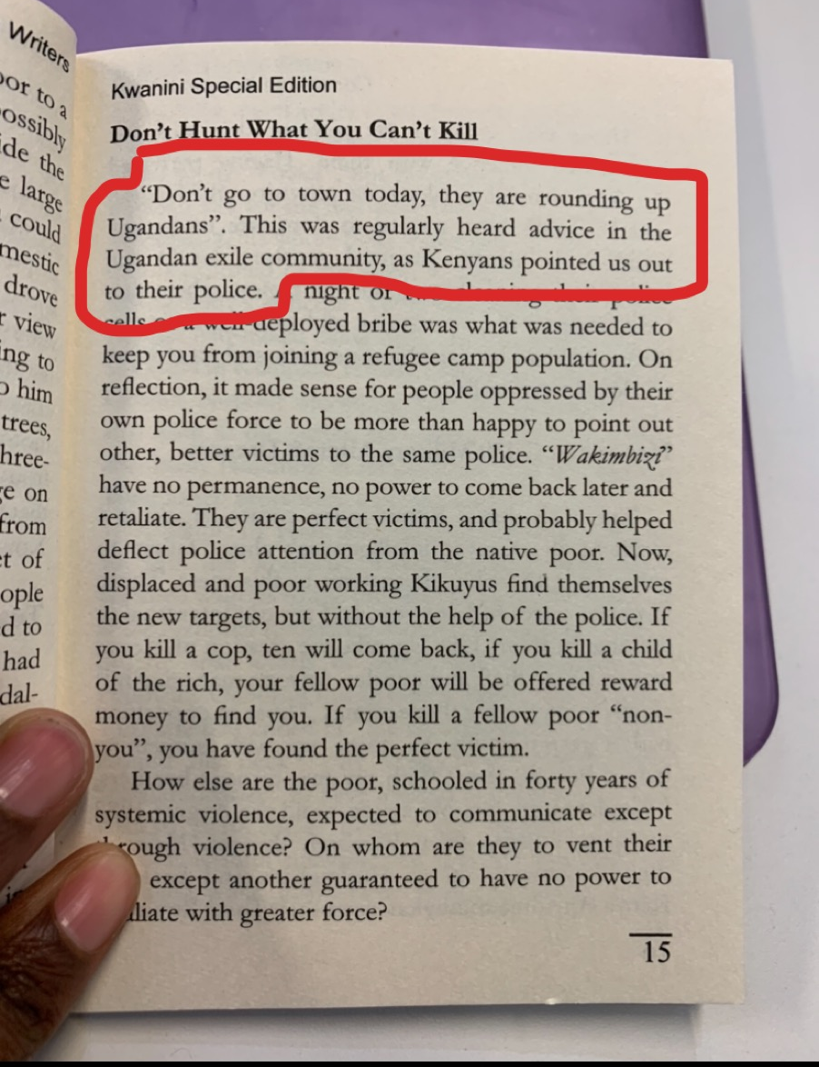
Why this research topic ?
Barasa N. M. 2019 pg. 15 of “After The Vote” Kwani Concerned writers( Kalundi Serumaga)

Slide 3
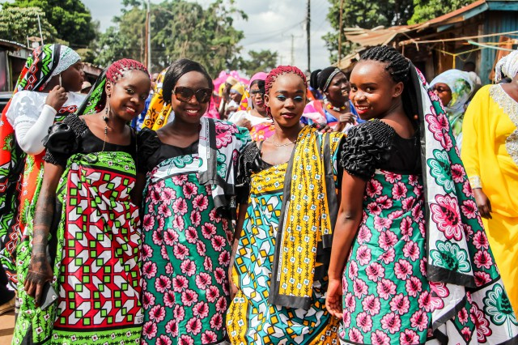
I DO NOT OWN THIS PICTURE AND DO NOT INTEND ANY COPYRIGHT INFRINGEMENT. ALL RIGHTS AND RESERVES BELONG TO BRIAN OTIENO . Accessed on 30th November 2019 at : https://www.kiberastories.com/portfolio/nubian-wedding/ and is part of their KIBERASTORIES PROJECT

Slide 4
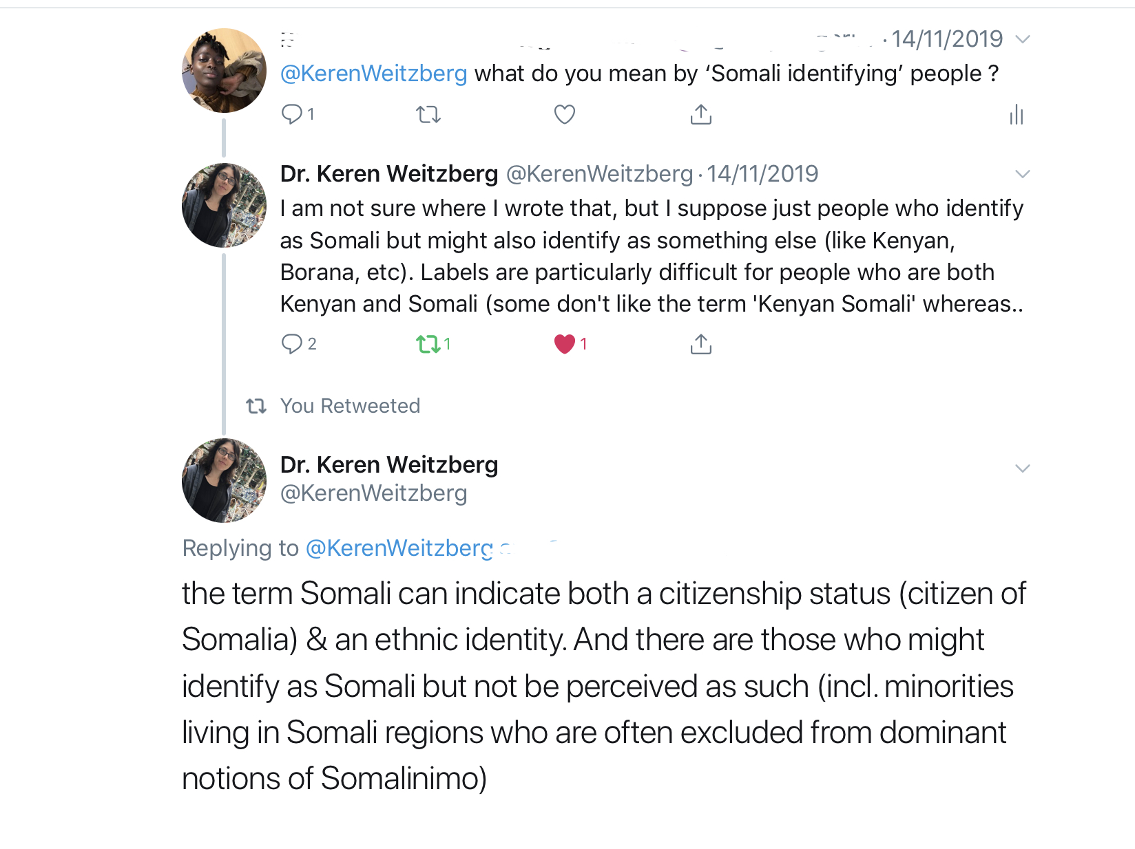
What do I mean by Somali ?
Barasa. N. M. 2019 Screenshot from conversation thread on twiter between Dr Keren Weitzberg and Melany Nang’ayo Barasa

Slide 5
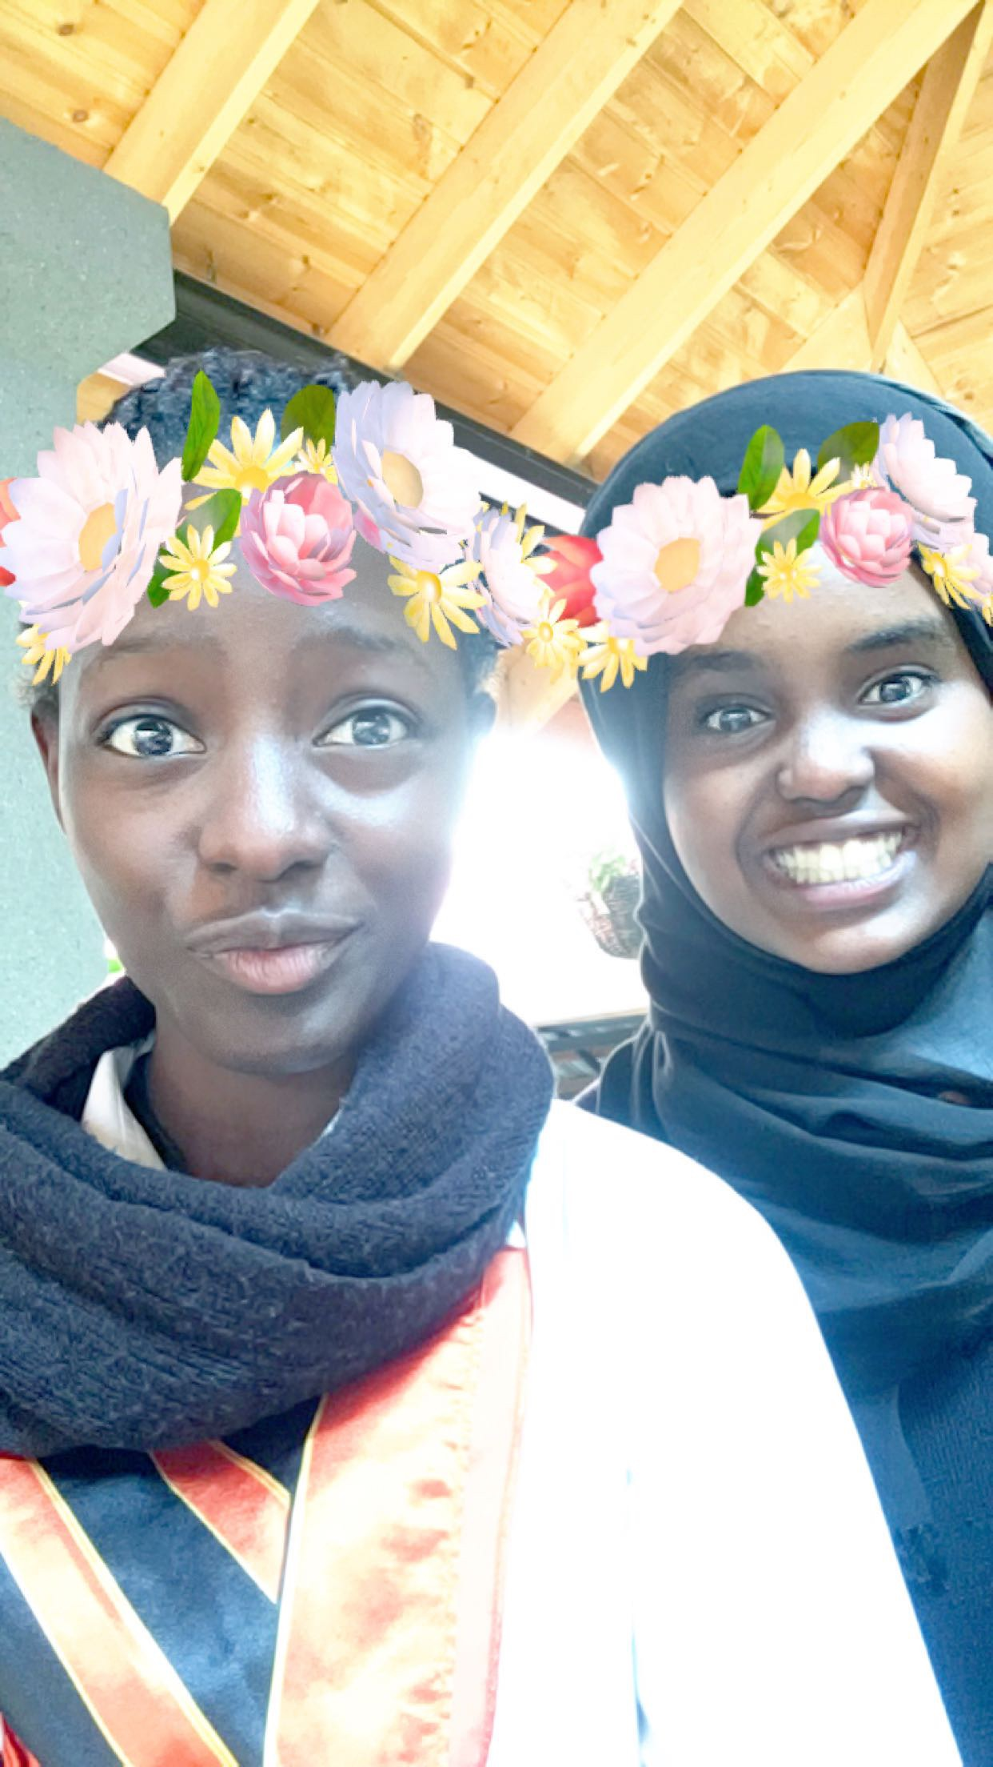
Other similar case studies :
Mexican- American Borderlands
Kurdish community-
Jewish Diasporas-
Nomadic populations of Tuareg of West Africa
Maasai of Kenya and Tanzania
Urban experiences of Nubians in Kenya
Other ethnic groups like my own Luhya, Swahili, Borana etc
(Weitzberg,2017:9)
Barasa. N. M 2017. Hamun and Melany taken with Iphone

Slide 6
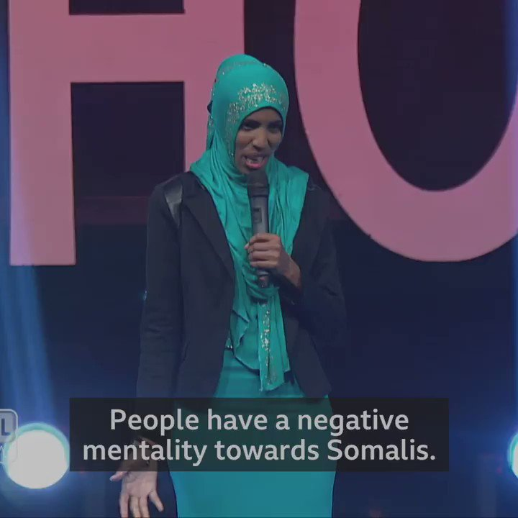
“Spatial Political [the politics of occupying space] interplay of politics and security in space where one lives not by citizenship.” (Mwangi, 2017)
‘Somalinized’ – Professor Oscar Gakuo Mwangi coined term
“The social construction of Somalis as a marginalized identity is created and perpetuated by the state and maintained through citizen society relations, applying to all Somali identifying people irrespective of their nationality” (Mwangi, 2017)
https://twitter.com/bbcafrica/status/1092483064683466752
Screenshot from BBC NEWS AFRICA (2019) NO COPYRIGHT INTENDEDhttps://twitter.com/bbcafrica/status/1092483064683466752

Slide 7
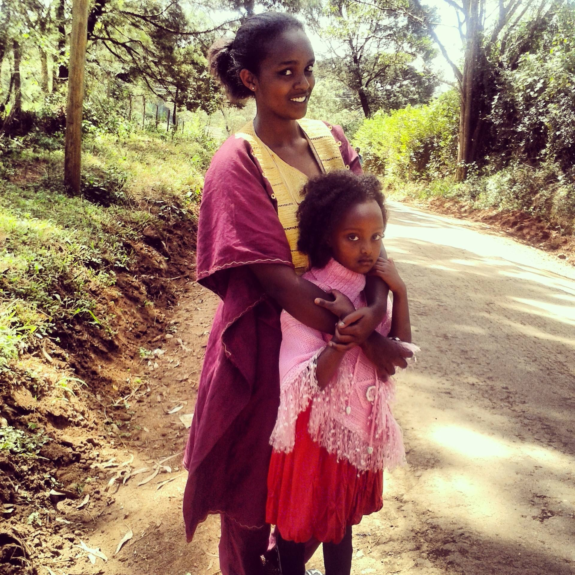
Methodology
Literature review incl. [contemporary press coverage] (Hart, 1998)
Critical assessment against relevant theoretical frameworks.
Barasa, N. M.(2014) Taken with camera phone. Qabale Ali and Nasibo Ali .

Slide 8
Theories and frameworks
Nativism- (Mamdani, 1998) (Castro, 2004)
Pan Africanism - (Biko, 1987)
Post colonialism- “Understanding the world today especially the global south, through the lens of colonialism and the domination of certain societies and peoples by others” (Krishna, 2009:4) (Appadurai, 1994)
Social exclusion theory- (Bowling, 2013:291)
Open borders theory - (Jones, 2019)

Slide 9
Discourse
The rise of the nation-state- failed state – the creation of Somalia through the berlin conference as a constructed state . Created to fail. Then given the label a failed state. (Weitzberg, 2017:1)
Political Islam: “non conformism has a distinguished place in Muslim thought on nationalism and the nation state” (Piscatori, 1986:101).

Slide 10
What next ??
Continue to do reading research that will inform and morph my current arguments

Slide 11
Reference
Weitzberg, K. (2017) We Do Not Have Borders: Greater Somalia and the Predicaments of Belonging in Kenya. Athens, Ohio :Ohio University Press
Mwangi, G. O. (2017) Statelessness, Space, Security: Somalis In Kenya. Available at: https://discoverysociety.org/2017/09/05/statelesness-space-security-somalis-in-kenya/
Hart, C. (1998) Doing A Literature Review. 1st Ed. London: Sage Publications Ltd.
Mamdani, M. (2012) Define and Rule : Native as Political Identity. Cambridge, Massachusetts: Harvard University Press.
Mamdani, M. (1998) When Does Settler Become Native ?: Reflections of the Colonial Roots of Citizenship in Equatorial and South Africa. Cape town: University of Cape Town Department of Communication.
Castro, J. M. (2004) “The Rise and Fall of the New Nativism: Economic Forces, Ethnic Politics and US Immigration Policy” in Han Entzinger; Marco Martiello; CatherineWihtol de Weden (eds). Migration Between States and Markets. Research in migration and ethnic relations series. Farham: Ashgate Publishing
Biko, S. (1972) I Write What I Like: A Selection of his Writings ed Aelred Stubbs C.R. Johannesburg: Heinemann Publishers (Pty) Limited.
Krishna, S. (2008) Globalization and Postcolonialism: Hegemony and Resistance in the 21st Century. Plymouth, Lanham;Maryland: Rowman & Littlefield Publishers
Appadurai, A. (1996) “Disjuncture and Difference in the Global Cultural Economy”. Modernity at Large: Cultural Dimensions of Globalization. Minneapolis, London: University of Minnesota Press
Appadurai, A. (1990) The Making of a Transnational Culture: Asians in America and the Nature of Ethnicity. Oxford: Berg Publishers.

Slide 12
11. Appadurai, A. (2013) The Future As A Cultural Fact: Essays on The Global Condition. New York, London: Verso Books.
12. Bowling, B. (2013) Epilogue: The Borders of Punishment: Towards a Criminology of Mobility, in Katja Franko, Aas Mary, Mary Bosworth (eds). The Borders of Punishment: Migration, Citizenship and Social Exclusion. Oxford: Oxford University Press.
13. Jones, R. (2019) Open Borders: In Defense of Free Movement. Athens, Georgia: University of Georgia Press.
14. Piscatori, P. J (1986). Islam in a World of Nation States. Cambridge: Cambridge University Press.

