Slide 1

How does the integration of information and intelligence enhance the effectiveness of both operational and digital policing?
By Luke Darnell

Slide 2

The Modern Policing Environment
Rapidly evolving crime landscape
Growth of cyber-enabled and organised crime
Increased reliance on data and intelligence
Shift from reactive to proactive policing

Slide 3
Understanding Information and Intelligence
Information: raw, unverified data
Intelligence: analysed, assessed, and prioritised
Decision-making across policing levels

Slide 4
Operational and Digital Policing Defined
Operational policing: frontline response and investigation
Digital policing: cybercrime, online intelligence, digital forensics
Increasing convergence of crime domains

Slide 5
Legal Framework Governing Information and Intelligence
Data Protection Act 2018 & UK GDPR
Police and Criminal Evidence Act 1984 (PACE)
Criminal Procedure and Investigations Act 1996 (CPIA)
Human Rights Act 1998

Slide 6

National Guidance and Policing Frameworks
Management of Police Information (MoPI)
National Intelligence Model (NIM)
Intelligence-led policing principles

Slide 7
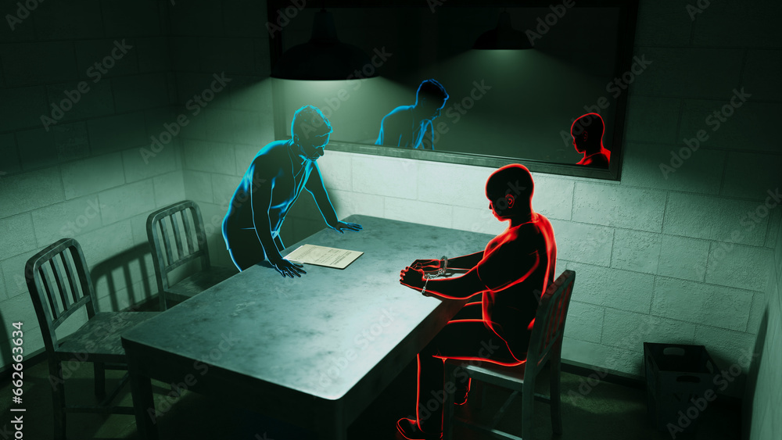
What Integration of Information and Intelligence Involves
Collation of multi-source data
Analytical assessment and validation
Intelligence products and briefings
Information sharing and coordination

Slide 8
Benefits for Operational Policing
Proactive crime prevention
Targeted enforcement activity
Improved investigative outcomes
Efficient resource allocation

Slide 9
Benefits for Digital Policing
Enhanced cybercrime investigation
Identification of online networks
Stronger digital evidence handling
Cross-border intelligence sharing

Slide 10
Key Challenges of Integration
Volume and complexity of data
Information silos and system incompatibility
Privacy, bias, and ethical risks
Skills and capacity gaps

Slide 11
Addressing Challenges and Ensuring Legitimacy
Governance and oversight mechanisms
Continuous training and upskilling
Ethical decision-making frameworks
Transparency and accountability

Slide 12
Conclusion
Intelligence integration is essential
Strengthens operational and digital policing
Effectiveness depends on lawful and ethical use

Slide 13
Research Timeline Graphic
Analysis of assessment brief and topic selection
Initial reading on intelligence-led policing theory
Review of legislation and national guidance
Academic journal and professional source research
Synthesis of evidence and critical analysis
Slide construction and speaker note drafting
Final review, proofreading, and Harvard referencing

Slide 14
Reference list
College of Policing (2022). Management of Police Information. [online] College of Policing. Available at: https://www.college.police.uk/app/information-management/management-police-information.
GOV.UK (1984). Police and Criminal Evidence Act 1984. [online] legislation.gov.uk. Available at: https://www.legislation.gov.uk/ukpga/1984/60/contents.
GOV.UK (1996). Criminal Procedure and Investigations Act 1996. [online] www.legislation.gov.uk. Available at: https://www.legislation.gov.uk/ukpga/1996/25/contents.
GOV.UK (2018). Data Protection Act 2018. [online] legislation.gov.uk. Available at: https://www.legislation.gov.uk/ukpga/2018/12/contents.
Human Rights Act (1998). Human Rights Act 1998. [online] Legislation.gov.uk. Available at: https://www.legislation.gov.uk/ukpga/1998/42/contents.
Office, H. (2025). Home Office Research, Development and Innovation strategy: 2025 to 2030 (accessible). [online] GOV.UK. Available at: https://www.gov.uk/government/publications/home-office-research-development-and-innovation-strategy/home-office-research-development-and-innovation-strategy-2025-to-2030-accessible.
Wall, D.S. (2024). Cybercrime: The Transformation of Crime in the Information Age, 2nd edition. ResearchGate. [online] doi:https://doi.org/10.13140/RG.2.2.28017.45928.

