Slide 1
Introduction to Gestalt Therapy
- The Gestalt approach set in the context of humanistic therapies and introducing some key concepts
Huw MacRae Jones

Slide 2
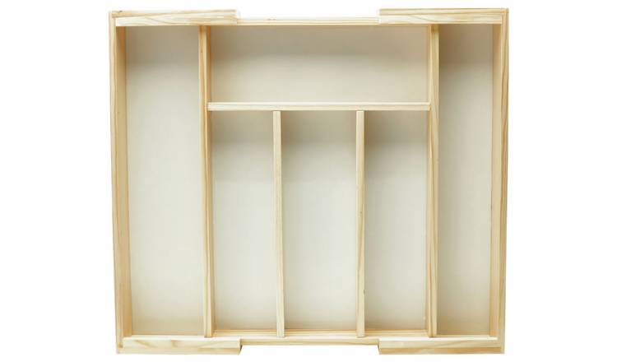
Psychotherapy – a smorgasbord of approaches
Given the number and variety of approaches to counselling / psychotherapy, some way of categorising these is useful. (why?)
One such categorisation is to talk of forces: first force, second force etc. See (Fleuridas and Krafcik, 2019) for more on this.
3. Humanistic-
existential
2. Behavioural
1. Psychoanalytic
Notes:
Fleuridas and Krafcik (2019) suggest: 4. transpersonal psychology, family systems, feminist psychology, multicultural psychology, ecopsychology, social constuctivism and postmodernism. 5. social justice & advocacy (“widlely acknowledged”) 6. ‘Integrative, inclusive & holistic approach’ suggested by these autors.

Slide 3
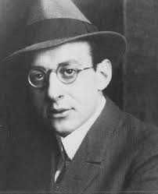
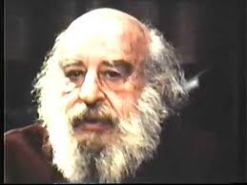
3 Facts about Gestalt Therapy
Developed by Fritz Perls in the 1950s (Clarkson and Cavicchia, 2013)
Like Person-centred Therapy, Gestalt belongs to the humanistic-existential approach to psychotherapy (Churchill et al, 2010)
Takes a phenomenological approach to human experiencing (Perls et al, 1994[1951])
Fritz Perls (b.1893 – d.1970)
More about this later…

Slide 4
Discussion: what is going on in therapy?
Notes:
‘Gestalt’ German meaning form, shape, figure. (Collinsdictionary.com, 2019)

Slide 5
The Plan
Here we aim to explore Gestalt Therapy’s answer to this big question by:
Examining the Theory
Exercises – trying it out
Watching a film (or two)
Case study examples

Slide 6
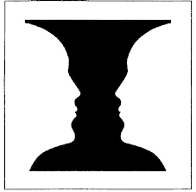
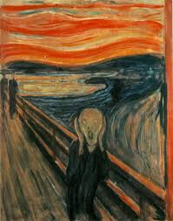
To explain Gestalt Therapy’s answer to this question, we begin with
the idea of figure (gestalt) and ground from gestalt psychology*
Edvard Munch’s ‘The Scream’
Rubin’s Vase
Visual examples of figure / ground
* See Ch. 1 of Clarkson and Cavicchia (2014) for more on the theoretical influences behind Gestalt Therapy

Slide 7

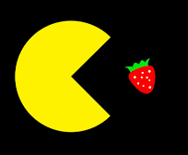
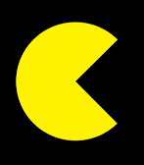
Perls generalised this concept by considering any form of psychological perception in terms of figure / ground. (Perls et al, 1994[1951]).
  “The figure (gestalt) in awareness is a clear, vivid perception, image, or insight; in motor behavior, it is the graceful energetic movement that has rhythm, follow-through, etc.” (p.7)
Perls called the process of forming a clear perception of the gestalt, contact
  “Contact, the work that results in assimilation and growth, is the forming of a figure of interest against a ground or context of the organism/environment field.” (p.7)
Gestalt Therapy’s view of how people actually change is as follows:
  Most important of all, the achievement of a strong gestalt is itself the cure, for the figure of contact is not a sign of, but is itself the creative integration of experience. (p.8)

Slide 8

Exercise: Identifying possible Gestalten “finding the food”
  Think of things in your life (a relationship, concern, need, experience really anything which holds importance for you) and label it. E.g. “my relationship with my sister”, “how I feel when I’m alone”, “how I feel being observed”, “my hopes” etc. Write them down in a list.

Slide 9
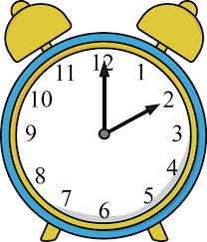
Bringing things into the present is important in Gestalt…
  “Contact, figure/background formation, is a mounting excitement, feelingful and concernful, and, conversely, what is not concernful, present to one, is not psychologically real.” (Perls et al, 1994[1951], p.9)
  “So in psychotherapy we look for the urgency of unfinished situations in the present situation, and by present experimentation with new attitudes and new materials from the experience of the actual day to day, we aim at a better integration.” (Perls et al, 1994[1951], p.10)

Slide 10
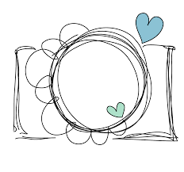
And so is creativity….both in terms of its view of human growth:
  “We may then define: psychology is the study of creative adjustments. Its theme is the ever-renewed transition between novelty and routine, resulting in assimilation and growth.” (Perls et al, 1994[1951], p.7)
and in the therapy room:
  “The Gestalt approach values a commitment to experimentation, creativity and risk-taking for both client and counsellor. (Clarkson and Cavicchia, 2014, ch.2).”

Slide 11
Laura and Fritz…a creative diversion.
Laura Perls (who later married Fritz) suggested he change the name from ‘Concentration Therapy’ to ‘Gestalt Therapy’ (Clarkson and Cavicchia, 2014). Take 5 minutes to write a dialogue of this conversation….e.g.
Fritz: I’m going with concentration therapy for my new approach…
Laura: Are you sure luv?
Fritz: Ya, why not?
Laura: It sounds kinda boring and difficult…how about, I dunno, ‘Gestalt Therapy’, you know like Gestalt psychology what we’re both into.
Fritz: Oooo, do you think? Could I? Yes I could, hey I’m a genius.. I mean you’re a genius. ‘Gestalt Therapy’ it is.

Slide 12

Exercise: Making contact – forming the gestalt aka exploring the ‘food’ – perhaps even eating it.
Choose one of the above list – it should be something which holds some curiosity for you, something which you don’t entirely ‘get’.
‘Brainstorm’ a list of words which describe the gestalt, these can be anything – adjectives, emotions, colours anything that for you ‘conjures up’ the gestalt and makes it present. Try not to think too much, you are not analysing it, you are describing how it feels to you, making ‘contact’ with it.
(In doing this exercise you are taking a phenomenological view of the world.)

Slide 13
Case Study Example
Sue has come for bereavement counselling. Since her Father died two years ago, she has felt anxious and at times fearful. This is affecting her day to day life. She finds it much more difficult to socialise and cannot face doing jobs at home which she would once have found easy.
A possible gestalt here is the ‘entire issue’ of the bereavement. As the work progresses, Sue recalls a particular conversation she had with her Father around a year before he died. In this conversation, she told him about her plans to move away, something she went on to do. He said little about this at the time but Sue had the feeling that he was sad about it.
This conversation – a ‘smaller’ gestalt within the ‘larger’ one of bereavement, is brought into the present by the client recounting it and by her being encouraged to report on her emotions and sensations as she does so. The gestalt is further brought into focus by Sue engaging in ‘empty chair’ work, where she role plays the conversation with her Father. She expresses to the therapist the regret she feels that this conversation ended in the way it did. She is surprised by the level of emotion she feels on recounting this conversation. She cries.
This represents a turning point for Sue. Making ‘contact’ with this ‘gestalt’ has changed it. She still recalls the conversation, but it has somehow lost its power and feels more in the past. Making contact with this ‘smaller’ gestalt was a critical step in making contact with the ‘larger’ gestalt of her bereavement. She still feels pain for the loss of her Father, but she feels less anxious and more able to look to the future.

Slide 14
What about the films?
‘A-ha’ moments:
‘Chimpanzee Insight’ (Kerwin, 2014)
“boom” (Kohl in Kerwin, 2014, 0:23)
Fritz Perls on Gestalt Therapy:
‘Fritz Perls and Gloria - Counselling (1965) Full Session’ (Duncan, 2013)
  “Gestalt therapy is working on an equation; Awareness = pleasant time = reality” (Perls in Duncan, 2013, 0:16)
  “The civil war of inner conflicts weakens the efficiency and comfort of the patient but every bit of integration will strengthen it” (Perls in Duncan, 2013, 1:35)

Slide 15
Gestalt's big ideas..
Figure and ground.
Making ‘contact’ with these figures – forming a strong gestalt - allows us to grow.
Therapy can aid this process by therapist and client bringing issues into the present and working creatively.

Slide 16
References
Churchill, R., Davies, P., Caldwell, D., Moore, T.H., Jones, H., Lewis, G. and Hunot, V. (2010) ‘Humanistic therapies versus other psychological therapies for depression.’, Cochrane Database of Systematic Reviews, (9).
Clarkson, P. and Cavicchia, S. (2014) Gestalt Counselling in Action. 4th ed. London: Sage.
Collinsdictionary.com. (2019). Collins German Dictionary | Translations, Definitions and Pronunciations. [online] Available at: https://www.collinsdictionary.com/dictionary/english-german [Accessed 1 Dec. 2019].
Duncan, S. (2013). Fritz Perls and Gloria - Counselling (1965) Full Session. YouTube. Available at: https://www.youtube.com/watch?v=it0j6FIxIog [Accessed 30 Nov. 2019].
Fleuridas, C. and Krafcik, D. (2019) ‘Beyond Four Forces: The Evolution of Psychotherapy’. SAGE Open, 9(1), pp.1-21.
Kerwin, G. (2014). Chimpanzee Insight (Kohler Study Footage). YouTube. Available at: https://www.youtube.com/watch?v=6-YWrPzsmEE [Accessed 30 Nov. 2019].
Perls, F., Hefferline, R.E. and Goodman, P. (1994[1951]) Gestalt therapy : Excitement and Growth in the Human Personality. New York: The Gestalt Journal Press.
Rogers, C.R. (1957) ‘The necessary and sufficient conditions of therapeutic personality change. Journal of Consulting Psychology’, 21(2), pp.95–103.
‌

