Slide 1
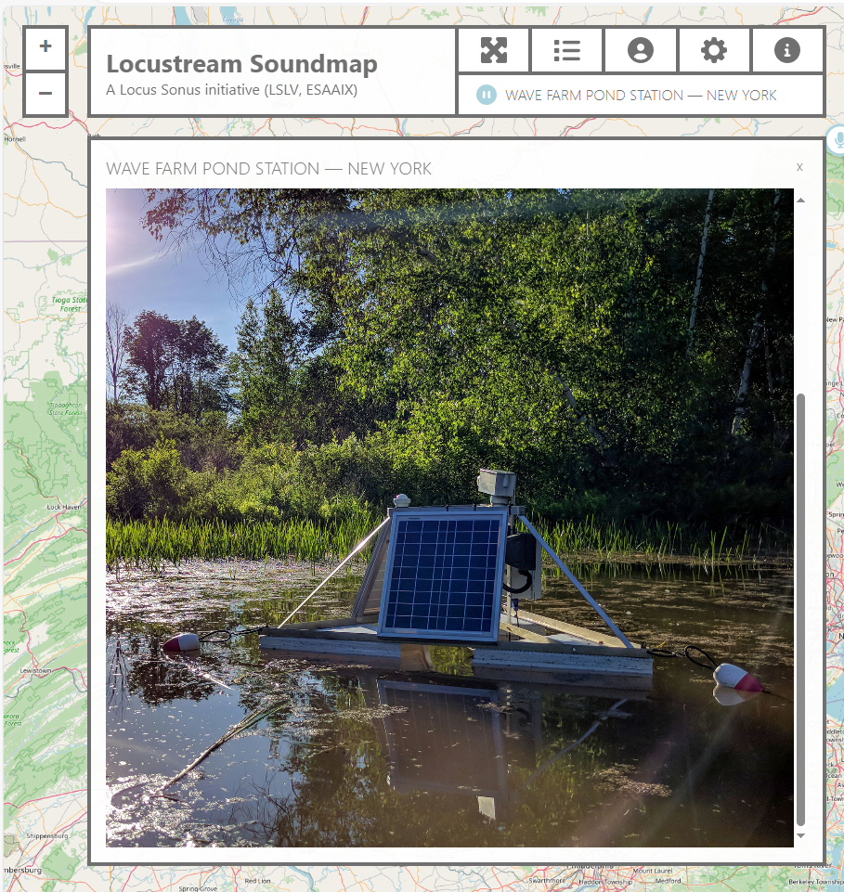
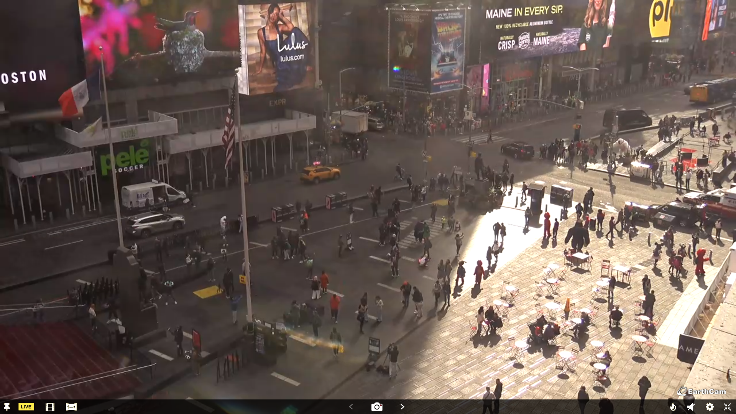
Introduction: Downtown, Upstate.
In this live-streamed installation, a webcam feed from Time Square merges with audio from Zach Poff's Pond Station at Wave Farm in Acra, New York. This juxtaposition of urban visuals and natural soundscapes, separated by approximately 130 miles, explores the simultaneity of experiences across contrasting environments. The bustling imagery of Time Square contrasts with the tranquil underwater sounds of Pond Station, creating a dialogue between visual and aural elements. This allows viewers to experience the dynamic interplay between urban and natural worlds in real time.
Where should this be projected to enhance its themes? Consider the environment, potential audience, and historical or social significance of the chosen location.
This is the solar powered apparatus used to record and transmit the pond audio feed. Wave Farm | Zach Poff
Locus Sonus – Locustream – sound map (locusonus.org)
This is the webcam feed of Time Square.
http://audio.wavefarm.org:8000/pondstation.mp3

Slide 2
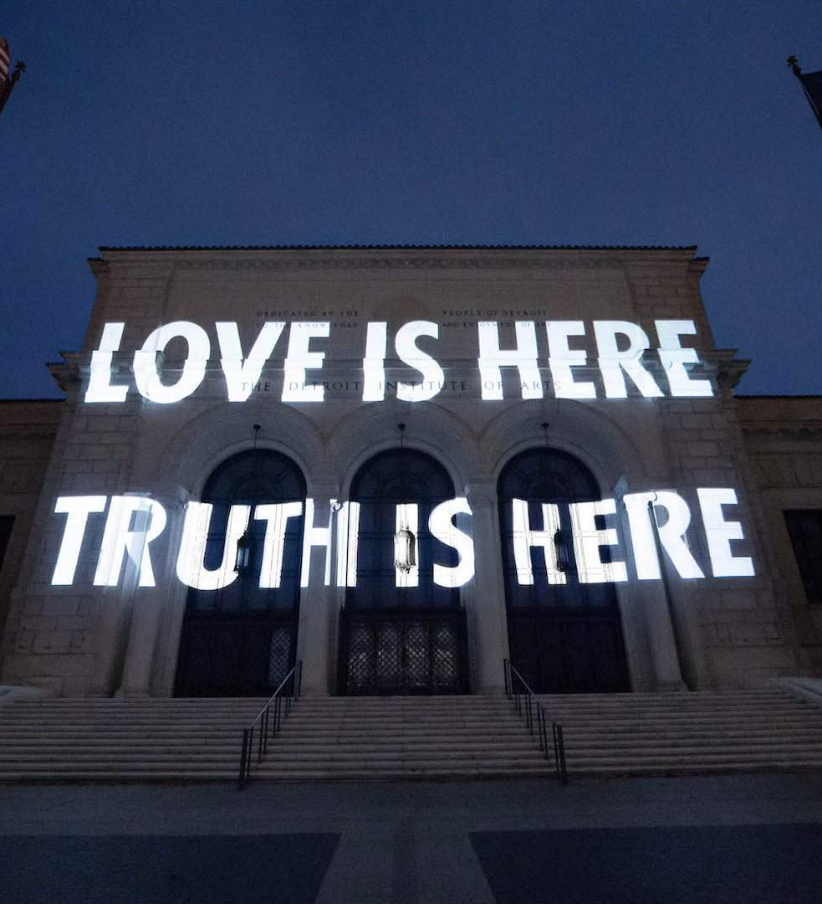
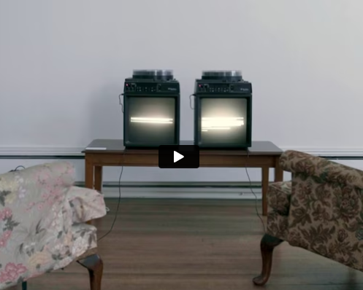
Projection Types Introduction
Large Scale Building Projection - Projection covering full building facades, ideal for public art or city events.
Installation - Smaller scale, often indoor projections as part of gallery installations.
Short Throw Projector - Used in confined spaces, allowing for close projection without distortion.
Data Projectors - Standard projectors for basic digital media projection, good for presentations or small installations.
Overhead Projectors - Traditional analogue projectors, often used with transparencies, offering a nostalgic or retro touch.
Projection Mapping - Digital projection tailored to irregular surfaces, like sculptures or architecture.

Slide 3
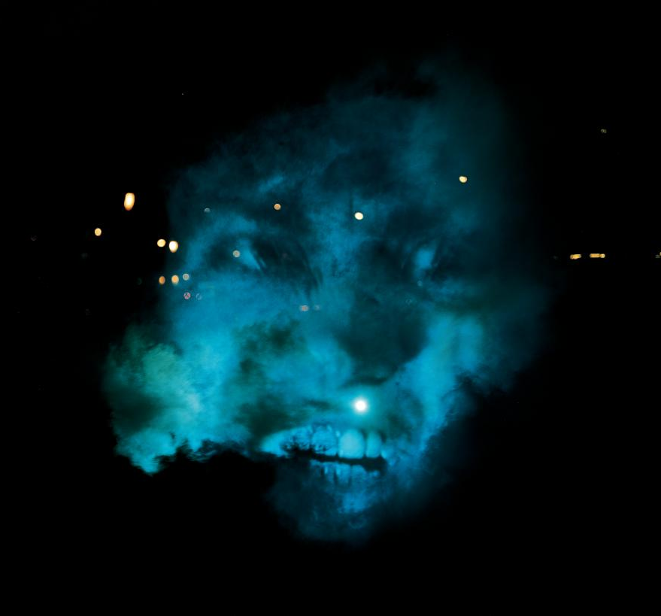
TO SEE, OR NOT TO SEE?
“In the same way, or perhaps even more effectively, technology creates a dream space that mimics reality” - Oursler
What ephemeral, unusual surface would you project on in your site?
Description: Oursler projected ghostly faces onto trees and smoke clouds in parks, creating eerie, disembodied figures in conversation with each other. The work explored the impact of media on perception, drawing viewers into a haunting, surreal experience.
The Influence Machine, 2000. Tony Oursler

Slide 4
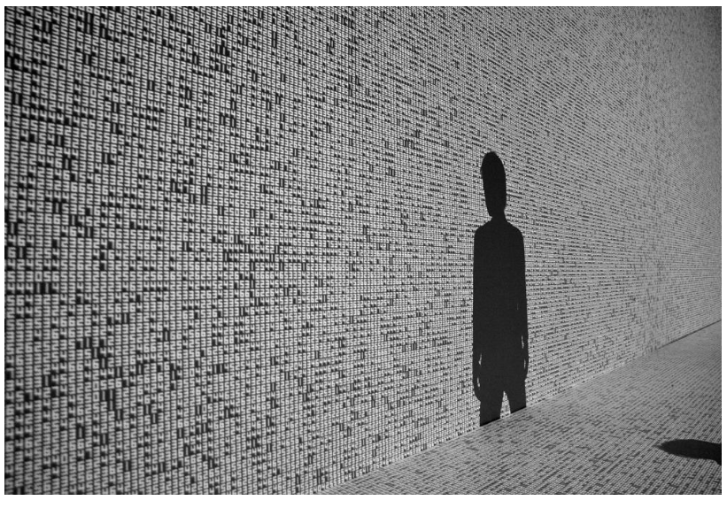
Data Streams
data.tron is an audiovisual installation in which each single pixel of visual image is strictly calculated by mathematical principle, composed from a combination of pure mathematics and the vast sea of data present in the world. These images are projected onto a large screen, heightening and intensifying the visitor's perception and total immersion within the work.
Why can the audience cast their shadow? How would this performativity work in your site?
Data.tron, 2007. Ryoji Ikeda.

Slide 5
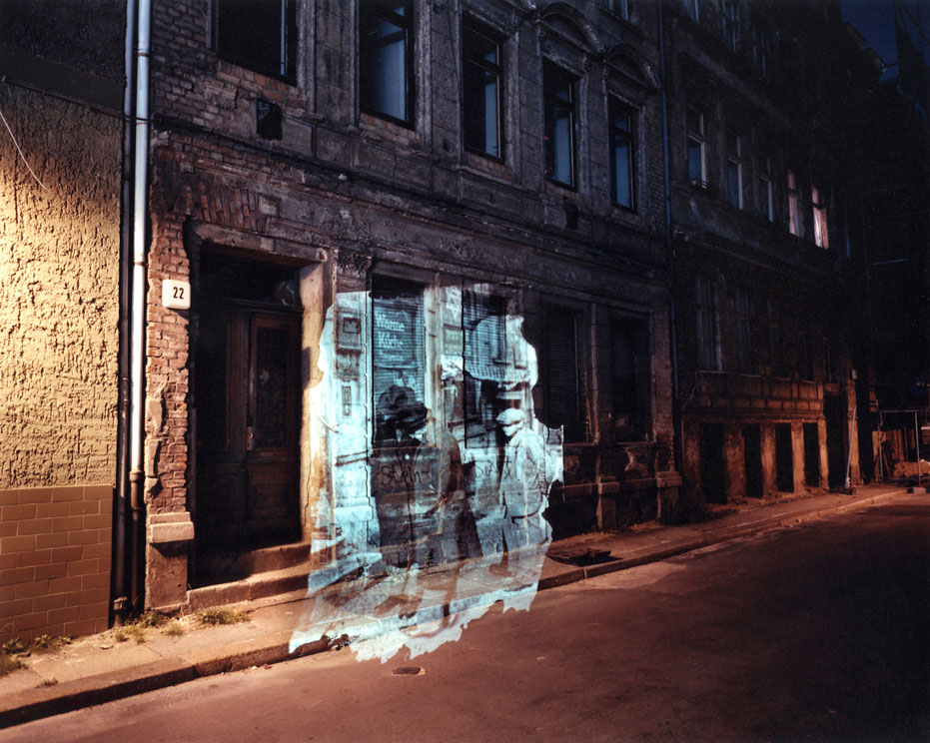
Visualising the Past
Attie’s work uses archival imagery of the past to transform our sense of the present.
What archival work could you project? What contexts would it explore?
Description: Attie “projected portions of pre-world war II photographs of Jewish street life in Berlin onto the same or nearby addresses where the photos were originally taken 60 years earlier” The Writing on the Wall – Shimon Attie.
The Writing On The Wall, 1993. Shimon Attie.

Slide 6
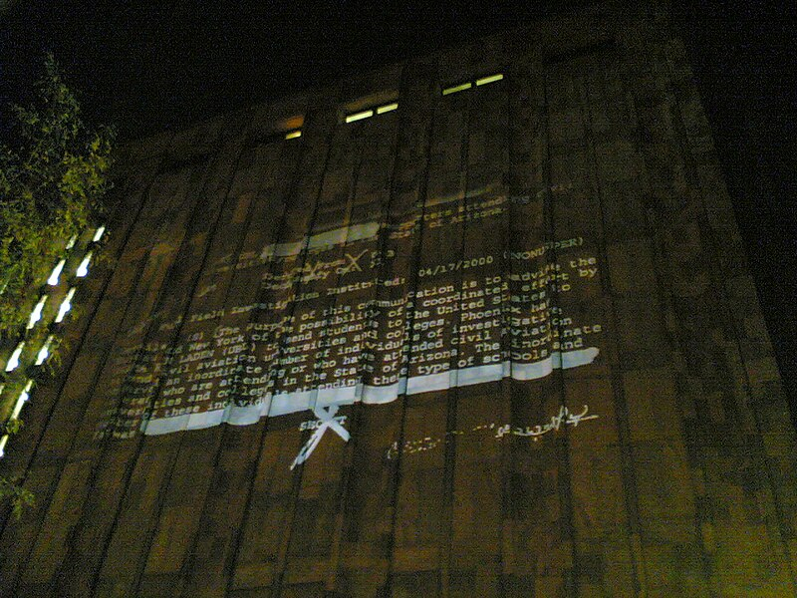
Scale and Publicity.
“At New York University’s Bobst Library, Holzer projected declassified government documents, which were released under the Freedom of Information Act. Holzer’s presentation of these documents suggested America’s struggle to achieve an equitable balance between transparency and secrecy, public and private.
Consider the political contexts of the location of this work – could you make work which has a context linked to the site?
For the City, 2005. Jenny Holzer
Description: Holzer’s projected documents aims to make small, hidden political decisions open and on show.

Slide 7
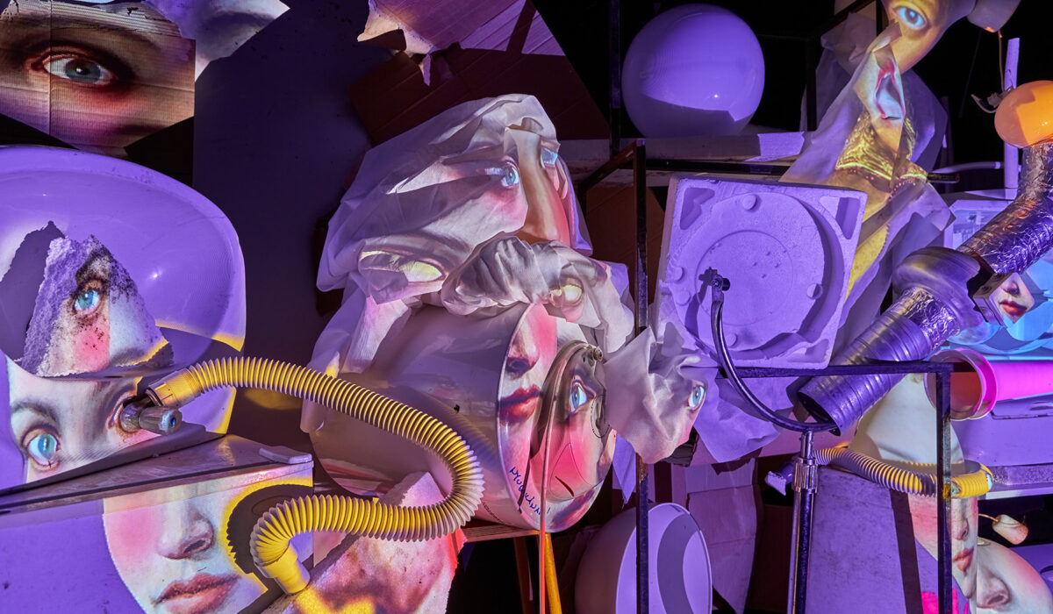
Conform to the space.
Trash Mapping is installed in the Light Art Museum – sited at an old Hungarian Market.
Pani, collected items left in the market, arranged them and prepared a surreal video, projection mapped to the objects.
What items would you use from your site? What would the projection and the object communicate?
Trash Mapping, 2023. Pani Pawlosky
Projection mapping: Work backwards, project onto the object to be mapped, and develop your image while projecting it. Use perspective tools (like we did in Photoshop last week) to warp and conform the image.

Slide 8
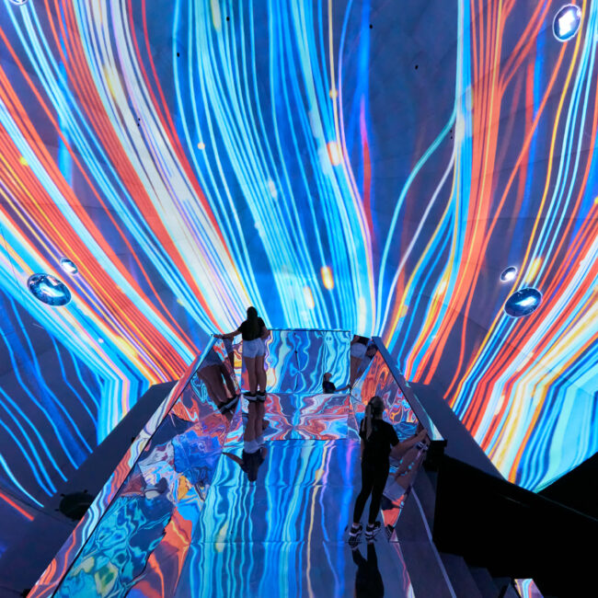
IMMERSIVE EXPERIENCE
At the hear of Budapest’s light art museum is the incredible Journey by NOHLAB.
An immersive projection which reflects off the mirrors around you.
Note: This work doesn’t respond to its site. It’s included due to the technical considerations and scale involved with this work, made possible by the technological advancements in projection over the last 15 years.
How would you create an immersive projection in your chosen space?
Journey, 2019. NOHLAB

Slide 9
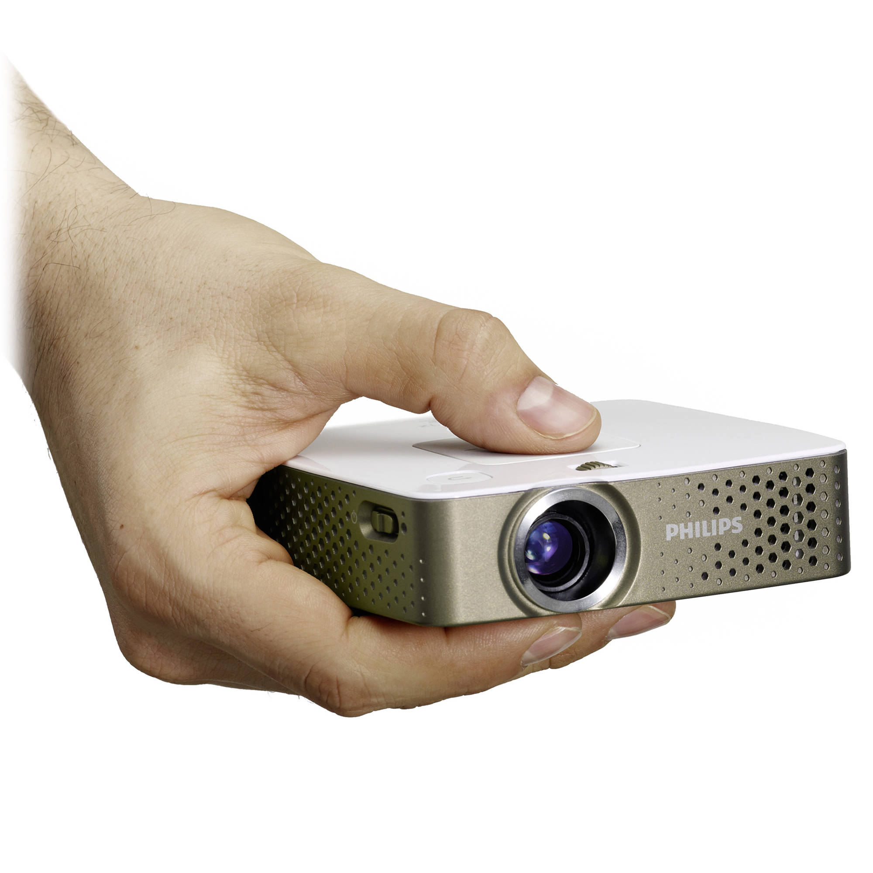
PORTABLE PROJECTOR
We have a portable, battery operated projector. It needs a media player (mains powered) or laptop for full portability.
What opportunities does this present? What complications does it add?

Slide 10
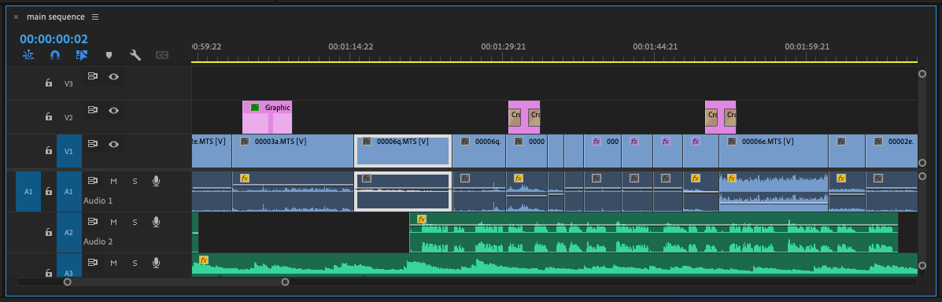
VIDEO OR PHOTOGRAPHY
Video or photography can be used. A media player can read folders of images from a USB drive.
Alternatively, you could put the images into a sequence on Premiere/Final cut to create a single video giving your more control over the “flow” of images.

Slide 11
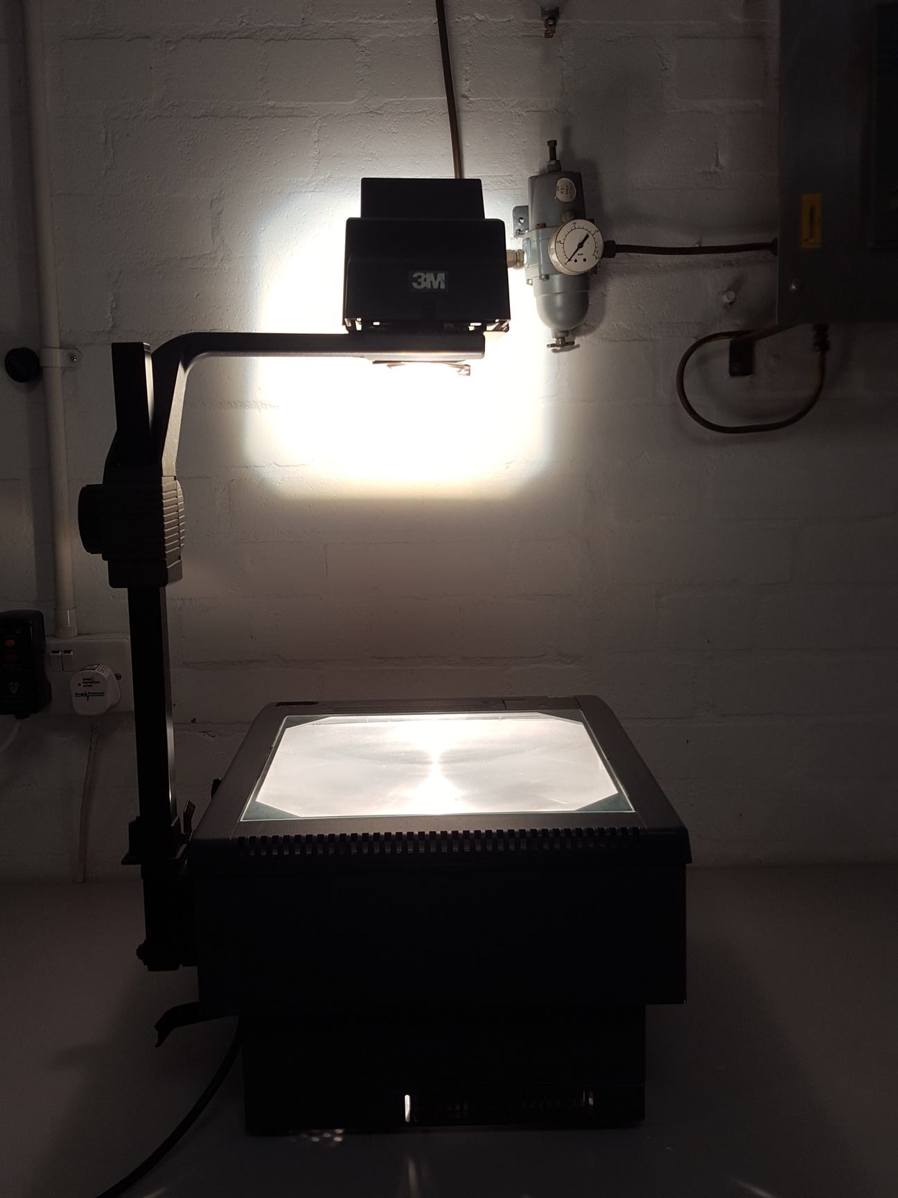
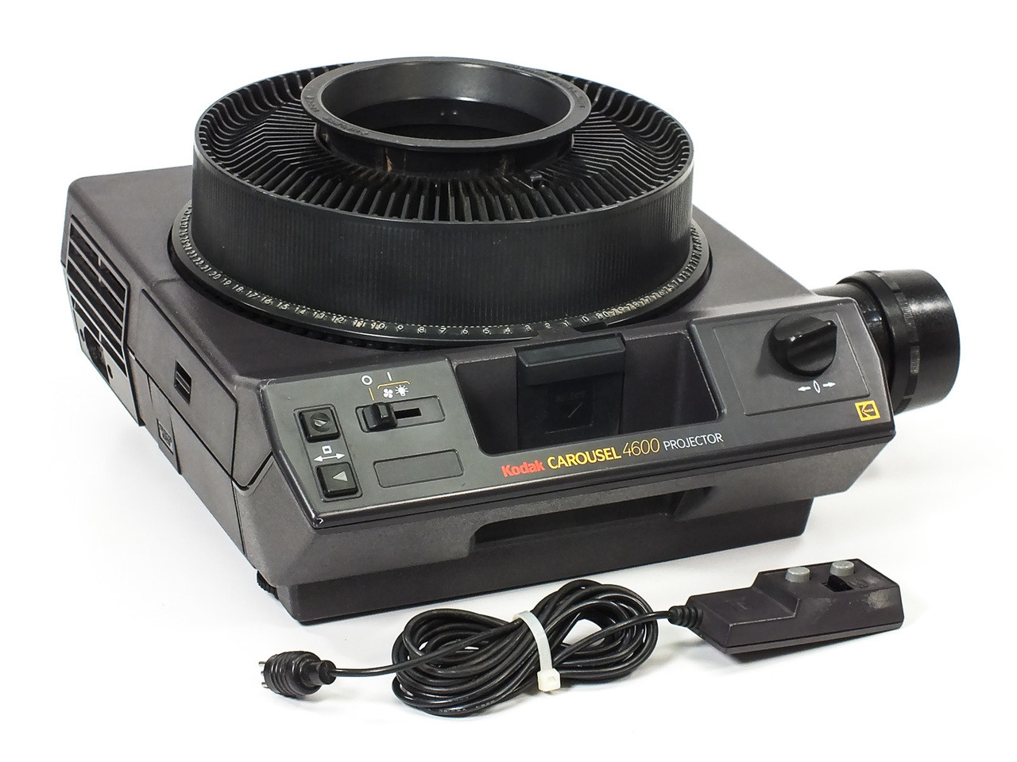
Device and context – legacy equipment

Slide 12
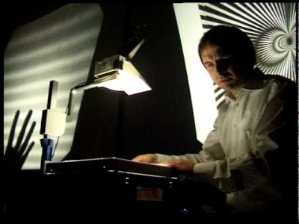
MIKOMIKONA
Fourier-Tanzformation I+II
“We layer several transparencies with raster patterns; flickering interferences are produced through shifting of the layers. Parallel to the projection, we capture these interferences with small video cameras and transform the video signal into acoustic events”
Legacy equipment and live, performative projection creates a different atmosphere and talks to progress/ technology/ automation and interaction.

Slide 13
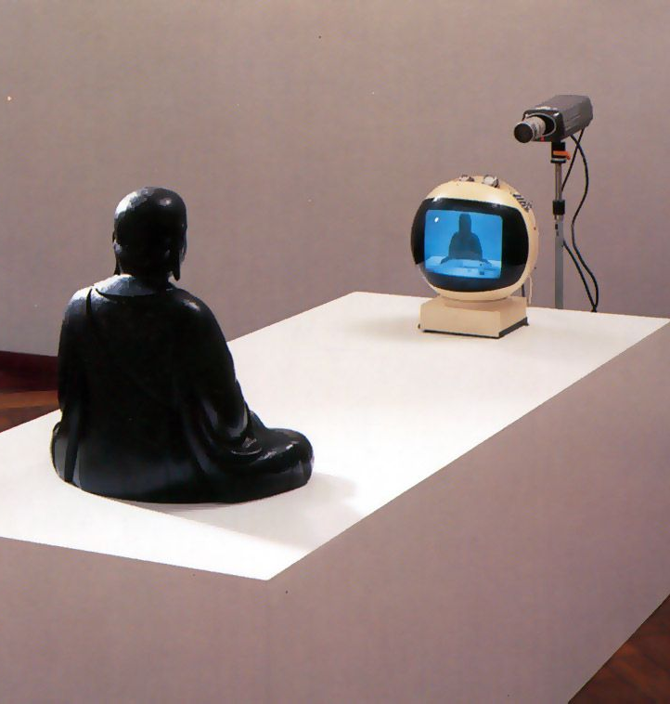
Projector as context itself
Nam June Paik used technology creatively to present how it reflected Post-War tech-dominated culture.
What does the equipment hear say about our relationship with tech. Given it was made in 1974 – how ahead of its time is it?
Could the use of a projector be a comment in itself?
TV Buddha, 1974. Naim June Paik.

Slide 14
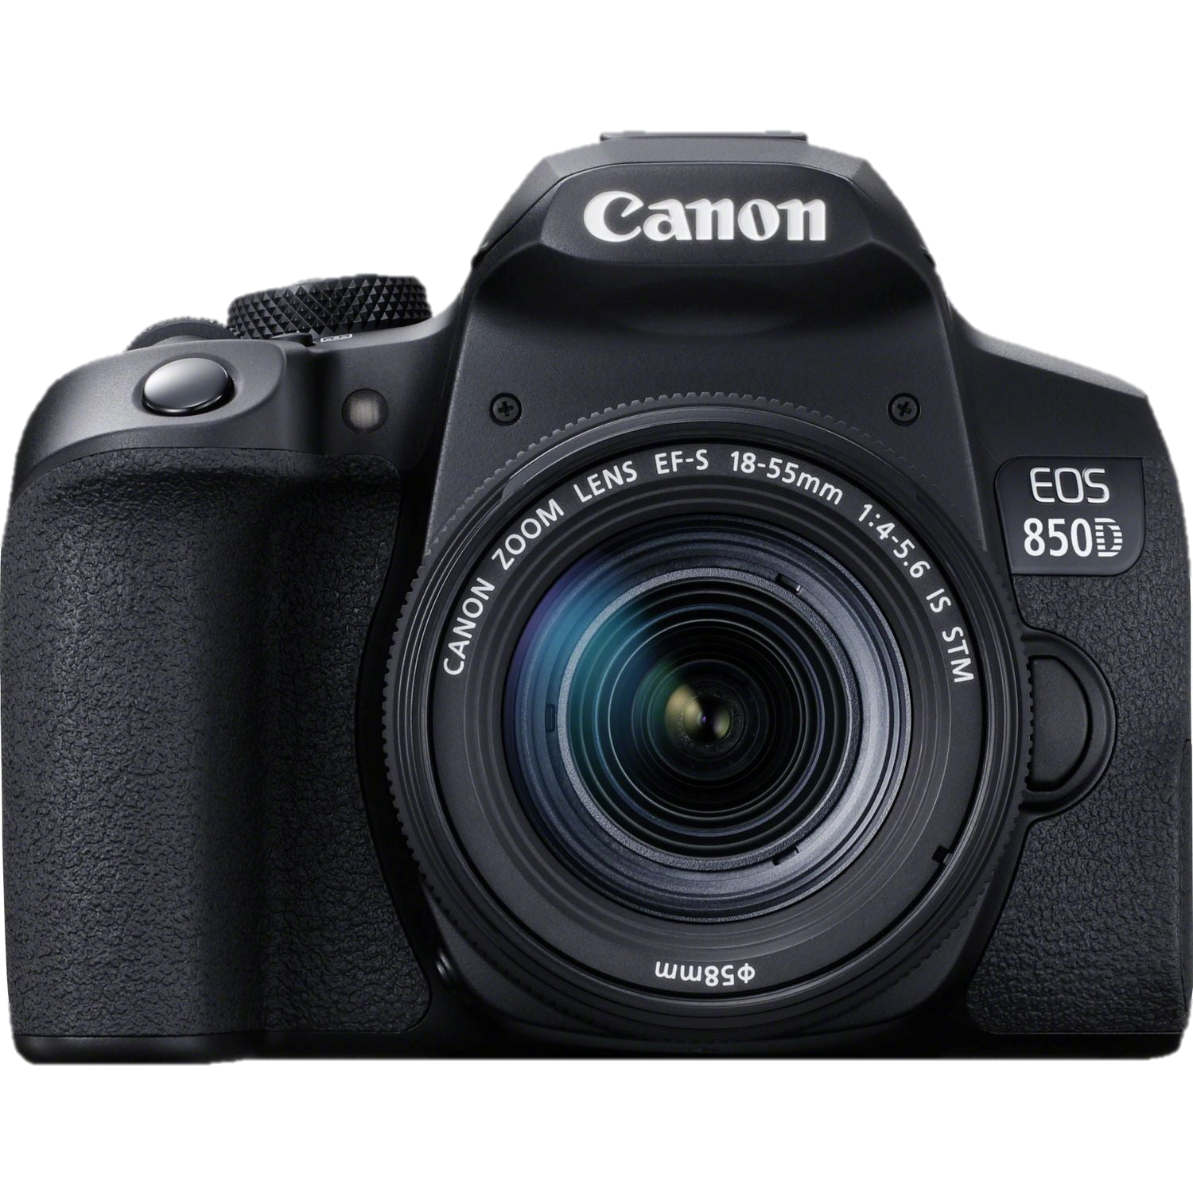
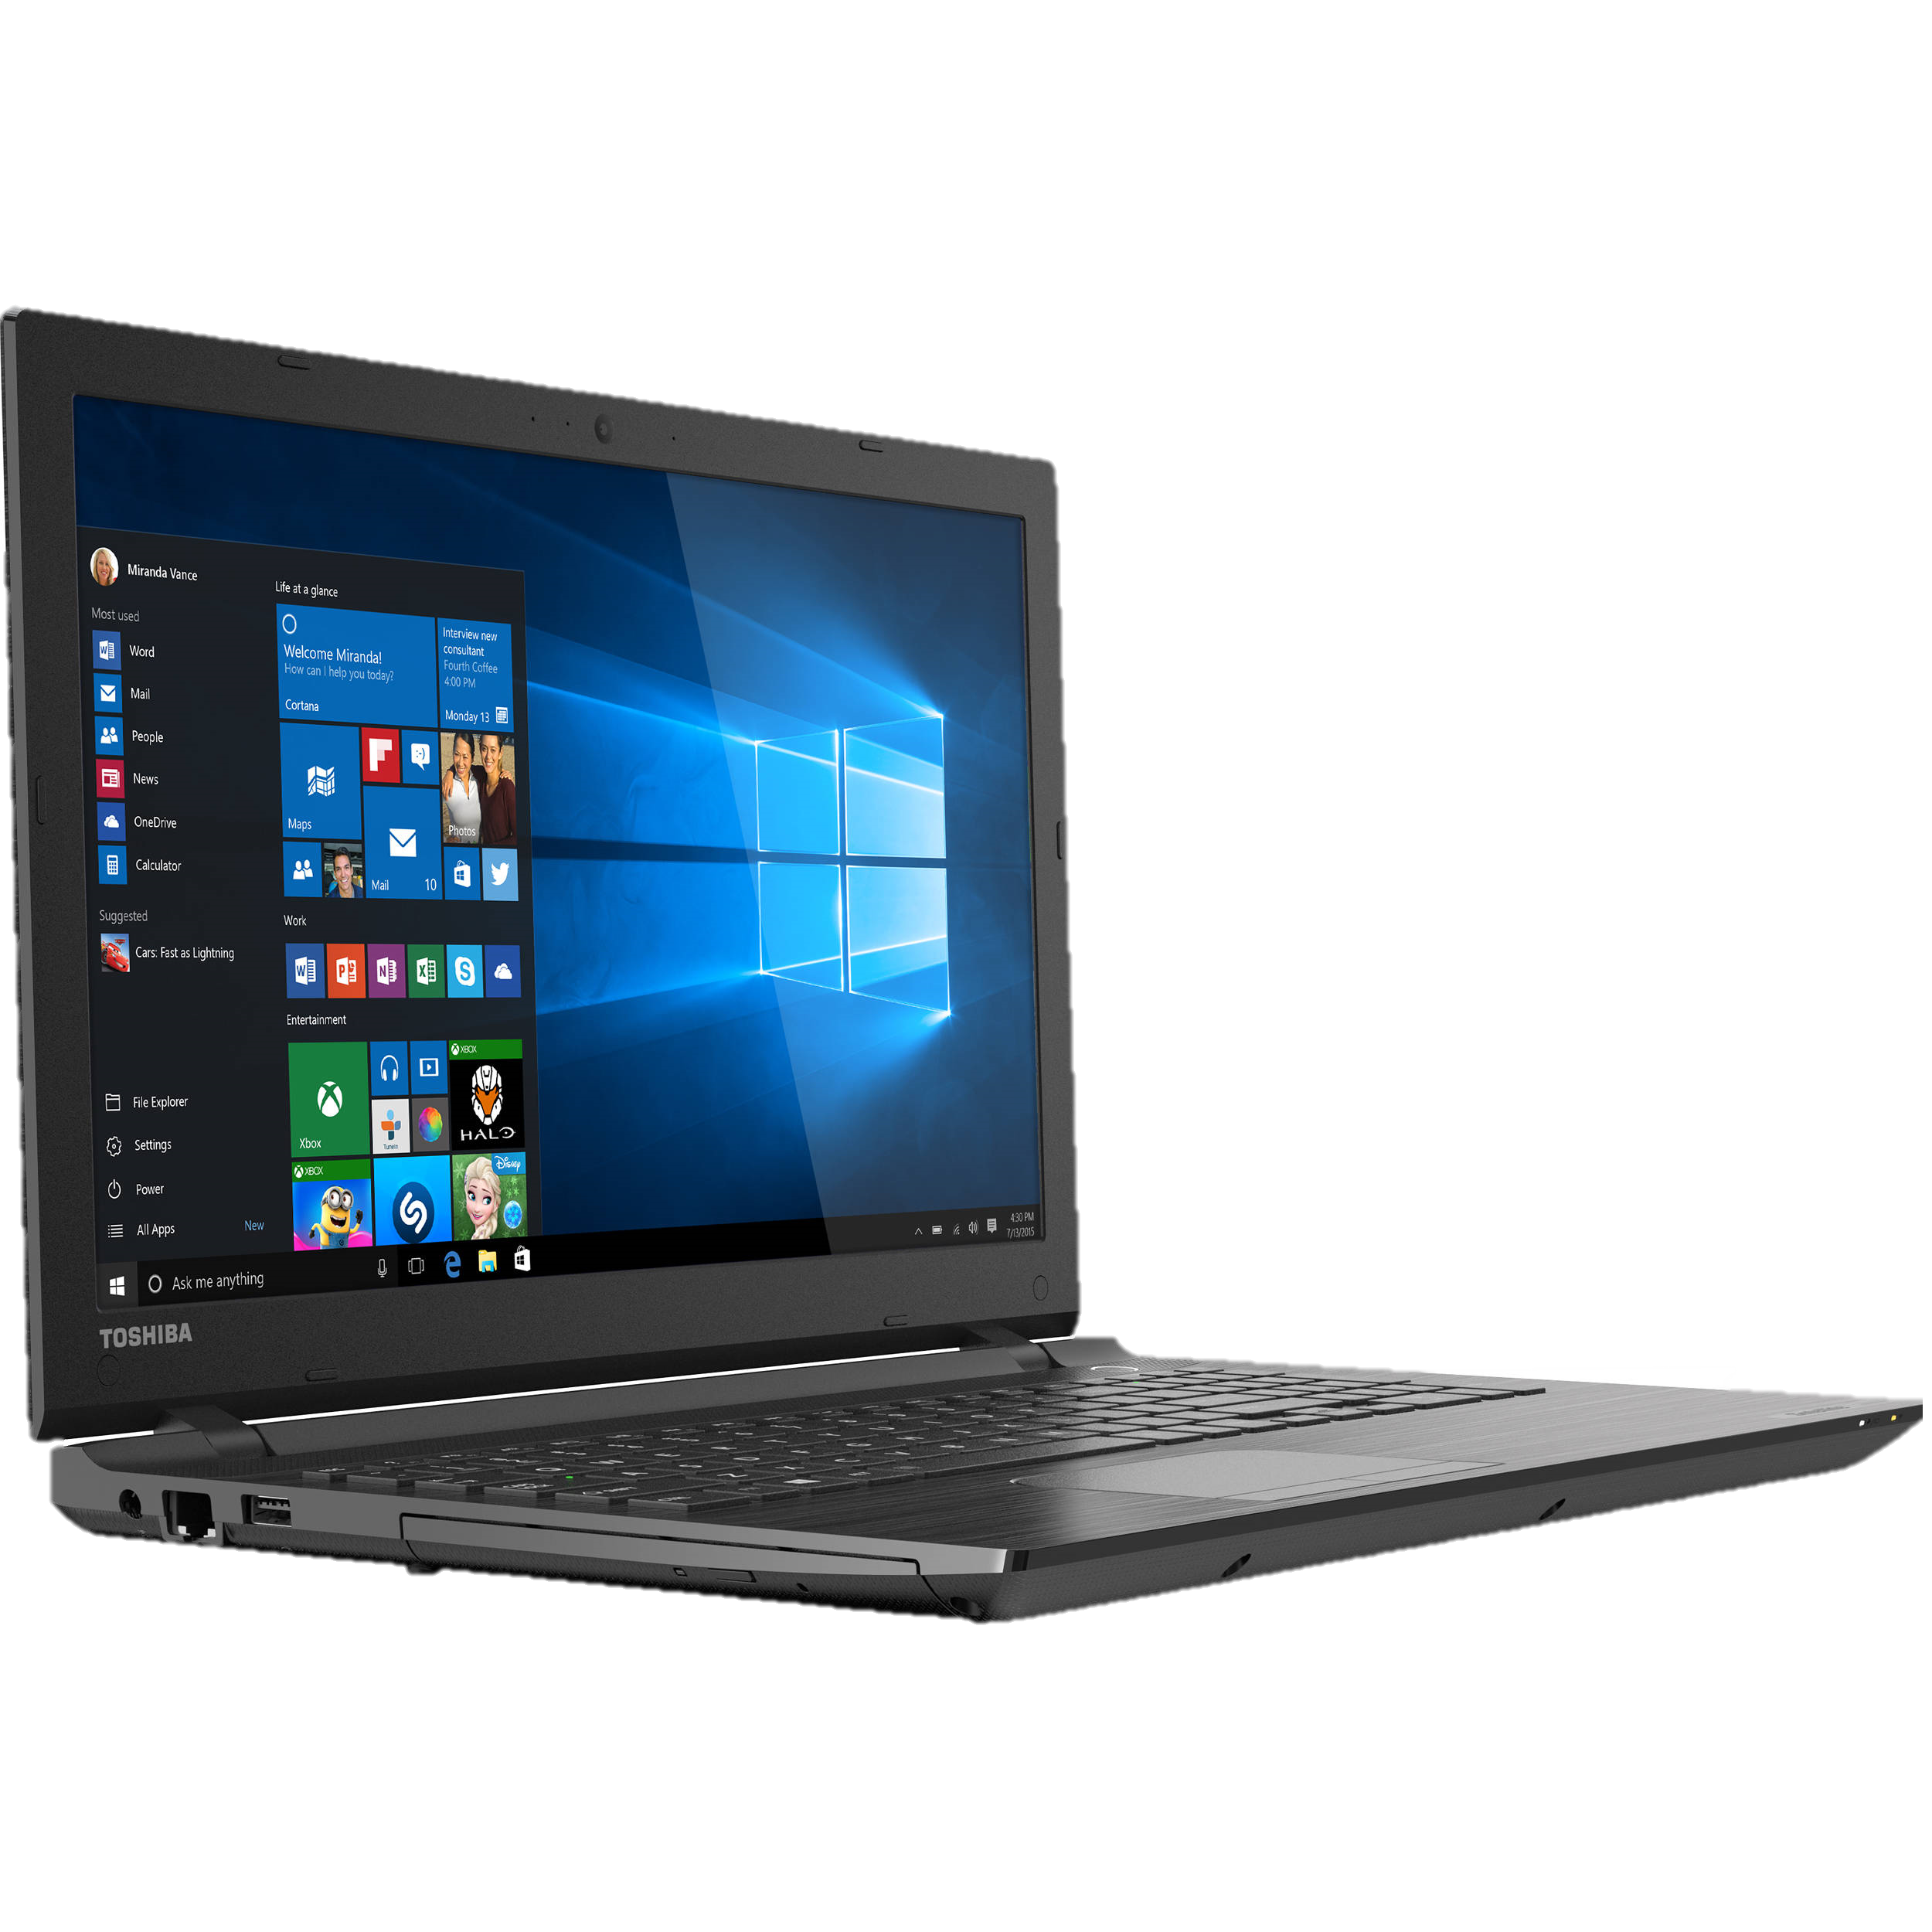
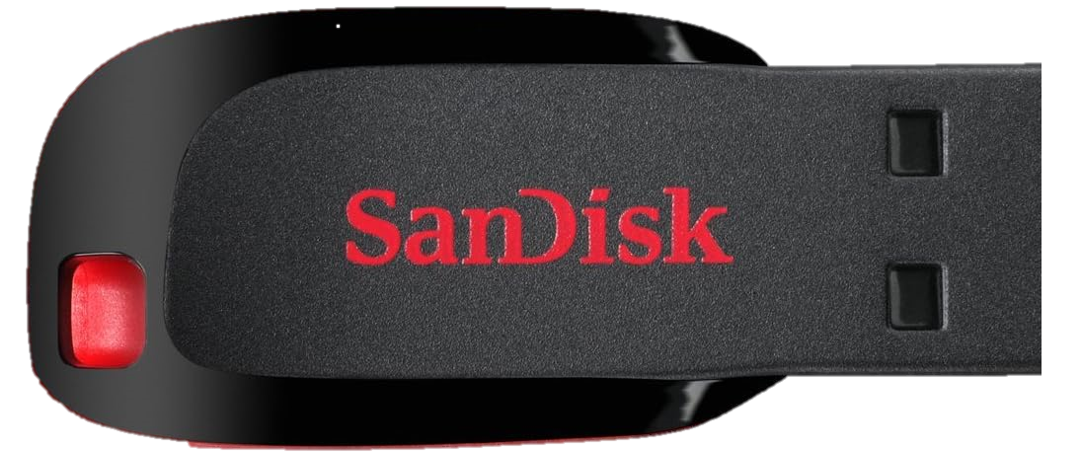

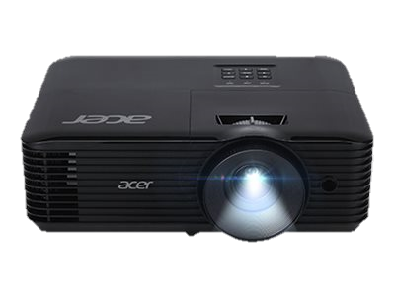
PLUGGING IN!
Live feed from DSLR
Feed from laptop
(video/photo/livestream)
Video/images files to repeat
HDMI cable
HDMI cable
HDMI cable
Media player “decodes” files for playback

Slide 15
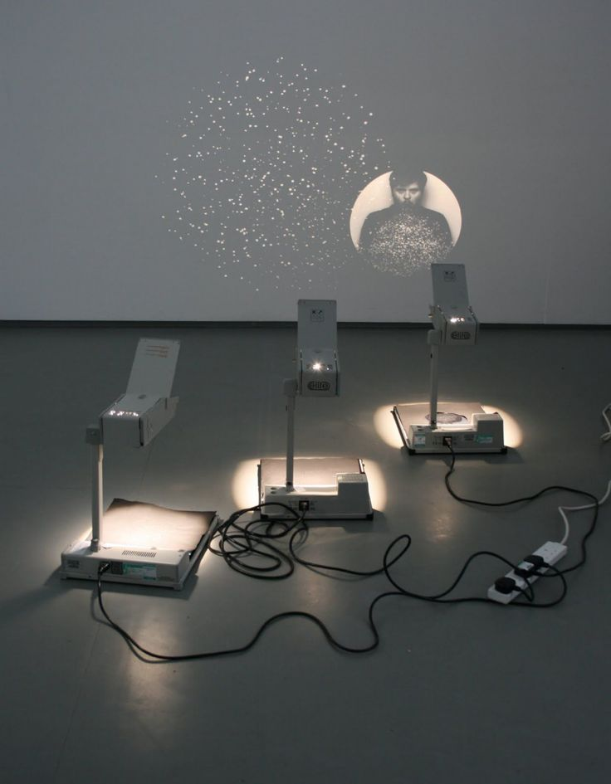
HEALTH AND SAFETY
Identify potential Health & Safety risks in using multiple projectors.
Rate their risk (high, medium, low)
Suggest ways to reduce this risk.

Slide 16
Weekly Task
As a group design a projection for your Site-Specific exhibition. Respond to one of the ideas used in the PowerPoint.
Produce a group idea using notes and discussion.
Decide the equipment to use.
Practice part of the installation in university or at your site.
While you don’t have to use it in your Site-Specific exhibition, you must demonstrate an attempt at a relevant outcome in your visual diary. Include, plans, drawings, context, artworks responded to, equipment, images of the attempts and Health And Safety

Slide 17
Module recap and visual diary work expected.
Week 1 – Introduction to site-specificity
Artwork study of at least 3 artworks, discussing key terms about site specificity.
Include at least one referenced definition of site-specific art.
Early ideas for mapping potential territories. Locations in Swansea, themes, exhibition ideas.
Week 2 – Archive Visit
Document visit to archive. Photos, maps, information from Andrew.
Week 3 – Artwork Study Seminar
Include notes form both seminars which you took part in. 100 words recap on how the seminar has informed your draft including key points/ideas.
Week 4 – Visualise the exhibition
Artwork study considering how one of the Visualisations functions – technical, funding application, convince a stakeholder, curator etc
Week 5 – No formal session (Cardiff/Tutorial)
Week 6 – Projections
Use the questions from the PowerPoint and your group answers to create a detailed set of artwork studies and response ideas.
Document your group ideas for a site-specific projection (weekly slide task)
As well as your visual enquiry tasks above, your visual diary should include group meetings, experimentation (planning, contacts sheets, edits etc), archive meetings, site visits etc. Please keep it in chronological (time) order.

