Slide 1
Diabetes Mellitus: Case Study of Patient A
Stoyan Grozdanov
1913753
BMHP5003 ITP A1
August 3, 2021

Slide 2
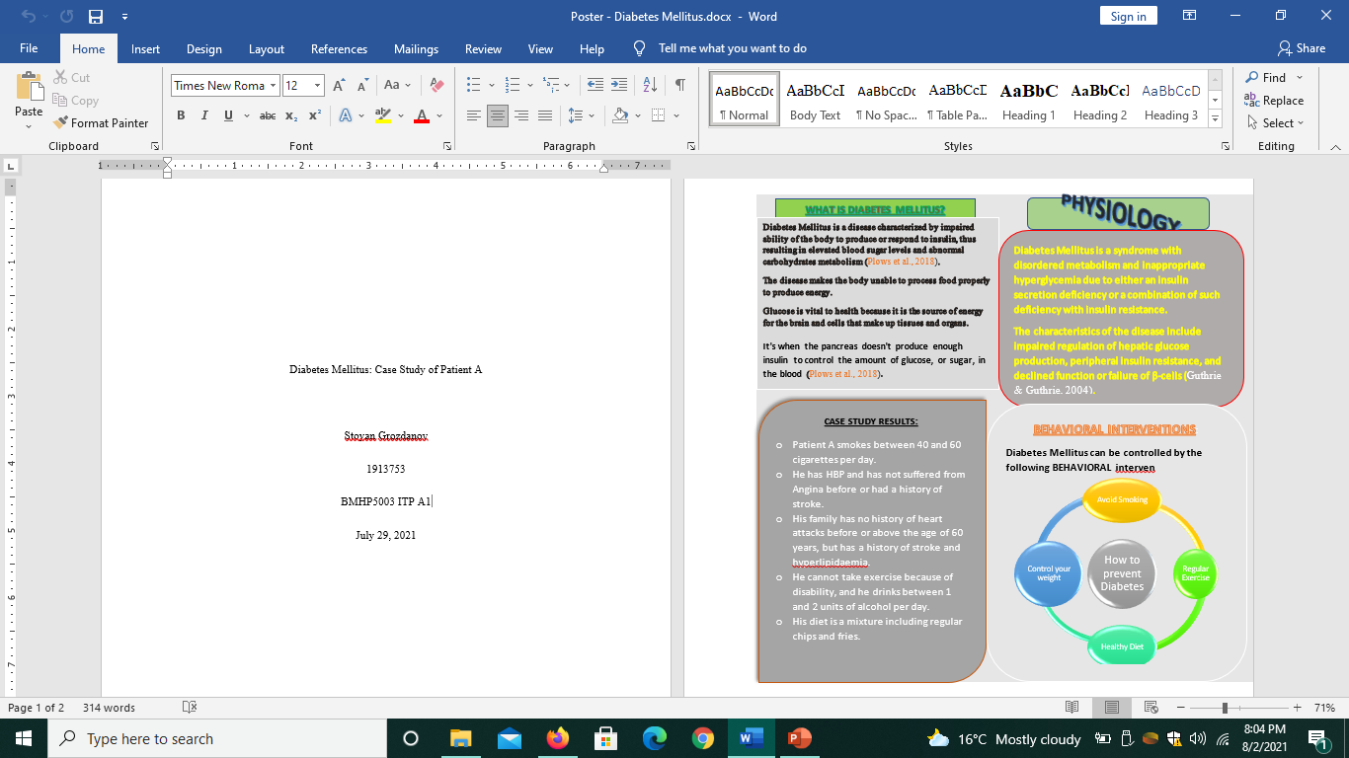
Notes:
Patient A has a history of an unhealthy diet and a lifestyle with minimal physical exercise contributed to by his physical disability. He is a heavy smoker with between 40 – 60 cigarettes per day.
With a weight of 80 kgs and 1.60 meters height, his Body Mass Index (BMI) is 31.3, which means he is in the obese category.
Due to conditions relating to body weight and obesity, he has had heart diseases such a HBP but has not suffered from angina or stroke in the past.
He has no family history of heart diseases but has a problem with hyperlipidemia in the family.
He also drinks between 1 and 2 units of alcohol per day.

Slide 3
References
Guthrie, R. A., & Guthrie, D. W. (2004). Pathophysiology of diabetes mellitus. Critical care nursing quarterly, 27(2), 113-125.
Plows, J. F., Stanley, J. L., Baker, P. N., Reynolds, C. M., & Vickers, M. H. (2018). The pathophysiology of gestational diabetes mellitus. International journal of molecular sciences, 19(11), 3342.

