Slide 2
ECIE6004
Global Perspectives on Education Session 1 - Introduction
Heike Griffiths |2025 |

Slide 3
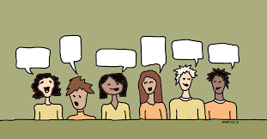
Global Perspectives on Education
1st definition of global: all-encompassing, all-inclusive
2nd definition of global: relating to the whole world; worldwide.
So which one relates to the module title?
Discuss……

Slide 4
Examining the Title -
What does it mean to have a global perspective?
1st definition of global: all-encompassing, all-inclusive
2nd definition of global: relating to the whole world; worldwide.
‘A global perspective is the capacity and predisposition for a person to think with complexity taking into account multiple perspectives, to form a unique sense of self that is value based and authentic, and to relate to others with respect and openness especially with those who are not like her…. [with a] sense of people, nation, and world beyond themselves’ (Finn, McNamara, 2011: p. 259).
Notes:
Insert a map of your country.

Slide 5
Module Aims
To examine and analyse aspects of the global challenges facing access to education for all, particularly in the developing world and the role of governments and international organisations in seeking to overcome these.
To develop knowledge and understanding of key aspects of global sustainability.

Slide 6
LEARNING OUTCOMES
Upon the successful completion of this module, the student should be able to demonstrate the ability to:
Identify and demonstrate critical understanding of the barriers facing universal education and the role of governments and international organisations in seeking to overcome these.
Demonstrate a critical appreciation of the value of a sustainable global education community.
Organise their knowledge and learning through the use of a range of information resources and present their work at an appropriate level.

Slide 7
On the Way to school
Samuel

Slide 8
What is a global citizen?
Watch the video below.
What is your definition?
https://www.youtube.com/watch?v=XVSgbU6WVSk

Slide 9
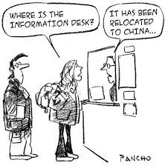
What is globalisation?

Slide 10
Definition of Globalisation
  Economic globalisation, characterised as long distance flows of goods, capital and services as well as information and perceptions that accompany market exchanges
  Social/cultural globalisation, expressed as the spread of ideas, information, images, and people
  Political globalisation, characterised by a diffusion of government policies
  What is globalisation of education? Globalisation of Childhood?

Slide 11

Globalised Childhoods Activity
What does this mean?
Think about globalisation of:
Culture
Policies
Goods, Services
Social Interactions/Conventions
Can you give examples of each?

Slide 12
Assessment Tip
Find three texts (one for each perspective) from the library, Leganto reading list or the other sources on Moodle which could help your understanding of these perspectives. Share on Teams.

Slide 13

Background to Sustainable Education
Key event UN Conference on Environment and Development – known as First Earth Summit (1992)
2002 Earth Summit in Johannesburg – link made between sustainability and education
Human activity threatening environment
Notes:
One of key events of 20th c was 1992 un conference on environment and development attended by world leaders and activists from all over the world. This event, which became known as the first earth summit recognised that human activity was increasingly threatening the environment or biosphere – that narrow zone of earth, air and water on which all life (plants, creatures, humans) depends. It also recognised that issues of development ie. global wealth and poverty were threatening people’s life chances in both rich and poor countries. The welfare of planet and people, issues of environment and development were thus recognised as being inextricably related. One of the terms often used to describe these concerns is ‘sustainable development’. In the 2002 earth summit in johannesburg again 10 years on to discuss sustainable development. Earth summit Johannesburg - agreement was made to restore the world's depleted fisheries for 2015
Agenda 21 refers to aiming to improve education and awareness of sustainability in order to be better place for 21 century.
Un also recognised that education had a crucial part to play in exproling resolution to these issues among the terms used to describe this is educat for sustainable development and the un declared 2005 – 14 to be the decade of ed for sustainable development.
Do they remember from last year in lines of enquiry how people view sustainable development differently. Remind them of economists they believe no limits to growth whilst ecologists recognise finite nature of earth’s natural systems.
Growth ie economy getting bigger is not the same as sustainable development which should aim to improve both human and environmental well-being.

Slide 14
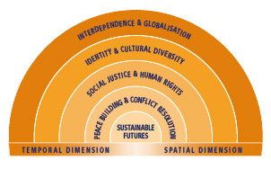
What are global perspectives in education?

Slide 15
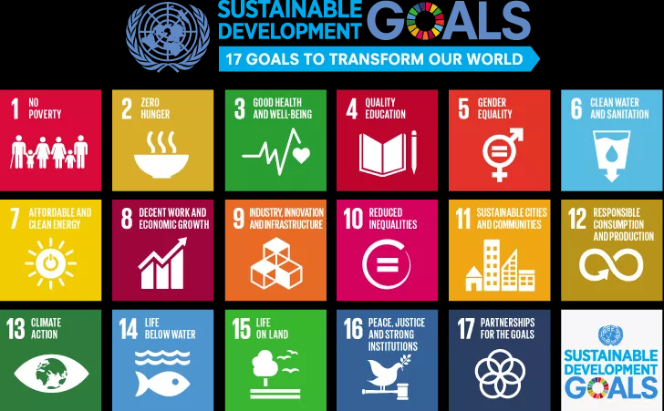
Policy Links International
(2015)

Slide 16
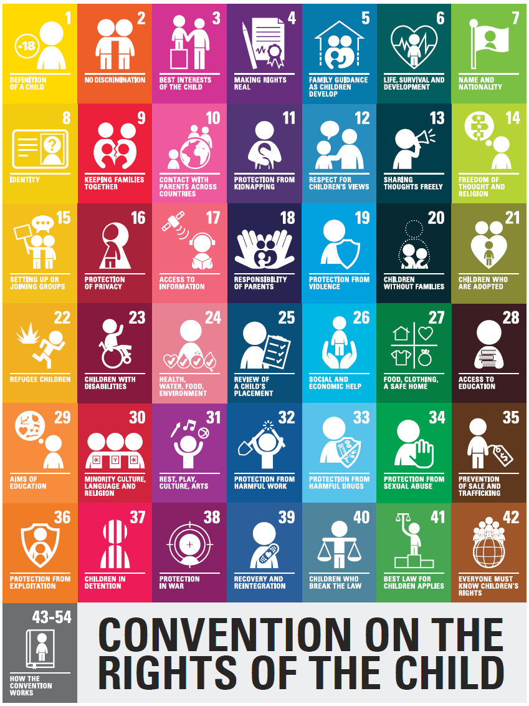
Policy links international
(1989)

Slide 17
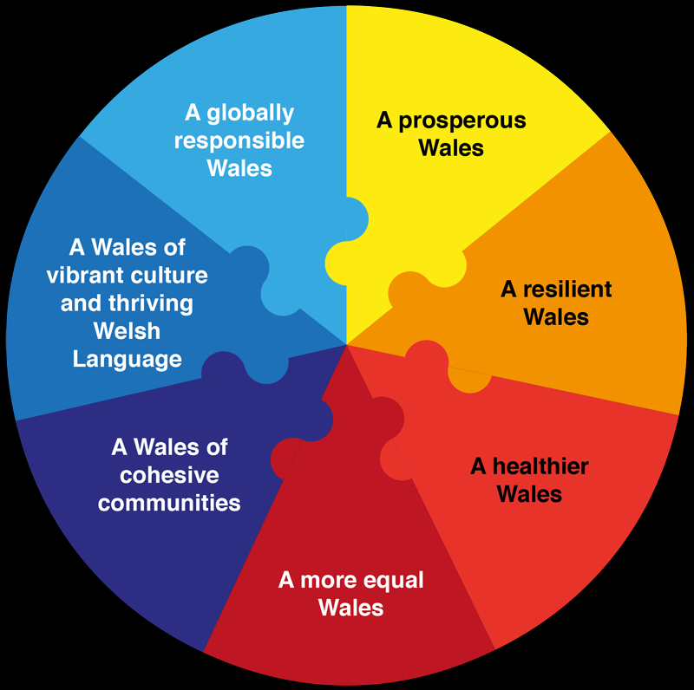
Policy links Wales
Wellbeing of Future Generations Act (2015)
Successful Futures (2015)

Slide 18
The Child as a global citizen - perspectives
Discussions of children’s participatory citizenship
Some researchers have examined the global implications of the Convention on the Rights of the Child, showing how its participatory rights such as to freedom of expression both empower children as global citizens but also control and discipline them on an adult-dominated global stage (Duhn, 2006; Ennew, 2008; Gadda, 2008).
Others have examined international children’s citizenship through a “cosmopolitan” lens that reveals, for instance, that a “recognition of interdependence is a foundation stone of a civic society that is vibrant, tolerant and welcoming” (Cockburn, 2013: 232).
And others still suggest the need for “postcolonial” interpretations of children’s citizenship as practiced in the majority world, that is, conceptions freed from European bourgeois ideals of individual autonomy and grounded instead in alternative political imaginations in which, for example, “various hierarchies of caste, gender and class continue to frame people’s everyday interactions with each other” (Balagopalan, 2011: 293).
(Wall, 2019)

Slide 19
Children as Global Citizens
The academic field of childhood studies has opened up new space in which to understand children’s citizenship as more than just passive membership in political regimes.
The field’s emphasis on children’s agency, voices, and participation makes it possible to understand and examine children and youth as active contributors to political life (Conrad, 2009; Invernizzi and Williams, 2008; James and Prout, 1997; Roche, 1999; Thomas, 2007; cited in Wall, 2019)

Slide 20
Children as global citizens
This recent focus on children’s political “participation” generated many fruitful studies of the ways in which children and young people are exercising citizenship on their own behalf, such as through
civil rights,
social media,
grassroots campaigning,
children’s commissioners,
child and youth parliaments,
children’s labor movements, and the like
(Austin, 2010; Cockburn, 2013; Hartung, 2017; James, 2011; Smith and Bjerke, 2009; cited in Wall, 2019)

Slide 21
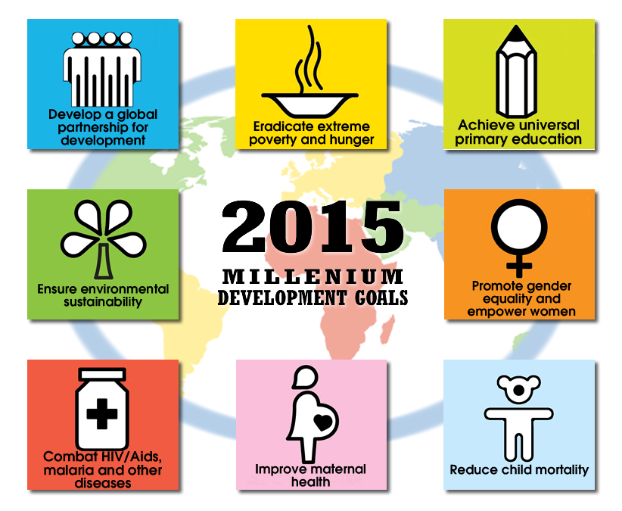





Module Content
A critical analysis of the rationale and impact of international directives such as Human Rights; United Nations Convention on the Rights of the Child (UNCRC); African Charter on the Rights and Welfare of the Child (ACRWC).
A critical evaluation of the impact of Millennium Development Goals (MDGs); Sustainable Development Goals (SDGs); Education For All (EFA).
A critical discussion of the different models of charity.

Slide 22
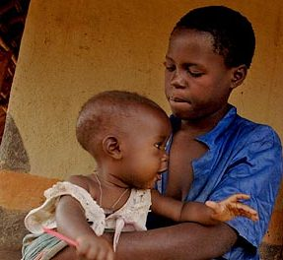
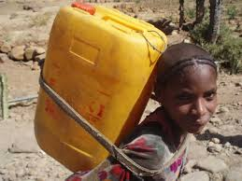
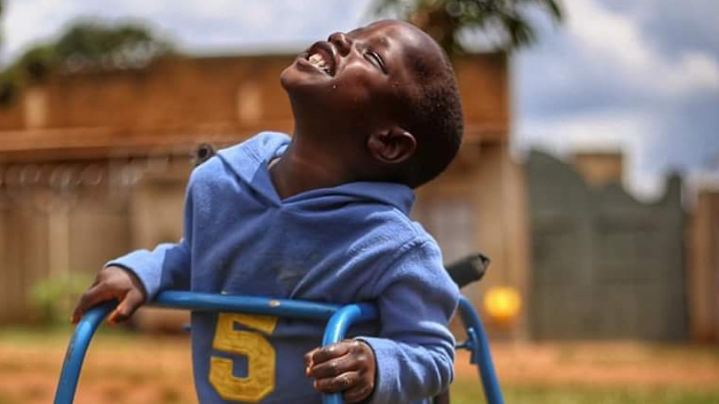
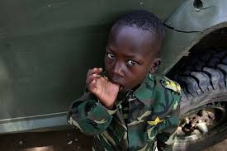
Module Content
Engagement in the international debate surrounding appropriate forms of aid
Consideration of Education for Sustainability.
Reflection on global gender issues; gender discrimination, childhood, with a focus on Africa: the value of a child; child labour; child soldiers; child brides; trafficking/slavery; the marginalised, e.g. the disabled child
Assignment Tip: Read this: https://reliefweb.int/report/world/20-reasons-why-2020-there-are-still-260m-children-out-school

Slide 23
Assessments:
Submission Date: 01.03.2026
Assessment Component 1 - 75% Essay (3000 words)
Choose one country in the majority world (low or middle income country) and critically explore the barriers to accessing good quality, consistent education for children and young people in your chosen country. Refer to national, regional, and international policies and reports; and apply theory throughout.
Assessment Component 2 - 25% Video Group presentation: 5 mins per person (maximum of 4 per group)
Critically explore how UNICEF is helping to develop sustainable practises in education around the world in one of their focus areas: Adolescents, Gender, Immigrant/Refugee Children, Climate Change.
Critically analyse case studies from around the world using the report below, relevant literature and policy.
https://www.unicef.org/reports/all-towards-tangible-solutions-equity-and-inclusion-education

Slide 24

Group work?
Group work is notoriously difficult, however, when we are in the work place, we will encounter team working rather a lot. Team work is the foundation of any work place.
Difficulties: In any team situation, there may be people who are not engaging, who do not seem to pulling their weight, and who sometimes fail to contribute. Some people only seem to work last minute, and some like to be organised and engaged from the beginning. It does not always seem fair. It can be frustrating, but it is all part of the learning.
Remember, each group member will be assessed on their personal contribution to the project.
Another point is, that while you may be held up, you can work on your essays individually.
Advantages: Group work can be rewarding and fun

Slide 25
Global Initiative On Out-of-School Children - South Sudan Country Study
More than 2.8 million children, or over 70 per cent, are out of school in South Sudan, putting at risk their futures and the future of the country. Some of the out-of-school children are living in pastoral communities, moving with their cattle and are not able to attend regular classes.
The largest group of out-of-school children in South Sudan are girls. Poverty, child marriage and cultural and religious views all hinder girls' education.
The latest on the education situation in South Sudan

Slide 26
Hope
I think that of all the attributes that I would like to see in my children or in my pupils, the attribute of hope would come high, even top, of the list. To lose hope is to lose the capacity to want or desire anything; to lose, in fact, the wish to live. Hope is akin to energy, to curi­osity, to the belief that things are worth doing. An education which leaves a child without hope is an education that has failed (Warnock, 1987).

Slide 27
One in Five Children, Adolescents and Youth is Out of School
In 2020, 260 million children, adolescents and youth were out of school, representing nearly one-fifth of the global population of this age group.
The number of children, adolescents and youth who are excluded from education fell steadily in the decade following 2000, but UIS data show that this progress essentially stopped in recent years; the total number of out-of-school children and youth has declined by little more than 1 million per year since 2012.
Some 63 million, or 24% of the total, are children of primary school age (about 6 to 11 years old); 61 million, or 23% of the total, are adolescents of lower secondary school age (about 12 to 14 years old); and 139 million, or 53% of the total, are youth of upper secondary school age (about 15 to 17 years old).
(http://uis.unesco.org/sites/default/files/documents/fs48-one-five-children-adolescents-youth-out-school-2018-en.pdf)

Slide 28
Progress stagnates
New UNESCO data shows that the global number of out-of-school children has risen by 6 million since 2021 and now totals 250 million. The figures, compiled by the Global Education Monitoring Report and the UNSCO Institute for Statistics, reveal that education progress continues to stagnate globally.

Slide 29
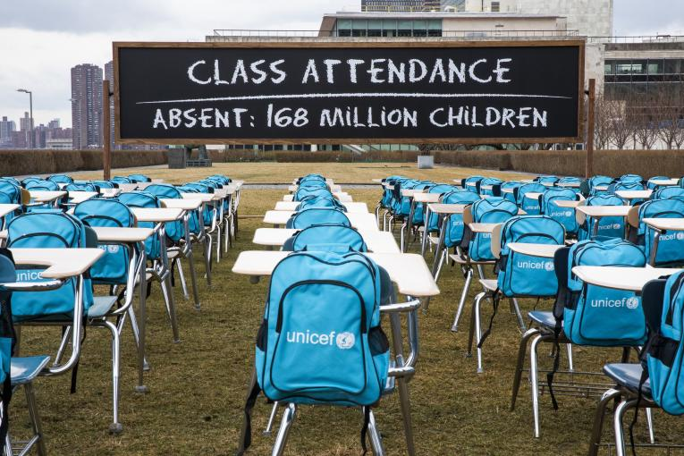
Covid19 and access to education in 2020
https://www.unicef.org/press-releases/schools-more-168-million-children-globally-have-been-completely-closed

Slide 30
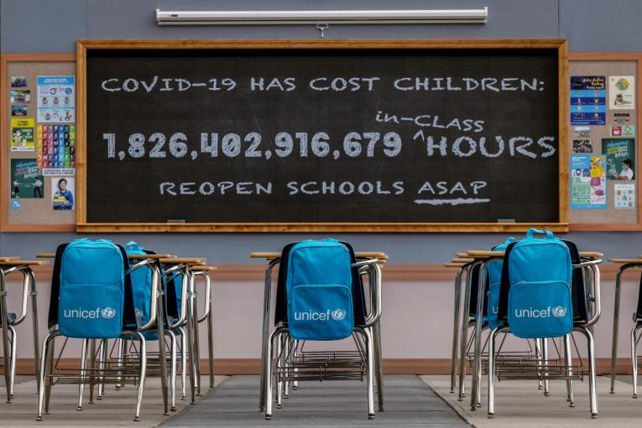
2021 Covid 19 continued……..
Globally, around 131 million schoolchildren in 11 countries have missed three-quarters of their in-person learning from March 2020 to September 2021.
Among them, 59 per cent – or nearly 77 million – have missed almost all in-person instruction time. Around 27 per cent of countries continue to have schools fully or partially closed.
Additionally, according to UNESCO’s latest data, more than 870 million students at all levels are currently facing disruptions to their education.
https://www.unicef.org/press-releases/schoolchildren-worldwide-have-lost-18-trillion-hours-and-counting-person-learning

Slide 31
Policy - UNCRC Article 28
(a) Make primary education compulsory and available free to all;
(b) Encourage the development of different forms of secondary education, including general and vocational education, make them available and accessible to every child, and take appropriate measures such as the introduction of free education and offering financial assistance in case of need;
(c) Make higher education accessible to all on the basis of capacity by every appropriate means;
(d) Make educational and vocational information and guidance available and accessible to all children;
(e) Take measures to encourage regular attendance at schools and the reduction of drop-out rates.
2. tTake all appropriate measures to ensure that school discipline is administered in a manner consistent with the child's human dignity and in conformity with the present Convention.
3. States Parties shall promote and encourage international cooperation in matters relating to education, in particular with a view to contributing to the elimination of ignorance and illiteracy throughout the world and facilitating access to scientific and technical knowledge and modern teaching methods. In this regard, particular account shall be taken of the needs of developing countries.

Slide 32
Policy - UNCRC – article 29
Article 29 of the Convention focuses on the aims of education and says that governments agree that “the education of the child shall be directed to:
The development of the child’s personality, talents and mental and physical abilities to their fullest potential;
The development of respect for human rights and fundamental freedoms and the principles enshrined in the Charter of the United Nations;
The development of respect for the child’s parents, his or her own cultural identity, language and values, for the national values of the country in which the child is living, the country from which he or she may originate and for civilisations different from his or her own;
The preparation of the child for responsible life in a free society in the spirit of understanding, peace, tolerance, equality of sexes and friendship among all peoples, ethnic, national and religious groups and persons of indigenous origin;
The development of respect for the natural environment.”

Slide 33
Assessment tip
https://www.unicef.org/research-and-reports
Please use the full versions of the UNCRC for your assignments, not the easy read ones in your schools.

Slide 34
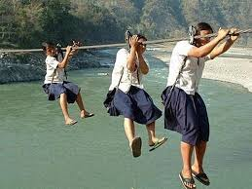
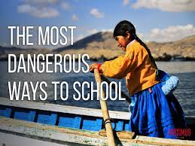
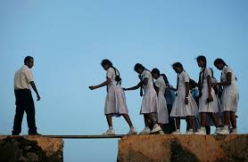
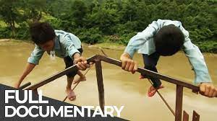
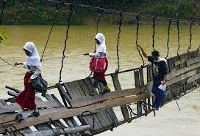
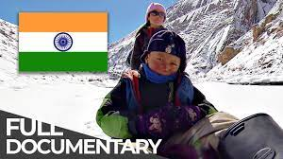
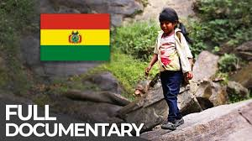
Assessment tip, which may help to choose your country. Directed Study for next week.
Watch a couple of episodes of ‘The most dangerous ways to school’ on YouTube.
Make some notes:
What are the barriers?
What are the aspirations?

Slide 35
References
Aronson, B (2017). The White Savior Industrial Complex: A Cultural Studies Analysis of a Teacher Educator, Savior Film, and Future Teachers, Journal of Critical Thought and Praxis 2017, Vol. 6, No. 3, 36-54
Fine, J.B. and McNamara, K.W. (2011).Community redefined: School leaders moving from autonomy to global interdependence through short-term study broad. Frontiers: The Interdisciplinary Journal of Study Abroad. 2011; 21: 254–274
Global Education, (2014). What are global perspectives?, © 2012 Commonwealth of Australia. http://www.globaleducation.edu.au/global-education/what-are-global-perspectives.html
Grover, S. (2004). Secondary education as a universal human right, Education and the Law, Vol. 16, No. 1, March 2004
Kiely, R. (2005). Globalization and poverty, and the poverty of globalization theory. Current Sociology, 53(6), 895.
Wall, J. (2019) ‘Theorizing children’s global citizenship: Reconstructionism and the politics of deep interdependence’, Global Studies of Childhood, 9(1), pp. 5–17..

Slide 36
References
Martell, L. (2007). The third wave in globalization theory. International Studies Review, 9(2), 173.
Nationmaster (2013 to 2017). Education > Duration of compulsory education: Countries compared © Copyright NationMaster.com 2003-2017.
Politics.co.uk (2013) ‘Education Leaving Age’, http://www.politics.co.uk/reference/education-leaving-age (Access 13/02/2017).
Ritzer, G. (2008). Modern sociological theory (7th ed.). Boston: McGraw Hill.
Smith, M. K. (2015). What is education? A definition and discussion. The encyclopaedia of informal education. [http://infed.org/mobi/what-is-education-a-definition-and-discussion/.
Unicef. What we do South Sudan. https://www.unicef.org/southsudan/what-we-do/education#:~:text=More%20than%202.8%20million%20children,able%20to%20attend%20regular%20classes.
Warnock, M. (1987). Hope in Education. The Modern Churchman. Volume 29, Number 2. https://doi.org/10.3828/MC.29.2.1
Welsh Government, The Wellbeing of Future Generations Act (205), Wales, The essentials. http://thewaleswewant.co.uk/sites/default/files/Guide%20to%20the%20WFGAct.pdf

