Slide 1

Poster presentation
Guidance

Slide 2
Poster Presentation 30% of total marks
You may decide to make a poster either using
Canvas
Powerpoint
Word

Slide 3
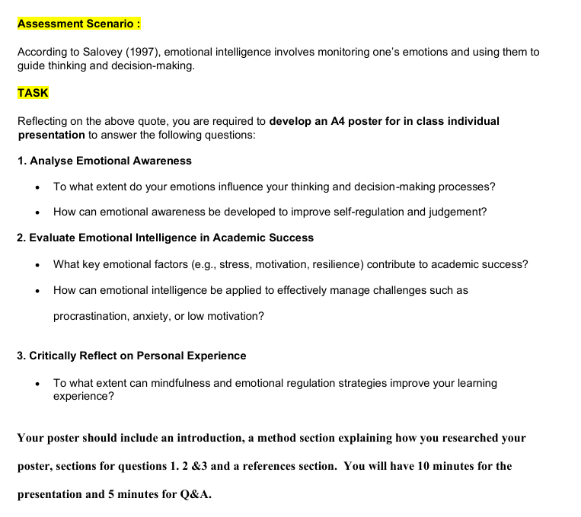
Poster scenario

Slide 4
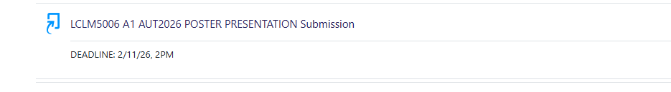
Submission deadline on Moodle

Slide 5
Poster MUST be presented in class
The poster will be presented in the classroom strictly between the student and the lecturer
5th and 12th of November for weekdays
8th and 15th of November for weekends
The presentation date may be extended depending on the classroom size

Slide 6
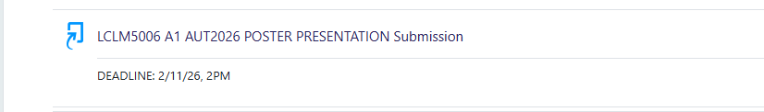
Submission
All posters MUST be submitted prior to the presentation day

Slide 7

Thank you
Good luck

