Slide 1
EAEE4005/C
EAEE4010/C
Y mathemategydd ifanc: archwilio a datrys problemau
The young mathematician: exploration and problem solving
Darlith 1 – Cyflwyniad i’r modwl
Lecture 1 – Introduction to the module
Notes:
Croeso
Cyflwyno gweddill y tîm

Slide 2
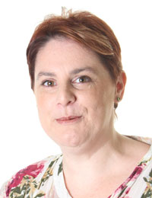
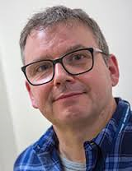

Tîm y modwl
The module team
Alison Rees Edwards
Paul Darby
Natalie MacDonald

Slide 3
Amcan y modiwl
Aim of module
Ennill dealltwriaeth o rôl dysgu gweithredol, archwilio a datrys problemau wrth hyrwyddo rhifedd cynnar a datblygiad mathemategol.
Ystyried systemau sy’n ymgorffori safbwyntiau’r holl randdeiliaid wrth fonitro a chynllunio ymhellach ar gyfer datblygiad mathemategol plant.
To gain an understanding of the role of active learning, exploration and problem solving in the promotion of early numeracy and mathematical development.
To consider systems which incorporate the views of all stakeholders in the monitoring and further planning for children’s mathematical development.

Slide 4
Deilliannau dysgu
Learning outcomes
adnabod dulliau o ddatblygu rhifedd cynnar, yn cynnwys gwerthfawrogiad o rôl dysgu gweithredol ac archwilio yn natblygiad cysyniadau mathemategol plant;
dangos dealltwriaeth o feysydd dysgu mathemategol mewn cwricwla blynyddoedd cynnar;
adnabod eu rôl eu hunain a rôl pobl eraill o ran cefnogi, monitro a chynllunio datblygiad pellach sgiliau rhifedd plant;
trefnu eu gwybodaeth a’r hyn y maent wedi’i ddysgu drwy ddefnyddio amrywiaeth o adnoddau gwybodaeth, a chyflwyno’u gwaith ar y lefel briodol.
identify approaches to early numeracy development, including an appreciation of the role of active learning and exploration in children’s development of mathematical concepts;
demonstrate an understanding of mathematical areas of learning in early years curricula;
identify their own role and the role of others in supporting, monitoring and planning further development of children’s numeracy skills;
organise their knowledge and learning through use of a range of information resources, and present their work at the appropriate level.

Slide 5
Cynnwys y modiwl
Module content
Rôl chwarae
Adnoddau a gweithgareddau
Gwyddoniaeth ac ardaloedd dysgu eraill
Amgylcheddau dysgu
Rôl rhieni, ymarferwyr a phlant
Rhywedd
Cwricwla a mentrau blynyddoedd cynnar
Fframwaith Llythrennedd a Rhifedd Cenedlaethol (2013)
Fframwaith Rhifedd a Chwarae
Role of play
Resources and activities
Science and other areas of learning
Learning environments
Role of parents, practitioners and children
Gender
Early years curricula and initiatives
National Literacy and Numeracy Framework (2013)
Numeracy and Play Framework

Slide 6
Yr asesiad The assessment
Porffolio ag iddo 4 rhan (cyfwerth â 3,000 gair) sydd rhaid cynnwys:
Cynllun gweithgaredd i hyrwyddo cysyniadau mathemategol a sgiliau rhifedd plant ifainc;
Gwerthusiad o’r cynllun gweithgaredd gyda chysylltiadau gyda theori ac ymchwil;
Trafodaeth am yr ystod ac amrywiaeth o adnoddau a sut gweithredwyd rhain trwy chwarae;
Esboniad am sut mae oedolion yn monitro a chynllunio datblygiad mathematwgol plant gyda chysylltiadau a fframweithiau cwricwlwm cyfredol (e.e. Fframwaith Rhifedd a Chwarae).
A portfolio with 4 components (equivalent to 3,000 words) which must include:
1. An activity plan for promoting young children’s mathematical concepts and numeracy skills;
2. An evaluation of the activity plan with links to theory and research;
3. A discussion of the range and diversity of resources and how they are implemented through play;
4. An explanation as to how the adult monitors and plans for children’s mathematical development with links to current curriculum frameworks (e.g. Numeracy and Play Framework).

Slide 7
Meini prawf
Marking criteria
Cynllun gweithgaredd (10 marc)
Gwerthusiad (30 marc)
Trafodaeth (20 marc)
Esboniad (20 marc)
Sgiliau allweddol (10 marc)
Cyfeiriadau (10 marc)
Gweler canllawiau pellach ar feini prawf ar gyfer yr aseiniad hwn ar Moodle.
Activity plan (10 marks)
Evaluation (30 marks)
Discussion (20 marks)
Explanation (20 marks)
Key skills (10 marks)
References (10 marks)
See further guidance on marking criteria for this assessment on Moodle.

Slide 8
Pedagogaeth Y Cyfnod Sylfaen
Foundation Phase Pedagogy
Meysydd dysgu sydd yn cyfannu ei gilydd
Amgylcheddau dysgu tu fewn a thu allan
Profiadau dysgu gweithredol
Creadigedd
Dychymyg
Defnydd o’r 5 synhwyrau
Datrys problemau
Areas of learning should complement each other
Indoor and outdoor learning environments
Active learning opportunities
Creativity
Imagination
Use of the 5 senses
Problem solving
(Welsh Government, 2014)

Slide 9
Amgylcheddau dysgu
Learning environments
Ethos
Cefnogi annibyniaeth
Adfywio
Hybu ymreolaeth ac ymholiad
Darparu cyfleoedd i ymarfer
Atgyfnerthu sgiliau a geirfa fathemategol
Oedolion gyda gwybodaeth dda am y pwnc a’r cwricwlwm
Ethos
Support independence
Stimulate
Promote autonomy and enquiry
Provide opportunities to practice
Consolidate mathematical skills and vocabulary
Adults with good subject and curriculum knowledge
(Hansen and Vaukins, 2012; Tucker, 2010)

Slide 10
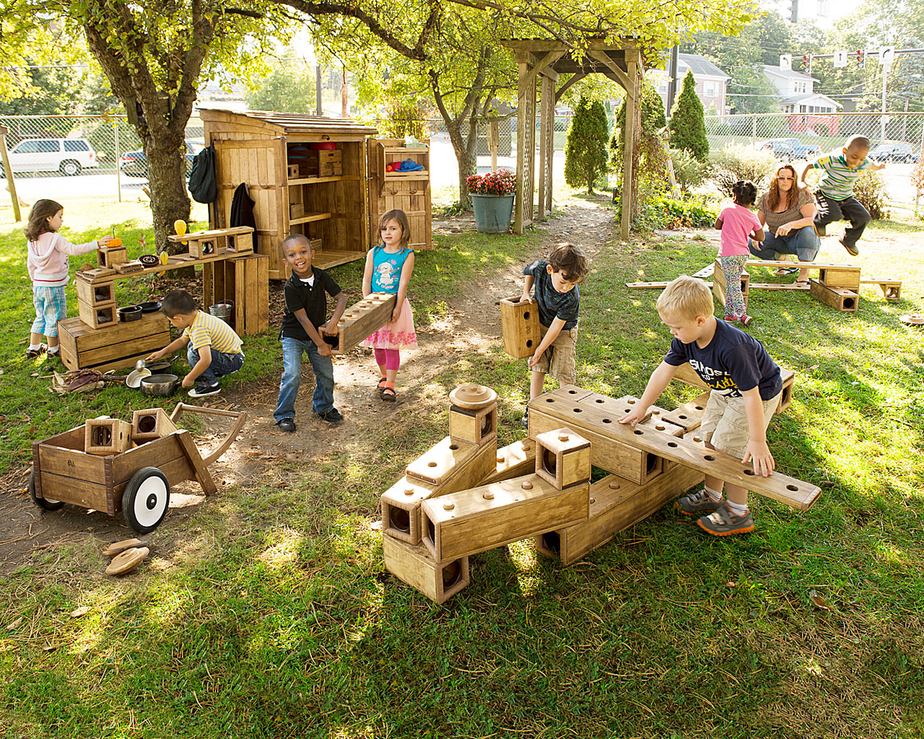
Chwarae blociau
Block play (Community Playthings, 2016)

Slide 11
Tasg grŵp – Maes Dysgu Datblygiad Mathemategol Y Cyfnod Sylfaen
Group task – Foundation Phase Mathematical Development Area of Learning
Gyda ffocws ar golofnau Meithrin, Derbyn a Blwyddyn 1, trafodwch sut mai hyrwyddo datblygiad mathemategol ym meysydd eraill y Cyfnod Sylfaen.
Cyflwynwch eich gwaith ar y papur a ddarparwyd.
Rhannwch eich syniadau gyda’r dosbarth.
With focus on Nursery, Reception and Year 1 columns, discuss how mathematical development could be promoted in other areas of learning within the Foundation Phase.
Present your ideas on the paper provided.
Feedback your ideas to the class.

Slide 12
Tasg – Gwyliwch y clipiau canlynol
Task – Watch the following clips
Create a rich mathematical environment (2016) https://www.youtube.com/watch?v=tzjN0SI7Ia8
Messy outdoor maths (2011)
https://www.youtube.com/watch?v=Nh_4SEUpSrA

Slide 13
Tasg annibynnol
Independent task
Darllenwch y bennod ganlynol cyn Darlith 2:
Tucker, K. (2014) ‘Creating and using a mathematical environment’, in K. Tucker (ed) Mathematics through play in the early years. London: Sage Publications Ltd.
Read the following chapter by Lecture 2:
Tucker, K. (2014) ‘Creating and using a mathematical environment’, in K. Tucker (ed) Mathematics through play in the early years. London: Sage Publications Ltd.

Slide 14
Darllen pellach
Further reading
Hansen, A. and Vaukins, D. (2012) Primary Mathematics Across the Curriculum (2nd ed). London: Sage Publications Ltd.
Taylor, H. and Harris, A. (eds) (2014) Learning and Teaching Mathematics 0-8. London: Sage Publications Ltd.
Tucker, K. (2010) Mathematics through play in the early years (2nd ed.). London: Sage Publications Ltd.

Slide 15
Cyfeiriadau
References
Hansen, A. and Vaukins, D. (2012) Primary Mathematics Across the Curriculum (2nd ed). London: Sage Publications Ltd.
Taylor, H. and Harris, A. (eds) (2014) Learning and Teaching Mathematics 0-8. London: Sage Publications Ltd.
Tucker, K. (2010) Mathematics through play in the early years (2nd ed.). London: Sage Publications Ltd.
Welsh Government (2014) ‘Foundation Phase Mathematical Development Area of Learning,’ http://dera.ioe.ac.uk/21175/1/141006-foundation-phase-mathematical-development-area-of-learning.pdf [Accessed: October 25 2016].
You Tube (2011) ‘Messy outdoor maths,’
https://www.youtube.com/watch?v=Nh_4SEUpSrA [Accessed: October 25 2016].
You Tube (2016) ‘Tony Wing - Create a rich mathematical environment,’ https://www.youtube.com/watch?v=tzjN0SI7Ia8 [Accessed: October 25 2016].

