Slide 1
ACCA7022 – Advanced Statistical Programming
Control Structures and Functions in R
Building Logical Flow & Reusability in R Programming

Slide 2
Learning Objectives
Understand key control structures: if, if-else, for, while, repeat
Use control flow to automate decision-making
Create reusable functions in R
Understand function arguments, return values, and scope

Slide 3
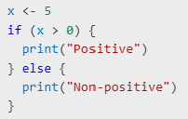
Conditional Statements in R
Activity 1: Write a script to classify numbers as positive, negative, or zero.

Slide 4
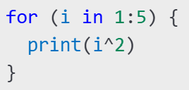
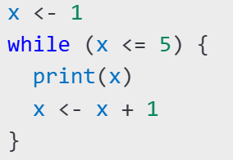
Loops in R
For Loop Example:
While Loop Example:
Activity 2: Use a loop to sum numbers from 1 to 100.

Slide 5
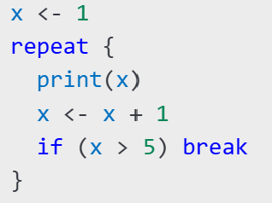
Repeat Loops and Break
Activity 3: Generate and print random numbers until one is greater than 0.9.

Slide 6

Vectorised Alternatives
Concept: Prefer vectorised operations for speed and clarity.
Activity 4: Rewrite a loop using vectorisation.

Slide 7
Examples of Inbuilt (base R) functions
mean(): Calculates the average
mean(c(10, 20, 30))
# Output: 20
sum(): Adds values
sum(1:5)
# Output: 15
length(): Returns the number of elements
length(c("A", "B", "C"))
# Output: 3
max() and min(): Finds maximum or minimum
max(c(3, 5, 1))
# Output: 5
min(c(3, 5, 1))
# Output: 1
round(): Rounds a number
round(3.14159, 2)
# Output: 3.14

Slide 8
Examples of Inbuilt (base R) functions
seq(): Generates a sequence
seq(from = 1, to = 10, by = 2)
# Output: 1 3 5 7 9
rep(): Repeats values
rep(1:3, times = 3)
# Output: 1 2 3 1 2 31 2 3
paste(): Concatenates strings
paste("Hello", "World")
# Output: "Hello World"
sort(): Sorts values
sort(c(3, 1, 2))
# Output: 1 2 3
unique(): Removes duplicates
unique(c(1, 2, 2, 3))
# Output: 1 2 3

Slide 9
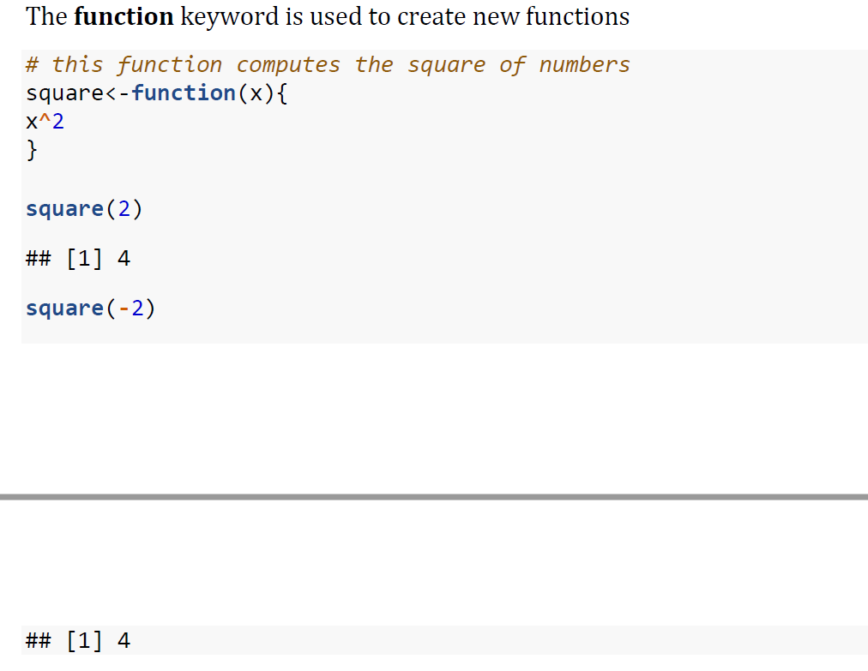
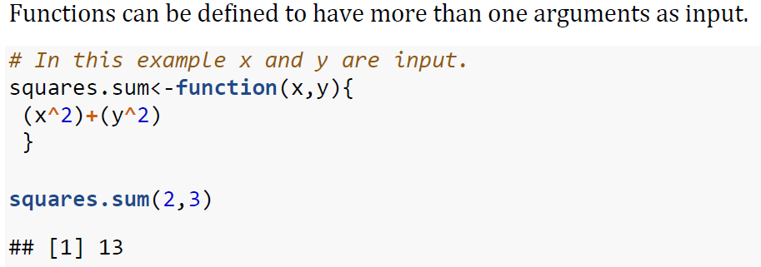
Writing Functions in R
Argument?
Define:
Use:

Slide 10
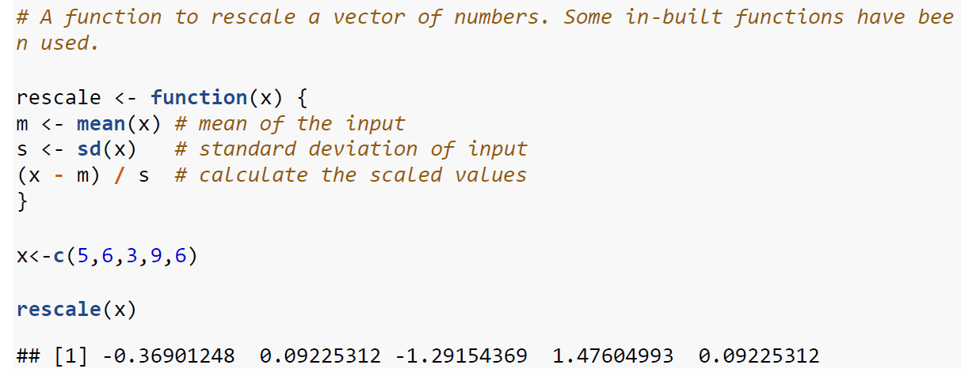
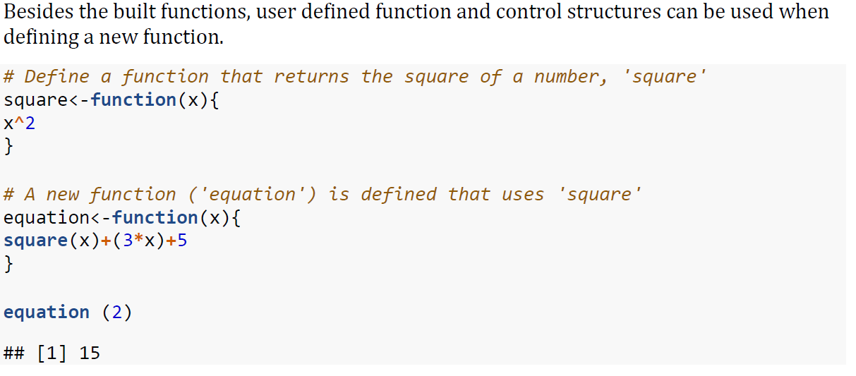
Functions in Functions

Slide 11
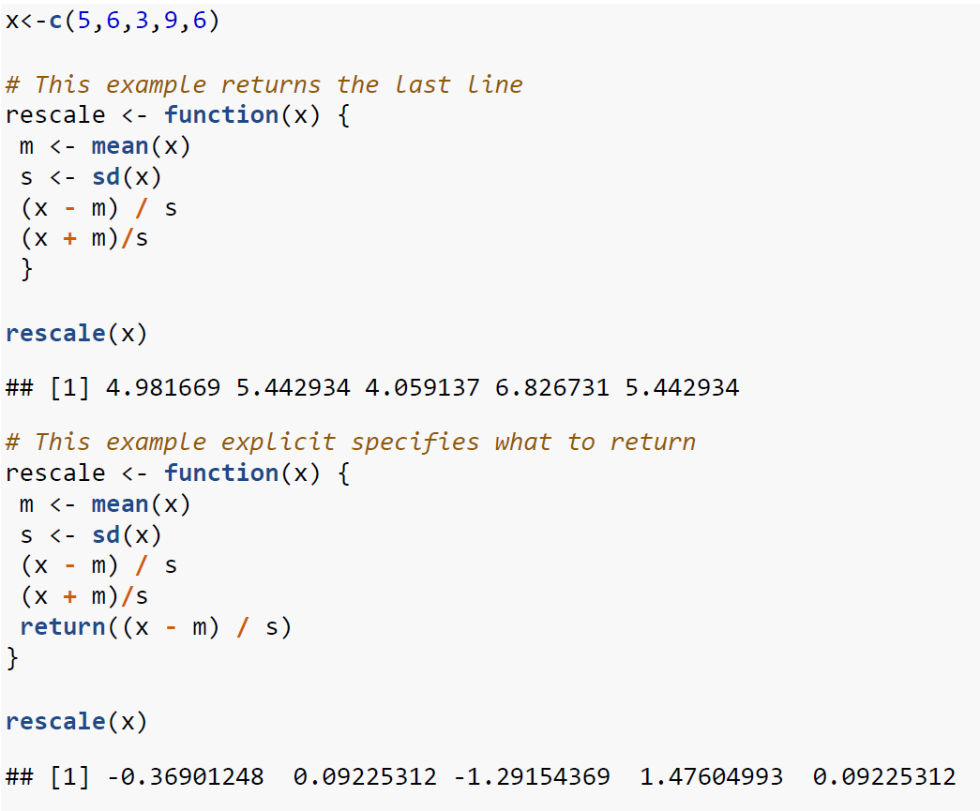
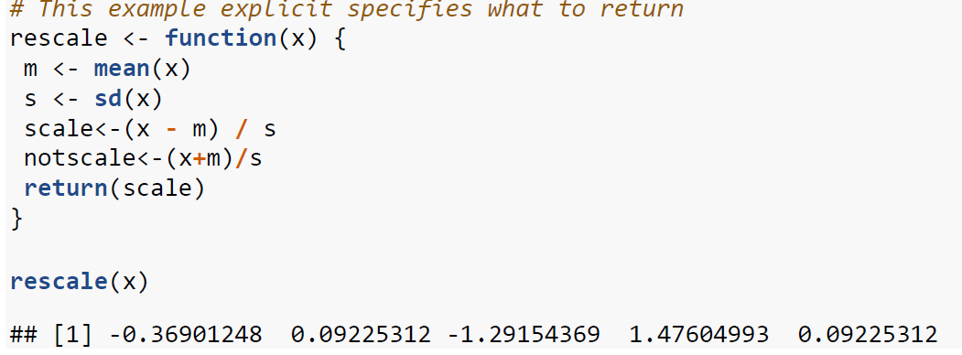
Return

Slide 12
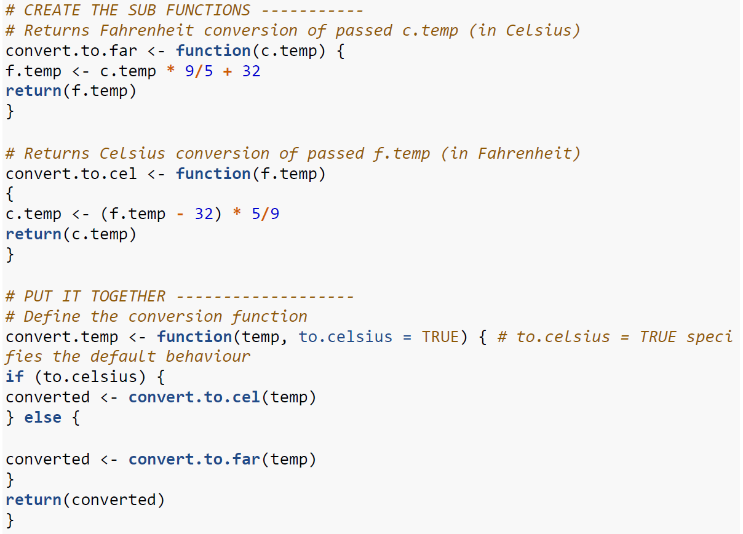
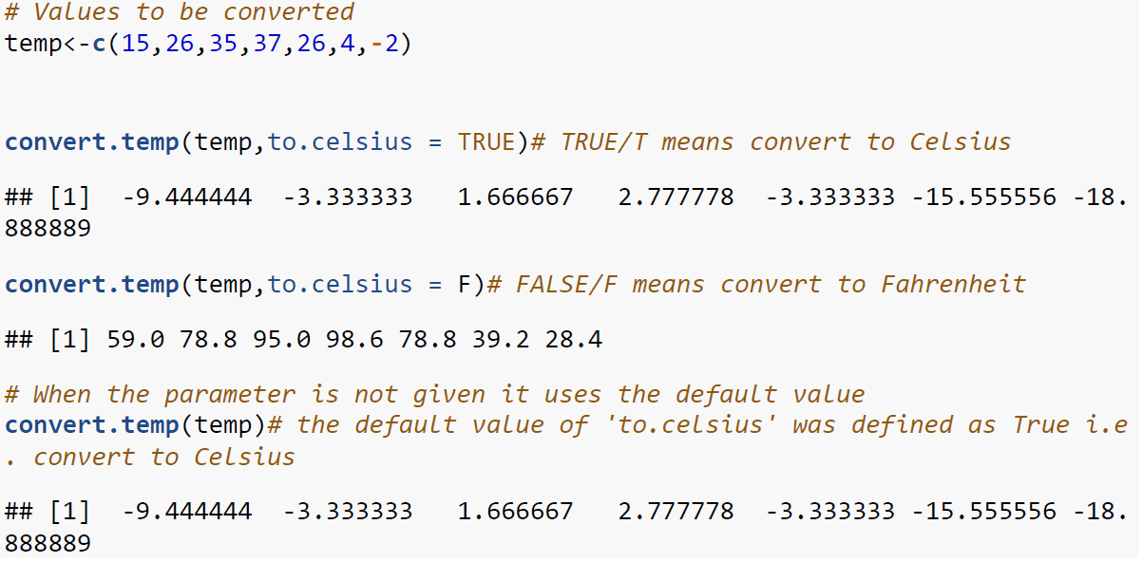
Parameters
Default setting
uses default setting

Slide 13
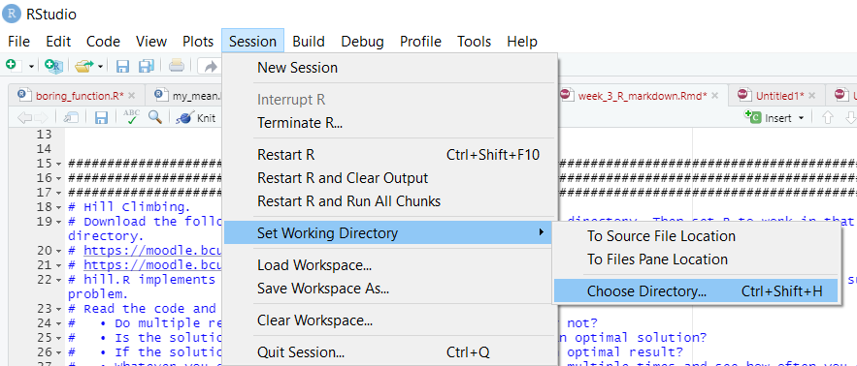
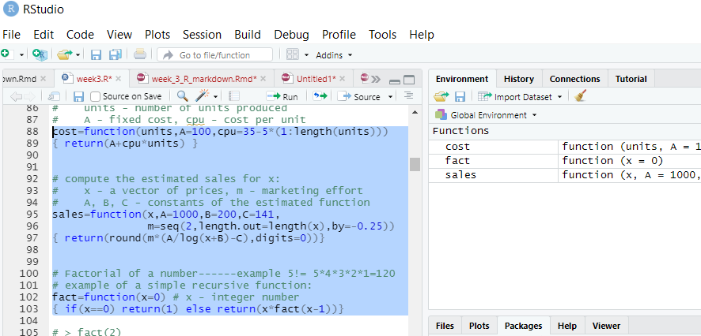
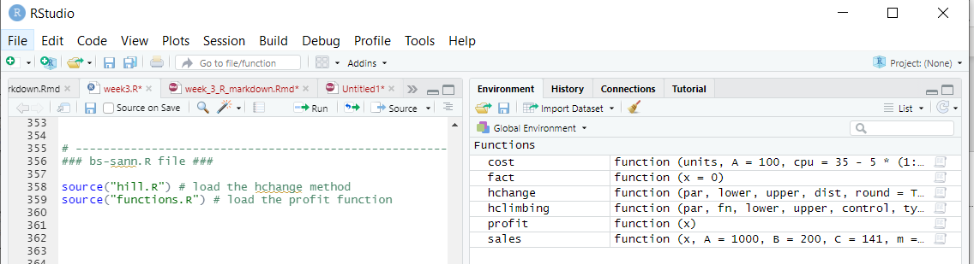
Configuring the R Workspace
(1) In R Studio: ‘Session’ Tab – ‘Set Working Directory’
OR load from file
(2) From R Console: setwd(“c:/Documents/my/myworkdirectory”)
to check current: getwd()

Slide 14
Activities
Open an R Markdown File
Do Activity 1- 4 from this presentation slides
Run the scrips F1 – F4 (see folder Activity – Function)
Submit a document (Word or PDF) with the result of activities.

