Slide 1
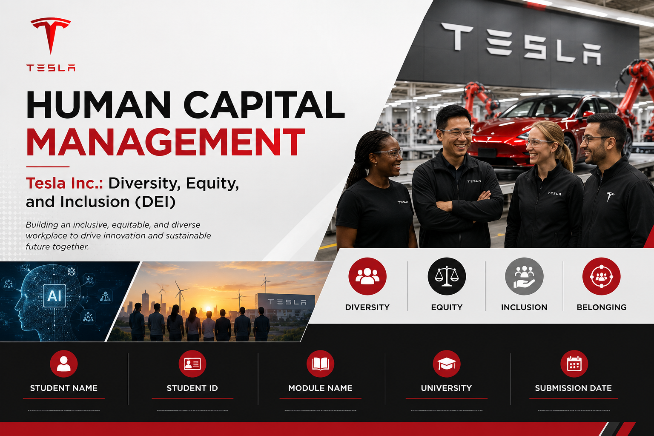
Vasukumar Jayeshbhai Patel
Motivaras Keval Kishorbhai
Dhruv Tusharbhai Prajapati
Kunjan Mukundbhai Patel

Slide 2

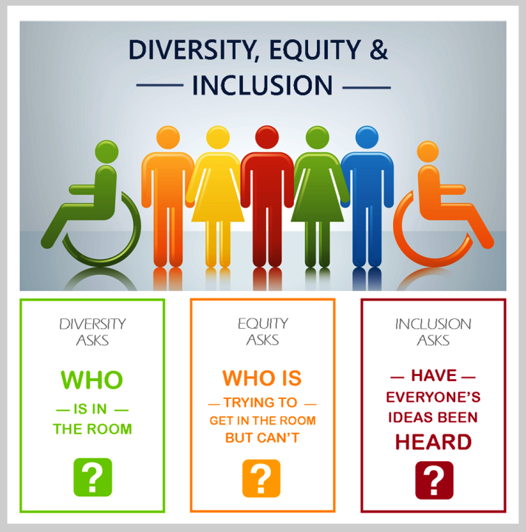
HUMAN CAPITAL MANAGEMENT AND DEI AT TESLA
Tesla brings in human capital, the principles of innovation and manufacturing and organisational growth.
Diversity, equity and inclusion improve workforce capability, collaboration and future competitiveness (Eeoc.gov, 2023).
Diversity, equity and inclusion improve workforce capability, collaboration and future competitiveness (Eeoc.gov, 2023).
Diversity, equity and inclusion improve workforce capability, collaboration and future competitiveness (Eeoc.gov, 2023).
Source: https://corporatefinanceinstitute.com/
Notes:
Human Capital Management (HCM) involves leveraging the best ability of the employees and ensuring that their working is aligned with the long-range or strategic goals and priorities of the organisation. At Tesla, DEI is integrals to its team's strategies to building the innovative workforce needed for continue to advance the company's technology and worldwide operations. A positive HCM and inclusive workplace culture helps employees feel at home, relate to and learn from one another and other cultures, make effective choices, and derive sustainable competitive benefits in cross-border operations. Fundamentals of these principles are helpful in understanding how Tesla is making DEI efforts, obstacles and avenues.

Slide 3
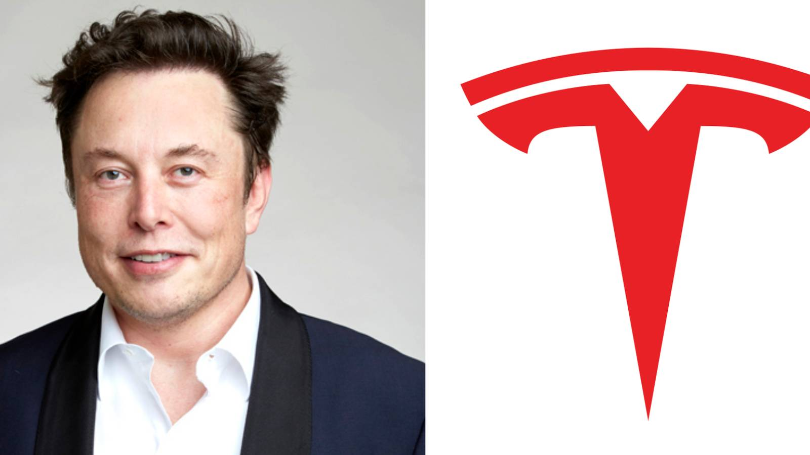
TESLA OVERVIEW
Tesla is an international electric vehicle, energy storage and artificial intelligence company.
The headquarters continue to be in Austin, Texas, with worldwide manufacturing support (Tesla.com, 2026).
The mission focuses on the materialisation of the global shift towards sustainable energy and sustainable transportation solutions (Tesla.com, 2025).
The global workforce is in excess of 100,000 in various global locations (Macrotrends.net, 2026).
Source: https://screenrant.com/
Notes:
Tesla's impressive technological innovation and investment at a regional level has evolved into one of the top electric vehicle (EV) and clean energy companies in the world. The swift growth in the international expansion of the workforce has led to a much more diverse and fragmented employee base and to new human capital management challenges in various countries, cultures, and business roles. As these organisational characteristics increase in importance, they also signify the key need for effective DEI practice to ensure long term business performance and effective innovation.

Slide 4
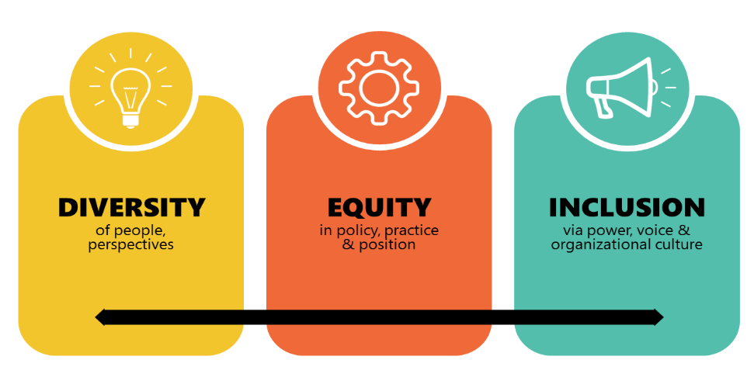
UNDERSTANDING DIVERSITY, EQUITY, AND INCLUSION
Diversities in an organisation means different workforce characteristics (Arsel et al., 2022).
Equity provides equal opportunities, resources, development and self-assessment activities.
Inclusion ensures good working places that are respectful and enriching for employees.
Shared DEI efforts shape innovation, creativity, collaboration and the performance of an organisation (Rosenkranz et al., 2021).
Notes:
Diversity works on the dimensions of representation of the workforce while equity is concerned about fair treatment, equal opportunity and omission of prejudice in career advancement within the organisation. The fact that it is included makes it easier for employees to share all ideas confidently in spite of their background, person, experience and job within the company. The company has demonstrated that company performance can increase, as well as employee engagement and commitment, due to innovation and an increase in inclusive organisations, which perform better than less inclusive ones. The knowledge of these concepts gives an important context to assess Tesla's current DEI performance.

Slide 5
IMPORTANCE OF DEI WITHIN HUMAN CAPITAL MANAGEMENT
An inclusive workplace leads to higher employee engagement, motivation, organisational commitment and productivity.
01
An inclusive workplace leads to higher employee engagement, motivation, organisational commitment and productivity.
02
An inclusive workplace leads to higher employee engagement, motivation, organisational commitment and productivity.
03
An inclusive workplace leads to higher employee engagement, motivation, organisational commitment and productivity.
04
Notes:
They values employees as strategic asset who contribute to the success and innovation of the organisation, and this is represented in their HCM. In organisations such as Tesla where knowledge creation depends on technology, a range of different knowledge, experiences and viewpoints leads to higher creativity, better cooperation and increased ability to adapt within the organisation.

Slide 6
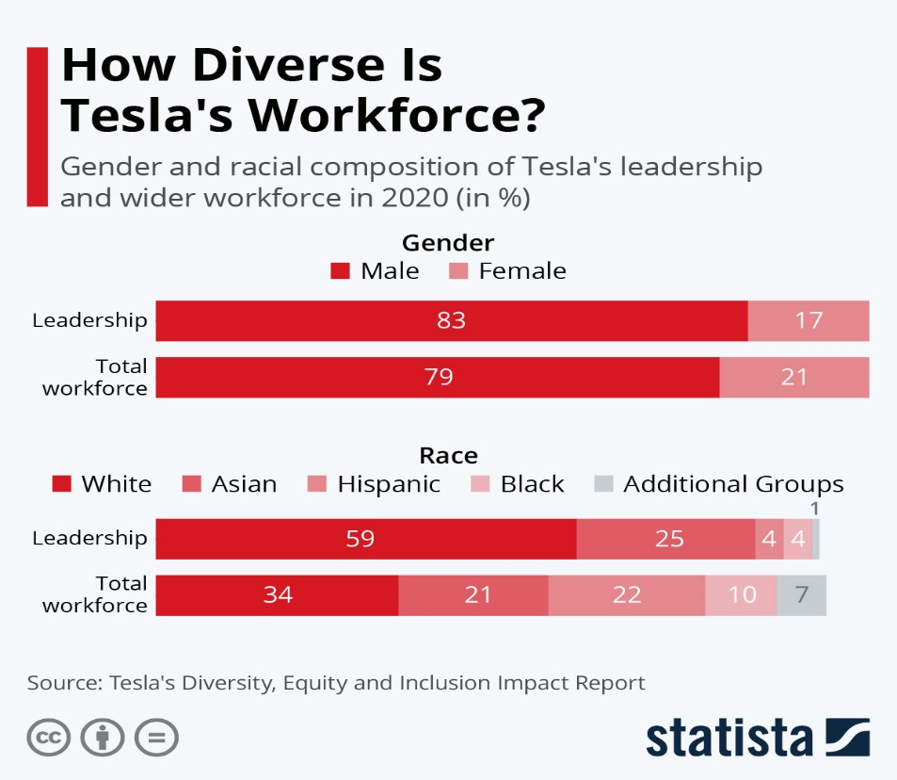
TESLA'S CURRENT DEI POLICIES AND PRACTICES
The Equality in Employment Policy is applicable for recruitment, promotion and at work decision making.
An Employee Resource Group fosters networking, mentoring, inclusion and professional development (Tesla.com, 2020).
Leadership development programs promote internal promotions and capacity building.
Annual impact reporting is a way of getting transparency on workforce D&I progress (Tesla.com, 2020).
Source: https://www.statista.com/
Notes:
Tesla has policies in place that guarantees equal opportunity in its employment practices and decisions based on legally protected characteristics are prohibited. The company is support of Employee Resource Groups (ERGs), leadership development programs, mentoring programs, and staff transparency by providing an annual Impact Report. These efforts reinforced Tesla's desire to increase inclusion and enhance the ability of their workforce, employees and organisation in all business operations around the world. The consistent monitoring and leadership support is still critical in obtaining measurable long-term outcomes from these policies.

Slide 7
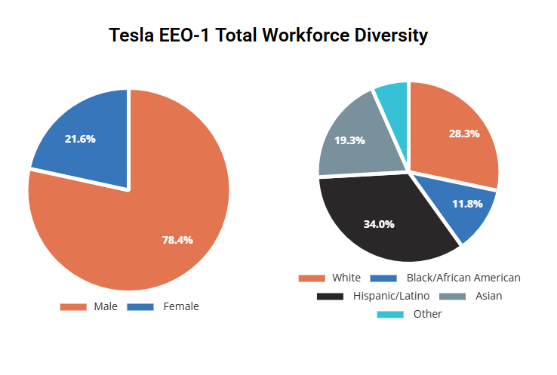
TESLA'S WORKFORCE DIVERSITY PROFILE
Women are still under-represented in engineering, manufacturing and senior leadership positions generally.
The workforce is diverse, consisting of employees from many ethnicities, cultures and professions all around the world (Peoplereturn.com, 2026).
There are significant gains in representation at entry-level operational and manufacturing levels.
Leadership diversity is currently lower than the overall workforce diversity.
Source: https://peoplereturn.com/company-profiles/tesla/
Notes:
The Tesla database of employee data shows positive results with respect to the diversity of the company's employee ranks in manufacturing, engineering and technical roles. The chances for enhance the diversity of representation in leadership for areas of less powerful aspects of organisational inclusion, equitable decision-making and career trajectory. These representations gaps be another step towards instilling employee confidence and credibility within organisations.

Slide 8
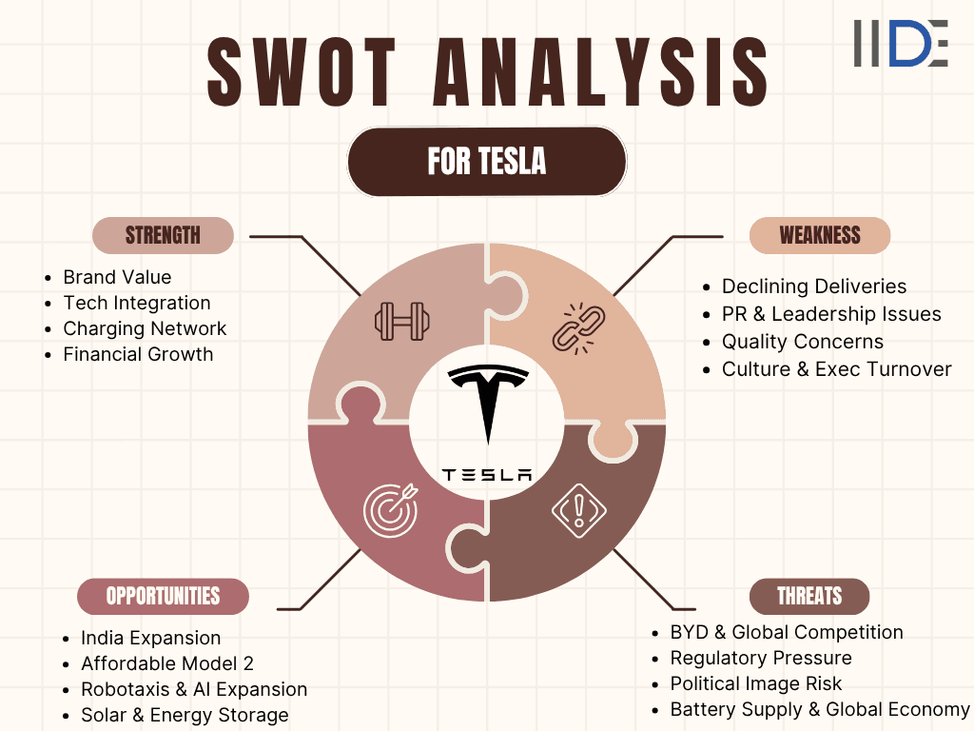
CURRENT OPPORTUNITIES FOR TESLA'S DEI STRATEGY
The application of AI makes it more fair to recruit with better data informed choices.
Digital learning platform makes access to inclusive leadership training and unconscious bias available to more people.
The opportunities for culturally diverse talent acquisition initiatives are greater as a result of global expansion (April, 2021).
Diversity measurement, planning and decision making for workforce is enhanced.
Source: https://iide.co/case-studies/swot-analysis-of-tesla/
Notes:
The technological innovation offers opportunities for Tesla to further enhance its efforts on the implementation of DEI via AI, automation and smart workforce analytics. The digital learnings platforms scalable leaderships development, inclusion and unconscious bias training for geographically spreaded operations across the world. Collecting data to make recruitments decisions helps reduce unfairness in recruitment, workforce planning, selection, screening, employee induction and workplace transparency; all of which underpin evidence-based Human Capital Management practices. These can enable Tesla to develop their more inclusive and future-proof workplace.

Slide 9
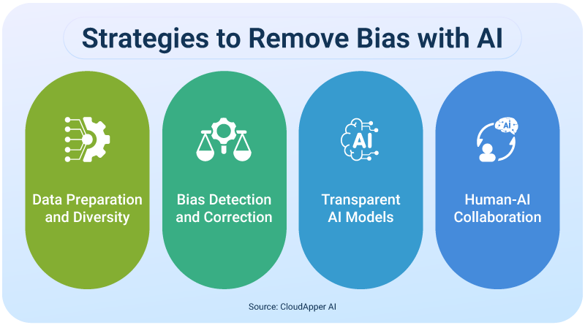
AI AND DIGITAL TECHNOLOGIES SUPPORTING DEI
AI can detect recruitment bias by objective methods of candidate screening and evaluation.
Predictive analytics are used for fair promotion, retention and workforce planning (Kondra et al., 2025).
The digital collaboration solutions increase the communication across distributed teams working worldwide.
Continuous engaging monitoring of inclusions indicators, employee engagement and organisational culture data.
Source: https://www.cloudapper.ai/
Notes:
As long as the people using AI are responsible, it can help eliminate unconscious biases and also help to improve consistency, transparency, and objectivity during the recruitment, promotion, and talent management decision-making process. In spite of this, AI systems need to be continuously assessed to reduce algorithmic bias and guarantee fairness in all employment-related applications. Therefore, responsible AI governance becomes a relevant aspect of the successful implementation of DEI.

Slide 10
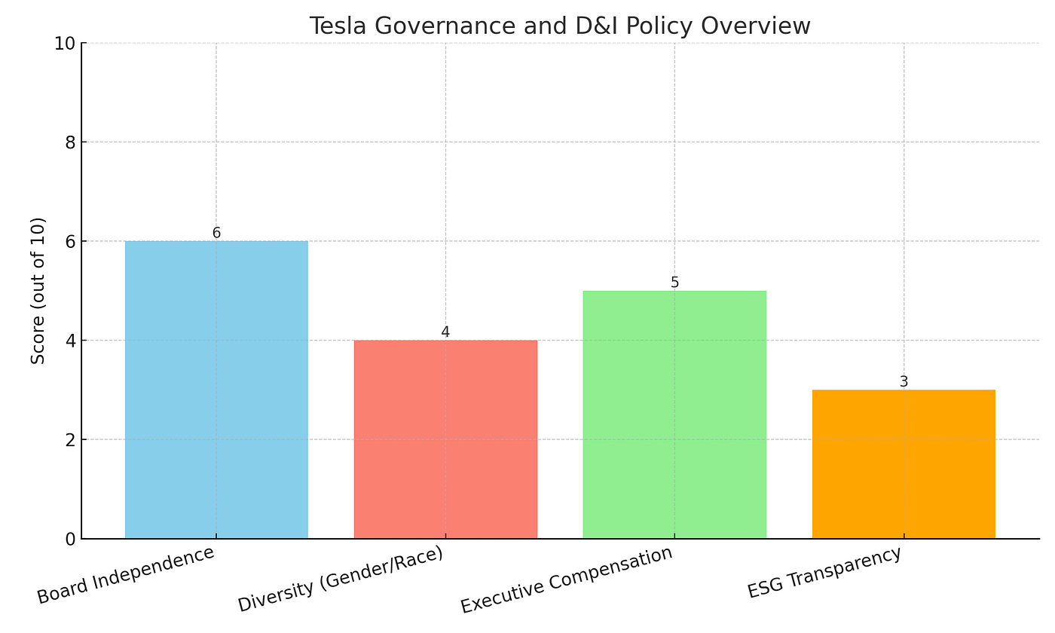
CURRENT DEI CHALLENGES AT TESLA
The accusations of workplace discrimination have impacted employee confidence and organisation's reputation.
National labor force diversification efforts are underway and leadership diversity is still limited (Hellerstedt et al., 2024).
The level of employee trust in inclusion may wane if it varies across operations sites.
Third-party review raises legal, regulatory and reputational risks of workplace practices.
Source: https://medium.com/
Notes:
Tesla received a lot of backlash for allegations of racisms in their workplace, racial discrimination, and workplace harassment, primarily at manufacturing facilities. In all of this cases there has been a growing focus on the construction of cultural, accountability and trust in the employees as part of the business practices of organisations. DEI implementations is a big work in HCM and requires constant efforts and commitment to do it consistently over the quickly expanding facilities setups around the globe.

Slide 11
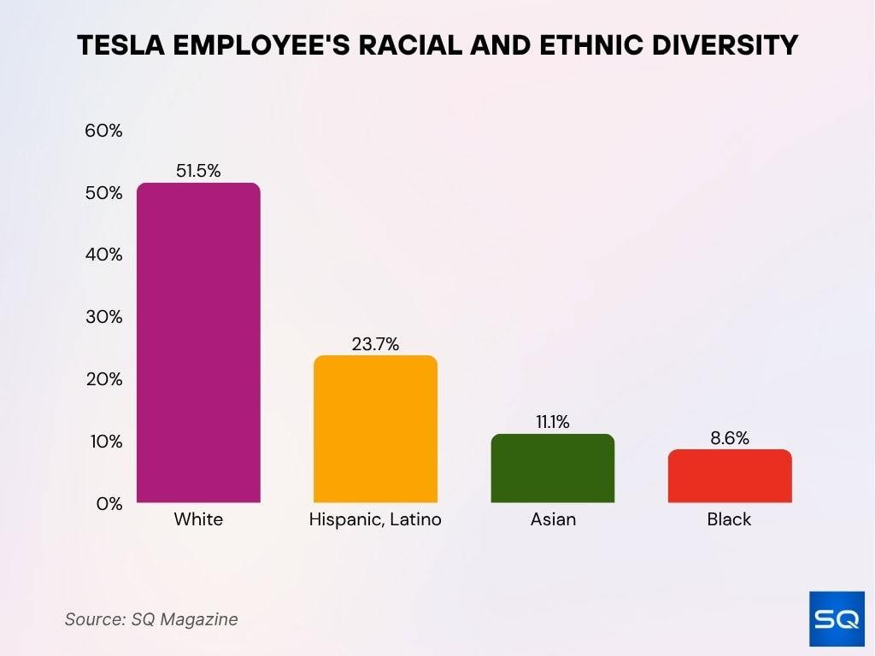
ROOT CAUSES ANALYSIS (INTERNAL FACTORS)
Leaders commitments to DEI is inconsistent which affected the consistent use of a DEI policy.
Developing relationships betweens workers is more important than setting production goals (Wolbring and Nguyen, 2023).
Policy implementations is different across various facilities resulting in less similarity among employees' experiences.
Diminished leaderships diversity leads to less inclusiveness bias and equal opportunity for career path.
Source: https://sqmagazine.co.uk/
Notes:
There are a number of organisations opportunities and externally challenges where Tesla shows their lack of DEI, though they do have some DEI initiatives of their own. The actions of leaders, organisation cultures, inconsistent policy and practice, and underrepresentation in top positions are other factors that impact employees' experience of fairness in the workplace.

Slide 12
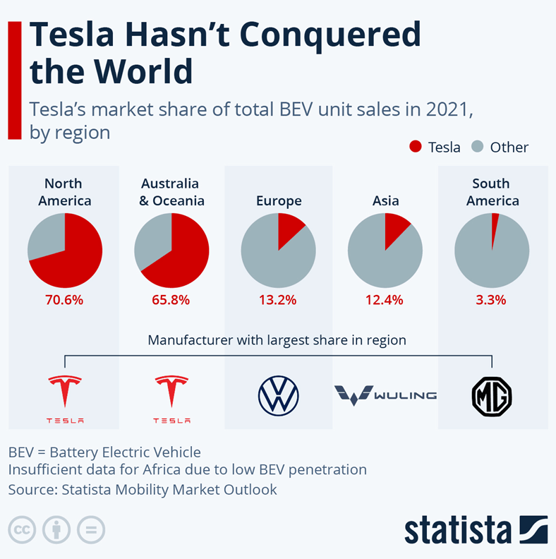
ROOT CAUSES ANALYSIS (EXTERNAL FACTORS)
The expansion of the world coupled with the growing complexity of workforces and human capital management needs.
After incidences of workplace discrimination and harassment, there was a rise in legal challenges (Gutterman, 2023).
AI recruiting tools need to be set and monitored to avoid algorithmic bias.
The industry-wide lack of talents further intensifies global talent competition for different technical activity professionals.
Source: https://strategicmanagementinsight.com/
Notes:
The externals effects also have an impact on Tesla's performance in DEI and HCM. According to Institutional Theory, HR policies and governance procedures of organisations should be continually evolved to meet the changing legal, social and stakeholder expectations.

Slide 13

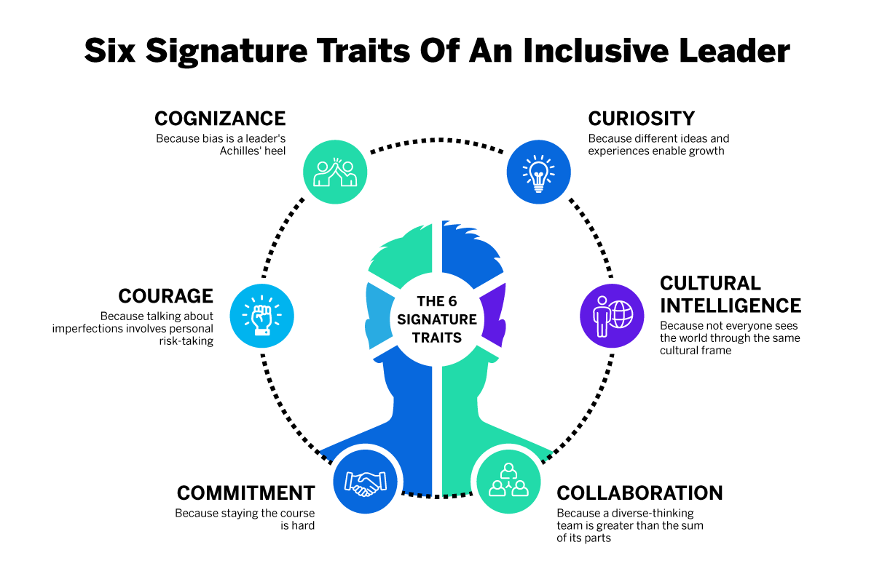
RECOMMENDATION 1:
INCLUSIVE LEADERSHIP DEVELOPMENT
Tesla can build up the capability of inclusive leadership by ongoing executive development programmes.
There should be ongoing unconscious bias and inclusive decision making workshops for the managers (Korkmaz et al., 2022).
Measurable diversity and inclusion performance indicators must be annually included on a leadership job description.
A consistent approach to the promotion, recognition and reward decisions should consider inclusive leadership behaviours.
Source: https://www.qualtrics.com/
Notes:
The inclusivity leaderships fosters employee engage and trusts and organisational commitment due to respectful decision making process established within diverse teams. Based on Social Exchange Theory, they believe that employees will return the favour in terms of their motivation, teamwork, and results. Incorporating DEI goals into leadership assessments guarantees accountability and backs Tesla's future talent management agenda.

Slide 14
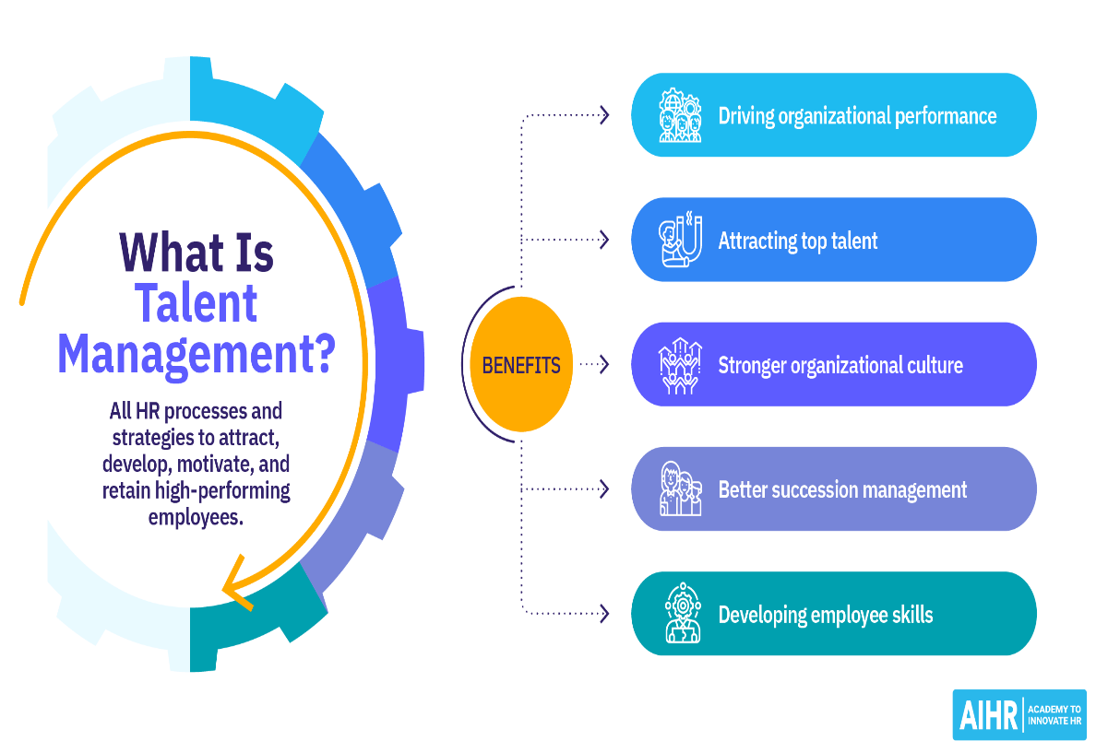
RECOMMENDATION 2:
AI-SUPPORTED FAIR TALENT MANAGEMENT
Algorithmic decision making processes must be transparent in order to ensure equitable recruitment processes.
A standard algorithm audit prior to implementation of recruitment should detect demographic bias (Weng and Golli, 2024).
Automated hiring and promotion evaluations must continue to have human oversight.
Explainable AI needs to bring transparency to workforce decision-making processes.
Source: https://www.aihr.com/
Notes:
An efficiently and appropriately regulated tool has the potentials to make the hiring process more effective and less time-consuming. Algorithms must be regularly tested to mitigate unintentional biases, however, in order not to perpetuate historical inequalities in biased datasets. The principle of explainable AI, combined with regular AI audits and human oversight, forms trustworthy recruitment systems that are compliant with ethical HRM practices.

Slide 15
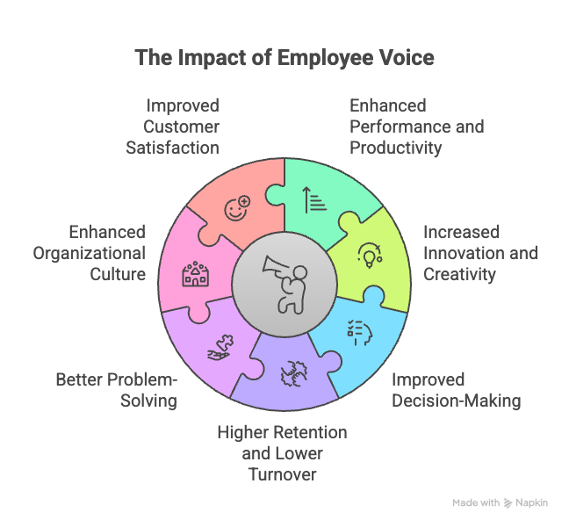
RECOMMENDATION 3:
STRENGTHENING EMPLOYEE VOICE
The employee resource groups should be more well-supported organisationally and have more executive sponsorship.
Low-risk anonymous digital feedback platforms should be encouraged to continue with workforce participation (Zhu et al., 2022).
The following perceptions of belonging, fairness and psychological safety should be measured through regular inclusion surveys.
The organisation survey results and actions taken as a result should be made transparent.
Source: https://www.vantagecircle.com/
Notes:
The employee voice enhances organisational learning as the employee can surface issues in the workplace before it becomes a major performance problem. According to Psychological Safety Theory, the contribution a employee is capable will increase in percentages where he or she can express their opinion without fear of the negative consequences. This clear and open reporting of survey results shows organisational focus of applying continuous improvement and considering employee welfare.

Slide 16
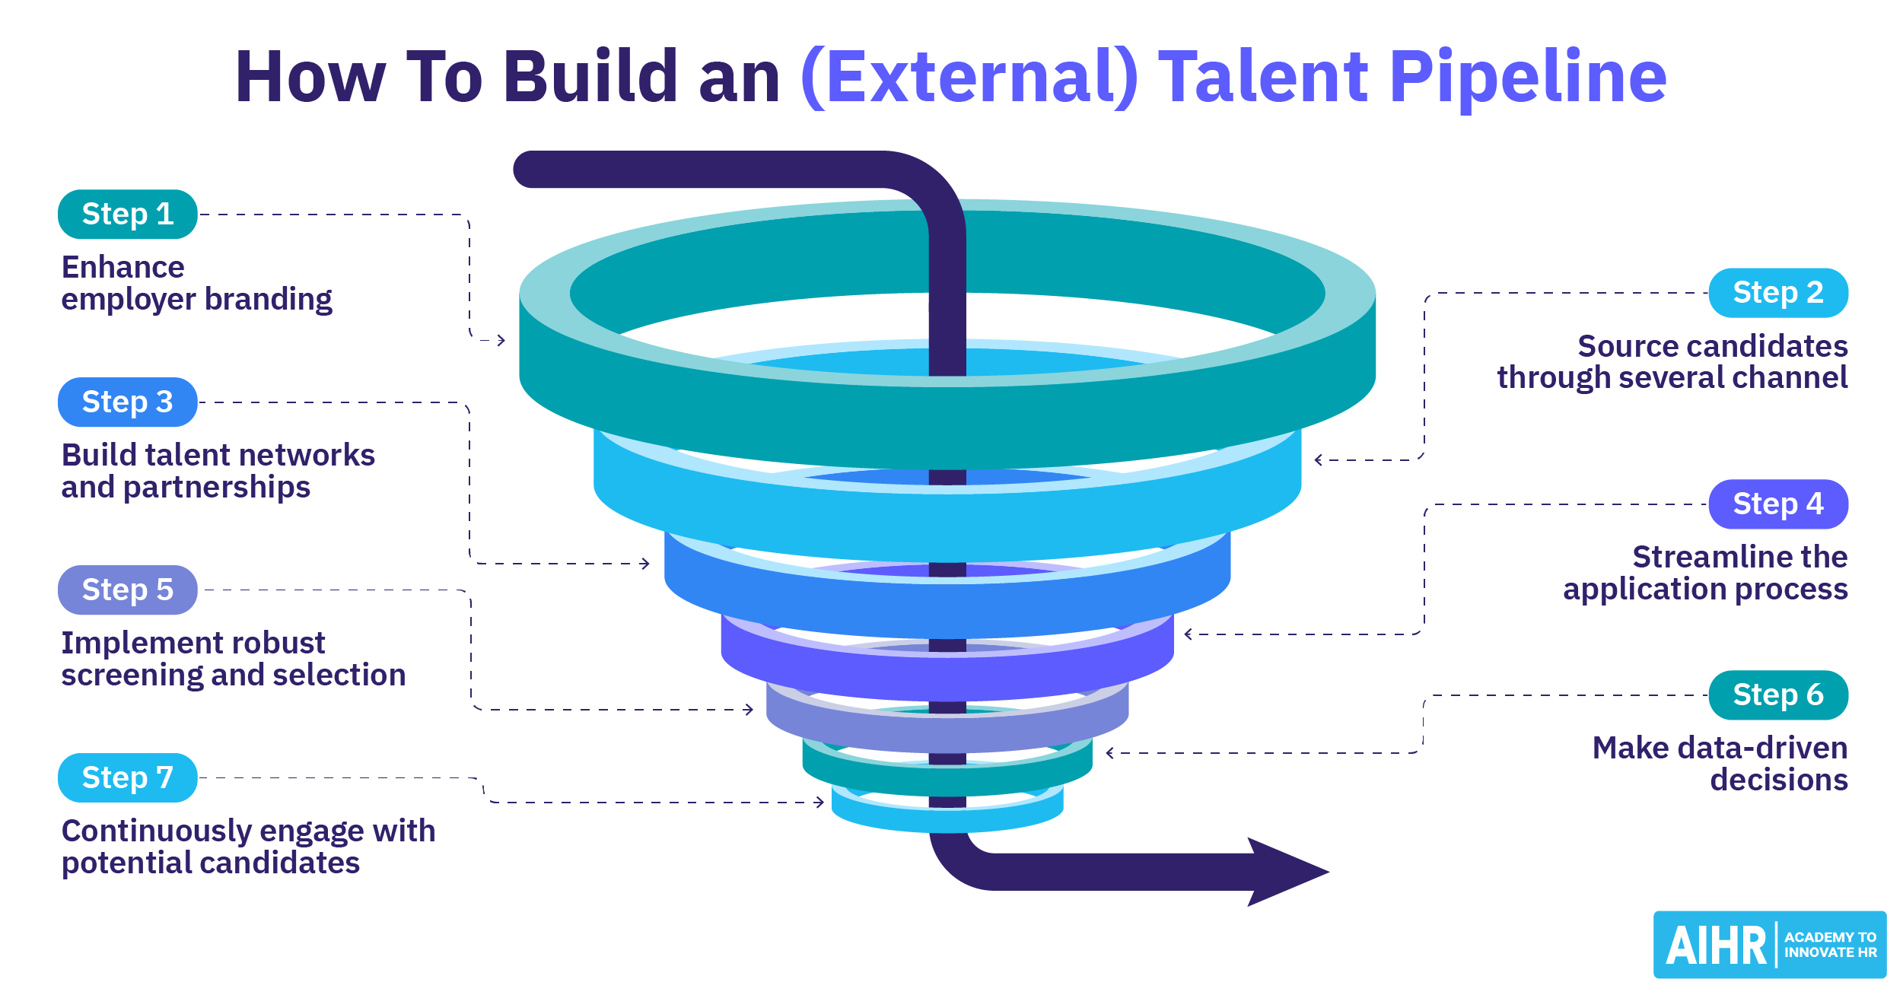
RECOMMENDATION 4:
EXPANDING DIVERSE TALENT PIPELINES
Tesla needs to develop more university contracts with various student bodies across the country.
Training in the technical trades should be represented in apprenticeship programs in a better way (Joyner et al., 2021).
It is complementary to the selections of candidates to recruit based on their qualifications.
Community outreach efforts must further boost engineering and manufacturing workforce diversity in a long-term and sustainable manner.
Source: https://www.aihr.com/
Notes:
A diverse talent pools allow for a more resiliented workforce and the filling of engineering and technology skills gaps. In line with Human Capital Approaches, it is thought that expenditure on education and the development of human resources are benefitting the organisation in long-term values. Apart from having accesses to various education and socioeconomic backgrounds, skills-based hiring also widens opportunities for having skilled workers.

Slide 17
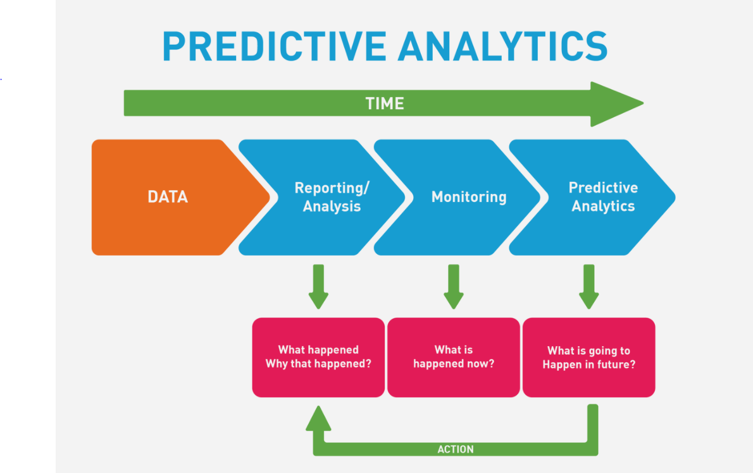
FUTURE OF WORK: AI AND DEI
AI will further automated hirings, go through workforce analytics and optimize learning systems.
Predictive analytical processed can anticipate attrition for any employees' diversity (Shams et al., 2025).
Programs of learnings and career development will be tailored to workers using intelligent learning platforms.
The governance over the use of tools will be gaining more significance in HR use cases.
Source: https://hr.university/
Notes:
AI in workforced management is taking the workforces to a new level of predictive analytics, personal learning and automated administration. In order to reap opportunities of tech but keep its adverse effects on inclusion to a minimum, the use of AI will require responsible governance. Those that incorporate ethical AI into HR processes will create better trust, innovation, and efficiency across their organisation.

Slide 18
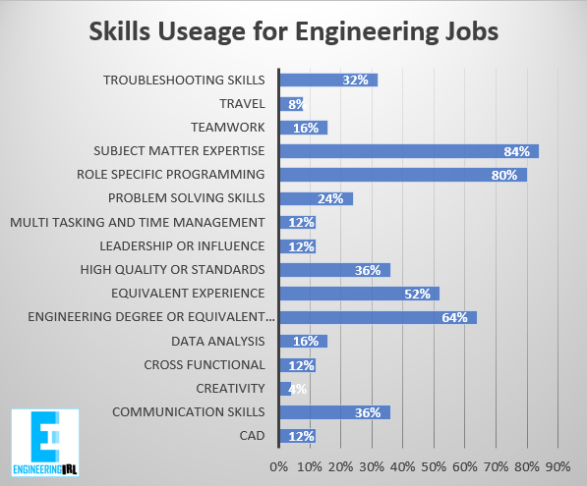
FUTURE SKILLS REQUIRED AT TESLA
Digital literacy in the manufacturing and engineering job market will be a requirement.
The skills of inclusive leadership will continue to be vital in more and more automated work environments around the world.
Organisations' competitiveness will be greatly enhanced with the use of data driven human resource decision making.
A culture of learning will facilitate adaptable workers in the context of technological changes (Abdelhalim et al., 2024).
Source: https://www.engineeringinreallife.com/
Notes:
Targeted technologal skills coupled with strong inter-personal and inclusivity leadership is essential to remain competitive. In manufacturing, engineering or a corporate context, workers must continually acquire the new competencies as automation becomes a reality. Life-long learnings enhances employability, maintains a strong and flexible organisation and helps to keep Tesla at the forefront of innovation.

Slide 19
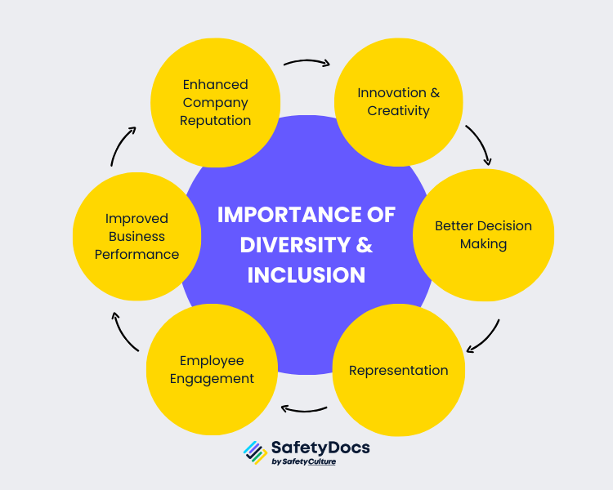
FUTURE DEI RISKS AND OPPORTUNITIES
Automations may exacerbated the unemployment and job insecurity of the disadvantaged majority in history.
Algorithmic bias frequently adopted by the AI buildings team can be reduced significantly.
The push towards strengthening innovations for the new R&D projects in emerging technologies, at global level.
Transparencies of governance will accrue from legality of organisations among investors and employees.
Source: https://safetydocs.safetyculture.com/
Notes:
Automations works well in efficiency but it be problematic if there is a biased applied to historical data contributing to the decision-making process. With a varieties of different development teams, there will be different subjective views which will improve fairness, creativity and responsible innovation.

Slide 20
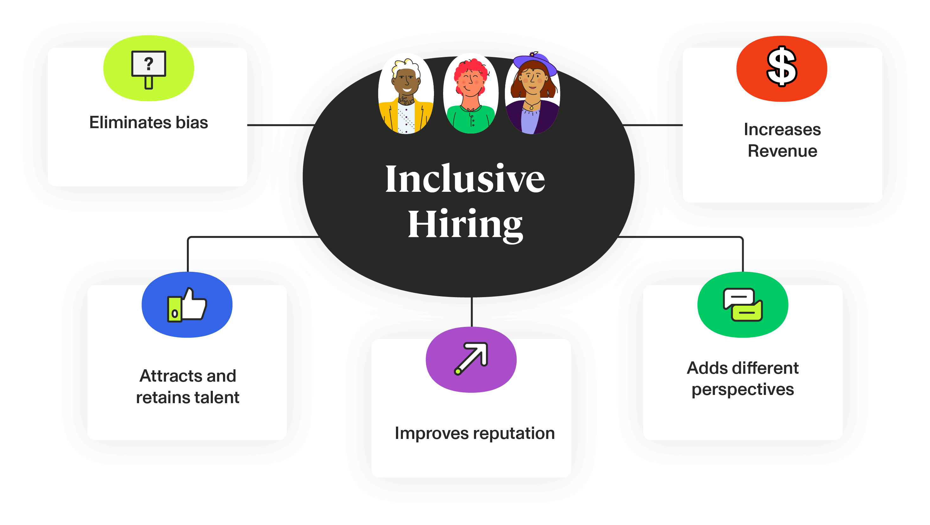
STRATEGIC HRM FRAMEWORK FOR TESLA
Commitment and drive from leaders is always paramount when implementing diversity and transforming an organisation.
An inclusive recruitment strategy should reinforce the strength of the workforce in these key areas of business consistently.
Measurable outcomes of diversity and inclusion should be evaluated during continuous workforce analytics (Chowdhury et al., 2024).
Human capital management and inclusion strategies need to be continually improved as part of organisational learning.
Source: https://www.untapped.io/
Notes:
SHRM is a type of strategic management that utilizes the practice of people management to enable the organisation's people to achieve its goals. Leaders can monitor continuously to find opportunities for improvement and be held to account. By implement a systematical HR system, value can be created and a sustainable competitive advantage can be realized by effective human capital management.

Slide 21
KEY TAKEAWAYS
Tesla appears be making real progresses with diversity efforts and has ongoing diversity issues in the organisation.
An organization's performanced and the trust of its members in leadership is one way to gain radical improvements.
AI offer numerous opportunities, far beyond governance, obligations.
The three elements of competitive advantages are inclusive culture, innovation and workforce growth.
Notes:
While Tesla has made strides in this areas of the DEI, there are some legally, cultural and organisations challenges that it needs to navigate. The evidence-based leaderships practices, transparent measures and responsible AI usage can complement the efforts to promote inclusivity goals. Person-to-person investment is still vital to the support of innovation and sustainable competitive advantage.

Slide 22
REFERENCES-1
Abdelhalim, E., Anazodo, K.S., Gali, N. and Robson, K., 2024. A framework of diversity, equity, and inclusion safeguards for chatbots. Business Horizons, 67(5), pp.487-498.
April, K., 2021. The new diversity, equity and inclusion (DEI) realities and challenges. HR: The new agenda, pp.119-132.
Arsel, Z., Crockett, D. and Scott, M.L., 2022. Diversity, equity, and inclusion (DEI) in the Journal of Consumer Research: A curation and research agenda. Journal of Consumer Research, 48(5), pp.920-933.
Chowdhury, S., Budhwar, P. and Wood, G., 2024. Generative artificial intelligence in business: towards a strategic human resource management framework. British Journal of Management, 35(4), pp.1680-1691.
Eeoc.gov. (2023). newsroom/eeoc-sues-tesla-racial-harassment-and-retaliation. Retrieved from: https://www.eeoc.gov/newsroom/eeoc-sues-tesla-racial-harassment-and-retaliation (Accessed on: 3rd July 2026).
Gutterman, A.S., 2023. Embedding diversity, equity, and inclusion. Equity, and Inclusion (December 20, 2023).
Hellerstedt, K., Uman, T. and Wennberg, K., 2024. Fooled by diversity? When diversity initiatives exacerbate rather than mitigate bias and inequality. Academy of Management Perspectives, 38(1), pp.23-42.
Irim, S., Salman, M. and Rauf, N., 2024. The Role of HRM in Promoting Diversity, Equity, and Inclusion (DEI) in the Workplace. Siazga Research Journal, 3(2), pp.221-237.
Joyner, D.M., Faris, E., Hernández, D., Howard, J.M., Fullilove, R.E., Cohn, E.G., Odlum, M., Mitchell, D. and Hutcherson, H., 2021. A Pipeline to Increase Public Health Diversity. Pedagogy in Health Promotion, 7, pp.44S-50S.
Kondra, S., Medapati, S., Koripalli, M., Nandula, S.R.S.C. and Zink, J.Z., 2025. AI and diversity, equity, and inclusion (DEI): examining the potential for AI to mitigate bias and promote inclusive communication. Journal of Artificial intelligence and Machine Learning, 3(1), pp.1-8.
Korkmaz, A.V., Van Engen, M.L., Knappert, L. and Schalk, R., 2022. About and beyond leading uniqueness and belongingness: A systematic review of inclusive leadership research. Human Resource Management Review, 32(4), p.100894.

Slide 23
REFERENCES-2
Macrotrends.net. (2026). stocks/charts/TSLA/tesla/number-of-employees. Retrieved from: https://www.macrotrends.net/stocks/charts/TSLA/tesla/number-of-employees (Accessed on: 3rd July 2026).
Peoplereturn.com. (2026). company-profiles/tesla. Retrieved from: https://peoplereturn.com/company-profiles/tesla/ (Accessed on: 3rd July 2026).
Rosenkranz, K.M., Arora, T.K., Termuhlen, P.M., Stain, S.C., Misra, S., Dent, D. and Nfonsam, V., 2021. Diversity, equity and inclusion in medicine: why it matters and how do we achieve it?. Journal of surgical education, 78(4), pp.1058-1065.
Shams, R.A., Zowghi, D. and Bano, M., 2025. AI and the quest for diversity and inclusion: a systematic literature review. AI and Ethics, 5(1), pp.411-438.
Tesla.com. (2020). sites/default/files/downloads/2020-DEI-impact-report.pdf. Retrieved from: https://www.tesla.com/sites/default/files/downloads/2020-DEI-impact-report.pdf (Accessed on: 3rd July 2026).
Tesla.com. (2025). ns_videos/2025-tesla-impact-report.pdf. Retrieved from: https://www.tesla.com/ns_videos/2025-tesla-impact-report.pdf (Accessed on: 3rd July 2026).
Tesla.com. (2026). contact-us#contact-us. Retrieved from: https://ir.tesla.com/contact-us#contact-us (Accessed on: 3rd July 2026).
Weng, Y. and Golli, A., 2024. AI in HR: Enhancing performance management and employee development through intelligent technologies. Journal Of Economics And Business Management, 3(11), pp.1-7.
Wolbring, G. and Nguyen, A., 2023. Equity/equality, diversity and inclusion, and other EDI phrases and EDI policy frameworks: A scoping review. Trends in Higher Education, 2(1), pp.168-237.
Zhu, H., Khan, M.K., Nazeer, S., Li, L., Fu, Q., Badulescu, D. and Badulescu, A., 2022. Employee voice: A mechanism to harness employees’ potential for sustainable success. International Journal of Environmental Research and Public Health, 19(2), p.921.

Slide 24


