Slide 1

Understanding Jenny’s Development through Erikson’s Psychosocial Theory
Sabah Tahir – 2432276
Psychology in Health & Social Care – LCHS4010
Today I’ll explain how Erikson’s psychosocial theory can help us understand Jenny’s development and wellbeing during her teenage years

Slide 2

This presentation explores Erikson’s psychosocial theory and how it relates to the case of Jenny.
She’s a teenager experiencing emotional challenges due to family instability over the last five years.
I’ll explain how Erikson’s ideas apply to her situation and discuss strategies for supporting her development.

Slide 3
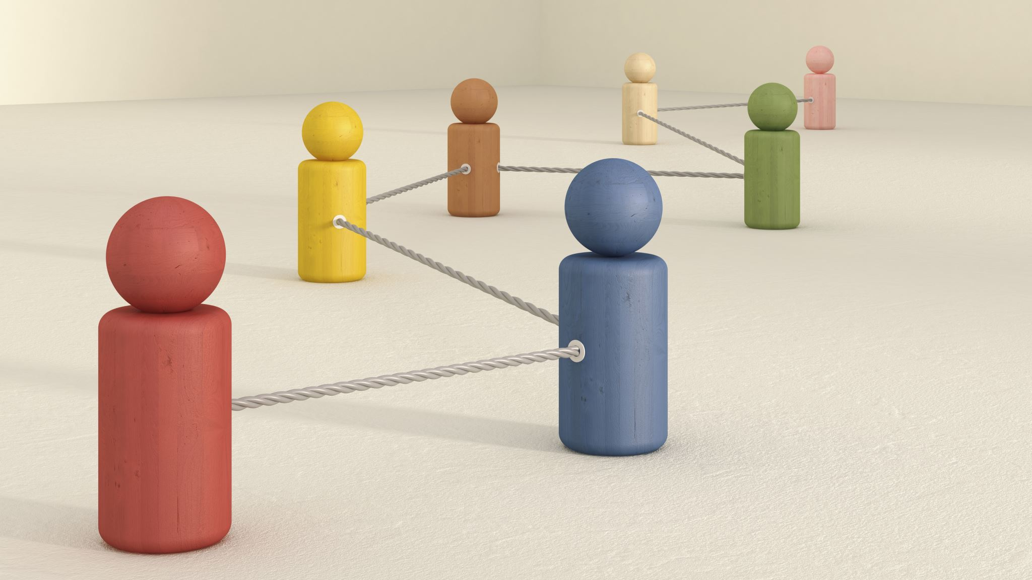
Lifespan theory covering eight stages
Each stage involves a key psychosocial conflict
Positive resolution supports identity and wellbeing.
Erikson’s psychosocial theory explains development across eight stages of life.
Each stage presents a challenge that shapes emotional and social growth.
For example, infancy focuses on building trust, while adolescence centers on identity.
Successful resolution supports self‑confidence and wellbeing.

Slide 4
Jenny is in adolescence: identity vs role confusion.
Family instability affects her sense of self
Impacts self‑esteem and belonging
Jenny is going through Erikson’s fifth stage — identity versus role confusion.
Because her environment has been unstable, she may struggle to understand who she is and where she fits in.
Erikson believed that failing to develop a clear identity at this stage can lead to confusion and low confidence.

Slide 5
Earlier life stages influence teenage experiences
Low trust or independence affects development
Importance of early emotional support
Erikson proposed that development builds on earlier experiences.
If Jenny didn’t develop a strong sense of trust or independence as a child, this could make her teenage years more difficult.
Such issues can affect her confidence and how she interacts with others.

Slide 6
Build stable, trusting relationships
Encourage positive identity exploration
Mentoring and support services
Professionals can help Jenny by offering consistent emotional support and mentoring.
Activities that promote self‑expression, such as group discussions and creative projects, may help her explore her identity safely.
These strategies reflect Erikson’s emphasis on social interaction and trust in adolescence.

Slide 7
Nature: biological and genetic influences
Nurture: environment, family, and social factors
Both shape Jenny’s wellbeing
Erikson recognised the influence of both biology and experience.
While genetic factors shape growth and emotions,
Jenny’s relationships and environment have a deep impact on her sense of belonging.
Any support plan should balance biological and social needs.

Slide 8
Lifespan perspective on growth
Highlights emotional and social factors
Erikson’s theory provides valuable insight into emotional and social development at all ages.
However, it can be too general, as it doesn’t fully consider cultural or individual differences.
An alternative.

Slide 9
References-
Cherry, K. (2020) Erik Erikson’s Stages of Psychosocial Development. Very well Mind.
Crain, W. (2016) Theories of Development: Concepts and Applications. 6th ed. Routledge.
Gross, R. (2021) Psychology: The Science of Mind and Behavior. 8th ed. Hodder Education.
McLeod, S. (2018) Erik Erikson’s Theory of Psychosocial Development. Simply Psychology.
Schultz, D. & Schultz, S. (2017) Theories of Personality. 11th ed. Cengage Learning.
Vygotsky, L. S. (1978) Mind in Society: The Development of Higher Psychological Processes.

