Slide 1
Croeso Cultural Summit
Module Code: BMIH6007
Title: International Meetings Management for the Hotel Industry
Student name: Mihai Daniel Mihalcea
Student ID: 2244870
Tutor: Kathryn Flynn
Al Acknowledgement:
I acknowledge the use of Copilot (https://copilot.microsoft.com/) on 18th May 2025 to check my work using the prompt(s):
1. Please review the following slides for: factual accuracy, logical flow, clarity of information, grammar and spelling. I confirm that I have not presented any AI generated text as my own work. I confirm I have copies of my drafts, notes, and other resources I used before, and after the use of AI tools which I may be asked to provide in evidence.

Slide 2

Introduction
Hybrid Event
Merges a formal business conference with immersive Welsh cultural experiences
"Year of Croeso" Campaign
Celebrates the essence of a Welsh welcome ‘croeso’
MICE Industry
Positions Wales as an ideal destination for responsible, culturally rich business gatherings

Slide 3
Event Overview & Objectives
Attract between 80–100 international delegates
Targeting international professionals
80–100 delegates
Ensure a minimum of 80% of suppliers and materials
Focus on local sourcing
80% of total suppliers/materials used
Partnership with Visit Wales, and targeted outreach
MICE growth, and Visit Wales‘ internationalisation goals
achieved by the start date of the event
The strong local artisan, hospitality, and produce networks
Aligns with sustainability goals and Welsh government’s Food & Drink Action Plan
Achieved during event procurement phase
Achieve at least 90% positive feedback
Within 2 weeks of the event
Focus on delegate satisfaction
90% positive ratings
Through high-quality planning, delivery, and delegate care
Event success and alignment with the “Croeso” welcome theme
Timely
SMART Objectives
Specific
Measurable
Attainable
Relevance

Slide 4
The Event Cycle
Planning phase
Delivery phase
Evaluation phase
We gather delegate feedback via surveys and assess our performance against the KPI
We conduct venue selection, budget forecasting, supplier research, and risk assessments
We focus on seamless execution, such as managing delegate arrivals, staff coordination, live sessions, catering, and activating contingency

Slide 5
Location & Venue Feasibility
Culturally Iconic Venue
Capacity & Accessibility
Atmosphere & Compliance
St. David’s Cathedral offers deep cultural and spiritual resonance, perfectly aligning with the “Croeso” theme and enhancing the event’s authenticity.
The venue accommodates around 150 guests, includes step-free access, and has designated routes and nearby coach drop-off points
Sustainable LED lighting will create an immersive evening ambiance, while all safety, fire, and licensing regulations will be strictly followed

Slide 6
Target Market & Demand
Niche International Audience
Targeting MICE delegates from creative industries, cultural organisations, and ethical tourism sectors
Alignment with Global Trends
Heritage integration, slower tourism, and sustainability
Strategic Location Advantage
St. Davids offers a unique, underutilised alternative to larger Welsh cities, providing a boutique, culturally immersive setting

Slide 7
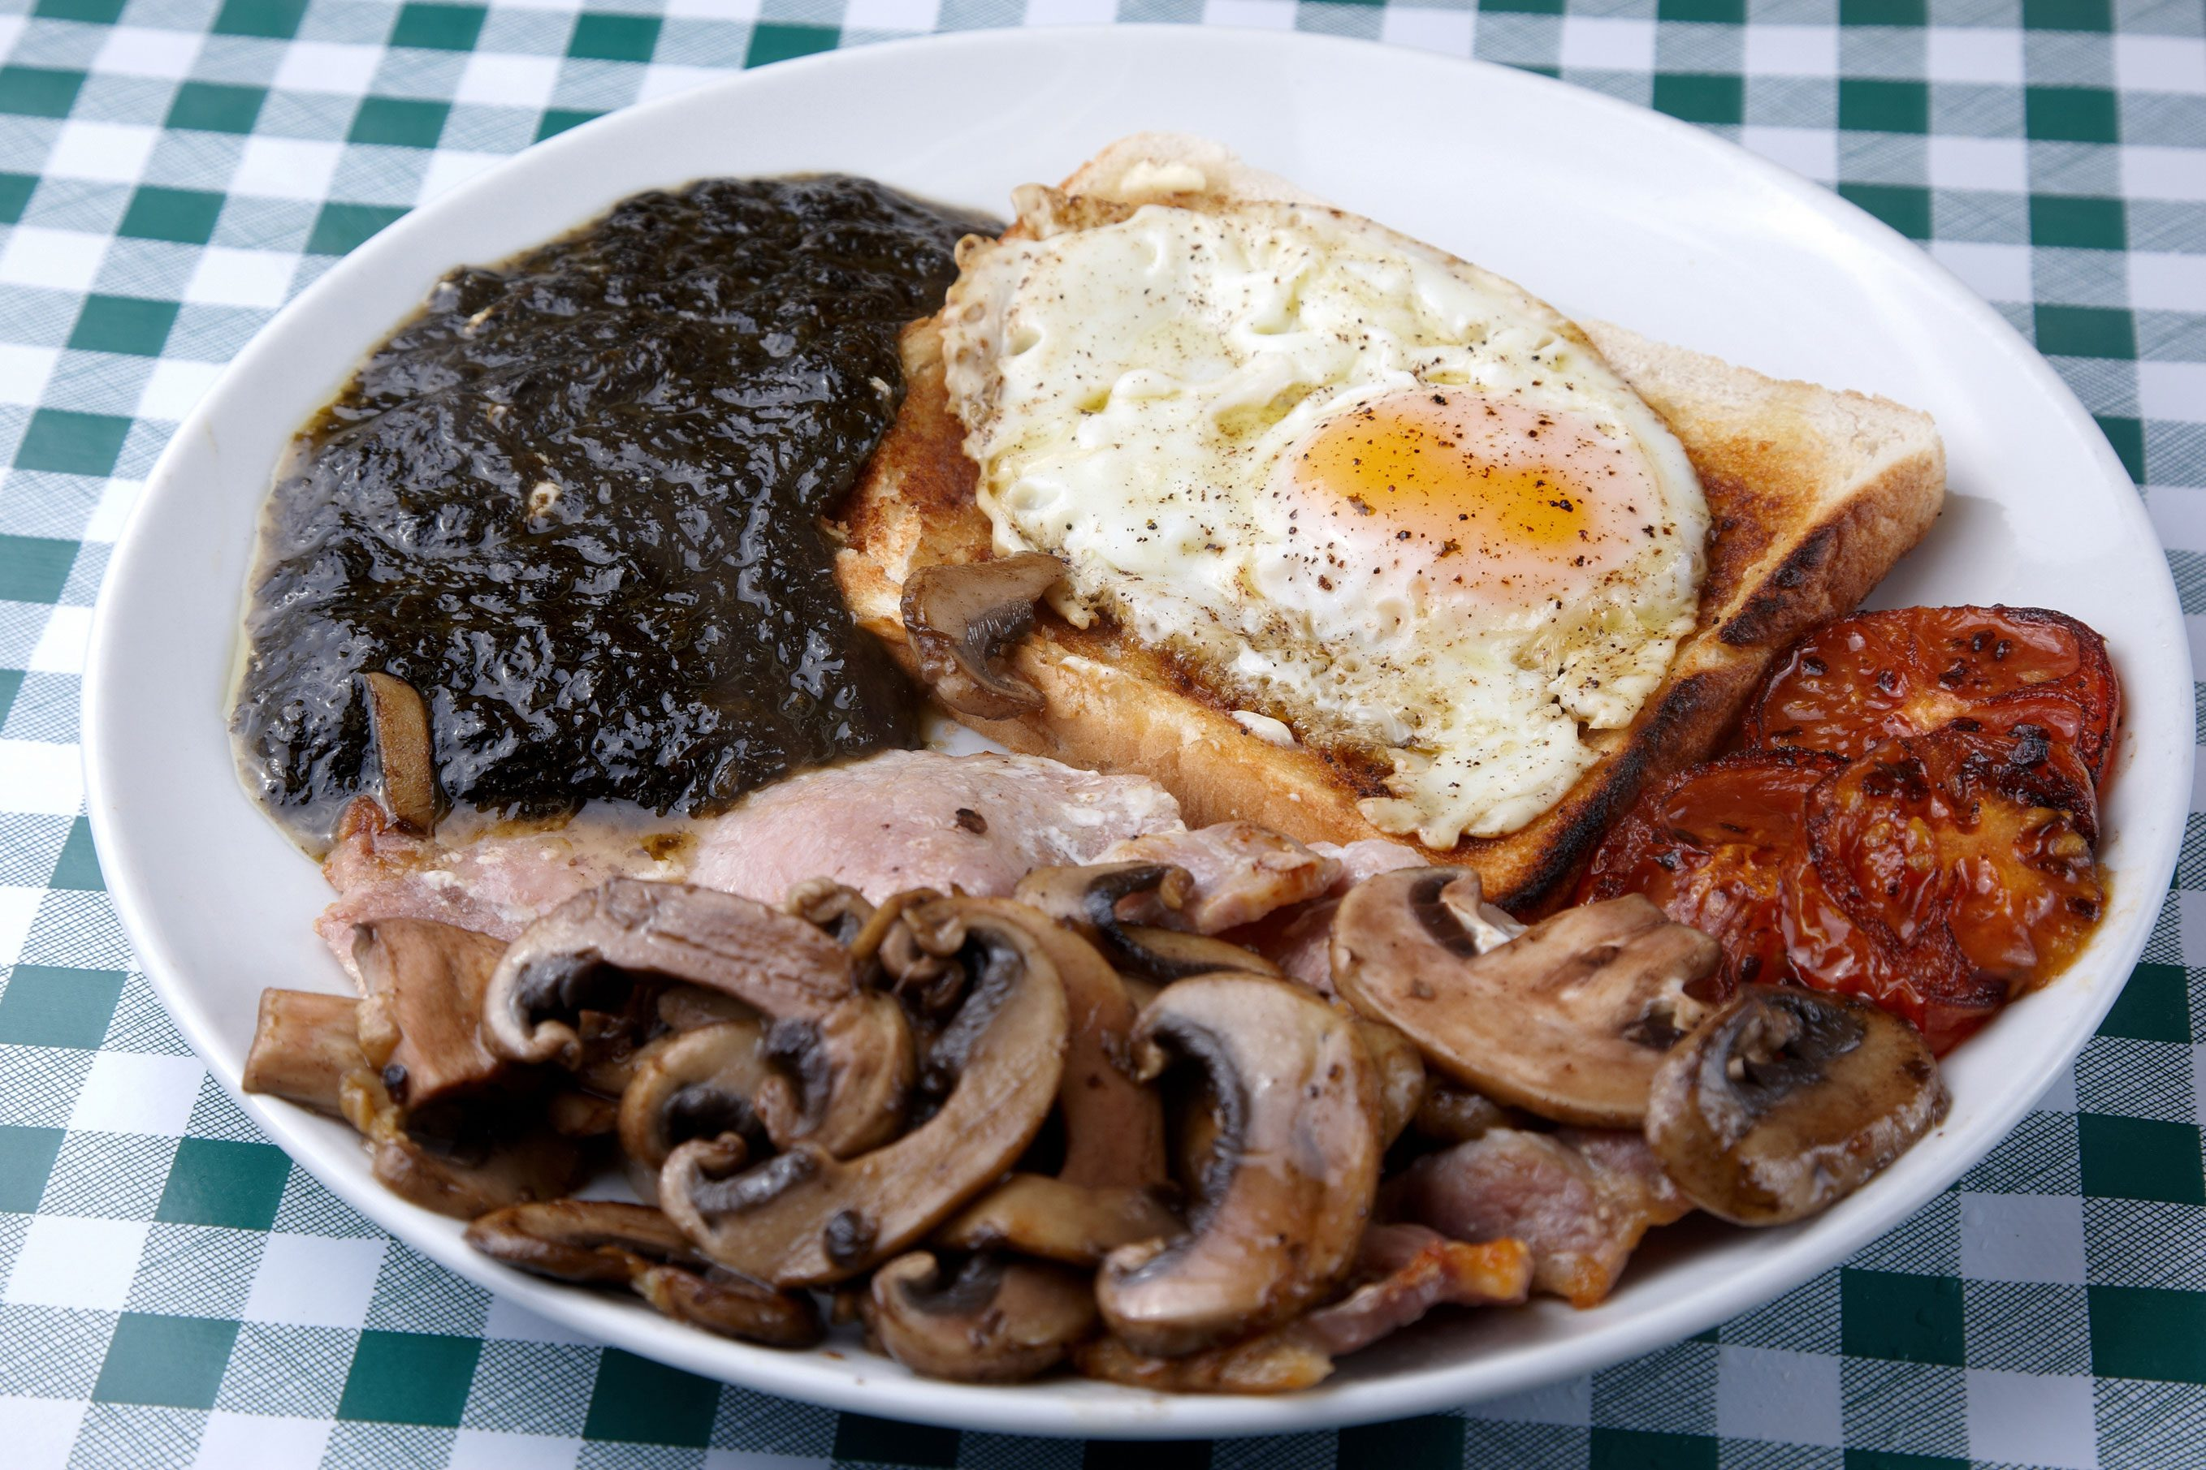
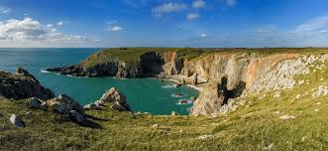
Programme & Activities
Day 1
Open with a formal welcome, followed by keynote sessions
In the afternoon: engage in interactive workshops
The evening: “Taste of Cymru” gala dinner and a traditional Welsh folk performance
Day 2
Visit the Pembrokeshire Coast Path
Begins with coastal foraging tours
End with the Eisteddfod-style poetry celebrating the Welsh language

Slide 8
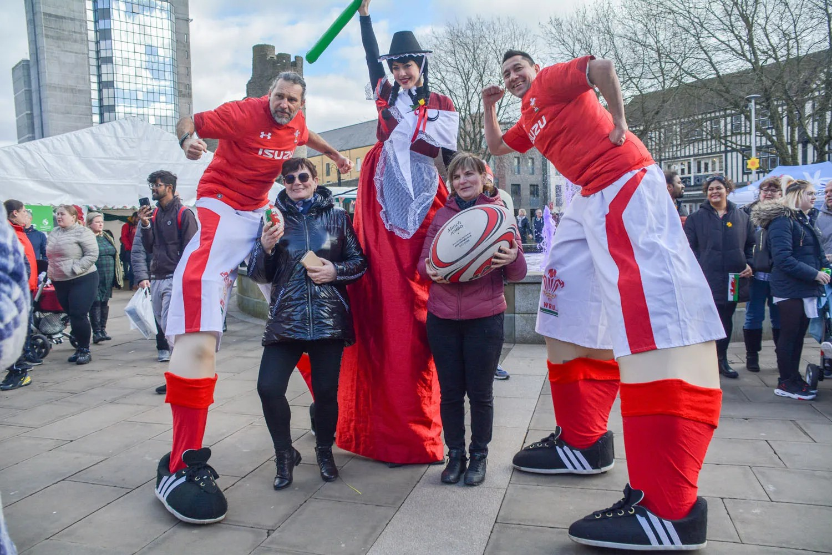
Accommodation & Transport
Sustainable, Local Accommodation
Delegates will stay in eco-friendly lodges and heritage guesthouses in St. Davids
Efficient & Accessible Transport
Shuttles from Haverfordwest station and coach transfers from Cardiff Airport
Eco-Friendly Mobility
Carpooling and bicycle hire will be encouraged

Slide 9
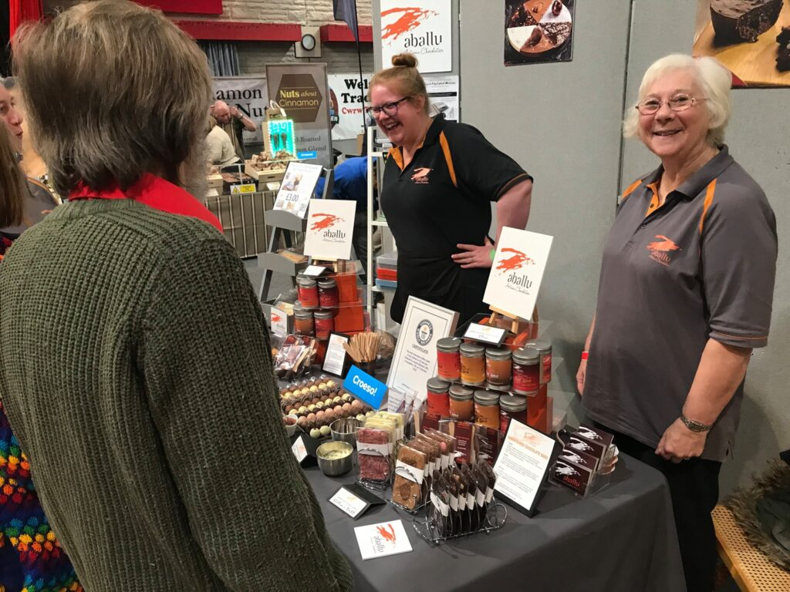
Cuisine & Local Suppliers
Signature Dining Experience
Locally Inspired Menu
Support for Welsh Producers

Slide 10
Budget & Financial Feasibility
Projected Cost |  | Projected Income
Venue hire at St. Davids Cathedral | 3000.00 | Delegate ticket sales at (£275 x 100) | 27,500
Accommodation (2 nights at £140/night x 100 guests) | 28000.00 | Visit Wales sponsorship | 6,000
Marketing and promotional materials | 2000.00 | Local partner/vendor contributions | 3,000
Catering at £50/head for 100 guests | 5000.00 | Public grants and tourism funds | 10,000
Additional costs (AV hire, insurance, staffing) | 5000.00 | Total | 46,500
Total | 43000.00 | Net Income | 3,500.00

Slide 11
Risk Management & Contingency Planning
Outdoor Contingency
Move coastal activities indoors to Cathedral’s museum wing
Invite local cultural groups and universities to maintain delegate numbers
Health & Safety
First-aid stations on-site
Overcapacity
Use pop-up tents and partner B&Bs as overflow for dining and accommodation
Undersubscription
Clearly marked emergency exits
Trained staff for crowd and risk management
Weather Protection
Branded umbrella giveaways for guests

Slide 12
Due Diligence & Licensing
Legal Compliance
All necessary licenses will be secured, including a Temporary Event Notice
Safety & Risk Management
Comprehensive risk assessments will be conducted for all activities
The summit aims to achieve Green Event Certification, and all staff will be trained in emergency protocols
Sustainability & Staff Training

Slide 13
Gantt Chart
Post event evaluation
Event Delivery
Operation & Logistic
Sales & Promotion
Vendors
Marketing Campaign
Cultural Program
Venue & Partner
 | Mar 04 | Mar 11 | Mar 18 | Mar 25 | Apr 01 | Apr 08 | Apr 15 | Apr 22 | Apr 29 | May 06 | May 13 | May 20 | May 27 | Jun 03 | Jun 10

Slide 14
Conclusion
Croeso Cultural Summit aligns with Year of Croeso 2025 objectives
Blends business networking with authentic Welsh culture
Delivers immersive delegate experiences (music, language, nature)
Backed by strong feasibility, sustainability, and financial planning
Local sourcing and partnerships create economic & cultural value
Comprehensive risk management and timeline execution
Enhances Wales’ global image as a premium MICE destination
Sets a model for purposeful, culturally rich event delivery

Slide 15
Reference
BBC (2025) St David’s Day 2025: Everything you need to know. [online] BBC Newsround. Available at: https://www.bbc.co.uk/newsround/articles/c4g03y1w9pdo (Accessed: 14 May 2025).
Business News Wales (2024) Pub Group Giving a Warm Welsh ‘Croeso’. [online] Business News Wales. Available at: https://businessnewswales.com/pub-group-giving-a-warm-welsh-croeso/.
Business Wales (2025) Croeso 25. [online] Available at: https://businesswales.gov.wales/news-and-blog/croeso-25 (Accessed: 14 May 2025).
David (2025) How MICE Tourism Is Quietly Dominating Global Travel. [online] Mize. Available at: https://mize.tech/blog/how-mice-tourism-is-quietly-dominating-global-travel/.
Fox, D., Gouthro, M.B., Morakabati, Y. and Brackstone, J. (2014) Doing events research: from theory to practice. London: Routledge.
Getz, D. (2012) Event studies: theory, research and policy for planned events. Oxford: Butterworth-Heinemann.
Industry (2025) Year of Croeso. [online] Available at: https://industry.visitwales.com/get-involved/visit-wales-themed-year-campaigns/year-croeso.
Lloyd, M. (2020) St David: Ten things to know about the patron saint of Wales. [online] BBC News, 1 March. Available at: https://www.bbc.com/news/uk-wales-51649367.
O’Toole, W. (2011) Event feasibility. Oxford: Butterworth-Heinemann.
Rogers, T. and Wynn-Moylan, P. (2022) Conferences and Conventions. Abingdon: Routledge.

