Slide 1

Student Name: Irene Baaba Quagraine student number: 2434408
Module code:LCHS4010
Modul Title: Psychology in Health and Social Care
Lectures Name: Dr Helen Pasons
Assignment Title: Attachment Theory to Jenny’s Development
Date: 16/February/2026

Slide 2

INTRODUCTION
The presentation will cover the below areas
An overview of Attachment Theory by Bowlby & Ainsworth.
Clarify why the theory is extremely pertinent in early childhood development.
Demonstrate how the theory directly relates to Jenny's developmental background and present behavior.
Will provide useful theory-driven support strategies and a succinct critique to demonstrate a broader understanding.

Slide 3
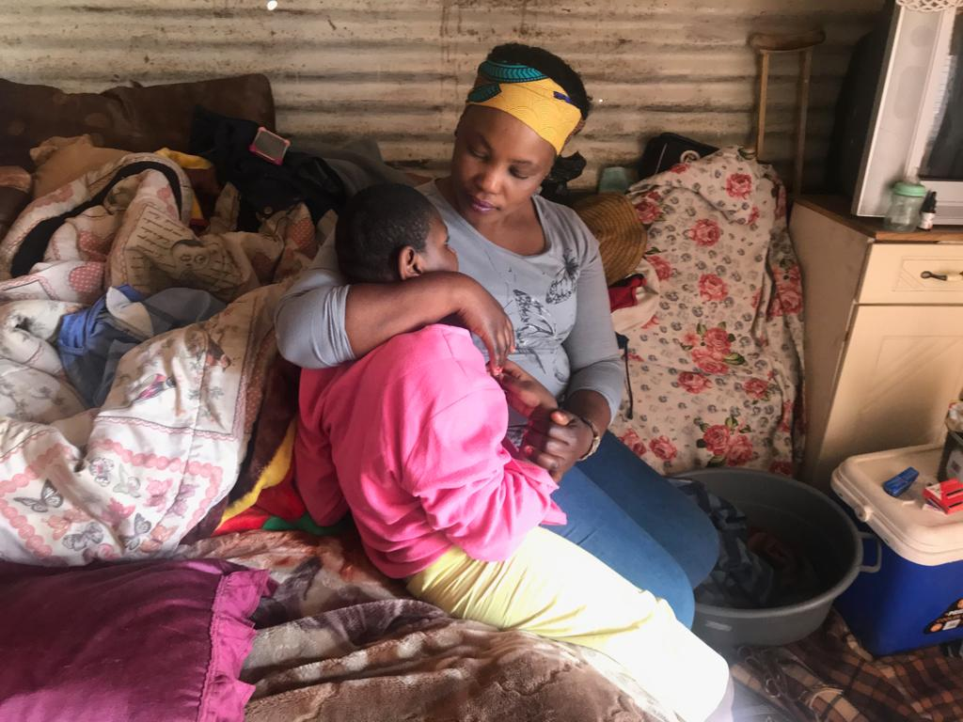

AN OVERVIEW OF ATTACHMENT THEORY OF JOHN BOWLBY
Bowlby argues that young children require a stable emotional connection to their primary carer {Bowlby, 1979}.
  This bond serves as a safe starting point for investigation, emotional control, self-assurance, and social skills development {Forsland and Duschinsky, 2021}.
Key components of social competence include:
Communication skills – expressing oneself clearly and listening actively.
Empathy – understanding and responding to the feelings of others.
Self‑control – managing emotions and behavior appropriately.
Cooperation – working well with others toward shared goals.
Conflict resolution – resolving disagreements constructively.
Social awareness – understanding social norms and expectations.
This Photo by Unknown Author is licensed under CC BY-ND
This Photo by Unknown Author is licensed under CC BY-NC

Slide 4
AN OVERVIEW OF ATTACHMENT THEORY
On the contrary, insecure attachments results in:
Anxiety
Clinginess
Disengagement
Mistrust
These are the signs of insecure attachment according to Lockman and Tamis-Lemonda,( 2020).
These early life events shape the beliefs about oneself and how the child sees and relate with other people.
This Photo by Unknown Author is licensed under CC BY-NC
This Photo by Unknown Author is licensed under CC BY-ND

Slide 5

KEY CONCEPTS
Secure Base: When a carer ensures safety, a kid can boldly explore. (Google Books, 2026)
Internal Working Model: A mental blueprint that directs relationship expectations.
The innate need to remain near the carer when under stress is known as proximity seeking.
Fear and distress when removed from the primary carer is known as separation anxiety.
Carer Sensitivity: Secure attachment is produced by attentive, consistent reactions (Ainsworth, 1978).

Slide 6
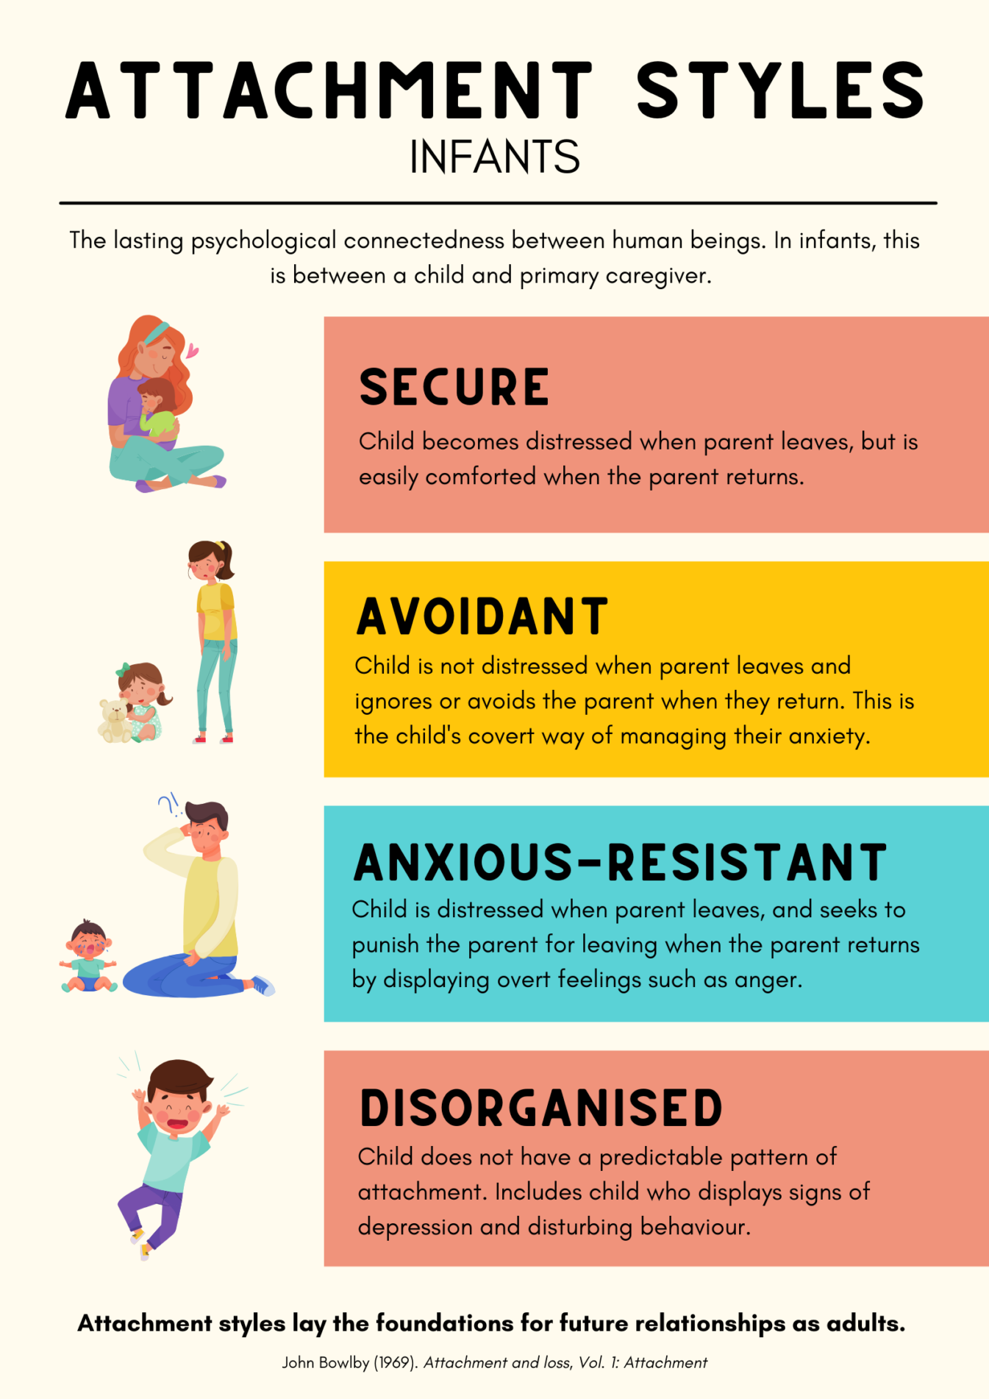
The Applicability of Attachment Theory to Early Childhood
Emotional and social development are crucial during the early years (0–5). Nearly all of a child's security comes from carers.
(Bowlby, 1969)
The Theory takes into account both nature (biology) and nurture that is the caregiving environment.
Again, the theory helps to explains the following:
Trust
Self-confidence
Managing emotions
Patterns of conduct
The theory has also been explained solid foundation of information from developmental and cross-cultural studies.

Slide 7

JENNY'S BACKGROUND SUMMARY
Jenny's life has been disrupted and stressful for the last 5 years.
As a result of potential complications in caregiving and routine.
Jenny's current Behavior's suggest emotional insecurity.
Attachment Theory provides insight into the ways early care giving could have changed her current experiences. (Bowlby, Bacciagaluppi and Francis, 2018)

Slide 8
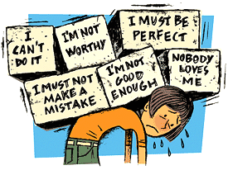

APPLYING ATTACHMENT THEORY TO JENNY'S
  Among the signs of an insecure attachment style are:
  >Clinginess or anxiety around grownups
  >Having trouble trusting other people
  >Having trouble controlling your feelings
  >Fear of being alone
  >Withdrawal or hypervigilance
  How this is explained by the theory:
  >A child's sense of safety is weakened by stressful or inconsistent surroundings.
  >Jenny might have adopted an avoidant or anxious-ambivalent attachment style.
  >Right now, her internal working model – beliefs and how she relate with others might anticipate rejection or instability.
  >Her actions show that she is trying to defend herself or find security. (Brisch, 2014)

Slide 9
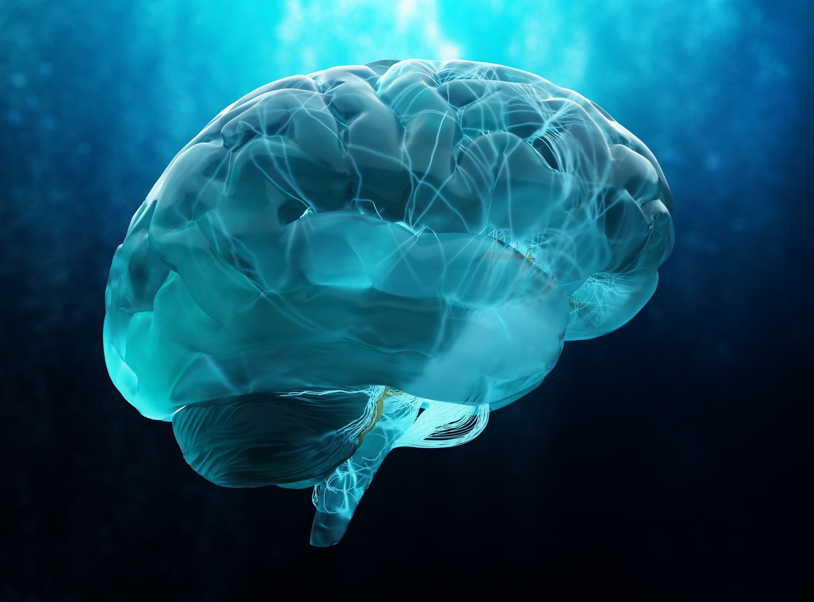
Biological and Environmental Factors
Biological component:
Temperament of the child . (Barnett, 2010)
Development of the brain (early shaped stress reactions).
Environment-related factors:
Response time of carers.
Home environment in terms of emotions.
Regularity and consistency .
Conflict or stress exposure.
Interaction between nature and nurture:
The way that biology influences stress sensitivity.
The environment influences the pattern of attachment.
Both effects are successfully integrated by attachment theory.…

Slide 10
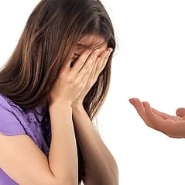
Jenny’s Support Techniques
These tactics contribute to enhancing Jenny's internal working model and bolstering her sense of security.
Regular routines: lower anxiety and provide predictability.
Warm, Responsive Caregiving: Rebuilding trust is facilitated by composed emotional reactions.
Key-Worker Approach: A stable relational foundation is provided by a single, reliable adult.
Emotion Coaching: Assisting Jenny in identifying and comprehending her emotions.
Promoting Safe Exploration: Offer security while fostering freedom.
Attachment-Based Interventions: such as relational play, stability planning, and nurturing interactions. (Lamb and Bornstein, 2013)

Slide 11

The Pros and Cons of Attachment Theory
Benefits:
Substantial body of evidence .
Extremely useful in health and social care settings.
Behavioral signs that are easy to see.
Aids in successfully identifying emotional needs. (Alloy and Riskind, 2006)
Restrictions :
Critics claim that it might favor Western parenting styles due to cultural prejudice.
The function of the mother was over Emphasized in the past. (Baker et al., 2016)
Minimal attention to cognitive development .
Not all Behavior’s are the result of attachment; other factors may play a role.
Comparative Analysis :
Erikson also emphasizes faith versus mistrust. (Erikson, 1959)
Vygotsky places a strong emphasis on social interaction rather than emotional ties for learning. (Vygotsky, 1978)

Slide 12

conclusion
The attachment theory has a lot to do with the development of young children.
Jenny's attachment experiences help to explain her current conduct.
Support techniques based on theory can enhance trust and emotional control.
Despite its shortcomings, the theory offers Jenny a solid, understandable framework for health and social care practice.

Slide 13
Alloy, L.B. and Riskind, J.H. (2006). Cognitive Vulnerability to Emotional Disorders. Routledge.
Baker, M.A., Ford, J., Canfield, B. and Grabb, T. (2016). Identifying, treating, and preventing childhood trauma in rural communities. Hershey, PA: Information Science Reference.
Barnett, L. (2010). Trauma and attachment: The John Bowlby Memorial Conference Monograph 2006. Psychodynamic Practice, 16(2), pp.237–241. doi:https://doi.org/10.1080/14753631003650829.
Bowlby, J. (1969). Attachment and Loss. New York: Basic Books.
Bowlby, J. (1979). The Bowlby-Ainsworth attachment theory. Behavioral and Brain Sciences, [online] 2(4), pp.637–638. doi:https://doi.org/10.1017/S0140525X00064955.
Bowlby, J., Bacciagaluppi, M. and Francis, T. (2018). The Milan seminar : clinical applications of attachment theory. Boca Raton, Fl: Taylor And Francis, An Imprint Of Routledge.
Brisch, K.H. (2014). Treating attachment disorders : from theory to therapy. New York: The Guilford Press.
Erikson, E.H. (1959). Identity and the life cycle. New York: Norton.
Forslund, T. and Duschinsky, R. (2021). Attachment theory and research : a reader. Hoboken, NJ: John Wiley & Sons, Inc.
Google Books. (2026). Development and Vulnerability in Close Relationships. [online] Available at: https://books.google.co.uk/books?hl=en&lr=&id=8-1hMQr64yEC&oi=fnd&pg=PA3&dq=Revisiting+internal+working+models+of+attachment+relationships.+Attachment+%26+Human+Development [Accessed 12 Feb. 2026].
Hopkins, B., Geangu, E. and Linkenauger, S. (2017). The Cambridge encyclopedia of child development. Cambridge, United Kingdom: Cambridge University Press.
Lamb, M.E. and Bornstein, M.H. (2013). Social and Personality Development. Taylor & Francis.
Lockman, J.J. and Tamis-LeMonda, C.S. (2020). The Cambridge Handbook of Infant Development. Cambridge University Press.
sami Gurdal, mahmut and Hakki Acar, I. (2025). Early Education and Development. [online] Available at: Informa Uk Limited [Accessed 15 Feb. 2026].
Vygotsky, L. (1978). Mind in society: The development of higher psychological processes. Cambridge: Harvard University Press.

