Slide 1

WEEK 1: WELCOME TO THE FAMILY
Contents
Learning outcomes Introduction to Family Law and Practice What is family law?
Defining the family
Exploring family life and regulation Family law in context
Current issues Family Justice
Working in Family Law Funding family cases Mediation

Slide 2
MODULE LEARNING OUTCOMES
Upon the successful completion of this module, the student should be able to:
• demonstrate a critical knowledge and understanding and apply the general
principles of Divorce Law to practical scenarios;
• evaluate the procedures surrounding court orders, domestic abuse, children
and finance;
• demonstrate knowledge and a critical understanding of family law relating to
children and apply the relevant legal principles to practical problems.

Slide 3
ASSESSMENTS
Assessment Type
Length
Weight
Due Date
Written Assessment
  Friday 13th November 2026 at 23:59pm
1
2000 words
50%
Portfolio (4 elements)
2
2000 words
50%
  Friday 8th January 2027 at 23:59pm

Slide 4

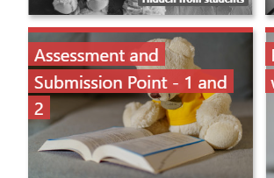
ASSESSMENT INFORMATION
Assignment 1
Essay style question – please see the GA34 document on Moodle with the title and requirements
Assignment 2
A 4-part element portfolio – please see the GA34 document on Moodle with the scenarios and requirements

Slide 5
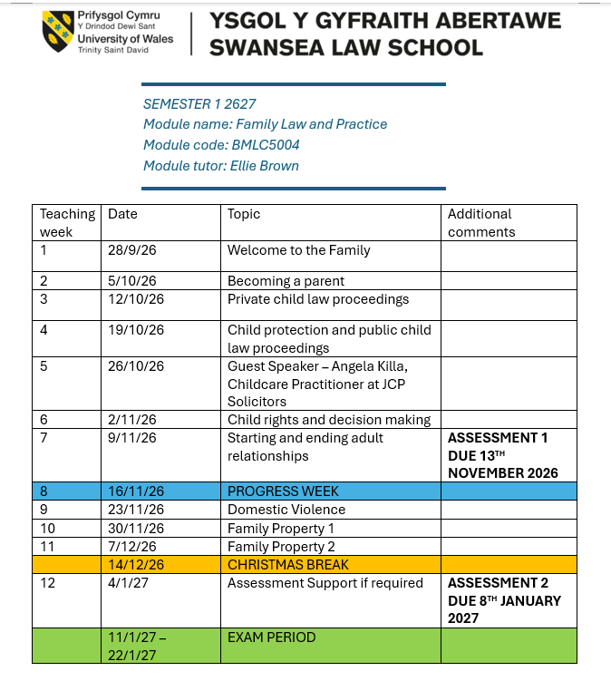
SCHEME OF WORK

Slide 6


WHAT YOU WILL STUDY: SCHEME OF WORK
Welcome to the family Becoming a parent
Private child law
Child protection (public law proceedings)
Child rights and making decisions
Starting and ending relationships
Financial consequences of relationship breakdown Planning for relationship breakdown
Domestic violence

Slide 7
FAMILY LAW SOURCES
Key legislation
Matrimonial Causes Act 1973 (MCA 1973)
Marriage Act 1949
Marriage (Same Sex Couples) Act 2013 Civil Partnerships Act 2004 (CPA 2004)
Children Act 1989 (CA 1989) Child Support Act 1991, as amended
Family Law Act 1996 (FLA 1996) Domestic Violence, Crime and Victims Act 2004
Domestic Abuse Act 2021
Trusts of Land and Appointment of Trustees Act 1996 (TLATA 1996)
Human Fertilisation And Embryology Act 2008 Social Services and Well-being Act (Wales) 2014
Legislation
Case law
Rules and procedures - Family Procedure Rules 2010 (FPR 2010)
Please consider the Reading List on Moodle for Essential and Further Reading

Slide 8
ACTIVITY
For what reasons do you think an individual would visit a Family Law practitioner?

Slide 9
WHO ARE FAMILY LAW CLIENTS?
Usually when a client seeks a lawyer’s help it will be a straightforward process to find out what the client’s immediate problem is. The client may want help with ending a relationship and/or to find out how they stand financially. The advice given and how these issues are dealt with by their family lawyer may depend on whether or not the couple are married, in a civil partnership or whether they are living together. Whilst the problems and worries of the clients may be the same, the remedies available in law are not.
Cohabitation disputes are not dealt with under the framework of family law but, instead, are treated as property law matters. It is essential that family lawyers have a thorough and detailed knowledge of the legal remedies available to both types of relationship so that they can advise clients whether a matter is appropriate to introduce in the Family Court.
Family clients may also request advice about their children, step-children or grandchildren. The issues might relate to a dispute over contact, child maintenance or medical treatment. At the more serious end of the spectrum, children may be deemed at risk of harm by social services, and the parent(s) need help and advice to work through complex care proceedings. Family lawyers should familiarise themselves with the Children Act 1989, a core statute covering both private and public family proceedings.
Domestic abuse is also a major issue contributing to relationship breakdown. It used to be referred to as domestic violence but there is growing recognition that not all abuse is physical. Who can apply for protection and the legal steps that need to be taken must be at the fingertips of family lawyers as the client will require immediate protection, and time to research law and procedure will be very limited.
The lawyer’s duty of care is to the client. The lawyer can only take instructions from their client. It is not uncommon for clients to bring friends or family with them to the office or for friends or family to telephone the lawyer for an update! Lawyers must politely explain their professional position and indicate that they can only take instructions directly from the client and are obliged to maintain client confidentiality.

Slide 10


STAKEHOLDERS
Who are the key stakeholders in family law?

Slide 11
KEY FAMILY LAW STAKEHOLDERS
Parents: biological, adoptive, step, foster Children, siblings
Partner: spouse, fiance,
Grandparent, great-grandparents etc Wider family: Aunts, uncles, cousins
State and its agencies: local authority, Cafcass, Child Maintenance (CMS) Professionals: solicitors, barristers, mediators, arbitrators, judges
Service providers: e.g. care agencies, schools, NHS Family friends
Pets

Slide 12

WHAT IS A FAMILY?
How do you define the term “family”?

Slide 13



DEFINING: THE FAMILY
Notoriously difficult to define - changes with society and time Stereotypical image of the ideal family - many different family structures - no longer assume a ‘traditional nuclear family’ (parents and dependents) But, usually intervention of family and child law based on biological connection, or the legal relationship having been recognised
However, wider definitions of family may include: extended families/kinship
household (e.g. group sharing accommodation) those with primary custodial roles of children

Slide 14
GOVERNMENTAL DEFINITIONS
Office for National Statistics, 2022 “A family is a married, civil partnered or iting couple with or without children, or a lone parent with at least one child.
Children may be dependent or non-dependent.”
Government Family test (DWP, 2021)
couple relationships (including same-sex), including marriage, civil partnership, itees and those living apart together
lone parent families, including between parent and children with non-resident parent, and with extended family
parent and step-parent to child
relationships with foster children and adopted children sibling relationships
children and grandparent relationships
kinship carers (relatives or friends looking after children who cannot live with their parents)
extended families, especially if they have a role in raising children, or caring for older or disabled family members

Slide 15
LEGAL DEFINITIONS
Gammans v Ekins [1950] 2 KB 328, 331
“two people masquerading as these two were as husband and wife, that they were members of the same family, seems to be an abuse of the English Language”
Whittington Hospital NHS Trust v XX [2014] UKSC 14, para 30 (Lady Hale)
“Traditionally, families were limited to those related by consanguinity (blood) or affinity (marriage). Hence at first only opposite sex married couples could apply for parental orders. Now they have been joined by same sex married couples, by same sex and opposite sex civil partners, and by couples, whether of the same or opposite sexes, who are neither married nor civil partners, but are living together in an enduring family relationship. They have also been joined by single applicants. All of these would be regarded as family relationships within the meaning of article 8 of the ECHR.”
Paradisio and Campanelli v Italy App No. 25358/12
ECtHR refused to recognise the right to a family life (art 8) applied where a couple who had asked a woman to carry a child for them as surrogate, as no genetic link, and had not cared for child.

Slide 16
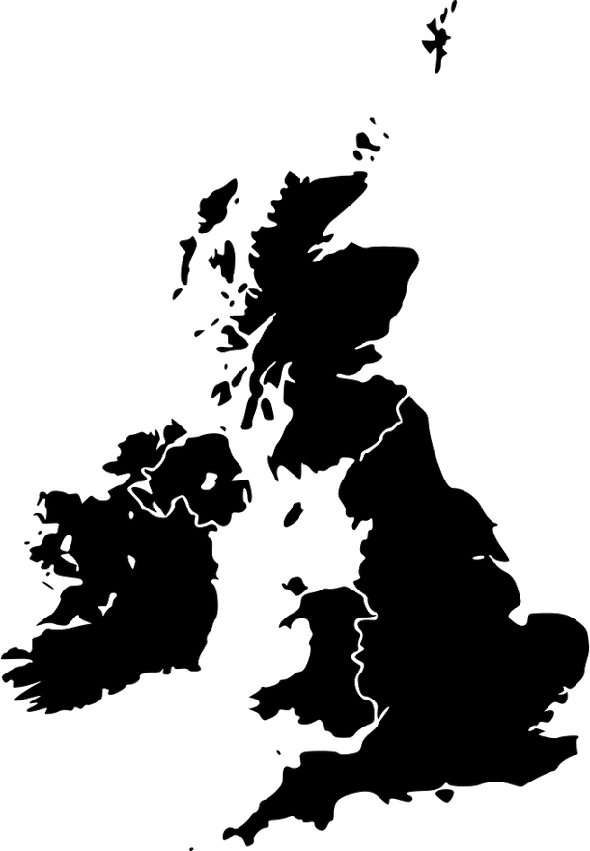
COHABITATION RATE UP TO 19% IN
2019, RISE OF 22.9% IN 10 YEARS
CHANGING FAMILIES
MARRIAGE RATE DOWN FROM 69% IN 2009 TO 58% IN 2021
RISE IN LIVING ALONE RATE BY 8% IN 10 YEARS. 26% IN LONDON; 36% IN SCOTLAND
SAME SEX RELATIONSHIPS INCREASING: 40% INCREASE FROM 2015: EST 212K SAME SEX FAMILIES IN 2019
BIRTHS TO MARRIED OR CIVIL-PARTNER
PARENTS DOWN FROM 91.6% IN 1971 TO 49% IN 2021. ALSO 15.4% FAMILIES HEADED BY SINGLE PARENT, 85.4% LONE WOMEN
3.6M AGED 20-34 LIVING WITH PARENTS. 28% OF AGE GROUP. 24% INCREASE IN 10 YEARS
1970S AND 1980S INCREASE IN DIVORCE RATE. 42% MARRIAGES END IN DIVORCE

Slide 17
SHOULD FAMILY LIFE BE ENCOURAGED?
For | Against
Emotional security and support | High levels of abuse occurs within families (domestic/child)
Benefits well-being (happier) | Oppression of women (historic hierarchy and oppression)
Benefits state - promote social cohesion | Reinforce social inequality
Supported institution - harder to oppress families than individuals | Promote selfishness, exclusiveness in pursuing private interest, undermining alturism, community and public good
The right architecture to support and protect children and family (elderly/disabled) - added cost to state if had to look after | Breakdown of family has social and economic cost, estimated at £51Bn in 2020

Slide 18
STUDYING SENSETIVE TOPICS
Families can be horrible!
This module often focuses on the worst parts of family life
Some of you may have personal experience of these
If anyone discloses personal experiences, please be respectful
Look after yourself and others
Step away from class - but speak to me or one of my colleagues before you leave campus
Check in with yourself regular Take your time
Reach out to your support networks Collate your toolkit of coping strategies
Keep in touch with your teaching
team
Step away if you need to

Slide 19

INTERACTION WITH OTHER AREAS OF LAW
Family law doesn’t occupy in a vacuum, it interacts with and borrows principles from other areas of law
CRIMINAL
TORTS
PROPERTY/LAND
PUBLIC LAW
TRUSTS
HEALTH
HUMAN RIGHTS
INTERNATIONAL

Slide 20
FAMILY LAW AND HUMAN RIGHTS LAW
European Convention on Human Rights 1950 Incorporated into UK law by Human Rights Act 1998 s3(1) - courts must read and give effect to law in a way that is as far as possible compatible with the Convention rights.
If finds that primary legislation is incompatible - can make a declaration of incompatibility - s4 HRA 1998. This does not strike down UK law, which still applies.
s6 - Public authorities (including courts) must apply law in a way which upholds ECHR, unless primarily law prevents them from doing so
Commonly cited ECHR rights in family cases
Article 2: Right to life
Article 3: Right not to be subjected to torture, inhumane or degrading treatment or punishment Article 6: Right to a fair trial
Article 8: Right to respect private and family life
Article 9: Freedom of thought, conscience and religion
Article 12: Right to marry and to found a family
Article 14: Right not to be discriminated against
ECHR rights are categorised as: Absolute, qualified or limited

Slide 21
IDENTIFYING RIGHTS
Consider the following scenarios. Which Article of the Convention might be relevant?
a. A local authority social
services department knows a child is being neglected and is being physically abused by the mother. The father complains to social services, but no action is taken.
b. A transperson who has
undergone gender reassignment wishes to change their birth certificate in order to get married.
c. An application for an
injunction has been heard by a judge removing someone from their home, but the partner accused of the abusive behaviour did not receive the papers in time and was unable to obtain legal advice.

Slide 22

UN CONVENTION ON RIGHTS OF A CHILD
General Assembly of the UN issued Declaration of the Rights of the Child in 1959
1989 - UNCRC created, one of most universally adopted Shared understanding of needs and status of children Has influenced child law, and changing perceptions Not exhaustive set of demands - but rights framework
designed to be flexibly applied to meet individual needs. UNCRC rights are indivisible and interdependent
Art 3: Child’s Best
interests
Art 12: Right to express views and be
consulted on decisions affecting them
Art 13: Right to have and
share information

Slide 23


CULTURES, NORMS AND PRACTICES
UK is a multicultural society, lived social and cultural experiences influence family practices
E&W law typically shaped around historic cultures operating in E&W - heavily influenced by Christianity Some areas where tried to accomodate other cultures, but others where E&W does not recognise, or approve of certain practices, giving rise to conflict
Can you think of any examples of where cultural practices conflict with E&W family law?
How can we mitigate some of these challenges in
family law practice?

Slide 24
MEDIATION
Briefly investigate the use of mediation in family law, and collate some notes on what it involves, and how it might be beneficial to clients.
UK Mediation’s ‘Mediation Minutes’ playlist for a brief overview of what mediation is and how to get parties to mediation: https://www.youtube.com/playlist?list=PLIWuzIxkus_ehGViVhrqyJ69WZBamF2rL Considering Mediation? What you need to know https://www.youtube.com/watch?v=RkTz_9AM3Mo&t=31s

Slide 25
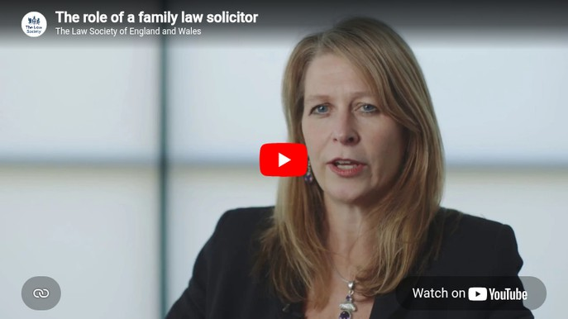
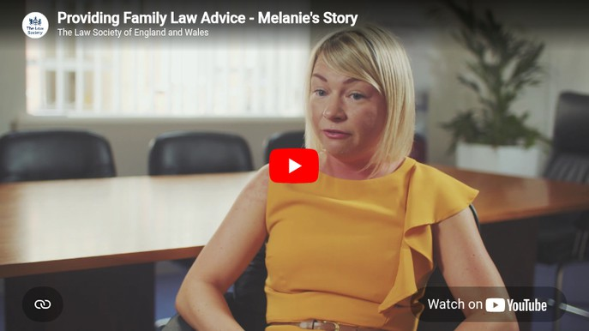
WORKING IN FAMILY LAW
The following videos produced by the Law Society describe the experience of working in family law

Slide 26

FAMILY LAW SKILLS
In the first part of this lecture, we explored the varying nature of family law. What key skills do you think lawyers need to succeed in family law practice?

Slide 27

SKILLS TO SUCCEED IN FAMILY LAW
Good client care - family law often brings out worst behaviour Help client understand law and procedures - manage expectations Interviewing skills and fact finding
Strong communication skills
Empathy and good emotional intelligence Persuasion, negotiation, diplomacy Resilience
Being a reflective practitioner
Application skills - ability to match the appropriate solution to the needs of individual client
Professional ethics Confidentiality
Advisor, but not decision maker Awareness and balance

Slide 28
FAMILY COURTS
Family Court - Crime and Courts Act 2013 Designated Family Judge presides over geographical cluster
Call me ‘Judge’
Hearings in ‘chambers’ or ‘open court’ Matrimonial proceedings (divorce separation) Children proceedings
Applicant v respondent
Accredited media - FPR 2010, part 27 Digital reform and e-bundles
FILE
ISSUE
Court papers
SERVED

Slide 29
FAMILY COURT AND INCREASE IN TECHNOLOGY
The Family Court has been trying to increase the use of technology to assist the court system to cope with the demand for Family Court cases. Some family law cases can be started via a dedicated secure Family Court online portal. Firms need to register an account in order to start cases this way. To register and to start a case this way the following link should be used (https://www.gov.uk/guidance/submit-an-application-with-myhmcts). This portal was the first measure to be introduced to help reduce the pressure on the Family Court.
The necessity to rapidly increase the use of technology was significantly hastened by the Covid-19 pandemic. A local authority v RK and others [2020] was the first complex multi-party final hearing in care proceedings to be dealt with by Skype for Business which is the software used on judicial laptops. This appears to have added further preference for remote hearings to be held wherever possible.
In national guidance issued on 19 March 2020, Sir Andrew McFarlane, President of the Family Division stated:
“…there is no category of case that may be listed in the Family Court which necessarily requires the physical attendance of key participants in the same courtroom…
… The following categories of hearing are suitable for remote hearing:
(a) all directions and case management hearings
(b) Public Law Children
(1) Emergency Protection Orders...
(c) Private Law Children
(1) First Hearing Dispute Resolution Appointments
(2) Dispute Resolution Appointments
(3) Other interim hearings…
(e) Financial Cases
(f) Appeals …
… and other hearings as directed by the judge concerned.”
On 8 January 2021 he issued further guidance in a document called “The Family Court and Covid-19, The Road Ahead 2021” for the Family Court. Given the increasing use of technology, one must be careful to check for updated guidelines regularly as these are likely to be updated many times.
However, some parts of the guidance, which state which party is to be responsible for certain pre-hearing tasks, will be unlikely to change. Below are the relevant extracts for the planning of all remote hearing cases in the Family Court.
(i) Remote hearings may be conducted using the following facilities as appropriate to the individual case

Slide 30
FAMILY COURT AND INCREASE IN TECHNOLOGY
The most recent guidance on the use of video and telephone hearings from HM Court and Tribunal Service (HMCTS) was issued on 23 July 2021:
https://www.gov.uk/guidance/what-to-expect-when-joining-a-telephone-or-video-hearing#our-telephone-and-video-hearing-platforms
HMCTS is reviewing the process of remote hearings and further reform is expected.
(ii) Responsibility for making technical arrangements for a remote hearing and for confirming the details of the arrangements for the hearing to the other parties no later than 24 hours prior to the remote hearing taking place is to be undertaken by the following party liaising with the court:
(a) the local authority in a public law case;
(b) the applicant, if legally represented, in a private law case;
(c) the respondent, if legally represented and where the applicant is not, in a private law case;
(d) the court where no party is legally represented.
(iii) Ensuring privacy during remote hearings
When conducting a remote hearing, there is a need for the judge to ensure that only those who would be allowed into the court room are present at a remote hearing and that all parties understand that privacy must be preserved and the system used by the court will record the proceedings and that no other recording is to be made. No one has the right to observe a hearing remotely. Courts and tribunals do, however, have powers to allow reporters and other members of the public to observe proceedings remotely, but this is subject to the following practice guidance:
https://www.judiciary.uk/wp-content/uploads/2022/06/Practice-Guidance-on-remote-observation-final.pdf
(iv) Filing of electronic documents prior to a remote hearing
On the day before a remote hearing the applicant must electronically file a PDF bundle which complies with FPR PD27A (https://www.justice.gov.uk/courts/procedure-rules/family/practice_directions/pd_part_27a).

Slide 31




MANAGING COURT BUSINESS
Allocation to suitable judge
Simple single issue - Magistrates
More complex - District or Circuit Judge Financial cases - all heard by DJ or higher depending on value of assets
Gatekeeper has role in deciding suitable judge by reviewing FM1 form
Gatekeeper will also ensure mediation requirements fulfilled before listing for hearing

Slide 32
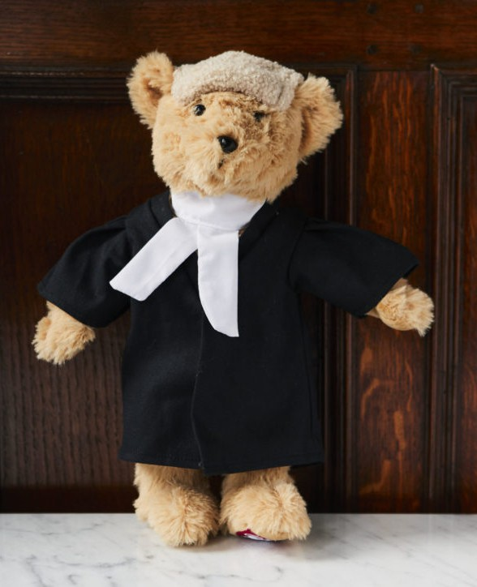
FAMILY COURT APPLICATIONS
Many different type of applications: Procedural matters
Relief from court Can be made:
inter partes - on notice
ex parte - without notice Orders
Appeal routes: Internal appeals procedure, with further appeal to CA or UKSC (Part 52 Civil Procedure Rules)
narrow grounds: lower court was wrong or unjust (FPR, 2010, para 30.12(3); see also GK v PR [2021] EWFC 106

Slide 33

FUNDING FAMILY PROCEEDINGS
Cost of divorce can range from few hundreds of pounds to several thousands of pounds, depending on case complexity
Public funding significantly reduced
Most ineligible for legal aid - rise in litigants in person Private funding:
Loan (friends or bank)
“Sears Tooth Agreement”
Court order requiring respondent to pay Online divorce websites (with package)
Traditional approach - charge by hour
Increasingly fixed fee - fixed package or ‘unbundled services’
Family practitioners cannot enter “no win, no fee” arrangements
Uncommon to agree to being paid out of assets

Slide 34

PUBLIC FUNDING (LEGAL AID)
Managed by Legal Aid Agency Decision on funding depends on:
Scope Means Test Merits test
Three types of LA available:
Legal help - initial advice and assistance Legal representation
Family mediation - cost of mediation
No longer available for divorce and financial remedy applications, unless evidence of domestic abuse or in
Key source: Legal Aid, Sentencing and Punishment Of Offenders Act 2012 (LASPO 2012)
children matters unless evidence of child abuse

Slide 35
LEGAL AID AVAILABILITY
Areas within scope:
public family law regarding protection of children (e.g. care proceedings);
private family law where there is evidence of domestic violence;
private law children cases where there is evidence of child abuse;
child abduction matters;
representation for child parties in private family cases;
legal advice in support of mediation; domestic violence injunction cases; and forced marriage protection order cases.
Generally only available for new private law family work if
applicant is a victim of domestic abuse. Straightforward divorce with children and financial no longer covered.
Level 1:
legal help, including obtaining initial legal advice, for example, in relation to an undefended divorce.
Level 2:
family help lower – this includes all work up to the issue of proceedings.
Level 4:
legal representation – this covers preparation for, and representation at, a final hearing.
Level 3:
family help higher – this covers representation in proceedings.

Slide 36
ELIGIBILITY TESTS
General concern LASPO 2012 led to huge rise in litigants in person - most vulnerable not represented in court services.
Huge burden on court to support unrepresented individuals Means and merits test must be passed
Some benefit recipients will automatically meet means test (passporting i.e. Universal Credit) Online form to calculate client eligibility
Merits
Sufficient benefit test: must have been a victim of domestic abuse and the perpetrator is bring/respoding to proceedings, or child at risk of abuse. Likelihood of successful outcome also assessed
Statutory charge
Civil legal aid cases, where client has retained money or property,
e.g. in financial settlement, they may need to pay back the LAA
costs. When LAA makes this claim, it is called a statutory charge.
Means
Assessment of financial situation - income and capital assessed

Slide 37
LEGAL AID IN CHILD PUBLIC PROCEEDINGS
In cases where local authority makes an application for a care or supervision order (child public law proceedings) the following parties are automatically eligible, without needing to pass the means or merits test.
biological parents of the subject children of the care proceedings; persons who hold parental responsibility for the subject children (for example, through child arrangements order, special guardianship order, step-parent parental responsibility order or adoption order);
children who are the subject of the proceedings

Slide 38
ALTERNATIVE APPROACHES
Any party has the right to represent themselves as litigants in person
The courts do not force anyone to be represented, and are very accomodating of unrepresented parties
Charities can also offer support, but typically cannot represent (though rarely pro bono)
Qualified Legal Representative Programme - Appointed by the court under s31W(b) MFPA 1984 and s85K(6) Courts Act 2003.
Alleged perpetrators and victims of abuse are prohibited from cross-examining each other.
QLRs ensure fairness of the proceedings is maintained, conducting cross-examination which the prohibited party cannot undertake (Part 4B Matrimonial Family Proceedings Act 1984, Part 7A Courts Act 2003)
When deciding to appoint a QLR the court must consider if it is in the interest of justice for a witness to be cross examined by a QLR to represent the interests of the party

Slide 39
MEDIATION
“not only is unnecessary litigation wasteful, it clogs up lists that are already over-
filled … However, if our lists are clogged up with this type of unnecessary, high conflict private law litigation, we will not be able [to provide legal services to those who really need them.....Therefore, the message in this judgment to parties and lawyers is this. Do not bring your litigation to the family court unless it is genuinely necessary for you to do so. You should settle your differences (or those of your clients) away from court, except where that is not possible. If you do bring unnecessary cases to this court, you will be criticised, and sanctions may be imposed upon you. There are many other ways to settle disagreements, such as mediation.” Re B (a child)
Requirement to mediate unless there is a valid exemption
Key part of lawyer role is to encourage mediation - going to court is last resort Re B (a child) (Unnecessary Private Law Applications) [2020] - warned parties and lawyers against making unnecessary applications
Government keen to encourage mediation Legal aid will pay for mediator to undertake work (voucher scheme) if eligible
May need to meet with a mediator to decide if case suitable for mediation
Key source:
Children and Families Act 2014, s10 FPR 2010 Part 3 and PD 3A

Slide 40

MEDIATION
Mediation is not
Focused on reconciliation An opportunity to intimidate Counselling or therapy
Legal advice
Help couples who’ve decided to separate to resolve matters in relation to finances and children
Mediators are specially trained impartial negotiators, often lawyers will start session by outlining principles which apply
Role: examine if the parties can agree settlement without costs, delay and aggravation associated with court proceedings Mediator will end proceedings if intimidation or bullying
Will suggest each party takes independent legal advice before reaching a final decision
Mediation is not a legally binding process
But successful mediation can result in cheaper resolution Some cases not suitable for mediation, e.g. domestic violence
Mediators can suggest that parties
do seek support of other agencies

Slide 41
MEDIATION INFORMATION AND ASSESSMENT MEETINGS (MIAMS)
MIAM is a meeting with a qualified family mediator to explore alternatives to the court process. Legal Requirement: s10(1) Children and Families Act 2014, MIAM attendance mandatory before applying to court for most family law matters, including children and financial remedies.
Purpose: Encourage mediation to resolve family disputes constructively. Applicants must show MIAM attendance before the court will proceed. Process:
Confidential meeting with a family mediator. Sessions can be individual or joint.
Only one party is initially required to attend, but both are expected, and the court can compel attendance.
Costs: Fees range from £50 to £300 per session. Legal aid may be available
Sessions can vary from 50 mins to 2 hours. Usually 3-5 two-hour sessions needed to reach full agreement.

Slide 42
EXCEPETIONS TO MIAM
2. An application to the court
1. A party, has made an allegation of domestic violence against the
other supported by clear evidence, for example either a police investigation took place, or an injunction was issued.
needs to be made urgently because there is a risk to the life or safety of the person who is making the application (the applicant) or his or her family (for example, their children) or his or her home.
3. Social Services are involved because there are concerns about
the safety and wellbeing of a child or children.
4. In the past four months mediation has been unsuccessfully
attempted. A mediator has to
confirm this.
5. The dispute is about money and either party is bankrupt.

Slide 43
MEDIATION V NEGOTIATION
Mediation is more formal than negotiation due to the involvement of a mediator. Neither involve arbitration by a third party
A mediator must be agreed upon by all parties, which can sometimes require negotiation.
Mediator Qualifications: Does not need to be a professional, but many prefer trained mediators, and in some cases, it's required.
Commitment from all parties is key to both mediation and negotiation.
Effective mediation often relies on parties having equal power or agreeing to operate on that basis.

Slide 44

ACTIVITY: MEDIATION
In your groups, research and produce a table of advantages and disadvantages of mediation as a tool to resolve disputes in family law

Slide 45
ACTIVITY: COMPLEXITY OF FAMILY LIFE
There is no such thing as a ‘standard
Isaac has been married to Elena for the
client’ in family law.
Most family cases are complex, and don’t present as single issues.
Consider the following scenario, and
identify the different issues which a family lawyer may need to assist with when advising Isaac.
past 7 years. They have three children and a dog. Recently, Isaac has decided to leave Elena due to her increasing violent behaviour, which escalated to the point where she not only harmed him but, on one occasion, also hurt their daughter.
Isaac is currently unemployed and has no
savings. He has fled their home, leaving most of his belongings behind, and his main concern now is to ensure a safe return to the family house where he and his children can live without fear. Elena owns the family home.

Slide 46
ACTIVITY: COMPLEXITY OF FAMILY LIFE
How will Isaac pay for legal advice? Eligible for legal aid? (Temporary) protection from violence, and return home: Non-molestation order and occupation order
Routes to separation - divorce
Permanent solution to housing and finances - financial arrangements on divorce: type of order e.g. clean break/maintenance
Arrangements for children, and maintenance, if there are child protection issues
Different routes for resolution: mediation, negotiation, court
Whether Issac may be entitled to welfare benefits (not taught) Property law aspects, e.g. changing/writing will (Land/Succession law)
Who gets the dog!
Isaac has been married to Elena for the past 7 years. They have three children and their dog. Recently, Isaac has decided to leave Elena due to her increasing violent behaviour, which escalated to the point where she not only harmed him but, on one occasion, also hurt their daughter.
Isaac is currently unemployed and has no savings. He has fled their home, leaving most of his belongings behind, and his main concern now is to ensure a safe return to the family house where he and his children can live without fear. Elena owns the family home.

Slide 47
WEEK 1: LEARNING OUTCOMES
Understand how to succeed in your study of Family Law and Practice
Explain the context in which family law operates and its interaction with other areas of law
Identify current issues in family law
Outline the family justice system, and the routes to funding cases Identify key skills to succeed in family law
Evaluate the use of mediation in family law
RECAP

Slide 48
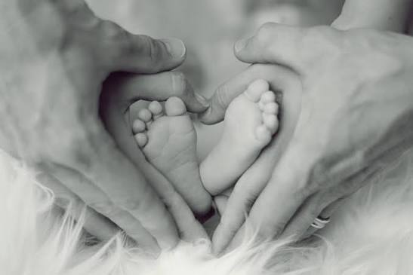
NEXT WEEK:
We are going to be looking at the topic of ‘Becoming a Parent’

