Slide 1
Resourcing and Talent Management:
Human Resource Planning Activities

Slide 2
“Workforce planning is getting the right number of people with the right skills employed in the right place at the right time to deliver an organisation’s short- and long-term objectives. It covers a diverse range of activities, such as succession planning, flexible working, job design, and many more. Whatever its precise form, workforce planning should be linked to strategic business goals and viewed as an important part of the strategic business planning process.”
(CIPD, 2016)

Slide 3
LO1:What activities do you think take place under the umbrella of human resource planning?
Succession Planning
Flexible working
Demand supply forecasting
Skills audit/gap analysis
Talent management
Multi -skilling
Role design
Risk management
Outsourcing
Career planning
Scenario planning
(Source: CIPD Factsheet 2016)

Slide 4
Session Overview:
The aim of this session is to enable you to undertake core talent planning activities
At the end of the session you will be able to:
1 | Describe the principles of effective workforce planning and the tools used to carry it out.
2 | Develop basic succession and career development plans.
3 | Contribute to plans for downsizing organisations.

Slide 5
LO1: Define Workforce Planning
Concerned with looking ahead and using systematic techniques to assess the extent to which an organisation will be able to meet its requirements for labour in the future.
Undertaken in order to assess whether an organisation will have ‘the right people, with the right skills, in the right place at the right time.’
It is about assessing the environment and bringing together the data required to plan the direction the organisation needs to take if it is to reach its goals.
(Taylor, 2010)
Notes:
It is worth noting that there is some different terminology to describe these activities, Human Resource Planning, Manpower Planning, Staffing Strategy and Workforce analytics. Some argue that HRP is different as it doesn’t only focus on the hard quantitative aspects but also softer P&D issues such as motivation, employee attitudes and culture.

Slide 6
LO1: Why is it important?
HRP is a way of assisting the best deployment of human resources & can help organisations to:
assess future recruitment needs
anticipate & possibly avoid redundancies
formulate training programmes
develop a promotion & career development policy including succession planning
keep staff costs to a minimum while permitting salaries to be competitive
assess future premises requirements.

Slide 7
LO1: HRP’s link to organisational strategy
HRP is credited with being one of the critical building blocks of organisational strategy.
Effective HRP is able to identify:
  Gaps in capabilities e.g. skills, knowledge, people
  Surpluses in capabilities
  Poor utilisation of people
  Need to develop a talent pool
  Human capital i.e. knowledge, skills, expertise etc need sophisticated policies, HRP, culture, structure etc to support effective & efficient deployment & usage
  Source: Lam, S. and Schaubroeck, J. (1998) ‘Integrating HR planning and organizational strategy’, Human Resource Management Journal, 8(3): 5-19.
Notes:
HRP has been defined as one of the critical building blocks of a more strategic approach - identify 4 ways in which it is critical to strategy:
Gaps = lack of sufficient skills or knowledge which will prevent successful implementation of strategy
Surplus capabilities – identifies scope for efficiencies &/or new ventures to capitalise on underused capabilities
Poor utilisation of people – suggests HR practices may need alteration
Development of talent pool – identify requirements & use old or new

Slide 8
LO1: Objectives of Workforce Planning
attract & retain the required number of people with the appropriate skills & competencies.
anticipate problems of potential surpluses or deficits of people
develop a well trained & flexible workforce, so contributing to the organisation’s ability to adapt to uncertain & changing environments
reduce dependence on external recruitment when key skills are in short supply by formulating retention & development strategies
improve the utilisation of people by introducing more flexible systems of work.
Source: Armstrong (2014)

Slide 9
LO1: Stages in the planning cycle
Investigation & analysis of internal & external labour markets & the corporate situation i.e. capability & strategy
Forecasting future demand for human resources
Forecasting future internal & external supply of human resources
Formulating responses to the forecasts i.e. producing the HR plan
Activating, maintaining & monitoring the plan i.e. implementation & control

Slide 10
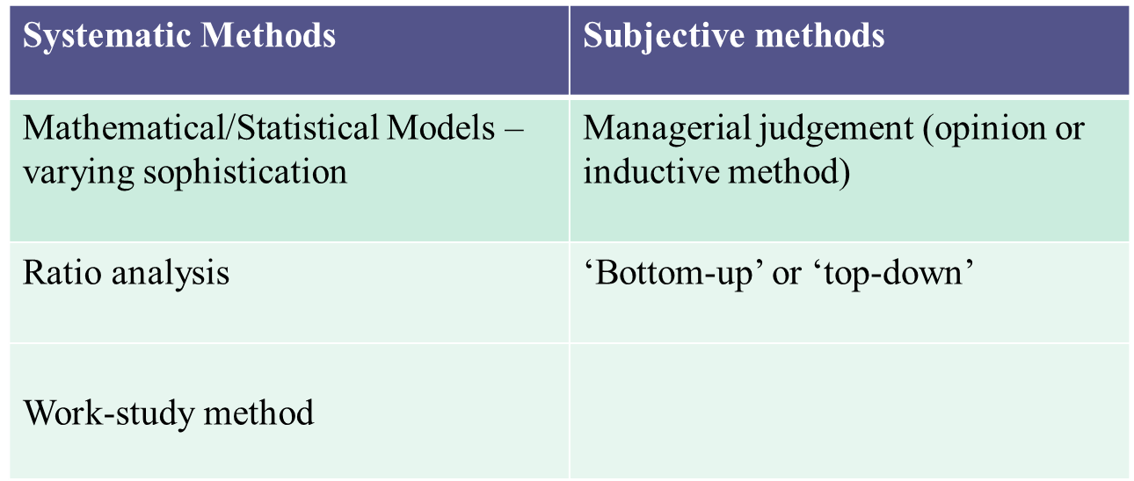
LO1: Demand Forecasting
Combination of objective (systematic) & subjective (managerial judgement ) methods may be used

Slide 11

LO1: Forecasting Supply and Demand
Internal Factors
External Factors

Slide 12
LO1: Supply Issues: factors affecting internal supply?
Internal supply is affected by various factors including:
Exits i.e. staff leaving the organisation because of:
resignations, dismissal, retirement, sickness
Reasons why people leave may be ascertained via qualitative measures to assess turnover including:
exit interviews & questionnaires, attitude surveys
Internal movements, workforce skills, personal attributes:
promotion, career progression or other movements
individual ability, nature & level of skills
attitudes, versatility, flexibility,
motivation & performance
Skills audits/scans of internal movements e.g. increase in ranks or grade, performance monitoring important

Slide 13
Supply issues: factors affecting external supply?
Demographics e.g. age profile of workforce, gender balance etc
Labour market trends e.g. unemployment levels, immigration & emigration etc
Economic cycle
Education output
Legislation
Political environment
Competitor behaviour
Enhanced customer & workforce expectations
Location
Transport links
Technological change
Notes:
Word wall activity

Slide 14
LO1: Reconciling Supply and Demand
Internal Factors
External Factors
In groups discuss how organisations can reconcile supply and demand when in a situation where:
Demand exceeds supply
Supply exceeds demand
Notes:
Group task:

Slide 15
LO1: Reconciling demand & supply: what measures may be used?
If demand exceeds supply Possible measures?
Increase external supply by:
Alter recruitment & selection criteria
different ages, gender, ethnic origin
different skills, qualifications, experiences
Alter recruitment & selection practices
advertise differently, target different labour markets
introduce new selection techniques, offer re-location
Change terms & conditions
more flexible working, improve pay & benefits
Increase internal supply by:
Train & develop existing staff
Alter internal movement patterns
promote differently, encourage lateral movement
Improve retention
change terms & conditions, introduce flexible working patterns
Reduce absenteeism
Redesign work
Use staff differently
overtime, multi-skilling, high performance work teams
Sub-contract work
Relocate work
Automate
Reduce demand by:
Notes:
In groups think of some strategies that organisations might use when demand for staff exceeds the supply.

Slide 16
LO1: Reconciling demand & supply: what measures may be used?
If supply exceeds demand | Possible measures?
Decrease supply | Early retirement Compulsory/voluntary redundancy Assisted career change & alternative employment Secondments, sabbaticals, career breaks
Discourage retention | Short term contracts Part time contracts Agency model
Increase demand | Increase markets for products & services Diversification
Source: Adapted from Rothwell (1995) cited in Beardwell & Clayden (2007:170) HRM: A Contemporary Approach, FT/Prentice Hall, Harlow
Notes:
In groups think of some strategies that organisations might use when demand for staff exceeds the supply.

Slide 17
........ and finally:
Plans should be flexible & reviewed regularly. The period will vary according to the size & type of organisation. More than one plan may be necessary. For example:
five-year strategic plan
three-year operating plan
six-monthly detailed plan
All levels of management and employees should be involved in the process
Process driven and ‘owned’ by senior management
Plans clearly linked to business and HR strategy
Not overly-complex
Plan on an issue-by-issue basis

