Slide 1


Module name: Psychology in Health and Social Care
Module code: LCHS4010
Assignment: Component 1: Presentation
Examining Isaac’s Development applying Bowlby’s Attachment Theory

Slide 2

Introduction
Isaac is a 4-year-old boy living in Children’s Centre.
His mother is a single mother and also has post-natal depression,
Bowlby’s Attachment Theory and examining early experiences of Isaac.
Notes:
Case overview
Isaac is a 4-year-old boy who is in Children’s Centre, London and resides with his single mother, having post-natal depression and low social assistance. Isaac’s childcare is highly disruptive and recently came to London.
Problems
The care professionals in Children Centre have said that Isaac is distressed, withdrawn, and quiet when away from his mother and his language development is delayed. There are issues with group work; he is highly clingy to his mother and cannot play on his own.
Aim
The aim of this presentation is application of Bowlby’s Attachment Theory to see how Isaac’s initial experiences affected social, emotional and broader development.

Slide 3
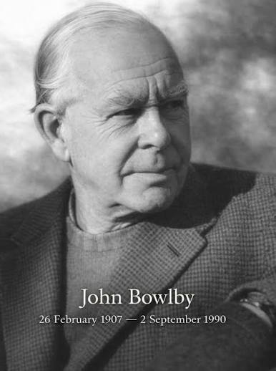
Bowlby’s Attachment Theory
Bowlby's theory comprises four stages (ClevelandClinic, 2025).
Isaac belongs to the fourth stage.
Theory explains emotional connections and early years.
Notes:
Concepts
Attachment Theory of Bowlby comprises four phases: pre-attachment (birth to 6 weeks), then attachment in-the-making (6 weeks to 7 months), clear-cut attachment (7- 2 years) and reciprocal connection (from 2 years) (ClevelandClinic, 2025). The main focus of Attachment Theory by Bowlby is that a child needs a strong connection with a caregiver. Isaac in the stage of reciprocal connection, where children are aware about separation and connection, while still requiring security from the caregiver.
Intrinsic working model
Children start developing an internalised working model regarding relationships, learning whom to trust and whether they are eligible for attention and care. These aspects influence their relationships along with emotions.
Developmental assumptions
The attachment process of children starts earlier among children from caregiving experiences. On the other hand, continuous disruption here affects trust and makes one emotionally unstable.
Relevance and usefulness
This theory is helpful for Isaac since, being 4 years old and in reciprocal or fourth stage, there are signs of clinginess along with distress at times of separation. Therefore, the theory serves two purposes since it gives a point of seeing how his past caregiving experiences are connected with present behaviour. The other reason is that the theory helps in knowing about his emotional development.

Slide 4
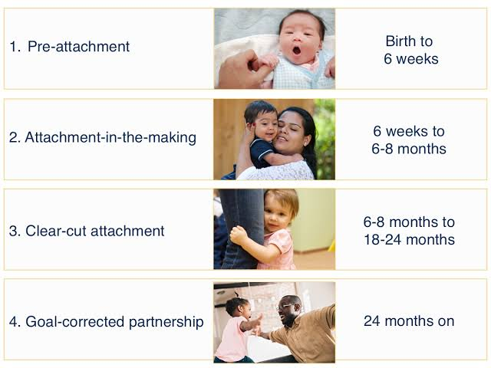
Using Bowlby’s Theory to Isaac
Isaac has encountered a completely disrupted childcare.
There is the negative impact caused due to maternal mental health.
Negative influences on emotional responses, low social interaction and language concerns.
Notes:
Disrupted childcare
Disruptions in childcare happened for Isaac across 2 years, and this affected attachment. The repeated changes bring lesser opportunities for creating stable and trustful connections with caregivers (Hodgson et al., 2024).
Maternal mental health
The condition of her mother is affected by post-natal depression and also less social constraint, hampering emotional availability and responsiveness. Therefore, both Isaac and his mother need support in this situation.
Poor social engagement
Poor social involvement and interactions imply that Isaac has less scope for communication and forming connections.
Emotional connection
The clinginess, issues with sleeping and distress show that Isaac needs security from a caregiver, which is lacking. As per the Attachment Theory, this insecurity shows a gap in early experiences where more protection and stability have been necessary. The theory further mentions, patterns such as avoidant or anxious or secure types. The distress and clinginess of Issac can be connected with anxious type looking for secure pattern, though the case do not give full evidence.
Language
The language delays create difficulty for Isaac in expressing feelings.

Slide 5
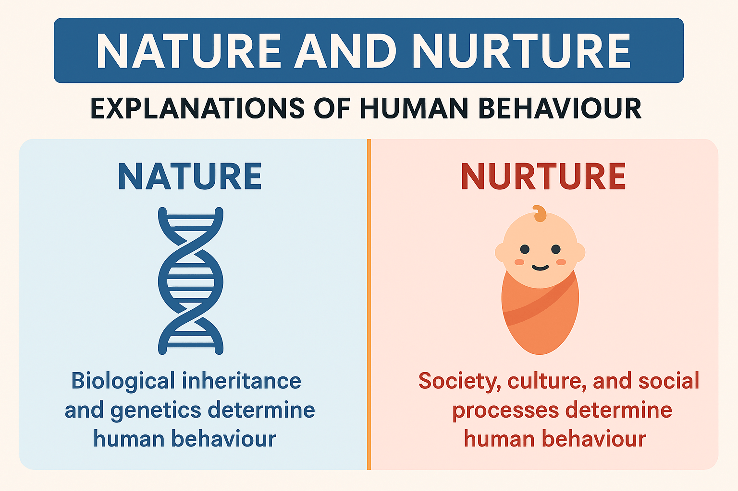
Nature and Nurture
The concept of nature implies biological influences inherent in a person (Szymkowicz et al., 2023).
Sensitive temperament can be part of Isaac’s nature.
Nurtures include the external and environmental influences.
Early relationships and influences are more seen in Isaac.
Notes:
Nature
Nature implies biological factors such as early development of the brain and temperament (Szymkowicz et al., 2023). In Isaac, there can be a highly sensitive temperament, though lacking evidence.
Nurture
Nurture implies the environmental influences such as social experiences and caregiving outcomes (Wang, 2023). For Isaac, the complications in maternal mental health and disruptions in childcare are environmental outcomes.
Attachment perception
Attachment Theory has focused on the significance of early relationships in caregiving, making nurture precise in case of Isaac. However, his development is influenced by interactions in terms of environmental and biological factors.

Slide 6

Influence on well-being and development
The emotional security of Isaac is completely affected.
Social development is hampered, along with communication.
This creates a negative impact on well-being and independence.
Notes:
Emotional protection
Isaac has issues of clinginess and distress, highlighting insecurity, not having his mother close by, affecting emotional regulation and confidence level.
Social development
The quiet withdrawal constrains Isaac’s opportunities in making friends and gaining social skills.
Communication
The language gaps affect involvement in learning and playing with others (Washington-Nortey et al., 2022).
Well-being
As per Bowlby’s Theory, having supportive and consistent connections can support Isaac in feeling protected, independent, and confident. Therefore, knowledge of his experiences of attachment is pivotal when planning advanced assistance.

Slide 7

Theory-informed practices
Bowlby’s Theory reinforces Isaac’s trust in the nursery setting.
Predictability and calmness support childcare (Honig, 2022).
Mother’s engagement enhances emotional context.
Notes:
Attachment-based outlooks
Bowlby’s theory highlights that it is necessary for Isaac for having sensitive and stable relationships. It is essential for consistently keeping a nursery professional to build trust as well as safety.
Play-based learning
The care staff can engage Isaac with stories, play, and simple interactions for helping him to be expressive. However, it is necessary for these activities to be predictable as well as calm (Honig, 2022).
Parental support and modelling
It is also necessary for Isaac’s mother to receive parental and mental health assistance. The support given to his mother makes the emotional environment develop well around Isaac.
Linking Theory
These practices are all oriented to Bowlby’s Theory since it gives Isaac a secure foundation. This increases safety, facilitates exploration, influences communication and makes him independent.

Slide 8

Critical examination of Bowlby’s Theory
Attachment Theory gives value to improve intervention for early years.
Theory does not look into diverse bonding.
Requires cultural responses and adaptive assimilation.
Notes:
Strengths and usefulness
An important aspect of Bowlby’s Theory is that it highlights the role of earlier experiences and relationships. This theory is effective to develop early years intervention since it tells professionals about withdrawal, distress from separation and difficulty in putting trust in caregivers.
Limitations
Attachment Theory most of the time emphasises the sole caregiver or the mother (McLeod, 2025). However, a child can form connections with multiple persons.
Context
Families include multiple practices of caregiving, diverse languages, and structural forms. It is necessary for professionals not to assume that only type of attachment is applicable to all families.
Relevance
The families in London have diverse social and cultural contexts. Bowlby’s Theory is helpful, while professionals have to integrate the theory in a flexible manner, with respect, recognising, family of the child, their language and culture.

Slide 9

Recommendations
Daily safety planning needs to be done (Hayes, 2023).
Isaac’s mother needs involvement.
Regular progress needs examination.
Notes:
Early assistance
The early years staff can make a daily plan that aligns with safety and comfort (Hayes, 2023). The staff have to respond in a calm manner and motivates Isaac to play independently.
Family coordination
The professionals had to involve Isaac’s mother in the care plan and identify his mother’s needs without saying that her behaviour hampered Isaac.
Controlling and monitoring
There needs regular reviewing of Isaac's progress, and it is necessary to share updates with all the members. These include his mother, care staff, and other professionals, focusing on Isaac’s communication, social and emotional requirements.

Slide 10

Multi-agency and extended support
Multi-agency functioning helps in addressing developmental requirements.
Teamwork focuses on communication, emotional and social objectives.
Comprehensive approach increases security, involvement.
Notes:
Multi-agency functioning
Isaac can gain support from multiple professionals, as maternal assistance needs to be given to his mother and early years care professionals can see Isaac’s relationships and behaviour. In addition, the language and speech professional can see the communication needs (Roth and Worthington, 2023).
Reasons for teamwork
Attachment Theory emphasises relationships, while in the case of Isaac, his requirements move beyond attachment. Therefore, all aspects need focus to solve social, emotional and language concerns.
Extended goal
The aim is not restricting Isaac from being upset; rather, there is the need for him to form confidence, security, autonomy, positive connections and engagement. On the other hand, his progress has to be seen so that it becomes a holistic and child-centric outlook.

Slide 11

Conclusion
Attachment Theory helps in explaining clinginess and Isaac’s sadness.
Requires broader insights.
Isaac needs stability and confidence.
Notes:
Based on the above presentation, it can be said that Attachment Theory provides an important means of understanding the position of Isaac. This happens since, through this theory, there is seeing and assessing the aspects of distress caused by separation, disruption in childcare and clinginess. All these are linked to initial relationships, including family connections. On the other hand, Isaac's situation has to be seen by combining wider insights, since there are also issues of delays in language and social connections. The supportive, sensitive and stable connections can make Isaac have confidence and gain autonomy in this process.

Slide 12
References
Christie, K.N. and Sandoval, A., (2024). Attachment styles and traumatic responses: Exploring the impact of parental interaction on child development and coping mechanisms. Open Journal of Psychiatry, 14(5), pp.467-489. https://www.scirp.net/pdf/ojpsych2024145_31420911.pdf
ClevelandClinic (2025) What Is Attachment Theory? And How Does It Impact You?, Cleveland Clinic. Available at: https://health.clevelandclinic.org/attachment-theory (Accessed: August 8, 2026).
‌Hayes, N., (2023). Early years practice: Getting it right from the start. Taylor & Francis.
Hodgson, S., Noack, K., Griffiths, A. and Hodgins, M., (2024). Between equilibrium and chaos, with little restitution: a narrative analysis of qualitative interviews with clinicians and parent carers of children with medical complexity. BMC health services research, 24(1), p.504. https://link.springer.com/content/pdf/10.1186/s12913-024-10973-6.pdf
Honig, A.S., (2022). Essentials for excellence in quality early child care. Early Child Development and Care, 192(12), pp.1940-1951. https://www.researchgate.net/profile/Alice-Honig/publication/353966945_Essentials_for_excellence_in_quality_early_child_care/links/614b700da3df59440ba4877a/Essentials-for-excellence-in-quality-early-child-care.pdf
McLeod, S.P. (2025) Attachment Theory In Psychology, Simply Psychology. Available at: https://www.simplypsychology.org/attachment.html (Accessed: August 8, 2026).
Roth, F.P. and Worthington, C.K., (2023). Treatment resource manual for speech-language pathology. Plural Publishing.
Szymkowicz, S.M., Gerlach, A.R., Homiack, D. and Taylor, W.D., (2023). Biological factors influencing depression in later life: role of aging processes and treatment implications. Translational Psychiatry, 13(1), p.160. https://www.nature.com/articles/s41398-023-02464-9.pdf
Wang, Y., (2023). Influence of early family nurturing environment on children’s psychological and emotional social development. Iranian Journal of Public Health, 52(10), p.2138. https://pmc.ncbi.nlm.nih.gov/articles/PMC10612553/pdf/IJPH-52-2138.pdf
Washington-Nortey, P.M., Zhang, F., Xu, Y., Ruiz, A.B., Chen, C.C. and Spence, C., (2022). The impact of peer interactions on language development among preschool English language learners: A systematic review. Early Childhood Education Journal, 50(1), pp.49-59. https://www.academia.edu/download/100333112/s10643-020-01126-520230327-1-d763hz.pdf

