Slide 1
Module Name : Electronics II
Module Code : ACDA6001
Topic : VHDL 2
Lecture : 12
Lecture By,
Mrs. Jenifer Prince Devaraj,
Lecturer - Embedded Electronics,
Faculty of Applied Computing,
UWTSD
Email:j.prince-devaraj@uwtsd.ac.uk

Slide 2
VHDL Codes
VHDL Codes for
OR Gate
Full Adder
Multiplexer
Binary Multiplier
JK Flip-flop

Slide 3
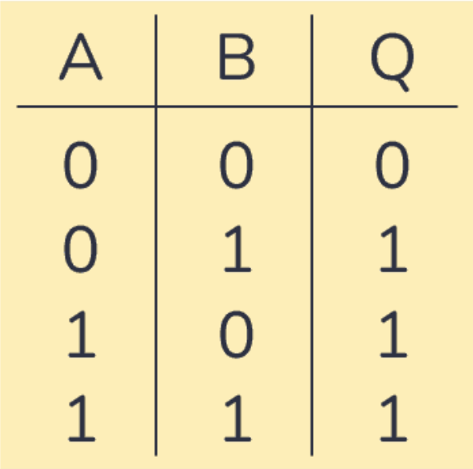
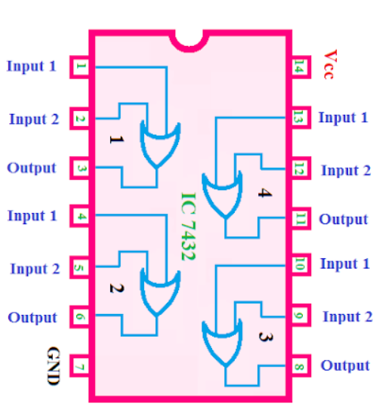
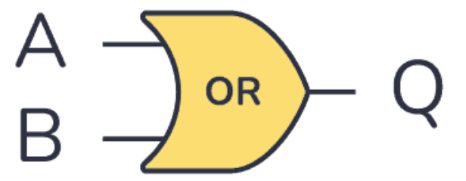

VHDL Codes
OR Gate
The OR gate performs a logical addition.
Truth table
Pin Diagram
Logic symbol
$$Q=A+B$$

Slide 4
VHDL Codes
OR Gate
library IEEE;
use IEEE.std_logic_1164.all;
-- Entity declaration
entity orGate is
port(A : in std_logic; -- OR gate input
B : in std_logic; -- OR gate input
Y : out std_logic); -- OR gate output
end orGate;
-- Dataflow Modelling Style
-- Architecture definition
architecture orLogic of orGate is
begin
Y <= A OR B;
end orLogic;

Slide 5
VHDL Codes
OR Gate – Test Bench
begin
uut: orGate port map ( A => A,
B => B,
Y => Y );
stimulus: process
begin
A<= '0';
B<= '0';
wait for 10 ns;
A<= '0';
B<= '1';
wait for 10 ns;
A<= '1';
B<= '0';
wait for 10 ns;
A<= '1';
B<= '1';
wait for 10 ns;
end process;
end;
library IEEE;
use IEEE.STD_LOGIC_1164.ALL;
entity orGate_tb is
end;
architecture bench of orGate_tb is
component orGate
port(A : in std_logic;
B : in std_logic;
Y : out std_logic);
end component;
signal A: std_logic;
signal B: std_logic;
signal Y: std_logic;

Slide 6
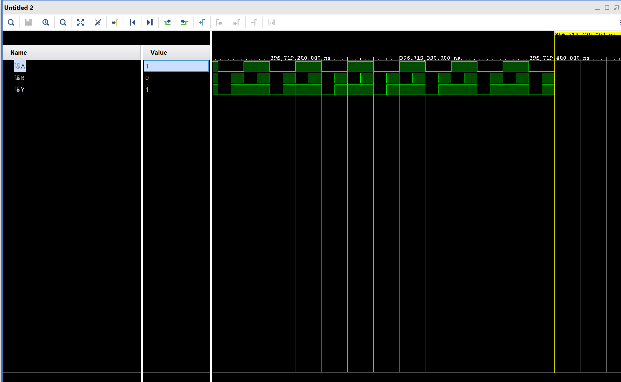
VHDL Codes
OR Gate – Simulation Output

Slide 7
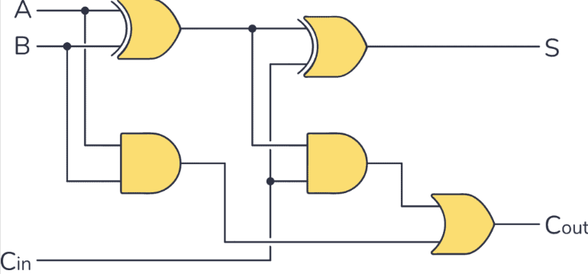


VHDL Codes
Full Adder
Truth Table
Logic Diagram
INPUTS |  |  | OUTPUTS
A | B | C_{in} | C_{out} | SUM
0 | 0 | 0 | 0 | 0
0 | 0 | 1 | 0 | 1
0 | 1 | 0 | 0 | 1
0 | 1 | 1 | 1 | 0
1 | 0 | 0 |  | 1
1 | 0 | 1 | 1 | 0
1 | 1 | 0 | 1 | 0
1 | 1 | 1 | 1 | 1

Slide 8
VHDL Codes
Full Adder – VHDL Code
library IEEE;
use IEEE.STD_LOGIC_1164.ALL;
use IEEE.STD_LOGIC_ARITH.ALL;
use IEEE.STD_LOGIC_UNSIGNED.ALL;
entity full_adder is port
(a,b,c:in bit; sum,carry:out bit);
end full_adder;
architecture data of full_adder is
begin
sum<= a xor b xor c;
carry <= ((a and b) or (b and c) or (a and c));
end data;

Slide 9
VHDL Codes
Full Adder – Test Bench VHDL Code
library IEEE;
use IEEE.STD_LOGIC_1164.ALL;
entity full_adder_tb is
end;
architecture bench of full_adder_tb is
component full_adder port
(a,b,c:in bit; sum,carry:out bit);
end component;
signal a,b,c: bit;
signal sum,carry: bit;
begin
uut: full_adder port map ( a => a,
b => b,
c => c,
sum => sum,
carry => carry );
stimulus: process
begin
a <= '0';
b<= '0';
c<= '0';
wait for 10ns;
a <= '0';
b<= '0';
c<= '1';
wait for 10ns;
a <= '0';
b<= '1';
c<= '0';
wait for 10ns;
a <= '0';
b<= '1';
c<= '1';
wait for 10ns;
a <= '1';
b<= '0';
c<= '0';
wait for 10ns;
a <= '1';
b<= '0';
c<= '1';
wait for 10ns;
a <= '1';
b<= '1';
c<= '0';
wait for 10ns;
a <= '1';
b<= '1';
c<= '1';
wait for 10ns;
end process;
end;

Slide 10
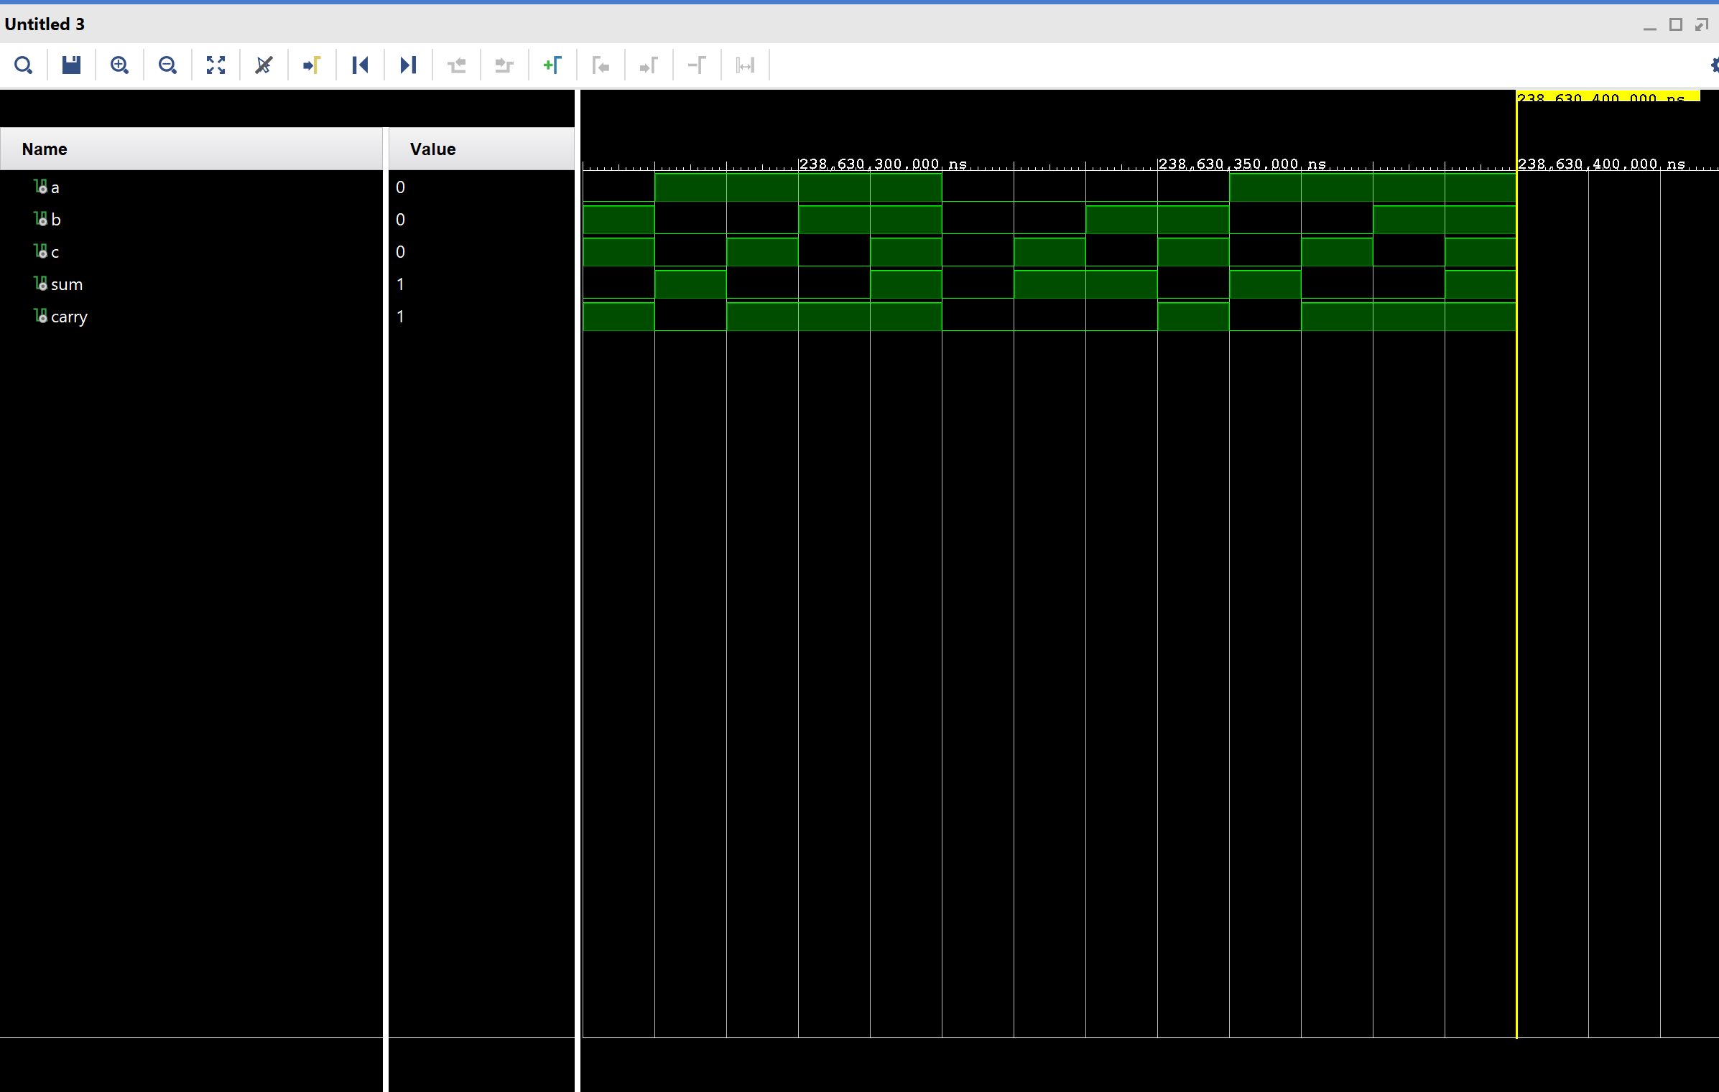
VHDL Codes
Full Adder – Simulation

Slide 11
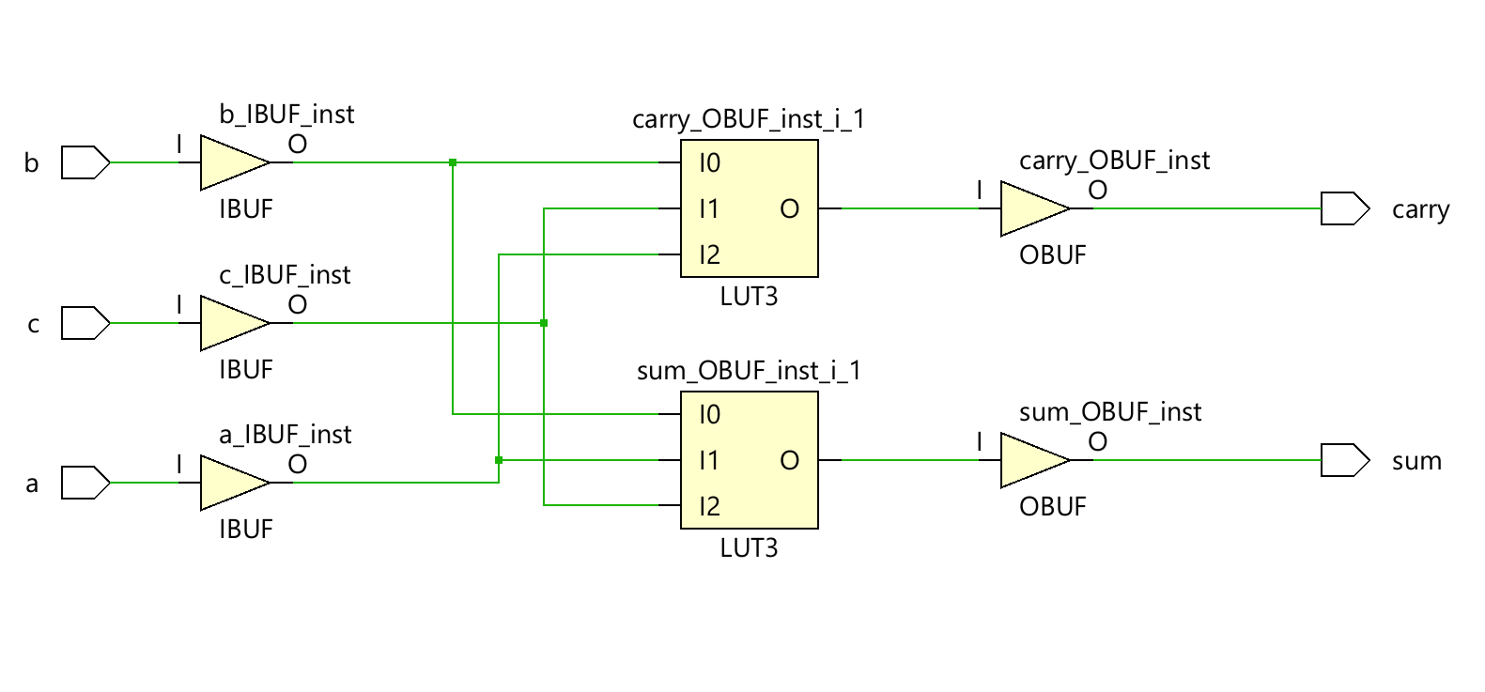
VHDL Codes
Full Adder – Schematic

Slide 12
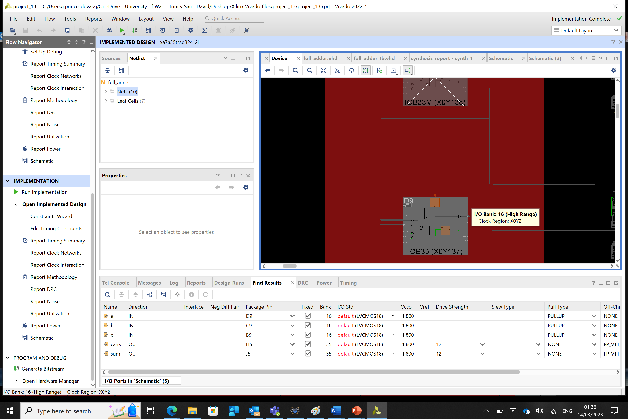
VHDL Codes
Full Adder – Implemented Results in FPGA

Slide 13
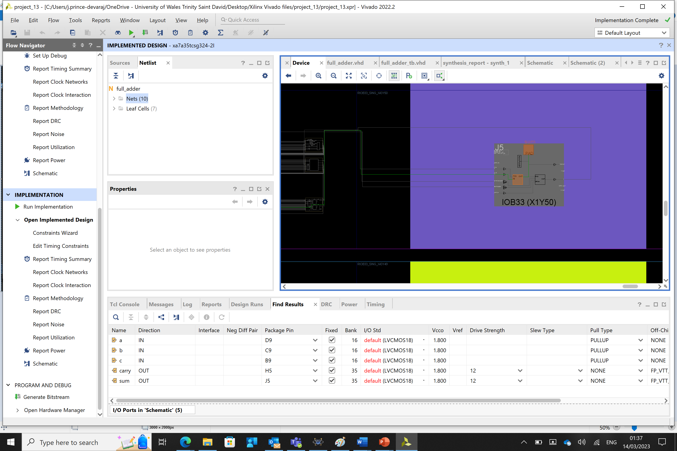
VHDL Codes
Full Adder – Implemented Results in FPGA

Slide 14
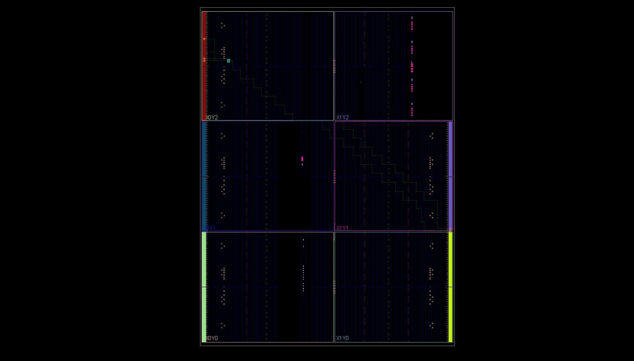
VHDL Codes
Full Adder – Implemented Results in FPGA

Slide 15
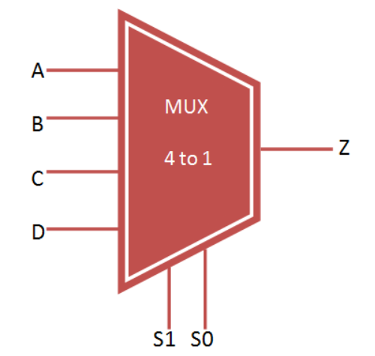
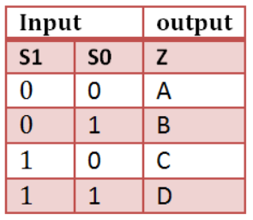
VHDL Codes
Multiplexer

Slide 16
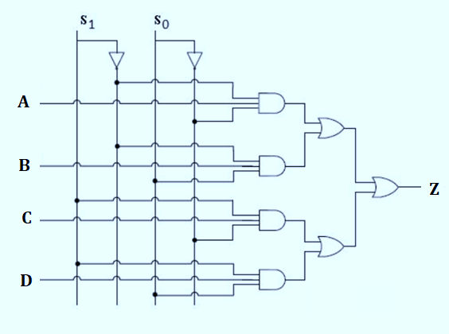

VHDL Codes
Multiplexer
4:1 Multiplexer – Logic Diagram
$$Z= A\overline{S_{1}}\overline{S_{0}}+ B\overline{S_{1}}S_{0}+CS_{1}\overline{S_{0}}+DS_{1}S_{0}$$

Slide 17
VHDL Codes
Multiplexer – VHDL Code
architecture bhv of mux_4to1 is
begin
process (A,B,C,D,S0,S1) is
begin
if (S0 ='0' and S1 = '0') then
Z <= A;
elsif (S0 ='1' and S1 = '0') then
Z <= B;
elsif (S0 ='0' and S1 = '1') then
Z <= C;
else
Z <= D;
end if;
end process;
end bhv;
use IEEE.STD_LOGIC_1164.ALL;
entity mux_4to1 is
port(
A,B,C,D : in STD_LOGIC;
S0,S1: in STD_LOGIC;
Z: out STD_LOGIC
);
end mux_4to1;

Slide 18
VHDL Codes
Multiplexer – Test Bench VHDL Code
A <= '1';
B <= '0';
C <= '1';
D <= '0';
S0 <= '0'; S1 <= '0';
wait for 100 ns;
S0 <= '1'; S1 <= '0';
wait for 100 ns;
S0 <= '0'; S1 <= '1';
wait for 100 ns;
S0 <= '0'; S1 <= '1';
wait for 100 ns;
end process;
end;
library IEEE;
use IEEE.STD_LOGIC_1164.ALL;
component mux_4to1
port(
A : in std_logic;
B : in std_logic;
C : in std_logic;
D : in std_logic;
S0 : in std_logic;
S1 : in std_logic;
Z : out std_logic
);
end component;
--inputs
signal A : std_logic := '0';
signal B : std_logic := '0';
signal C : std_logic := '0';
signal D : std_logic := '0';
signal S0 : std_logic := '0';
signal S1 : std_logic := '0';
--outputs
signal Z : std_logic;
begin
-- instantiate the unit under test (uut)
uut: mux_4to1 port map (
A => A,
B => B,
C => C,
D => D,
S0 => S0,
S1 => S1,
Z => Z
);
-- stimulus process
stim_proc: process
begin
-- hold reset state for 100 ns.
wait for 100 ns;

Slide 19
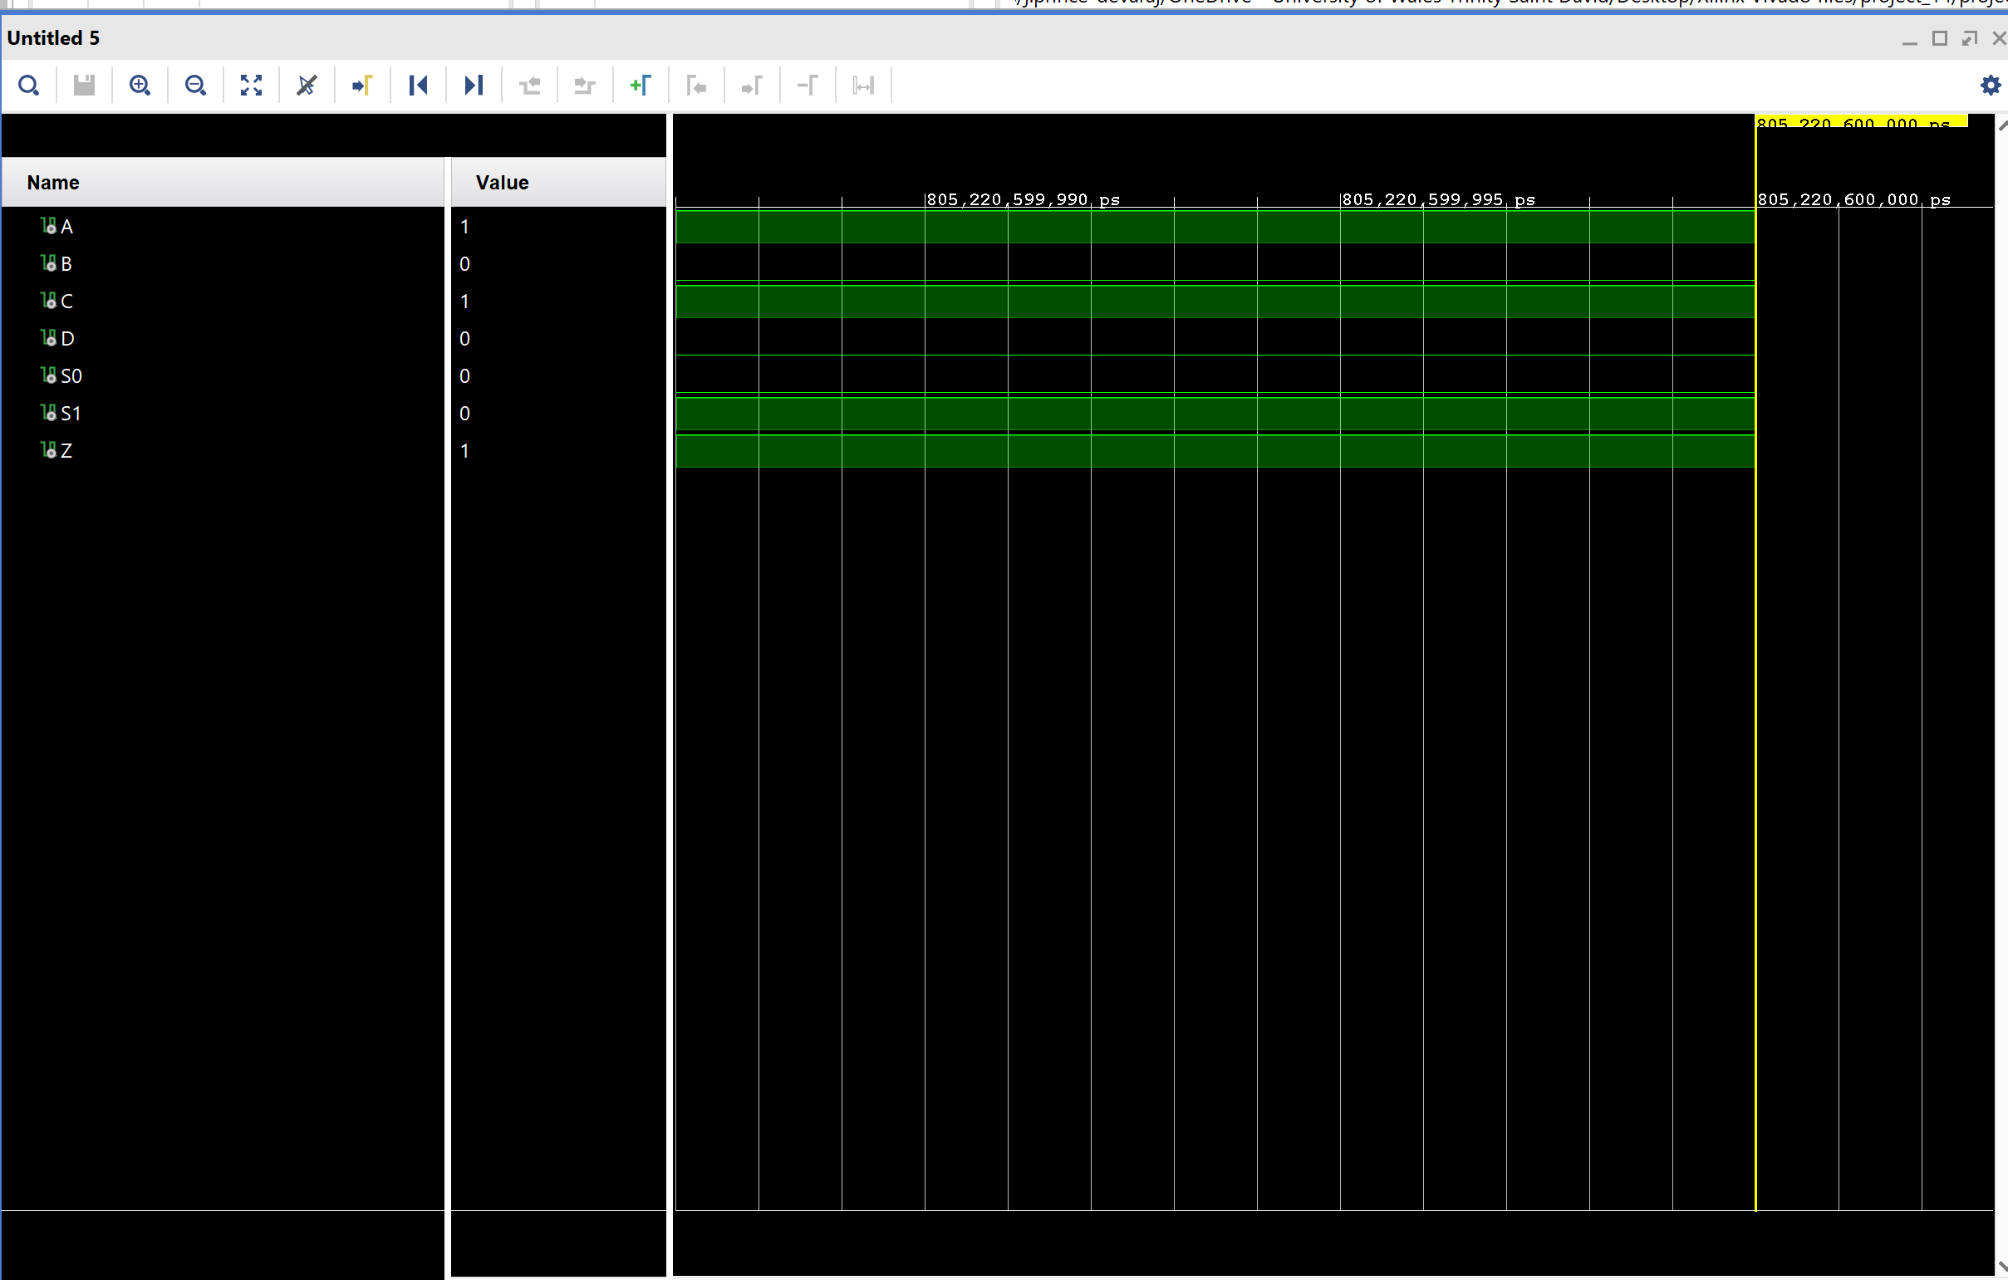
VHDL Codes
Multiplexer – Simulation

Slide 20
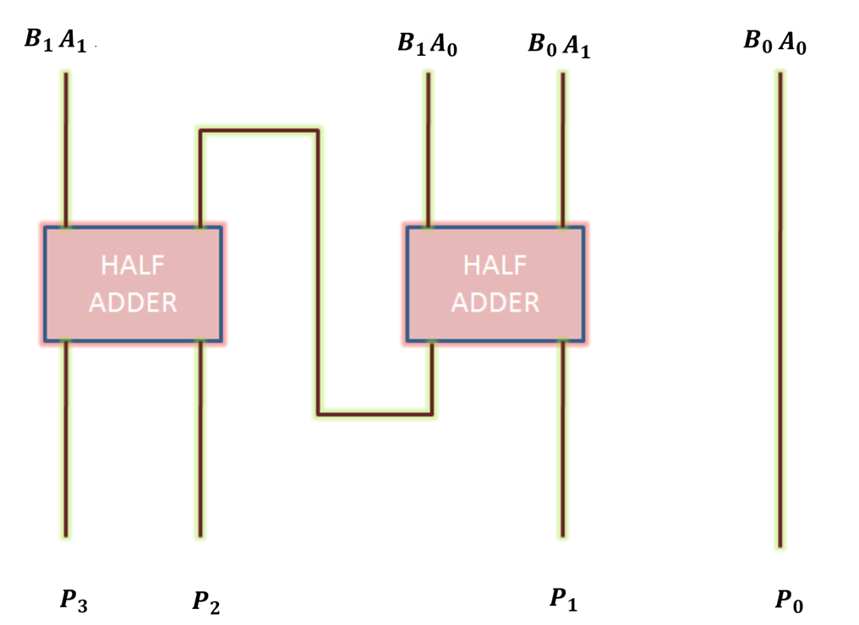
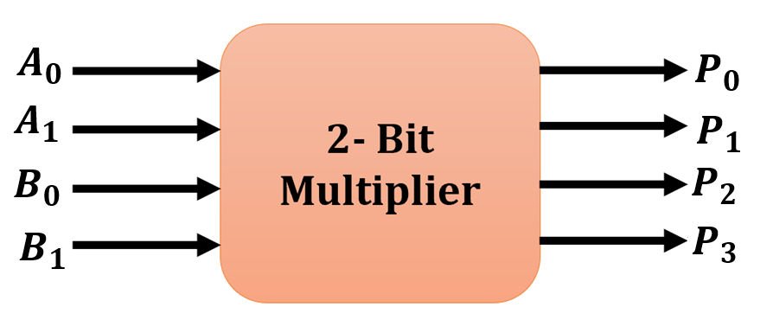
Xilinx VIVADO
Binary Multipliers
A Binary Multiplier is a digital circuit used in digital electronics to multiply two binary numbers and provide the result as output.
Example : Block Diagram for an 2- Bit Multiplier is shown below

Slide 21
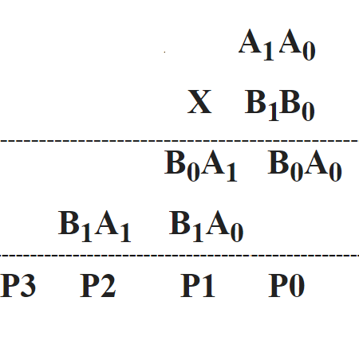
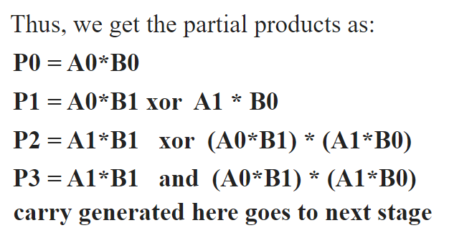
Xilinx VIVADO
Binary Multipliers

Slide 22
Xilinx VIVADO
VHDL Code for Binary Multipliers
library ieee;
use ieee.std_logic_1164.all;
entity multiply is
port (A, B : in bit_vector(1 downto 0);
P : out bit_vector(3 downto 0));
end multiply;
architecture dataflow of multiply is
begin
P(0) <= A(0) AND B(0);
P(1) <= (A(1) AND B(0)) XOR (A(0) AND B(1));
P(2) <= ((A(1) AND B(0)) AND (A(0) AND B(1))) XOR (A(1) AND B(1));
P(3) <= ((A(1) AND B(0)) AND (A(0) AND B(1))) AND (A(1) AND B(1));
end architecture;

Slide 23
Xilinx VIVADO
Simulation – Test Bench
Force:process
constant period: time := 20 ns;
begin
A <= "00";
B <= "00";
wait for period;
A <= "00";
B <= "01";
wait for period;
A <= "00";
B <= "10";
wait for period;
A <= "00";
B <= "11";
wait for period;
A <= "01";
B <= "00";
wait for period;
A <= "01";
B <= "01";
wait for period;
A <= "01";
B <= "10";
wait for period;
library ieee;
use ieee.std_logic_1164.all;
entity multiply_behav_tb is
end multiply_behav_tb;
architecture tb of multiply_behav_tb is
component multiply_behav is
port (A, B : in bit_vector(1 downto 0);
P : out bit_vector(3 downto 0)
);
end component;
signal A, B : bit_vector(1 downto 0);
signal P : bit_vector(3 downto 0);
begin
UUT : multiply_behav port map (
A => A,
B => B,
P => P);
A <= "11";
B <= "10";
wait for period;
A <= "11";
B <= "11";
wait for period;
wait;
end process;
end tb;
A <= "01";
B <= "11";
wait for period;
A <= "10";
B <= "00";
wait for period;
A <= "10";
B <= "01";
wait for period;
A <= "10";
B <= "10";
wait for period;
A <= "10";
B <= "11";
wait for period;
A <= "11";
B <= "00";
wait for period;
A <= "11";
B <= "01";
wait for period;

Slide 24
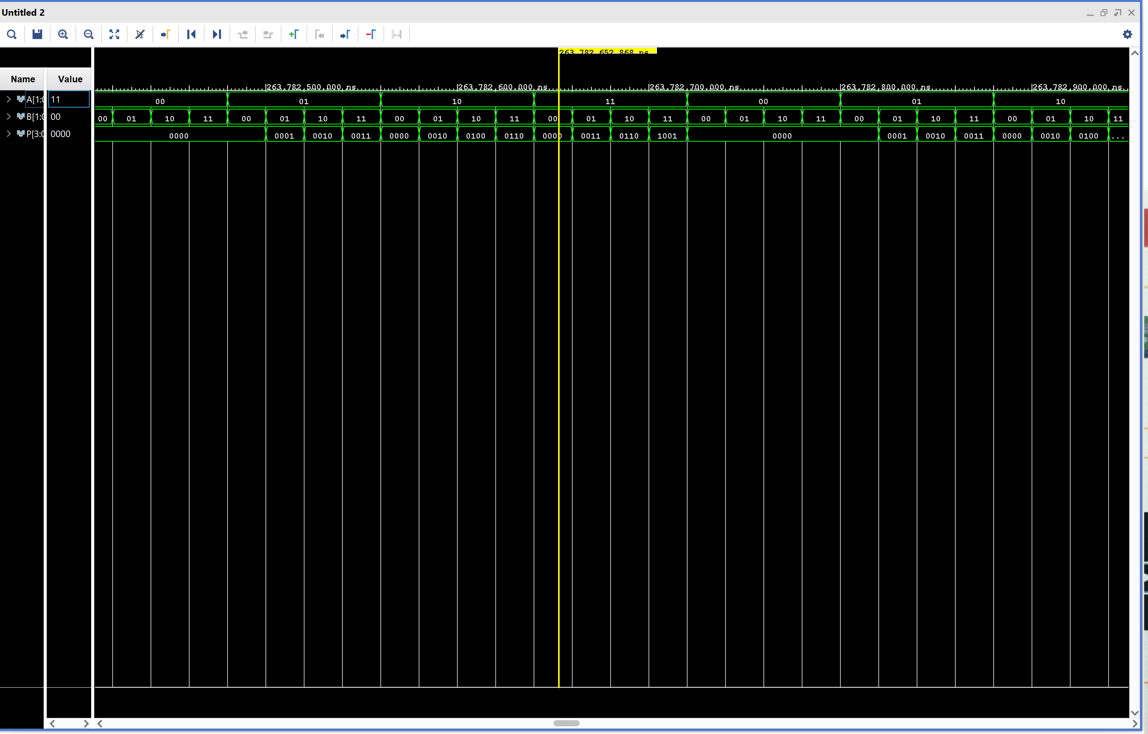
Xilinx VIVADO
Simulation - Binary Multipliers

Slide 25
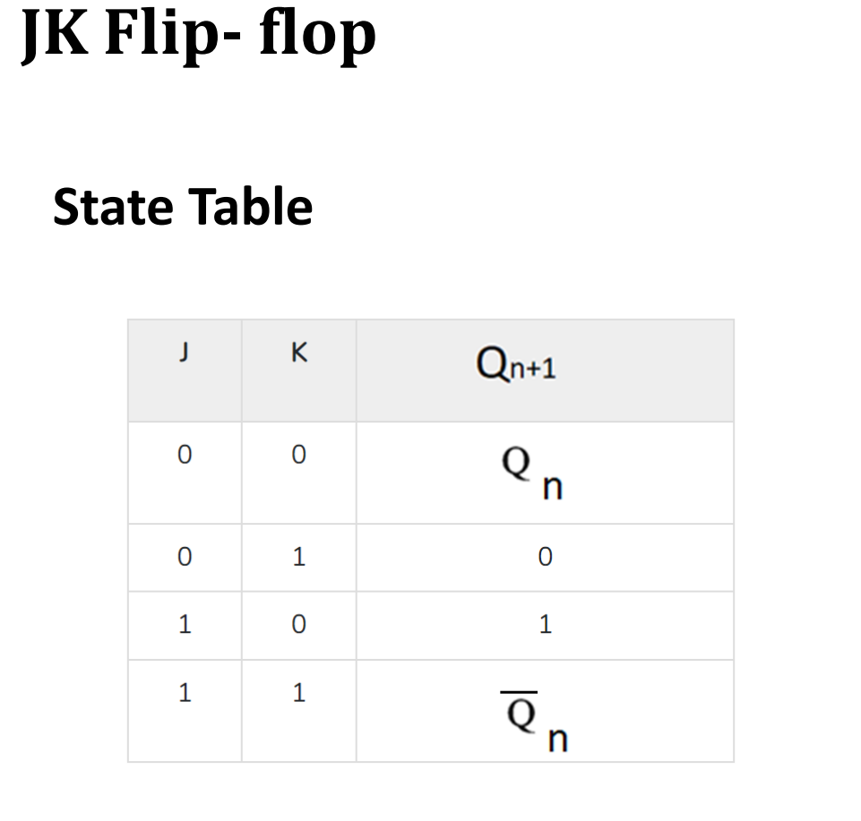
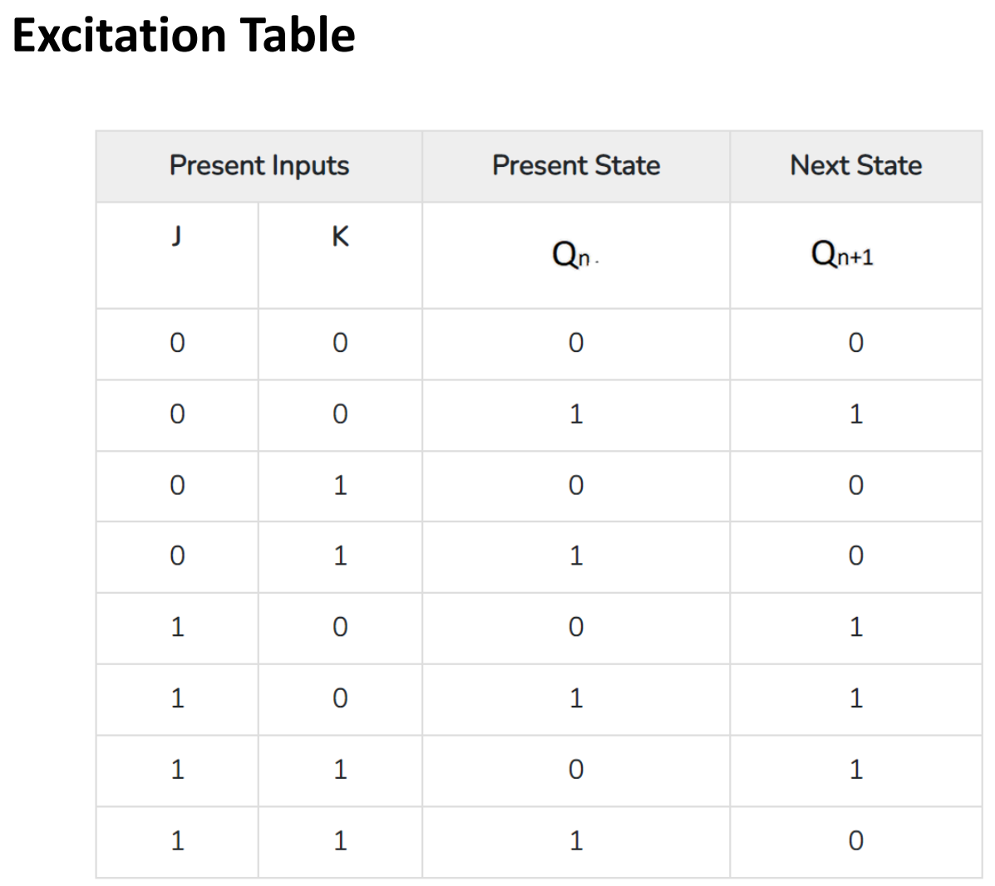
Xilinx VIVADO

Slide 26
Xilinx VIVADO
JK – Flip flop
begin
input<=j&k;
process(clk,j,k,pr,cr)
variable temp:std_logic:='0';
begin
if(cr='1' and pr='1')then
if rising_edge(clk) then
case input is
when "10"=> temp:='1';
when "01"=> temp:='0';
when "11"=> temp:=not temp;
when others=> null;
end case;
library ieee;
use ieee. std_logic_1164.all;
use ieee. std_logic_arith.all;
use ieee. std_logic_unsigned.all;
entity jk is
port(j,k,cr,pr,clk:in std_logic;
q,qbar:out std_logic);
end jk;
architecture behavioural of jk is
signal input:std_logic_vector(1 downto 0);
end if;
else
temp:='0';
end if;
q<=temp;
qbar<=not temp;
end process;
end behavioural;

Slide 27
Xilinx VIVADO
JK – Flipflop test bench
begin
-- Connect DUT
DUT: jk port map(
j => j,
k => k,
cr => cr,
pr => pr,
clk => clk,
q => q,
qbar => qbar
);
clk <= not clk after 1 ns;
process
begin
cr <= '1';
pr <= '1';
j <= '0';
k <= '1';
wait for 2 ns;
cr <= '1';
pr <= '1';
j <= '1';
k <= '1';
wait for 2 ns;
wait;
end process;
end tb;
cr <= '1';
pr <= '1';
j <= '0';
k <= '0';
wait for 2 ns;
cr <= '1';
pr <= '1';
j <= '1';
k <= '0';
wait for 2 ns;
entity jk_tb is
-- empty
end jk_tb;
architecture tb of jk_tb is
-- DUT component
component jk is
port(j,k,cr,pr,clk:in std_logic;
q,qbar:out std_logic);
end component;
signal j,k,cr,pr, clk: std_logic := '0';
signal q,qbar: std_logic;

Slide 28
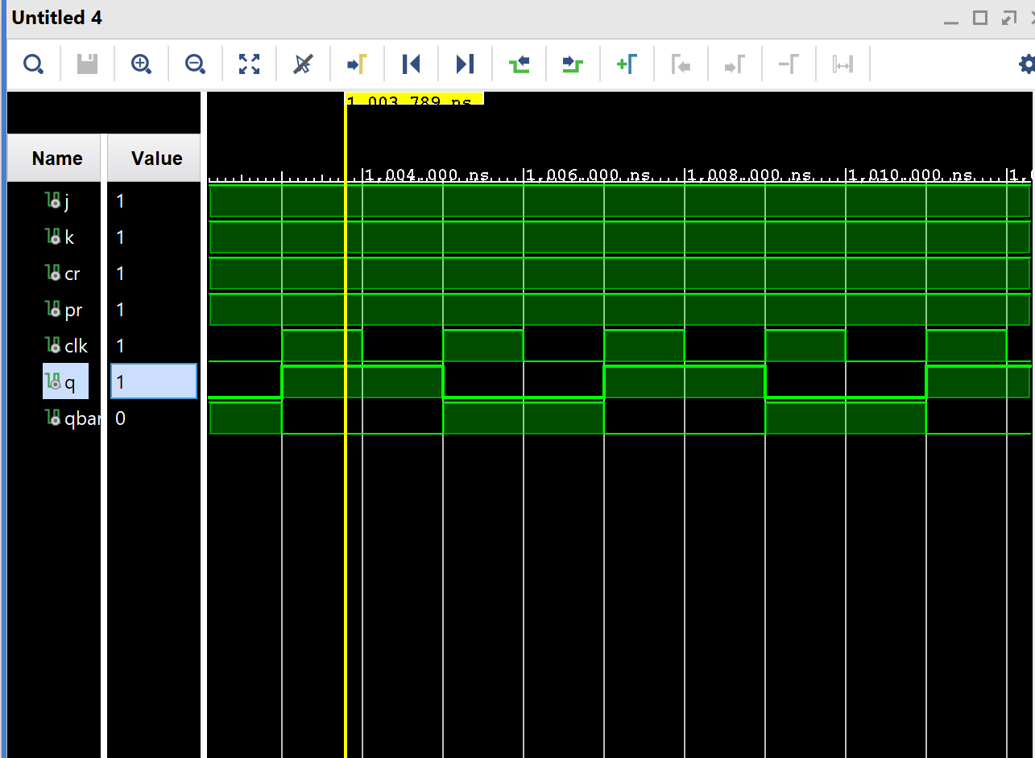
Xilinx VIVADO
JK - FLipflop

Slide 29
Thank you

