Slide 1
‘The question is not, can they reason, nor can they talk, but can they suffer’ (Bentham).
Discuss in relation to the principle of equality and animals.

Slide 2
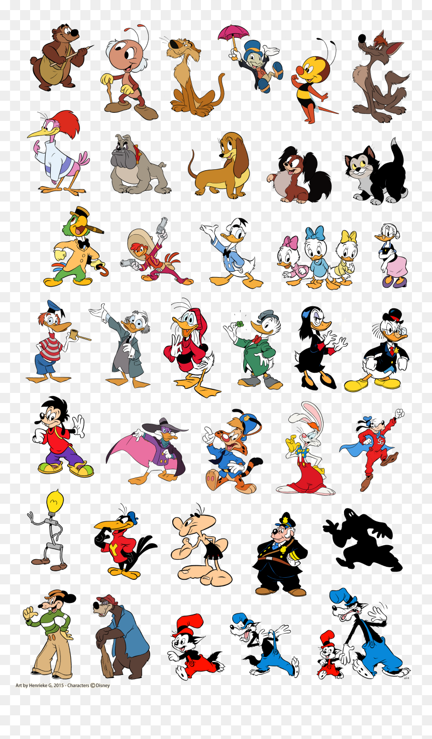
Background:
Records of human and non-human relationships extend as far back as cave dwellers
for food, domestication as pets, rearing for food, used in religion for worship or sacrifice
Arluke and Sanders (1996, p.10) that children learn through Disney movies, fairy tales and listening to parents what constitutes wild animals and those which are tame and kept as pets
Animal liberation groups “have emerged out of ideas, theories, and actions based upon the seemingly simple, but profoundly radical, premise that nonhuman animals are subjects with agency, not objects to be used as humans see fit.” (Nocella et al, 2014)

Slide 3
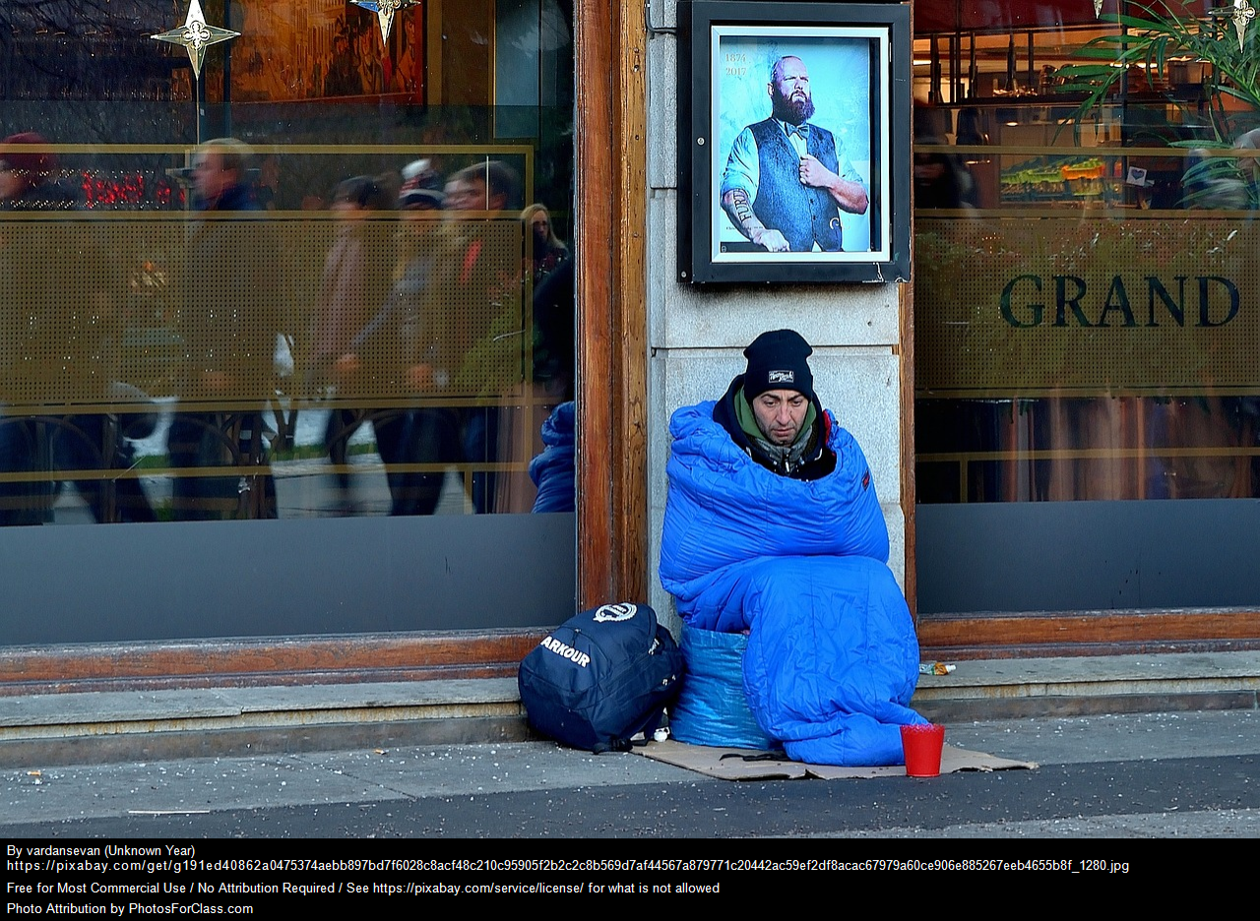
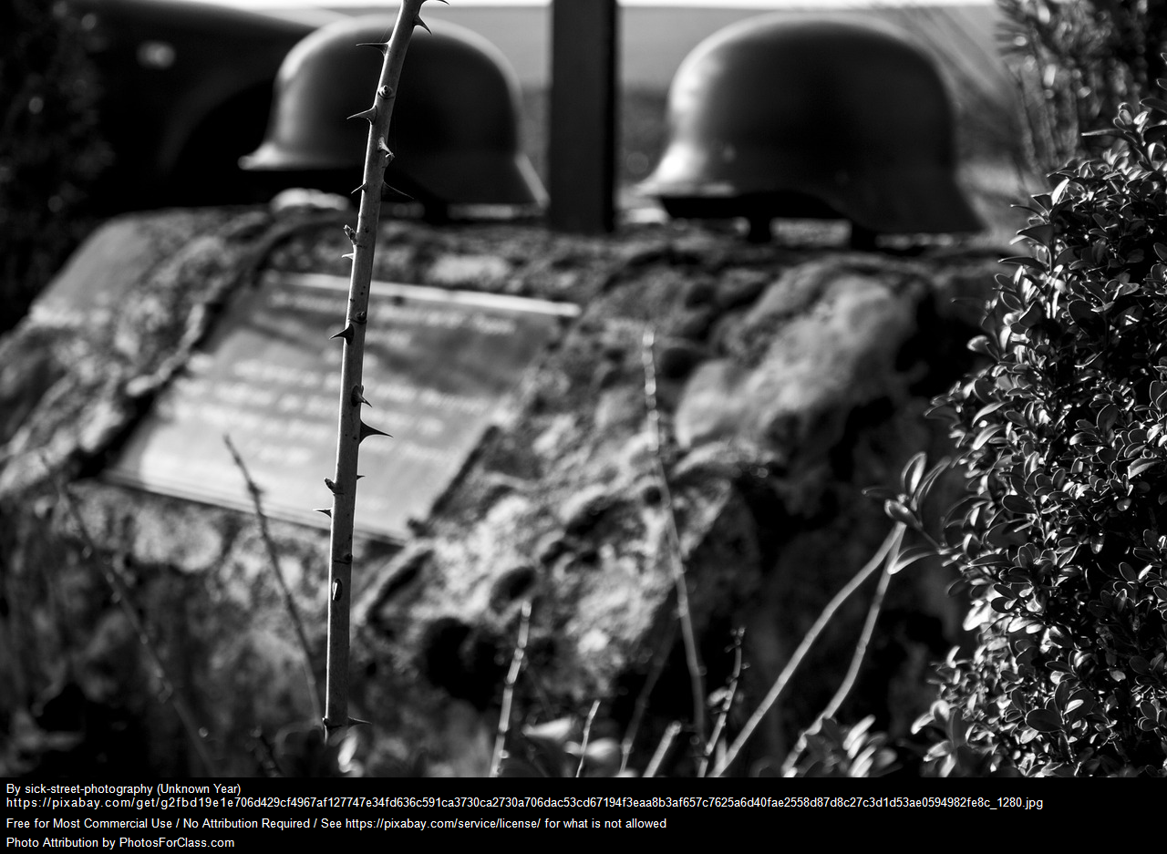


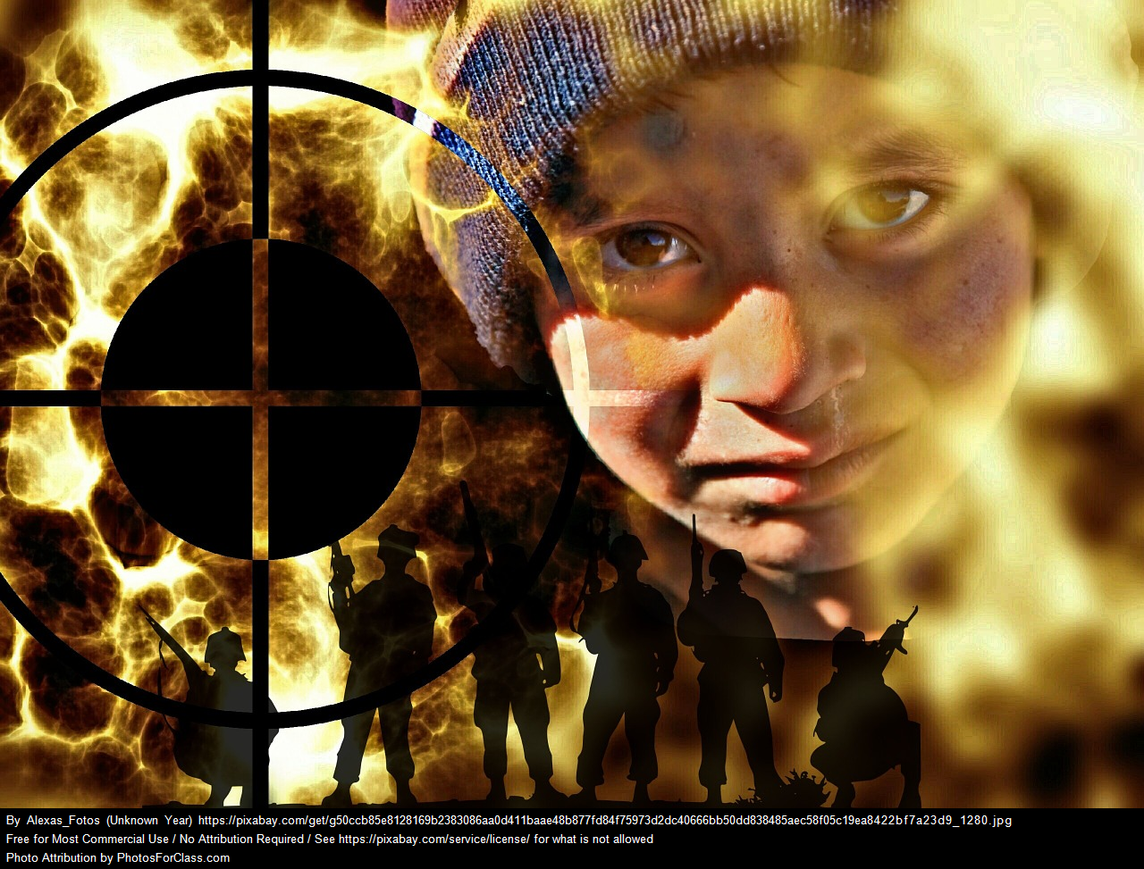
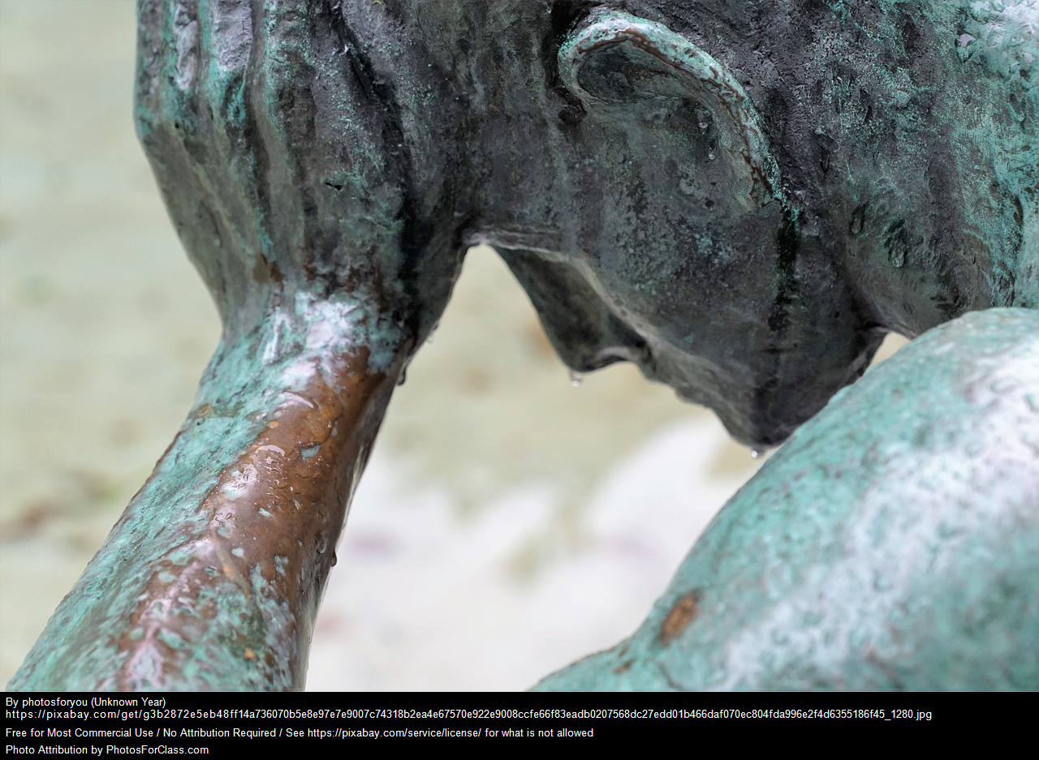

WHAT DETERMINES SUFFERING?

Slide 4

Womens Rights
Racism
Differences not a reason for depriving equal rights
Rights to exist

Slide 5


conclusion

