Slide 1

LCLM4006 · ENTERPRISE AND ENTREPRENEURSHIP
PureBake London
Beautiful baking, without compromise.
Individual Presentation Pitch — Assessment Task 2
Student: Aset Abdusalamova · No: 2511403
Lecturer: Mustakkima Afrin
Programme: Certificate in HE Business Skills for the Workplace
University: University of Wales Trinity Saint David — London Campus

Slide 2
Contents
01
Introduction
05
Marketing Strategies
02
Overview of the Business Idea
06
Funding Requirements & Allocation
03
Legal Format & Management Structure
07
Conclusions
04
PESTEL Analysis
08
References
2

Slide 3
SECTION
Introduction
Purpose of the presentation
PureBake London is a specialist bakery for customers who want delicious bakery products with dietary-friendly choices.
This presentation evaluates the business idea, company structure, external environment, marketing approach and financial requirements.
The goal is to demonstrate how PureBake London can become a profitable and scalable London bakery brand.
3

Slide 4
SECTION 1
Overview of the Business Idea
What We Offer
Competitive Advantage
Who It's For
Gluten-free artisan bread
Free-from range without compromising on taste
Personalised celebration cakes
Same-day delivery & online ordering
Seasonal menus
Coeliac & lactose-intolerant customers
Health-conscious consumers & fitness enthusiasts
Parents seeking healthier snacks
Dairy-free cakes
Reduced-sugar desserts
Market Need — the Evidence
Vegan cookies & muffins
A UK study tracked coeliac disease from 2000–2020: diagnosed cases nearly doubled. By 2020, about 1 in 278 people in the UK had coeliac disease — almost twice the 2010 rate.
Fresh pastries
Sustainability
Coffee, matcha & herbal teas
Recyclable packaging & reduced food waste
Charity partnerships for surplus food
Locally sourced ingredients where possible
Personalised celebration cakes
64%
of UK coeliac cases are still undiagnosed.
4

Slide 5


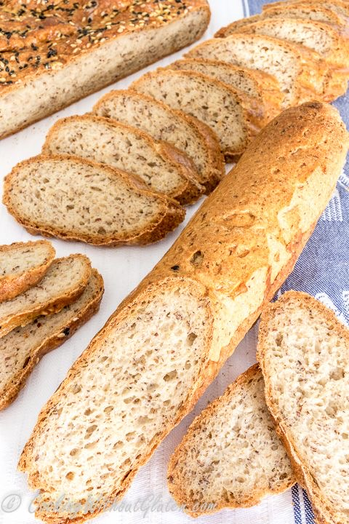
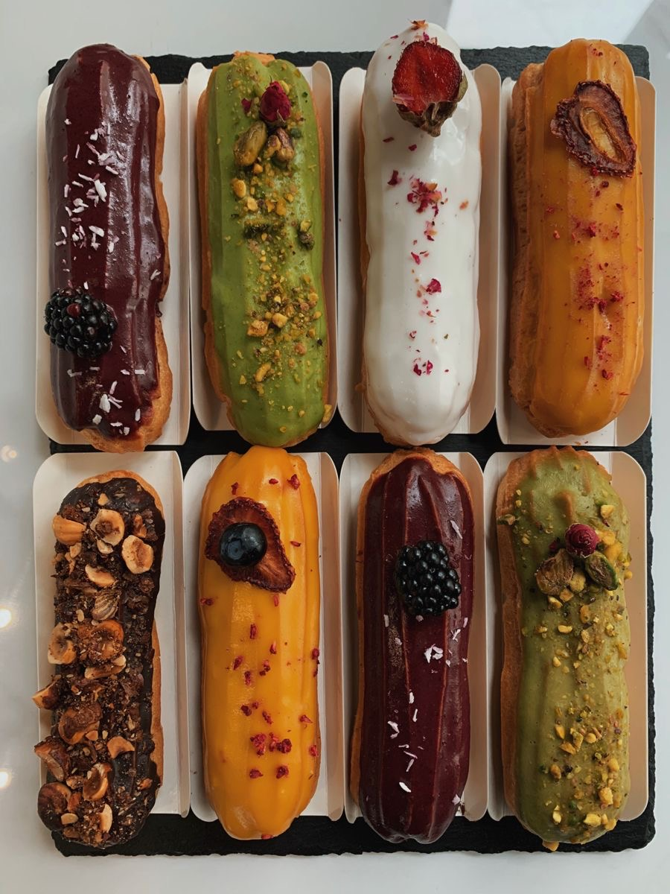
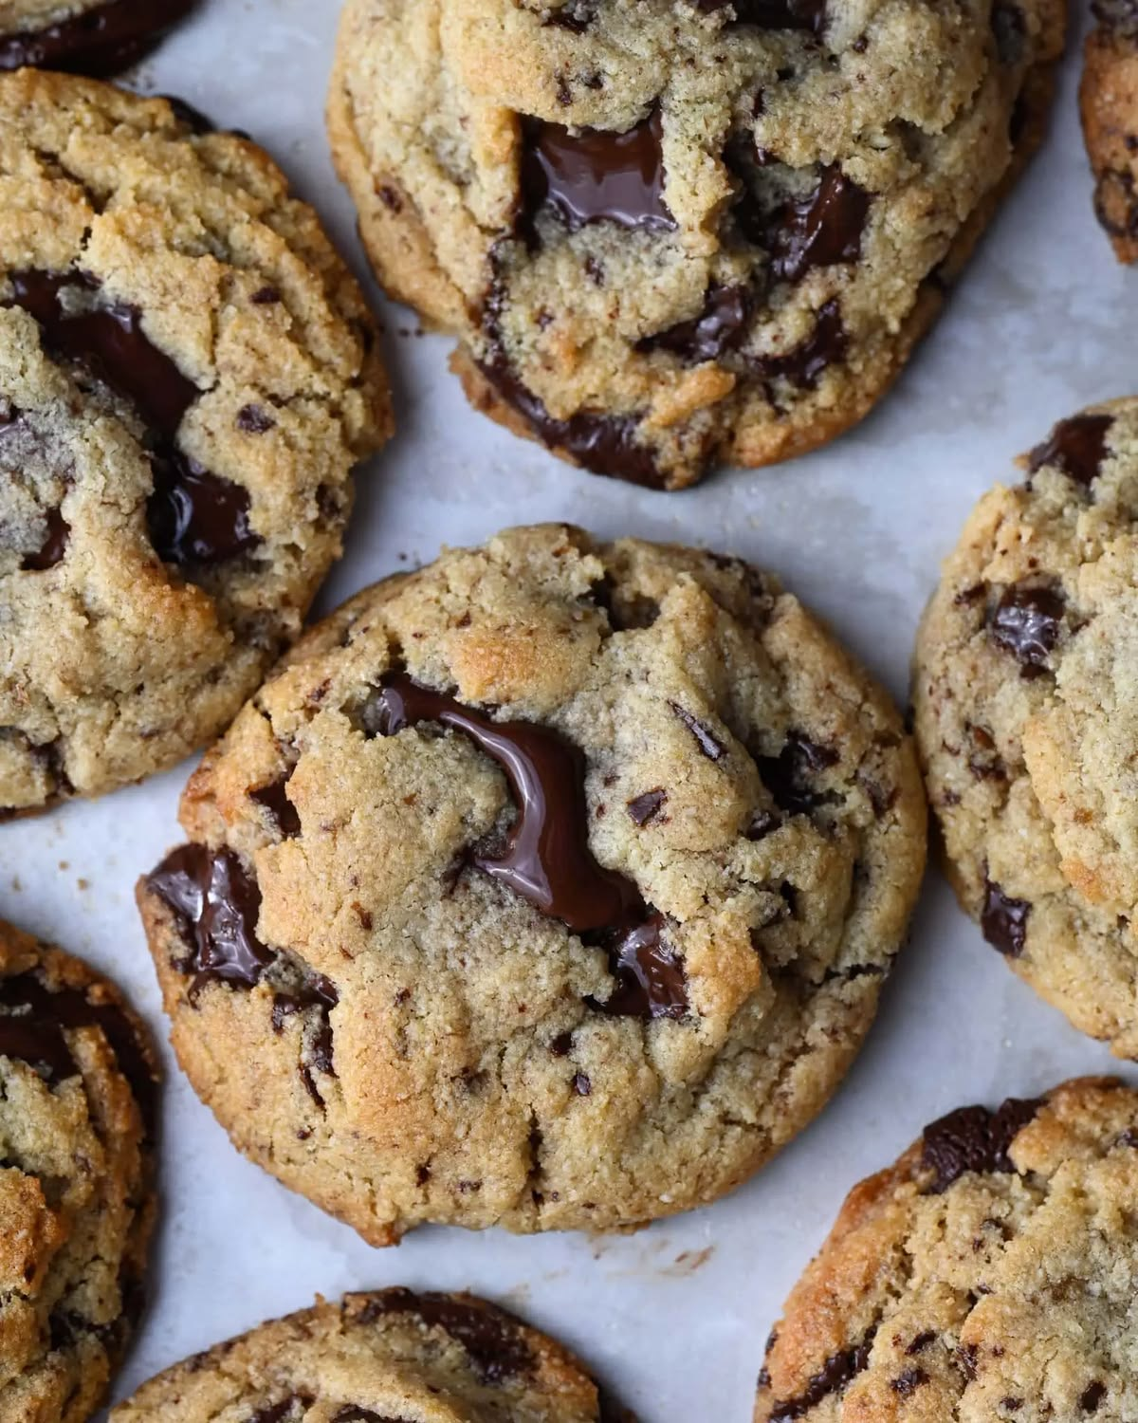
SECTION 1
Our Products
Every day, we bake a wide range of gluten-free and dairy-free products — from fresh bread and pastries to celebration cakes and éclairs.
Raspberry & mango layer cake
Triple chocolate berry drip cake
Raspberry cheesecake tart
Gluten-free artisan bread
Assorted gourmet éclairs
Chocolate chunk cookies
5

Slide 6
SECTION 2
Legal Format & Management Structure
Legal structure: Private Limited Company (Ltd)
Chosen to limit personal financial liability and support future growth, investment and expansion across London.
Owner / Manager
Planning, finance, suppliers
Head Baker
Assistant Baker
Sales Assistant
Marketing Assistant
Recipes, production, quality
Prep, ingredients, packaging
Customers, orders, payments
Social media, campaigns
6

Slide 7
SECTION 3
PESTEL Analysis — Key External Factors
Three factors most relevant to PureBake London's strategy:
SOCIAL
ECONOMIC
TECHNOLOGICAL
Growing interest in gluten-free, dairy-free and healthy diets is creating strong, sustained market demand for PureBake London's product range.
Rising ingredient and operating costs may affect margins, but strong demand for healthy bakery products supports a premium pricing strategy.
Online ordering, social media, contactless payments and delivery apps (Deliveroo, Uber Eats) improve customer convenience and reach.
7

Slide 8
SECTION 4
Marketing Strategies
Target market
Adults aged 20–55, medium-to-high income, who value healthy, premium-quality food — including coeliac, lactose-intolerant and fitness-focused customers across London.
1. Social Media & Influencer Marketing
2. Loyalty Cards & Student Discounts
Instagram and TikTok content combined with influencer collaborations to build brand awareness and reach health-conscious, younger audiences where they already spend time online.
Loyalty cards and student discounts to encourage repeat visits and build a base of regular customers — directly supporting the objective of 500+ regular customers in Year 1.
YEAR 1 OBJECTIVES
£12,000 monthly sales by year-end
500 regular customers
5,000 Instagram followers
3+ café/gym partnerships
8

Slide 9
SECTION 5
Funding Requirements & Allocation
Total funding required: £45,000
6-month cash flow forecast (£)
Monthly operating costs
Break-even
Ingredients | £3,100
Packaging | £600
Utilities | £800
Kitchen supplies | £500
Total | £5,000
Within Year 1
Cumulative cash flow turns positive by Month 3; monthly net cash flow is already positive from Month 2.
9

Slide 10
SECTION 5 (cont.)
Funding Allocation
The £45,000 raised will be allocated across five key start-up areas:
Equipment
Shop Renovation
Inventory
Licences
Working Capital
Ovens, mixers, refrigeration and kitchen fit-out for daily production.
Fitting out the commercial kitchen and customer-facing retail space.
Initial stock of premium ingredients (flours, natural sweeteners, packaging).
Food hygiene registration, business licences and insurance.
Cash buffer to cover early trading costs before the business turns cash-positive.
Categories reflect the initial investment plan; exact per-category amounts to be finalised with supplier quotes.
10

Slide 11
Conclusions
Clear market gap: strong and growing demand for gluten-free, dairy-free and healthy bakery products in London
Differentiated by USPs — personalisation, delivery and sustainability — not just price
Realistic funding plan (£45,000) combining savings, loan and grant to reduce financial risk
Diversified revenue channels: in-store, website, and delivery platforms
Forecast break-even within Year 1, supporting a sustainable path to profitability

Slide 12
References
Burns, P. (2023) Entrepreneurship and Small Business: Start-up, Growth and Maturity. 6th edn. London: Red Globe Press.
British Dietetic Association (2024) Coeliac Disease: an underdiagnosed condition that is on the rise worldwide. Available at: https://www.bda.uk.com (Accessed: 9 August 2026).
Food Standards Agency (2024) Food business registration and food hygiene guidance. Available at: https://www.food.gov.uk (Accessed: 26 July 2026).
Kotler, P. and Keller, K.L. (2022) Marketing Management. 16th Global edn. Harlow: Pearson.
Mintel (2024) Free-from Foods UK Market Report. London: Mintel Group Ltd.
Office for National Statistics (2025) Family spending in the UK. Available at: https://www.ons.gov.uk (Accessed: 26 July 2026).
Scarborough, N.M. and Cornwall, J.R. (2021) Essentials of Entrepreneurship and Small Business Management. 9th edn. Harlow: Pearson.
Statista (2025) Gluten-free food market in the United Kingdom. Available at: https://www.statista.com (Accessed: 26 July 2026).
West, J., Fleming, K.M., Tata, L.J., Card, T.R. and Crooks, C.J. (2014) 'Incidence and prevalence of celiac disease and dermatitis herpetiformis in the UK over two decades: population-based study', American Journal of Gastroenterology, 109(5), pp. 757–768.
12

Slide 13
Questions?
Thank you for your time.

