Slide 1
EMOT LIT+MH 6007

Slide 2
ECAD6007
Llythrennedd Emosiynol Iechyd Meddwl /
Emotional Literacy and Mental Health
Medi/September 2022

Slide 3
Deilliannau/Outcomes
I amlinellu agweddau o’r cyd-destun cyfredol a materion yn ymwneud â llythrennedd emosiynol a iechyd meddwl.
I adolygu peth tystiolaeth a fframweithiau damcaniaethol perthnasol.
To outline aspects of the current context and issues involving emotional literacy and mental health.
To review some of the evidence and related theoretical frameworks.

Slide 4
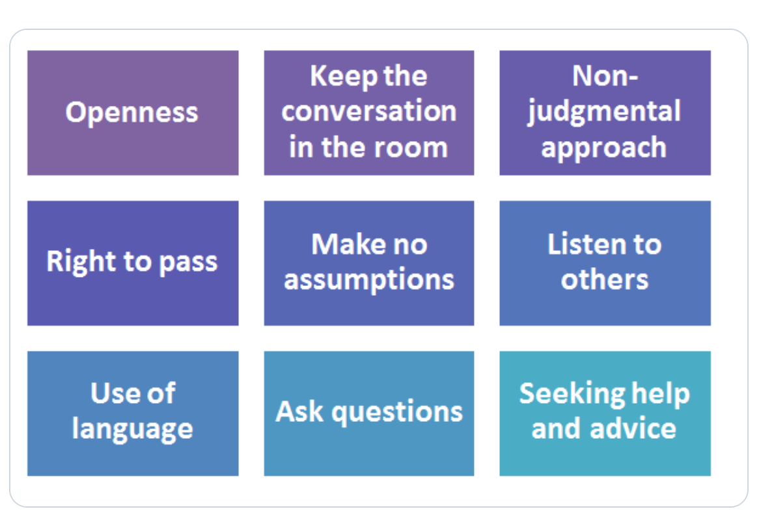
Rheolau / Rules
Notes:
PSHE Association 2019

Slide 5
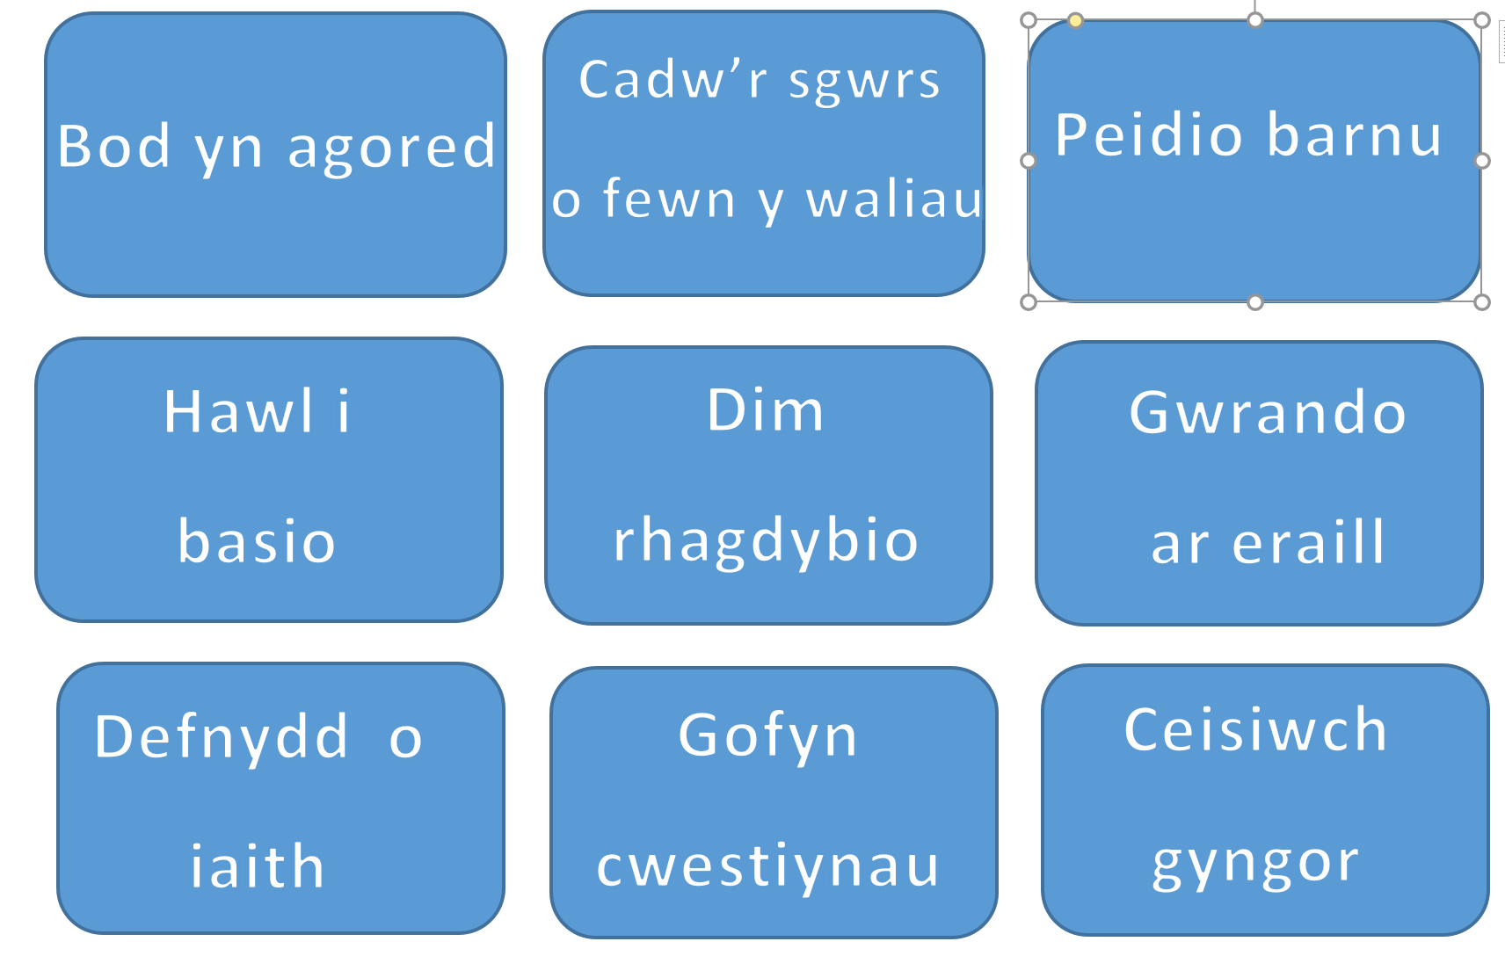

Slide 6
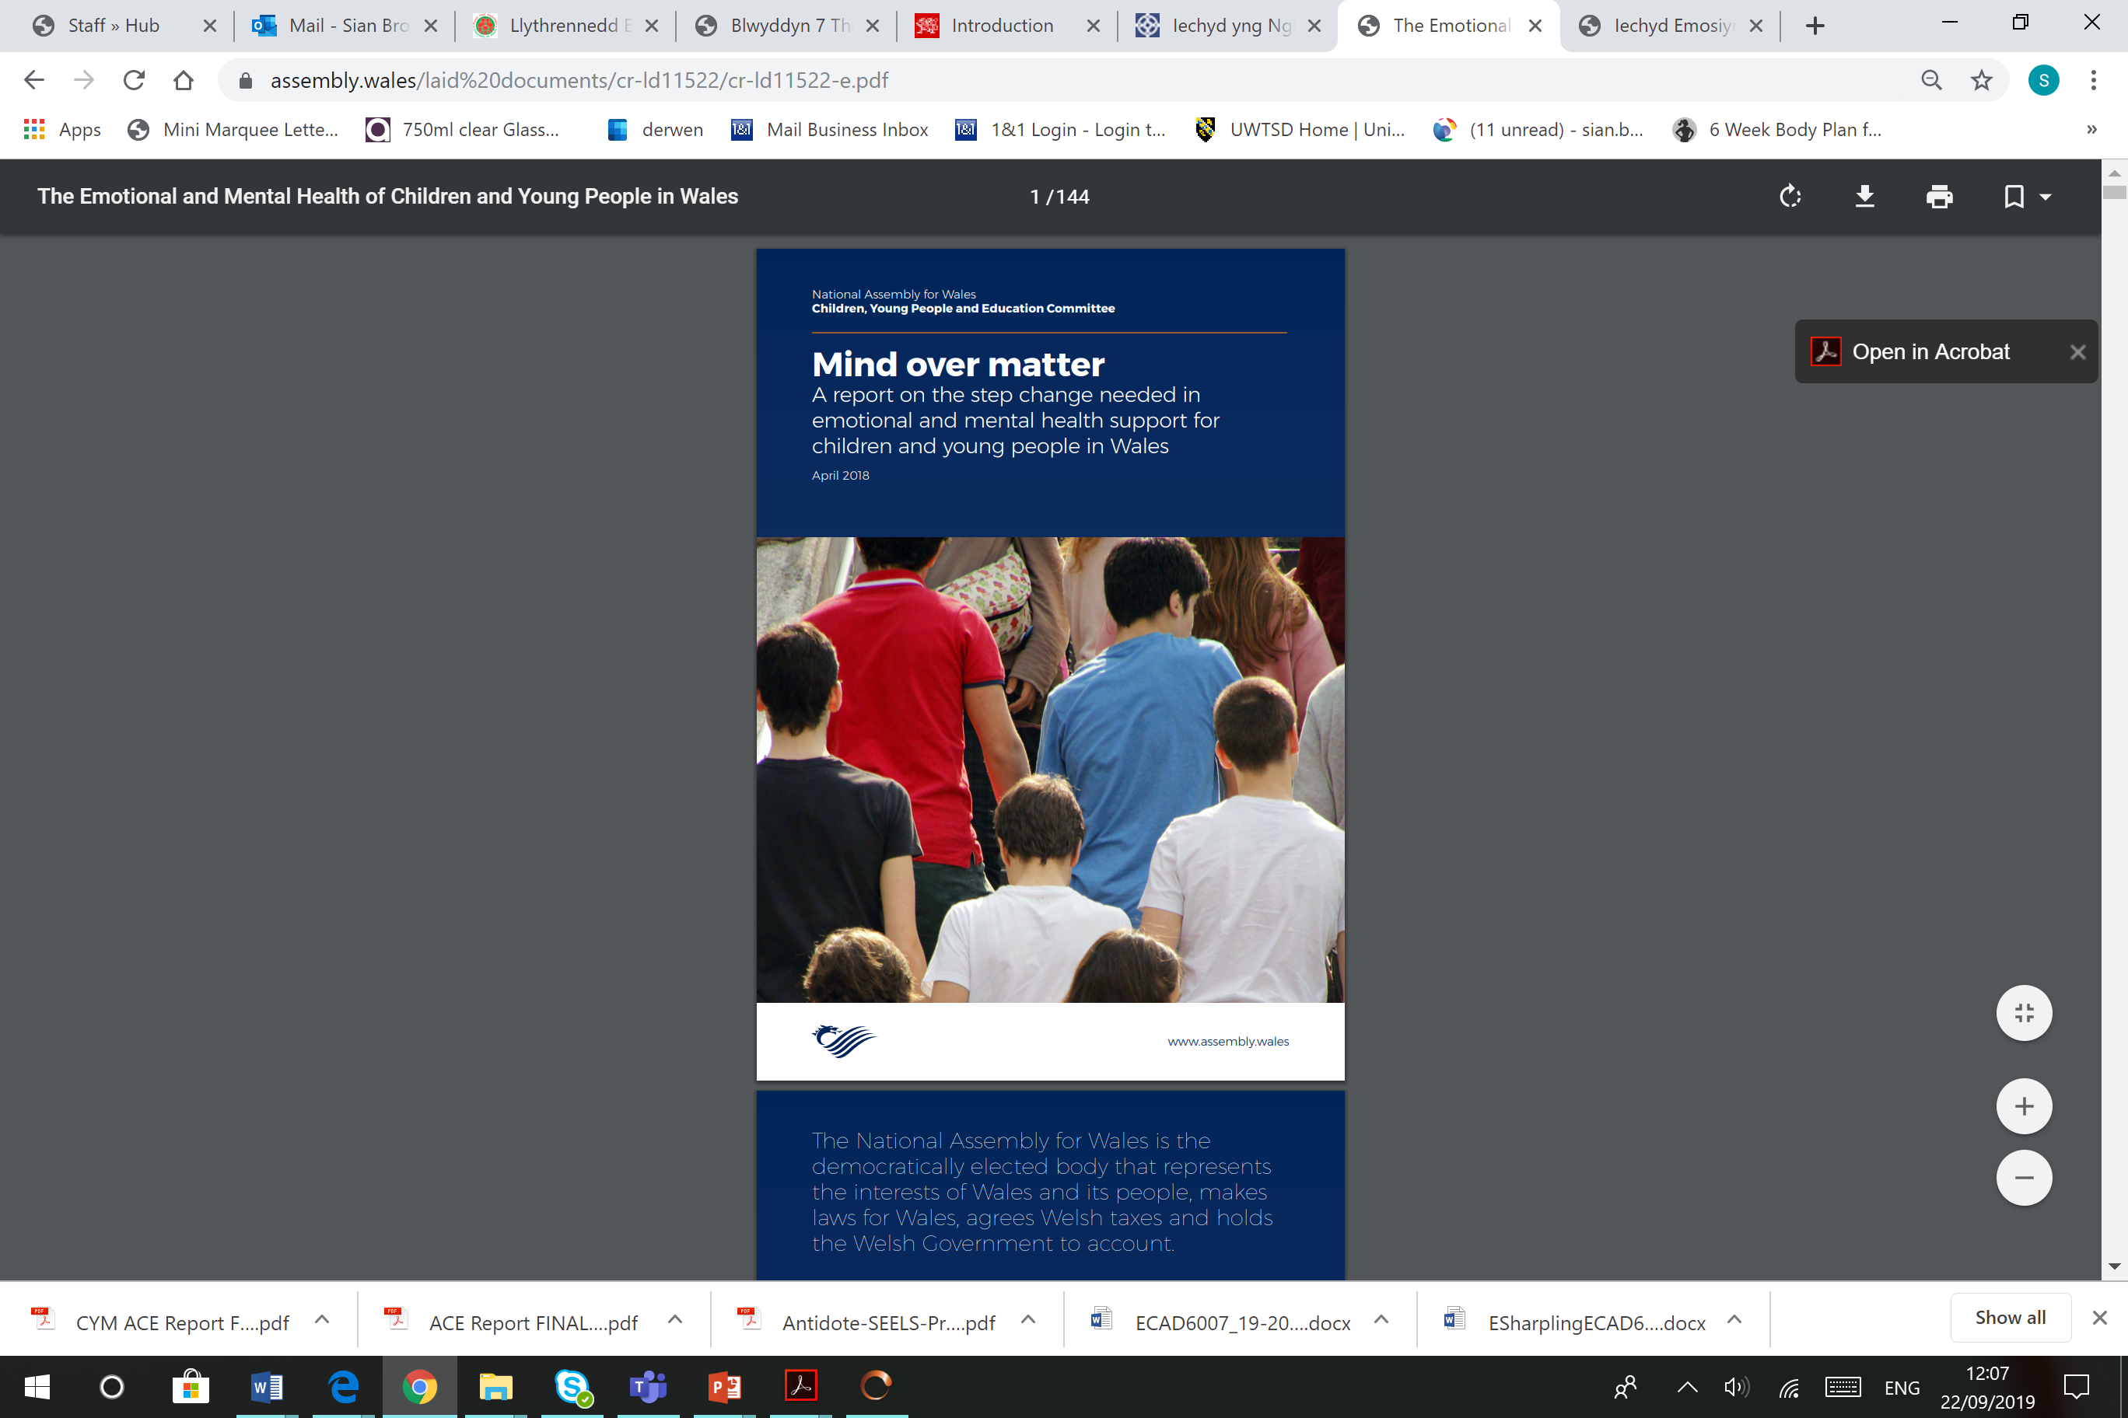
Cymru nawr / Wales now
‘It is estimated that three children in every average size classroom will have a mental health issue. By the age of 14, half of all mental health problems will have begun’.
‘levels of stress and anxiety among pupils are rising’
‘Action for Children highlighted that:
the proportion of 15-16 year olds self-reporting anxiety or depression has doubled in recent years;
one in ten 5-16 year olds suffers a
diagnosable mental health disorder;
between 10-15 per cent of teenagers have some symptoms of depression at any one time’.
‘school-based staff, including
teachers, often lack the confidence
and capacity to help pupils
with their emotional and mental health’.

Slide 7
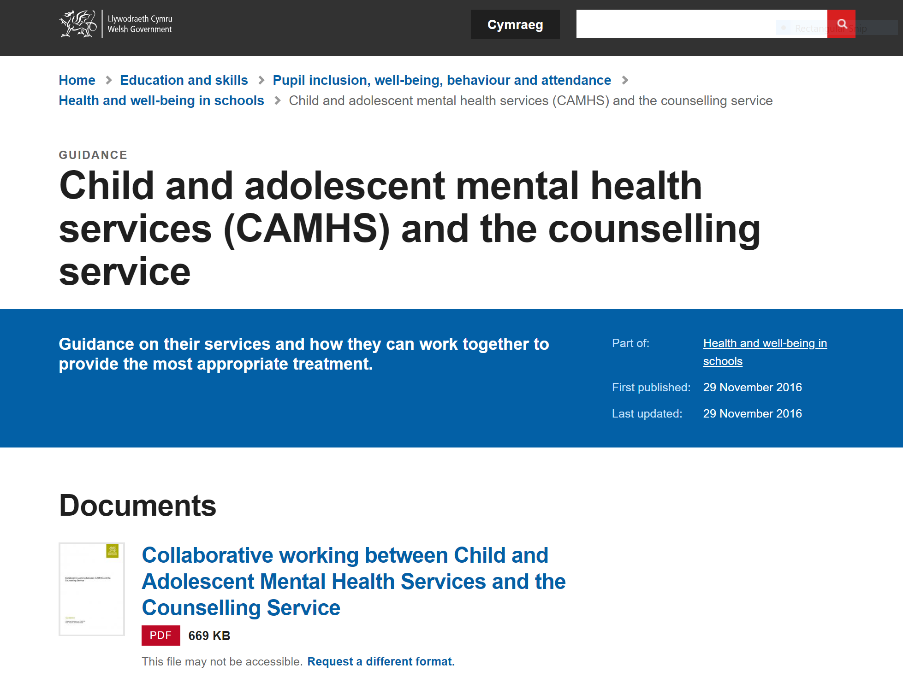
Programmes for emotional and mental health

Slide 8
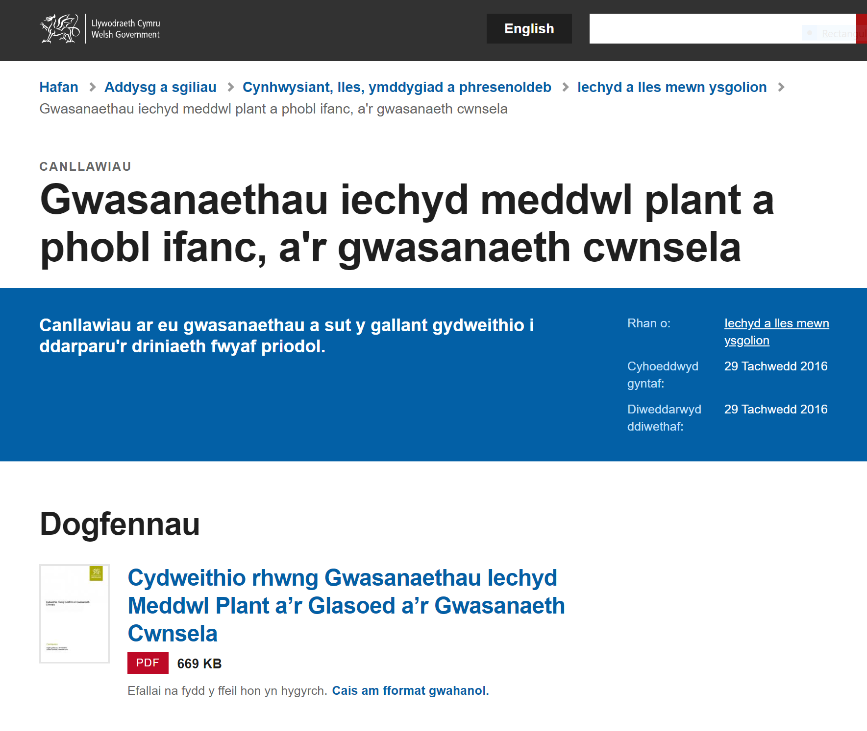
Rhaglenni ar gyfer iechyd meddyliol ag emosiynol

Slide 9


Agweddau cymdeithasol ag emosiynol ar ddysgu – Social and emotional aspects of learning
Cynradd Cymraeg: https://hwb.gov.wales/repository/discovery/resource/8da29064-8aaf-47b9-9937-8d9610f2a744/cy
Primary English
https://hwb.gov.wales/repository/discovery/resource/8da29064-8aaf-47b9-9937-8d9610f2a744/en
Secondary UwchraddCymraeg: https://hwb.gov.wales/repository/discovery/resource/716933b8-1e05-4412-b344-b8dabc864620/cy
Secondary English: https://hwb.gov.wales/repository/discovery/resource/716933b8-1e05-4412-b344-b8dabc864620/en

Slide 10
be effective and successful learners
make and sustain friendships
deal with and resolve conflict effectively and fairly
solve problems with others or by themselves
manage strong feelings such as frustration, anger and anxiety
be able to promote calm and optimistic states that promote the achievement of goals
recover from setbacks and persist in the face of difficulties
work and play cooperatively
compete fairly, and win and lose with dignity and respect for competitors
recognise and stand up for their rights and the rights of others
understand and value the differences and commonalities between people, respecting the right of others to have beliefs and values different from their own.

Slide 11
fod yn ddysgwyr effeithiol a llwyddiannus
ffurfio a chynnal cyfeillgarwch
delio â gwrthdaro a’i ddatrys mewn modd effeithiol a theg
datrys problemau gydag eraill neu ar eu pennau eu hunain
rheoli teimladau cryf megis rhwystredigaeth, dicter a phryder
gallu hyrwyddo cyflwr tawel ac optimistaidd sy’n hyrwyddo’r gallu i gyflawni nodau
dod dros rwystrau a dyfalbarhau yn wyneb anawsterau
gweithio a chwarae’n gydweithredol
cystadlu’n deg, ac ennill a cholli gydag urddas a pharch at gystadleuwyr
cydnabod a sefyll dros eu hawliau nhw a hawliau pobl eraill
deall a gwerthfawrogi’r hyn sy’n wahanol ac yn debyg rhwng pobl, gan barchu hawl pobl eraill i gael credoau a gwerthoedd sy’n wahanol i’w rhai nhw eu hunain.

Slide 12
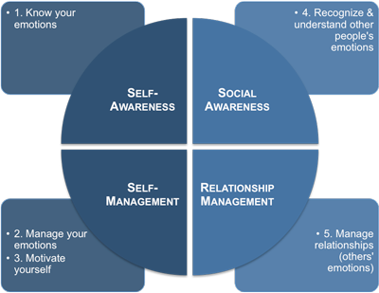
Deallusrwydd Emosiynol / Emotional Intelligence
Mae’r canlynol yn amlinellu rhao gofidiau
Mayer, Roberts + Barsade (2008)
Outline some concerns

Slide 13

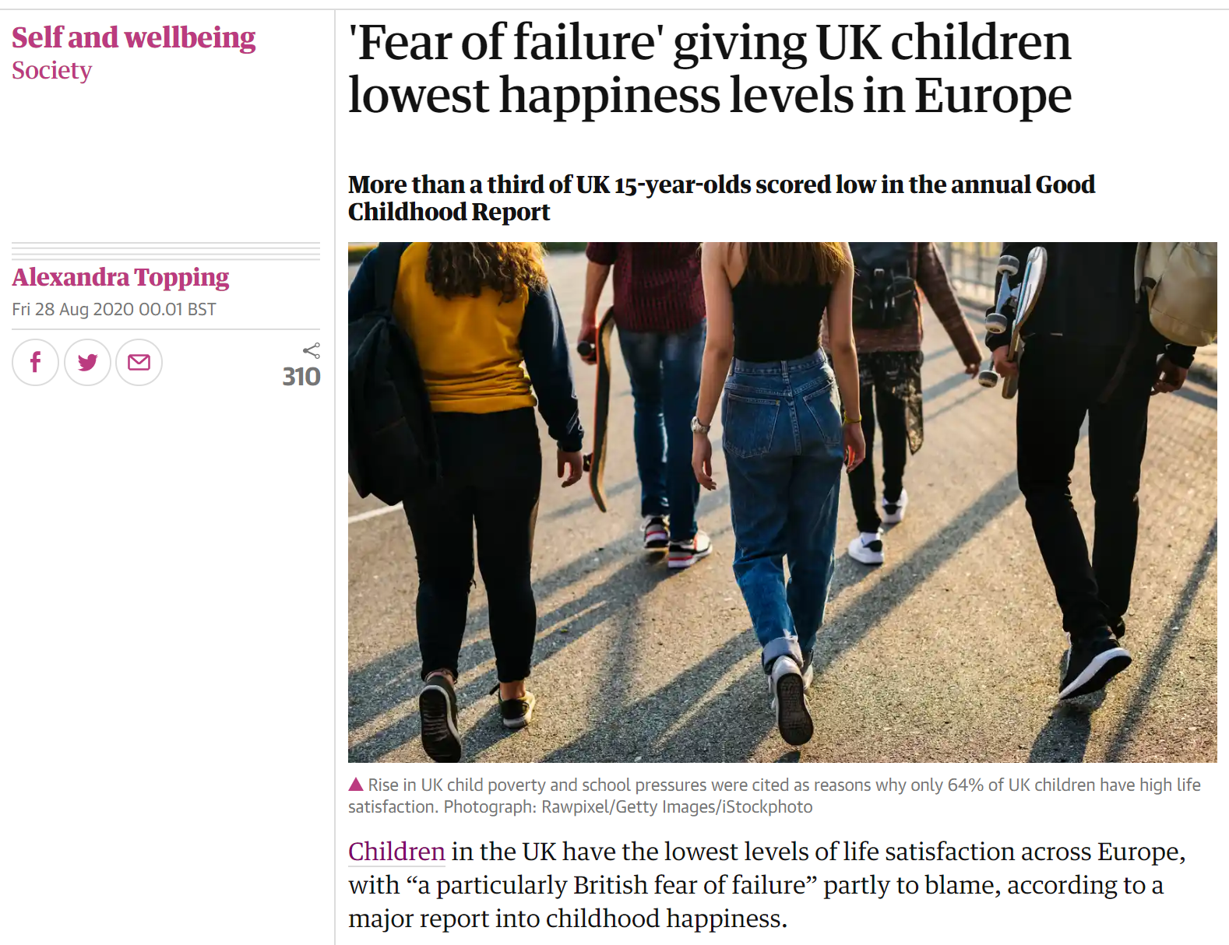

Slide 14

Pwysigrwydd lles / the importance of well-being
Teulu
Defnydd amser
Iechyd
Cartref
Ffrinidau
Dyfodol
Dewis
Golwg
Pethau
Ysgol
Family
Time use
Health
Home
Friends
Future
Choice
Appearance
Things
School

Slide 15

Darllennwch argymhellion yr adroddaid ar gyfer byd addysg ac ystyriwch yr hyn rydych chi wedi ei brofi a’i weld.
Read the reports recommendations for education and consider what you have seen or experienced.

Slide 16
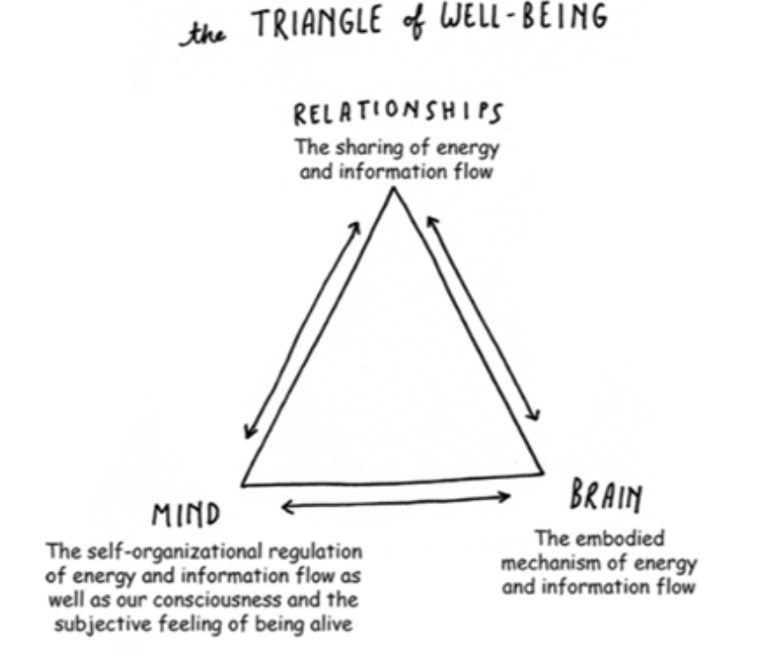

Slide 17
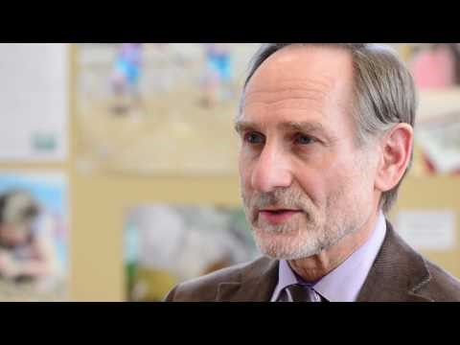
https://www.youtube.com/watch?v=2ZPrMbppyhA
Ferre Laevers – How do we measure well-being?
Ferre Laevers – Sut gallwn fesur lles?

Slide 18
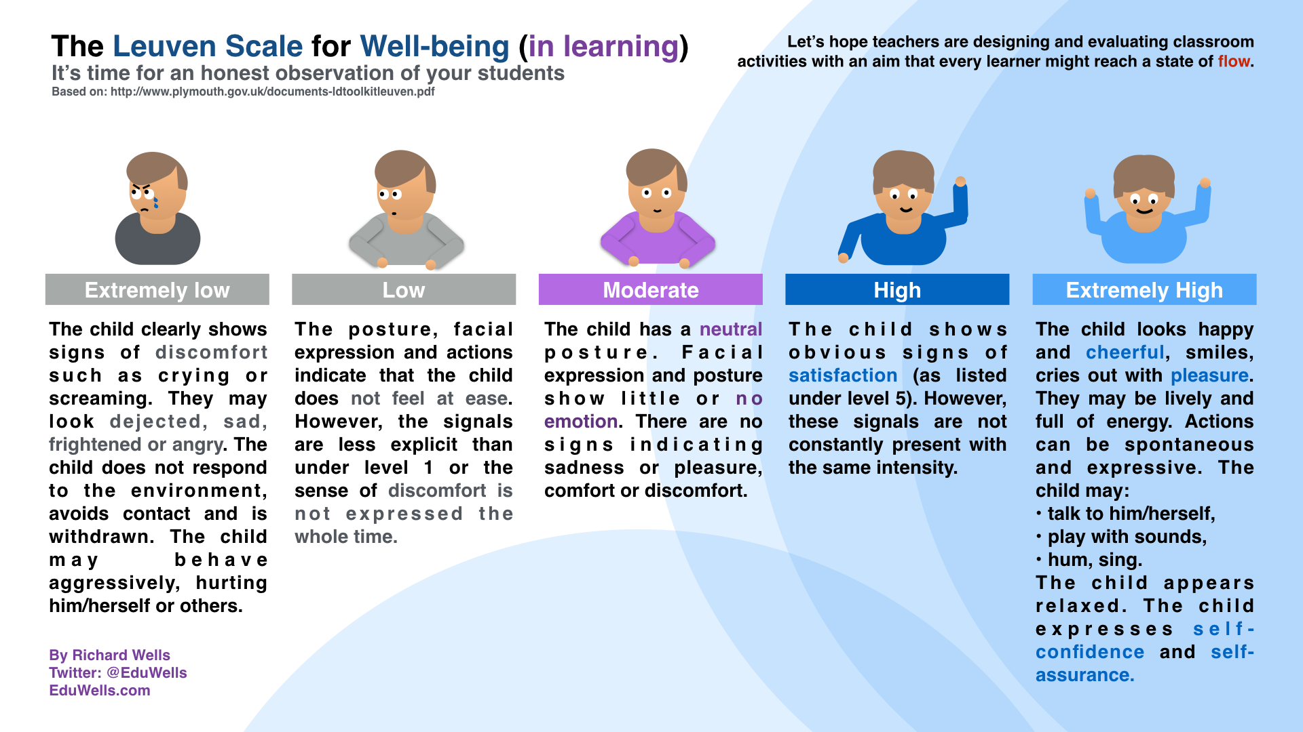

Slide 19
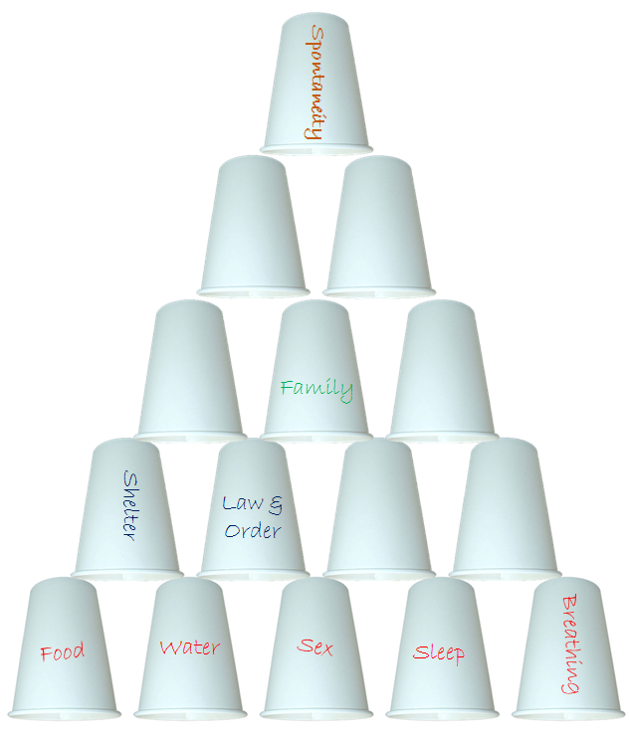
Beth sy’ angen arnom i ffynu? / What do we need to thrive?
Bwyd – Rhyw – Cwsg – Anadlu – Lloches – Diogelwch – Cyfraith a Threfn – Gwaith – Teulu – Agosatrwydd rywiol – Hunan barch – Llwyddiant – Parch am eraill – Hyder - Creadigrwydd – Digymelldeb – Moesoldeb - Dewis
Food – Sex - Sleep – Breathing - Shelter - Security - Law and Order – Employment – Family – Health - Friends – Sexual Intimacy – Self esteem – Achievement – Respect for others – Confidence – Creativity – Spontanaeity – Morality - Choice

Slide 20
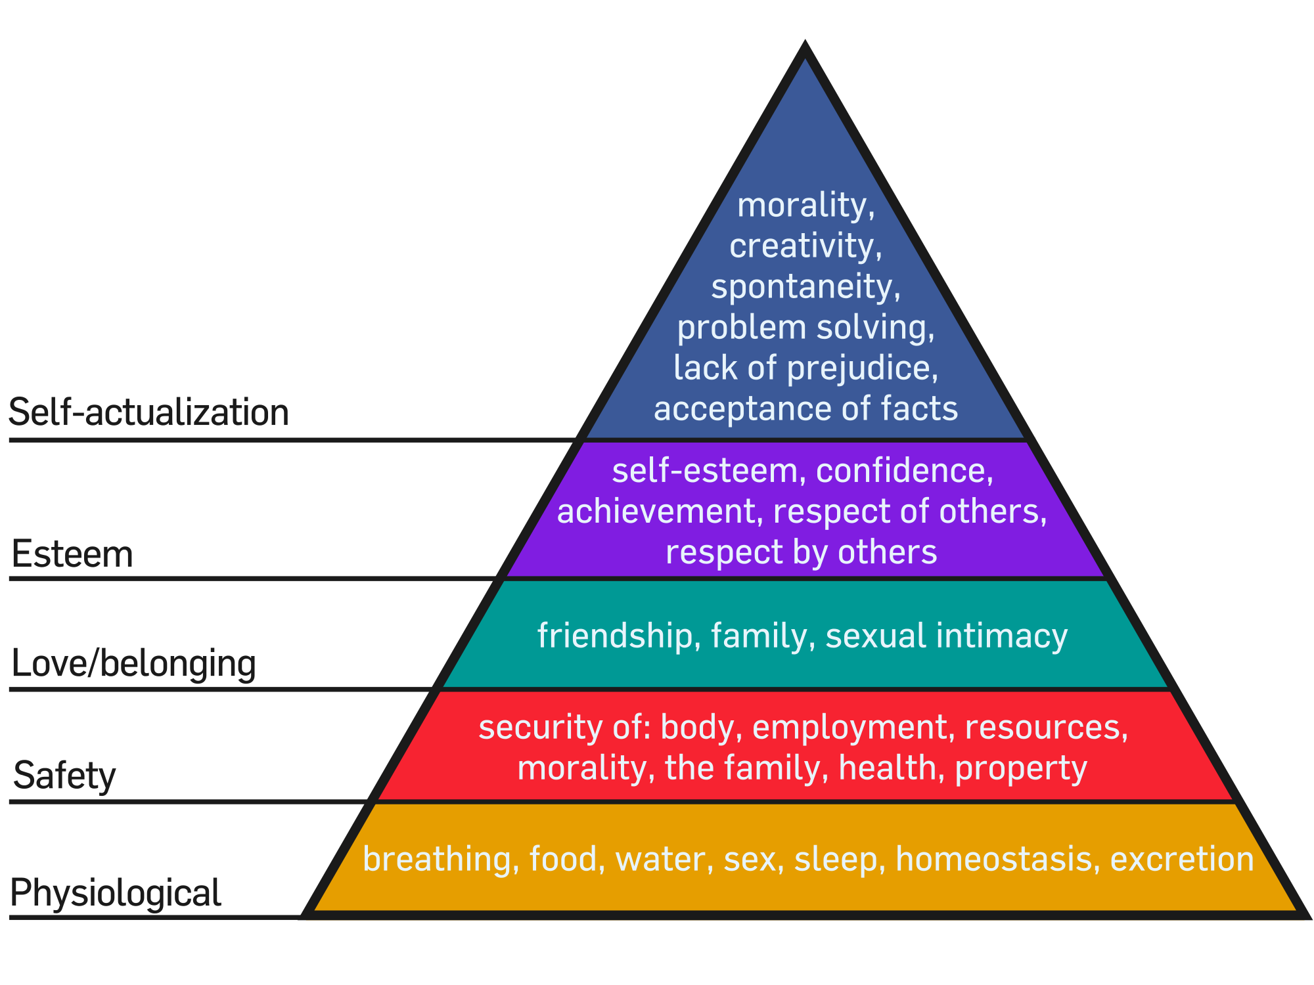
Hierarchaeth Maslow/ Maslow’s Hierarchy (1943)

Slide 21
Rhesymau statudol am les / Statutory reasons for well-being
1. https://www.complantcymru.org.uk/adnoddau/dull-hawliau-plant/
2. https://www.futuregenerations.wales/wp-content/uploads/2017/01/wfg-essentials-guide-cy.pdf
United Nations Convention On The Rights Of The Child (1989) - https://www.childcomwales.org.uk/uncrc-childrens-rights/
Wellbeing of Future Generations Act (2015) - http://gov.wales/docs/dsjlg/publications/160401-wfg-easy-read-en.pdf

Slide 22
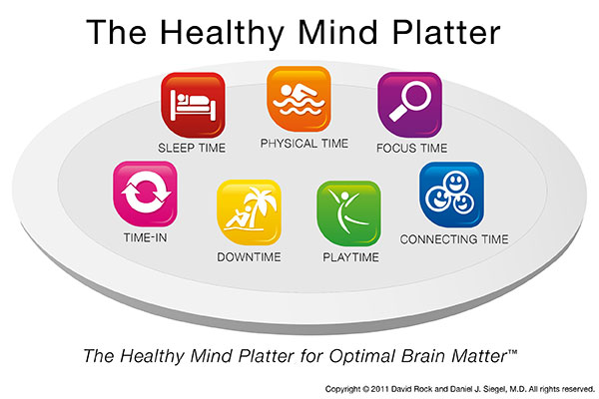
Addysgu’r meddwl / Educating the mind – Siegal (2011)

Slide 23
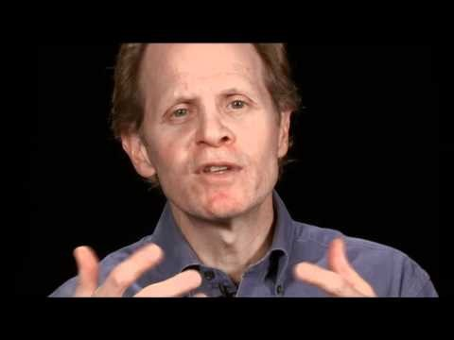
https://www.youtube.com/watch?v=3EQ2tzHl3Ks

Slide 24
Dull ysgol gyfan / A whole school approach
Llais y plentyn
Partneriaeth gyda rhieni/gofalwyr ag asiantaethau allanol
Datblygiad proffesiynol parhaus ar gyfer staff.
Cynllunio cwricwlwm ag arfer i hyrwyddo lles a iechyd meddwl.
Ethos, diwylliant ag amgylchedd
Ymrwymiaeth arweinyddiaeth a rheolwyr at newid a gweithredu polisi.
The voice of the child
Partnership with parents/carers and outside agencies
Continued professional development for staff
Curriculum planning and practice to promote well-being and mental health
Ethos, culture and environment
Leadership and management committed to change and implementing policy

Slide 25


Cwricwlwm /Curriculum

Slide 26
Cyfeirnodi / References
Haque.M.F., Haque M.A., and Islam Md. (2014) Motivational Theories a Critical Analysis. ASA University Review. Vol. 8. No1. Jan 2014. 61-68. Researchgate
Howard C., Burton M., Levermore D. and Barrell R. (2017) Children’s Mental Health and Emotional Well Being in Primary School. London. Sage
Humphrey N., Lendrum A. and Wiglesworth M. (2010) Social and Emotional Aspects of Learning in Secondary Schools. School of Education Manchester University
PSHE Association (2019) Teacher Guidance: teaching about mental health and emotional well-being. Department for Education
The Children’s Society (2020) Good Childhood report:Summary.
Welsh Government (2018) Mind over matter: A report on the step change needed in emotional and mental health support for chidren and young people in Wales. National Assembly for Wales Commission

