Slide 1


STUDENT NAME : RAVJEET KAUR
STUDENT NO. : 2421160
PROGRAMME : BSc HEALTH AND SOCIAL CARE
MODULE : INTRODUCTION OF PHYSIOLOGY
MODULE CODE : BMHP5023
LECTURER : GILLIAN WEAVER
Assignment Title: Presentation (PowerPoint with Voice-Over) ABOUT ASTHMA CARE PLAN

Slide 2
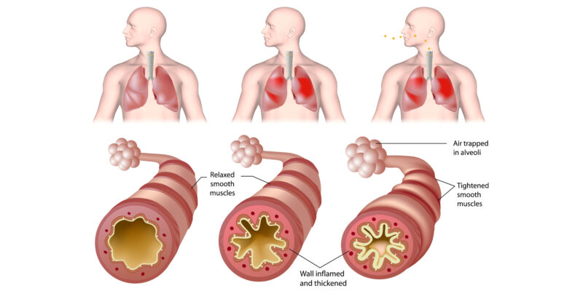
Introduction (Asthma) Asthma develop at any age Asthma is a long-term lung dieses Pollen, weather changes, dust, animal hair affects airways and breathing The airways become narrow, swollen People may wheeze, cough, or feel short of breath Common in the UK Asthma can be controlled through medication and support. (NHS, 2023)
(NHLBI, 2022)

Slide 3
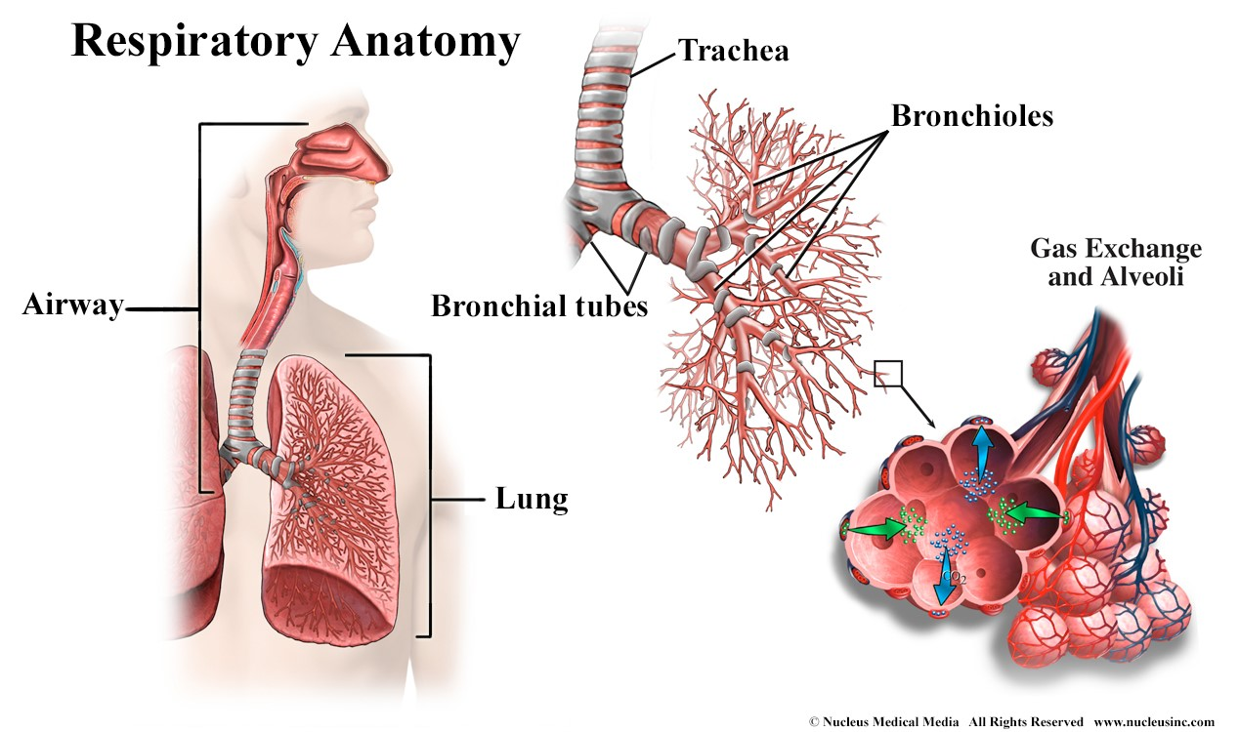

Respiratory System Structure(Anatomy) Trachea (windpipe) Bronchi (main airways) Bronchioles (small airways) Alveoli (gas exchange) (Tortora and Derrickson, 2021)
National Heart, Lung, and Blood Institute (2022) Asthma airway inflammation diagram

Slide 4
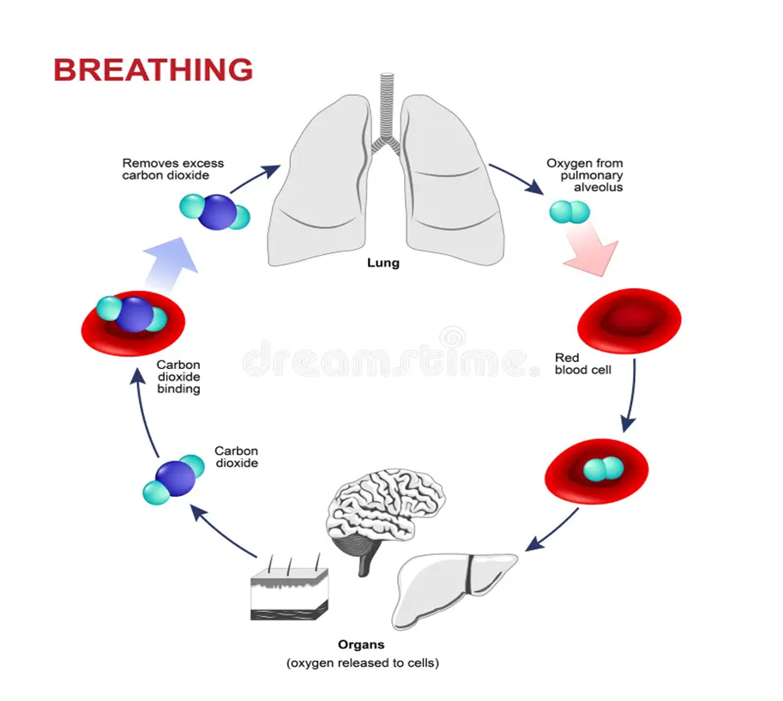
Respiratory System Function (Physiology) Air moves into lungs during breathing (inhalation) Oxygen passes into blood in alveoli Carbon dioxide is removed Helps the body breathe Supplies oxygen to the blood (Tortora and Derrickson, 2021)
Breathing process showing oxygen intake and carbon dioxide removal (Dreamstime, 2024).

Slide 5
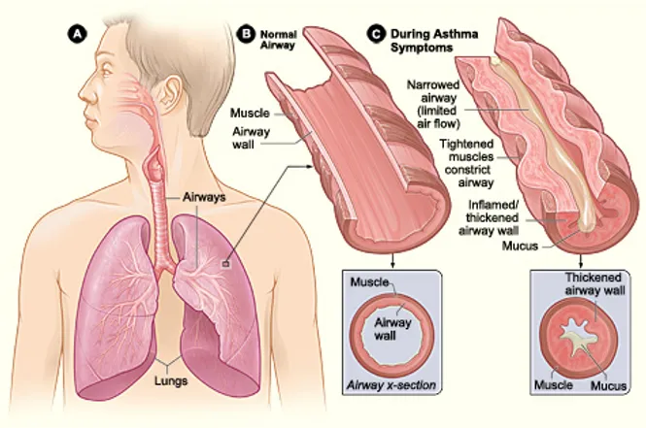
What Happens in Asthma Airways become inflamed Muscles tighten (bronchospasm) More mucus is produced Airways become narrow (NHS, 2023)
(National Heart, Lung, and Blood Institute, 2022)

Slide 6
Symptoms of Asthma Shortness of breath Wheezing Chest tightness whistling sound when breathing Cough (Asthma UK, 2023)

Slide 7
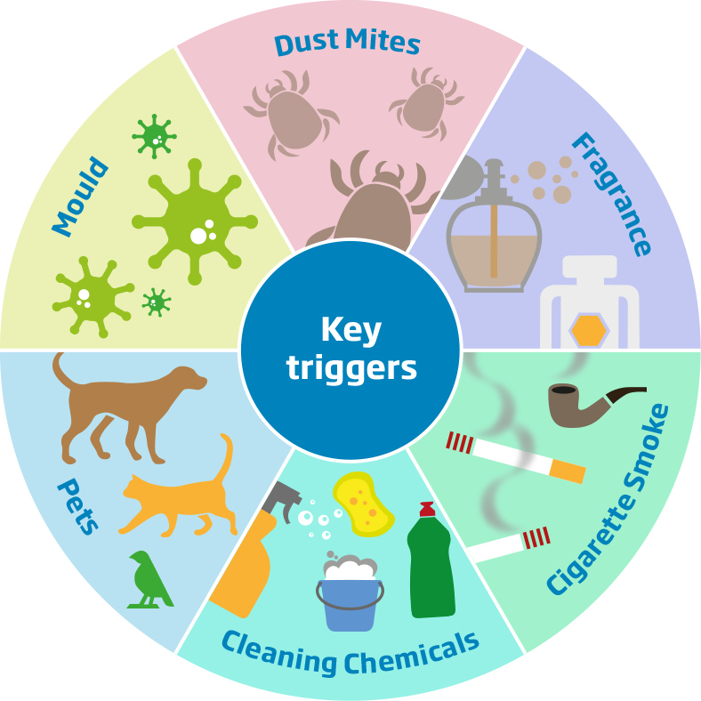
Causes & Triggers Smoking Dust, pollen, pollution Cold air Exercise Allergies Chemical Pets Mould (WHO, 2023)

Slide 8

Care plan Patient profile Name: A. J. Age: 45 Gender: Female Occupation: Office worker Lives: in urban area Diagnosis: Asthma

Slide 9
Risk Factors (Lifestyle) Smoker Low physical activity Exposure to pollution Poor diet (Public Health England, 2022) Impact on Body System Reduced airflow Less oxygen to body Increased breathing effort Reduced activity (McCance and Huether, 2019)

Slide 10
Diagnosis Spirometry test ( Lung function test ) Peak flow monitoring Medical history Physical exam Blood and allergy test Breath test (NICE, 2022)

Slide 11
Treatment Combination Inhalers Reliever inhaler (blue) Preventer inhaler (steroids) Spacers Anti-inflammatory Reliever Avoid triggers Regular GP reviews (NICE, 2022)

Slide 12
Monitoring Lung function tests Oxygen level checks GP appointments Daily symptom check Peak flow monitoring Medication Emergency action plan (NHS, 2023)

Slide 13
Care Routine Stop smoking Use inhalers as prescribed Healthy balanced diet Regular physical activity Pulmonary rehabilitation Family history of asthma (NHS, 2023)

Slide 14
Communication and Ethical Use simple language and clear communication Educate patient about inhaler use Encourage questions Respect and dignity Informed consent Provide person-centred care (NICE, 2022)

Slide 15
References
National Heart, Lung, and Blood Institute (2022) Asthma airway inflammation diagram.
Available at: https://www.nhlbi.nih.gov (Accessed: 10 March 2026).
NHS (2023) Asthma. Available at: https://www.nhs.uk/conditions/asthma/ (Accessed: 12 March 2026).
NICE (2022) Asthma: diagnosis, monitoring and chronic asthma management.
Available at: https://www.nice.org.uk (Accessed: 13 March 2026).
Asthma UK (2023) What is asthma? Available at: https://www.asthma.org.uk (Accessed: 15 March 2026).
World Health Organization (2023) Asthma. Available at: https://www.who.int (Accessed: 17 March 2026).
Global Initiative for Asthma (2023) Global strategy for asthma management and prevention.
Available at: https://ginasthma.org (Accessed: 18 March 2026).
Tortora, G.J. and Derrickson, B.H. (2021) Principles of anatomy and physiology. 16th edn. Hoboken: Wiley.
McCance, K.L. and Huether, S.E. (2019) Pathophysiology: The biologic basis for disease in adults and children. 8th edn. St. Louis: Elsevier.
Public Health England (2022) Respiratory disease profile. Available at: https://www.gov.uk (Accessed: 19 March 2026).

