Slide 1
Lila Restaurant - Farm-to-Table Dining in the UK
Student’s Name
Institutional Affiliation
Course
Professor’s Name
Date

Slide 2
Introduction
Mission: Deliver exceptional, innovative, and sustainable dining experiences that align with modern consumer values (Korede et al., 2023).
Vision: Lead in sustainable restaurant practices and culinary innovation, setting a new standard for quality and responsibility.
Target audience of Lila Restaurant consists of food enthusiasts aged 26-56 who prioritize quality dining and ethical, sustainable choices (Razzak et al., 2023).
Lila Restaurant strives to use locally sourced ingredients to support freshness, sustainability, and community connections.
Lila Restaurant is commited to the creation of unique dining experience by celebrating culinary traditions with contemporary, creative twists (Marshall, 2023).

Slide 3
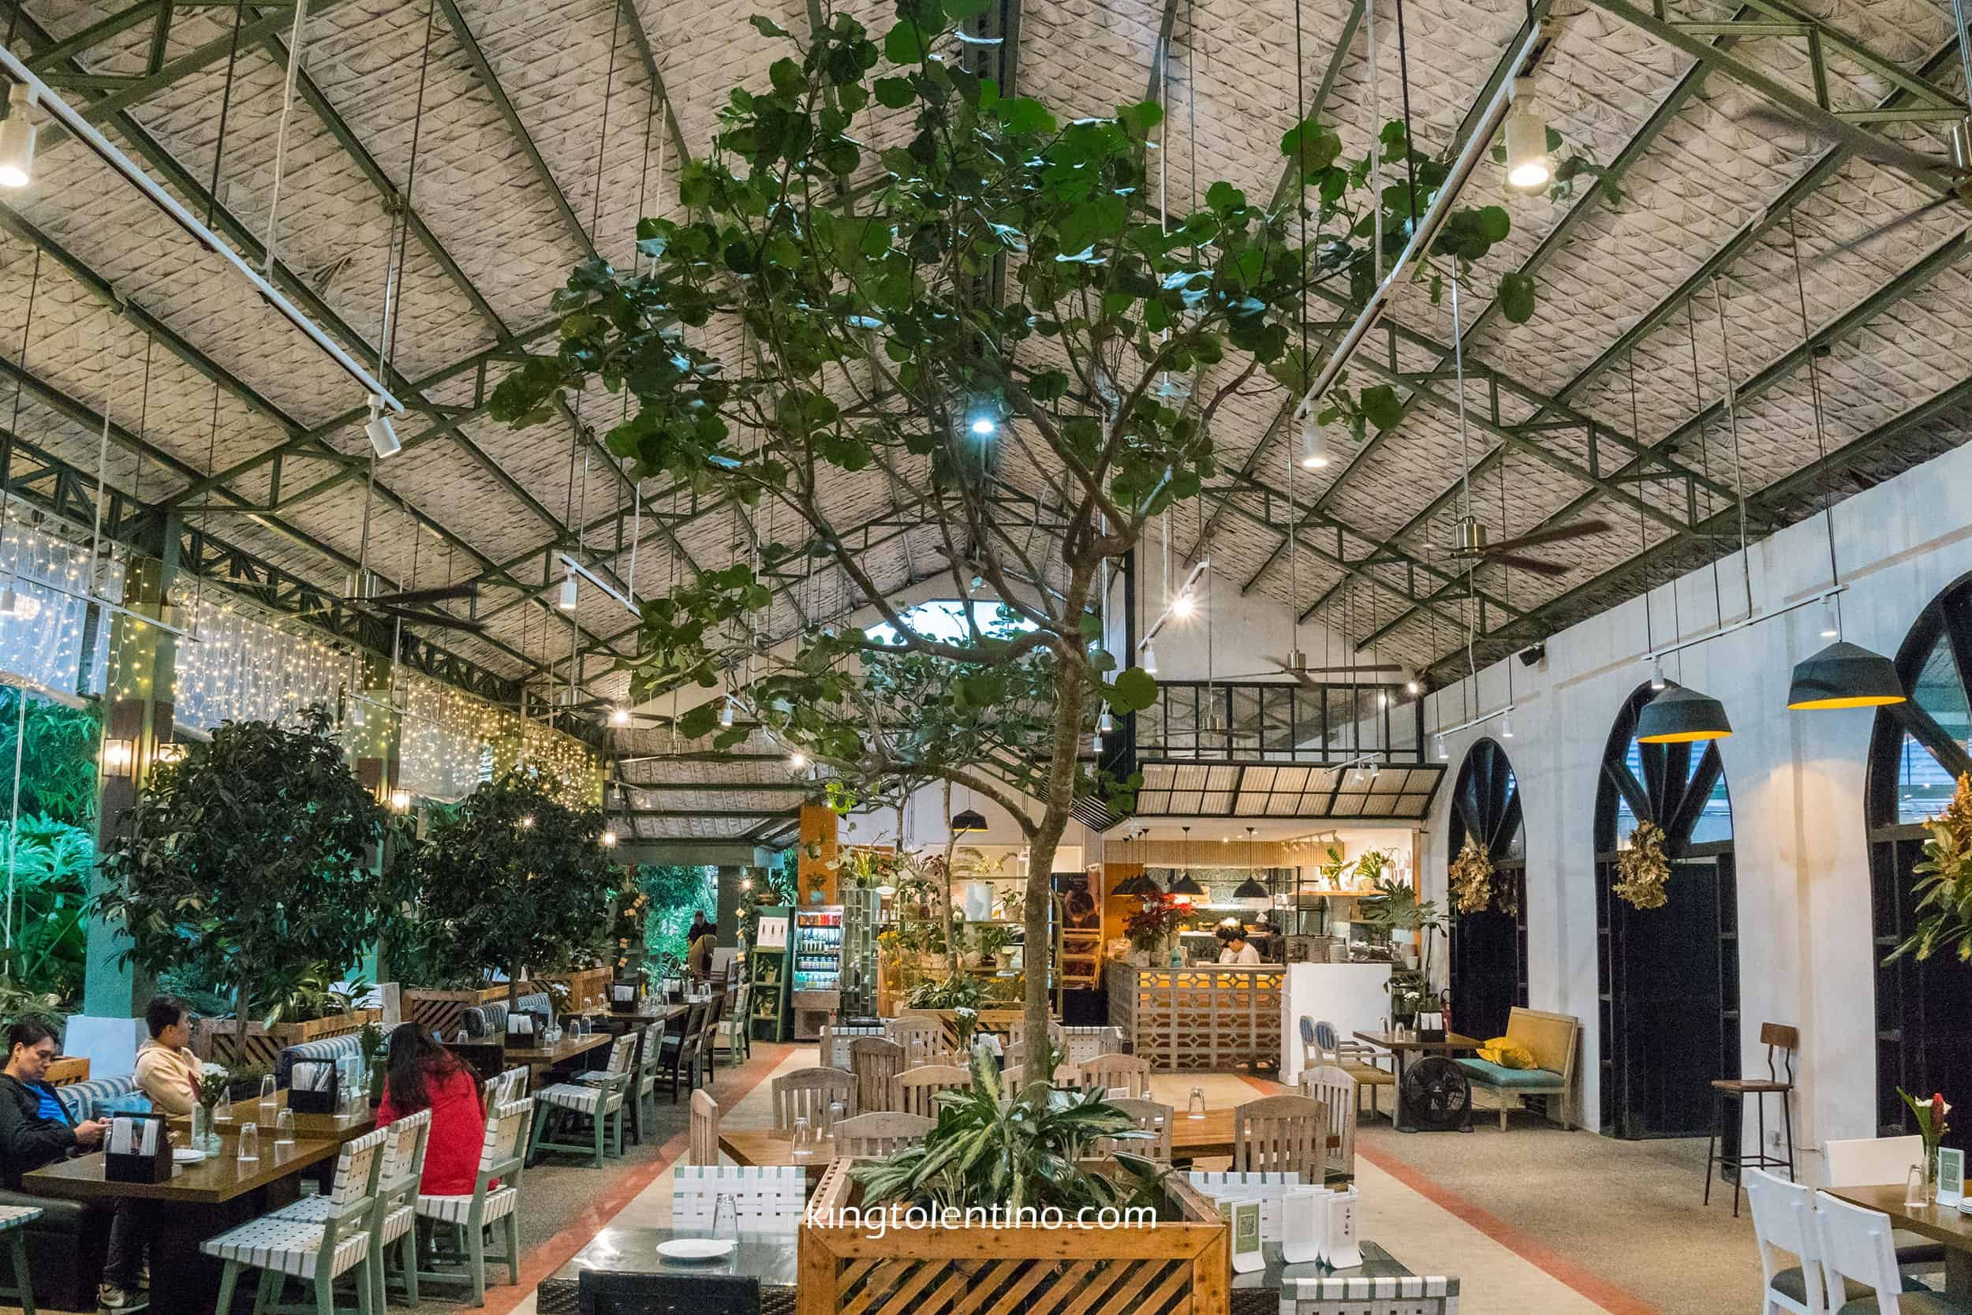
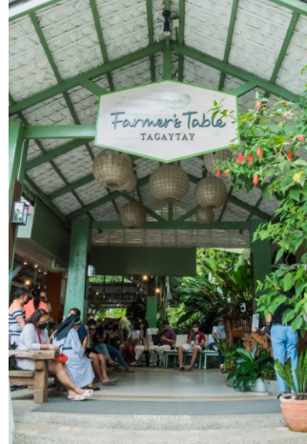
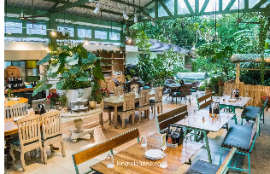

Overview of Business Idea, Product, and Service
Lila Restaurant aspires to offer premium dining with a farm-to-table model (Beksh, 2023)
Use of locally sourced organic ingredients, aligning with the sustainability mission
Core offerings: Fresh and innovative culinary dishes rooted in British cuisine
Additional services: Online booking, home delivery through partners like Uber Eats (Chaudhry et al., 2023)
Payment options: Digital wallets for cashless transactions, enhancing customer convenience
Community focus: Celebrating local farmers and winemakers to foster connection (Garieri, 2023)

Slide 4

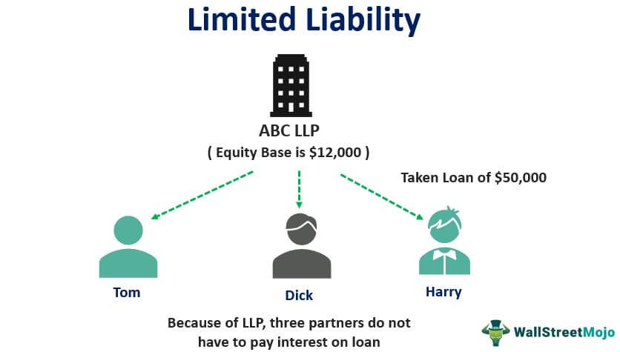

Ownership and Legal Format
Business structure: Limited Liability Company (LLC) for legal protection and flexibility (Garieri, 2023)
Benefits of LLC: Asset safeguarding, personalized operational focus (Marshall, 2023)
Allows sustainable growth with fewer regulatory restrictions
Owner oversees strategic planning and maintains investor relationships
Ensures long-term protection and alignment with sustainability goals (Garieri, 2023)
Ownership structure encourages investor confidence and business resilience

Slide 5
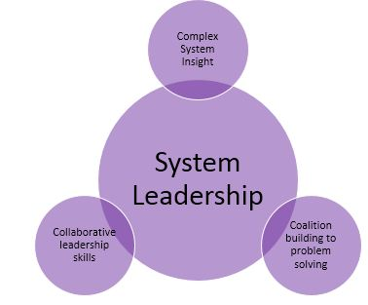
Management of the Company
The restaurant's leadership consists of an Owner, General Manager, and Executive Chef at the top, ensuring a clear chain of command for both culinary and operational activities (Marshall, 2023).
General Manager manages service operations, coordinating
with front-house staff
Executive Chef oversees culinary innovation and quality
control (Marshall, 2023)
Service Manager supervises guest services and customer satisfaction
Operational Manager handles daily administrative tasks and logistics
External consultants for food trends, legal compliance, and business advisory (Garieri, 2023)

Slide 6
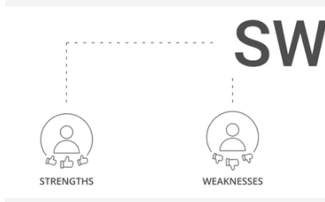
SWOT Analysis - Strengths and Weaknesses
Strengths:
Use of locally sourced, organic ingredients appealing to sustainability-focused consumers (Bui, 2023)
Central location attracts both local and tourist clientele, enhancing visibility (Garieri, 2023)
Skilled management team ensures operational efficiency and strategic growth
Weaknesses:
Higher price point may alienate cost-sensitive consumers in a
competitive market
Seasonal variations impact menu consistency and customer
satisfaction (Bui, 2023)
Dependence on local suppliers risks disruptions in quality and
consistency (Razzak et al., 2023)

Slide 7
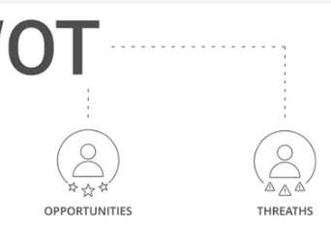
SWOT Analysis - Opportunities and Threats
Opportunities:
Growth in gourmet dining demand with added experiences, like cooking workshops (Karamina & Fachira, 2023)
Partnerships with local festivals to expand brand visibility and appeal (Garieri, 2023)
Delivery services broaden reach to new customer segments
Threats:
High competition within the restaurant industry affecting
market share (Bui, 2023)
Economic downturns may impact customer spending on
premium dining
Agricultural fluctuations affect ingredient costs and quality

Slide 8
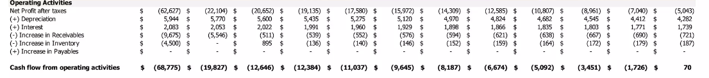
Cash Flow Forecast for the First 12 Months
Initial investment: £25,000 allocated for start-up costs and operations
Projected revenue: Based on average meal prices and estimated monthly footfall (Korede et al., 2023)
Operating costs: Rent, salaries, utilities, and raw materials (Beksh, 2023)
Marketing expenses: Advertising through digital and social media channels (Barrow, 2023)
Contingency fund: Set aside for unforeseen expenses like supply chain fluctuations (Garieri, 2023)
Expected profitability timeline: Anticipated breakeven by month 9 with steady growth

Slide 9

4Ps of Marketing for Lila Restaurant
Product: Unique dishes made with fresh, locally sourced ingredients (Aleskerova & Fedoryshyna, 2023)
Place: Strategic location in Plymouth for high footfall and seafood access (Beksh, 2023)
Price: Penetration pricing to attract early customers with discounts
Promotion: Social media campaigns and influencer collaborations
(Barrow, 2023)
Customer loyalty: Memberships and exclusive discounts for early
patrons (González-Márquez et al., 2023)
Sustainability focus: Emphasis on eco-friendly practices appeals
to target market

Slide 10
References
Aleskerova, Y. and Fedoryshynа, L., 2023. Financial mechanism in the system of economic vectors of development of hotel and restaurant and agricultural enterprises. Baltic Journal of Economic Studies, 9(4), pp.19-30.
Barrow, C., 2023. Starting & Running a Business All-in-one for Dummies. John Wiley & Sons.
Beksh, D., 2023. Business plan for an anime-themed café.
Bui, N.K.U., 2023. Start-up pans business.
Chaudhry, S., Crick, D. and Crick, J.M., 2023. I'll be there for you: coopetition and competitor-oriented activities among South Asian restaurants in two UK regional clusters. International Journal of Entrepreneurial Behavior & Research, 29(9/10), pp.1973-2004.
Garieri, E., 2023. Finnish Restaurateur’s Handbook: Starting a new restaurant business in Finland.

Slide 11
González-Márquez, R., Rosa-Díaz, I.M., Caro-González, F.J. and Galán-González, J.L., 2023. Where to internationalise and why: Country selection by restaurant franchises. Journal of Retailing and Consumer Services, 72, p.103287.
Karamina, N. and Fachira, I., 2023. Proposed Marketing Mix Strategy for Indonesian Restaurant in The Netherlands (Case Study: Pasundan). International Journal of Current Science Research and Review, 6(08), pp.5567-5578.
Korede, T., Al Mamun, A., Lassalle, P. and Giazitzoglu, A., 2023. Exploring innovation in challenging contexts: The experiences of ethnic minority restaurant owners during COVID-19. The International Journal of Entrepreneurship and Innovation, 24(1), pp.19-31.
Marshall, L.A., 2023. Restaurant management and operations: A tourism virtual experience. In The Internet and Travel and Tourism Education (pp. 169-182). CRC Press.
Razzak, B.M., Idris, B., Hasan, R., Saridakis, G. and Hansen, J.M., 2023. The impact of Covid-19 on struggling ethnic minority entrepreneurs' business strategy: the case of Bangladeshi curry houses in the United Kingdom. International Journal of Entrepreneurial Behavior & Research, 29(8), pp.1837-1866.

