Slide 1
OME Electromagnetic Radiation
Lecture 1
Introduction to the EM Spectrum

Slide 2
OME Electromagnetic Radiation
Upon the successful completion of this module, the student should be able to:
• Provide evidence of a systematic understanding of the scientific concepts underpinning magneto-static and AC time-harmonic problems;
• Analyse results obtained from the application of specific electromagnetic modelling techniques and correlate those results with physical characteristics.

Slide 3
Indicative content
• Electromagnetic Theory;
• Electromagnetic spectrum;
• Electromagnetic wave properties;
• Wave guides;
• Waves and beams, phased array systems, tracking systems;
• Material Properties, Magnetization and Hysteresis, Magnetic Circuit Theory, Electromagnetic Induction, Maxwell’s Equations, Complex Impedance and Transient Circuit Theory;
• Electromagnetic compatibility testing;
• Ionising and non-ionising radiation;
• Radar Hardware;
• Lasers: properties, hazards and selection;
• Doppler effects;
• Hazards, health and safety;
• Issues arise with EMC.

Slide 4
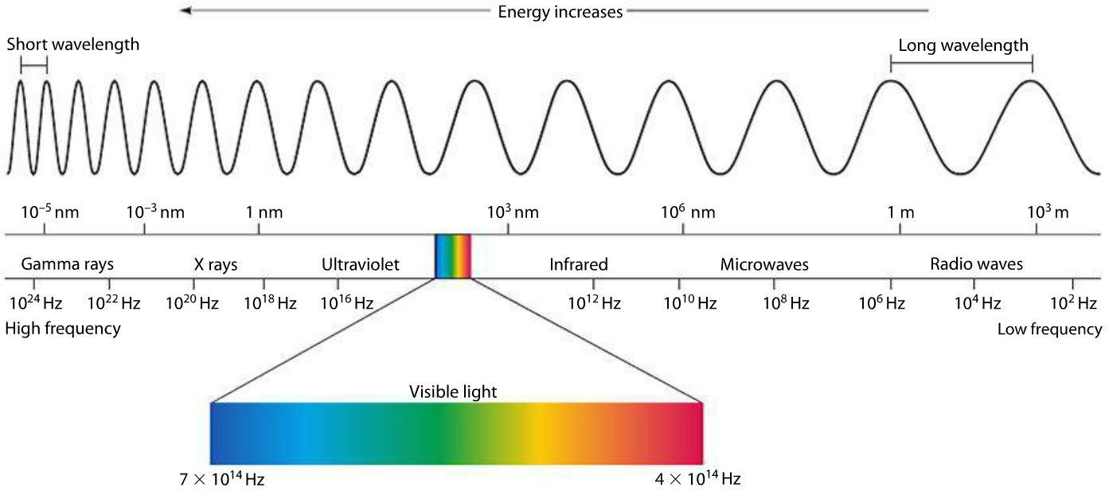
Electromagnetic spectrum

Slide 5
Changes in properties of electromagnetic radiation from radio to gamma rays
Increase or decrease?
wavelength;
frequency;
velocity;
penetration;
diffraction;
energy

Slide 6
Topics
Types of electromagnetic radiation;
Propagation electromagnetic radiation in free-field and wave-guides;
Duality of electromagnetic radiation as particles or waves;
Fundamentals of an electromagnetic wave;
Inverse Square Law;
Energy of a photon;
Discussion - effects of each region of EMR on primary explosive

Slide 7
Types of electromagnetic radiation
Radio waves: communication, navigation, remote control;
Microwaves: data and heating;
Infrared: invisible heat rays;
Visible light rays;
Ultraviolet waves: energetic light;
X-rays: penetrating radiation;
Gamma rays: nuclear energy.

Slide 8
Propagation of electromagnetic radiation
Free field – energy attenuation is proportional to distance². (‘Inverse square law’, 1/r²)
Waveguide – energy attenuation is proportional to distance, but waves are dispersed according to wavelength.
Analogy: shouting in open air cf. voice pipe

Slide 9
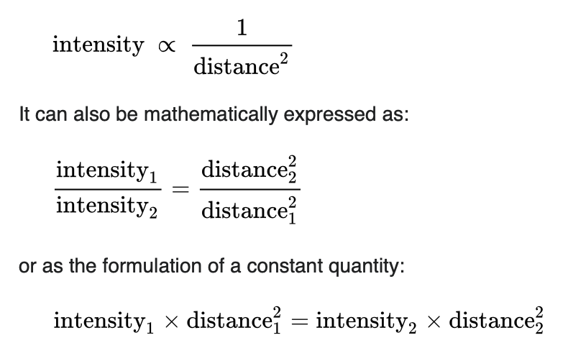
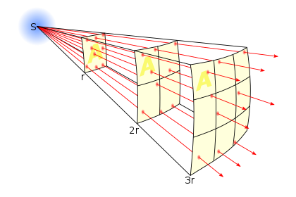
Inverse square law

Slide 10


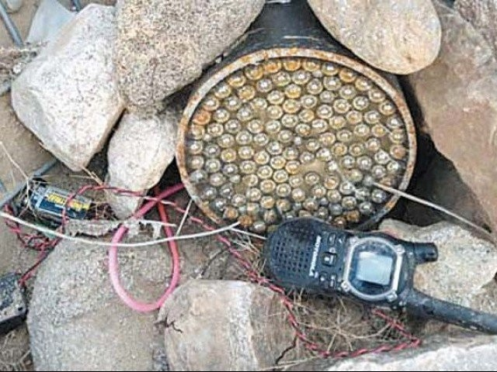
Radio waves example - ‘trial of strength’
An insurgent armed with a handheld radio transceiver has positioned himself 100 m from a roadside IED. The transceiver radiates 5 W of radio energy.
An approaching soldier is equipped with electronic countermeasures in the form a transmitter which radiates 10 W of radio energy.
Assume that the insurgent will not be able to fire the IED when the ECM radio power received by the IED exceeds the radio power received from the insurgent. Assume that there is ideal hemispherical radiation from both transmitters.
Calculate the radius of the protective bubble around the soldier?

Slide 11
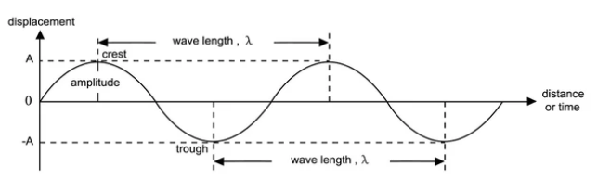
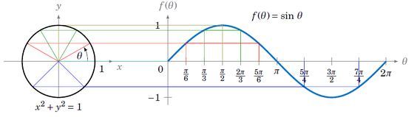
Representations of a wave

Slide 12
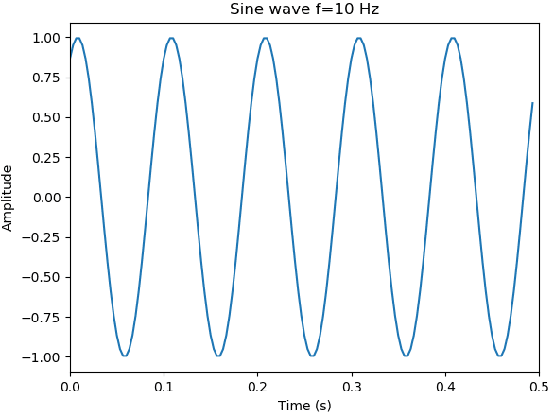
Fundamentals of a wave
Quantity | Units
Amplitude, A, y_{max} | [m], [V], [Vm⁻¹], [T],…
Displacement, y | [m], [V], [Vm⁻¹], [T],…
Wavelength, λ | [m]
Frequency, f, ν ‘nu’ | [s⁻¹] Hertz
Period, T | [s]
Angular frequency, ω | [rads⁻¹]
Wave velocity, v | [ms⁻¹]
Phase, θ | [rad]
Polarisation, E | [°] (angle from vertical)
Energy, W | [W]

Slide 13
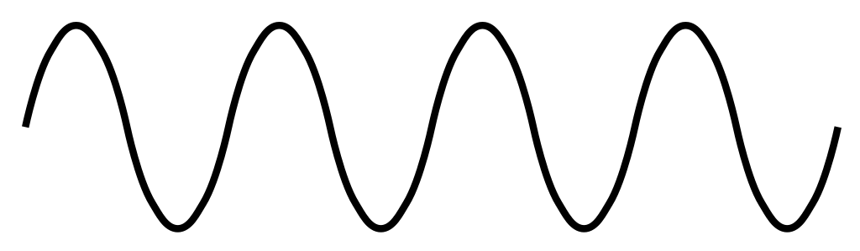
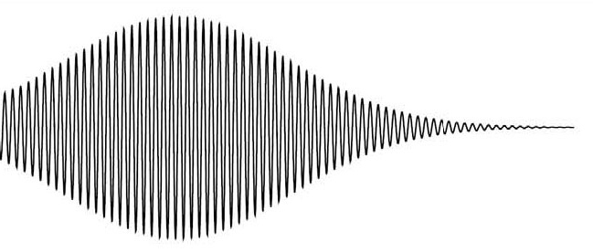
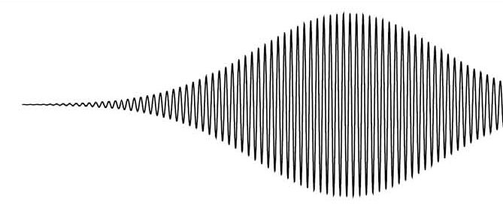
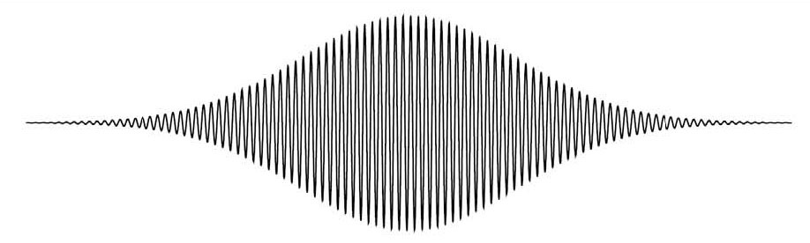
Duality of electromagnetic radiation as particles or waves
Continuous wave, e.g. radio wave produced by electronic circuit.
Stream of particles, e.g. a ray of light, produced by discrete events at an atomic level.

Slide 14
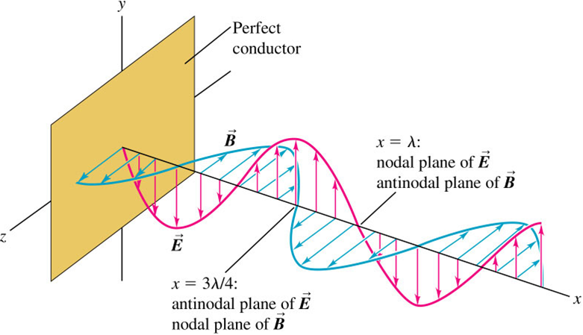
Anatomy of an electromagnetic wave

Slide 15
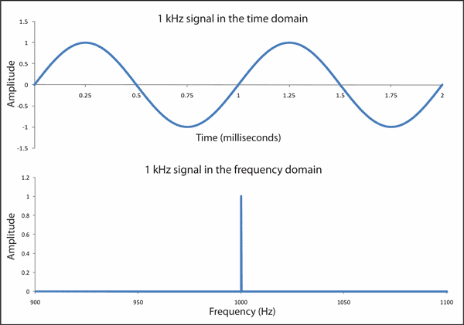
Time and frequency domain representation

Slide 16
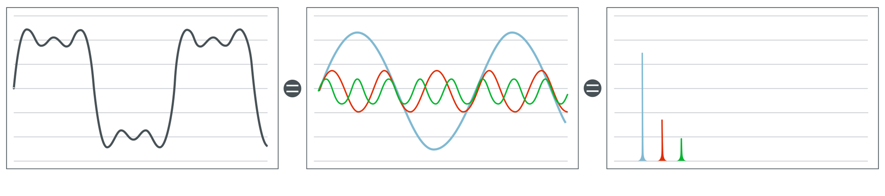
Time and frequency domain representation
Signal in time domain
Signal in frequency domain

Slide 17
The wave equation
y_{(x,t)} = y_{max} sin (kx − ωt)
where:
y_{(x,t)} = displacement at position x and time t
y_{max} = amplitude
k = wave number = 2π/λ
ω = angular frequency
https://www.youtube.com/watch?v=9WZM68aVnGk

Slide 18
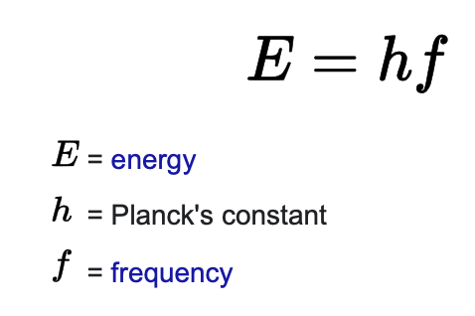
Energy of a photon
A photon's energy is equal to its frequency multiplied by the Planck constant.

Slide 19
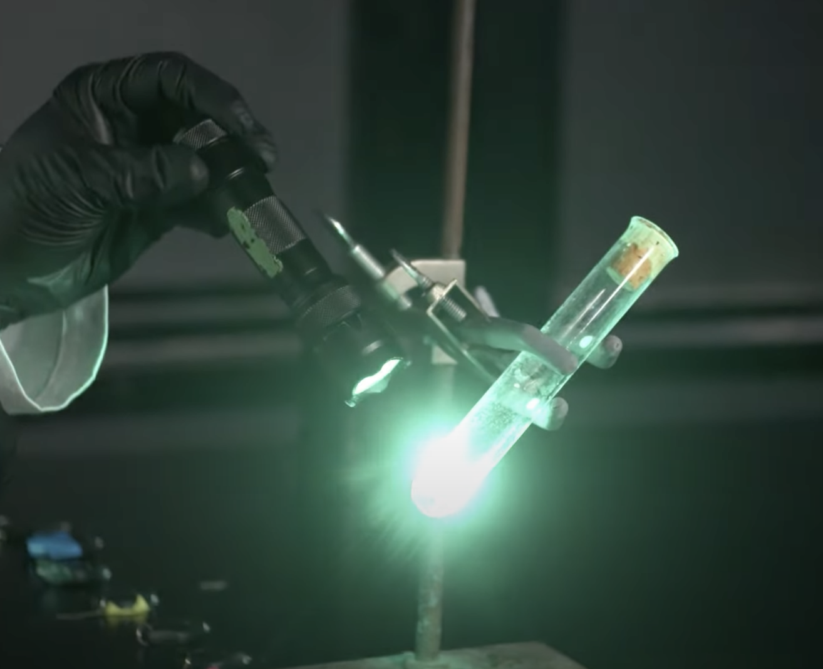
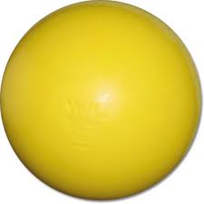

Initiation of reaction between
hydrogen and chlorine
Cl
H
H
Cl
H
Cl
Cl
Cl

Slide 20
Effects of electromagnetic radiation on energetic materials
Radio waves;
Microwaves;
Infrared;
Visible light rays;
Ultraviolet waves;
X-rays;
Gamma rays.

Slide 21
Example exam question (open book and access on-line)
A radio transmitter placed on the surface of Mars radiates 1 watt of power hemispherircally to send data back to earth.
Q1. How much power will be received by a 10 m diameter dish on Earth?
At the frequency being detected, the noise from space is 2 x 10⁻²³ Wm⁻².
Q2. What issue does this present and what might be done to remedy

Slide 22
Example exam question (open book and access on-line)
A radio transmitter placed on the surface of Mars radiates 1 watt of power hemispherircally to send data back to earth.
Q1. How much power will be received by a 10 m diameter dish on Earth?
At the frequency being detected, the noise from space is 2 x 10⁻²³ Wm⁻².
Q2. What issue does this present and what might be done to remedy
Area of hemisphere = 2 * π * r². I₁ = 0.159 Wm⁻².
I₂ = I₁ x d₁^2 / d₂^2 = 1.173 x 10 ⁻²³ Wm⁻².
For 10 m dish x 3.142 x 25 = 9.21 x 10⁻²²
Signal cannot be heard above noise floor. More transmitter power, focus power, signal processing.

Slide 23
Example exam question (open book and access on-line)
A certain travelling wave has frequency (f) of 200 Hz, a wavelength (λ) of 2m and an amplitude (a) of 0.02 m.
Q1. What is the velocity of the wave?
Q2. What is the period of the wave?
Q3. Calculate the displacement (y) at a point 0.3m from the origin

