Slide 1
Open Badges:
New Credentials and
New Opportunities

Slide 2
What are Badges?
Historically
Symbol of authority
Boy Scout / Girl Guide awards
Recognisable award system
Proven Motivational system
Brand Loyalty
Notes:
Symbol of authority: Military, Police
First Digital badges discussions circa 2005 but Mozilla and others entered field in 2011.
Open Architecture Allows ANYONE to issue badges.
Gamers have been earning badges since around 2000

Slide 3
What are Digital Badges?
(the New bit)
Effectively three years old
Open Architecture
Digital Natives already value Badges
New Credentials for a new technology landscape
Notes:
2011, the release of “An Open Badge System Framework,” a white paper authored by Peer 2 Peer University and The Mozilla Foundation.
Mozilla are offering the badge design/code for any users or developers
Digital Natives have been receiving electronic awards for some time, Nintendo’s POKEMON allowed players to attain badges from 1996, more recently Microsoft’s Xbox allowed users to display achievements, awards and rankings online (2005). Current young adults are aware of and acclimatised to digital reward systems and Status gained from sharing them.
Instructional sites such as P2PU and Khan Academy make use of a digital badging system. Technology employers will be looking for New qualifications and Students with reduced incomes will want affordable qualifications.
Why offer paper certification for online qualifications? E-Learners will want E-Creditation.

Slide 4
Why Adopt Badges?
“Revised qualifications need to be developed in partnership with schools, Higher Education and industry.”
ICT steering group report to Welsh Government
“over the next three-to-five years, as more institutions start using Open Badges, it may be necessary to support Open Badges in order to remain attractive to potential students”.
Glover, I. (2013). Investigating perceptions and potential of open badges in formal higher education
Notes:
- See more at: http://www.jiscrsc.ac.uk/wales/news/2013/october/ict-steering-group-report-to-welsh-government.aspx#sthash.Wf3LEMXp.dpuf
academically rigorous qualifications are needed which cater for all learners.
“Given that about a quarter of the UK population has a university degree, it's no longer a strong selling point on its own – and means very little once you've been working for a few years”
http://www.theguardian.com/money/2013/apr/22/top-10-things-employers-looking-for

Slide 5
Because -
If students leave Further Education –
  Or even Secondary Education,
  With Badges
  They will seek Universities that offer Badges

Slide 6
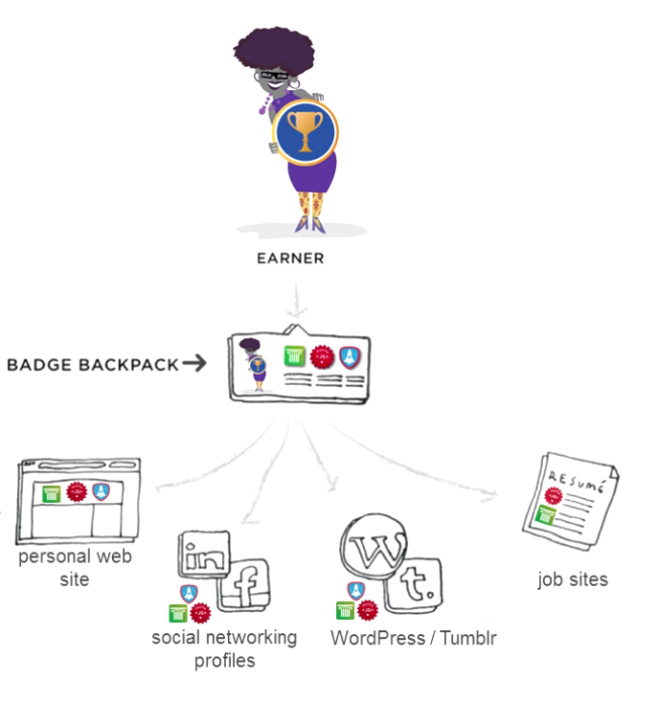
How Open Badges are used
Notes:
The badge Earner can keep their badges in a “backpack” {Mozilla, Credly, Basno, Purdue Passport) and from there display them across many other media,
Facebook, Twitter, Blogs etc. Mozilla is in talks with Linkedin and other providers to adopt the Open Badges Infrastructure.
Digital badges allow learners to differentiate themselves to employers.
Open Badges are: Portable, Stackable & VERIFIABLE

Slide 7
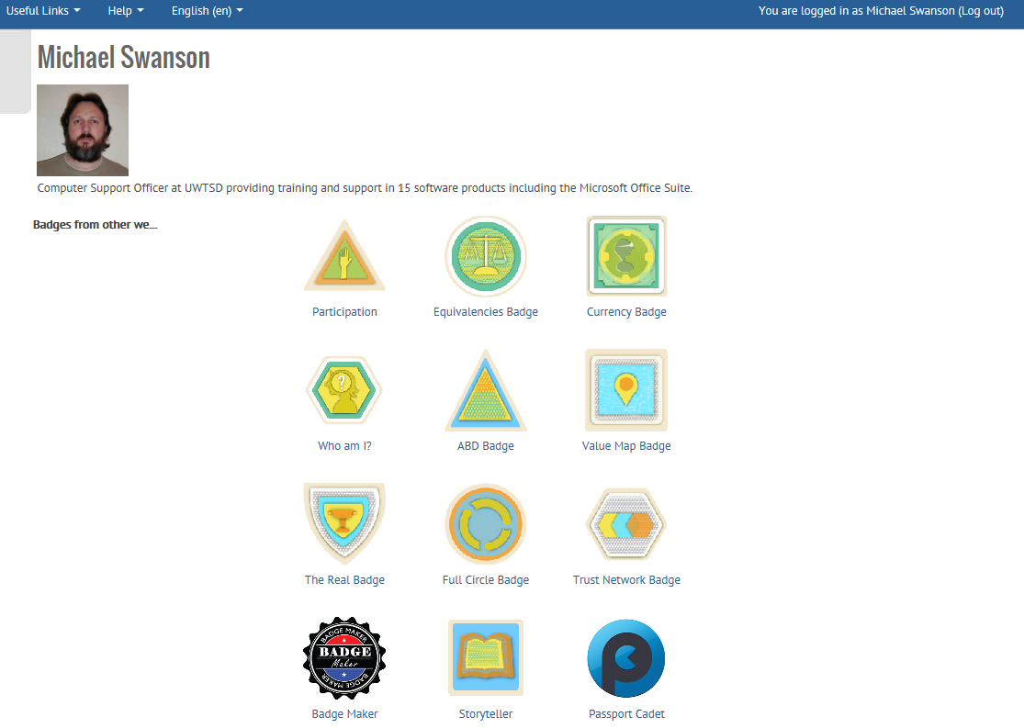
Example of backpack
Notes:
Example of badges awarded from Mozilla training event.
Each of these required submission of a written report of 1-2k words with analysis, descriptive discussion and a narrative element and was assessed by the organisers of the event to a published rubric.

Slide 8
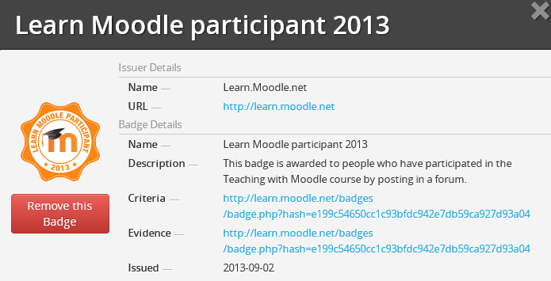
Behind the Badge
Notes:
Hyperlinks to the issuer and both criteria and evidence held by the issuer.
Through these links an employer can verify the Validity of the badge and the learning it represents.

Slide 9
What skills do employers want?
Teamwork
Problem Solving
Communication
Time Management
IT Skills
Numeracy
Customer Awareness.
Do our degrees deliver these skills?
Can employers see the evidence?
Could we Badge these skills instead?
Notes:
http://www.prospects.ac.uk/applying_for_jobs_what_skills_do_employers_want.htm

Slide 10
Employers often ask for knowledge of
Diversity
Equality
Data Protection
Freedom of Information
Health and Safety.
Do our degrees deliver that knowledge?
Can employers see the evidence?
Could we Badge these skills instead?
Notes:
http://www.prospects.ac.uk/applying_for_jobs_what_skills_do_employers_want.htm

Slide 11
The Opportunities
Digital Credentials support E-Learning
Awards designed to meet learners needs
Employability gained through targeted competency awards
Recruiting Global learners
Early adopters secure market share
Notes:
Learners seeking online courses will likely seek and respect online accreditation.
Badges allow prospective employees to directly illustrate skills applicable for positions they apply for.
Awards can be created to meet employer expectations.
Those organisations First to provide awards and have them endorsed by employers are likely to recruit the next batch of learners.

Slide 12
Facts and Figures
1,900 independent issuers have aligned with the Open Badge standard
210,000 badges issued to their community members
”Badge The UK” report 50,000 badges issued to 23,000 students by over 120 partner organizations (as of February 2014.)
Notes:
Badge The UK efforts, reporting 50,000 badges issued to 23,000 students by over 120 partner organizations (as of February 2014.)
Source: Mozilla Foundation email: Jade Forester, Global Marketing Coordinator + Liaison

Slide 13
Question Time

Slide 14



Proposal for badge Imagery
University heraldic Shield and elements promote recognition
Notes:
“given that one of the most important functions of a badge system is often to build community and to create trust, it is important that the visual display of the badge remains stable.”
Halavais, Alexander M. C. “A Genealogy of Badges: Inherited Meaning and Monstrous Moral Hybrids.” Information, Communication, and Society 15, no. 3 (2012): 354-373.
To build trust and stability it is suggested that the use of the Heraldic device, colours and elements in badge design will inherit validity, brand strength and historic trust.

Slide 15






Badges Stack for Greater Award
Notes:
Windows colours and mini Logo Star and Uni. colours and Leaf Emboss Star.

Slide 16



Social Participant Badges
Denoting:
Social Skills
Peer Evaluation/Recognition
Mentoring and Support
Attendance at Seminar events
Participation in Group work
Notes:
Uni. colours and Leaf Emboss Star. Hands theme denoting Social interaction, Awarded on Merit or through peer election/support rather than EARNED through evidence submission.

Slide 17

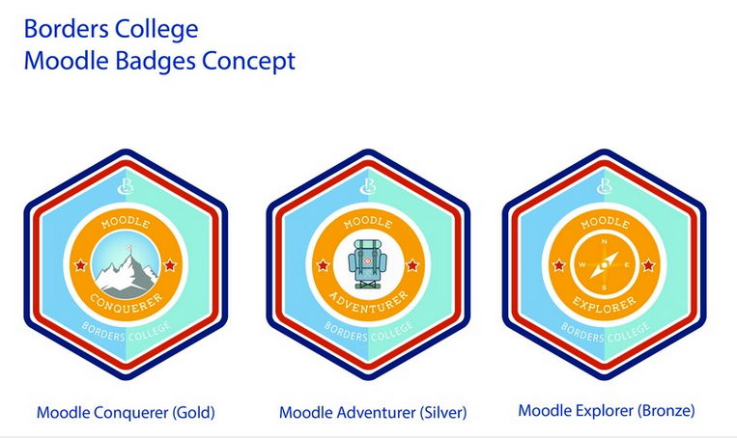
Why Should We Care?
If we don’t someone else will.
  For Example:
  gained funding of approximately £113,000 from JISC to develop capability in e-learning.

Slide 18
If They do, We Should
  The e-Learning team at Borders College believes that the Mozilla-led Open Badges ecosystem offers an opportunity to increase student engagement, retention and employability.
  http://www.borderscollege.ac.uk/news-and-events/funding-success-for-the-e-learning-bolt-project/
  http://www.rsc-scotland.org/?p=2454

