Slide 1
Week 9: Session 1 & 2:
Big Data & Business Implications
Data Handling & Business Intelligence
LCBB5014

Slide 2
Lesson Aims
By the end of this session, students should be aware of:
Learn what Big Data is and how it is changing the world of analytics
Understand the motivation for and business drivers of Big Data analytics
Become familiar with the Big data best practices
Learn about Hadoop, MongoDB, Rainstor, Hunk and Presto as they relate to Big Data analytics
Learn about the applications of stream analytics

Slide 3
Big Data -
Definition and Concepts
Put simply, big data is larger, more complex data sets, especially from new data sources.
These data sets are so voluminous that traditional data processing software just can’t manage them.

Slide 4
The three Vs of big data
Volume | The amount of data matters. With big data, you’ll have to process high volumes of low-density, unstructured data. This can be data of unknown value, such as Twitter data feeds, clickstreams on a webpage or a mobile app, or sensor-enabled equipment. For some organizations, this might be tens of terabytes of data. For others, it may be hundreds of petabytes.
Velocity | Velocity is the fast rate at which data is received and (perhaps) acted on. Normally, the highest velocity of data streams directly into memory versus being written to disk. Some internet-enabled smart products operate in real time or near real time and will require real-time evaluation and action.
Variety | Variety refers to the many types of data that are available. Traditional data types were structured and fit neatly in a relational database. With the rise of big data, data comes in new unstructured data types. Unstructured and semi structured data types, such as text, audio, and video, require additional pre-processing to derive meaning and support metadata.

Slide 5
The three Vs of big data

Slide 6
How big data works
Big data gives you new insights that open up new opportunities and business models. Getting started involves three key actions:
1. Integrate
2. Manage
3. Analyse

Slide 7
1. Integrate
Big data brings together data from many disparate sources and applications. Traditional data integration mechanisms, such as ETL (extract, transform, and load) generally aren’t up to the task. It requires new strategies and technologies to analyse big data sets at terabyte, or even petabyte, scale.
During integration, you need to bring in the data, process it, and make sure it’s formatted and available in a form that your business analysts can get started with.

Slide 8
2. Manage
Big data requires storage. Business storage solution can be in the cloud, on premises, or both. Business/Data can store data in any form business want and bring to the desired processing requirements and necessary process engines to those data sets on an on-demand basis.
Many people choose their storage solution according to where their data is currently residing. The cloud is gradually gaining popularity because it supports business current compute requirements and enables business to spin up resources as needed.

Slide 9
3. Analyse
Business investment in big data pays off when you analyse and act on your data. Get new clarity with a visual analysis of your varied data sets. Explore the data further to make new discoveries.
Share business findings with others. Build data models with machine learning and artificial intelligence. Put business data to work.

Slide 10
Big data best practices
Align big data with specific business goals | More extensive data sets enable you to make new discoveries. To determine if you are on the right track, ask how big data supports and enables your top business and IT priorities. Examples include understanding how to filter web logs to understand ecommerce behaviour, deriving sentiment from social media and customer support interactions, and understanding statistical correlation methods and their relevance for customer, product, manufacturing, and engineering data.

Slide 11
Ease skills shortage with standards and governance | One of the biggest obstacles to benefiting from your investment in big data is a skills shortage. Standardizing your approach will allow you to manage costs and leverage resources. These can be addressed by training/cross-training existing resources, hiring new resources, and leveraging consulting firms.

Slide 12
Optimize knowledge transfer with a centre of excellence | Use a centre of excellence approach to share knowledge, control oversight, and manage project communications. Whether big data is a new or expanding investment, the soft and hard costs can be shared across the enterprise. Leveraging this approach can help increase big data capabilities and overall information architecture maturity in a more structured and systematic way.

Slide 13
Top Payoff is aligning unstructured with structured data | It is certainly valuable to analyse big data on its own. But you can bring even greater business insights by connecting and integrating low density big data with the structured data you are already using today. For example, there is a difference in distinguishing all customer sentiment from that of only your best customers. Which is why many see big data as an integral extension of their existing business intelligence capabilities, data warehousing platform, and information architecture.

Slide 14
Plan your discovery lab for performance | Discovering meaning in your data is not always straightforward. Sometimes we don’t even know what we’re looking for. That’s expected. Management and IT needs to support this “lack of direction” or “lack of clear requirement.” At the same time, it’s important for analysts and data scientists to work closely with the business to understand key business knowledge gaps and requirements.

Slide 15
Align with the cloud operating model | Big data processes and users require access to a broad array of resources for both iterative experimentation and running production jobs. A big data solution includes all data realms including transactions, master data, reference data, and summarized data. A well-planned private and public cloud provisioning and security strategy plays an integral role in supporting these changing requirements.

Slide 16





Big Data Technologies
Hadoop
Rainstor
MongoDB
Hunk
Presto

Slide 17
Hadoop Framework
Hadoop Framework was designed to store and process data in a Distributed Data Processing Environment with commodity hardware with a simple programming model.
It can Store and Analyse the data present in different machines with High Speeds and Low Costs.

Slide 18
MongoDB
The NoSQL Document Databases like MongoDB, offer a direct alternative to the rigid schema used in Relational Databases.
This allows MongoDB to offer Flexibility while handling a wide variety of Datatypes at large volumes and across Distributed Architectures.

Slide 19
RainStor
RainStor is a software company that developed a Database Management System of the same name designed to Manage and Analyse Big Data for large enterprises.
It uses Deduplication Techniques to organize the process of storing large amounts of data for reference.

Slide 20
Hunk
Hunk lets you access data in remote Hadoop Clusters through virtual indexes and lets you use the Splunk Search Processing Language to analyse your data.
With Hunk, you can Report and Visualize large amounts from your Hadoop and NoSQL data sources.

Slide 21
Presto
Presto is an open source Distributed SQL Query Engine for running Interactive Analytic Queries against data sources of all sizes ranging from Gigabytes to Petabytes.

Slide 22
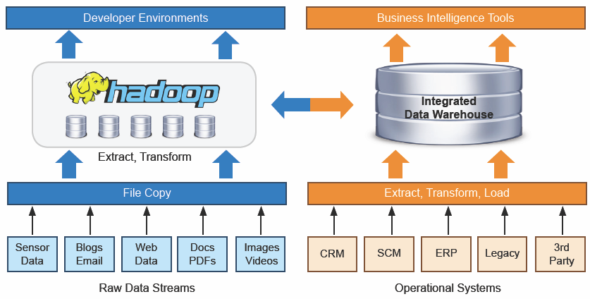
Coexistence of Hadoop and DW

Slide 23
Top 10 Big Data Vendors with Primary Focus on Hadoop

Slide 24
Big Data And Stream Analytics
Streaming analytics, also known as event stream processing, is the analysis of huge pools of current and “in-motion” data through the use of continuous queries, called event streams.
These streams are triggered by a specific event that happens as a direct result of an action or set of actions, like a financial transaction, equipment failure, a social post or a website click or some other measurable activity.
https://youtu.be/xJFpEjxFYWk

Slide 25

Questions

