Slide 1
Reporting and Presenting Data
Will Fleming

Slide 2
Turning data into information
Remember, we collect data first and then it is how we manipulate and interpret the data that turns it into information. Therefore it is important that the information is:
Well structured
Sensibly summarised
Clearly labelled and is….
Visually interesting

Slide 3
Quantitative Data
This tends to be a relatively easier process than we have for qualitative data. We use:
Presentation – the analysed data can then be presented in many different ways. Common forms are tables, bar charts and pie charts.
Tabulations – the main output will be in the form of tables. These typically show the number and percentage of respondents in the sample and various subgroups.
Cross tabulations - allow comparisons to be made between sub-samples, such as demographics, attitudes or behaviour.
Infographics – currently very popular.

Slide 4
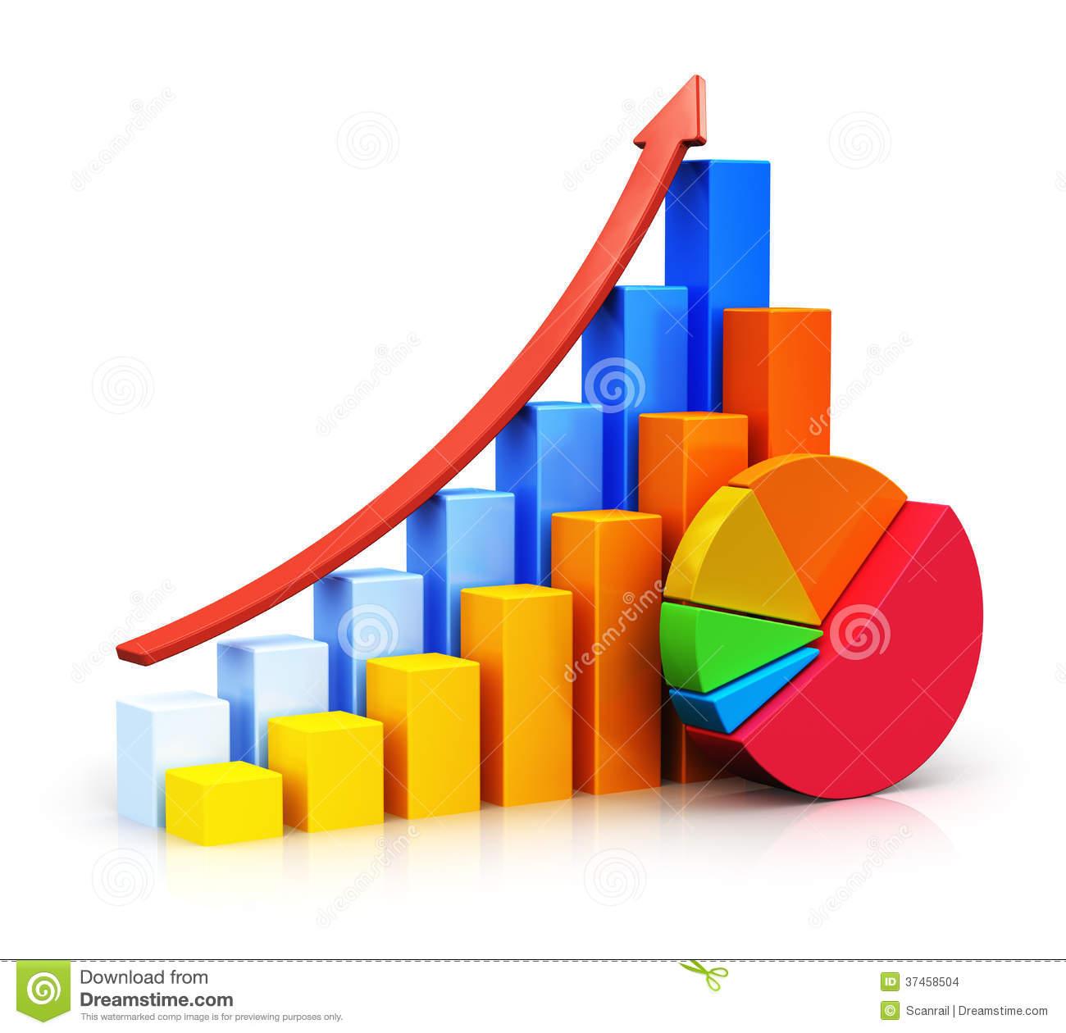
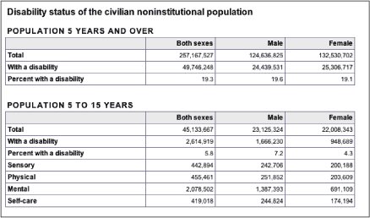
Charts and Tables

Slide 5

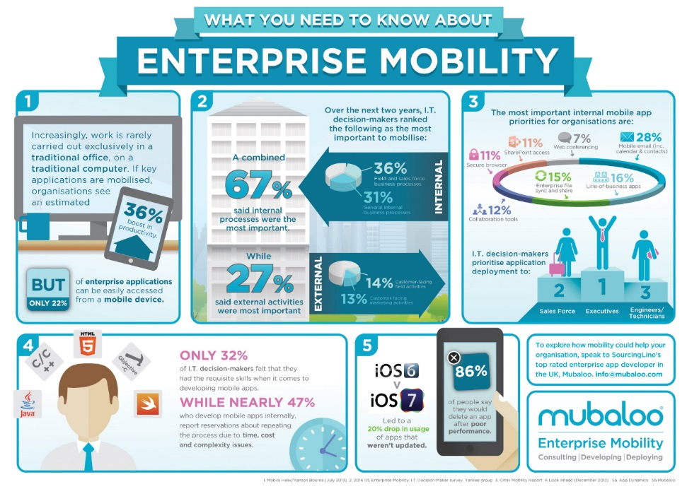
Infographics

Slide 6
Presenting Qualitative Data
Qualitative data can be organised in a number of ways (CIM 2009):
Organising data manually –
The tabular method as with quants.
The cut and paste method creating piles of useful data Three ways you can ‘cut n paste’ data • Thematically • By case • By case and theme.
Spider – type/ mind mapping diagrams.
Annotation method.
Organising data via computer –
Content analysis thru creating categories which can be compared and contrasted for linkages .
Text analysis from conversation and narrative.

Slide 7
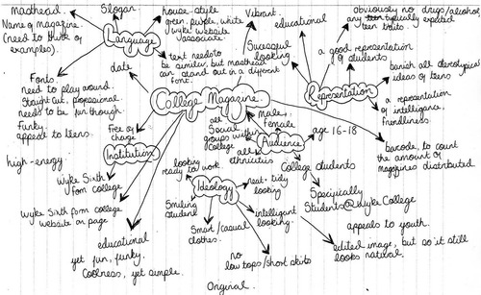
Spider diagrams

Slide 8
Annotation
Writing notes on the research results;
Use a pen, pencil, post-it notes, or a highlighter.
Summarize important ideas in your own words.
Comment on things that intrigue, impress, surprise, disturb, etc.
Feel free to draw picture when a visual connection is appropriate.
Explain the historical context or traditions/social customs used.
Comment on the actions or development of participants.
Define words that are new to you.
Mark passages that you find confusing with a ???
Write questions that you might have for later discussion/ research.

Slide 9
Presenting Qualitative Data Transcript
One suggested approach to analysing a transcript is to (CIM 2009):
Start by referring to the survey objectives.
Take each heading or objective and read through each transcript identifying behaviour, attitudes or opinions of significance under each heading or objective.
Highlight any appropriate comments or quotes that support that view.

Slide 10
Analysing a Qualitative Data Transcript
4. Identify the extent to which a particular view is held by all, most or a minority of those questioned.
Decide which to report as typical of the respondent group.
Decide which others to report as variations in behaviour or attitude.
7. Select the quotes that you will use to illustrate the findings of the report.

Slide 11
Presenting transcripts
Presentation – quite simply the analysed data is then presented in a text format where the findings are typically grouped under key headings and themes or under individual questions.
Appropriate comments or quotes that support a particular view or are variations of that view are included.

Slide 12
Student Activity
Why is this such an important part of the marketing research process?
Should quantitative and qualitative data be reported in the same way? If not, then why not.
Identify some of the main ways that quantitative data can be reported.
Identify some of the main ways that qualitative data can be reported.

