Slide 1
Statistical Power, Effect Size and Sample Sizes
Stacey Coleman

Slide 2
Statistical Power, Effect and Sample Sizes
Statistical significance versus clinical significance
The importance of sample size and the factors that need to be considered to calculate an appropriate sample size
Power
Effect sizes

Slide 3
Statistical Significance
We are never certain of an effect/relation, so we always deal in the area of probability (p-values!)
We (usually) test for one of two main things:
  Differences between scores
  Usually sets of scores calculated as grand means e.g., t-test
  Associations between scores
  Is there a relationship between (x) and (y) e.g., correlation

Slide 4
Reminders!
0.05 means there is a 5% likelihood that the results were due to chance/random (null hypothesis)
1.0 would mean a 100% certainty that the results were down to chance
In statistical language, ‘significant’ simply means that there was a less than 5% chance of getting a result under what would be correct for the null hypothesis to be true…

Slide 5
Reminders!
But! Finding a statistically significant result doesn’t necessarily mean that you can now go out and change the world
  Likewise, not finding a statistically significant result doesn’t necessarily mean that there is nothing of interest…Statistical significance is determined through conducting inferential tests (the stuff you’ve been doing), and is noted as the sig. or sig. value in SPSS

Slide 6
Reminders!
Type 1 error: (find a significant p-value in error)
  Reject the null hypothesis when it is correct
  Accept the alternative hypothesis in error
  Displayed like this: Type I error
Type 2 error: (find a non-significant p-value in error)
  Reject the alternative hypothesis in error
  Accept the null hypothesis by mistake when there really is an underlying effect
  Displayed like this: Type II error

Slide 7
Clinical Significance
The practical importance of a study, with a genuine effect on real life!
E.g., how effective is a new treatment?
E.g., does one type of intervention work better than another?

Slide 8
Clinical Significance
If findings from research are considered clinically significant then they are likely to influence how actual patients in the real world are treated
It could amend the way in which health professionals work and what guidance is given from regulatory bodies, and even provide supporting evidence to allow government to pass new or update legislation

Slide 9
Sample Size
We typically use estimates or % chance/confidence
It would be great if we could collect data from an entire population – we could remove this chance and estimation element
  This is impossible to achieve in most cases, and not needed
So, we select a sample of individuals who we believe are representative of the population we are looking to investigate

Slide 10
Sample Size
Common sense suggests that having the largest sample size possible would be of most benefit in order to make meaningful conclusions about the population
  If your sample size is too small, then you may not detect an important underlying effect.
  But – in clinical studies in particular, the population that we can draw our sample from may already be small (e.g., patients with a rare disease).

Slide 11
Sample Size
So, we need to try and get the balance right between getting enough P’s to detect an effect without running in to the problem of trying to get an unrealistically large sample.
We can calculate an optimal sample size – this must be done during the design stage

Slide 12
Calculating Sample Size
We need to specify the following quantities during the design stage:
POWER
The chance of detecting a statistically significant effect (if there is one). Power should be 70%+.
SIGNIFICANCE LEVEL
Usually remains at 0.05 (point where we reject the null)
SMALLEST EFFECT OF INTEREST
Magnitude of the effect that is clinically important – i.e., the difference (this can be expressed as the Standardised Difference)

Slide 13
Calculating Sample Size
Power and significance are relatively easy to specify
Obtaining a value for the standardised difference requires two further things:
  An estimate of the smallest difference in means needed
  An assumed equal standard deviation of the observations (either in groups or across responses)

Slide 14
Methods for Calculating Sample Size
General formulae
Quick formulate
Special tables
Computer packages

Slide 15
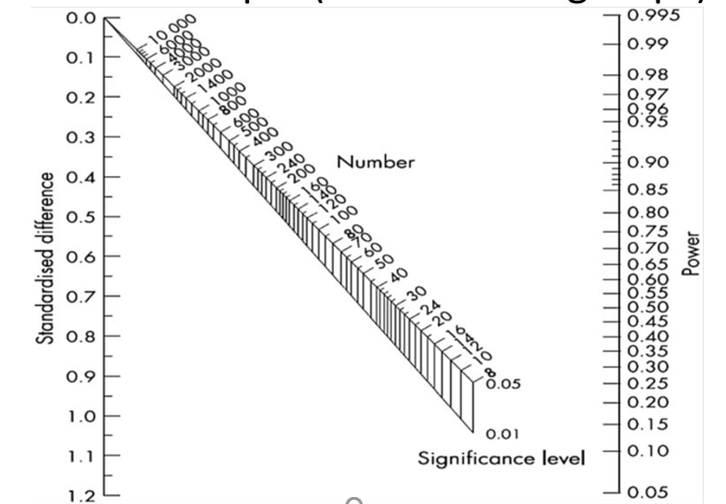
1. Altman’s Nomogram
Requires the calculation of the standardised difference and to join values on the left-hand axis of the nomogram to the power we have specified on the righ- hand side of the axis
NB: also need to specify alpha level - .05 or .01

Slide 16
1. Altman’s Nomogram
The required sample size is indicated at the point at which the resulting line and sample size axis meet
Example
Power = 80%
Standardised difference = 0.4
Alpha level = 0.05
200 participants

Slide 17
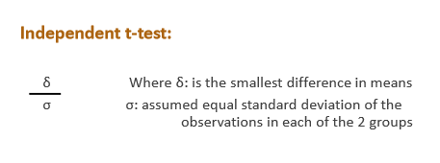
Calculating the Standardised Difference
The formulae for calculating the standardised difference will depend upon the test you are looking to conduct:

Slide 18
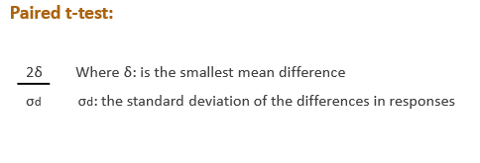
Calculating the Standardised Difference

Slide 19
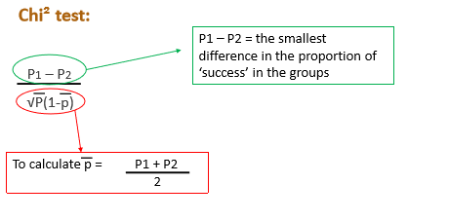
Calculating the Standardised Difference

Slide 20
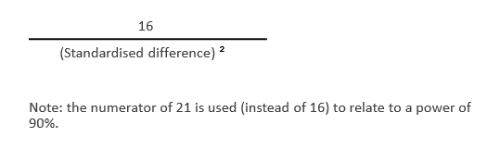
2. Quick Formulae: Lehr’s Formula
For independent t-test and the Chi² test, you can use Lehr’s formula for calculating the sample size for a power of 80% and a two-tailed significance level of 0.05

Slide 21
Power Statement
With applied research, you will more than likely need to include a power statement as part of your study protocol or in the method section of a report to show that you considered the sample size during the designing stages of your study
A typical statement could be:
  “84 patients in each group were required to have a 90% chance of detecting a difference in means of 2.5 days (SD = 5 days) at the 5% level of significance using an Independent samples t-test.”

Slide 22
Effect size
The REAL effect in the population; the magnitude of the difference between groups
  Sometimes it’s not enough to simply know that an effect is significant
We may also want to know the size of the effect
  E.g., we may want to know by how much does a new drug reduce episodes of depression
Whether the manipulation of an IV has created a sizeable difference between our samples on some measure
  The further the difference between the two means, the larger the effect size

Slide 23
Effect size
The popular measures of effect size to compare groups are Cohen’s d and eta squared (η2)/partial eta squared.
In Psychology we typically use partial eta squared, which is what SPSS provides us with in the very last column of our inferential statistics box when conducting more complex analyses (such as ANOVA).
  If we have remembered to tick Display ‘Estimates of effect size’ in the Options Dialogue box!

Slide 24
Effect size: Eta Squared
Guidelines proposed by Cohen (1988) for interpreting the eta squared value are:
0.01 – 0.06 = small
0.06 – 0.14 = medium
> 0.14 = large
NB: eta squared more appropriate to report as the measure of effect size when your model has more than one IV.

Slide 25
Effect size: Cohen’s d
Cohen’s d reporting of effect size:
0.2 = small
0.5 = medium
0.8 = large
NB: Cohen’s d indicates the size of the difference between two means in standard deviation units. Useful to report when you are only comparing two means.

Slide 26
Effect size: Pearson’s r
Correlation co-efficient values are also relevant measures of effect size
0.2 = small
0.5 = medium
0.8 = large
NB: Pearson’s r for use with correlational / relationship studies – not suitable for comparison of differences in groups means

Slide 27
Task for Today
Practice using Altman’s nomogram to estimate sample sizes
Write up power statements for each of the scenarios
Group work:
Assessment of attraction should be chosen
Work done on AI images
Qualtrics accounts
Materials started (information sheet, consent form, debrief)

