Slide 1
Using Radar

Slide 2
What Can We Measure?
Distance (via return signal delay estimation)
Speed (via the Doppler frequency shift in the returned signal)
Direction (because our antennae are generally directional, or by using multiple receivers)

Slide 3
Signature Analysis and Inverse Scattering
Target size (from magnitude of return)
Target shape and components (return as a function of direction)
Moving parts (modulation of the return)
Material composition
More functions, more complex radar
  Cost and size increases

Slide 4
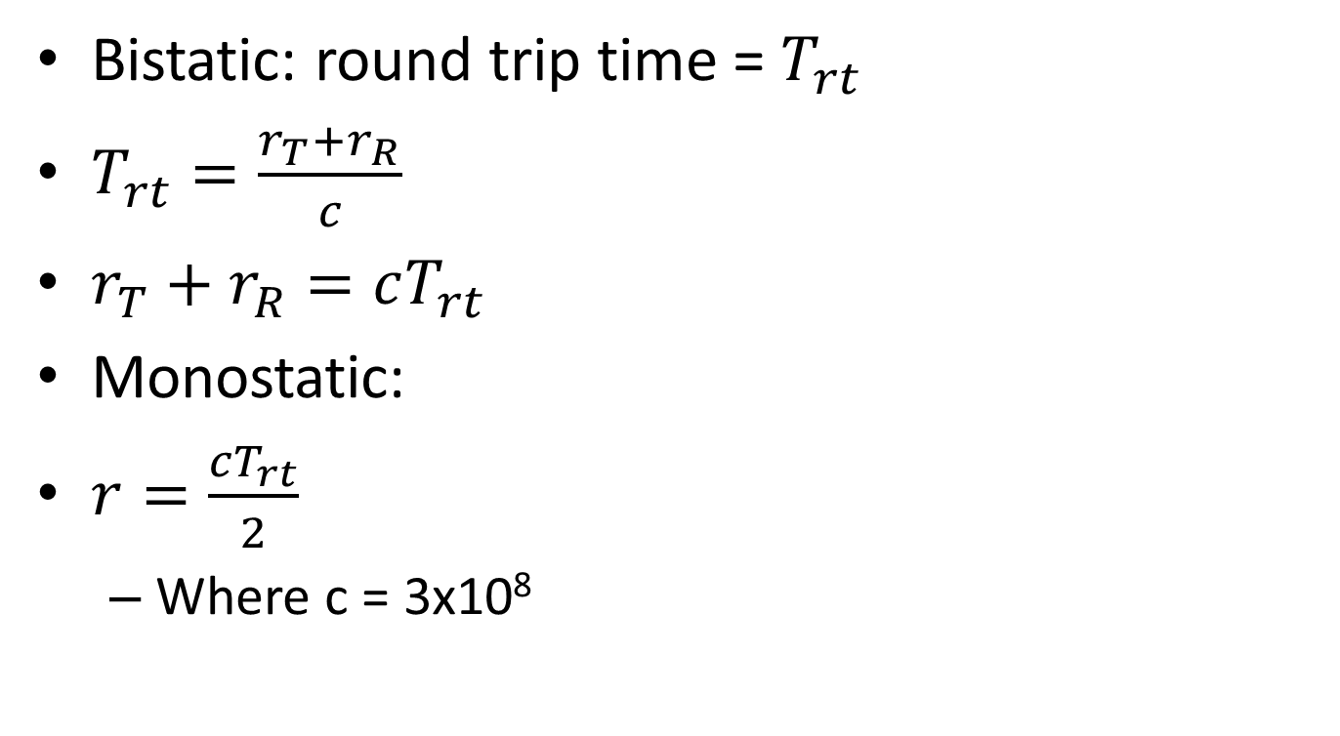
Time Delay Range Estimation
Bistatic: round trip time = $T_{rt}$
$T_{rt}=\frac{r_{T}+r_{R}}{c}$
$r_{T}+r_{R}=cT_{rt}$
Monostatic:
$r=\frac{cT_{rt}}{2}$
  Where c = 3x10⁸
r_{T}
Object (target)
T
r_{R}
R

Slide 5
Only One (Small?) Problem
Multipath reflections or multiple targets?
Scenario
  Multiple pulses transmitted
  Which one generated the return?
Pulse 1
Pulse 2
T_{R2}
T_{R1}

Slide 6
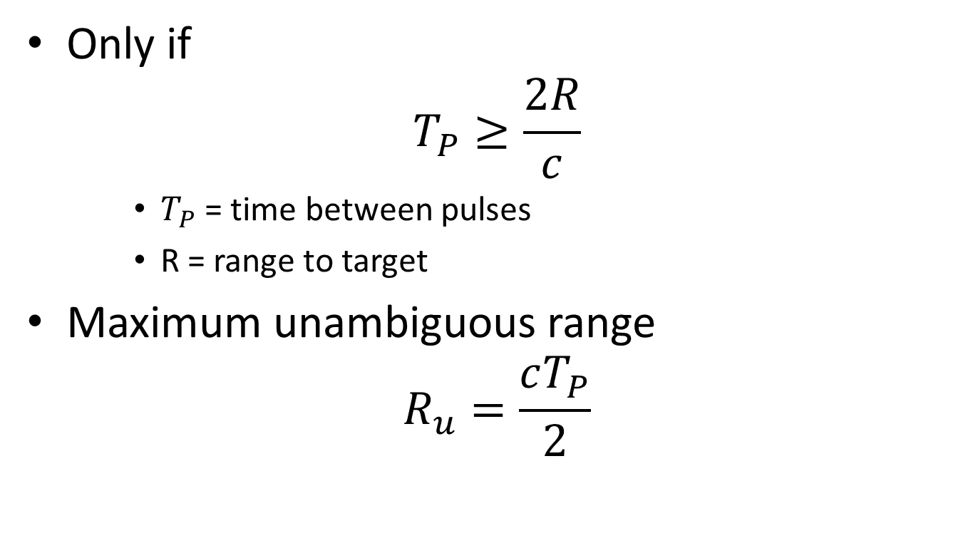
Unambiguous Range?
Only if
$$T_{P}≥\frac{2R}{c}$$
    $T_{P}$ = time between pulses
    R = range to target
Maximum unambiguous range
$$R_{u}=\frac{cT_{P}}{2}$$

Slide 7
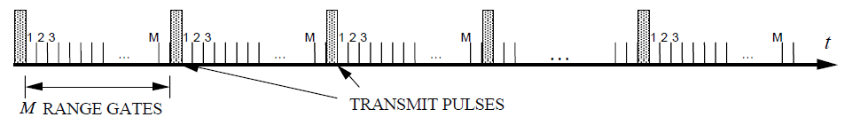
Range Gates
Use our knowledge of pulse propagation to create a set of sub-sets of time (gates)
Each gate is opened and closed
The time each gate is open is a range increment
Gates must include the ranges of interest, or cover interval between pulses
For tracking a target, we acquire it in one particular gate period
We can then follow it
We know which gate period it is going into next so can continue to track
Dwell time = N/f_{p}

Slide 8
Range Gates and Bins
The returned signal “gates” are imaginary, a way to describe dividing time into slots according to range
This is all handled by the signal processing at the receiver
  As DSP&Comms – timing of gate open, delay intervals based on time of transmission

Slide 9
Multipath Returns
Airborne radar
Aircraft
Target
H_{A}
Grazing angle, ψ
H_{T}
Ground

Slide 10
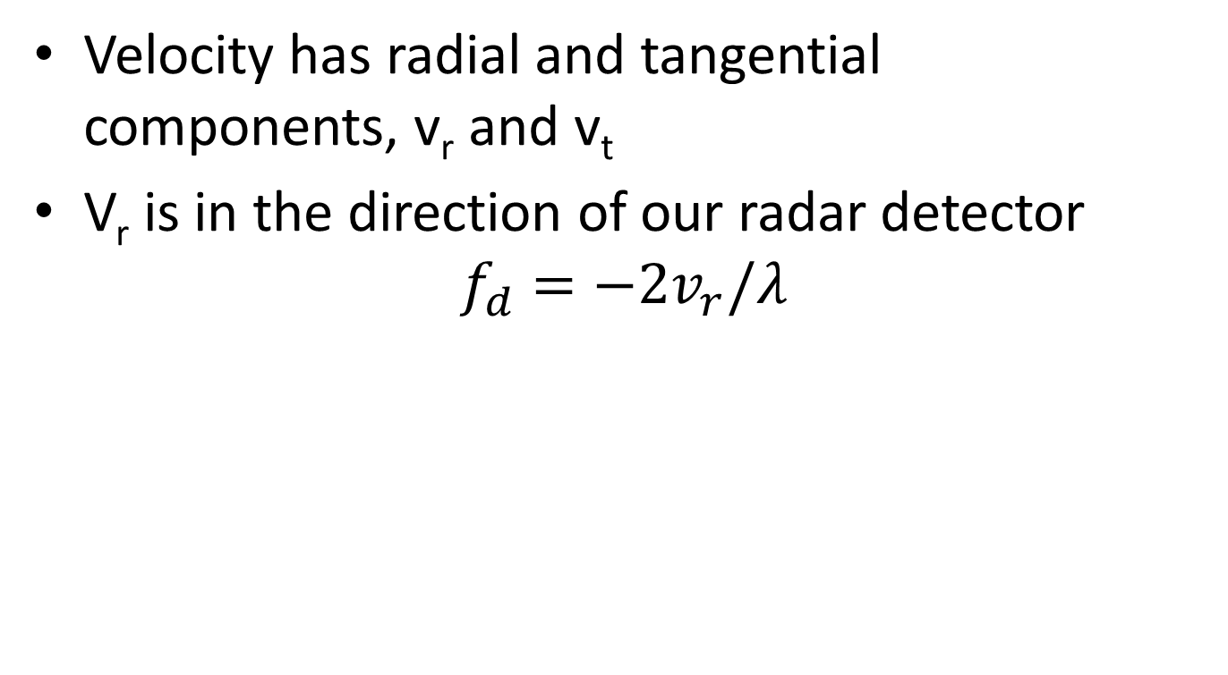
Doppler Frequency Shift
Velocity has radial and tangential components, v_{r} and v_{t}
V_{r} is in the direction of our radar detector
$$f_{d}=−2v_{r}/λ$$
v_{t}
v
Radar Set
v_{r}

Slide 11
Doppler Issues
Our transmitted signal isn’t spectrally “pure”
  Can we tell side bands from Doppler return?
  Only if sufficiently high pulse repetition frequency
  But high f_{P} = small T_{P} , which give us problems with range ambiguity (see earlier)

Slide 12
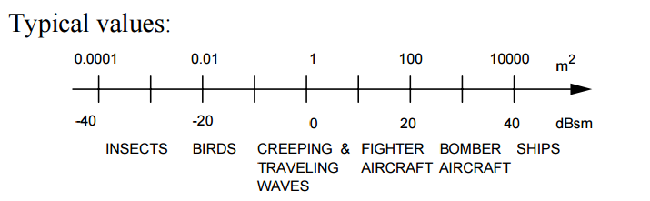
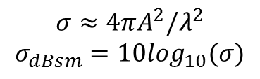
Radar Cross Section
$$σ≈4πA^{2}/λ^{2}$$
$$σ_{dBsm}=10\log_{10}(σ)$$
Courtesy of Prof. David Jenn, Navy Postgraduate School, available from:
http://faculty.nps.edu/jenn/Seminars/RadarFundamentals.pdf,
accessed 11.00, 04/03/16

Slide 13

Huygens Principle
The wavefront of a propagating wave of light at any instant conforms to the envelope of spherical wavelets emanating from every point on the wavefront at the prior instant (with the understanding that the wavelets have the same speed as the overall wave).
http://www.mathpages.com/home/kmath242/kmath242.htm

Slide 14
Huygens Principle
Allows a decent explanation of diffraction and reflection
Lots of debate about the scientific value of Huygens’ work
It gives the right answers to some early problems

Slide 15
Shape of the Plane Wave in the Far Field Case
Far field? Where
Consider a plane wave. All points on the wavefront propagate at the same speed.
Take three imaginary “rays”
As the waves propagate in the x-direction, over time the front curves as shown
r
r
r

Slide 16
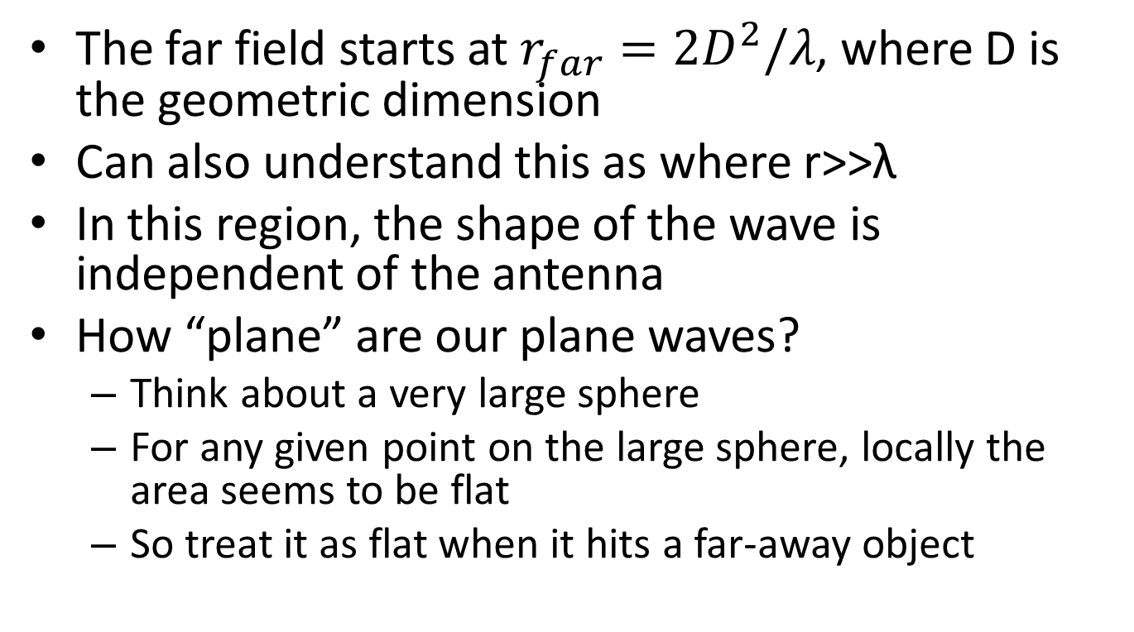
Far Field (Fraunhofer Region)
The far field starts at $r_{far}=2D^{2}/λ$, where D is the geometric dimension
Can also understand this as where r>>λ
In this region, the shape of the wave is independent of the antenna
How “plane” are our plane waves?
  Think about a very large sphere
  For any given point on the large sphere, locally the area seems to be flat
  So treat it as flat when it hits a far-away object

Slide 17
Let’s Look at Phased Arrays
Wavefront
δr
θ
θ
d
d
d
The phase difference between successive elements is how far additionally the wavefront has to travel to hit the next array element = δr
δr=dsinθ
δr=cδt
δt=δr/c
= dsinθ/c
This is the equation for time delay beam steering: array separation is d,
pick your direction, θ, and calculate the time delay between elements δt

Slide 18
Phased Arrays – Phase Steering
A full cycle of wavelength λ = 2π radians of phase
δφ/2π = δr/λ
δφ = 2πδr/λ
= 2πdsinθ/λ
There’s no reason why δφ should not exceed 2π
  If so, simply subtract 2π to get the phase angle

Slide 19
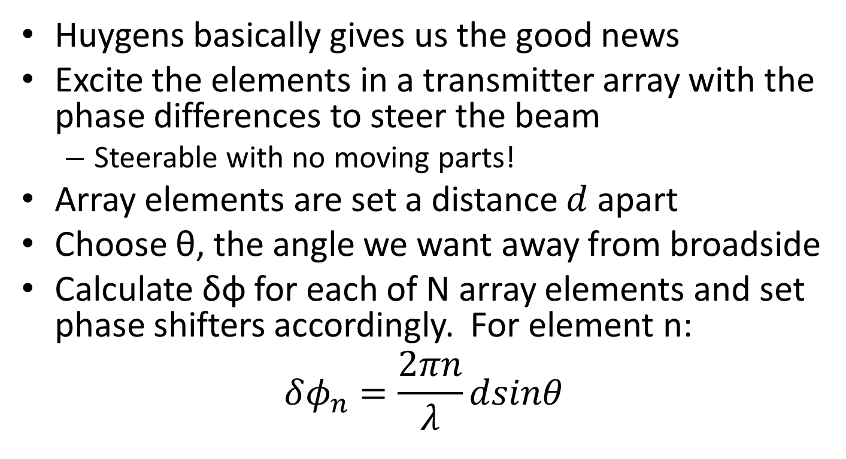
Phased Array Antennae
Huygens basically gives us the good news
Excite the elements in a transmitter array with the phase differences to steer the beam
  Steerable with no moving parts!
Array elements are set a distance $d$ apart
Choose θ, the angle we want away from broadside
Calculate δφ for each of N array elements and set phase shifters accordingly. For element n:
$$δφ_{n}=\frac{2πn}{λ}dsinθ$$

Slide 20
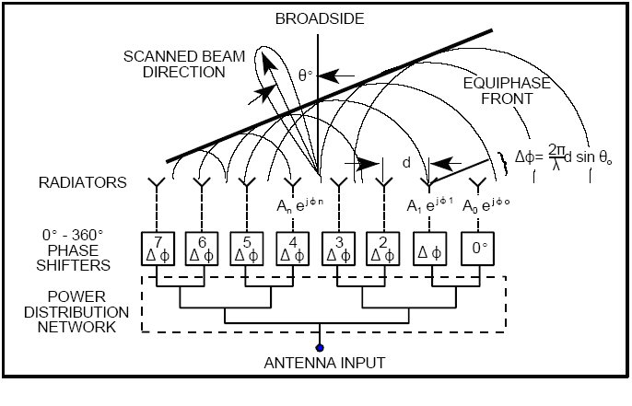
Corporate-fed Phased Array

Slide 21
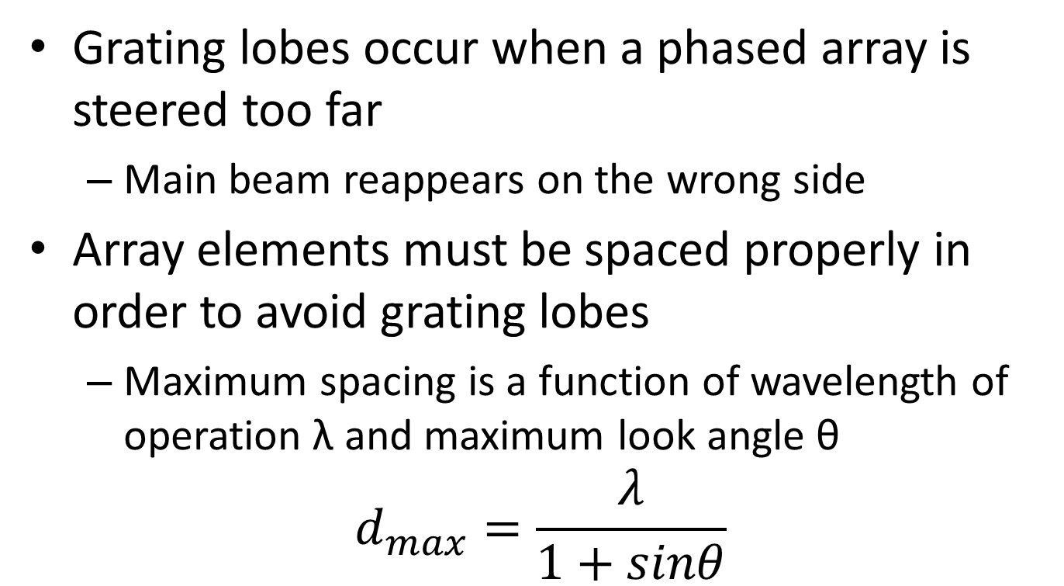
Grating Lobes
Grating lobes occur when a phased array is steered too far
  Main beam reappears on the wrong side
Array elements must be spaced properly in order to avoid grating lobes
  Maximum spacing is a function of wavelength of operation λ and maximum look angle θ
$$d_{max}=\frac{λ}{1+sinθ}$$

Slide 22
Questions
What are the maximum separations of array elements for an x-band (λ = 3cm) radar with a maximum steer angle of (a) 60 degrees; (b) 30 degrees?

Slide 23
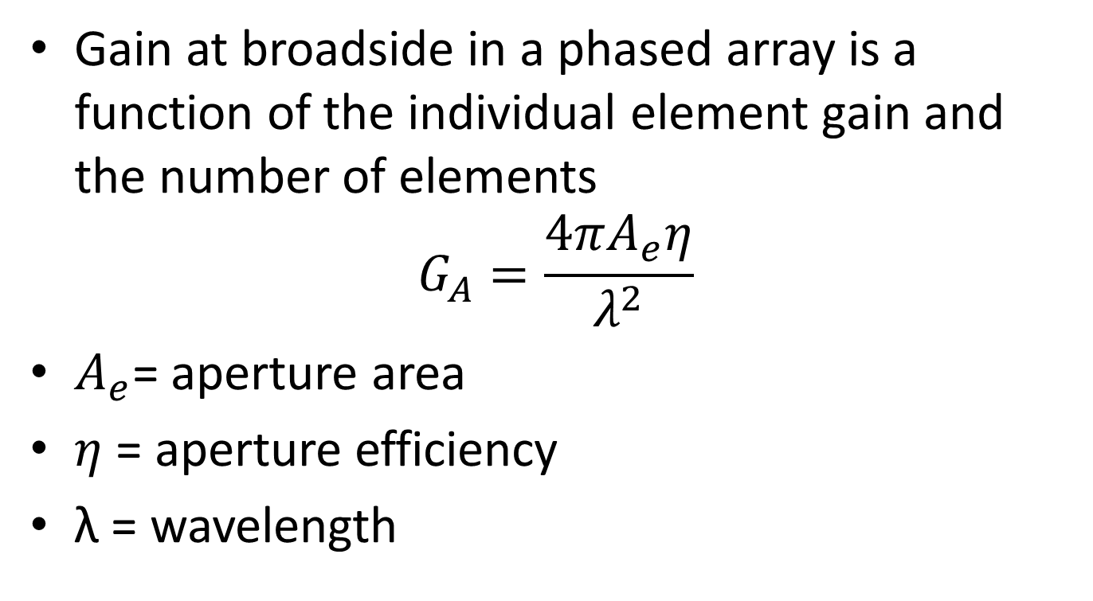
Phased Array Gain
Gain at broadside in a phased array is a function of the individual element gain and the number of elements
$$G_{A}=\frac{4πA_{e}η}{λ^{2}}$$
$A_{e}$= aperture area
$η$ = aperture efficiency
λ = wavelength

Slide 24
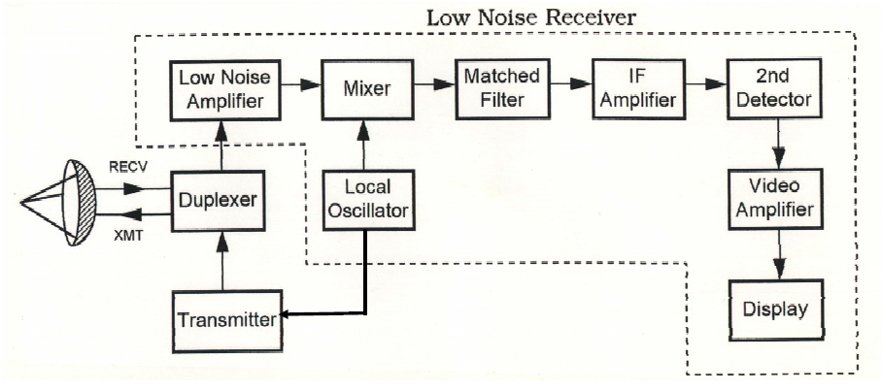
A Radar Block Diagram
Courtesy of Prof. David Jenn, Navy Postgraduate School, available from:
http://faculty.nps.edu/jenn/Seminars/RadarFundamentals.pdf,
accessed 11.00, 04/03/16

