Slide 1
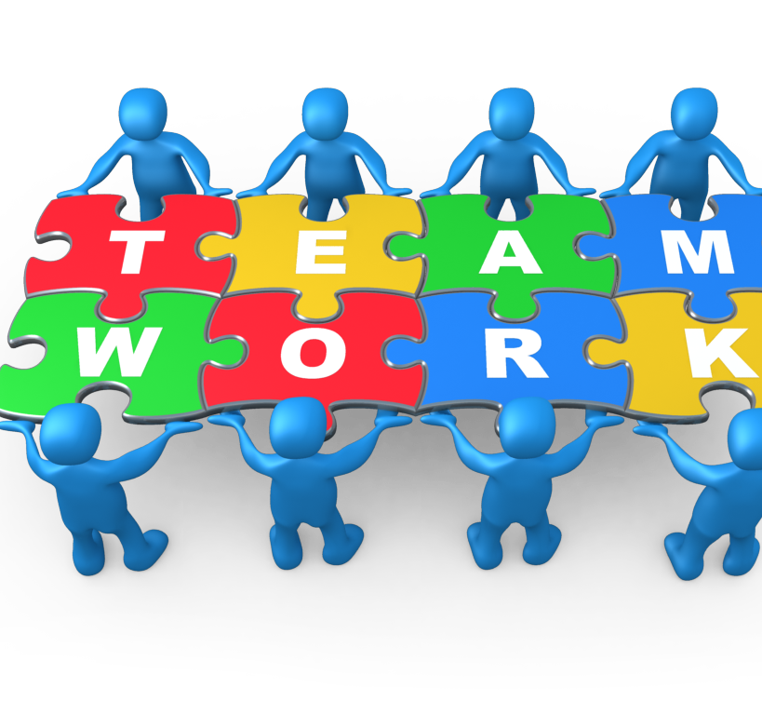
June Kelly Ring
2505639
Hajara Mustaism
LCHS4009
Component 1- Working in Teams.
Powerpoint Presentation
Working in Teams

Slide 2


Introduction
Hello my name is June Kelly Ring. I am going to present and explore the importance of working in teams within health and social care. Using Tuckman's model of communication 1965. I will examine how teamwork influences professional practice, Collaboration, and work ethic, highlighting both the positives and the negative aspects of team dynamics.
I will reflect on a personal experience of working within a team and discuss how effective reflection supported my professional development.

Slide 3

IMPORTANCE OF TEAMWORK
Person Centred Care, ensures holistic care, Health and social care act (2012)
Shared responsibilities, collaboration prevents task duplication and promotes accountability.
Communication reduces errors and improved patient outcomes.
Learning and reflection. Continuous proffesional development and reflective practice.
Understanding your role gives clarity of roles to maintain proffessional boundaries and efficiency.

Slide 4

Positive and negatives of teamwork
Positive
Negative
Improved communication
Person centred care.
Shared responsibility
Learning and development
Supportive environment
Efficiency and motivation
Conflict and disagreement
Unequal participation
Communication breakdowns
Role confusion
Time constraints
Resistance to change

Slide 5

Tuckman's model of communication
Forming: Team members meet and clarify roles​
Storming: Conflicts arise as ideas are shared​
Norming: The team builds trust and agrees on goals​
Performing: Collaboration becomes efficient and respectful​
Adjourning: The team reflects and learns for future practice.​
Tuckman (1965)

Slide 6
My personal experiences
I previously worked in a medium secure mental health setting. This was physically and mentally challenging. Reflection was an essential part of daily practice. Effective teamwork and communication were vital to ensure safe, person‑centred care. Also, staff safety.
Applying Tuckman’s model, our team moved from forming to performing as we learned to trust one another and share responsibilities. Reflection helped us identify areas for improvement and strengthen collaboration skills, principles of professionalism and partnership working.

Slide 7
Reflection and learning
Teamwork has strengthened my communication and collaboration skills
Applying Tuckman's model helped me understand how teams grow and overcome challenges
Reflection supports continuous improvement principles of professionalism
I aim to continue developing teamwork skills to enhance safe, person-centred care.

Slide 8
Conclusion and thankyou
Teamwork is essential for delivering safe person-centred care
Applying Tuckman's model helped me understand how teams grow and overcome challenges
Reflection supports continuous learning and professional development
I will continue improving my teamwork and communication skills
Thankyou- I welcome any questions

Slide 9
References
Health and Social Care Act 2012. (2012). London: The Stationery Office.
Nursing and Midwifery Council (NMC). (2018). The Code: Professional standards of practice and behaviour for nurses, midwives and nursing associates. London: NMC.
West, M. A. (1999). Communication and teamworking in healthcare. Journal of Health Organisation and Management, 4(1), pp. 1–12.
Tuckman, B. W. (1965). Developmental sequence in small groups. Psychological Bulletin, 63(6), pp. 384–399.
Department of Health and Social Care. (2021). Integration and innovation: working together to improve health and social care for all. London: DHSC.
West, M. A. and Lyubovnikova, J. (2013). Illusions of team working in health care. Journal of Health Organisation and Management, 27(1), pp. 134–142.
I have used co-pilot to proofread my work.

