Slide 1
UK Drug Policy
By Izzy Elias

Slide 2
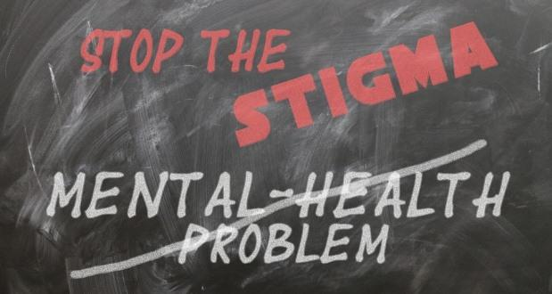
Challenges: Stigma
‘Policies were based on ideology and not evidence’, ‘when it comes to drugs and alcohol just say no’.
An ‘estimated 8.8% of people aged 16 to 59 years (around 2.9 million people) reported using any drug in the last 12 months for the year ending March 2024’ (Office for National Statistics, 2024).
‘The Scottish Government’s strategy for reducing harm from drugs and alcohol - Rights, Respect and Recovery - has advocated for a ‘human rights-based, public health approach, highlighting stigma as a significant barrier to support’. (Scottish Government,2019)
‘The number of adults entering treatment in 2024 to 2025 was 169,542, which is higher than the previous 2 years’ figures (137,749 in 2022 to 2023 and 158,991 in 2023 to 2024)’ (Gov.UK, 2025).
According to GOV.UK (2021), ‘The number of adults entering treatment in 2020 to 2021 was 130,490, which is similar to the previous year’s figure (132,124).’

Slide 3
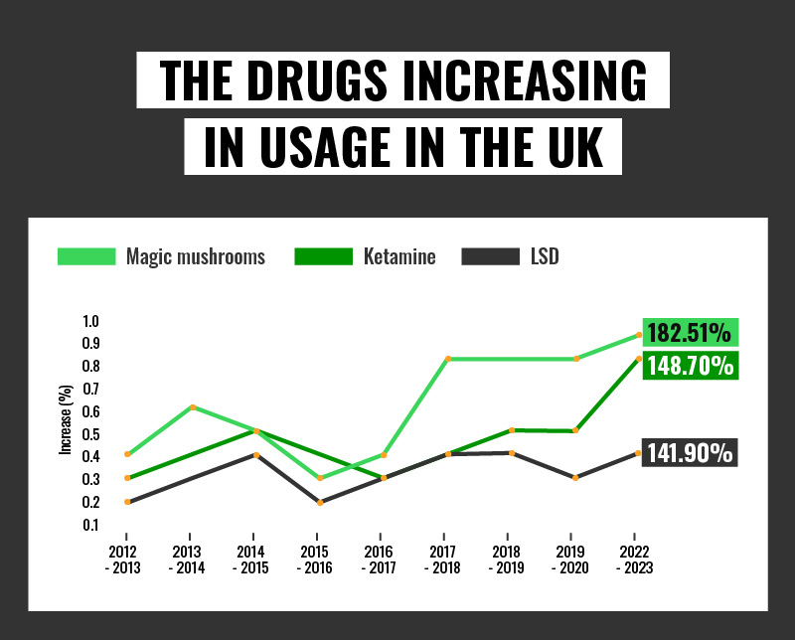
Challenges: Prohibition does not affect rates
According to the Office of National Statistics (2023), an estimated ‘9.5% of people aged 16 to 59 years (approximately 3.1 million people) reported using a drug in the last 12 months’ compared to 2013, ‘year ending March 2013) for any drug (8.1%)’.
‘punitive elements of drug policies do not actually change the rate of drug use’.
Portugal decriminalized illicit substances for personal use in 2001. 15 years later and the evidence states that due to treating it as a health issue rather than a criminal offence, the deaths of heroin users is a third of what it was before the legislation in 2001.
Get-licensed.co.uk. (2024). UK Drug Misuse Report 2024: Trends & Stats

Slide 4
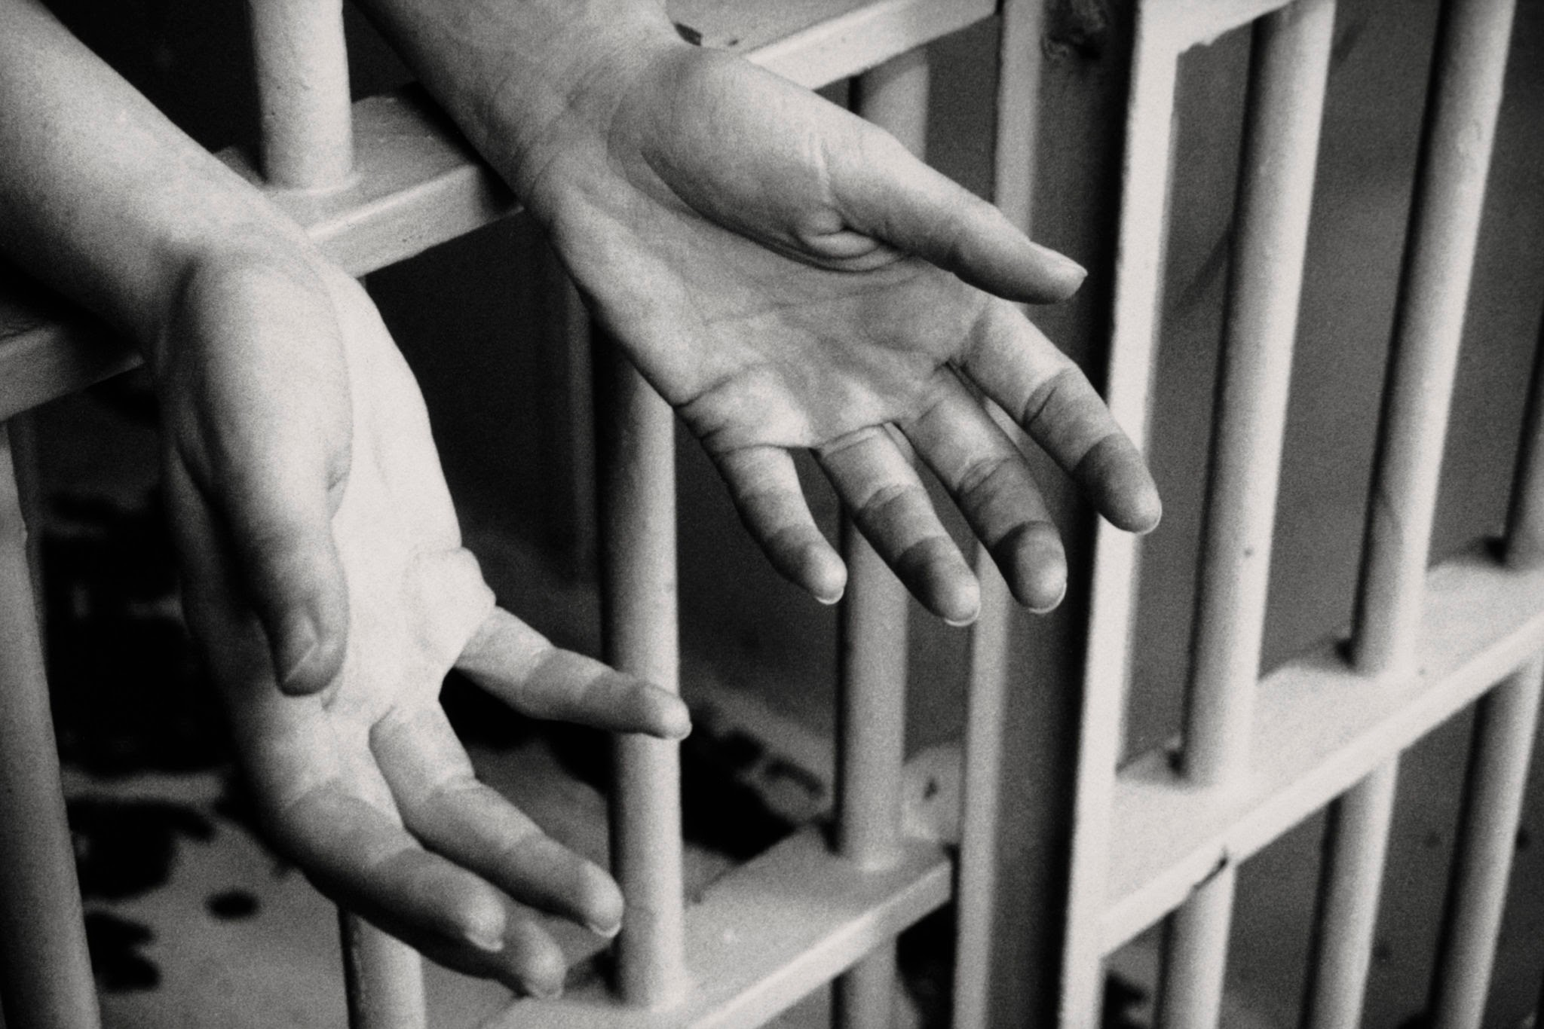
Challenges: Criminalising drug use ruins futures
‘The issue with criminalising drug use means that it criminalises a lot of young people, and can potentially ruin their future’.
According to Howard Becker’s book ‘Outsiders’ (1963) the labelling theory explains how people may be labelled as a deviant and that crime comes from society’s labels rather than from within the individual.
‘There were 16,212 children (aged 17 and under) in alcohol and drug treatment between April 2024 and March 2025’. (GOV.UK, 2025)
‘Girls tended to report some vulnerabilities more than boys, particularly self-harming behaviour (48% compared with 16%) and sexual exploitation (9% compared with 1%). Boys reported some vulnerabilities more than girls, such as criminal exploitation (10% compared with 5%).’ (GOV.UK, 2025)
The BBC (2025) states that the drug rate in an open prison reached 40%, the reasons were that ‘Inmates found "illicit drugs were far too freely available" and that inmates "were frustrated and bored"’.
GOV.UK (2025) states that ‘Nearly half (48%) of children starting treatment in 2024 to 2025 said they had a mental health treatment need’.

Slide 5
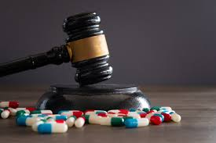
Recommendations: Legal regulation
‘Legal regulations around drugs are out of date and should be changed’.
‘The Misuse of Drugs Act 1971 regulates the production, supply and possession of controlled drugs in the UK. The act is complemented by the Misuse of Drugs Regulations 2001, which set out exceptions that allow the lawful possession and use of certain controlled drugs for medical, dental and veterinary use’(commons library.parliamentary).
‘The UK government has said it will not make changes to drug laws to allow the creation of more legal drug consumption rooms’ (BBC, 2025).

Slide 6
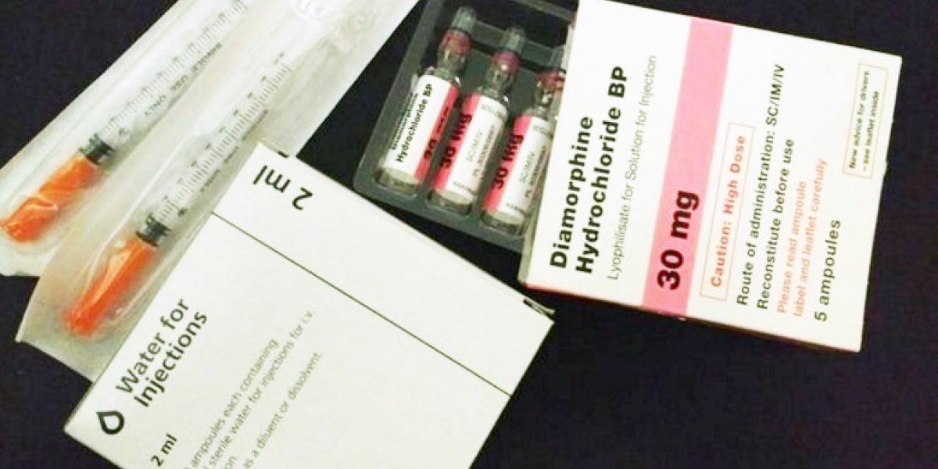
Recommendations: Heroin assisted therapy
‘Heroin assisted therapy proven to help with adherence to treatment’.
‘In Canada the North American Opiate Medication Initiative (NAOMI) clinical trial opened its doors in Vancouver and Montreal between 2005 and 2008. Results of the NAOMI trial were similar to those in the Swiss programs in that there were significant positive outcomes for participants in the heroin arm of the trial including: high retention rates in the treatment program, illegal heroin use fell by 70%, the proportion of participants involved in illegal activities fell by half from over 70% to 36%, illegal activity among participants decreased significantly as did the amount of money spent monthly on illegal drugs, marked improvements in participants ‘ medical and health status were also experienced’ (drugpolicy.ca, 2025).

Slide 7
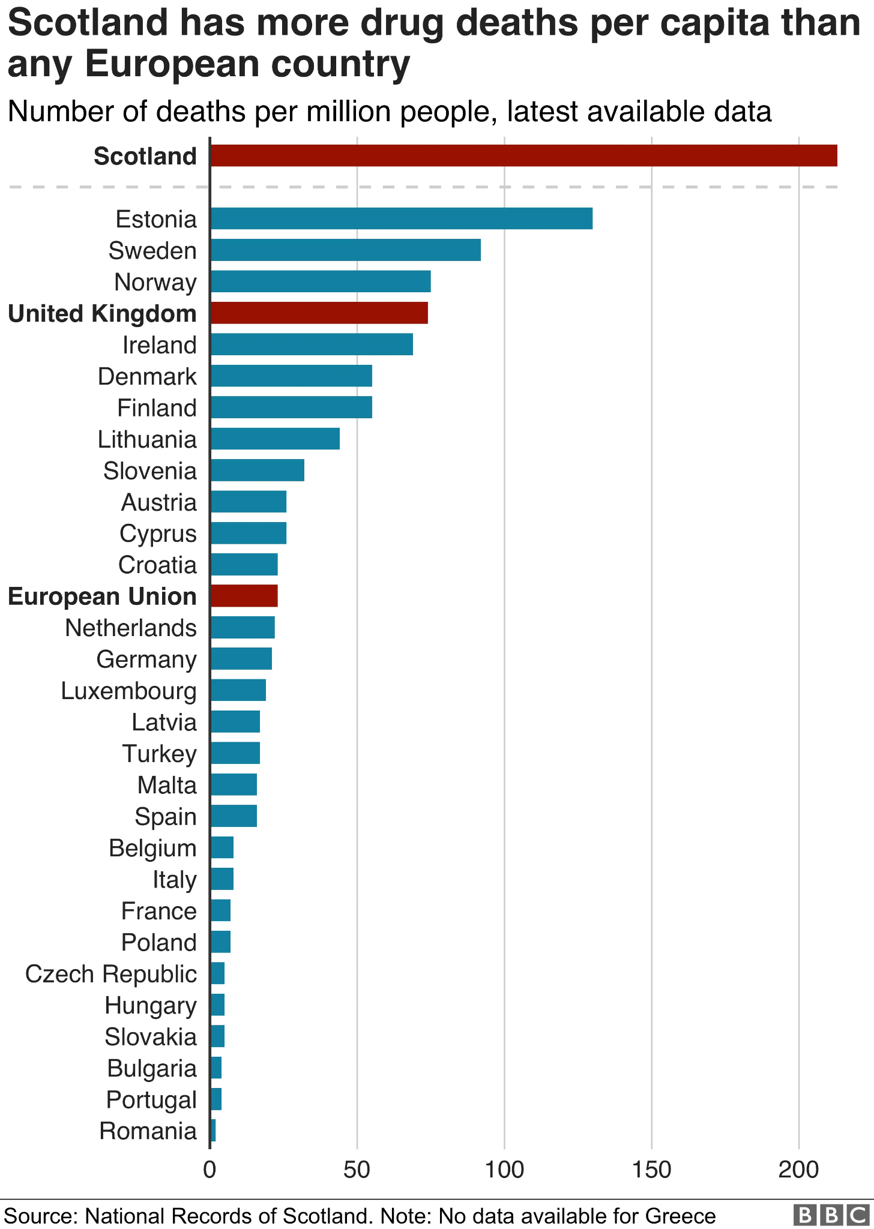
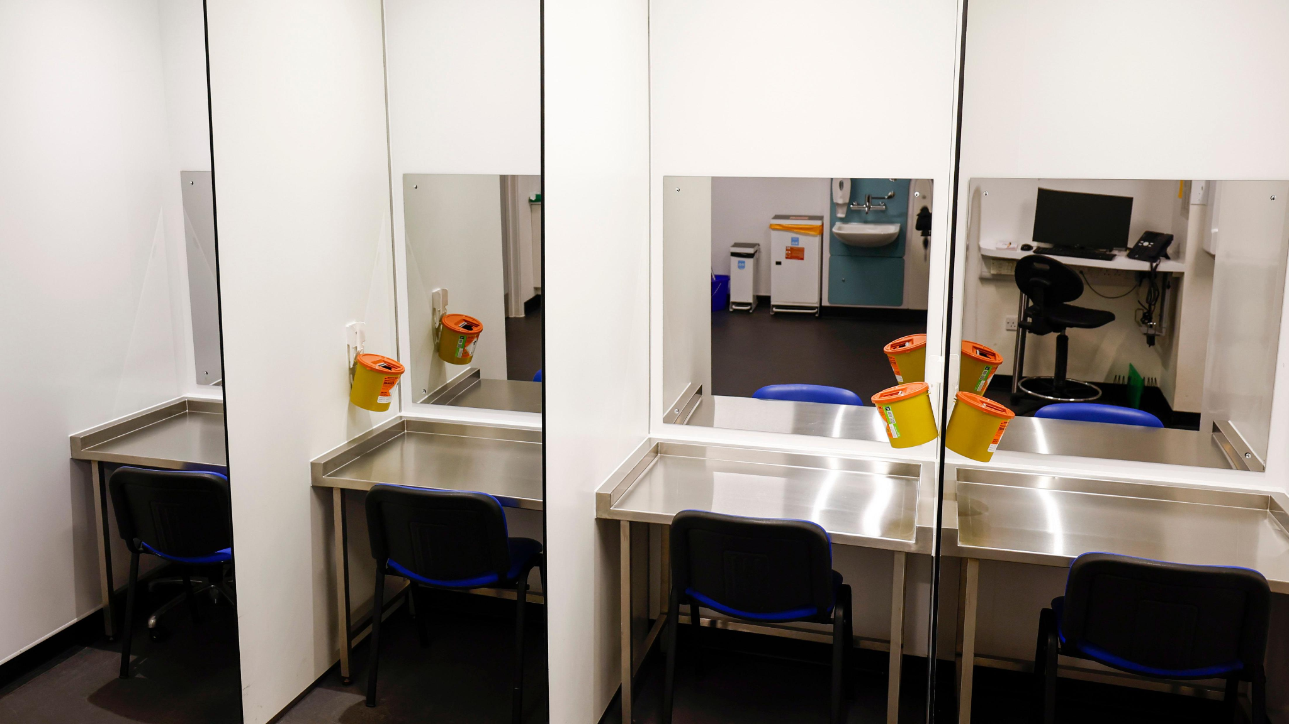
Recommendations: Drug consumption rooms
‘Drug consumption rooms are proposed to be a safer way for drug users to administer.’
The first drug consumption room in the UK opened in January 2025 in Glasgow, Scotland.
According to the Scottish Government (2021), drug consumption rooms ‘Contribute to lower rates of fatal overdoses, reduce rates of infection transmission, reduce levels of public drug consumption and publically discarded drug-related litter’.
The first drug consumption room in the world was in Switzerland, 1986.

Slide 8

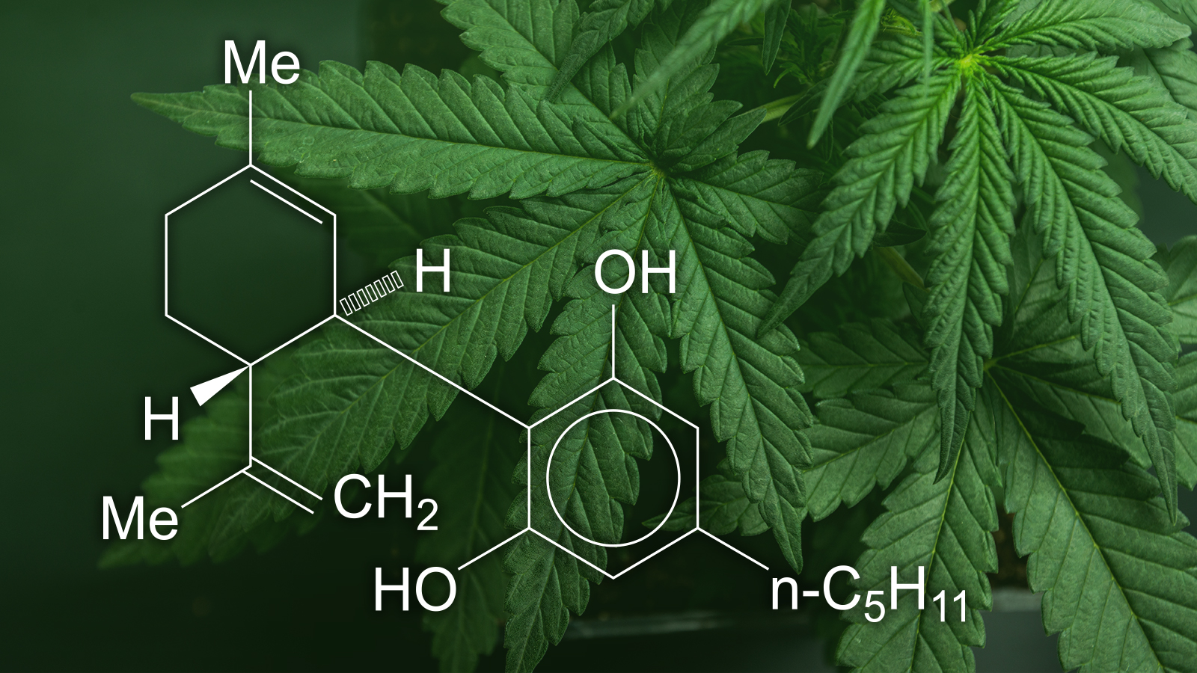
Legalising Cannabis
‘Heroin assisted therapy proven to help with adherence to treatment’.
Countries like Canada have legalised cannabis and from 1985 to 2017, the rate of cannabis use went from 5.6% to 14.8%, showing that the use of cannabis has risen exponentially.
‘Around 16,000 people were charged with cannabis possession before legalistion in 2016’.
‘Only 486 adults charged with new Cannabis Act offences after legalisation in 2020’.
‘25% decrease in Canada's total cannabis crimes between 2019 and 2020’.
‘Possession of cannabis counted for almost all cannabis related offences before the legalisation came into place, however, it now only counts for 12% of offences while ‘(67%) of the 10,824 total cannabis offences were for illicit importation and exportation’ as of 2022.’ (Statistics Canada, 2023)

Slide 9
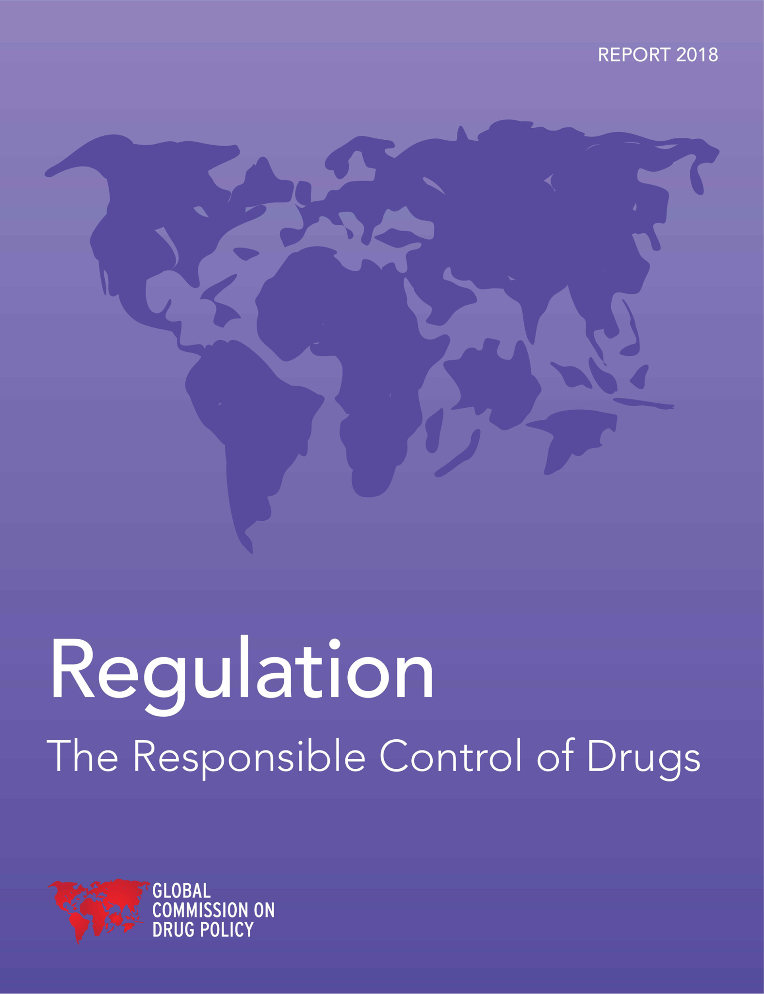
Regulation and control
‘Outdated and simply does not work to deter drug use’.
According to Revolving Doors (2023), ‘The Misuse of Drugs Act (1971) (MDA) has failed on its own merits – to prevent and control the use and supply of illicit drugs. The obsession with enforcement-led, punitive ‘solutions’ to drugs is tired, ineffective and, in fact, harmful.’

Slide 10
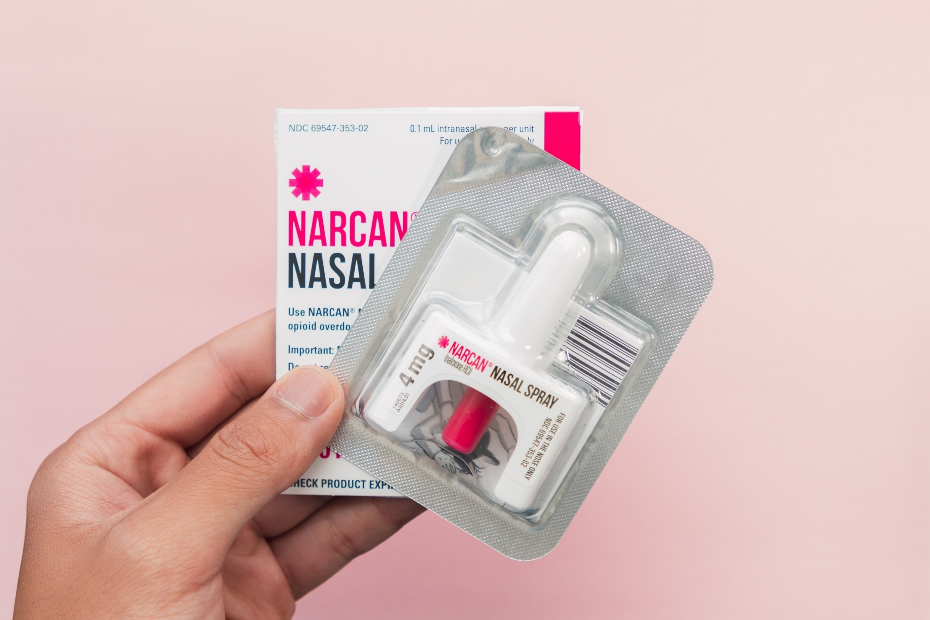
Drug related deaths and overdose crisis
‘There have been 1,232 administrations of naloxone in the UK by the police between June 2019 and 30 December 2024’ (GOV.UK)
‘There has been an increase in the number of people who have been administered naloxone over the last ten years’ (GOV.UK)
Death rates of drug use are 1.84 in Switzerland and 4.16 in the UK. (worldlifeexpectancy.com, 2020)
Death rates of Hepatitis C per 100,000 is 0.10 in Switzerland and 0.29 in the UK.

Slide 11
Research timeline
Background reading: Government websites since they have a lot of statistical evidence and are reliable sources.
Planning: I included most of the sources i wrote about in my essay and expanded on the statistics i put on the slides.
Wider reading: I went back and used some graph evidence to back up statements from sources and give more statistical evidence.
Structure: I linked the sources i used in A and B to C where i stated what the government should focus on. I was able to use some of the same sources from A and B in C.
Reflection/ challenges: Some parts were difficult to find sources for, i found it difficult staying within the word count for the essay. Next time i would start the assignment earlier and have more of a structured plan on what i will tackle first.

Slide 12
Reference List
In accordance with Harvard referencing
BBC News (2025) UK government will not change law for more drug consumption rooms. Available at: https://www.bbc.co.uk/news/articles/cly9yx4xg1zo.
Canadian Drug Policy Coalition. (2025). Canadian Drug Policy Coalition. Available at: https://www.drugpolicy.ca/issues/heroin-assisted-treatment/.
Duddy, C. and Downs, W. (2024). Misuse of drugs: regulation and enforcement. Available at: https://commonslibrary.parliament.uk/research-briefings/cbp-10154/.
Office for Health Improvement & Disparities (2021). Adult substance misuse treatment statistics 2020 to 2021: report. Available at: https://www.gov.uk/government/statistics/substance-misuse-treatment-for-adults-statistics-2020-to-2021/adult-substance-misuse-treatment-statistics-2020-to-2021-report.
Office for National Statistics (2023). Drug misuse in England and Wales - Office for National Statistics. Available at: https://www.ons.gov.uk/peoplepopulationandcommunity/crimeandjustice/articles/drugmisuseinenglandandwales/yearendingmarch2023.
ONS (2024). Drug misuse in England and Wales: year ending March 2024. Available at: https://www.ons.gov.uk/peoplepopulationandcommunity/crimeandjustice/articles/drugmisuseinenglandandwales/yearendingmarch2024.
Office for Health Improvement & Disparities (2021). Adult substance misuse treatment statistics 2020 to 2021: report. Available at: https://www.gov.uk/government/statistics/substance-misuse-treatment-for-adults-statistics-2020-to-2021/adult-substance-misuse-treatment-statistics-2020-to-2021-report.
Office (2025). Adult substance misuse treatment statistics 2024 to 2025: report. Available at: https://www.gov.uk/government/statistics/substance-misuse-treatment-for-adults-statistics-2024-to-2025/adult-substance-misuse-treatment-statistics-2024-to-2025-report.
Scottish Government (2019). Alcohol and Drugs. Available at: https://www.gov.scot/policies/alcohol-and-drugs/.

Slide 13
Office (2025). Adult substance misuse treatment statistics 2024 to 2025: report. Available at: https://www.gov.uk/government/statistics/substance-misuse-treatment-for-adults-statistics-2024-to-2025/adult-substance-misuse-treatment-statistics-2024-to-2025-report.
Office (2025). Children’s substance misuse treatment statistics 2024 to 2025: report. Available at: https://www.gov.uk/government/statistics/substance-misuse-treatment-for-children-2024-to-2025/childrens-substance-misuse-treatment-statistics-2024-to-2025-report.
Office, H. (2025). Police carriage of naloxone process evaluation - monitoring data. Available at: https://www.gov.uk/government/publications/police-carriage-of-naloxone-monitoring-data/police-carriage-of-naloxone-process-evaluation-monitoring-data.
Revolving Doors (2023). Rethinking drugs: criminalisation is causing harm. Available at: https://revolving-doors.org.uk/rethinking-drugs-criminalisation-is-causing-harm/.
Scottish Government (2019). Alcohol and Drugs. Available at: https://www.gov.scot/policies/alcohol-and-drugs/.
Scottish Government (2021) Safer Drug Consumption Facilities – Evidence Paper. Available at: https://www.gov.scot/binaries/content/documents/govscot/publications/research-and-analysis/2021/10/safer-drug-consumption-facilites-evidence-paper/documents/safer-drug-consumption-facilities-evidence-paper/safer-drug-consumption-facilities-evidence-paper/govscot%3Adocument/safer-drug-consumption-facilities-evidence-paper.pdfafer

Slide 14
Statistics Canada (2023). Five years since legalization, what have we learned about cannabis in Canada? Available at: https://www150.statcan.gc.ca/n1/daily-quotidien/231016/dq231016c-eng.htm.
Wareing, D. (2025). Open prison with worst drugs rate in country sees problem worsen. Available at: https://www.bbc.co.uk/news/articles/cd9j984j9l7o.
World Life Expectancy. (2020). DRUG USE DEATH RATE BY COUNTRY. Available at: https://www.worldlifeexpectancy.com/cause-of-death/drug-use/by-country/.

Slide 15
THANK YOU

