Slide 1
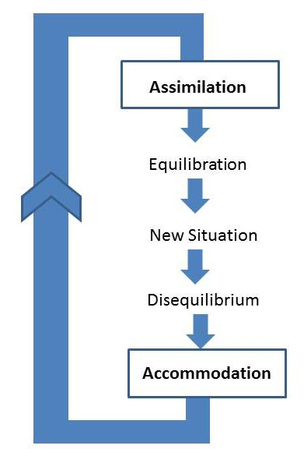
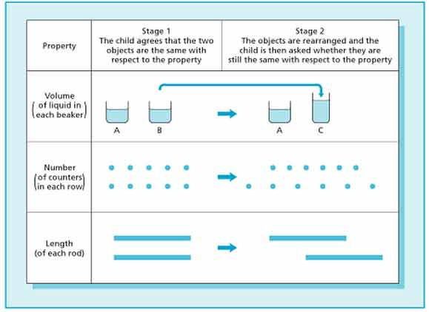
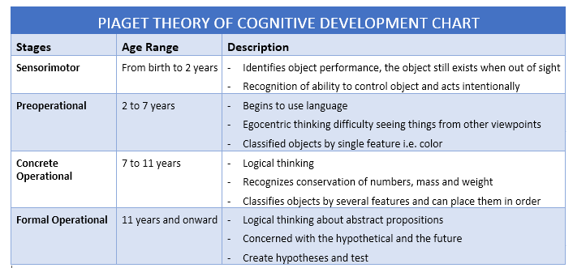
Piaget’s Cognitive Development Stage Theory
In relation to assimilation and accommodation, Piaget suggests that these processes link up with schemas which helps with a child’s growth and development. Assimilation is when a child uses a schema they already poccess to deal with ‘a new object or situation’, accommodation will then kick in to help the child deal with the new object or situation due to it being slightly different to the schema they already process. An example of assimilation would be when a child comes in contact with a garden bench for the first time. When first seeing the bench, they assume it is a settee. This is because to them it serves the same purpose. An example of accommodation would be when someone explains to the child that it is not a settee and even though you sit on it like you would with a settee, it is made out of wood and stays outside in the garden unlike a settee which is soft and stays inside. Due to the child now being told this, they would be able to adapt their schema of a settee to have a better mental image of the concept of a settee.
(Simplypsychology, 2018) , (Prichard, 2018)
Without schemas, assimilation and accommodation, children would find it hard to improve their cognitive abilities and move up with the stages of development.
Kailam Fearn
Introduction
Concrete operational stage
Cognitive development is defined by (Prichard, 2018) as a psychological process of learning, remembering, reasoning, problem solving, perceiving and using languages which takes place from early childhood up to adulthood.
There are several theories regarding the cognitive development of children which have been developed over the years and all have sufficient evidence to support their finding. However, Jean Piaget’s ‘development stage’ theory is often referred to as one of the most influential approaches to the understanding of children’s development and is quite often used to base other theories on and is also very highly used by teachers and schools. His theory puts children’s cognitive development into different stages which are age-related. In other words, he believes that certain things should develop at a certain age or ‘development stage’. These age-related stages start whena baby is born and continue up until the child becomes an adult.
The third stage of development occurs during the ages of seven and eleven years and is known as the Concrete Operational Stage. During this stage, Piaget believes that children begin to consider the point of view of other people and begin to realise that there are many different opinions and perspectives. Children at this stage also adapt the ability to think logically towards situations. For example, before this stage, children would believe that two identical quantities of something would still be the same even if the appearance of one changes. An example of an experiment carried out to back up this thought is Piaget’s Conservation Task. During this experiment, two identical glasses are filled with exactly the same amount of water, various children we’re asked on an individual basis whether one glass had more water than the other. Once it was established that the two glasses were holding the same amount of water, the water from one of the glasses was poured into a thinner but taller sized glass. The same individuals were then asked the same question regarding the quantities of water being identical. Before the concrete operational stage, children most often believed that the new glass was holding more water due to it being ‘taller’ in size. It is at this stage where children begin to use logical thinking and now realise that the both glasses must be holding the same amount of water even though they are now in different size glasses. (Devpsy.org, 2018)
(Simplypsychology.org, 2018)
Sensorimotor Stage
Educational influences
The first stage of Piaget’s ‘development stage’ theory occurs during a child’s first two years of life. This is known as the Sensorimotor Stage. According to simplypshycology.org (2018), this stage of cognitive development is a ‘period of rapid cognitive growth’. Piaget believed that a child’s cognitive ability is very limited to begin with and only motor reflexes are present when a child is born. These reflexes would include a baby knowing to suck when something touches the roof of its mouth and a baby closing their fingers in a ‘grasp’ when the palm of their hand is stroked. (Simplypsychology.org, 2018) He believed that the child will then build upon these basic reflexes to ‘develop more sophisticated behaviour’ (Prichard, 2018) During the sensorimotor stage, it is believed that a baby builds upon their reflexes and develops a more enhanced understanding of the word by the use of trial and error.
Piaget found that during the first 6 months of this stage, babies are unable to understand that when an object is not in direct view of themselves, it still exists. This is something that is believed to not be realised by the child until it is approximately 8 months old. For example, Piaget found that if a baby’s interest was gained by showing it a toy and then the toy was covered up by a blanket, a baby within its first 6 months of life would act as if the toy didn’t exist anymore. As soon as the toy was uncovered again, the baby would smile and reach to grab it. Once a child reaches approximately 8 months, they realise that the toy is still under the blanket. (Stanfordchildrens.org, 2018) , (Oli.cmu.edu, 2018)
Piaget’s theory of development stages is highly applied to the education of children. His work has been very influential in regards to developing the teaching practices in the UK but also in developing new educational policies. Piaget’s ideas and ways of thinking gives teachers guidance towards the development of children and allows them to be more aware of at what approximate age a child is more likely to do certain things. Even though it does indeed help give guidance to teachers, the exact timeframes of the development stages have been slightly criticised over the years (Prichard, 2018)
An example of his work influencing educational policies in the UK was in 1966 when the primary education being delivered in schools was reviewed by the UK government.
Formal operations stage
The final stage of Piaget’s ‘development stage’ theory occurs from the age of eleven and is known as the Formal Operations Stage. During the final stage of development, Piaget believes that children have the ability to think logically about different situations and outcomes. According to (Prichard, 2018), Piaget believed that even though he felt this was the ‘ultimate’ stage of intellectual development, most children of this age were still in a position where they had very little knowledge of the world however their ‘thought processes’ were at the highest developmental stage in their life. (Prichard, 2018) There are several tasks created by Piaget in 1970 to test the formal operational thought in children. One of the most straight forward tests used is the ‘third eye problem’. In this task, a variety of children were asked, if they were able to have an additional eye, where would they place it on their body and why. It was reported by Schaffer in 1988 that when the question was asked to children in the final stage of development, many of them were very inventive with where they would like the extra eye. Some for example suggested having an extra eye on the back of their head so they could see behind and others suggested having the eye on their hand so they would be able to see around corners. When children a few years younger were asked, most suggested having the extra eye on their forehead. This shows that during the formal operations stage, children have the ability to think thoughtfully and logically. (Simplypsychology.org, 2018)
The review carried out was very much totally based on Piaget’s theories. As a result of this review, the Plowden report was published in 1967 which helped change the way in which education was delivered to children and made education more child-centred. (Simplypsychology.org, 2018)
As well as the significant impact his work had on the education system, his theories regarding the cognitive development of children has also taken a big influence in the field of developmental psychology. (Prichard, 2018)
Preoperational stage
The next stage of Piaget’s ‘development stage’ theory is the Preoperational Stage. This stage occurs during the approximate ages of two and seven years. During this stage, children gain the ability to represent ideas, take part in mental imagery and begin to talk. (Prichard,2018) Their ability to think past their own point of view is very limited however at this stage, especially in the first few years of it. Children believe that other individuals think exactly the same thing as them. This is known as decentring. (Prichard, 2018)
An example of a study which satisfies this was carried out where a researcher showed a video of a girl putting a ball into a red box to another child. The girl in the video leaves the room after putting the ball into the red box while the researcher puts the ball from the red box into the blue box. The girl in the video comes back in the room to get her ball. The child watching the video is asked where the girl in the video is going to look for the ball, they choose the blue box due to them watching the ball being switched in to that box while the girl in the video was not in the room. The child watching the video is unable to understand that the girl in the video doesn’t actually know that the ball has been moved. (Oli.cmu.edu, 2018)
At this stage, children will start using their imaginations especially towards playing with toys. For example, children as this age might enjoy having ‘pretend tea parties’ with their toy dolls and pretending to play ‘mummies and daddies’.
(Oli.cmu.edu, 2018)
Schemas, assimilation & Accommodation
(Simplypsychology.org, 2018)
As well as the 4 developmental stages, there are two other basic components to Piaget’s Cognitive Development Theory. These are Schemas as well as Assimilation and Accommodation. Schemas are defined by Piaget in 1952 as “a cohesive, repeatable action sequence possessing component actions that are tightly interconnected and governed by a core meaning.” Schemas, in a more similar form are the vital ‘building blocks’ which enable individuals to form a mental image of the world. (Simplypsychology.org, 2018) When a child grows and learns new things, they are increasing the number of schemas in which they possess. This helps them to progress onto each different developmental stage. An example of a schema could be when a person goes shopping. In this case, the schema stored will include walking into the selected shop, finding the item and going to the till to pay for the item. Individuals know that every time they want to buy something in a shop, they need to pay at the till first before leaving the store, this is because the schema is stored in their memory and they can access it when in that particular situation. An example which would apply to Piaget’s Sensorimotor stage would be a baby’s sucking reflex. When something comes in contact with a baby’s lips, they begin to suck This would suggest that babies are born with a sucking schema. (Simplypsychology, 2018) , (Prichard, 2018)
conclusion
To conclude, there are a variety of well-known theorists who have all got their own interpretations of cognitive development in children. However it is clear to see that Jean Piaget’s work regarding cognitive development has had the biggest influence in the way in which the education of children is viewed. Piaget’s work in the field and most importantly, his development stages theory has had a massive influence on how primary education in the UK is delivered, and as a result the Plowden report was introduced in 1967. Also, his work still plays a big part in schools and other education establishments today as teachers work closely to his development stage theory with the way they teach their children and monitor their progress. Finally, a lot of later work in the field of Cognitive Development carried out by other theorists have been based on and spanned off into more depth from Piaget’s theories. If it wasn’t for Piaget’s influential work in the field of Cognitive Development of children, we might not be where we are today in regards to the cognitive development of children.
(Studylecturenotes.com,
2018)

