Slide 1
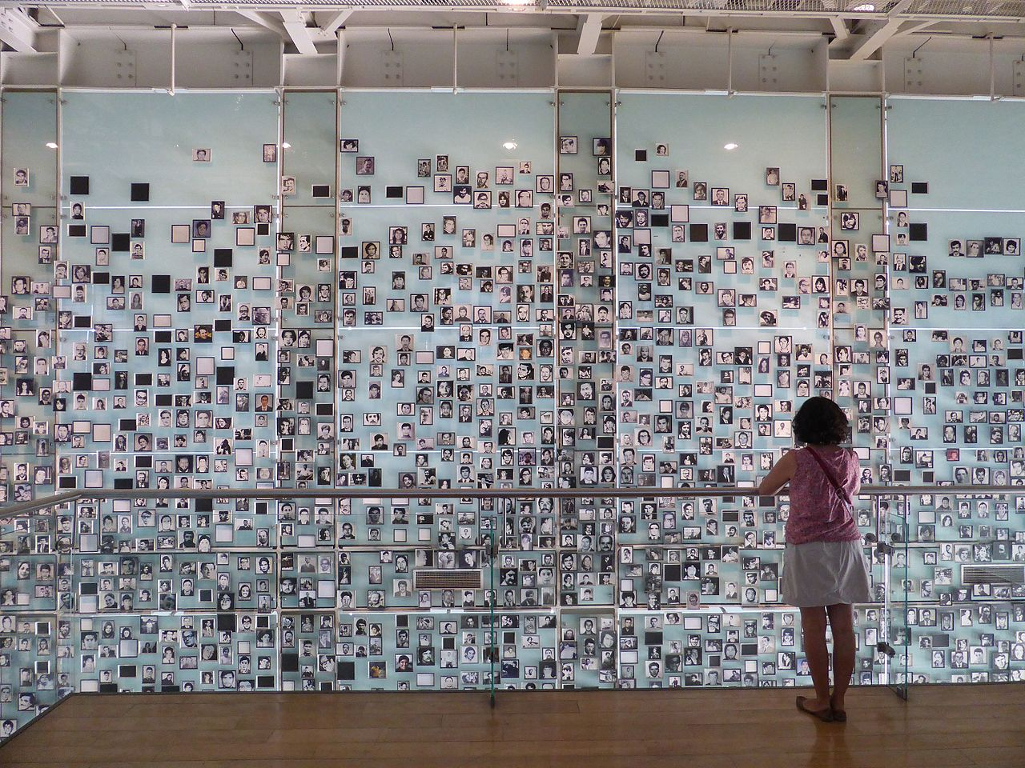
‘Pathways to Evil': Genocide - History, Theory, and Denial (HPHP4009)
(Creative Writing & Literature )
After the Raid
After
the raid
and the
unexpected
gunfire
there remains
only a village
in darkness
an ambiguous
sky
Far away
A rainbow
the furious
sound
of a waterfall
and the
uncertain
abyss
of the missing
voices
Chile
Kurdistan
Balkans
Holocaust
Biafra
Distortions
Marketing hatred
(China)
Portraits of the Disappeared in the Museum of
Memory and Human Rights, Santiago, Chile
Humberto Gatica, The Sand Garden, Hafan, 2008
https://www.rhysowainwilliams.com/blog/an-introduction-to-humberto-gatica

Slide 2
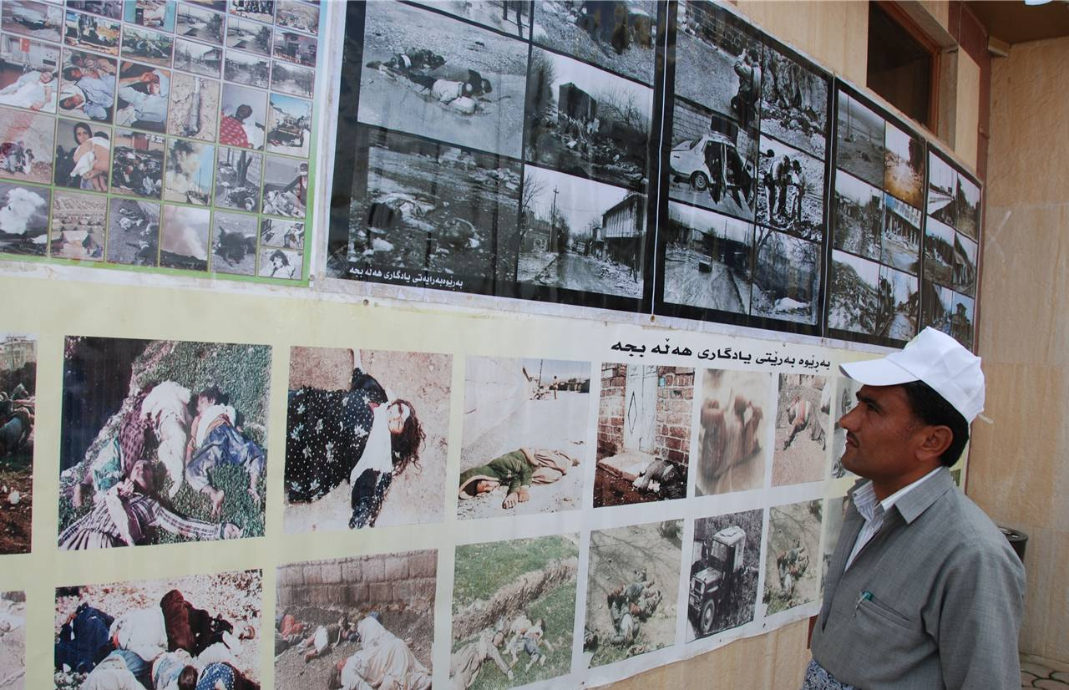
Anfal

Slide 3
At A Happiness Symposium In Wales
A psychologist said
Graveyards may help you feel happier,
visit a graveyard when you are depressed
There is a thin line between life and death, my friend
and I am a graveyard
I am happy to be alive, my friend
After Halabja and Anfal
I am happy to become the voice
of a land
that contains the mass graves of our brothers
There is a thin line between life and death, my friend
There is a thin line between life and death
Nazand Begikhani, from Fragments from the Dark,
ed Jeni Williams & Latefa Guemar, Hafan 2008

Slide 4
An Ordinary Day
The security officer
got up early
put on his white shirt
had honey toast with nuts
kissed his three children
hugged his wife passionately
and left for work
At his desk
sat ten files
of ten men to be shot
He signed them
while drinking mint tea
At ten o'clock
he ordered the shooting
got angry over a gunman who missed his target
Taking out his pistol
he fired at the missed target ten times
Before the end of his shift
he visited the mothers of the ten shot men
ordered each to pay 100 dinars
for the cost of the bullets that killed their sons
In the evening
he celebrated his brother's birthday
At night
on the surface of a mirror
he saw a drop of blood trickling down to his feet
he tried to wash it
the trickle rose to his chest
Where does the difference lie between the killer and killed?
Nazand Begikhani, Bells of Speech , Ambit 2007
poem shortlisted for the Forward Poetry Prize
https://www.poemhunter.com/nazand-begikhani/poems

Slide 5
The purpose of Writing the holocaust Elie Wiesel , Night
without this testimony, my life as a writer—or my life, period— would not have become what it is: that of a witness who believes he has a moral obligation to try to prevent the enemy from enjoying one last victory by allowing his crimes to be erased from human memory.
But today, thanks to recently discovered documents, the evidence shows that in the early days of their accession to power, the Nazis in Germany set out to build a society in which there simply would be no room for Jews. Toward the end of their reign, their goal changed: they decided to leave behind a world in ruins in which Jews would seem never to have existed. That is why everywhere in Russia, in the Ukraine, and in Lithuania, the Einsatzgruppen carried out the Final Solution by turning their machine guns on more than a million Jews, men, women, and children, and throwing them into huge mass graves, dug just moments before by the victims themselves. Special units would then disinter the corpses and burn them. Thus, for the first time in history, Jews were not only killed twice but denied burial in a cemetery

Slide 6
I had many things to say, I did not have the words to say them. Painfully aware of my limitations, I watched helplessly as language became an obstacle. It became clear that it would be necessary to invent a new language. But how was one to rehabilitate and transform words betrayed and perverted by the enemy? Hunger—thirst—fear—transport—selection—fire—chimney: these words all have intrinsic meaning, but in those times, they meant something else. Writing in my mother tongue—at that point close to extinction—I would pause at every sentence, and start over and over again. I would conjure up other verbs, other images, other silent cries. It still was not right. But what exactly was "it"? "It" was something elusive, darkly shrouded for fear of being usurped, profaned. All the dictionary had to offer seemed meager, pale, lifeless. Was there a way to describe the last journey in sealed cattle cars, the last voyage toward the unknown? Or the discovery of a demented and glacial universe where to be inhuman was human, where disciplined, educated men in uniform came to kill, and innocent children and weary old men came to die?
Elie Wiesel , Night Preface

Slide 7
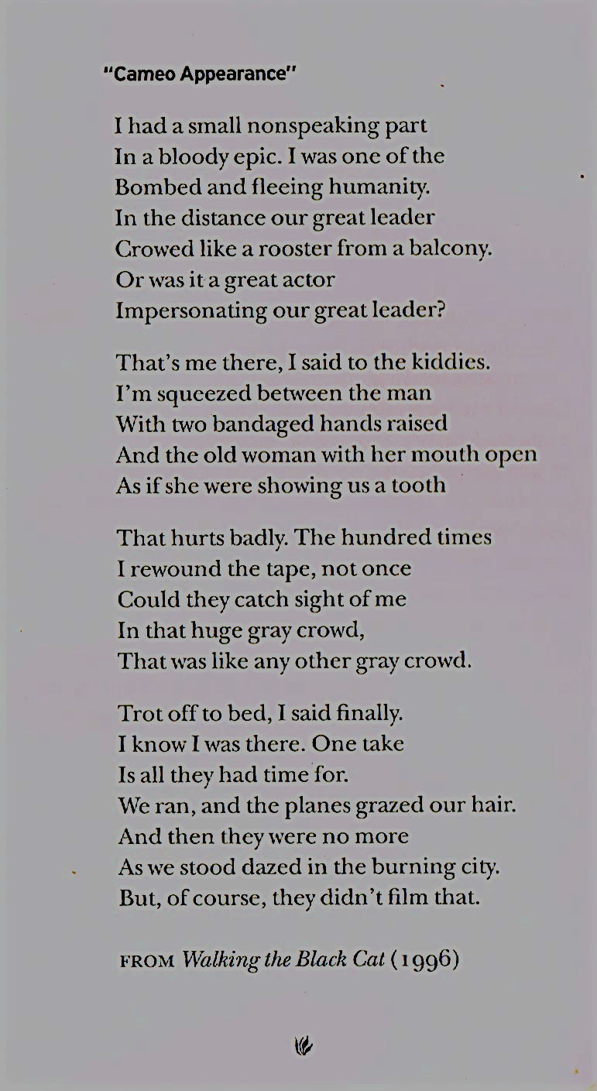
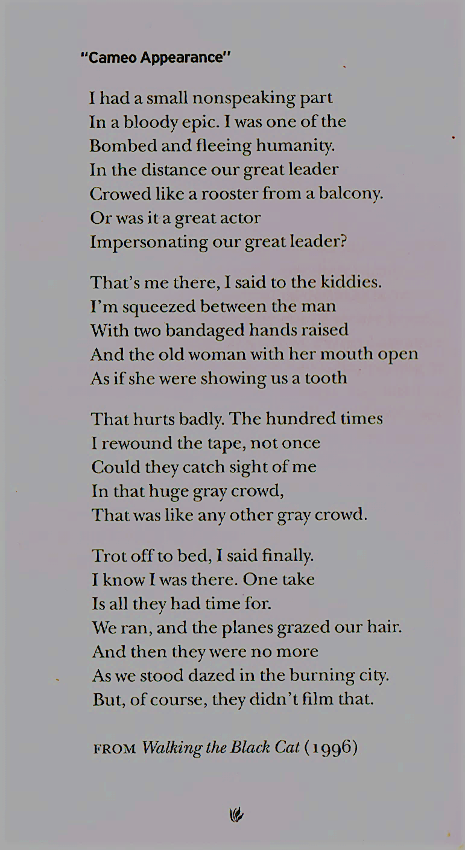
Charles Simic , quoted in Simic, ‘Refugees, ’ in Andre Aciman ed, Letters of Transit: Reflections on Exile, Identity, Language and Loss, New Press, 1999

Slide 8
Day after day, night after night, he went from one Jewish house to the next, telling his story and that of Malka, the young girl who lay dying for three days, and that of Tobie, the tailor who begged to die before his sons were killed.
Moishe was not the same. The joy in his eyes was gone. He no longer sang. He no longer mentioned either God or Kabbalah. He spoke only of what he had seen. But people not only refused to believe his tales, they refused to listen. Some even insinuated that he only wanted their pity, that he was imagining things. Others flatly said that he had gone mad.
As for Moishe, he wept and pleaded:
"Jews, listen to me! That's all I ask of you. No money. No pity. Just listen to me!" he kept shouting in synagogue, between the prayer at dusk and the evening prayer
… our first impressions of the Germans were rather reassuring. The officers were billeted in private homes, even in Jewish homes. Their attitude toward their hosts was distant but polite. They never demanded the impossible, made no offensive remarks, and sometimes even smiled at the lady of the house. A German officer lodged in the Kahns' house across the street from us. We were told he was a charming man, calm, likable, and polite. Three days after he moved in, he brought Mrs. Kahn a box of chocolates. The optimists were jubilant: "Well? What did we tell you? You wouldn't believe us. There they are, your Germans. What do you say now? Where is their famous cruelty?"
The Germans were already in our town, the Fascists were already in power, the verdict was already out—and the Jews of Sighet were still smiling.
Sleepwalking into horror 1

Slide 9
Little by little life returned to "normal." The barbed wire that encircled us like a wall did not fill us with real fear. In fact, we felt this was not a bad thing; we were entirely among ourselves. A small Jewish republic …A Jewish Council was appointed, as well as a Jewish police force, a welfare agency, a labor committee, a health agency—a whole governmental apparatus.
People thought this was a good thing. We would no longer have to look at all those hostile faces, endure those hate-filled stares. No more fear. No more anguish. We would live among Jews, among brothers…
Of course, there still were unpleasant moments. Every day, the Germans came looking for men to load coal into the military trains. Volunteers for this kind of work were few. But apart from that, the atmosphere was oddly peaceful and reassuring.
Most people thought that we would remain in the ghetto until the end of the war, until the arrival of the Red Army. Afterward everything would be as before.
The ghetto was ruled by neither German nor Jew; it was ruled by delusion.
Sleepwalking into horror 2

Slide 10
People's morale was not so bad: we were beginning to get used to the situation. There were those who even voiced optimism. The Germans were running out of time to expel us, they argued … Tragically for those who had already been deported, it would be too late. As for us, chances were that we would be allowed to go on with our miserable little lives until the end of the war. The ghetto was not guarded. One could enter and leave as one pleased.
Maria, our former maid, came to see us. Sobbing, she begged us to come with her to her village where she had prepared a safe shelter.
My father wouldn't hear of it. He told me and my big sisters, "If you wish, go there. I shall stay here with your mother and the little one… Naturally, we refused to.
Sleepwalking into horror 3

Slide 11
We did not know, as yet, which was the better side, right or left, which road led to prison and which to the crematoria. Still, I was happy, I was near my father. Our procession continued slowly to move forward.
Another inmate came over to us:
"Satisfied?"
"Yes," someone answered.
"Poor devils, you are heading for the crematorium."
He seemed to be telling the truth. Not far from us, flames, huge flames, were rising from a ditch. Something was being burned there. A truck drew close and unloaded its hold: small children. Babies! Yes, I did see this, with my own eyes … children thrown into the flames. (Is it any wonder that ever since then, sleep tends to elude me?)
So that was where we were going. A little farther on, there was another, larger pit for adults.
I pinched myself: Was I still alive? Was I awake? How was it possible that men, women, and children were being burned and that the world kept silent? No. All this could not be real. A nightmare perhaps…Soon I would wake up with a start, my heart pounding, and find that I was back in the room of my childhood, with my books…
The recognition of horror

Slide 12
Break for 10 minutes

Slide 13
The development of an allergic response – one without thought
In the context of asylum, information is selected (and omitted) according to particular interests that turn it into a kind of magical thinking aimed at the credulous spectator, a system of signs which produces and manages the dehumanised spectacle of refugees as a mass. Baudrillard doubts the credibility of information per se: ‘Do people believe in information? Everyone pretends to. …. But in the end, do people believe in it? I’m not so sure.’
Rational explanation of these horrors cannot unpick a magical system with its hypnotic repetition of such key words; a kind of non-language that prevents meaningful communication of tragedies which, after all are - in part - of our making. Baudrillard sees the prevalence of hate as a violence generated by a determined indifference: ‘people don’t know what they want anymore. People are only sure what they don’t want. The current processes are processes of rejection, of disaffection, of allergy.’

Slide 14
The magical language of asylum works as an isolating non-language , one that loses connection to the physical and temporal being of the individual through generalisation and abstraction, categories and rules. Guy Debord characterises our modern societies as having ‘reached the stage of integrated spectacle’ and details the 5 essential principles under which he sees them operating ‘incessant technological renewal, integration of state and economy, generalized secrecy, unanswerable lies, and eternal present’. This degraded language enables a social retreat from broader ethical responsibilities (such as the care of the vulnerable other) and, starting with the asylum process has now spread to groups such as the unemployed and the sick.
Jeni Williams ‘Framing refugees: creative writing choices in a context of disbelief, paranoia and malicious rumour’, Migration & Marginalities: C21 Routes,
University of Brighton, 2015
The development of an allergic response – degrading language

Slide 15
distortions feeding racism: a case study of Plastic rice 1
In what is the most diabolical thing I have read today, a report from Very Vietnam alleges that some Chinese food producers are creating synthetic rice out of potatoes, sweet potatoes, and plastic. The “rice” is made by mixing the potato material together, shaping it into grains, and then adding an “industrial resin” as a binding agent. Very Vietnam says that these resins can be very harmful if eaten … “A Chinese Restaurant Association official said that eating three bowls of this fake rice would be like eating one plastic bag.”
The obvious motivation behind this scheme would be money, since the synthetic “rice” is cheaper to produce. This is just another, albeit somewhat more disquieting, in the long line of tainted or defective products apparently coming out of China. These would include the poisonous drywall, and tainted milk. If true, this [is] a cruel, calculated maneuver[.]
Quoted on First Draft News https://firstdraftnews.org

Slide 16
distortions feeding racism: where does the Plastic rice story come from?
Perennial plastic rice rumors bear all the hallmarks of a standard “food from China” panic, including identical claims rehashed year in and out without substantiation. The “Chinese Restaurant Official” is always warning that consuming the purported product is akin to eating a plastic bag and asserting that the motive behind the food fakery is cynically financial (without offering any proof that it’s cheaper to go to the trouble of making plastic rice than growing real rice).
Another marker of panic over fabricated food from China is the existence of multiple videos purportedly depicting the shady manufacturing of fake rice in factories
First Draft News https://firstdraftnews.org

Slide 17
manipulated media : generating emotional reactions
At roughly the 1:40 mark, an individual’s hand enters the frame to manually sift the “grains of rice.” However, the product produced looks way too thick to pass as rice anywhere (commenters surmised the substance shown was actually non-food pellet filling). Language barriers are often effective in advancing such rumors, because unrelated videos can easily be labeled as “proof” of untoward practices when most viewers can’t understand the audio content of the clips.
The repurposed video angle was at the forefront of another Chinese export panic involving labor intensive wax cabbage, proffered via a video clip swiped from an Asian television show about making “display food” which is not intended for consumption. And like the plastic rice rumor, the wax cabbage claim circulated bearing the implausible assumption that people would carry on unaware the salad they were eating tasted like a candle, or their rice had a styrofoam-y mouthfeel.
First Draft News https://firstdraftnews.org

Slide 18
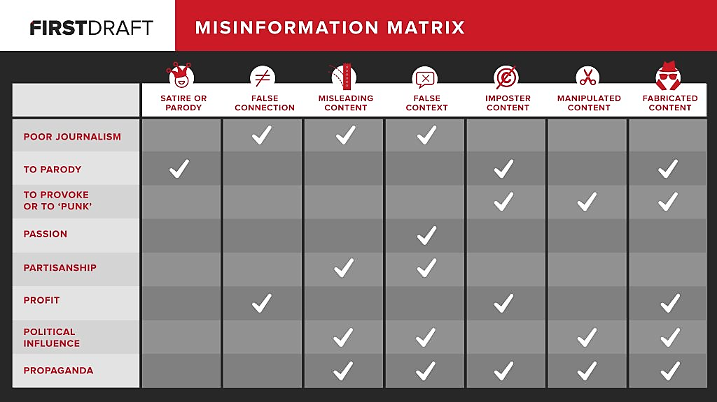
The tools to challenge fake news https://firstdraftnews.org/about

Slide 19
From scare stories to scare politics: The case of the “Chinese virus”
According to the database website Factbase, the president used the expression “Chinese virus” more than 20 times between March 16 and March 30. The deliberateness of the wording was made clear when a photographer captured the script of his speech wherein Trump had crossed out the word “Corona” and replaced it with “Chinese.” Secretary of State Mike Pompeo accused China of putting the world at risk for its lack of transparency, even scrapping a joint G7 statement after its members refused to refer to the virus as the “Wuhan virus.” [ … ]
This is when the president started using the expression “Chinese virus.” When faced with accusations of racism, he dismissed its impact on Asian Americans, saying:
“It’s not racist at all. No, it’s not at all. It’s from China. That’s why. It comes from China. I want to be accurate.” (March 18)
This is a seemingly common-sense justification – after all, the virus did originate in China. This line of defense was eagerly taken up with by conservative media and Republican officials as another battle against “political correctness” in America’s culture war.
https://theconversation.com/donald-trumps-chinese-virus-the-politics-of-naming-136796

Slide 20
Language matters President Trump may not have had racist intentions in this case, but the intent matters less than the effect. By early March, racist acts and harassment against Asians had already surged and they continued to spike through March and into April (here, here, here or here). Trump’s own Department of Homeland Security (DHS) issued a warning that white supremacists may exploit the crisis against Asian-Americans. While Donald Trump did not commit these terrible acts, elected officials and scientists have a responsibility for the way they talk about the virus – words matter. That is why the WHO has had a strict guideline since 2015 regarding the naming of diseases, a guideline followed by other world leaders.
The expressions “Chinese virus” and “Wuhan virus” personify the threat. Personification is metaphorical: its purpose is to help understand something unfamiliar and abstract (i.e. the virus) by using terms that are familiar and embodied (i.e. a location, a nationality or a person). But as cognitive linguists George Lakoff and Mark Johnson have long shown, metaphors are not just poetic tools, they are used constantly and shape our world view. The adjective “Chinese” is particularly problematic as it associates the infection with an ethnicity. Talking about group identities with an explicitly medical language is a recognized process of Othering (here and here), historically used in anti-immigrant rhetoric and policy, including toward Chinese immigrants in North America. This type of language stokes anxiety, resentment, fear and disgust toward people associated with that group.
https://theconversation.com/donald-trumps-chinese-virus-the-politics-of-naming-136796

Slide 21
Break for 10 minutes

Slide 22
Biafra
“Ugwu!” Master called. The guests had arrived. Ugwu went into the living room and his hands worked mechanically, serving kola nuts and alligator pepper, uncorking bottles, shoveling ice, laying out steaming bowls of pepper soup. Afterward, he sat down in the kitchen and pulled at his toenails and imagined what was going on in the bedroom. He could hear Master’s raised voice from the living room.
“Nobody is saying that burning government property is a good thing, but to send the army in to kill in the name of order?
There are Tiv people lying dead for nothing. For nothing!
Balewa has lost his mind!”
Ugwu did not know who the Tiv people were, but hearing the word dead made him shiver. “It is not yet your time,” he whispered. “Not yet your time.”
the way to hell: things start to unravel 1
Chimamanda Ngozi Adichie, Half a Yellow Sun Knopf/Anchor, 2006

Slide 23
the way to hell: things start to unravel 2
“What happened?” Master asked.
The man placed the bottle of water down and said quietly,
“They are killing us like ants. Did you hear what I said? Ants.”
“Our eyes have seen plenty, anyi afujugo anya, ” Obiozo said. “I saw a whole family, a father and mother and three children, lying on the road to the motor park. Just lying there.”
“What about Kano? What is happening in Kano?” Master asked.
“It started in Kano,” the man said.
Obiozo was speaking, saying something about vultures and bodies dumped outside the city walls, but Ugwu no longer listened.It started in Kano rang in his head. He did not want to tidy the guest room and find bedsheets and warm the soup and make fresh garri for them. He wanted them to leave right away. Or, if they would not leave, he wanted them to shut their filthy mouths. He wanted the radio announcers to be silent too, but they were not. They repeated the news of the killings in Maiduguri until Ugwu wanted to throw the radio out of the window, and the next afternoon, after the men left, a solemn voice on ENBC Radio Enugu recounted eyewitness accounts from the North: teachers hacked down in Zaria, a full Catholic church in Sokoto set on fire, a pregnant woman split open in Kano. The newscaster paused. “Some of our people are coming back now. The lucky ones are coming back. The railway stations are full of our people. If you have tea and bread to spare, please take it to the stations. Help a brother in need.”

Slide 24
“Stay here,” Mohammed said, as he stopped the car outside Uncle Mbaezi’s compound. She watched him run out. The street looked strange, unfamiliar; the compound gate was broken, the metal flattened on the ground. Then she noticed Aunty Ifeka’s kiosk, or what remained of it: splinters of wood, packets of groundnuts lying in the dust. She opened the car door and climbed out. She paused for a moment because of how glaringly bright and hot it was, with flames billowing from the roof, with grit and ash floating in the air, before she began to run toward the house. She stopped when she saw the bodies. Uncle Mbaezi lay facedown in an ungainly twist, legs splayed. Something creamy-white oozed through the large gash on the back of his head. Aunty Ifeka lay on the veranda. The cuts on her naked body were smaller, dotting her arms and legs like slightly parted red lips.
Olanna felt a watery queasiness in her bowels before the numbness spread over her and stopped at her feet.
….
The smoke was thickening around her so that she was not sure if the crowd of men drifting into the yard were real or just plumes of smoke, until she saw the shiny metal blades of their axes and machetes, the bloodstained caftans that flapped around their legs. Mohammed pushed her into the car and then went around and got in.
“Keep your face down,” he said.
“We finished the whole family. It was Allah’s will!” one of the men called out in Hausa. The man was familiar. It was Abdulmalik. He nudged a body on the ground with his foot and Olanna noticed, then, how many bodies were lying there, like dolls made of cloth.
“Who are you?” another asked, standing in front of the car. Mohammed opened his door, the car still on, and spoke in rapid, coaxing Hausa. The man stood aside. …
“Allah does not allow this,” Mohammed said. He was shaking; his entire body was shaking. “Allah will not forgive them. Allah will not forgive the people who have made them do this. Allah will never forgive this.”
the way to hell

Slide 25
“It’s rather silly how the Northerners will pay foreigners twice more rather than hire a Southerner. But there’s quite a bit of money to be made there. Nigel’s just rung to tell me about his friend, John, a ghastly Scot. Anyway, John’s a charter pilot and has made a small fortune flying Igbo people to safety these past few days. He said hundreds were killed in Zaria alone.”
Richard felt as if his body was gearing up to do something, to shiver, to collapse. “You know what’s happening there, then?”
“Of course I do. I just hope it doesn’t spread to Lagos. One really can’t predict these things.”
Susan downed her drink in a gulp. He noticed the ashen tone of her skin, the tiny beads of sweat above her lip. “There are lots and lots of Igbo people here—well, they are everywhere really, aren’t they? Not that they didn’t have it coming to them, when you think about it, with their being so clannish and uppity and controlling the markets. Very Jewish, really. And to think they are relatively uncivilized; one couldn’t compare them to the Yoruba, for example, who have had contact with Europeans on the coast for years. I remember somebody telling me when I first came to be careful about hiring an Igbo houseboy because, before I knew it, he would own my house and the land
European views: the way to hell 1

Slide 26
“Ancient tribal hatreds,” the Herald wrote, was the reason for the massacres. Time magazine titled its piece man must whack, an expression printed on a Nigerian lorry, but the writer had taken whack literally and gone on to explain that Nigerians were so naturally prone to violence that they even wrote about the necessity of it on their passenger lorries. Richard sent a terse letter off to Time. In Nigerian Pidgin English, he wrote, whack meant eat. … Richard began to write a long article about the massacres. …. about the refugee problem, a result of the massacres, about the traders who fled their markets in the North, university lecturers who left their campuses, civil servants who fled their jobs in the ministries. He struggled over the closing paragraph.
  It is imperative to remember that the first time the Igbo people were massacred, albeit on a much smaller scale than what has recently occurred, was in 1945. That carnage was precipitated by the British colonial government when it blamed the Igbo people for the national strike, banned Igbo-published newspapers, and generally encouraged anti-Igbo sentiment. The notion of the recent killings being the product of “age-old” hatred is therefore misleading. The tribes of the North and the South have long had contact, at least as far back as the ninth century, as some of the magnificent beads discovered at the historic Igbo-Ukwu site attest. No doubt these groups also fought wars and slave-raided each other, but they did not massacre in this manner. If this is hatred, then it is very young. It has been caused, simply, by the informal divide-and-rule policies of the British colonial exercise. These policies manipulated the differences between the tribes and ensured that unity would not exist, thereby making the easy governance of such a large country practicable.
…He sent it off to the Herald. When he got a response two weeks later, he ripped the letter up after reading it. The international press was simply saturated with stories of violence from Africa, and this one was particularly bland and pedantic, the deputy editor wrote, but perhaps Richard could do a piece on the human angle? Did they mutter any tribal incantations while they did the killings, for example? Did they eat body parts like they did in the Congo? Was there a way of trying truly to understand the minds of these people?
the way to hell: seen from outside 2

Slide 27
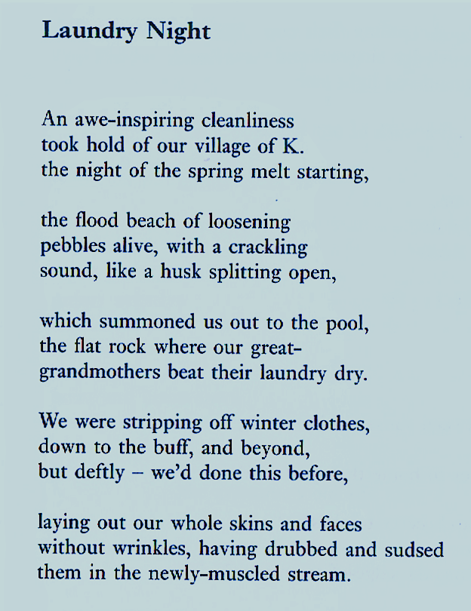
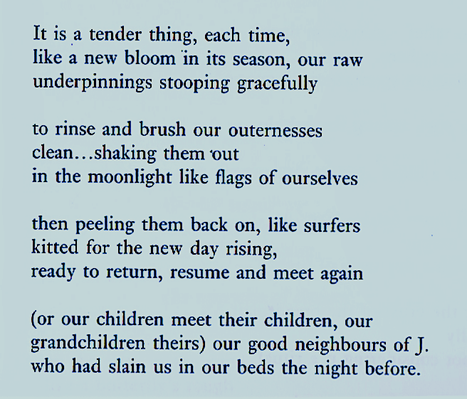
Ethnic cleansing in the Balkans-
Philip Gross, The Egg of Zero, Bloodaxe, 2006

Slide 28
Final discussions

