Slide 1

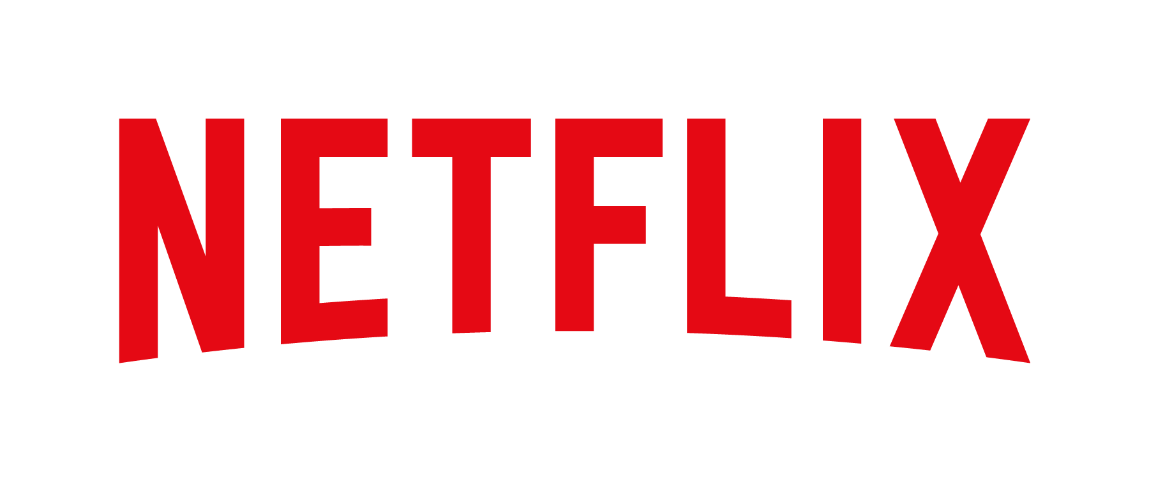
Managing Marketing Change (BMMB7026)
Planning For Marketing Drivers Of Change
Group Presentation
Laura Yildiz (1816439)
Dan Brown (1905439)
Stanislav Kim (1807730)
Kate Davies (2316342)
Mark Lewis (2017589)

Slide 2
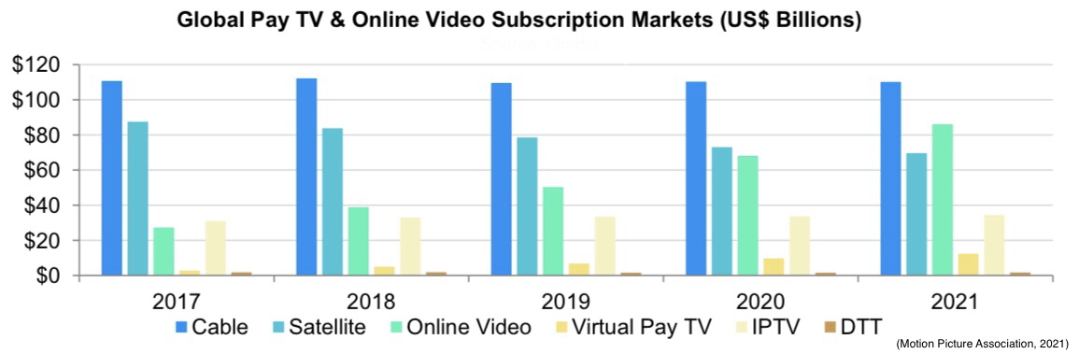
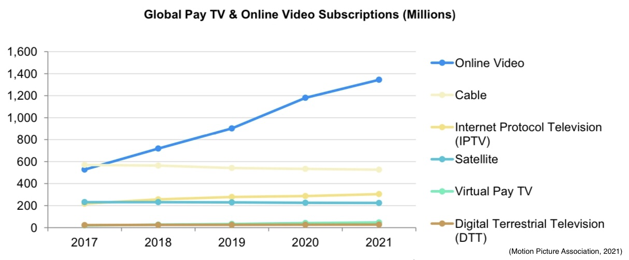
Global Theatrical, Home/Mobile Entertainment, and Pay TV Market
Combined Market Value
$328.2 billion
72%
Digital Streaming
1.3 billion
Online Streaming Subscribers Worldwide
2nd Largest Subscription Revenue Market
(Motion Picture Association, 2021)
Student: Laura Yildiz (1816439)

Slide 3
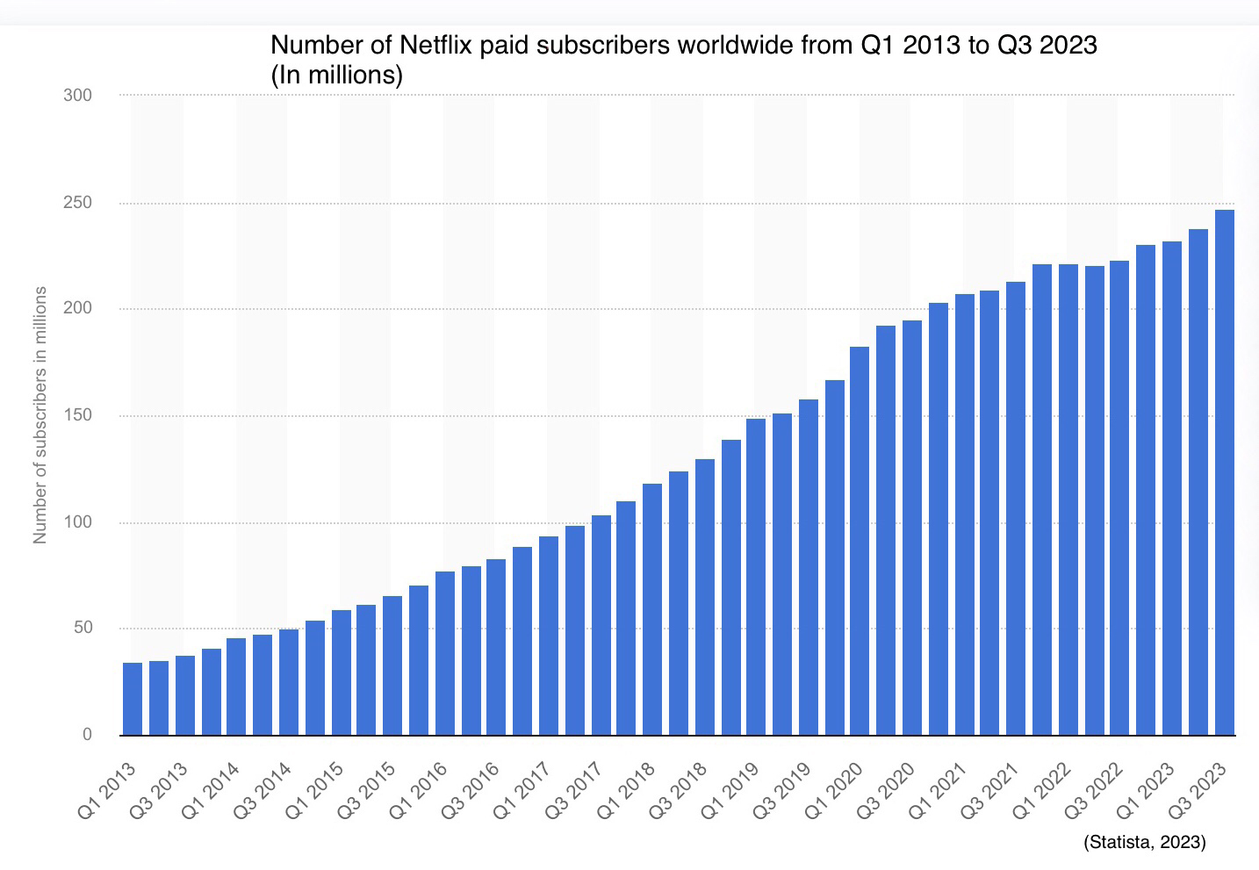
Netflix History
1997 - Founded by Wilmot Reed Hastings Jr and Marc Randolph – DVD rentals-by-mail concept
    1998 – Netflix.com website launched
    1999 – Subscription service launched
2006 – 5 million subscribers
2007 – Online streaming services launched in America
    2008 – Consumer electronic brand partnerships established
    2009 – Streaming partnerships expand Netflix to Internet-connected TVs
2010 – Netflix arrives in Canada
    2011 – Launches in Latin America and the Caribbean
    2012 – Expands to the United Kingdom, Ireland and the Nordic countries
    2014 – International expansion continues to Austria, Belgium, France, Germany, Luxembourg and Switzerland
2017 – Netflix expanded to 130 new countries, in 21 languages – 100 million subscribers globally
2020 – Post Covid-19 Pandemic
    Increase to over 200 million subscribers
    Brand value = up 72% to $26.7 billion
2023 – 247 million paid subscription memberships,
    Available in 190 countries,
    Streaming in more than 30 languages
(Statista, 2023)
Student: Laura Yildiz (1816439)
(Netflix, 2023), (BBC, 2018), (Statista, 2023), (Forbes, 2020), (Corbett, 2023), (FlixPatrol, 2023)

Slide 4
THE CHANGES
experienced by organisations and businesses are increasing (Balogun and Hailey, 2008) in such a fast pace that organisations “will necessitate movement from the status quo” (McCalman, Paton and Siebert, 2016, p.9)
THE FUTURE
of individuals and businesses` performance is influenced by macroenvironment (Chaston, 2017) that cannot be directly controlled or influenced by them (IONOS, 2023)
ANALYSIS
For marketing planning, organisational change, strategic planning, business and product/services development in a macroenvironment context, the organisations use PESTLE Analysis (Myers, Hulks and Wiggins, 2012) in conjunction with other analysis tools like SWOT, TOWS, SOSTAC etc.
Student: Dan Brown (1905439)

Slide 5
PESTEL Analysis
Political | Regulatory changes during Covid-19 Pandemic: lockdown US, major market, trading with most countries of the world, however there are disruptions in China and Russia. Malaysia emergent market. Increased taxation to 6% for streaming services
Economic | Subscription cancelations due to financial restrains, shifting to essential products, however it is expected a 2.25% growth within the US Impact of post pandemic: affordability Inflation to a record high of 7.5%
Social | Binge-watching emerged, specifically among youngsters aged 16-24, seconded by 25-34 years old 8% increased spending on streaming platforms Lifestyle changes – family orientated, home-based entertainment, balanced lifestyle
Technological | Usage of AI for tracking consumer behaviour Trailers can be produced in 24 hours, rather than a week as before Cloud computing facilitate streaming videos uninterrupted, and on high quality
Environmental | Carbon footprint for Streaming Industry is 55 grams of Carbon Dioxide for each hour of content streaming High energy consumption Governments facilitates renewable energy
Legal | US Law: The Protecting Lawful Streaming Act Net neutrality laws – equal treatment for all streaming platforms from internet providers The Communications and Multimedia Act (Malaysia) encourage competition
Source: Miller (2022)
Student: Dan Brown (1905439)

Slide 6
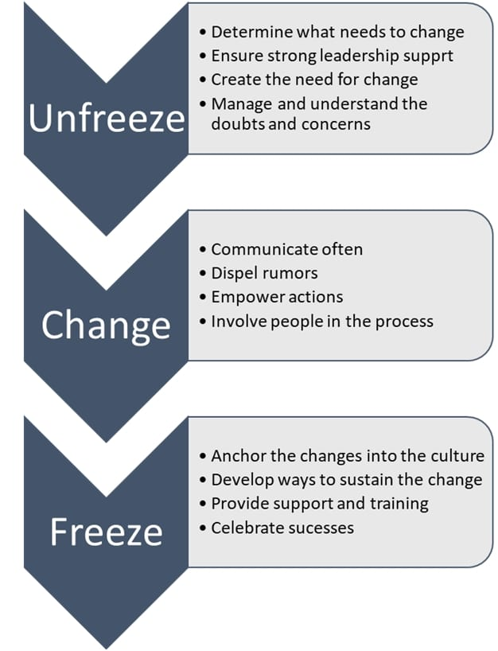
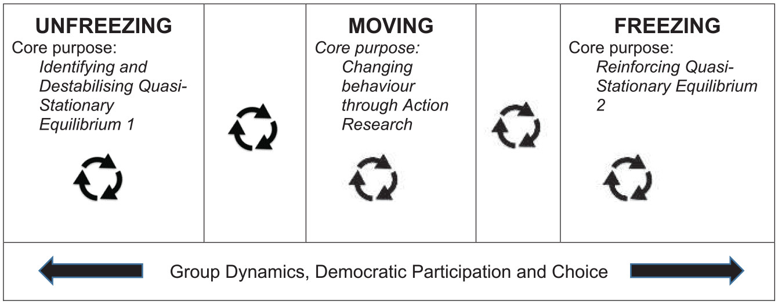
Lewin`s Three-Step Level of Change
- Developed in 1940
- Metatheory, field theory
- Identifies driving and restraining forces to change
Source: 9mconsulting (2020)
Burnes (2020)
Student: Dan Brown (1905439)

Slide 7
Lewin`s Force Field Analysis
Score | Driving Forces | Desired Change | Restraining Forces | Score
5
Demand for streaming services
Increase subscriptions
Broadcast chanells
3
4
Consumer behaviour shift to digital entertainment
Consumer behaviour shift to hybrid entertainment
4
4
Economic recovery, affordability
Economic uncertainty, prioritizing costs
2
4
Health Consciousness
Health ignorant
3
Total score: 17 | Marketing Change Strategy | Total score: 12
Student: Dan Brown (1905439)

Slide 8
Personalized Content
Multi-mode Experience
Better interactions
NETFLIX MARKETING
A unique example and inspiration
Blend Technology with Marketing Tactic
Target emails
Arun (2023)
Student: Dan Brown (1905439)

Slide 9

Competitor analysis
1) Content library
2) Global Reach and localization
3)Subscription model and additional benefits
4) User experience and Interface
Amazon Prime Video | Extensive library , included with prime, global reach, competes with Netflix.
Disney+ | Launched in 2019, Extensive collection of Disney, Pixar, Marvel, Star Wars, and National Geographic content Competes with Netflix, especially in family-friendly entertainment.
Apple TV+ | Apple's streaming service with exclusive, high-quality original content, aiming to compete through its brand strength and unique offerings.
YouTube | Offers live TV streaming and competes with Netflix in the broader streaming market by providing a variety of live channels and on-demand content.
Now TV | Operated by Sky, offers live sports, movies, and TV series Unique selling point: flexible subscription options tailored to user interests.
(The Strategy Story, 2023)
Student: Stanislav Kim (1807730)

Slide 10
Micro-Environment and Customer value
  Netflix's internal and external factors, including employees, management, content partners, customers, marketing strategies, technology, regulations, and financial performance, directly shape its operations and competitive standing, crucial for its industry leadership.
  Netflix aims to provide customer value through prompt customer service, high-quality content, a user-friendly experience, personalized recommendations, and satisfaction, all contributing to a positive customer experience.
(Prezi, 2023), (Haughey, 2023),
Student: Stanislav Kim (1807730)

Slide 11
Porters five forces
  Threat of new entrants:
Streaming industry faces high threat of new entrants due to ease of market entry
Netflix's size and loyal customer base create barriers for new competitors
  Bargaining power of suppliers:
The streaming industry is vulnerable to new entrants due to the ease of market entry.
Established companies like Netflix possess advantages in size and a loyal customer base, making it challenging for new competitors to enter the market.
  Bargaining power of buyers:
Customers in streaming industry have significant power due to many choices, influencing pricing and retention strategies for companies.
  Threat of substitutes:
Netflix competes with streaming platforms like Amazon Prime Video, Disney+, Hulu, HBO Max, and Apple TV+, as well as traditional cable TV providers.
This influences Netflix's market positioning and customer retention efforts.
  Competitive rivalry:
The streaming industry is highly competitive, with established and new companies vying for content, customers, and retention.
Unique shows and movies, a top-notch user experience, and global reach are crucial for maintaining a leading position in the market.
(EdrawMax, 2022), (Team, 2022)
Student: Stanislav Kim (1807730)

Slide 12
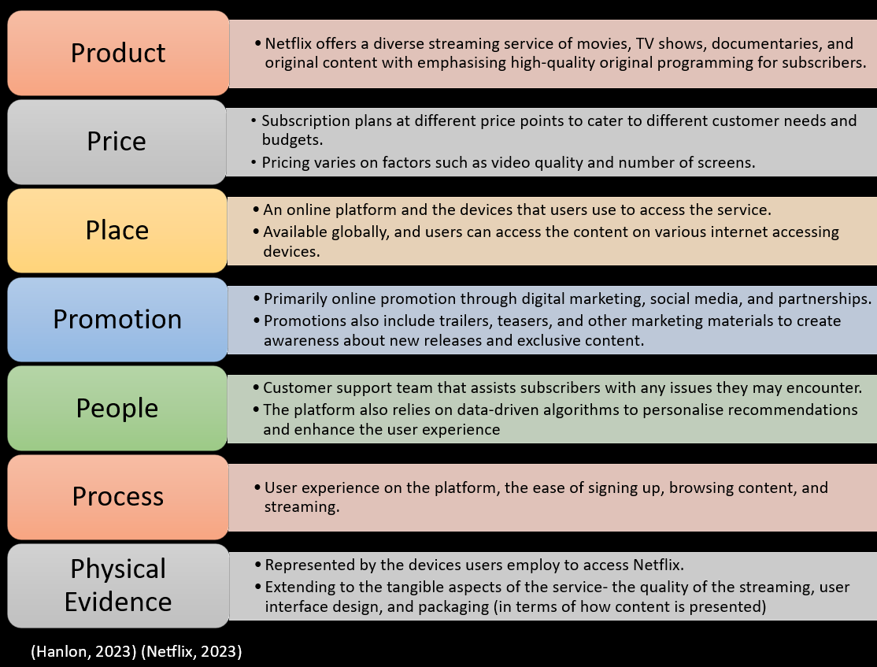
7Ps Marketing Mix
Drivers for change
Changes in consumer Behaviour,
resulting in loss subscribers and increased competition.
Organisational change response
Product
subscription levels,
stop password sharing
Price
Levels
Student: Kate Davies (2316342)

Slide 13
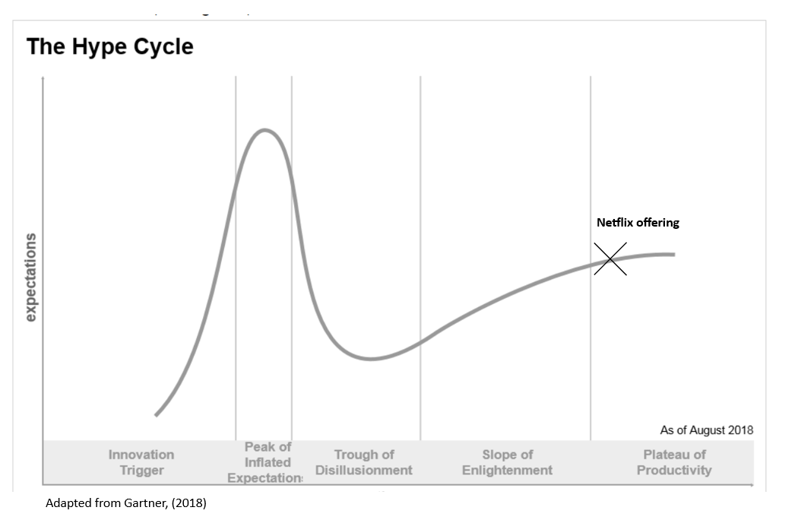
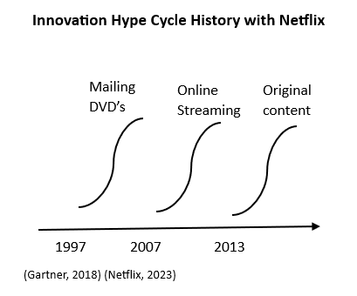
Netflix and the Hype Cycle
Following a history of innovation when reaching phase 2 Netflix adapt their product. Currently Netflix are in unchartered waters in phase 5
Student: Kate Davies (2316342)

Slide 14



Key points
Important questions:
1. Type of recent organisational change
They have altered their 7p’s model focusing on just two areas.
2. Why was it needed
Fall in subscriptions and increased competition
3. Who decided and how was it communicated
Communicated incrementally these changes have been on the horizon for years with Netflix saying they were considering them.
4. Scale
Small alterations.
5. Who led/ influenced
Netflix influenced by competition
6. Did it or will it work?
Too soon to determine
Netflix face unchartered, stagnant and competitive waters.
Course is disconnected from successful original innovative culture.
Organisational change is minimal to combat drivers of change.
Recommendations
Leverage innovative culture
Collaborate with technology partners to innovate
Alter more areas of the offering/7Ps
Increase customer marketing to manage expectations
Student: Kate Davies (2316342)

Slide 15
Key Drivers of change
Netflix relies heavily on data analytics to understand viewers preferences.
Netflix relies heavily on analytics to understand viewers preferences. This data can then be analysed to improve content
Data-Driven decision making
Artificial Intelligence and machine learning
Continuous technology innovation
Original content strategy
Netflix is always pushing technological boundaries with innovative streaming algorithms and interactive content. This helps the platform stay ahead of the curve.
By 2023, Netflix is predicted to spend $7 billion on original content, placing it fifth among the world's leading media companies.
Student: Mark Lewis (2017589)

Slide 16
Data Analytics
Potential for Market Disruption
Positive User Experience
Balancing Algorithmic Personalization and Creativity
Industry Leader in Analytics
Netflix's success in the streaming market is driven by its data analytics strategies for personalized recommendations, content optimization, and technical improvements. However, growing competition and the need for global localization require ongoing innovation and strategic adaptation to remain competitive. Netflix's data analytics strategies will be crucial in maintaining its market position and ensuring customer satisfaction as the industry matures.
(Stoll, 2023)
Student: Mark Lewis (2017589)

Slide 17
Exploring The Impact Of Advances In Technology
Customers more aware of how data is being used and government intervention
Netflix spend 25% of their
Budget on acquiring new
content. Balancing the need for high-quality content with costs is essential.
Data Privacy and Security.
Ethical Considerations
Talent Shortage and skills gap
Emerging Technologies
High- Content costs.
Bias in algorithms and misuse of AI and data pose significant risks to the organisation
The rapid pace of change in technology means Netflix needs to integrate emerging technologies such as augmented reality such as VR (Virtual Reality) to stay competitive
The rapid advancement of technology has created a high demand for skilled professionals who can analyse and harness complex data.
(Goswami, 2022)
Student: Mark Lewis (2017589)

Slide 18

Artificial Intelligence
With the rapid advancements in AI and machine learning, the streaming market is experiencing significant impacts, both for the customers and for Netflix's marketing strategy.
Impact on the streaming market.
Content Creation and Diversity.
Privacy Concerns.
Algorithmic Bias and Unfairness.
Entrance of New Players.
Student: Mark Lewis (2017589)

Slide 19
Customer Relationship Management
Continuous Personalization and Recommendation Refinement
Netflix's CRM continuously improves its personalization algorithms to accommodate new competitors. Through the analysis of user behaviour and preferences, Netflix maintains a high level of relevance and engagement for its content recommendations, setting itself apart from competitors with a personalised experience.
Innovative Communication Strategies
Innovative communication techniques are utilized by Netflix's CRM to engage users, set itself apart, and provide a personalized experience. This includes promoting interactive content and sending targeted email campaigns based on user data insights.
Global Adaptation and Localization
Netflix adapts its CRM approaches to fit different markets by localizing content, considering cultural differences, and adjusting recommendations. This commitment helps maintain strong customer relationships amidst growing competition.
(Williams et al., 2023)
Student: Mark Lewis (2017589)

Slide 20
SWOT Analysis
Strengths Vast content Library Global Subscriber base Award winning original content | Weaknesses Dependency on third-party content High content production costs Subscription fee sensitivity
Opportunities Expanding into emerging markets. Investing in virtual reality (VR) content. Enhancing original content portfolio. | Threats Intense competition (Disney, Hulu and Amazon Prime. Piracy and unauthorised access. Shifting consumer preferences.
(Maddodi & Prasad, 2019)
Student: Mark Lewis (2017589)

Slide 21
The Future of Netflix…
“Because the purpose of business is to create and keep a customer, it has only two central functions – marking and innovation. The basic function of marketing is to attract and retain customers at a profit”.
(Drucker in Fahy & Jobber, 2019)
Student: Laura Yildiz (1816439)

Slide 22




Ansoff Matrix - Netflix
Products / SERVICES
Existing
New
Attract new subscribers with promotional offers.
Retain existing subscribers with enhanced engagement strategies.
Season renewals for Netflix’s most popular shows.
Market Penetration Strategy
Product Development Strategy
Continue development of new ‘Netflix Originals’ productions.
Expansion of streaming languages available.
Merchandise for popular shows and original content.
New
Existing
INCREASING RISK
Markets
Market Development strategy
Diversification strategy
Expand into untapped international markets.
Target specific demographics with tailored content.
Focus on emerging markets.
Alternative subscription packages – tiered pricing plans.
Explore new products or services in unrelated markets – live events or interactive media experiences.
INCREASING RISK
(LinkedIn, 2021), (Vizzlo, 2023), (Netflix, 2023), (CPI, 2023), (Ansoffs, 2020)
Student: Laura Yildiz (1816439)

Slide 23
SOSTAC Marketing Planning Model - Netflix
Situation Analysis
Control
Struggling to maintain and increase market share and competitive advantage within the industry.
No new innovations and misaligned algorithms to meet / exceed consumer expectations.
Monitor KPI’s
Actions
C
S
Executing marketing campaigns.
Malaysia expansion, followed by other emerging markets.
Review planned future content for opportunities of diversity.
Action additional R&D funds.
Approach technology partnerships for collaboration possibilities.
Action feedback loops and database information.
Objectives
Utilise global emerging markets to achieve new subscriptions target of 48 million by Q3 2024.
Diversify content to avoid substitution.
Release market disruptive innovative technology (VR viewing technology) compatible with new META headset.
Increase subscriber personalization with algorithms and original content.
SOSTAC Marketing Planning Model
A
O
Tactics
T
S
Targeted marketing campaigns.
Expand into emerging markets.
Continue to produce new original content, increasing diversity.
Collaborate with META and/or other technology companies.
Integrate user feedback tools to enhance algorithm and CRM.
Strategy
Increase the personalized experience when expanding to emerging markets.
Diversify original content to avoid substitution.
Invest in R&D, collaborate and leverage Netflix’s innovative culture.
Enhance CRM through personalized innovative algorithm changes.
(Chaffey, 2023), (Statista, 2023)
Student: Laura Yildiz (1816439)

Slide 24
Thank you

Slide 25
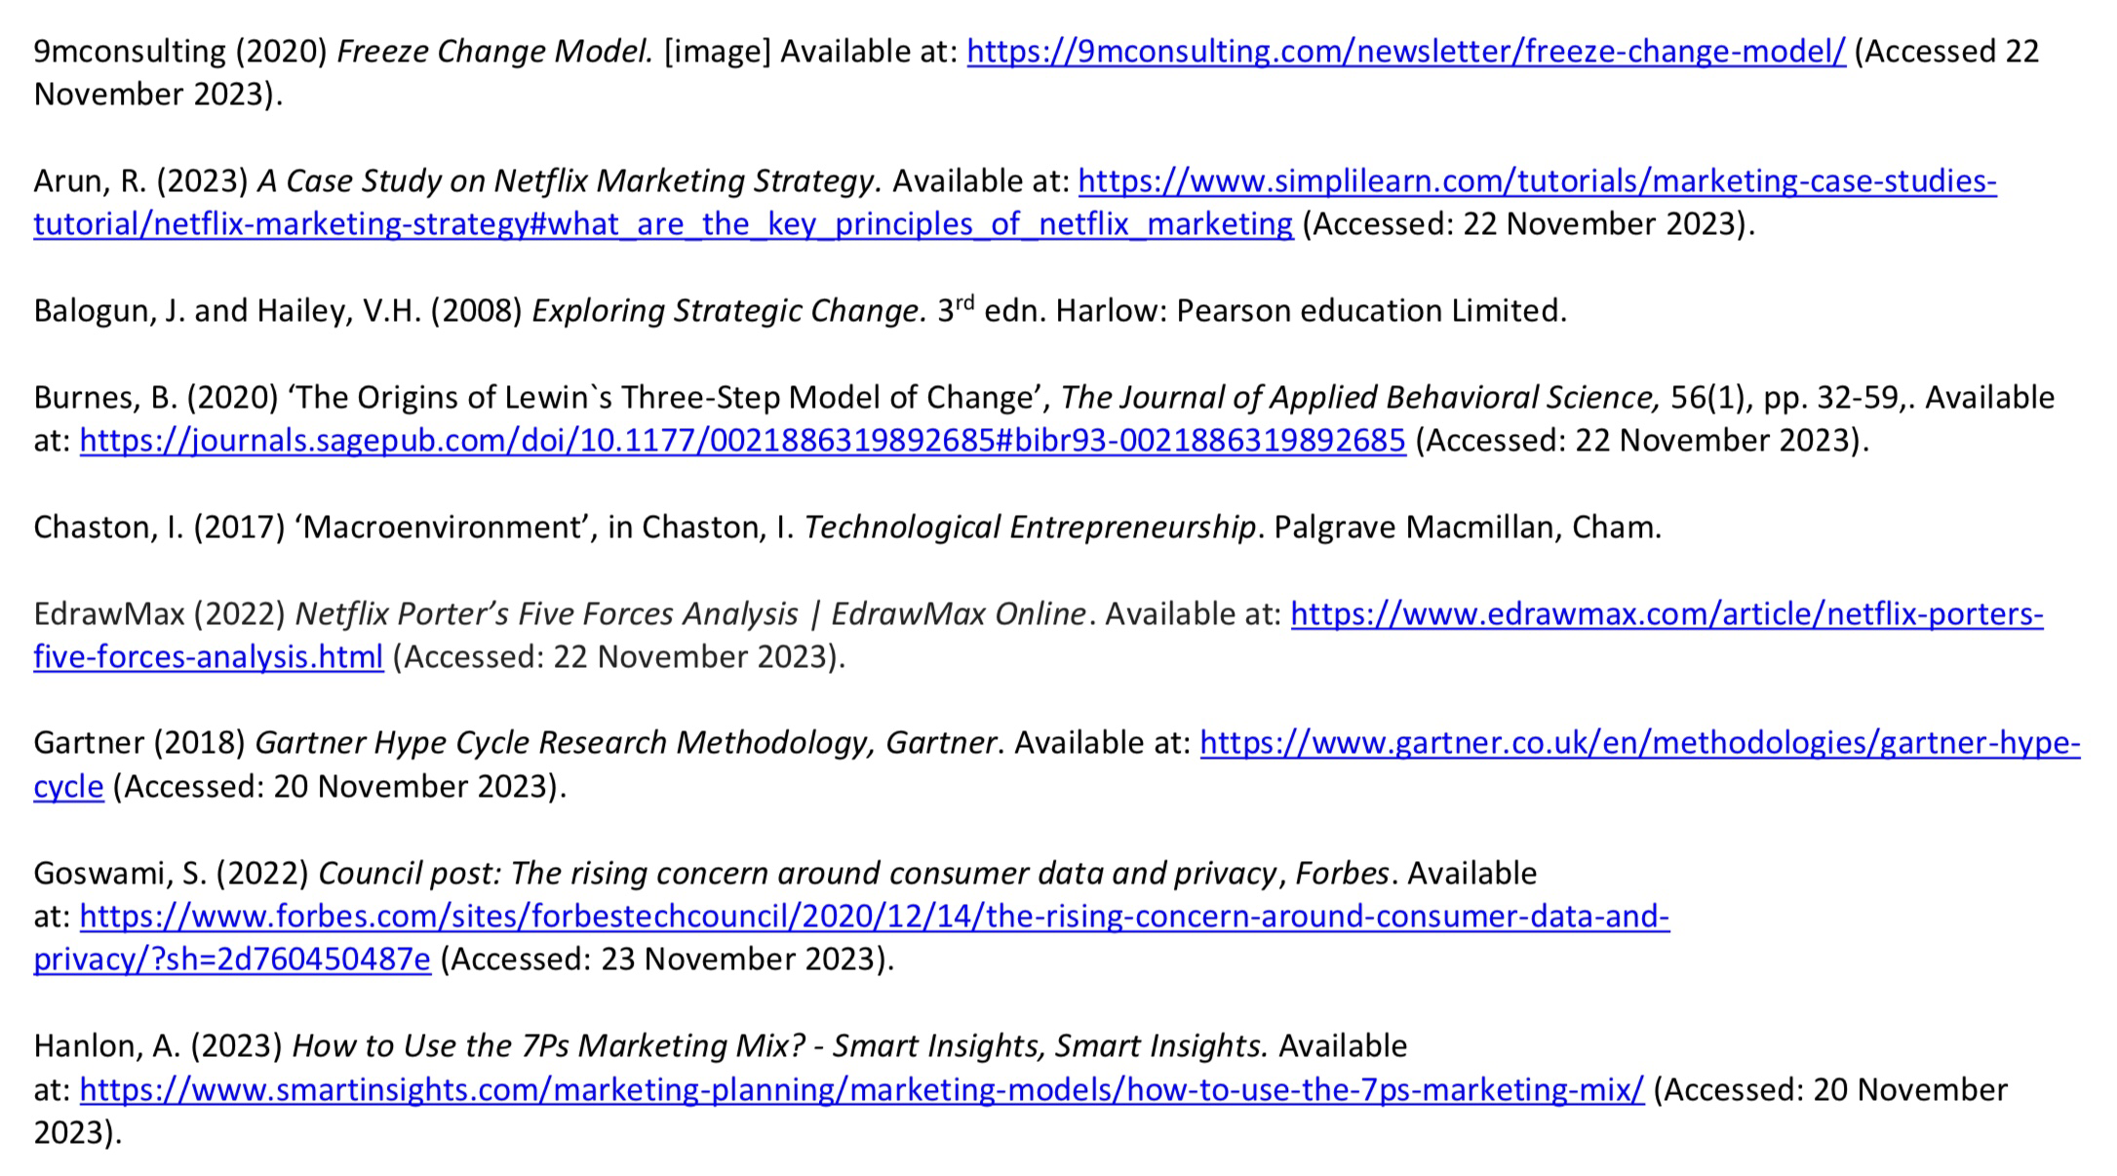
Reference List

Slide 26
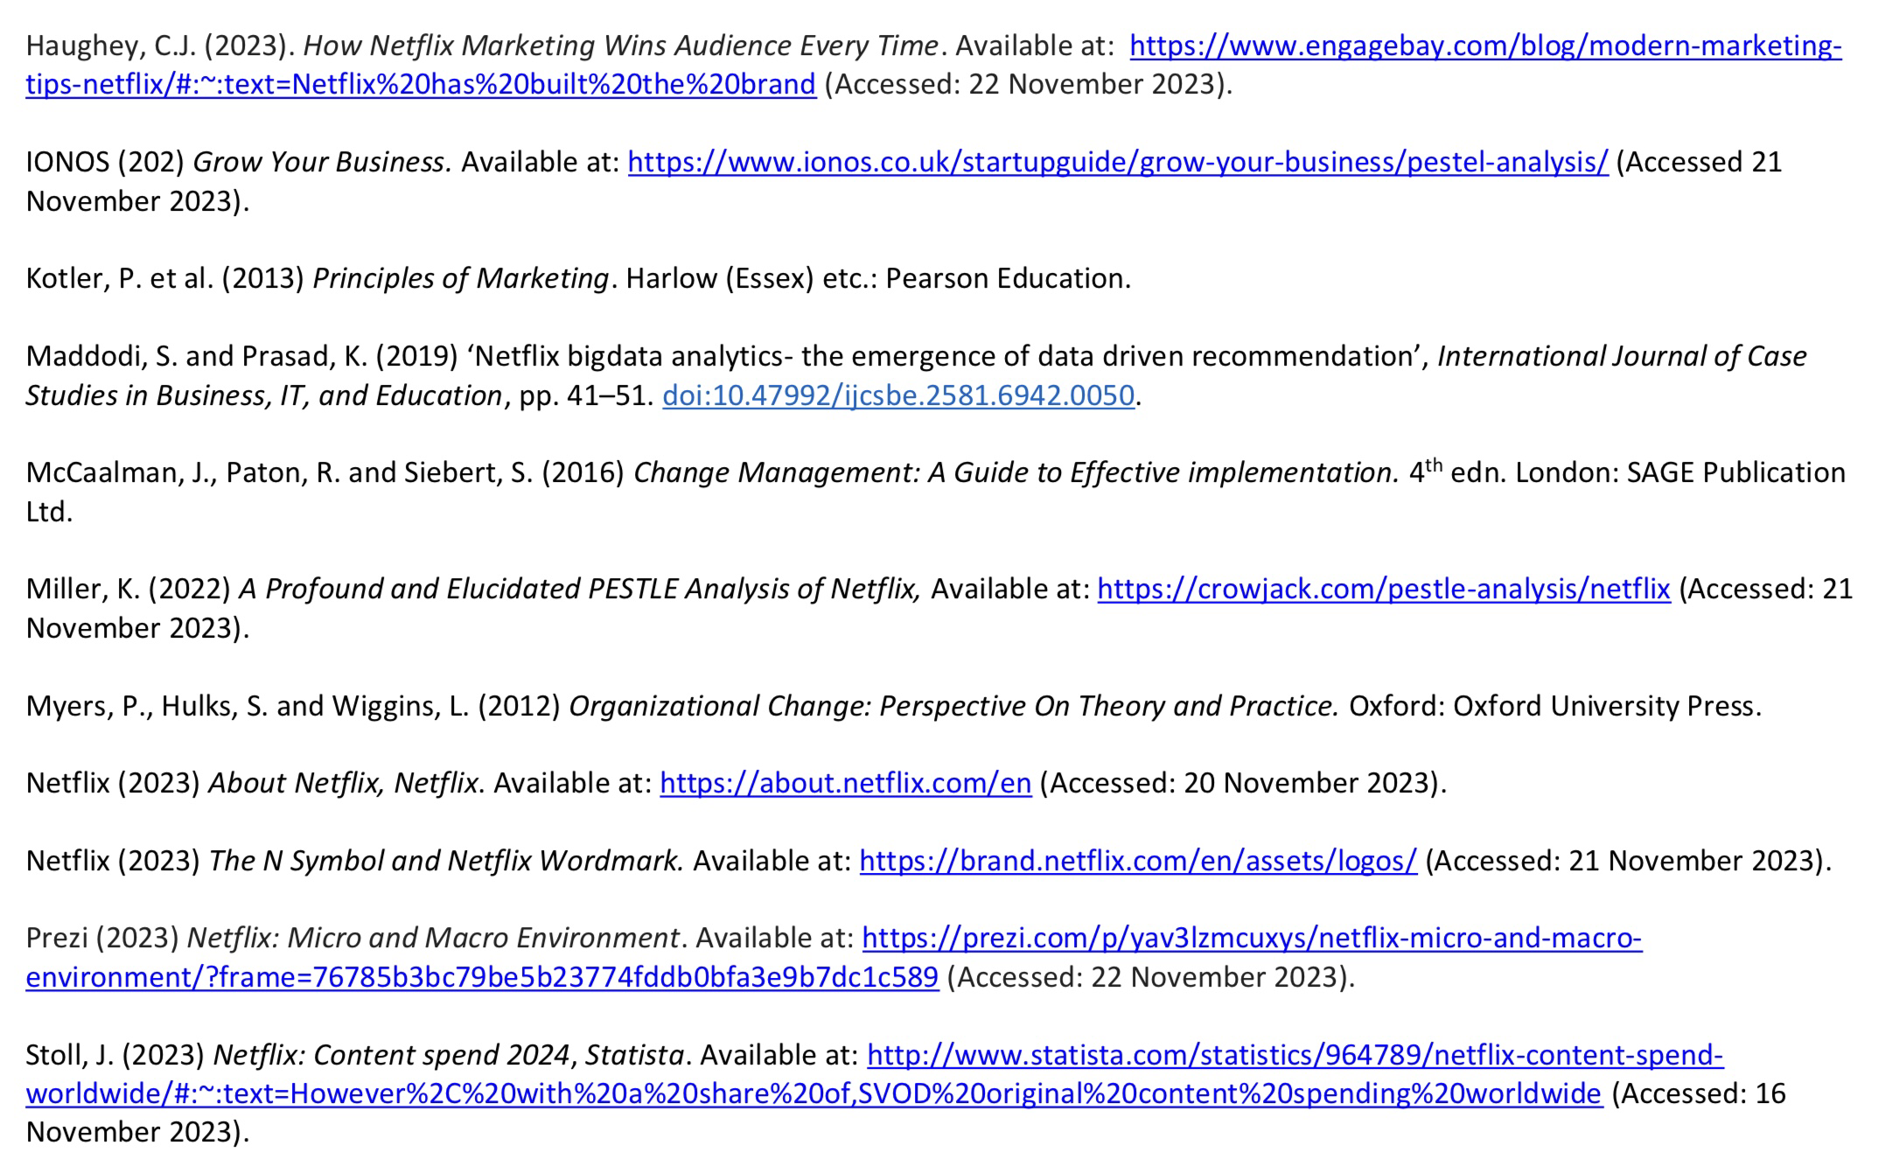
Reference List

Slide 27
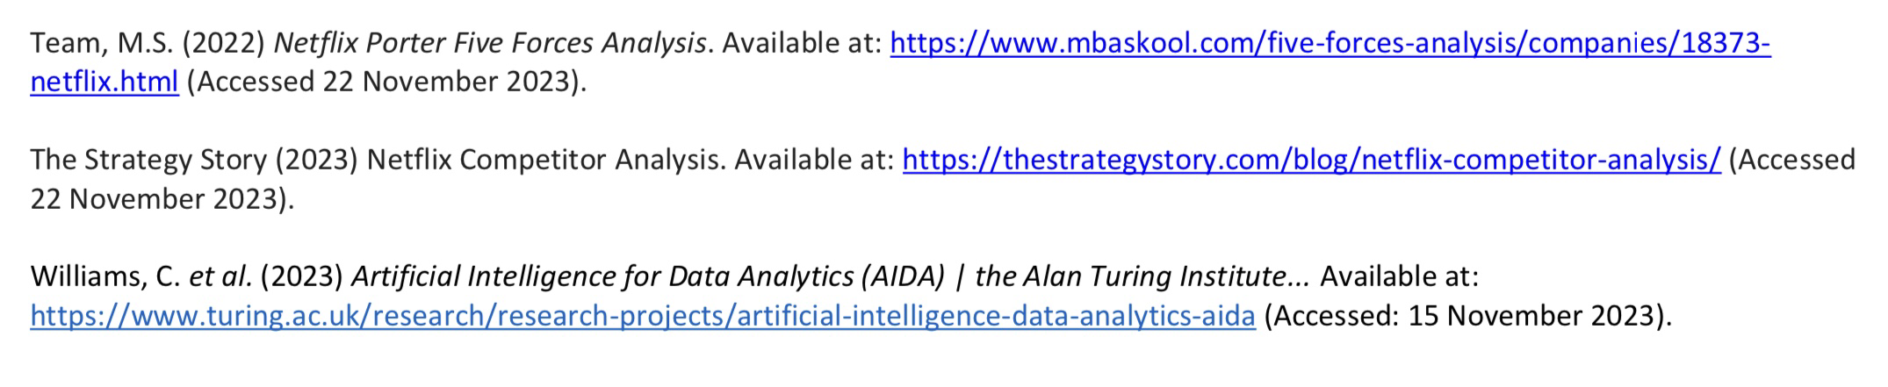
Reference List

