Slide 1

Waterstones Marketplace
By Debora James
Student No: P147916
Module BMMB7002D

Slide 2
The Business Environment
Waterstones is the largest book shop chain in the UK and is a bookshop that aims to give the customer the ‘local bookshop’ experience.
It was founded in 1982 by Tim Waterstone, which employs over 3000 staff in 280 stores throughout Britain (Waterstones 2020).
Their main competitors online are Amazon, and WH Smith on the high street.
Customer demand drives growth of e-commerce services (Chaffey 2011, p394), and Waterstones has responded by offering digital products and setting up their own e-commerce site, as innovation and agility to adapt what the company offers in response to changes in the market environment supports survival (Bessant & Tidd 2019, p37)
The increasingly faster pace of change and technological development in an organisations’ business environment, makes it more critical for Waterstones to keep up with these advances, and stay competitive in their market (Palmer & Hartley, 2009, p7).
Waterstones can analyse their market environment by dividing it into three distinct areas, the internal environment, the micro-environment and the macro-environment, as careful analysis will allow Waterstones to make profitable strategic decisions.

Slide 3
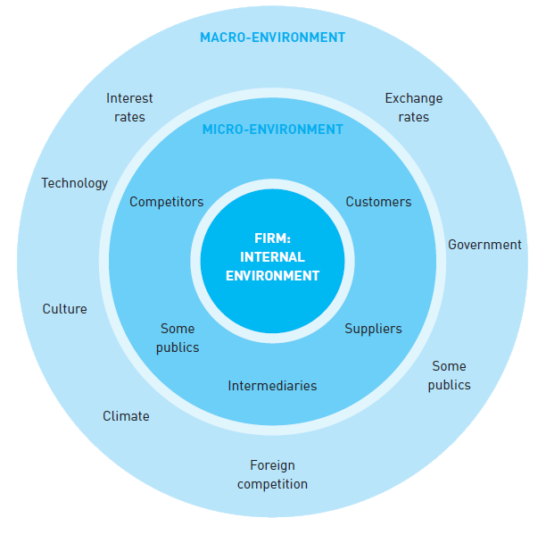
Market Environments

Slide 4
Macro-Environment
The macro-environment is a range of environmental factors outside of Waterstones, which could indirectly affect the business and how it operates.
The micro-environment is the relationships and the decisions that Waterstones makes in response to the events outside of the company. These responses could affect the company’s success.
To analyse in greater detail the macro-environment that could affect Waterstones, a PEST (Political, Economic, Socio-cultural and Technological) analysis could be used.
This would give Waterstones a general idea about the macro-environmental conditions in which the company operates so that they can make informed decisions in relation to future foreseeable situations that might arise (Yuksel 2012).

Slide 5
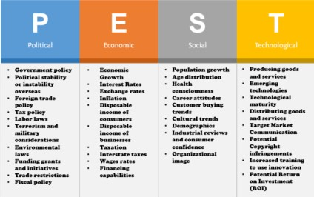
Pest Framework

Slide 6
Political Factors
Waterstones operates in the UK, and some countries in Europe.
Changes in UK and EU legislation will affect the company, such as changes in VAT rates, company tax rates and changes in laws which may affect how the organisation operates.
Political issues such as Brexit could affect Waterstones, as customers become more cautious of non-essential spending, however the cost of digital information and communication is dramatically falling (Soete 2001, p22, cited in Farnham 2010) aiding the growth of online communication and purchasing.
The law is struggling to keep up with rapid technological developments and is not always easy to apply current laws to social media or internet sites (Managing Intellectual Property 2019) so it can be difficult to enforce rules in e-business to protect a company like Waterstones.
Waterstone do not have a presence in countries that are not in the EU, so this strategy saves them a lot of problems that might arise politically from selling in other countries.

Slide 7
Environmental Factors
Environmental issues such as deforestation can have an effect on Waterstones physical side of their business. Out of the 17 billion cubic feet of trees deforested each year, over 60% of it is used for paper (Capital Solutions 2018). Reducing deforestation could have an effect on the availability of physical books. By offering digital versions, Waterstones is ensuring their business continuity.
Issues such as climate change may also affect the physical side of the business as it may cause problems with the transportation of books/products, and customers expectations of environmentally friendly products and processes may create operational issues with in the company.
Waterstones has made efforts to address these customer expectations by financially supporting the development of electrical appliance recycling collection points, and works with the British Safety Council to manage its environmental impact (Engage Business Media 2020) in general.

Slide 8
Social
Factors which can affect a customers buying decision, includes their gender, age, socio-economic group, income and marital status. Most of these factors are considered part of the customer’s life cycle. Waterstones has addressed this by offering products of a wide range to cater to everyone’s needs, both digitally and physically.
The develpment of mobile technology and the use of internet and apps has changed how consumers are able to make their buying decision, buy their products and share with other consumers their experiences (Heinonen 2011, cited in Husain et al 2016). Waterstones have embraced this technological advancement and have their own app for selling both digital and physical books. They also have a presence on many social media sites, and their own blog, as well as having their own website, increasing their interaction with customers to achieve more sales.
Brassington and Pettit (2005, cited in Armstrong & Kotler 2007) suggest that buyers are also influenced by their environment, such as trends, product prices, product reviews, or quality which information is easily accessible digitally or online sites, so Waterstones provides as much information that they can on their website, to encourage more customers to buy.
The consumers drive change as the companies try to give the consumers what they need and want, with added value (Hamelin 2011), and Waterstones seem to have taken notice and have made changes to their business strategy to give the customers a greater choice of products, in a choice of digital or print.

Slide 9
Technological
The use of technology in marketing has seen huge growth in the new millennium (Husain et al 2016) and it has become a ‘usual’ part of marketing in most businesses, including Waterstones, to stay competitive.
Social Media platforms such as Facebook, Twitter, Linkedin or specialist blogs and forums play a vital part in businesses reaching out to and engaging their customers and potential clients (Chaffey 2011, p19), which Waterstones also fully utilises.
Social media is thought of as a ‘peer influencer’ when customers make buying decisions, as 71% of consumers admitted to buying a product due to social media referrals (Husain et al 2016).
A study by Hubspot claimed that 92% of businesses said that social media marketing was a very important tool (Magee 2017), making it very wise for Waterstones to be using social media marketing.
Palmer (cited in Harris & Dennis 2002, p2) supports Waterstones strategy by noting that businesses that converge their e-business along with more conventional operations, enjoy greater success, in ‘shared’ rather than ‘revolutionary’ business operations.

Slide 10
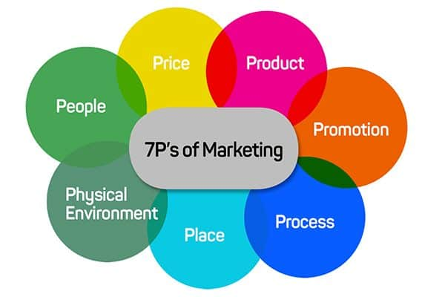
Marketing:

Slide 11
7 P’s Of Marketing
The 7 P’s of the marketing mix are the what the company uses to translate its strategy into successful marketing practice (Hooley et al 2008, p50).
Engel (1990, cited in Martin 2010) suggests that the buyer goes through stages before they make the decision to buy. These stages include the recognition of a need (Product), the information search of a suitable product, the evaluation of alternatives, the purchase decision and the post purchase behaviour. This process is made quicker and easier with the information available on social media and online sites (Process, Place, Promotion).
The choice of the market segment that a business chooses to penetrate is important to their success, according to Moriarty and Reibstein (1986, cited in Martin 2010). However the use of technology has expanded the ‘local market’, so businesses can sell a wider range of products further afield more easily (Morrison 2017, p39), causing greater business competition within market sectors (Price).
With customers embracing the digital age (People) and developing technology becoming easier to use (Process) access to the internet will increasing grow (Chaffey 2011, p394).
Waterstones strategy for marketing is clearly following this model, and is putting an emphasis on the ‘people’ experience as a part of their business model.

Slide 12
Customer Value and the Online Value Proposition
Companies who offer e-commerce services need to have a clear online value proposition, or unique selling point to encourage customers to use their services over other online retailers. Chaffey (2011, p39) proposes ‘six C’s’ which have the potential to give the customer added value.
Content – detailed information available, on products and processes.
Customisation – targeted newsletters, recommendations.
Community – blogs, chat rooms, forums for customers.
Convenience – 24 hours a day availability of service.
Choice – large choice of products
Cost reduction – online shopping is perceived as cheaper than in store.
Waterstones also seem to be using this model and providing all 6 C’s through their online presence.

Slide 13
Conclusions
Waterstones seem to be using many of the frameworks outlined for a successful business, such as the on line value proposition and implementing many of the 6 C’s of customer value, as well as the 7 P’s of marketing.
For most businesses setting up e-business operations involves structural business changes as well as cultural changes, with both traditional and new businesses operating a long side each other (Harris & Dennis 2002, p1). Waterstones have embraced these changes, and made the move from book shops to having an online presence particularly well, supported by the revenue figures of £392.78 million in 2019 (Statista 2020).
Technology usage has expanded the ‘local market’, so businesses can sell a wider range of products further afield more easily (Morrison 2017, p39), causing more business competition within market sectors. Waterstones has taken this opportunity to increase its product lines to include gifts stationery, games and in the current global conditions hand sanitiser and face masks, but still chooses to have a physical presence in the UK and some EU countries. It does not seem interested in expanding further globally.

Slide 14
Social media marketing does not work well in creating awareness for a brand or product (Whiting et al 2014), however due to Waterstones having a physical presence as well as online and on social media, they have a well known brand that customers know to look for increasing their marketing reach.
Waterstones seem to have successfully straddled the two elements of physical and digital book sales, as they have improved the customer ‘bricks and mortar’ experience with their ‘local book shop’ feel by refurbishing their shops, extending their print titles and incorporating coffee shops, with wifi and customer help for those who want to digitally download (Bradshaw & Felsted 2012). Their on line value proposition is to offer the same level of service on line, linked to all their services, even physical, so that online purchases can be seen in store, and the Waterstones Points card can be used both online and in store.
There are barriers to some customers shopping on line, lack of computer skills, lack of trust in online shopping, security issues for payment or lack of perceived benefits (Chaffey 2011, p39). Waterstones has guarded against this issue by having physical local book shop feel stores, with the customer experience being key in their success (Engage Business Media 2020).
Waterstones strategy of maintaining a physical presence seems very wise in the current market environment, supported by the recorded drop in consumer ebook sales of 27.4% between 2013 and 2018 (Statista 2020).

Slide 15
References
Armstrong & Kotler (2007) Marketing An Introduction. Pearson Prentice Hall: New Jersey
Bessant. J., and Tidd. J., (2019). Innovation and Entrepreneurship. 3rd Ed. UK: Wiley.
BRADSHAW, T. and FELSTED, A., (2012). ‘Waterstones strikes deal with Amazon’. FT.com. Available at: https://search-proquest-com.ezproxy.uwtsd.ac.uk/abicomplete/docview/1015154699/8300DB58F691498CPQ/14?accountid=130472 (accessed: 22nd July 2020)
Capital Solutions (2018). ‘Cutting Down Paper, Not Trees’. Capital Solutions. 5th April. Available at: https://www.capital-solutions.co.uk/cutting-down-paper-not-trees/. (accessed 25th July 2020).
Chaffey, D., (2011). E-Business and E-Commerce Management: Strategy, Implementation and Practice. 5th Edition. Harlow: Prentice Hall
Engage Business Media (2020). ‘Why Organisations Should Take a Leaf Out of the Waterstones Book’ Engage Customer. 19 March. Available at: https://engagecustomer.com/why-organisations-should-take-a-leaf-out-of-the-waterstones-book/. (accessed 25th July 2020).
Farnham, D (2010). Human Resource Management in Context. 3rd Edition. London: CIPD.
HAMELIN, G., (2011). ‘Consumers Power Transformational Marketing: CRM’. Customer Relationship Management, 15(9).
Hooley, G., Piercy,N., Nicoulaud, B., (2008). Marketing Strategy and Competitive Positioning. 4th Edition. Harlow: Prentice Hall.
HUSAIN, S., GHUFRAN, A. and CHAUBEY, D.S., (2016). ‘Relevance of Social Media in Marketing and Advertising’ A Monthly Peer Reviewed International Journal of Management & IT A Monthly Peer Reviewed International Journal of Management & IT. Splint International Journal of Professionals, 3(7)
Harris. L., and Dennis. C., (2002). Marketing the E-Business. New York:Routledge.

Slide 16
In-house: social media challenges, best practices. (2019). Managing Intellectual Property.
Kotler, P; Armstrong, G; Li C; Percy, N (2017) Principles of Marketing. 7th Edition. Harlow: Pearson Education Limited.
MAGEE, B., (2017). RAPID SOCIAL MEDIA GROWTH IS HUGE BUSINESS GAME-CHANGER. Scottish Business Insider, , pp. 86.
Martin H., (2010) ‘Introduction to Marketing’ CBT 405,
Mercer, D (1997). ‘The Ultimate Marketing Machine’. Marketing Management. Available at: https://uniwales.curatr3.com/courses/BMMB7012-PT-Marketing_Management_2018_2019/home#object/425430
Morrison, J., (2017). The Global Business Environment. Fourth Ed. London. Palgrave
Palmer, A. and Hartley, B., (2009). The Business Environment. Sixth Edition. London: McGraw-Hill.
Parsons, E., Maclaran, P., (2011) Contemporary Issues in Marketing and Consumer Behaviour. Oxon: Routledge.
Statista (2020). Revenue of Waterstones Booksellers Limited in the UK From 2011 and 2019. Available at: https://www.statista.com/statistics/1016136/waterstones-booksellers-revenue-united-kingdom-uk/. (accessed: 24th July 2010).
Yuksel, I., (2012). ‘Developing A Multi-Critera Decision Making Model For PESTEL Analysis’. International Journal of Business and Management. 7(24). p52-66. (Accessed 23rd July 2020). DOI:10.5539/ijbm.v7n24p52.
WHITING, A. and DESHPANDE, A., (2014). ‘Social Media Marketing: A Myth or a Necessity’. The Journal of Applied Business and Economics, 16(5), pp. 74-81.

