Slide 1
Population Health and Public Health Promotion
Big Data and Internet of Things (IoT)
LCHS7007
Week 6
Dr Diola Bijlhout

Slide 2
Learning objectives
At the end of this session, student should be able to:
Present group findings on the concept Big Data
Present group findings on the concept of Internet of Things (IoT)
Discuss assignment briefs 1 and 2

Slide 3

Latest health tech news?
Notes:
Elis Aspire Smart Body Scale
Track your weight and fitness goals with the Elis Aspire Smart Body Scale. Perfect for those looking to get fit or learn about your body type with 13 body metrics. Connect with Wi-Fi for greater convenience and automatically sync to the Renpho Health app. Step on the scale, track your data and see your trends overtime.
BENEFITS
Delivers comprehensive insight to help you reach your health and fitness goals.
Provides real-time information to track progress
Track your milestones by using the Renpho Health app
Access your data on any device by syncing with Samsung Health, Fitbit, Google Fit, or Apple Health
Unlimited users for the entire family to share progress
Body Composition Analysis
Gain detailed information on 13 essential body measurements (Body Weight, BMI, Body Fat%, Body Water %, Skeletal Muscle, Fat-free Body Weight, Muscle Mass, Bone Mass, Protein, BMR, Subcutaneous Fat, Visceral Fat, and Metabolic Age).
Set Your Goals
Reach key milestones by managing your goals through the app.
Personalised User Experience
Get accurate progress data through graphs that update in real-time.

Slide 4
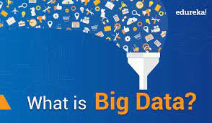
Group Activity – Big Data
Break out in smaller groups and address the below questions (30min)
What is big data
Why is big data used in public health and social care
Provide 3 examples of big data
What are the benefits of using big data
What can be the shortfalls of using big data
Present your findings in class

Slide 5
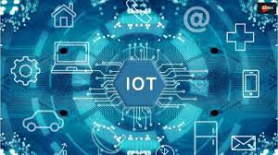
Group Activity – Internet of Things (IoT)
Break out in smaller groups and address the below questions (30min)
What is big data
Why is big data used in public health and social care
Provide 3 examples of big data
What are the benefits of using big data
What can be the shortfalls of using big data
Present your findings in class

Slide 6
Do you have any critical questions?
Take part in the student panel
5 students
Ask critical questions to the experts during the Q/A

Slide 7
Assignment briefs
Q/A

