Slide 1
Hierarchical Network

Slide 2
Objectives
Describe how a hierarchical network supports the voice, video and data needs of a small and medium-sized business.
Match the appropriate Cisco switch to each layer in the hierarchical network design model.

Slide 3
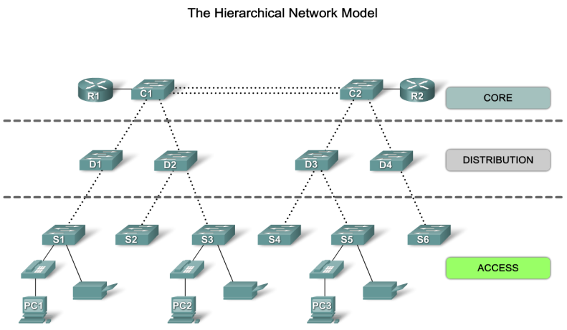
Hierarchical Network
Notes:
Access Layer – PC, hub, bridges, IP phones, wireless AP – connecting devices to network
Distribution Layer – Controls flow of network traffic using policies and delineates broadcast using routing – High performance switches with high availability & high performance
Core Layer – backbone – capable of forwarding large amount of traffic.

Slide 4
Benefits of Hierarchical Network

Slide 5
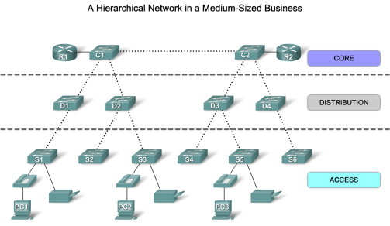
Principles of Hierarchical Network
  Network Diameter
  Bandwidth aggregation - add multiple links to increase bandwidth – Etherchannel (Cisco prop)
  Redundant links
Notes:
Principles of hierarchical network

Slide 6
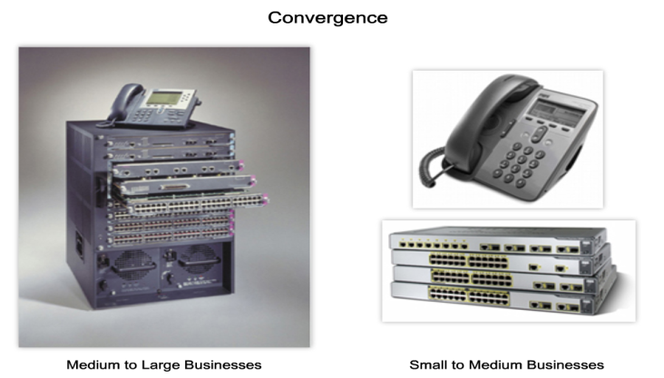
Convergence
Convergence is the process of combining voice and video communications on a data network.
Notes:
Convergence is the process of combining voice and video communications on a data network.
Converged networks also required extensive management in relation to Quality of Service (QoS), because voice and video data traffic needed to be classified and prioritized on the network.
Converged networks give you options that had not existed previously. You can now tie voice and video communications directly into an employee's personal computer system

Slide 7
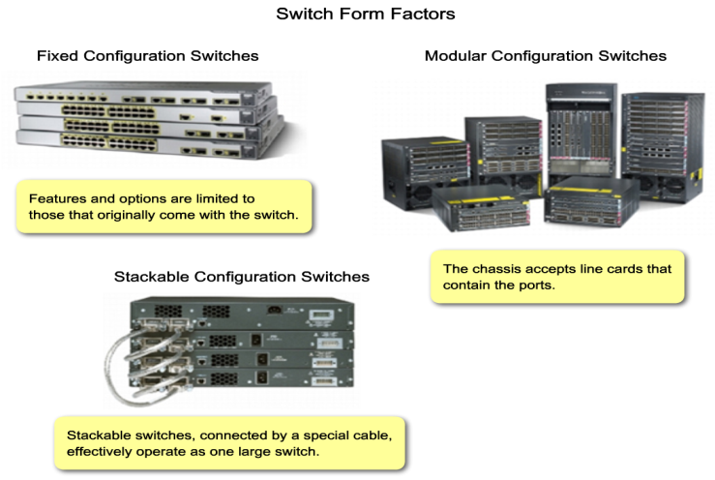
Switch Features
Notes:
Switches interconnected using spl black plane cable. Cisco introduces stackwise tech -- Uses spl ports for interconnection so line speed is faster

Slide 8
Switch Features
After design consider proper switches.
    Traffic flow analysis
    User communities
    Future growth
    Data store & Data server analysis – When analysing traffic on a network, consider where the data stores and servers are located so that you can determine the impact of traffic on the network. -- Storage area networks (SANs), network-attached storage (NAS), tape backup units, or any other device
    Topology diagram

Slide 9
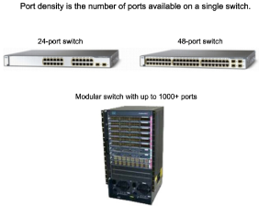
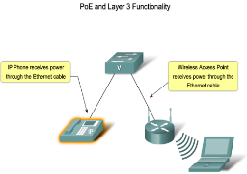
Switch Features
Performance – support port density, forwarding rate, link aggregation for the network
Port density - number of ports available on a single switch
Link Aggregation - you should determine if there are enough ports on a switch to aggregate to support the required bandwidth – between dist & core – reduce bottleneck of traffic
Forwarding Rates - processing capabilities of a switch by rating how much data the switch can process per second (24 ports – 24Gbps)
PoE - deliver power to a device over the existing Ethernet cabling.
Layer 3 Functionality

Slide 10
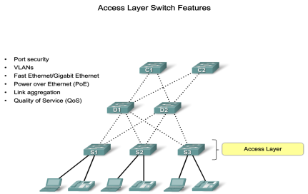
Switch Features in Hierarchical Network

Slide 11
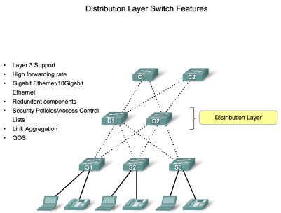
Switch Features in Hierarchical Network

Slide 12
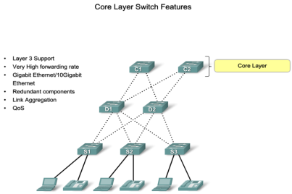
Switch Features in Hierarchical Network

Slide 13
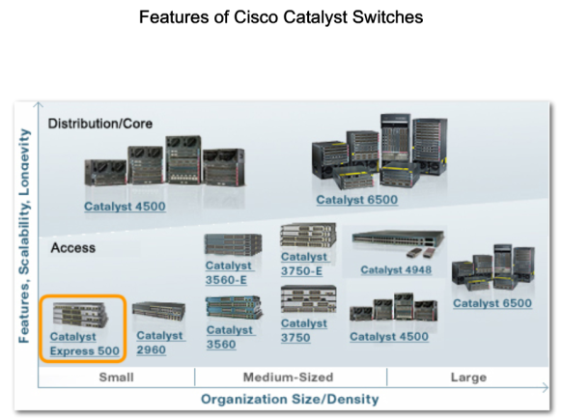
Switches for Small and Medium Size
Business (SMB)
Notes:
Cisco has seven switch product lines
Catalyst Express 500
Catalyst 2960
Catalyst 3560
Catalyst 3750
Catalyst 4500
Catalyst 4900
Catalyst 6500

Slide 14
Summary
Hierarchical Design model addresses performance, scalability, maintainability & manageability issues.
Traffic Analysis is used to monitor network performance.
Hierarchical Design Model is composed of 3 layers:
  Access
  Distribution
  Core
Switches selected for each layer must meet the needs of each hierarchical layer as well as the needs of the business.

