Slide 1
Azure Load Balancing
Lecturer: Michael Dacey
E-mail: michael.dacey@uwtsd.ac.uk
https://docs.microsoft.com/en-us/learn/certifications/azure-fundamentals/

Slide 2
Overview
VM Scale
Set
VM
Internet
Application
Gateway
Load
Balancer
VM
VM
Note: for the demo we will just connect the load balancer directly to the internet. Typically, we want to avoid doing this and use an Application Gateway.
VM Scale
Set
VM
Internet
Load
Balancer
VM
VM

Slide 3
What is load balancer?
Routes incoming client traffic to a target (e.g. a VM)
Monitors the health targets so that it only routes to healthy targets
  High availability
Distributes traffic evenly across targets to give better performance by preventing one target becoming overloaded
A load balancer is a reverse proxy
  A type of proxy server that retrieves resources on behalf of a client from one or more servers.
  These resources are then returned to the client, appearing as if they originated from the proxy server itself.

Slide 4
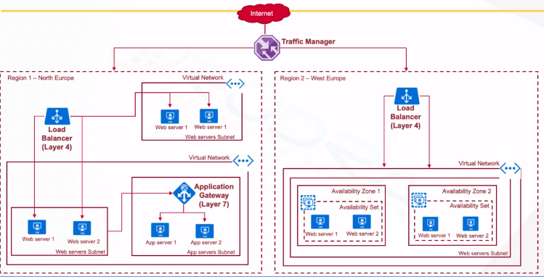
Architectural Overview
A load balancer is a Layer 4 switch, that works at the TCP/UDP packet level
Distributes traffic between the VMs

Slide 5
Load Balancing Techniques
Static vs Dynamic: fixed rules vs server selection based on current traffic & loading
Round robin: a “taking it turns” approach, choosing each server in the pool in some sequence that distributes the load equally between them in rotation e.g. a circular list
IP hash: select servers based on a has on the incoming traffics source and destination IP addresses
Cooperative: distributed nodes work together to achieve a common LB decision. Provides a Pareto-optimal response time and also guarantee the fairness of the resource allocation to all the jobs, such that the jobs obtain the same response time independent of the allocated computer.
Least connections: pass load to servers with the least number of current (aka active or outstanding) connections
Least connections + response time: as least connections but also use the average response time of each server. By sending traffic to the servers with the quickest response time, the algorithm ensures the fastest service for user.
Response-based: requires “agent” software running on each VM to measure servers resource usage such as CPU and memory.
Weighted: LB algorithms can be combined with weighting, so that more powerful servers are given a higher weighting and process more of the load
A good load balancing approach:
https://kemptechnologies.com/load-balancer/load-balancing-algorithms-techniques
https://www.researchgate.net/publication/229455409_Cooperative_load_balancing_in_distributed_systems
https://www.cloudflare.com/en-gb/learning/performance/types-of-load-balancing-algorithms/
Reduces:
response times
server overloading
packet loss
Increases:
scalability
reliability
network lifetime
time until the packet loss rate is above a threshold value

Slide 6
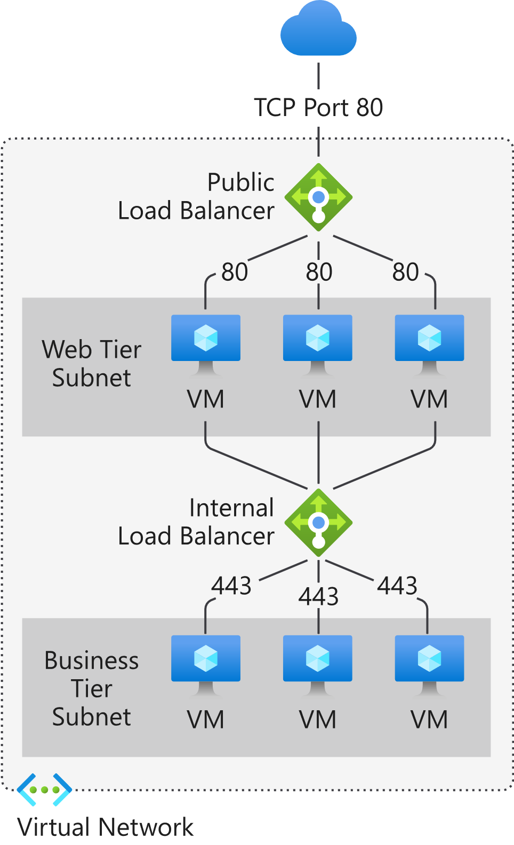
Layer-4 Load Balancing
Load balancing refers to evenly distributing load (incoming network traffic) across a group of backend resources or servers.
  Layer-4: uses <ip-address>:<port> combination for load balancing rules
A public load balancer are used to load balance inbound internet traffic to your VMs
An internal (or private) load balancer is used where private IPs are needed at the frontend only.
  Internal load balancers are used to load balance traffic inside a virtual network.
Internet
Public IP address
Private IP addresses
Private IP address
TCP Port 443
Private IP addresses
Note: internally the traffic does not have to be web traffic. Obviously, a public load balancer is connected to a public IP address on the Internet and receives web traffic.

Slide 7
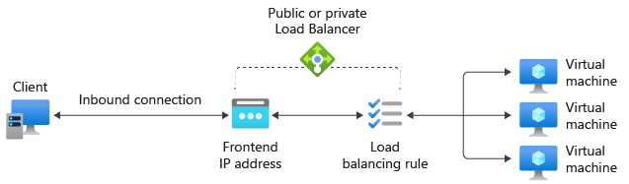
Load Balancer Components
Load balancer decides which pool should handle this traffic
Backend port
Incoming traffic
NIC
We stick all the VMs in a pool that will handle the incoming traffic
NIC
Frontend port
Frontend address pool
NIC
Rule selects the pool that should handle the traffic
Backend address pool
Frontend IP Address Pool: you can specify a number of frontend IP addresses public or private
DON’T WORRY ABOUT THIS, FOR OUR PURPOSES THERE IS JUST ONE PUBLIC IP ADDRESS
Load Balancing Rule: a rule connecting a <frontend IP + frontend port> to a <backend pool + backend port>
Backend Address Pool: a list of NICs for VMs which form a group able to handle traffic for the same service (backend port)

Slide 8
Load Balancer Rule
A load balancer rule is used to define how incoming traffic is distributed to all the instances within the backend pool.
A load-balancing rule maps a given frontend IP configuration and port to multiple backend IP addresses (in a pool) and the port being used by these VMs.
You can choose to use a different frontend port from the backend pool but the traffic will be sent to the same backend port for each VM. For example, use a load-balancing rule for port 80 to route traffic from your frontend IP to port 81 of your backend VM instances. The load balancer rewrites the headers of TCP/UDP headers flows when directing traffic to the backend pool instances
$ az network lb rule create
--resource-group myvm-resource-gp
--name myLBRule
--lb-name myLB
--backend-pool-name myLBPool
--backend-port 81
--frontend-ip-name myLBFrontEnd
--frontend-port 80
--protocol tcp
10.7.19.X:81
189.5.6.9:80
10.7.19.2:81
10.7.19.3:81
10.7.19.4:81
Public IP
189.5.6.9
VM Private IPs
10.7.19.X

Slide 9
Backend Address Pool
A load balancer has a pool of backend address pools
A backend pool defines the group of resources that will serve traffic for a given load-balancing rule.
NIC Configuration: use to add existing virtual machines and virtual machine scale sets to the load balancer
  This method builds the most direct link between VM and load balancer
Each backend pool must either contain NIC#s or IP addresses
Load Balancer
Backend Address Pool
VM
NIC
NIC
VM
# Technically speaking the Load Balancer requires an IPConfig that belongs to a NIC
https://docs.microsoft.com/en-us/azure/load-balancer/backend-pool-management

Slide 10

Load Balancer Components
Remember a NIC is only required for VMs inorder to allow the OS to recognise that the network exists. Since a load balancer does not have an OS it just needs an IPConfig to attach to the public IP address.
Note: A load balancer can actually have multiple front end IP Configs so that it can handle multiple public IP addresses. However, we are not interested in doing this.
IP Config
myFrontEnd
Public IP
myPublicIP
Internet
Load Balancer
myLoadBalancer
LB
80
Front End Port
Backend Pool
myBackEndPool
Back End Port
80
Load Balancer Rule
Specify front end receiving traffic is myFrontEnd on the public IP address using TCP port 80 (front end). Forward it to a VM in the myBackEndPool where the VMs are listening on port 80 (back end)
Incoming packet from browser heading for VM running Nginx
Dest Addr | Dest Port | Src Addr | Src Port | Protocol | Data
* | 80 | * | * | TCP

Slide 11
Create a Load Balancer Rule
What traffic to receive (frontend)….
CREATE A LOAD BALANCER RULE
$ az network lb rule create --resource-group myvm-resource-gp --lb-name myLoadBalancer --name myHTTPRule
--frontend-ip-name myFrontEnd --protocol tcp --frontend-port 80
--backend-port 80 --backend-pool-name myBackEndPool
--probe-name myHealthProbe --disable-outbound-snat true --idle-timeout 15 --enable-tcp-reset true
….where it should go (backend)….
https://docs.microsoft.com/en-us/azure/load-balancer/quickstart-load-balancer-standard-public-cli?tabs=option-1-create-load-balancer-standard

Slide 12
Add NSG Rules
CREATE A NETWORK SEC GROUP (NSG) FOR THE VMs TO SHARE
$ az network nsg create --resource-group myvm-resource-gp --name myNSG
ADD A RULE TO THIS NSG TO ALLOW ACCESS TO PORT 80
$ az network nsg rule create --resource-group myvm-resource-gp --nsg-name myNSG --name myNSGRuleHTTP --protocol '*' --direction inbound --source-address-prefix '*' --source-port-range '*' --destination-address-prefix '*' --destination-port-range 80 --access allow --priority 200
Port 80
These rules are applied in order of priority (highest first)
Internet
Dest Addr | Dest Port | Src Addr | Src Port | Data
* | 80 | * | *
Anything destined to port 80 arriving from any address/port

Slide 13
Demo 1
Create a Network Security Group and Rule to allow us to connect to port 80 of the load balancer
Create 3 VMs running the Nginx web server
Create a public IP address
Create a load balancer
Add a load balancer rule to map the public port to the VM ports
Add the VMs to the load balancer
Test the web server is running
  Refresh a few times to see responding VM change
  Might have to force it by stopping a VM ☺

Slide 14
Answer
$ az group create --name myvm-resource-gp --location ukwest
CREATE A vNET, SUBNET AND VMs FOR THE BACKEND POOL
TO BE USED BY THE LOAD BALANCER
$ az network vnet create --resource-group myvm-resource-gp --location ukwest --name myVNet --address-prefixes 10.1.0.0/16 --subnet-name myBackendSubnet --subnet-prefixes 10.1.1.0/24
Create a Network Security Group and add rule to allow public access to port 80
$ az network nsg create --resource-group myvm-resource-gp --name myNSG
$ az network nsg rule create --resource-group myvm-resource-gp --nsg-name myNSG --name myNSGRuleHTTP --protocol '*' --direction inbound --source-address-prefix '*' --source-port-range '*' --destination-address-prefix '*' --destination-port-range 80 --access allow --priority 200

Slide 15
Answer
Create 3 NICs, VMs running Nginx.
REPEAT THESE STEPS 3 TIMES FOR myVM1/myNIC1, myVM2/myNIC2, myVM3, myNIC3
$ az network nic create --resource-group myvm-resource-gp --name myNIC1 --vnet-name myVNet --subnet myBackEndSubnet --network-security-group myNSG
$ az vm create --resource-group myvm-resource-gp --name myVM1 --nics myNIC1 --image UbuntuLTS --admin-username azureuser --generate-ssh-keys --public-ip-address ""
Note: unfortunately, if the extension times out in the next step then you may need to use the alternative approach which is to create your own image or see end of slide deck for an “Alternative Image Approach”.
$ az vm extension set --resource-group myvm-resource-gp --vm-name myVM1 --publisher Microsoft.Azure.Extensions --name CustomScript --version 2.0 --protected-settings '{"fileUris":["https://raw.githubusercontent.com/UWTSDStudents/nginxquickapp/refs/heads/main/automate_ngnix.sh"], "commandToExecute":"./automate_ngnix.sh"}'
REPEAT FOR myVM2/myNIC2 AND myVM3/myNIC3
Same line, not a new line
Note: the VMs share the same vNet and NSG
Remember, in the CLI you can just up arrow and change the VM and NIC names for the previous commands you executed

Slide 16
Answer
CREATE PUBLIC IP
$ az network public-ip create --resource-group myvm-resource-gp --name myPublicIP --sku Standard
CREATE THE LOAD BALANCER
$ az network lb create --resource-group myvm-resource-gp --name myLoadBalancer --sku Standard --public-ip-address myPublicIP --frontend-ip-name myFrontEnd --backend-pool-name myBackEndPool
CREATE A HEALTH PROBE
A way of checking if a VM is still working
$ az network lb probe create --resource-group myvm-resource-gp --lb-name myLoadBalancer --name myHealthProbe --protocol tcp --port 80
CREATE THE LOAD BALANCER RULE
$ az network lb rule create --resource-group myvm-resource-gp --lb-name myLoadBalancer --name myHTTPRule --protocol tcp --frontend-port 80 --backend-port 80 --frontend-ip-name myFrontEnd --backend-pool-name myBackEndPool --probe-name myHealthProbe --disable-outbound-snat true --idle-timeout 15 --enable-tcp-reset true
This creates a default IP config for us with this name
Even if you create a load balancer without specifying the --frontend-ip-name a default IP config is created for it anyway with the name “LoadBalancerFrontEnd”

Slide 17
Answer
ADD THE VMs TO THE LOAD BALANCER BACKEND POOL REPEAT FOR myNIC1, myNIC2, myNIC3
$ az network nic ip-config address-pool add --address-pool myBackendPool --nic-name myNIC1 --ip-config-name ipconfig1 --resource-group myvm-resource-gp --lb-name myLoadBalancer
REPEAT FOR myNIC2 AND myNIC3
TEST THE LOAD BALANCER: GET THE PUBLIC IP ADDRESS FOR THE LOAD BALANCER
$ az network public-ip show --resource-group myvm-resource-gp --name myPublicIP --query ipAddress --output tsv
CONNECT TO THIS IP ADDRESS IN A WEB BROWSER
RECONNECT TO SEE RESPONDING VM CHANGE
HINT: You a new private/incognito window each time to avoid browser caching response...it doesn't consistently switch from one VM to another so we may need to switch a VM off to demo it.
$ az vm deallocate --resource-group myvm-resource-gp --name myVM1
$ az vm start --resource-group myvm-resource-gp --name myVM1

Slide 18
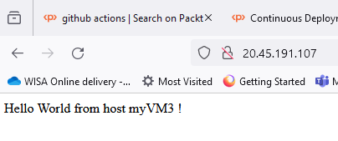
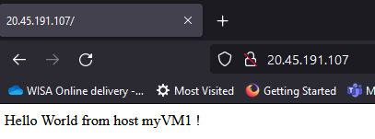
$ az network public-ip show --resource-group myvm-resource-gp --name myPublicIP --query ipAddress --output tsv
20.45.191.107
It’s using VM3
Prevent it from using VM3 by stopping it
$ az vm deallocate --resource-group myvm-resource-gp --name myVM3
Open a private web browser window because the previous page can be cached so may not see it change
It’s using VM1

Slide 19
Always Remember to Clean Up
Delete the resource group
This will delete all of the resources we created
In the Azure Web Portal you can do the same thing this way!!
In Azure Portal, select Resource groups on the left.
Find the your resource group and select it.
In the Overview tab of the resource group, select Delete resource group.
This opens a new dialog box. Type the name of the resource group again and select Delete.
$ az group delete --name myvm-resource-gp --yes
SHORTHAND
$ az group delete -n myvm-resource-gp -y

Slide 20
Alternative Image Approach

Slide 21
Approaches
If simply loading a script file directly from GitHub as an extension fails (typically because of timeout issues) then you will need to use one of these two alternative approaches:
Create your own Nginx VM image then we don’t need to create an extension
Upload the script file to a local blob store and then create an extension that reads it from the store. This is a little more interesting.

Slide 22
Create VM Image
$ az group create --name myvm-resource-gp --location ukwest
$ az vm create --resource-group myvm-resource-gp --name myVM --image UbuntuLTS --admin-username azureuser --generate-ssh-keys --security-type TrustedLaunch
$ az vm show --resource-group myvm-resource-gp --name myVM --show-details --query publicIps
"20.90.8.168“
…LOG INTO THE VM AND INSTALL NGINX
$ ssh azureuser@20.90.8.168
azureuser@myVM:~$ sudo apt-get -y update
azureuser@myVM:~$ sudo apt-get -y install nginx
ureuser@myVM:~$ echo "Hello World from host" $HOSTNAME "!" | sudo tee /var/www/html/index.html
azureuser@myVM:~$ sudo waagent -deprovision+user
azureuser@myVM:~$ exit
$ az vm deallocate --resource-group myvm-resource-gp --name myVM
$ az vm generalize -g myvm-resource-gp -n myVM
TrustedLaunch is the default setting anyway but I am making it explicit for you here. Images created from such a VM must be added to an Azure Compute Gallery
https://learn.microsoft.com/en-us/azure/virtual-machines/trusted-launch-portal?tabs=cli%2Ccli3%2Cportal2#deploy-a-trusted-launch-vm

Slide 23
Create VM Image (Cont)
$ az sig create --resource-group myvm-resource-gp --gallery-name myGallery
$ az sig image-definition create --resource-group myvm-resource-gp --gallery-name myGallery --gallery-image-definition nginxapp --publisher Me --offer nginx --sku FirstImage --description "A basic nginx image" --os-type Linux --os-state Generalized --features SecurityType=TrustedLaunchSupported --hyper-v-generation V2
$ vm_id=$(az vm get-instance-view --resource-group myvm-resource-gp --name myVM --query id -o tsv)
$ az sig image-version create --resource-group myvm-resource-gp --gallery-name myGallery --gallery-image-definition nginxapp --gallery-image-version 1.0.0 --target-regions "ukwest" --replica-count 1 --virtual-machine $vm_id
$ az vm delete --resource-group myvm-resource-gp --name myVM –yes
$ imgId=$(az sig image-definition show --resource-group myvm-resource-gp --gallery-name myGallery --gallery-image-definition nginxapp --query id -o tsv)
https://learn.microsoft.com/en-us/azure/virtual-machines/trusted-launch-portal?tabs=cli%2Ccli3%2Cportal2#deploy-a-trusted-launch-vm-from-an-azure-compute-gallery-image
CREATE THE 3 VMs LIKE THIS, NO VM EXTENSION REQUIRED
$ az vm create --resource-group myvm-resource-gp --name myVM1 --nics myNIC1 --image $imgId --admin-username azureuser --generate-ssh-keys --public-ip-address ""

Slide 24
Alternative Extension Approach
If you have timeout issues when using extensions, you may need an alternative approach of loading the script into the VM.
CHECK THE STORAGE ACCOUNT NAME IS AVAILABLE
$ mystorename=mystore$RANDOM
$ az storage account check-name --name $mystorename
CREATE A BLOB STORAGE ACCOUNT
$ az storage account create --name $mystorename --resource-group myvm-resource-gp --location ukwest --sku Standard_LRS --encryption-services blob
GIVE YOURSELF PERMISSION TO USE THE BLOB STORAGE
$ mystoreid=$(az storage account show --resource-group myvm-resource-gp --name $mystorename --query id -o tsv)
$ assignee=$(az ad signed-in-user show --query id -o tsv)
$ az role assignment create --role "Storage Blob Data Contributor" --assignee $assignee --scope $mystoreid
GIVE A USER-ASSIGNED MANAGED IDENTITY ACCESS TO THE STORAGE
$ az identity create --resource-group myvm-resource-gp --name myuserspidentity
$ usrasgnsp=$(az identity show --resource-group myvm-resource-gp --name myuserspidentity --query principalId -o tsv)
$ az role assignment create --role "Storage Blob Data Reader" --assignee $usrasgnsp --scope $mystoreid

Slide 25
Alternative Extension Approach (Cont)
.
CREATE A CONTAINER “myblobcontainer” AND UPLOAD FILE INTO IT
$ az storage container create --account-name $mystorename --name myblobcontainer --public-access off --auth-mode login
Assuming you have automate_ngnix.sh in the directory you are in.
$ az storage blob upload --account-name $mystorename --container-name myblobcontainer --name automate_ngnix.sh --file automate_ngnix.sh --auth-mode login
ASSIGN ACCESS TO THIS FILE TO EACH VM AND SET THE EXTENSION
$ usrasgnid=$(az identity show --resource-group myvm-resource-gp --name myuserspidentity --query id -o tsv)
$ clientId=$(az identity show --resource-group myvm-resource-gp --name myuserspidentity --query clientId -o tsv)
Assign the managed identity to each VM and set the extension to read from the blob storage. We can use the same user-assigned identity each time so that each VM is granted the same access to the storage.
$ az vm identity assign --resource-group myvm-resource-gp --name myVM1 --identities $usrasgnid
$ az vm extension set --resource-group myvm-resource-gp --vm-name myVM1 --publisher Microsoft.Azure.Extensions --name CustomScript --version 2.0 --protected-settings '{"fileUris":["https://'$mystorename'.blob.core.windows.net/myblobcontainer/automate_ngnix.sh"], "commandToExecute":"./automate_ngnix.sh","managedIdentity":{"clientId":"'$clientId'"}}'
You can copy the automate_ngnix.sh file from here: https://raw.githubusercontent.com/UWTSDStudents/nginxquickapp/refs/heads/main/automate_ngnix.sh

