Slide 1
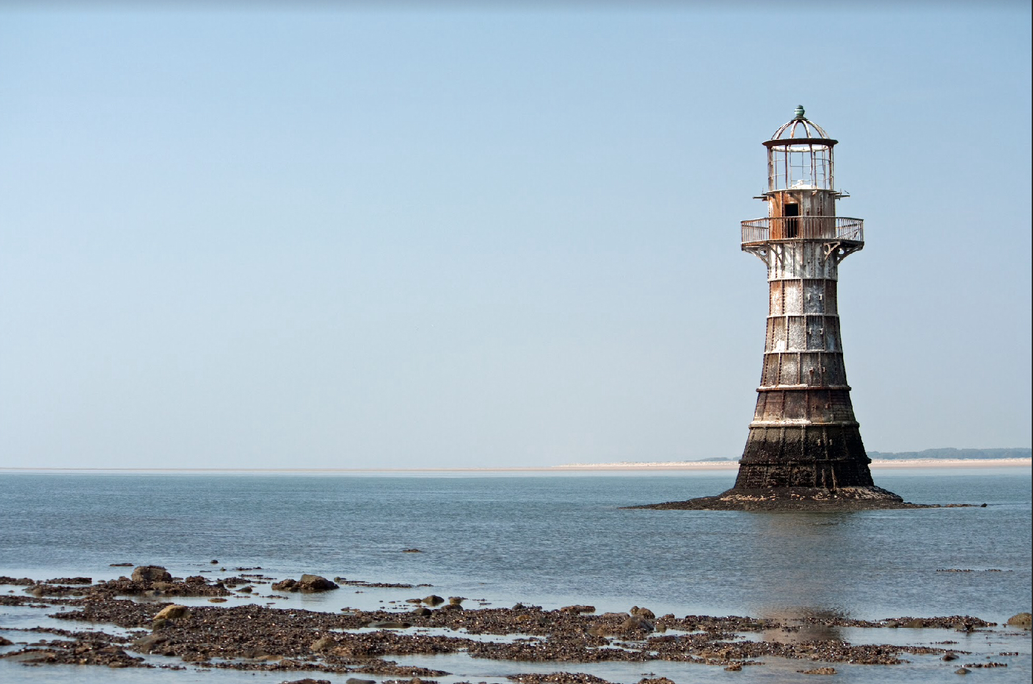
Adrienne Boran
The Gower Walking festival
Postcard Presentation
STUDENT ID: 1816438

Slide 2

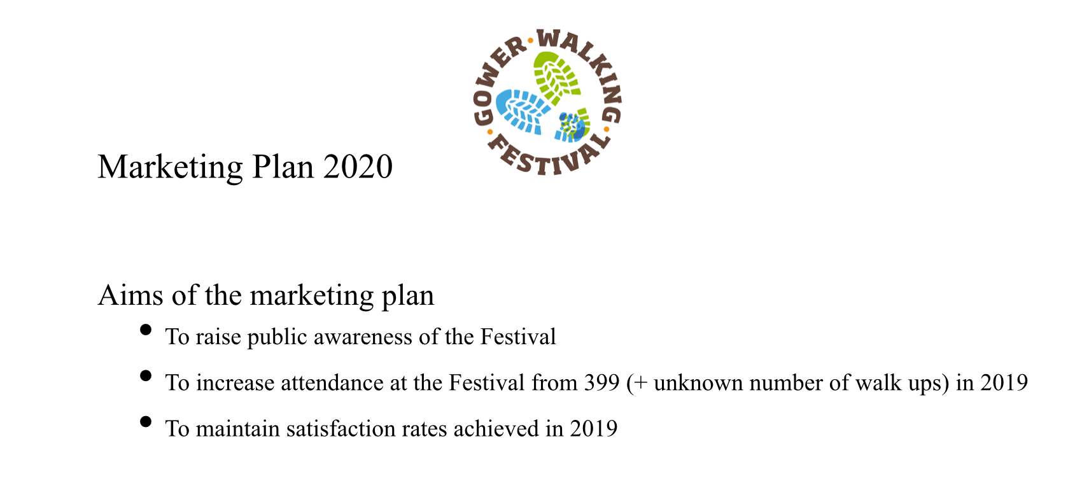
Marketing intern IN PROMOTIONS AND ADVERTISEMENT

Slide 3
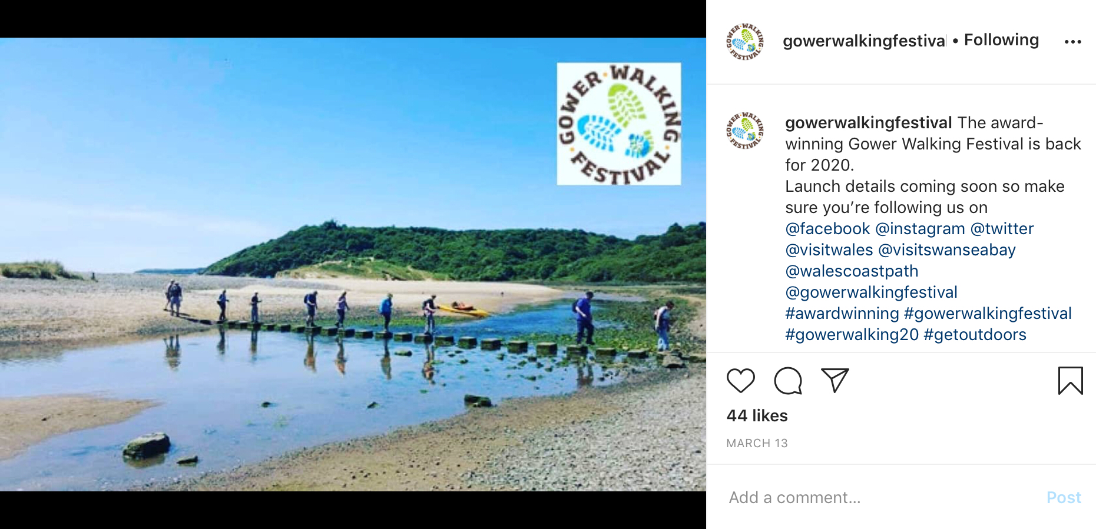
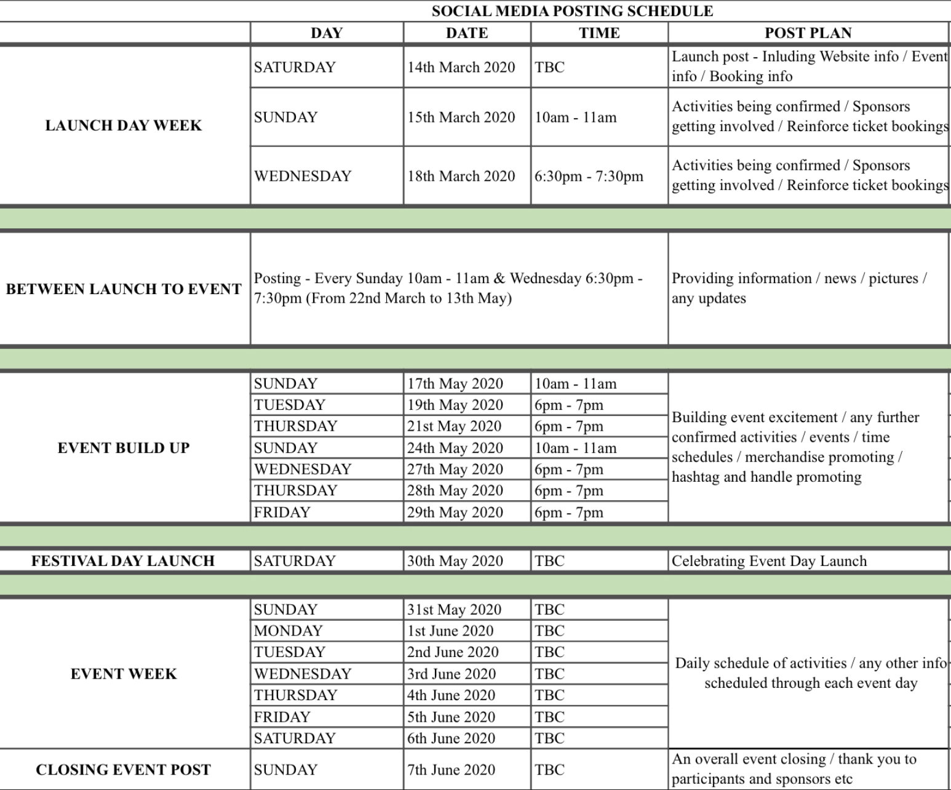



Social Media Marketing Strategy

Slide 4
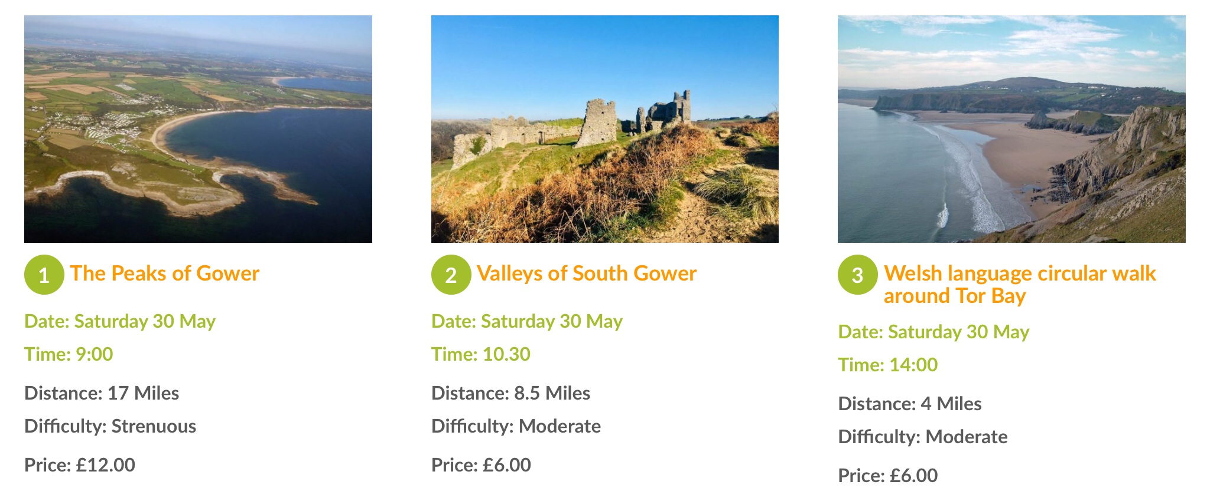
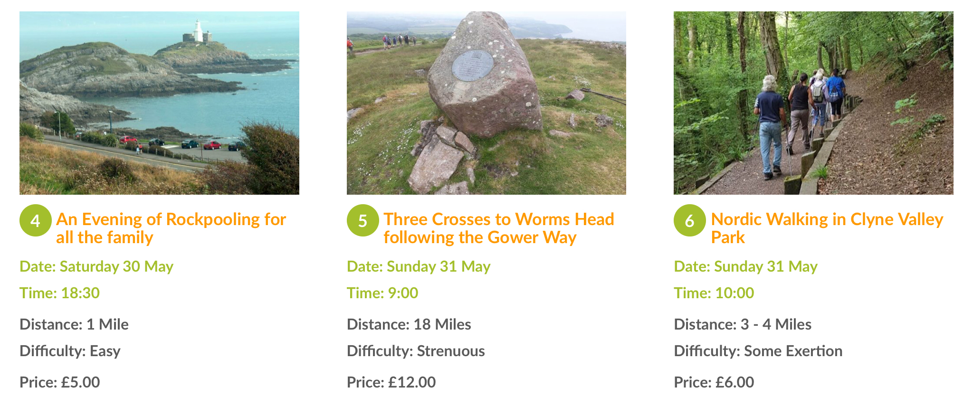
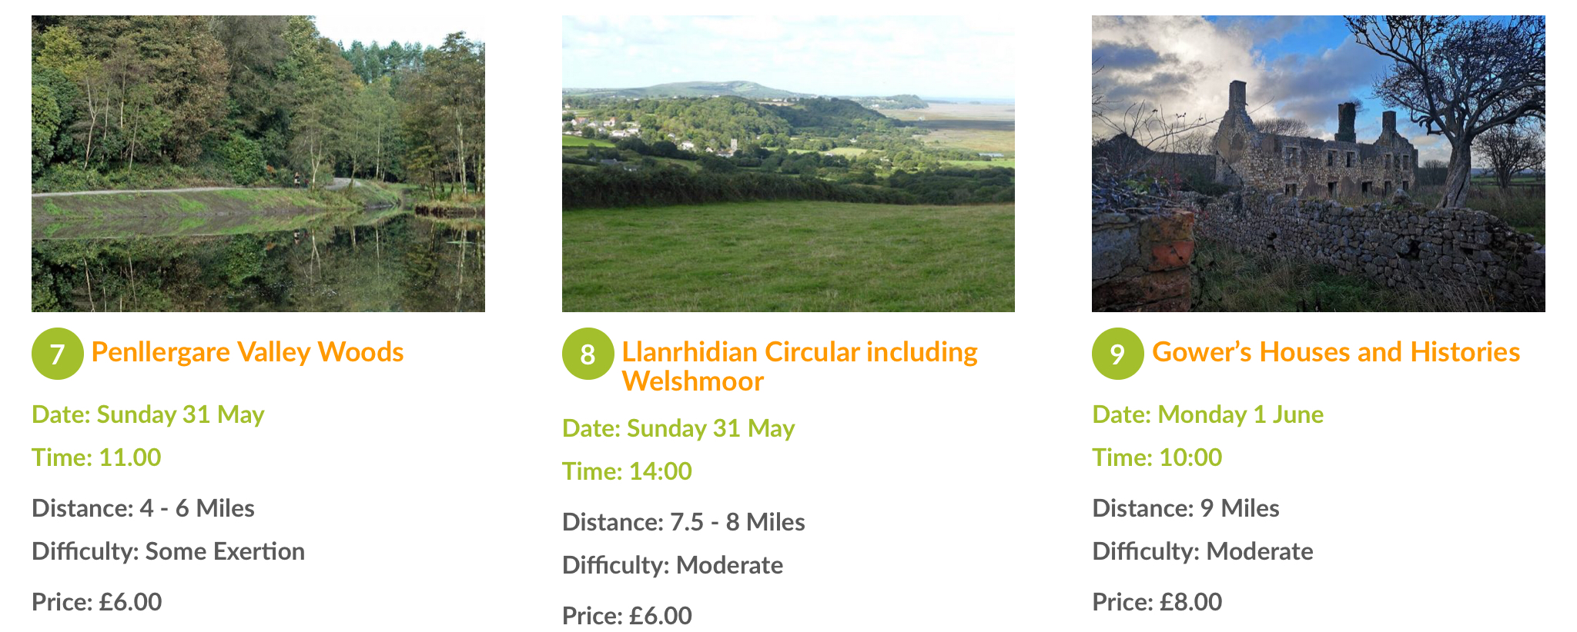
Festival Itinerary

Slide 5
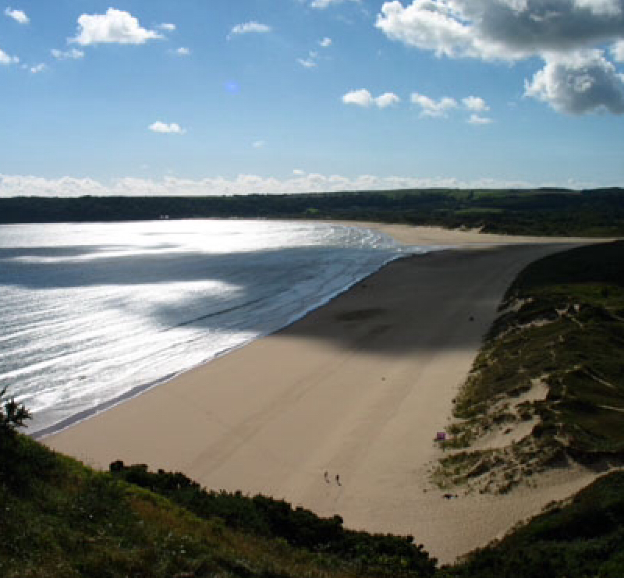
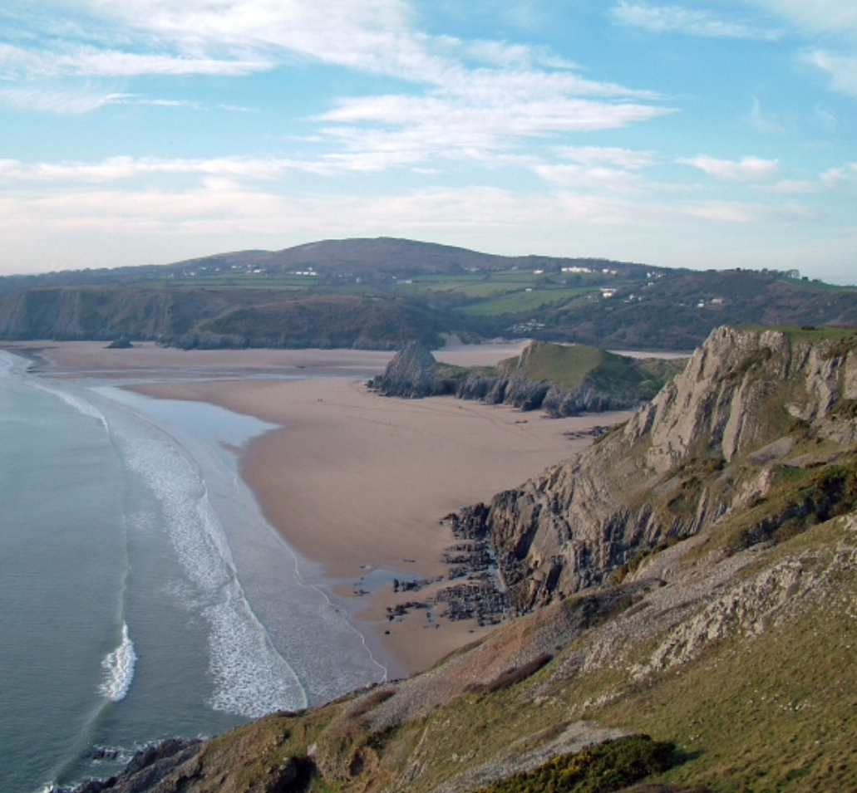
The Award Winning Festivals Views of the Gower

Slide 6
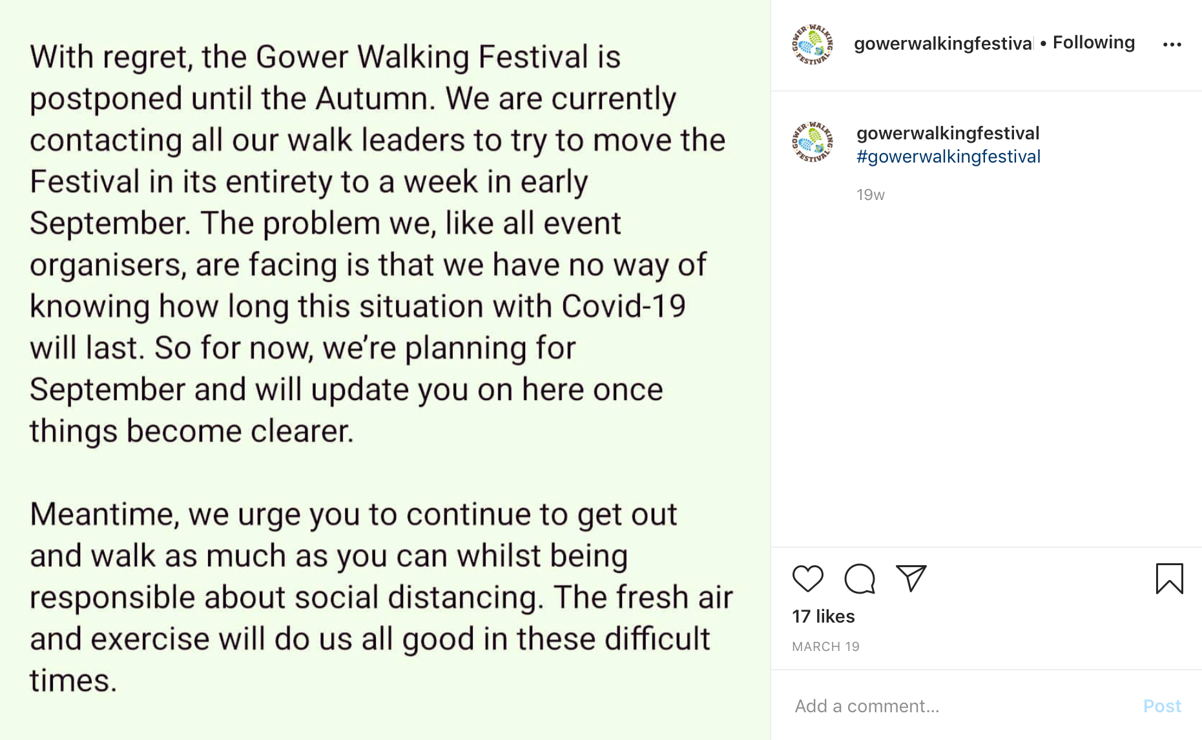
Cancellation of the 2020 Gower walking festival due to coved-19

